Slide 1
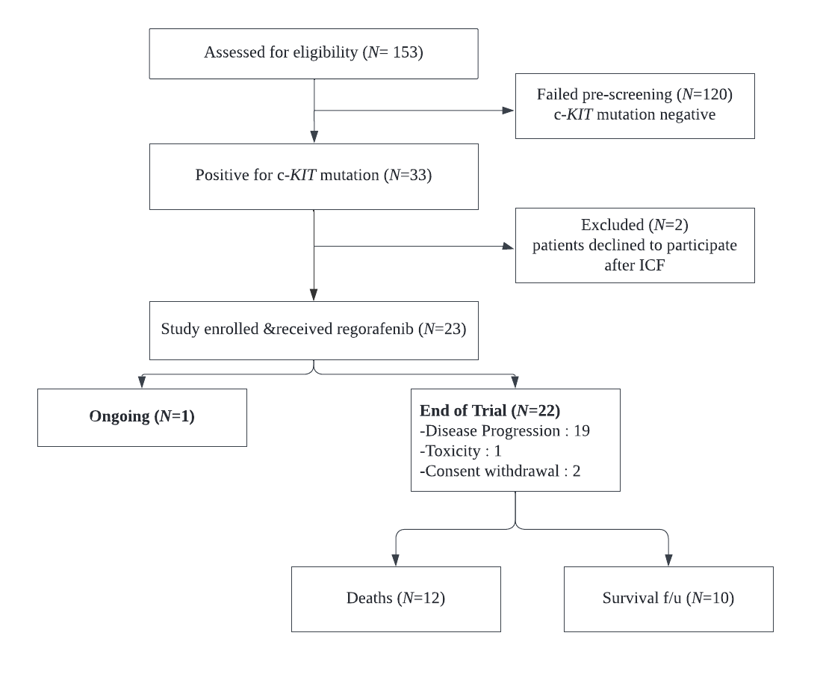
Supplementary Figure 1. Consort Diagram

