Slide 1
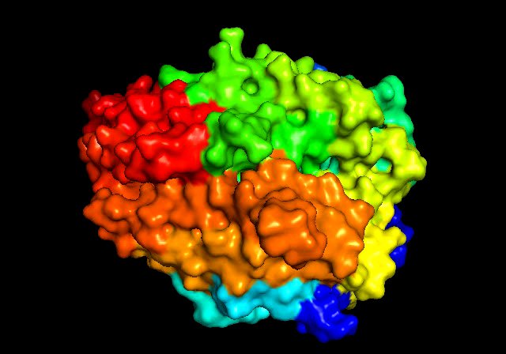
Figure S2: Video of ACE2 open state vs close state
Movie : open/closed state of ACE2 from PDB ids 1r42 and 1r4l

Slide 2
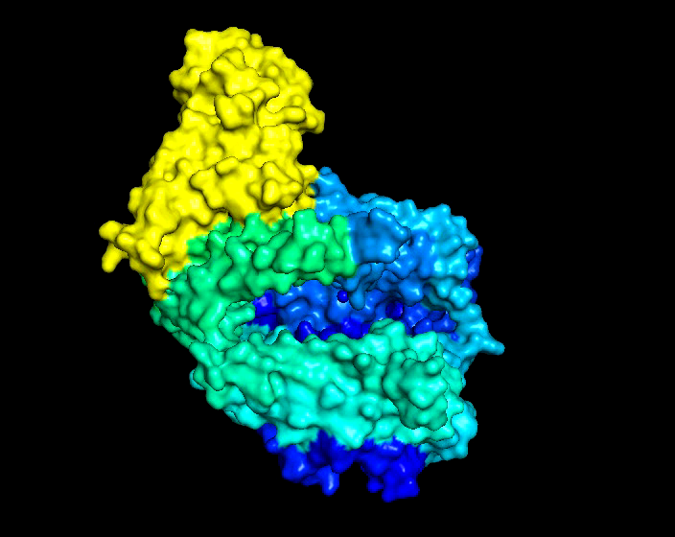
Figure S3: Video of SARS S-protein binds both ACE2 open and closed state
Movie: SARS S-protein (yellow-colored) binds on both open and closed state from two monomers of ACE2 from PDB 3scl

