Slide 1
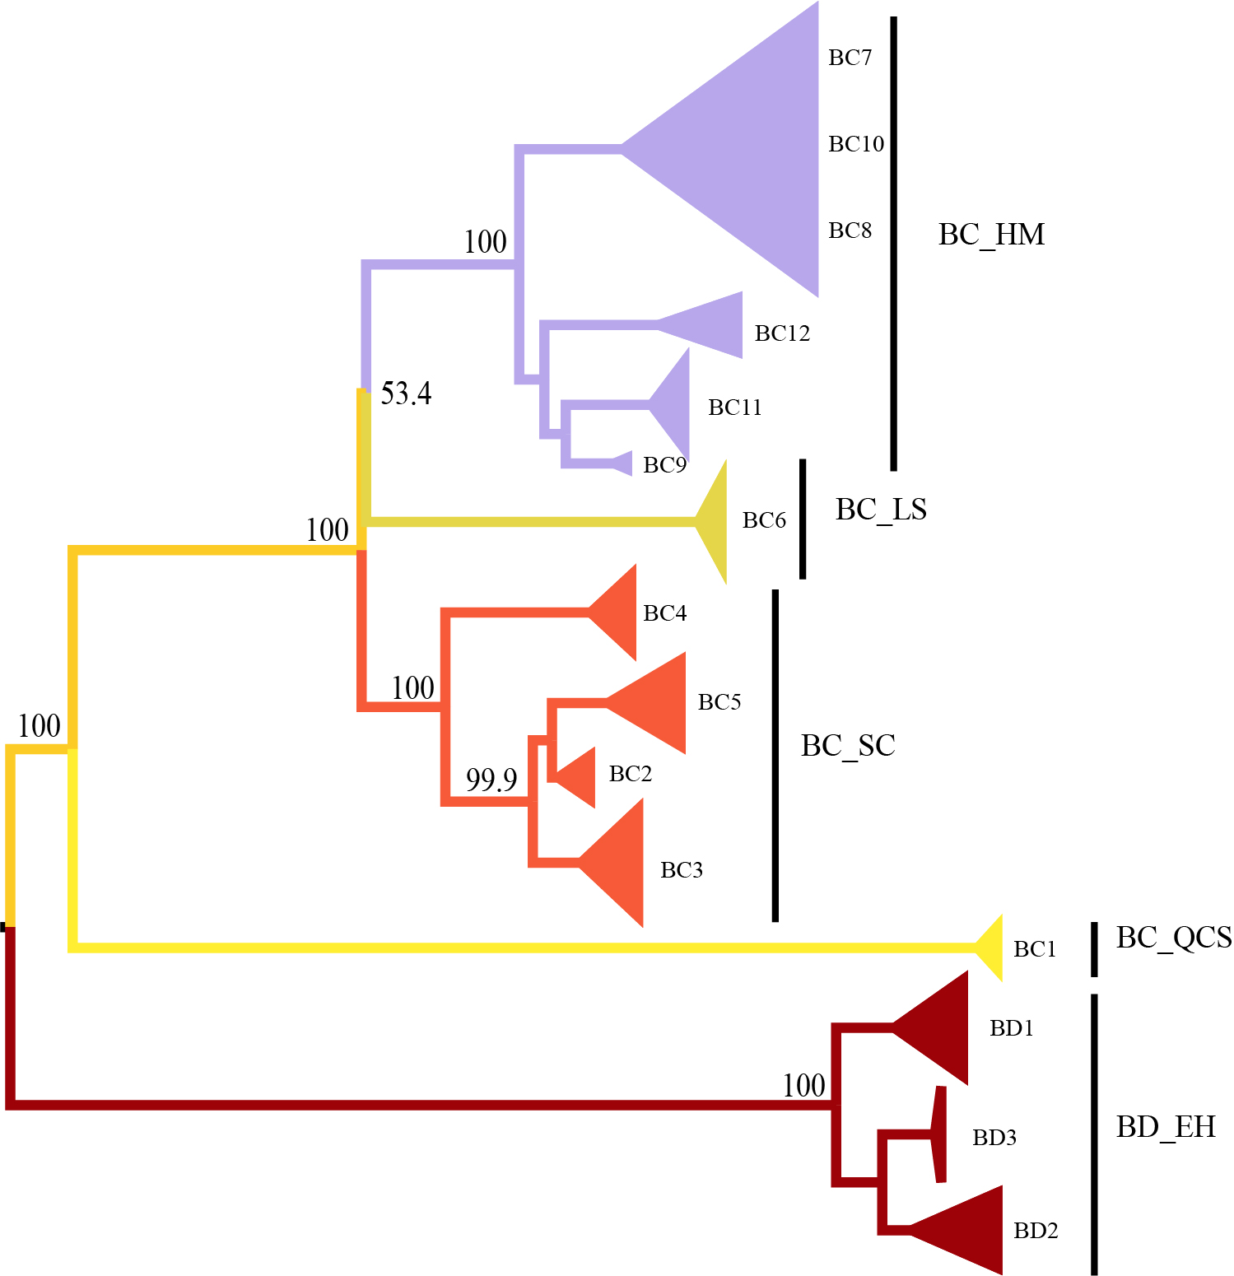
Fig. S1 Phylogenetic analysis of Beesia based on dataset B119.

Slide 2
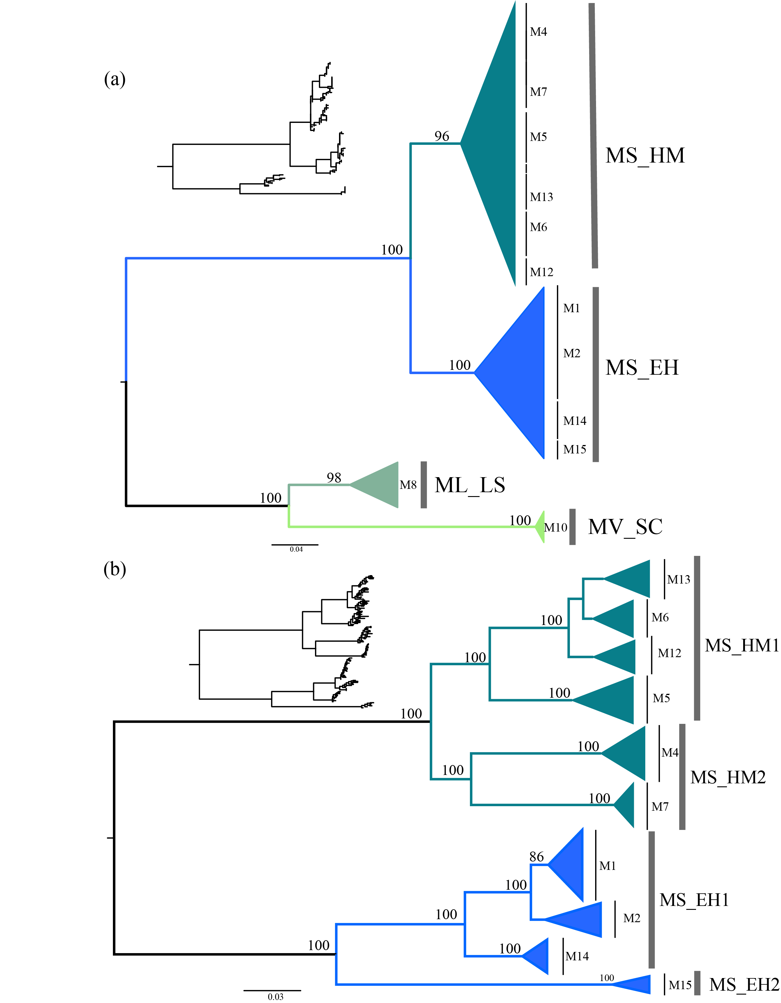
Fig. S2 Phylogenetic analysis of Megacodon. (a) Maximum likelihood tree based on dataset M155. (b) Maximum likelihood tree based on dataset M131.

Slide 3
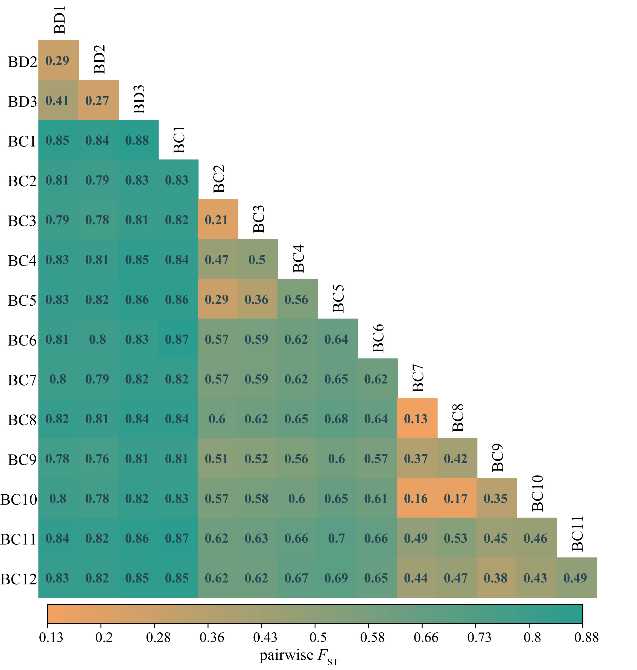
Fig. S3 Pairwise F_{ST} of populations of Beesia based on dataset B119.

Slide 4
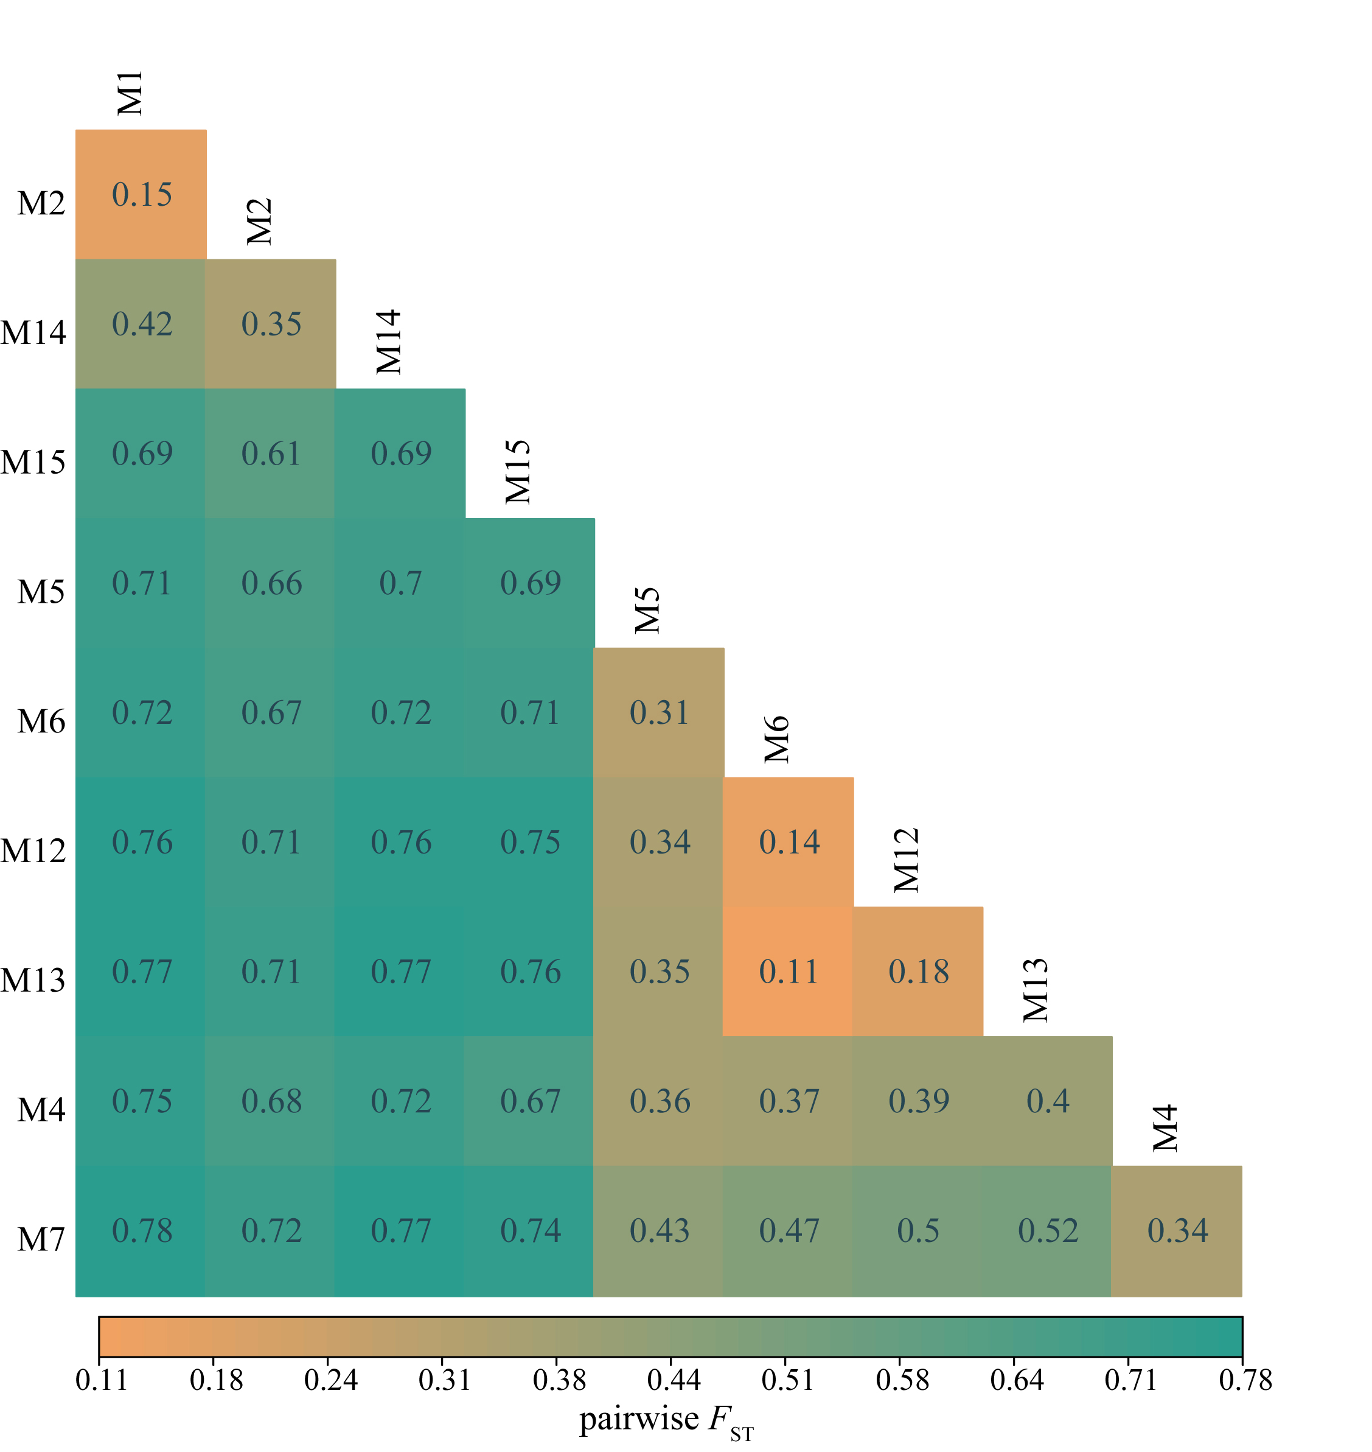
Fig. S4 Pairwise F_{ST} of populations of M. stylophorus based on dataset M131.

Slide 5
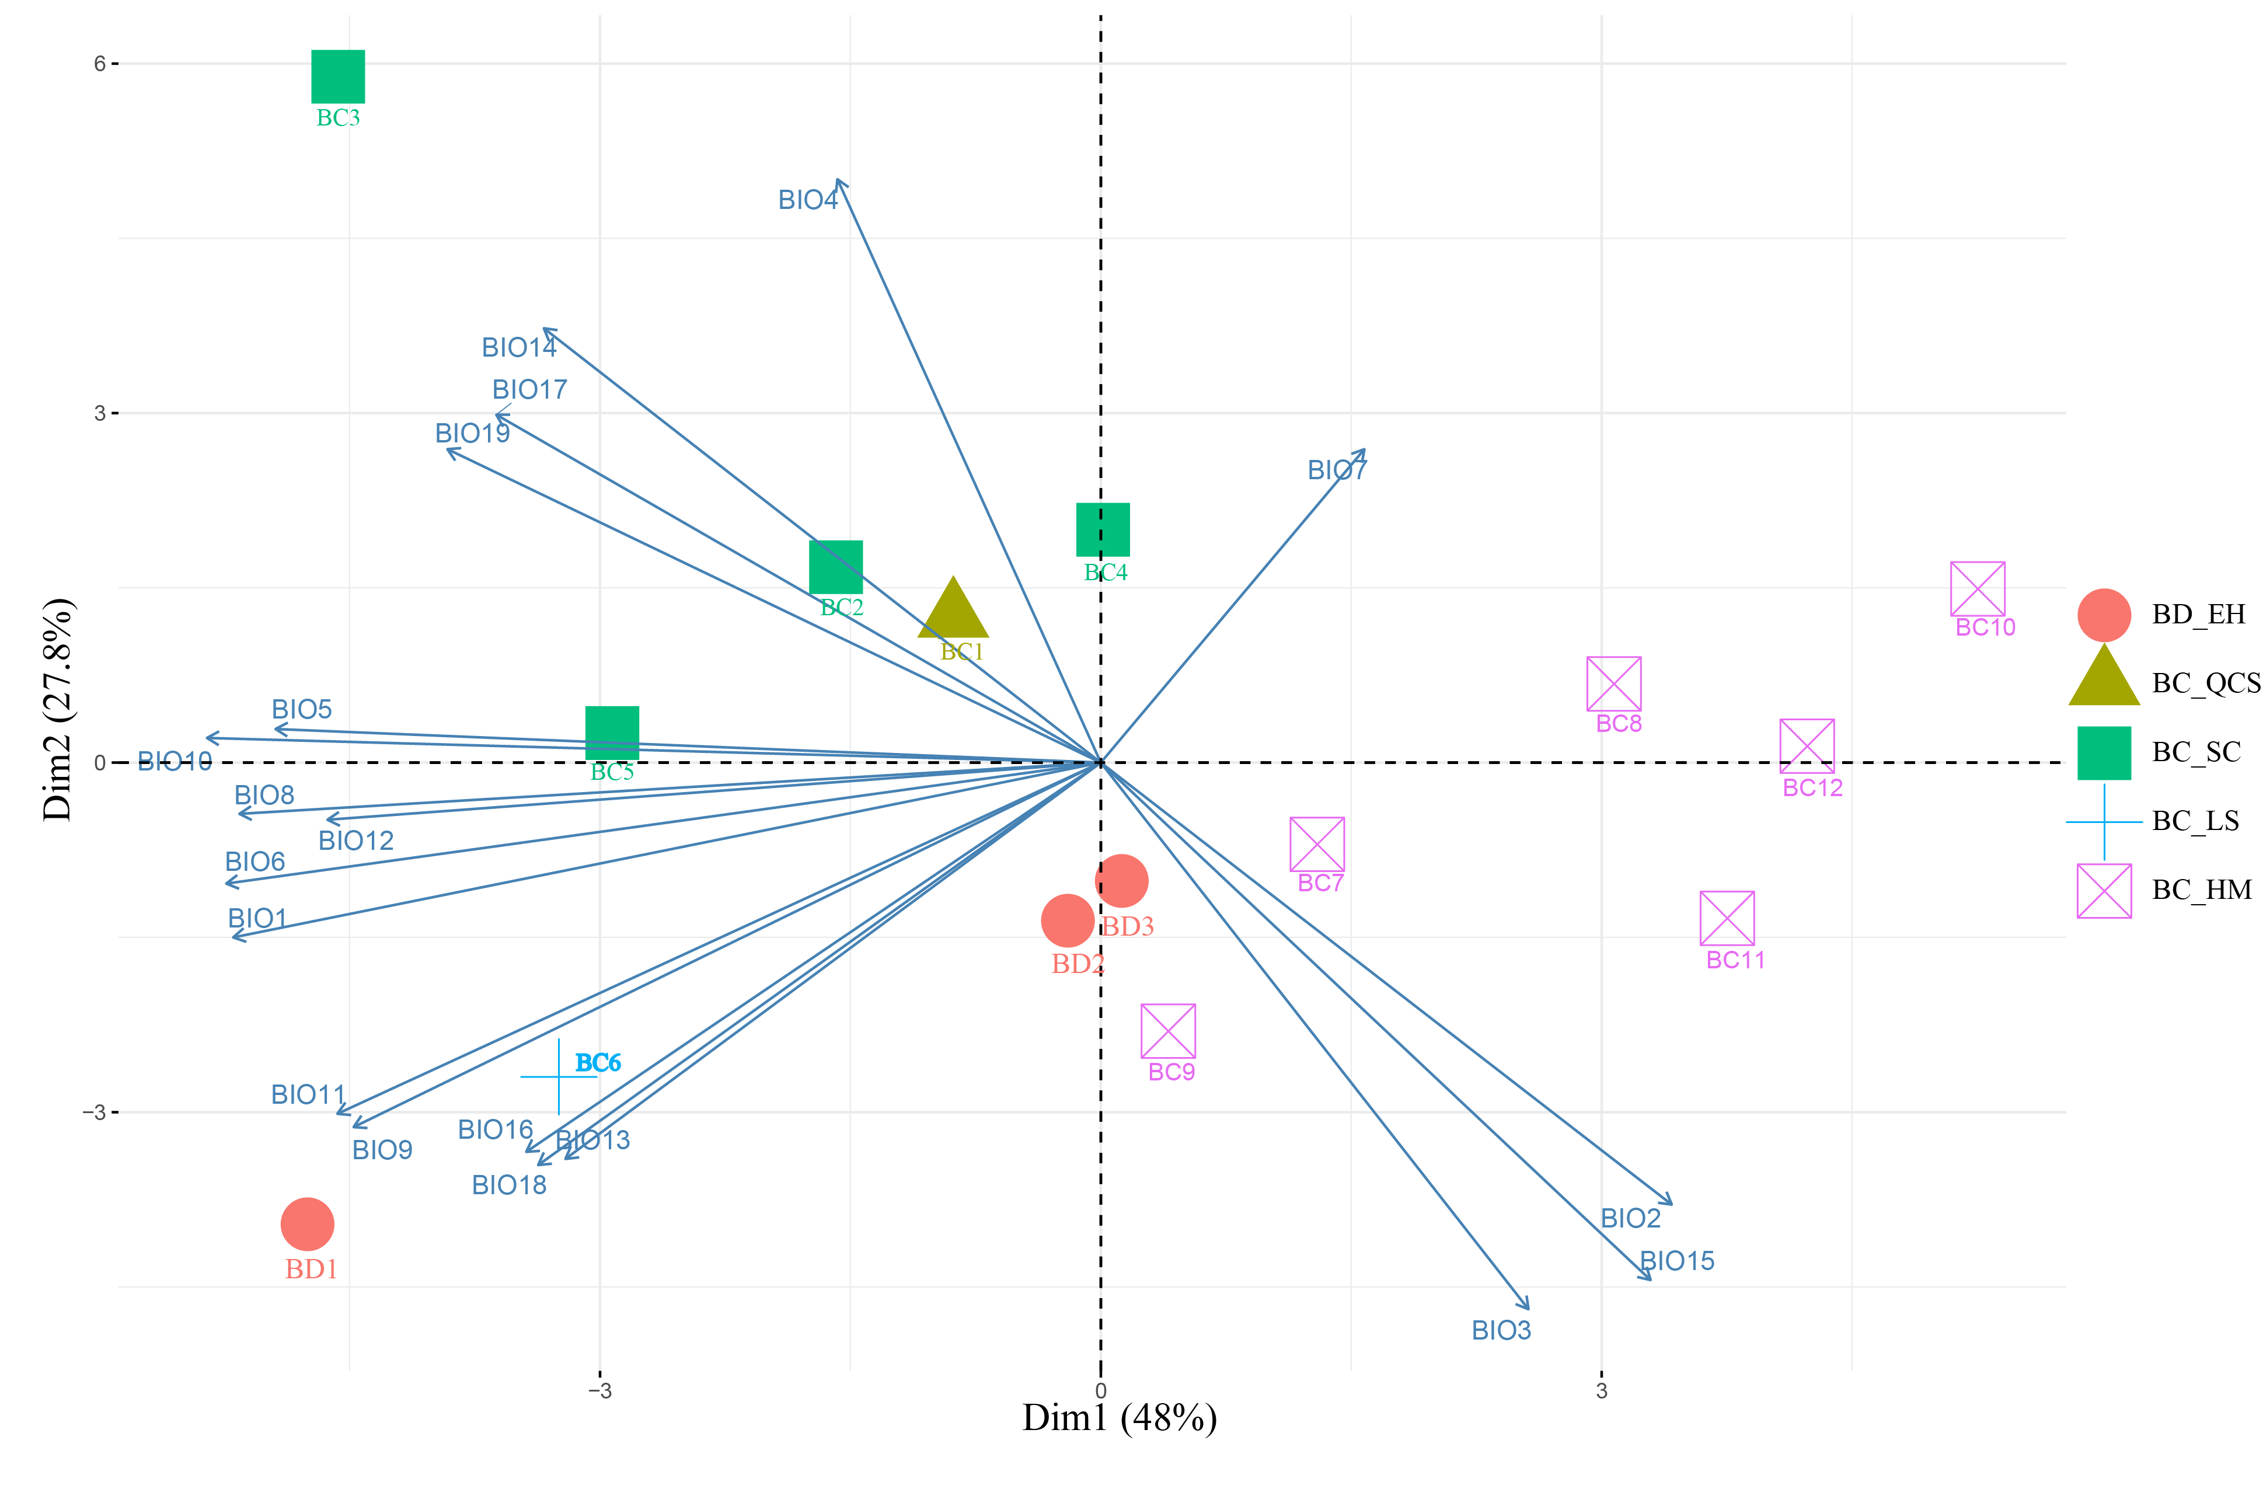
Fig. S5 PCA analysis of bioclimatic factors affecting Beesia. Each arrow represents a projection of a bioclimatic variable.

Slide 6
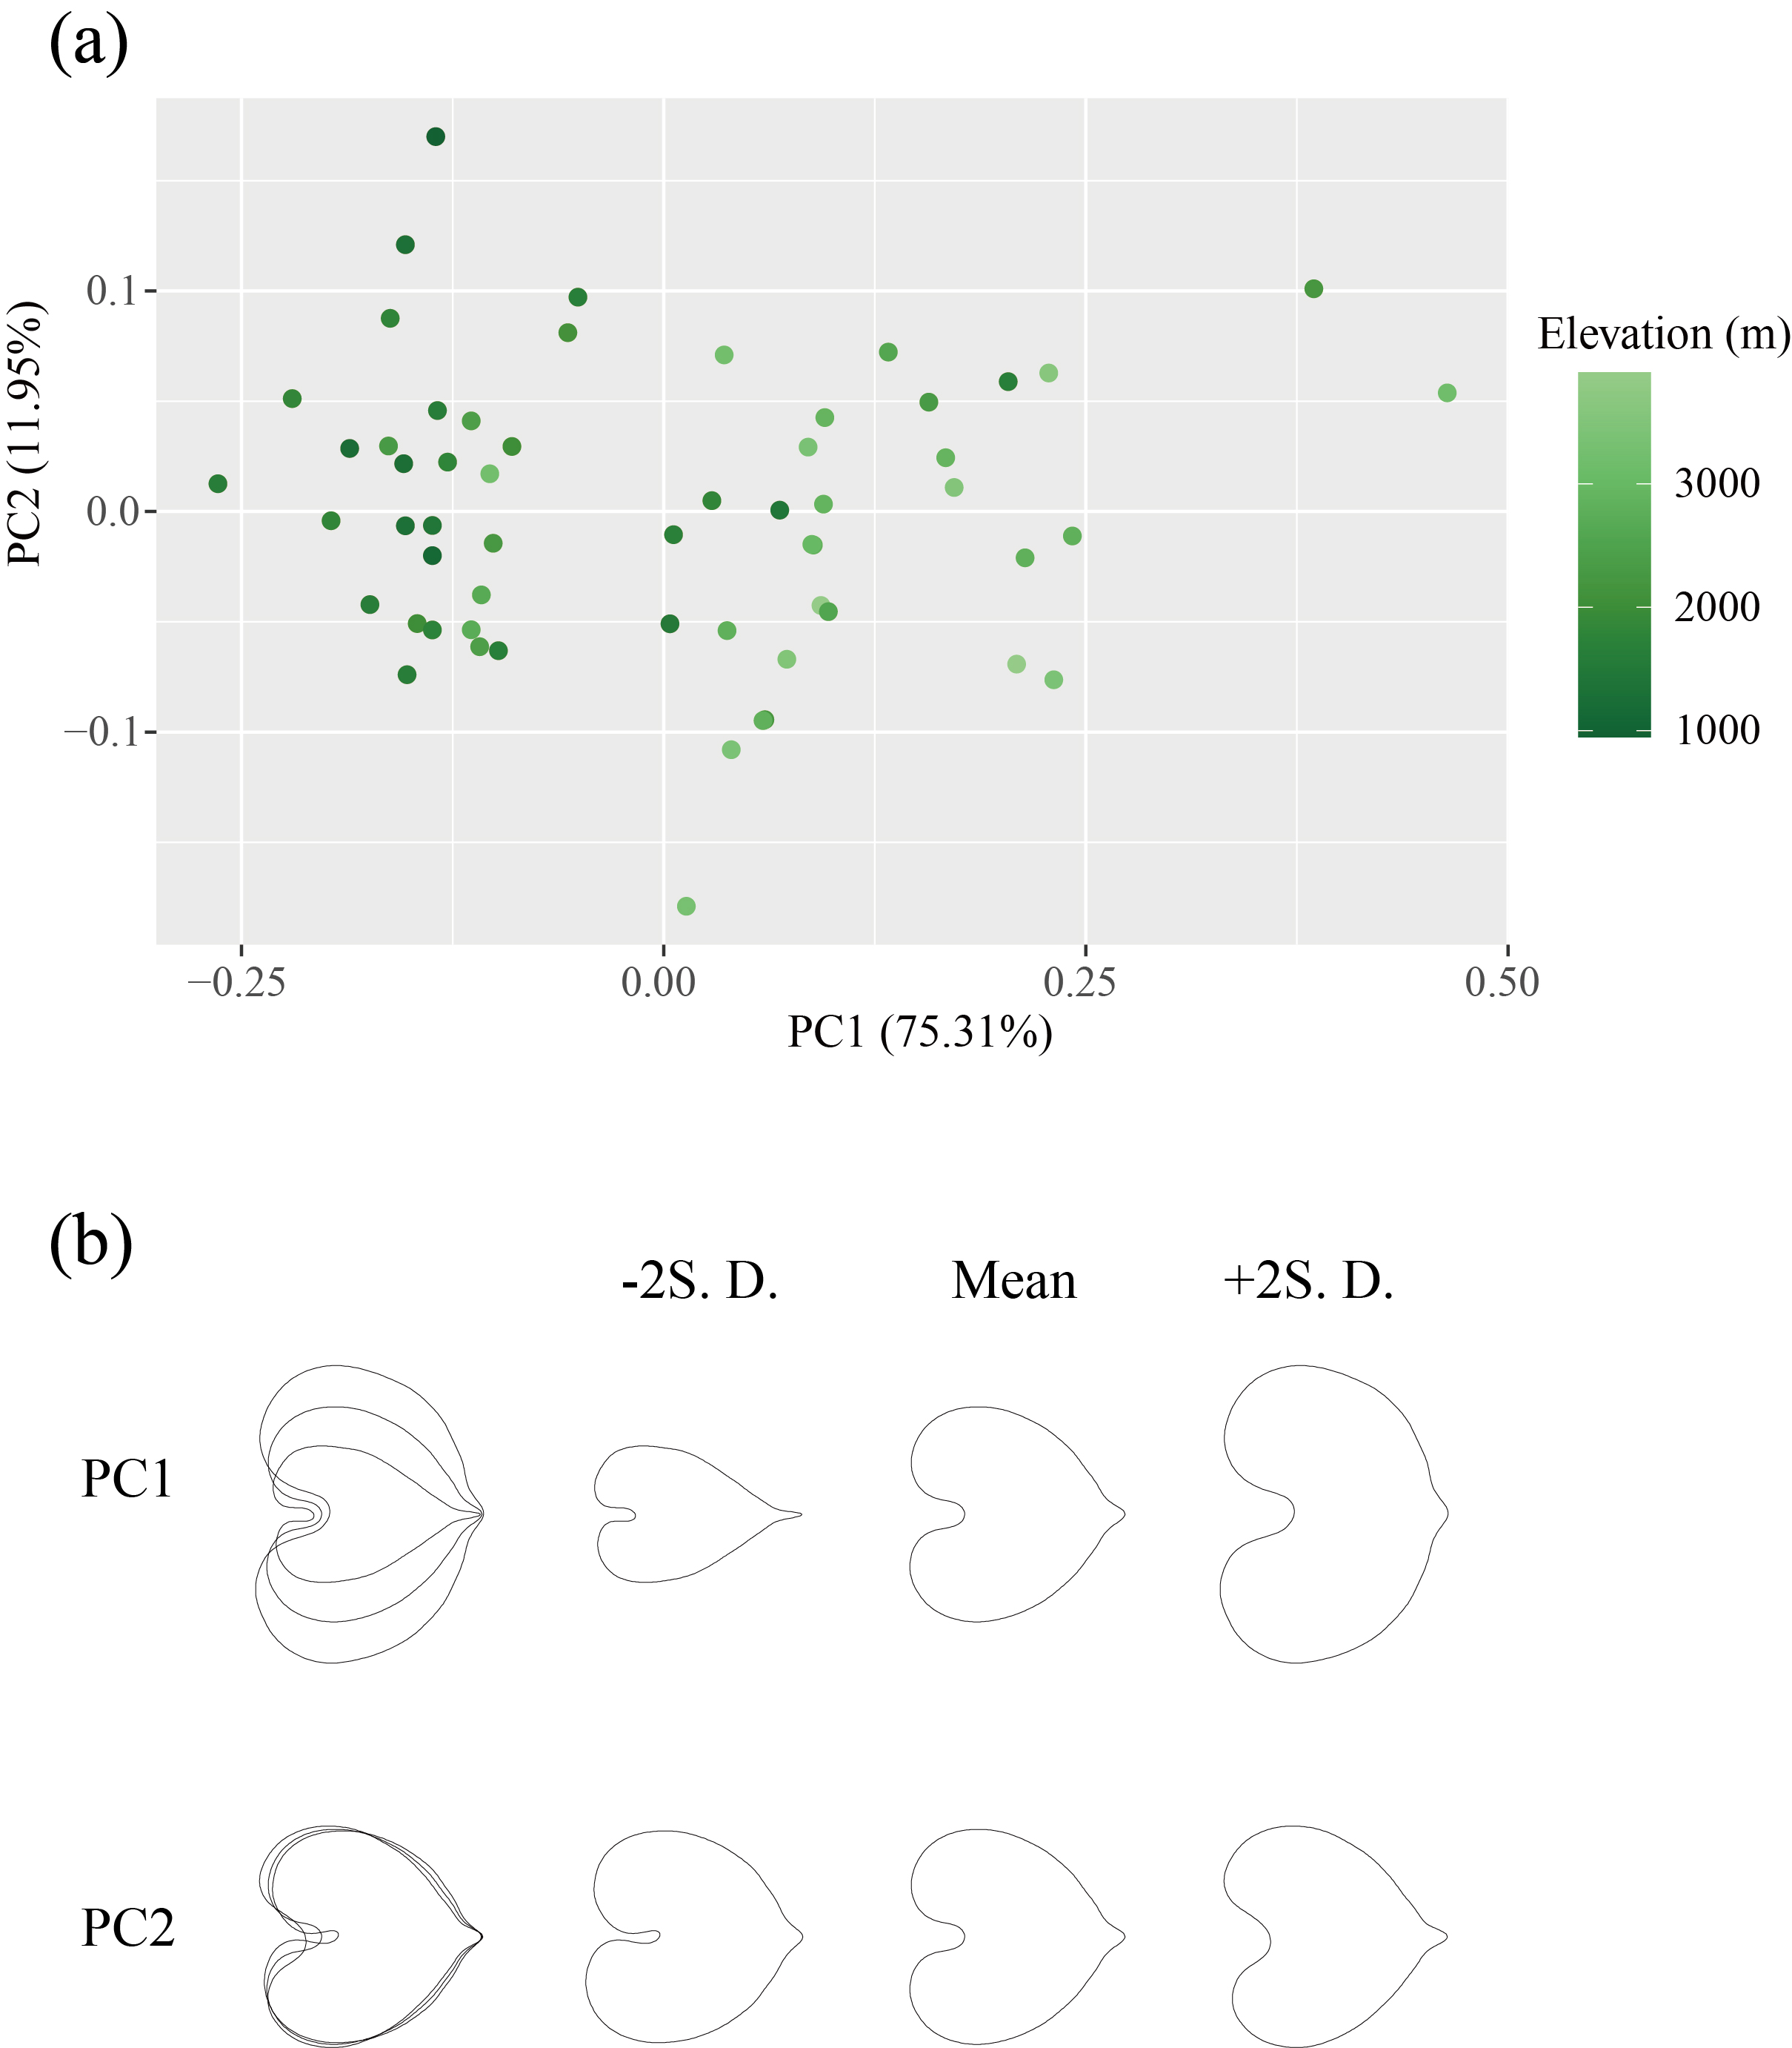
Fig S6 EF-PCA of shape variation in B. calthifolia based on 58 intact leaves. (a) Scatter plot of individuals along PC scores of shape variation; points are color-coded according to individuals’ elevation (the scale dark green to light green represents low elevation to high elevation). (b) The first two principal components explain variation in the leaf shape (PC1: 75.31%, PC2: 11.95%). From the right, +2 SD (standard deviation), mean and -2 SD represent the score for each column of drawings which are superimposed in the leftmost column.

Slide 7
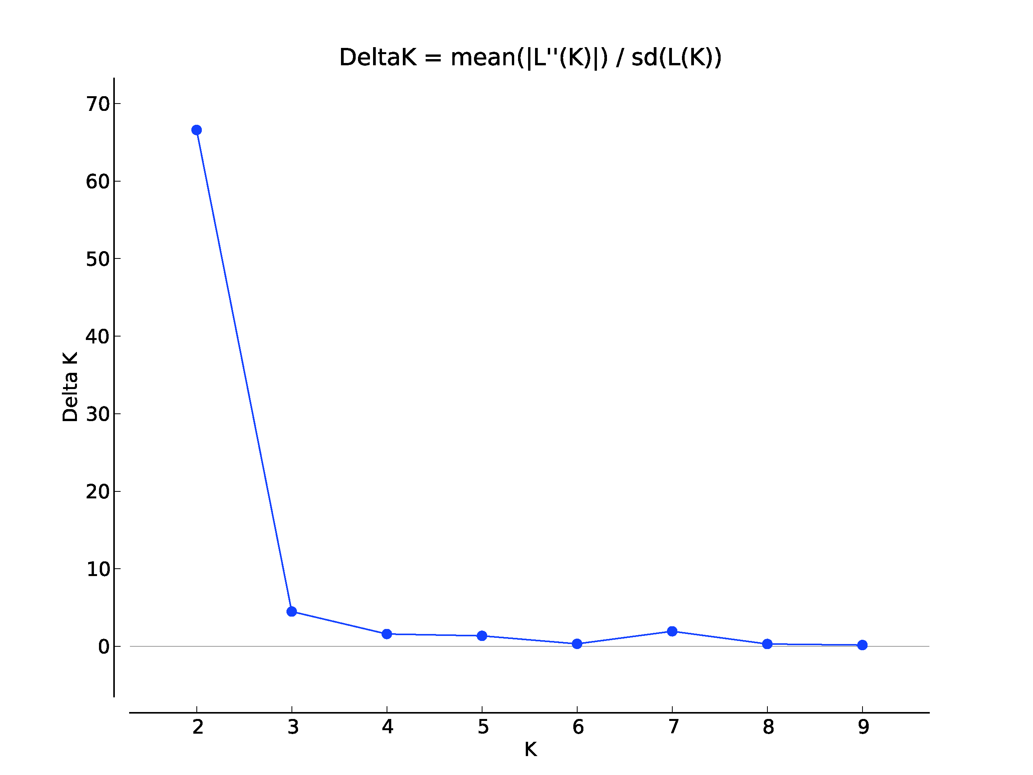
Fig S7 Delta-K distribution from STRUCTURE analysis of Beesia based on B119 dataset.

Slide 8
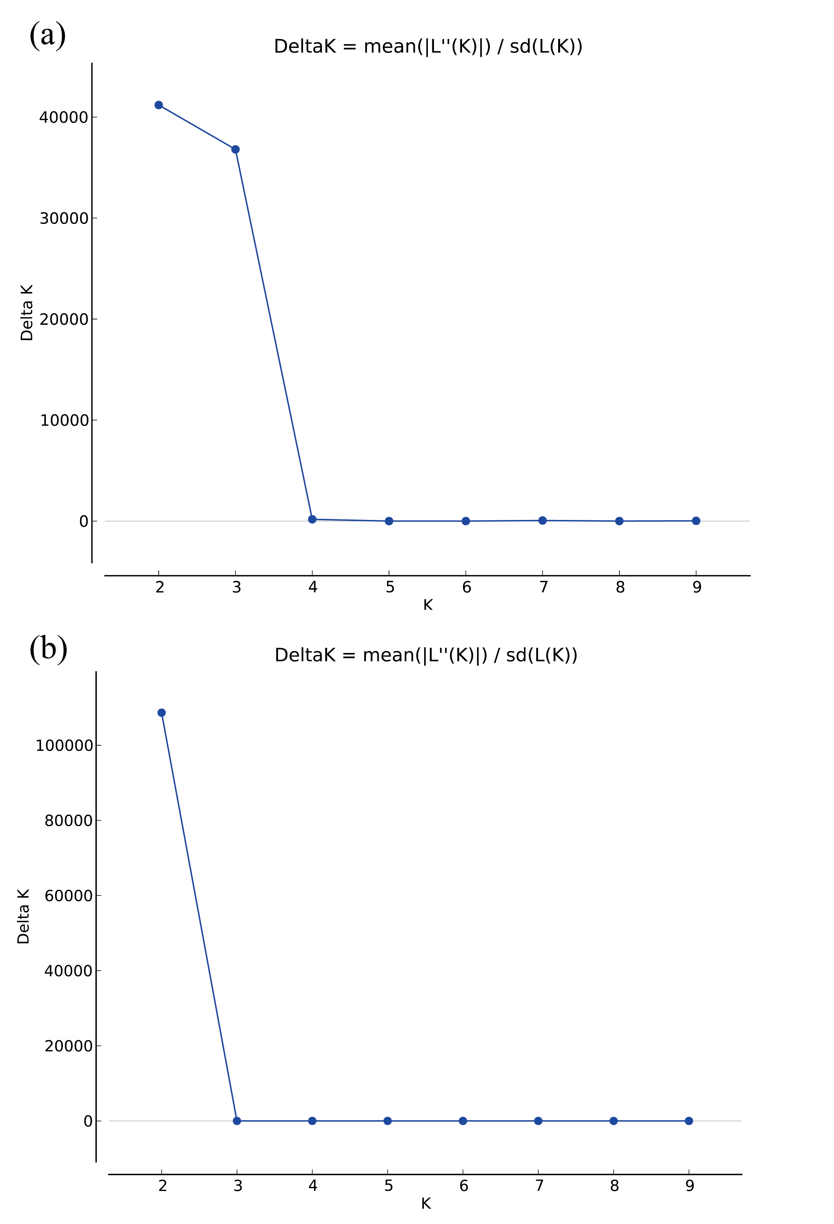
Fig. S8 Delta-K distribution from STRUCTURE analysis of Megacodon based on dataset M155 (a) and M. stylophorus based on dataset M131 (b).

Slide 9
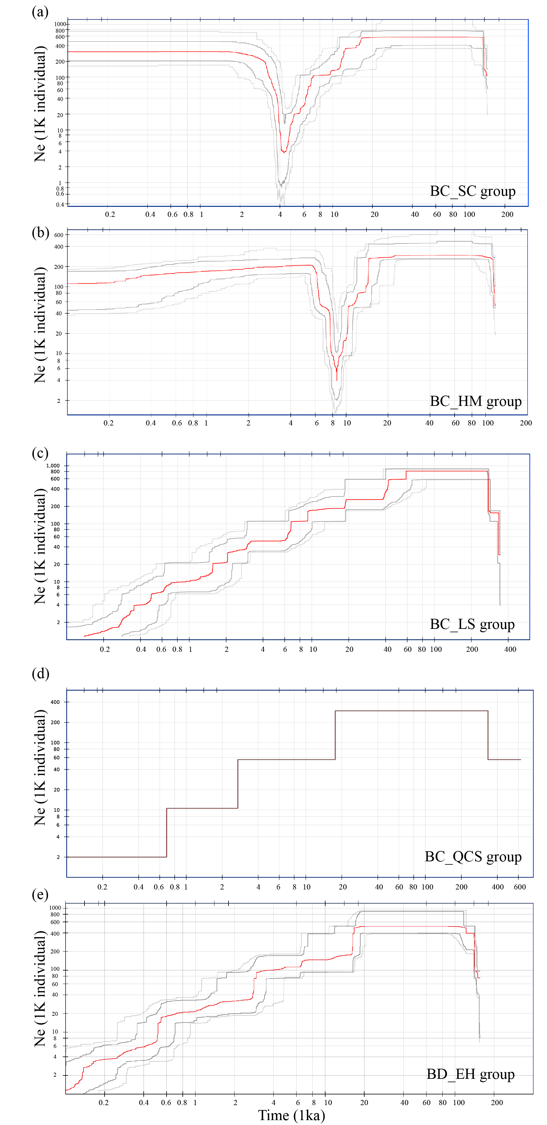
Fig. S9 Demographic changes in Beesia using stairway plot2.

Slide 10
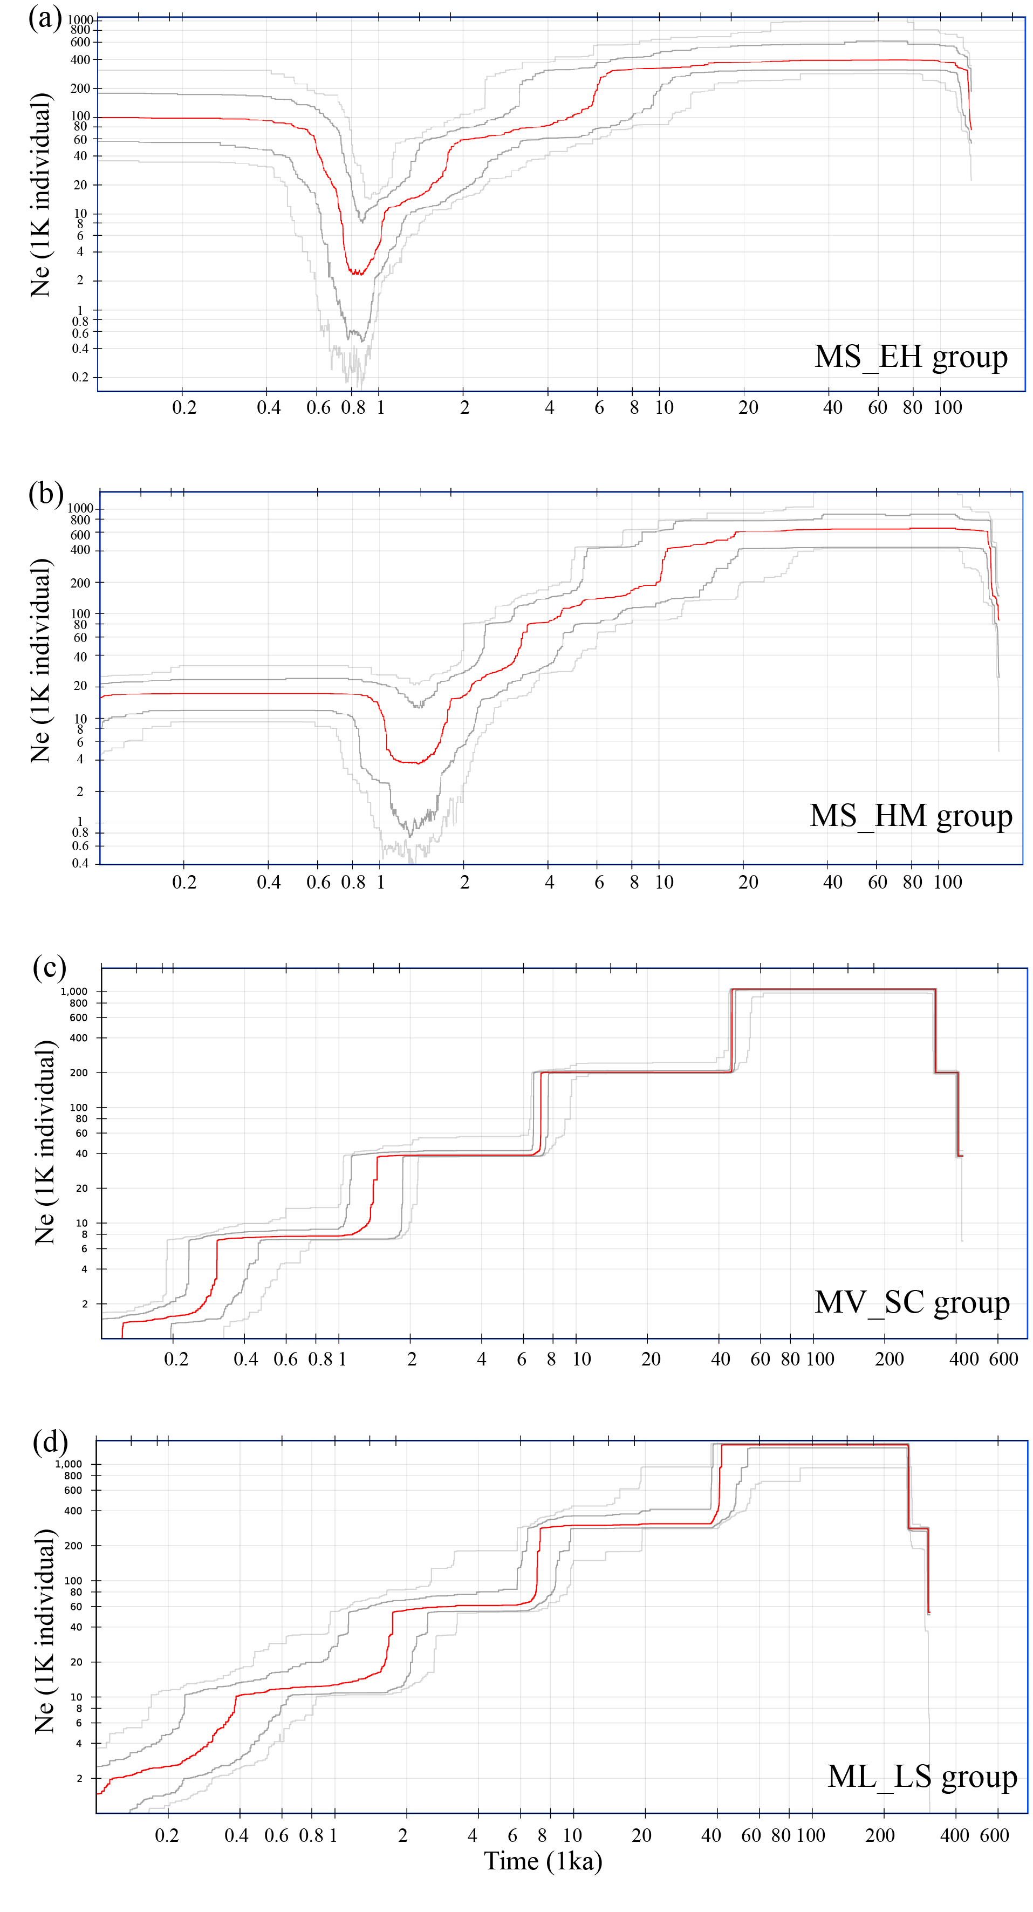
Fig S10 Demographic changes in Megacodon using stairway plot2.

Slide 11
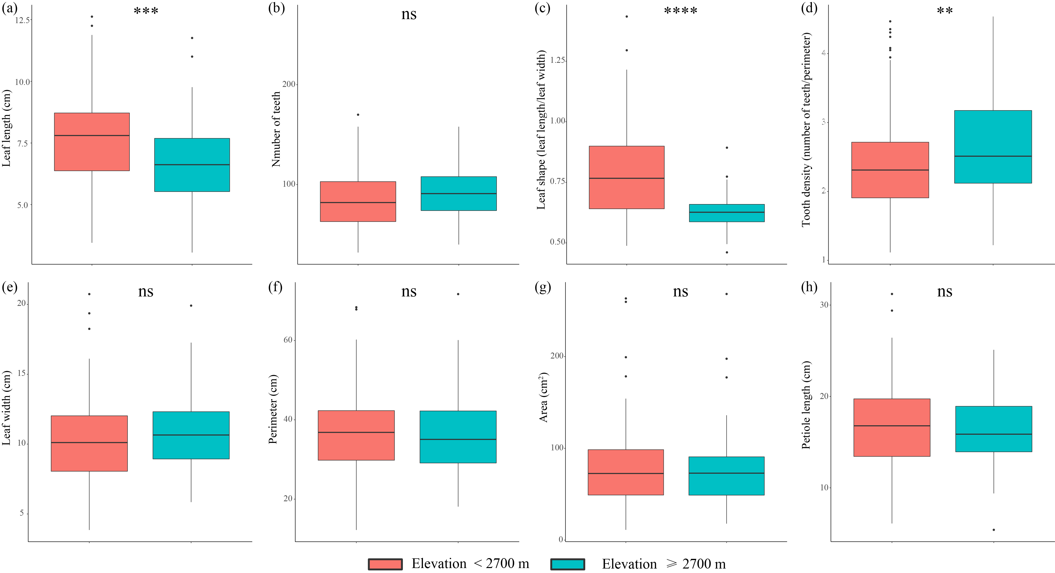
Fig. S11 Boxplot and t test between high and low elevations for leaf traits of B. calthifolia based on 258 specimens. (a): leaf length (cm), (b): number of teeth, (c): leaf shape (represented by ratio of leaf length to leaf width), (d): tooth density (calculated by number of teeth divided by perimeter), (e): leaf width (cm), (f): perimeter (cm), (g): leaf area (cm²), (h): petiole length (cm). Significant differences in the t-test between two elevation levels of each leaf trait are indicated with * < 0.05, ** < 0.01, *** < 0.001, **** < 0.0001, and ns > 0.05.
.

