Slide 1
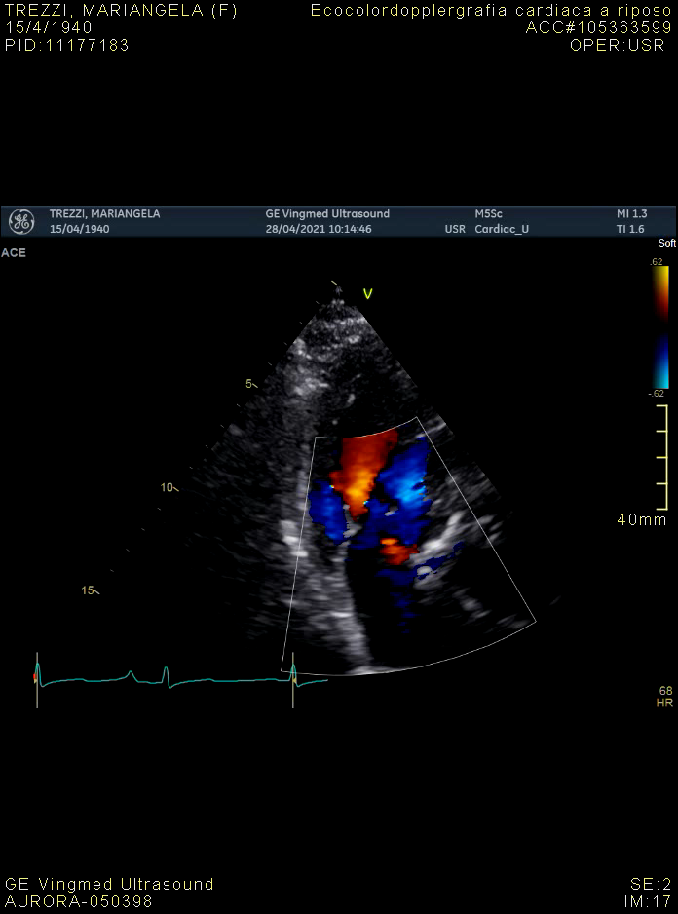
Video 1.
Transthoracic echocardiogram showing severe aortic stenosis (AVA: 0.6 cm², mean gradient of 55 mm Hg) and mild aortic regurgitation.

Slide 2
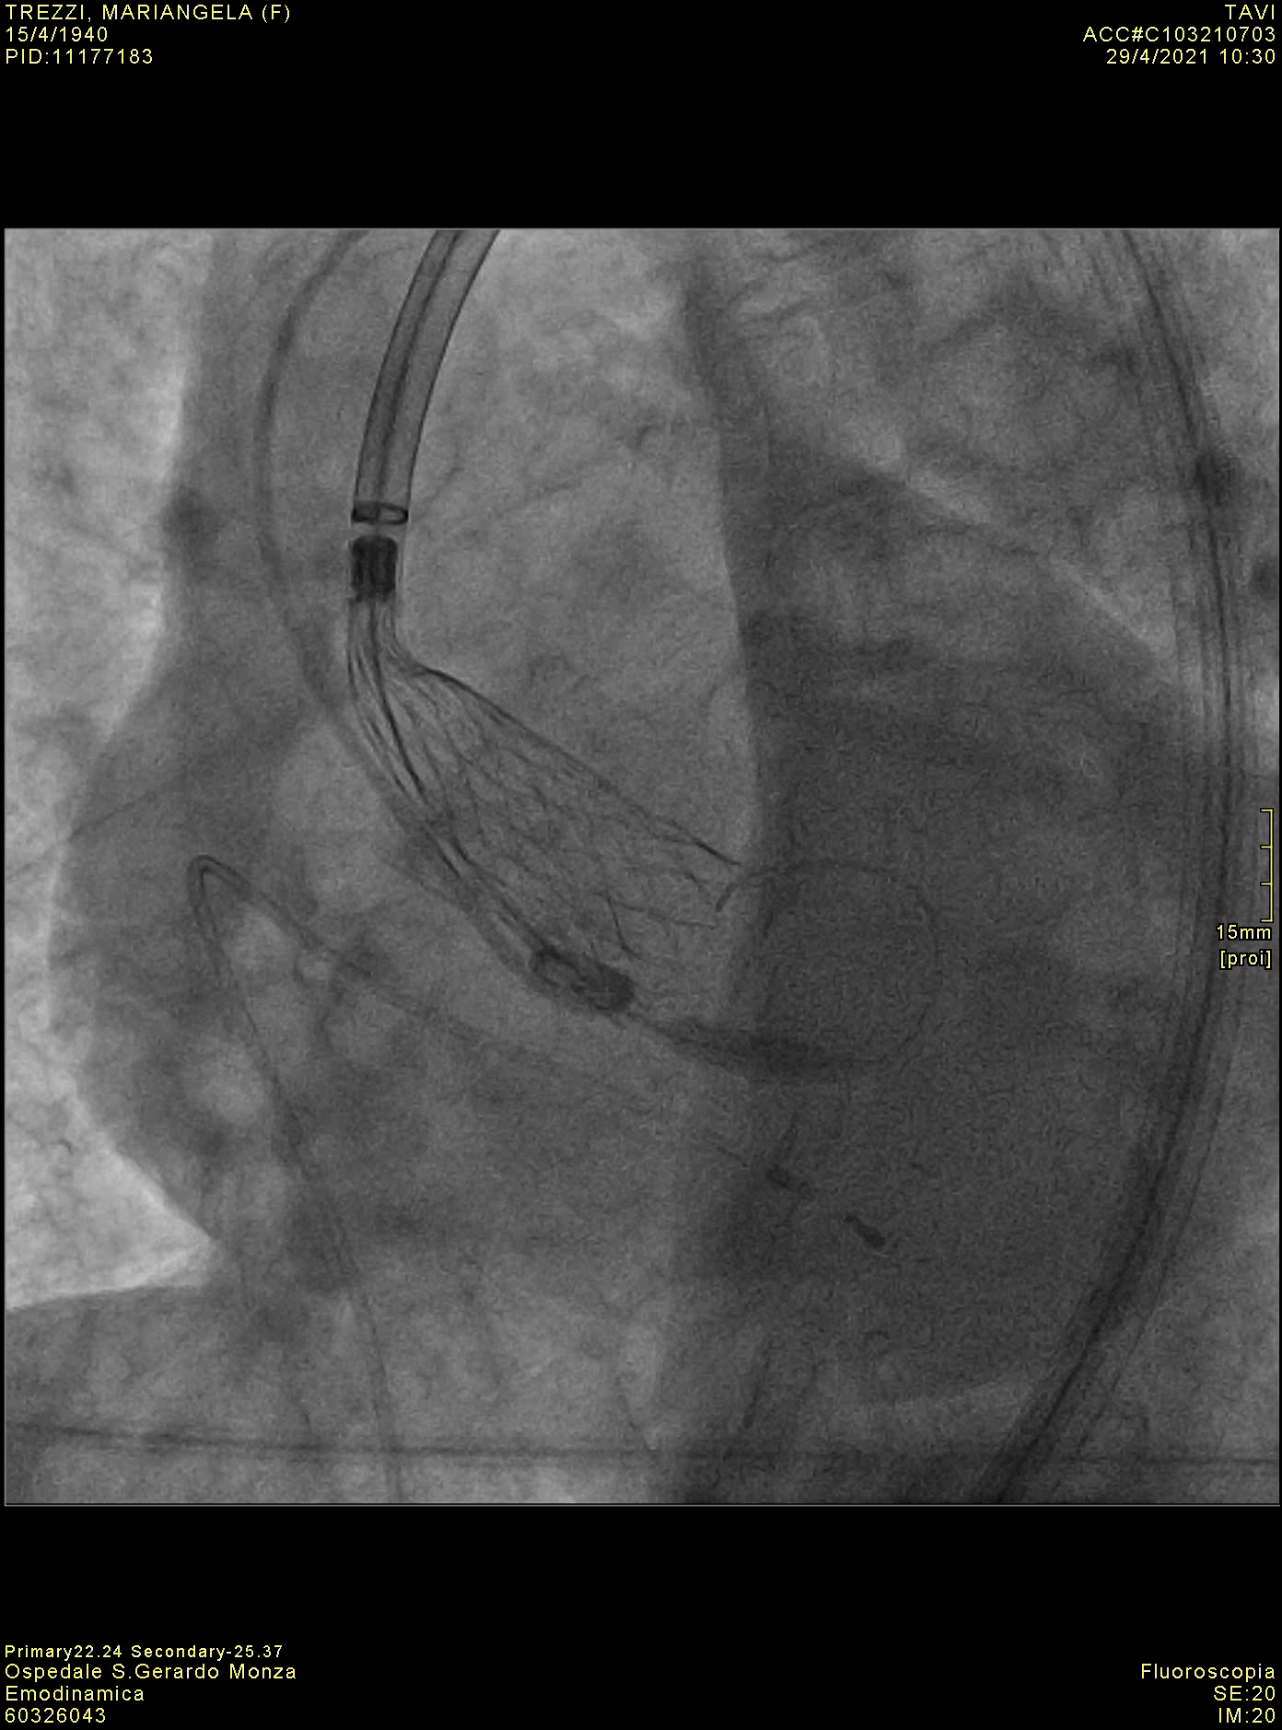
Video 2.
Transcatheter Aortic Valve Replacement. Deployment of Evolute R 29 (Self-expanding) aortic valve.

Slide 3
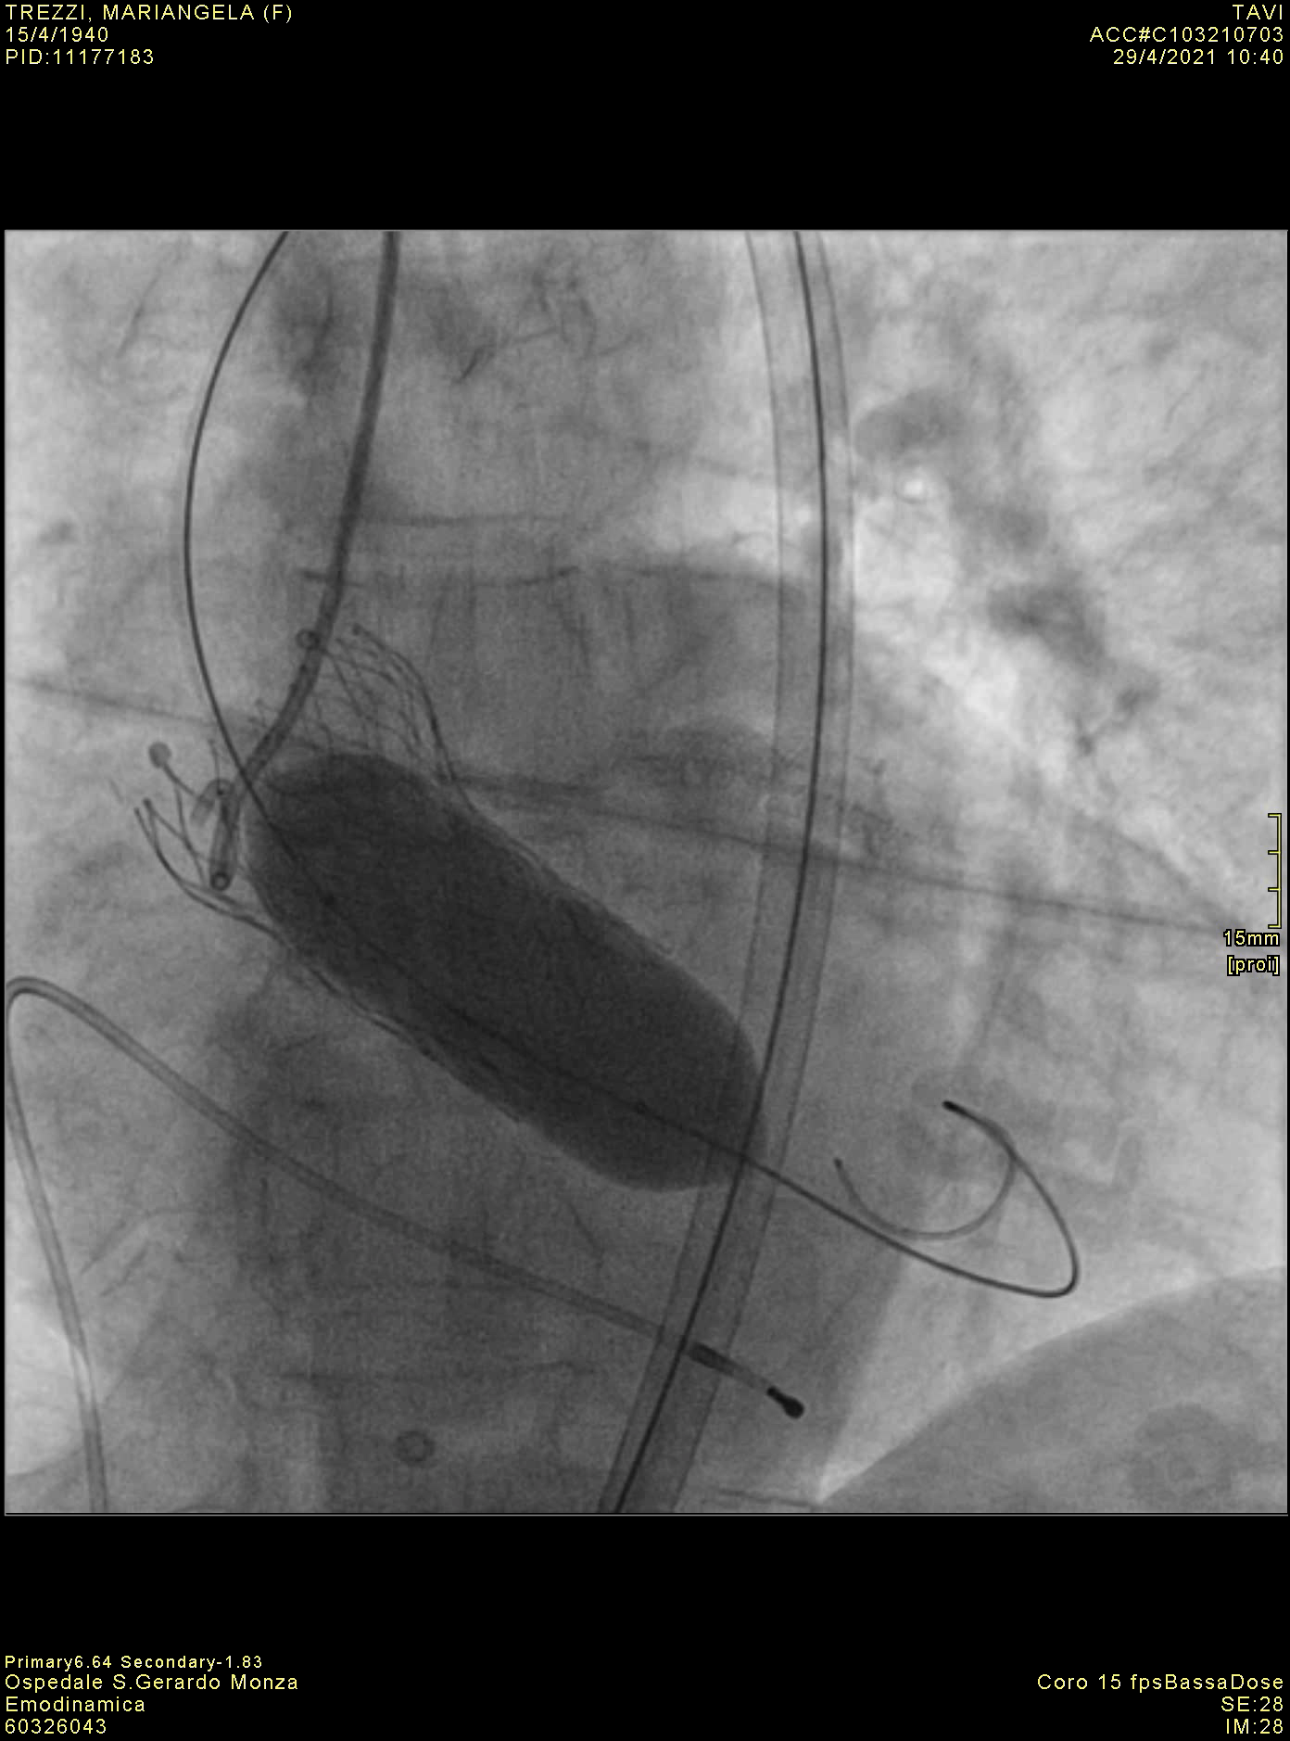
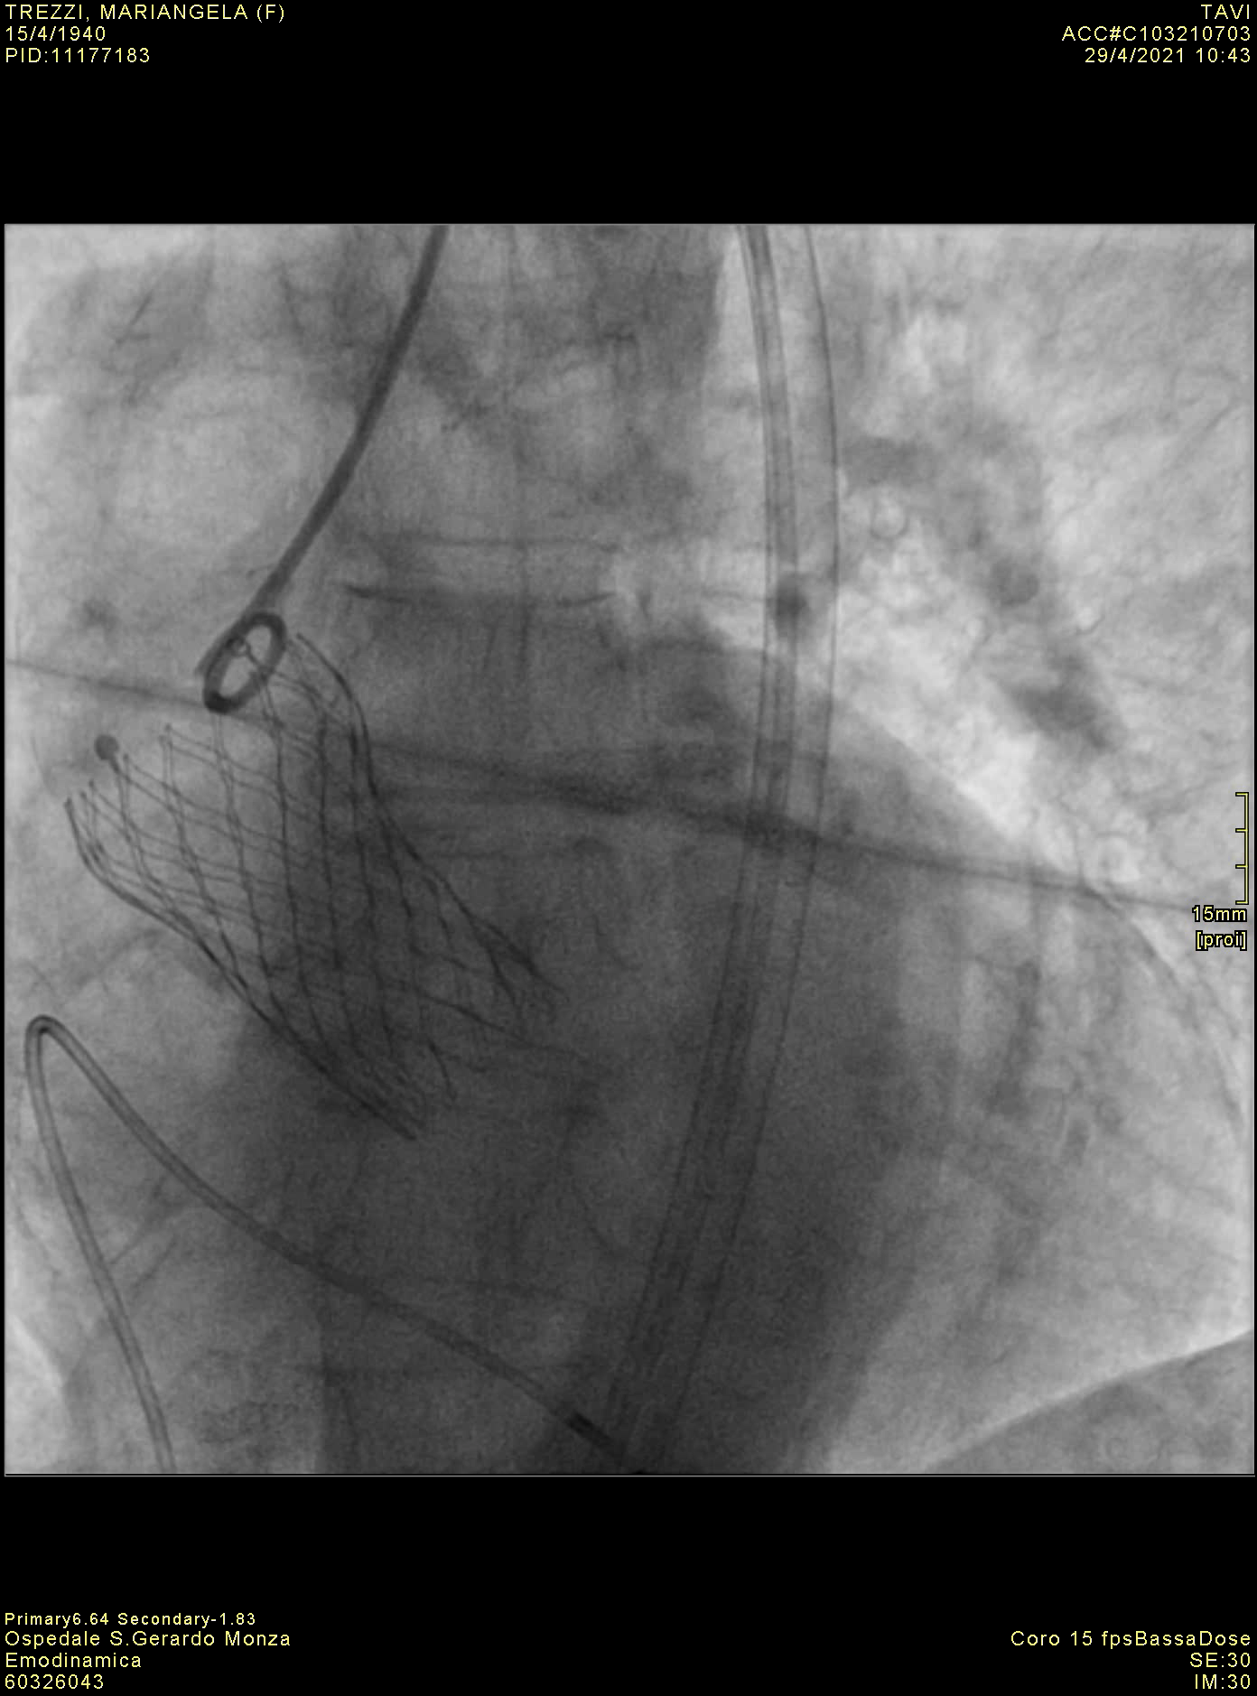
Video 3
A
B
A. Transcatheter Aortic Valve Replacement. Post-dilation with VACS III 22 x 40 mm.
B. Transcatheter Aortic Valve Replacement. Residual mild paravalvular leak.

Slide 4
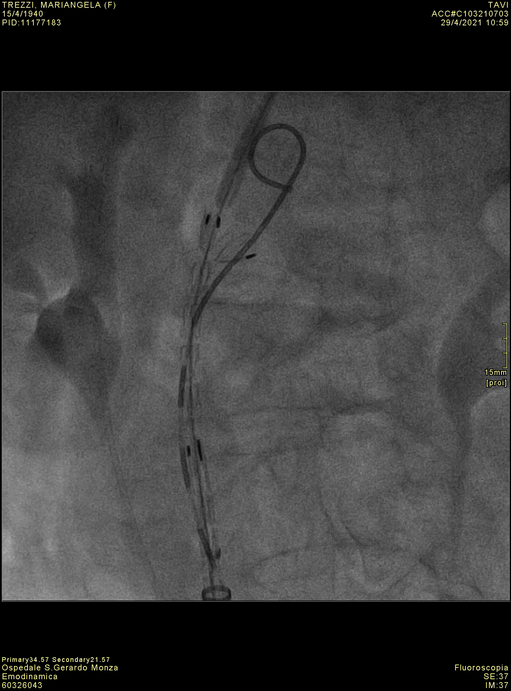
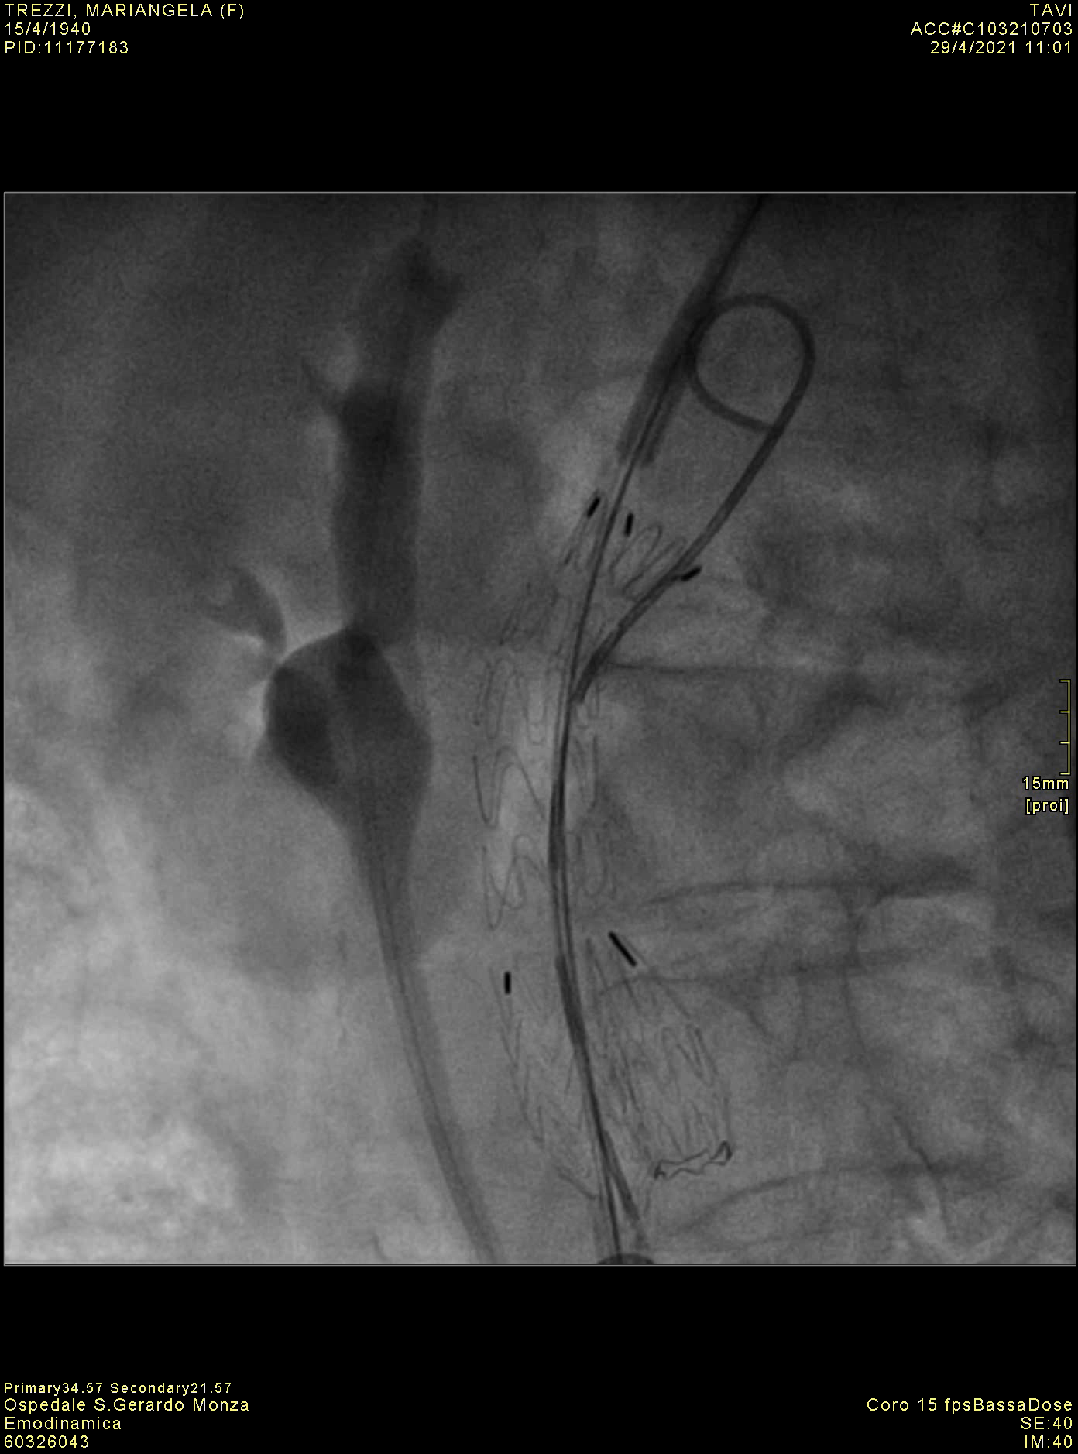
Video 4
A
B
Endovascular aneurysm repair. Positioning (A) and deployment (B) of the endovascular stent graft.

