Slide 1
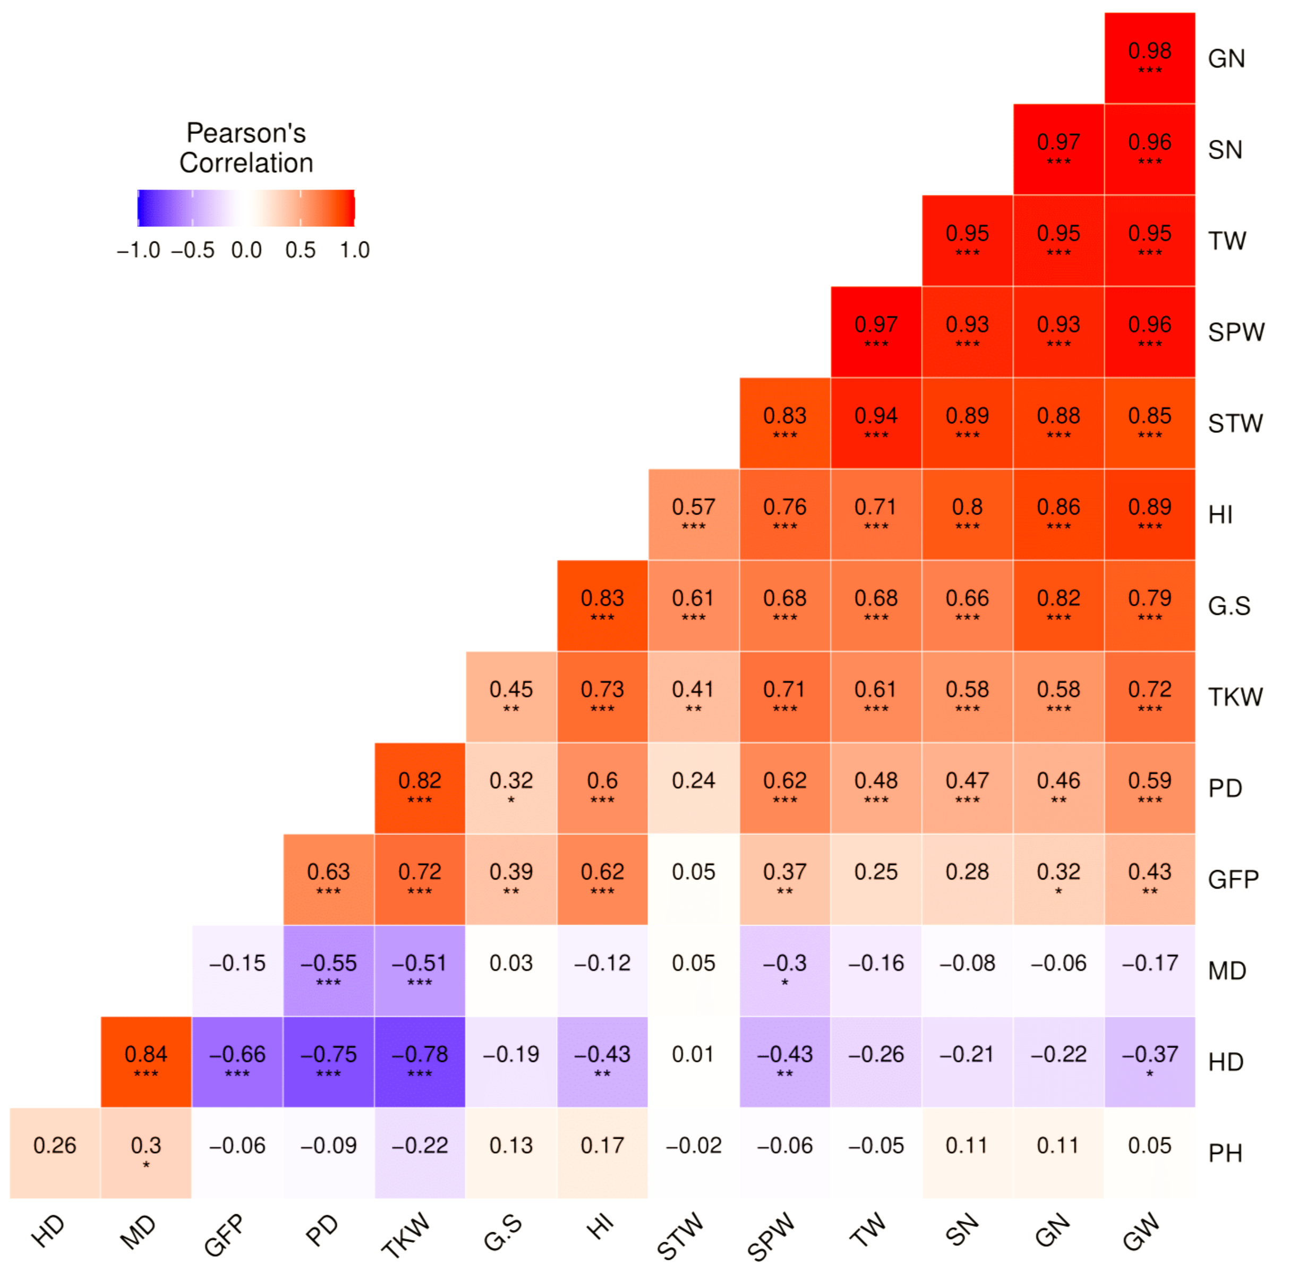
December-irrigated conditions

Slide 2
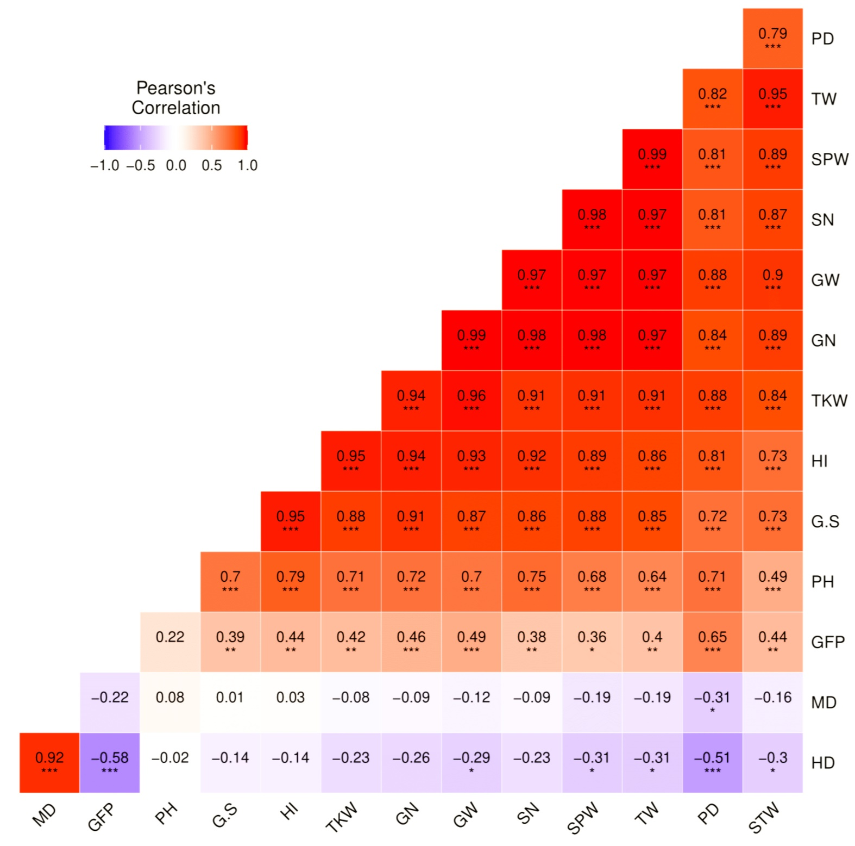
December-rainfed conditions

Slide 3
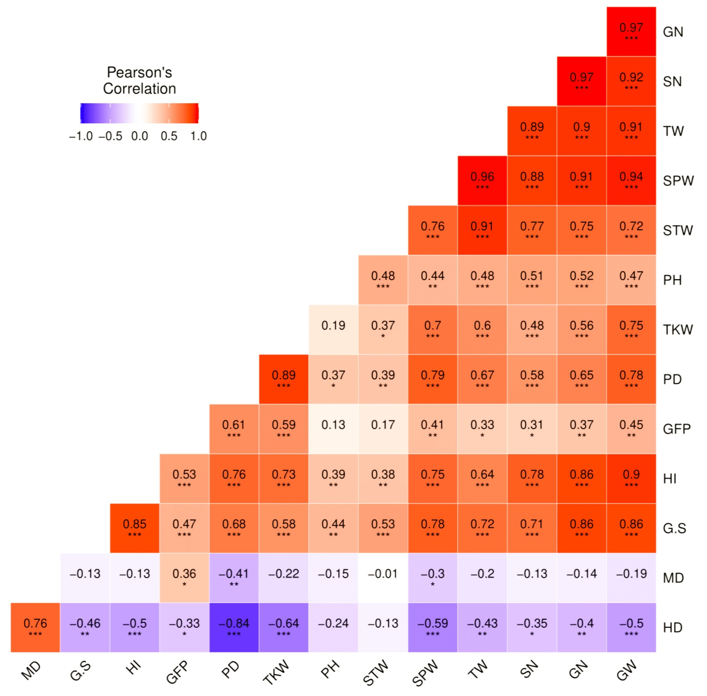
February-irrigated conditions

Slide 4
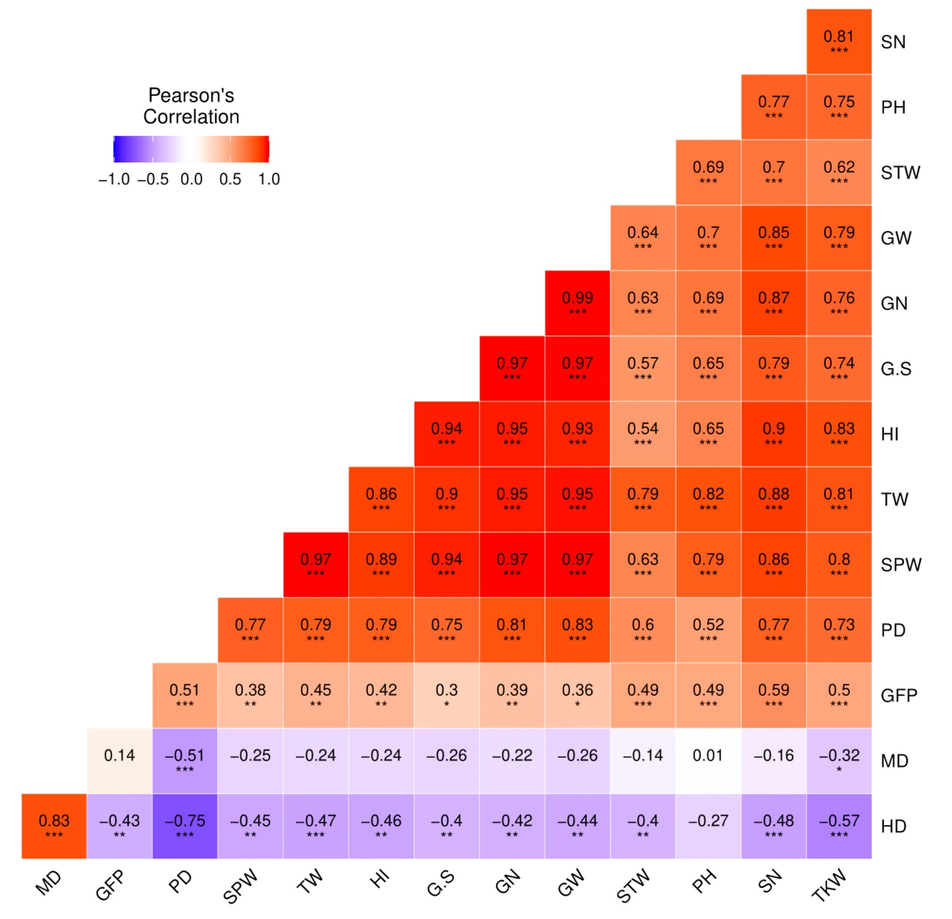
February-rainfed conditions

