Slide 1
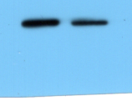
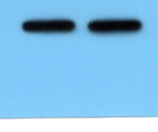
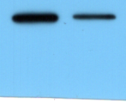
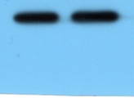
miR-NC
miR-597-3p
miR-NC
miR-597-3p
BCL-xL
30 kDa
LNCaP
GAPDH
37 kDa
LNCaP
Supplementary Figure 1A for Figure 4D (upper panel BCL-xL in LNCaP cells)
Supplementary Figure 1B for Figure 4D (upper panel GAPDH in LNCaP cells)
miR-597-3p
miR-NC
miR-597-3p
miR-NC
BCL-xL
30 kDa
GAPDH
37 kDa
PC-3
PC-3
Supplementary Figure 1C for Figure 4D (upper panel BCL-xL in PC-3 cells)
Supplementary Figure 1D for Figure 4D (upper panel GAPDH in PC-3 cells)

Slide 2
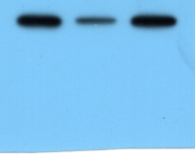
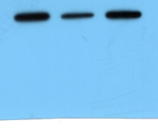
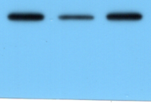
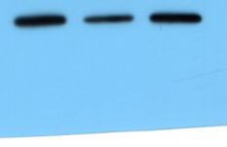
miR-597-3p+
pcDNA3.1-LINC01213
miR-597-3p+
pcDNA3.1-LINC01213
miR-NC
miR-597-3p
miR-NC
miR-597-3p
BCL-xL
30 kDa
LNCaP
BCL-2
26 kDa
LNCaP
Supplementary Figure 2A for Figure 5F (upper panel BCL-xL in LNCaP cells)
Supplementary Figure 2B for Figure 5F (upper panel BCL-2 in LNCaP cells)
miR-597-3p+
pcDNA3.1-LINC01213
miR-597-3p+
pcDNA3.1-LINC01213
miR-597-3p
miR-NC
miR-597-3p
miR-NC
BCL-xL
30 kDa
PC-3
BCL-2
26 kDa
PC-3
Supplementary Figure 2C for Figure 5F (upper panel BCL-xL in PC-3 cells)
Supplementary Figure 2D for Figure 5F (upper panel BCL-2 in PC-3 cells)

Slide 3
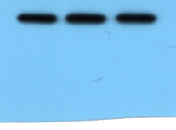
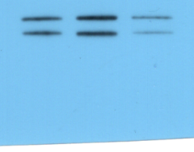
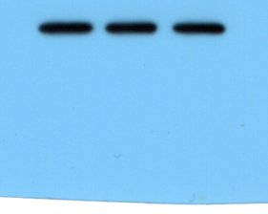
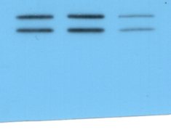
miR-597-3p+
pcDNA3.1-LINC01213
miR-597-3p+
pcDNA3.1-LINC01213
miR-NC
miR-597-3p
miR-NC
miR-597-3p
CASPASE3
17 kDa
LNCaP
Cleved-
CASPASE3
19 kDa
LNCaP
Supplementary Figure 2E for Figure 5F
(upper panel CASPASE3 in LNCaP cells)
Supplementary Figure 2F for Figure 5F
(upper panel Cleved-CASPASE3 in LNCaP cells)
miR-597-3p+
pcDNA3.1-LINC01213
miR-597-3p+
pcDNA3.1-LINC01213
miR-NC
miR-597-3p
miR-NC
miR-597-3p
Cleved-
CASPASE3
19 kDa
PC-3
CASPASE3
17 kDa
PC-3
Supplementary Figure 2G for Figure 5F (upper panel CASPASE3 in PC-3 cells)
Supplementary Figure 2H for Figure 5F
(upper panel Cleved-CASPASE3 in PC-3 cells)

Slide 4
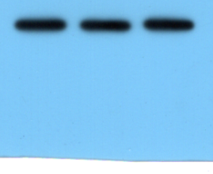
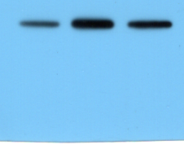
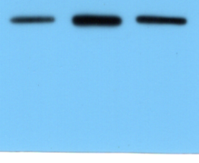
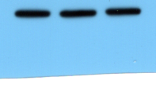
miR-597-3p+
pcDNA3.1-LINC01213
miR-597-3p+
pcDNA3.1-LINC01213
miR-NC
miR-597-3p
miR-NC
miR-597-3p
CASPASE9
46 kDa
LNCaP
Cleved-
CASPASE9
37 kDa
LNCaP
Supplementary Figure 2I for Figure 5F
(upper panel CASPASE9 in LNCaP cells)
Supplementary Figure 2J for Figure 5F
(upper panel Cleved-CASPASE9 in LNCaP cells)
miR-597-3p+
pcDNA3.1-LINC01213
miR-597-3p+
pcDNA3.1-LINC01213
miR-597-3p
miR-NC
miR-NC
miR-597-3p
Cleved-
CASPASE9
37 kDa
CASPASE9
46 kDa
PC-3
PC-3
Supplementary Figure 2K for Figure 5F
(upper panel CASPASE9 in PC-3 cells)
Supplementary Figure 2L for Figure 5F
(upper panel Cleved-CASPASE9 in PC-3 cells)

Slide 5
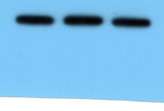
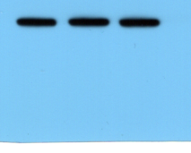
miR-597-3p+
pcDNA3.1-LINC01213
miR-597-3p+
pcDNA3.1-LINC01213
miR-NC
miR-597-3p
miR-NC
miR-597-3p
GAPDH
37 kDa
LNCaP
GAPDH
37 kDa
PC-3
Supplementary Figure 2M for Figure 5F
(upper panel GAPDH in LNCaP cells)
Supplementary Figure 2N for Figure 5F
(upper panel GAPDH in PC-3 cells)

