Slide 1
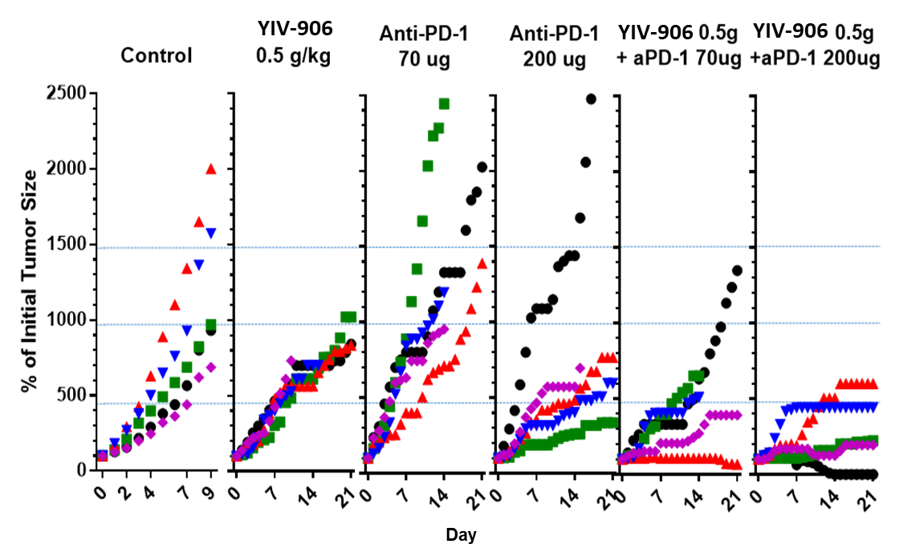
Supplementary Figure 1
A
Figure S1. Anti-tumor activity of YIV-906 (500mg/kg p.o. bid x7 days) plus different dose of anti-PD1 (70ug or 200ug/mice i.p. once) against Hepa 1-6 in vivo. Tumor size at the beginning were about 270mm³. Details of experimental procedures are given in Materials and Methods.

Slide 2
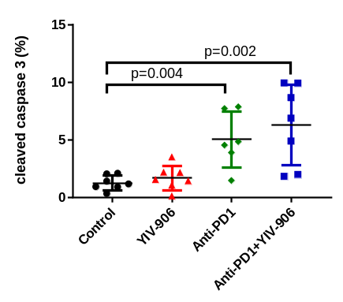
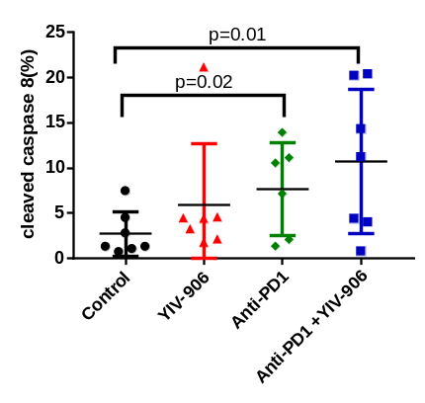
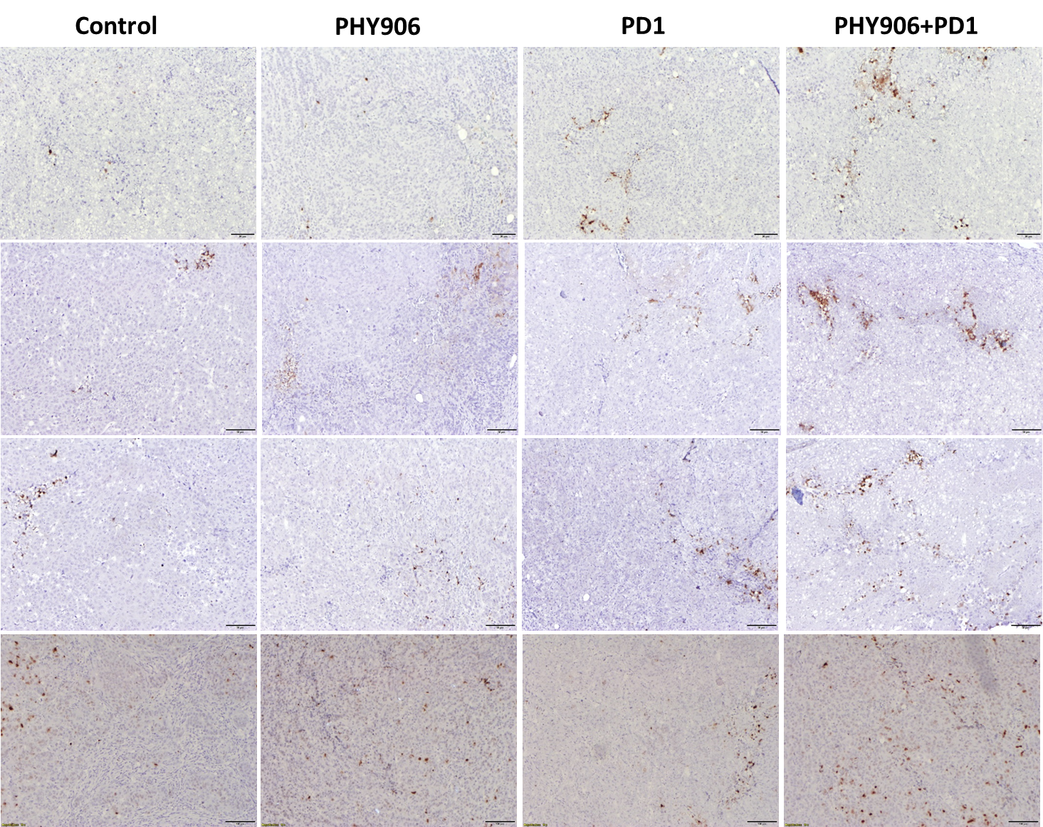
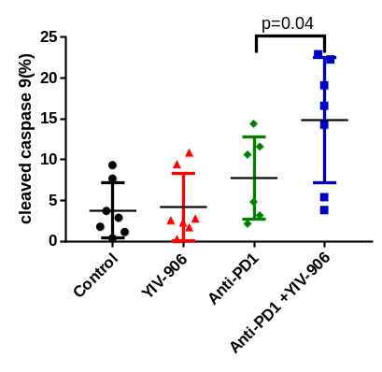
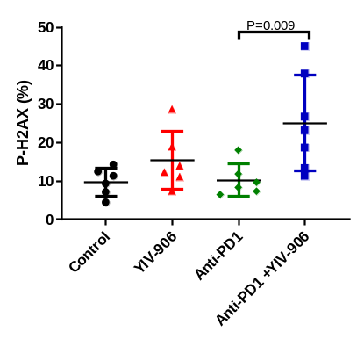
Supplementary figure 2
B C
D E
A
Control YIV-906 Anti-PD1 YIV-906+Anti-PD1
H2AX-P Cleaved Cas9 Cleaved Cas8 Cleaved Cas3
Figure S2. Effect of YIV-906 and/or Anti-PD1 on apoptosis and DNA damage of Hepa 1-6 tumor. (A) Immunohistochemistry staining for cleaved caspase 3, 8, 9 for apoptosis and H2AX-ser139P for DNA damage. (B to E). Quantification for caspase 3, 8, 9 and H2AX-ser139P from (A). Details of experimental procedures are given in Materials and Methods.

Slide 3
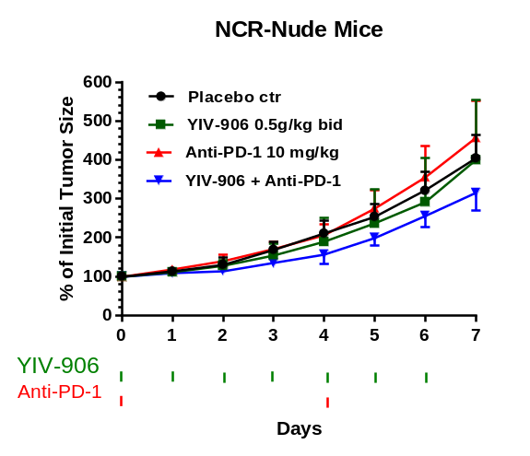
Supplementary figure 3
Figure S3. Effect of YIV-906 and/or Anti-PD1 on Hepa 1-6 tumor growth in nude mice. Details of experimental procedures are given in Materials and Methods.

Slide 4
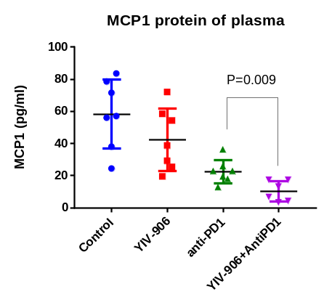
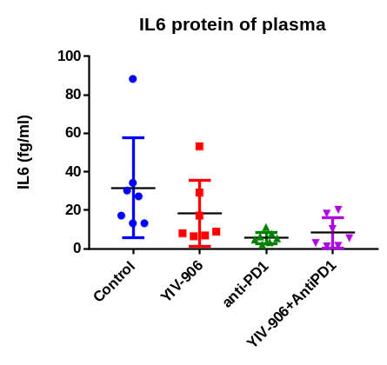
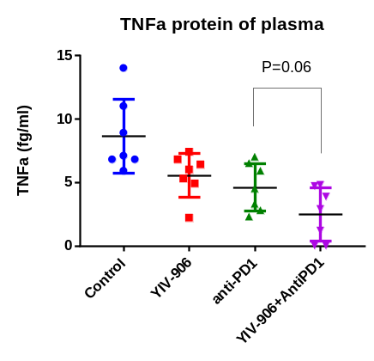
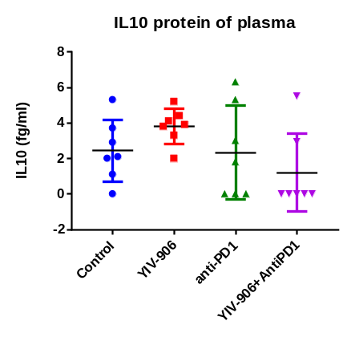
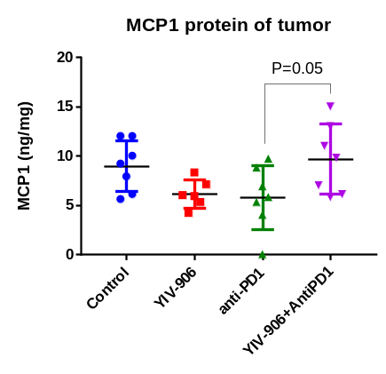
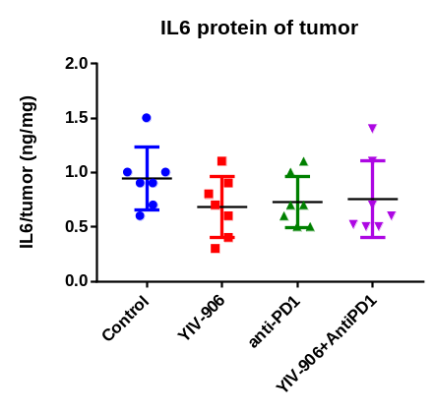
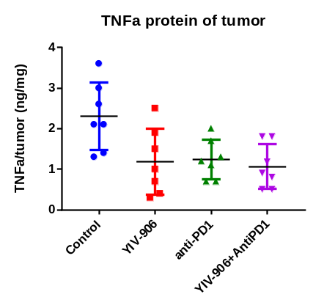
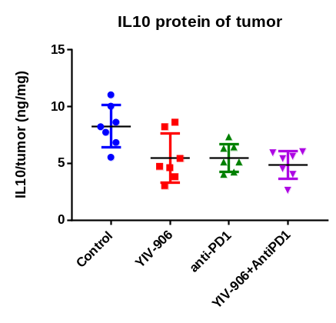
Supplementary Figure 4
A
B
C
D
E
F
G
H
Figure S4. Effect of YIV-906 and/or Anti-PD1 on inflammatory cytokines in plasma and tumor tissue. (A-D) Inflammatory cytokines MCP1, IL6, TBFa, IL10 were detected in plasma. (E-H) Inflammatory cytokines MCP1, IL6, TBFa, IL10 were detected in tumor. MCP1 and TNFa amount in the plasma are decreased by the treatment of anti-PD1 and can be further decreased by YIV-906, indicated that YIV-906 could decrease inflammatory cytokines in plasma. Fluorescence bead multiplex assay was used to determined cytokine/chemokine profiles.

Slide 5
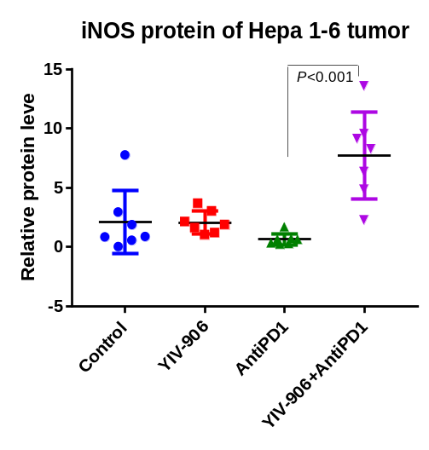
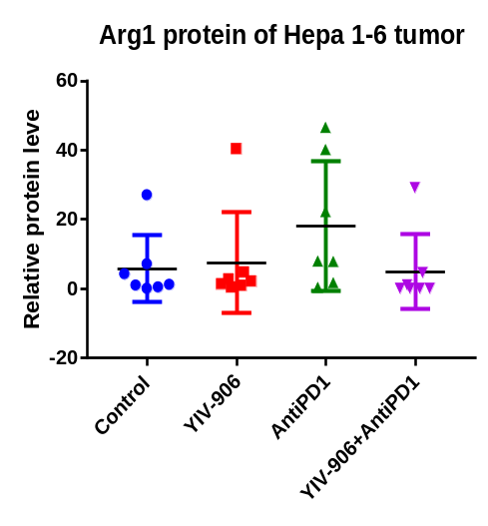
Supplementary Figure 5
C
YIV-906group_1
YIV-906group_2
YIV-906group_4
YIV-906group_5
YIV-906group_3
YIV-906group_6
YIV-906group_7
Mix_1
Mix_2
Control_1
Control_2
A
B
130
iNOS
Arg1
H3
Anti-PD1group_1
Anti-PD1group_2
Anti-PD1group_4
Anti-PD1group_5
40
Anti-PD1group_3
Anti-PD1group_6
Anti-PD1group_7
17
Mix_1
Mix_2
Control_3
Control_4
iNOS
Arg1
H3
130
YIV-906+Anti-PD1group_3
YIV-906+Anti-PD1group_6
YIV-906+Anti-PD1group_7
40
YIV-906+Anti-PD1group_1
YIV-906+Anti-PD1group_4
YIV-906+Anti-PD1group_5
YIV-906+Anti-PD1group_2
17
Mix_1
Mix_2
Control_5
Control_6
Control_7
iNOS
Arg1
H3
130
40
17
Figure S5. Effect of YIV-906 and/or anti-PD1 treatment on iNOS (A) and Arg (B) protein in Hepa 1-6 tumor. (C) Western blot analysis for the iNOS, Arg1 protein expression of Hepa 1-6 tumor following 4 days treatment of Anti-PD1-/+YIV906. Histone H3 was used for normalization of protein loading. Each sample was normalized to a master mix sample (MIX) which loading duplicated in each gel. T-test P values were shown in the graph.

Slide 6
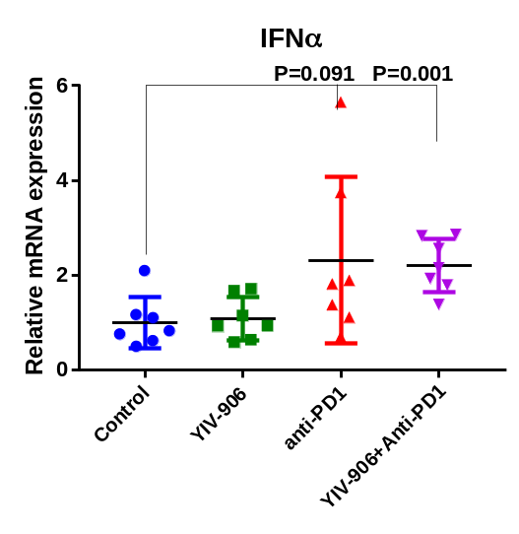
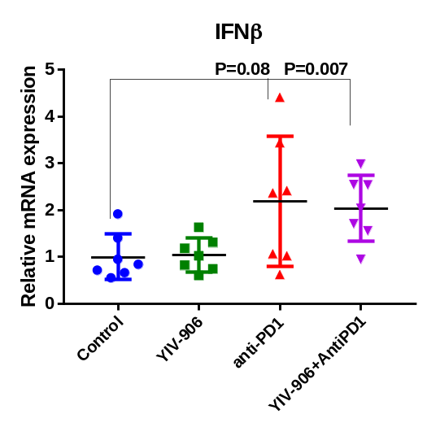
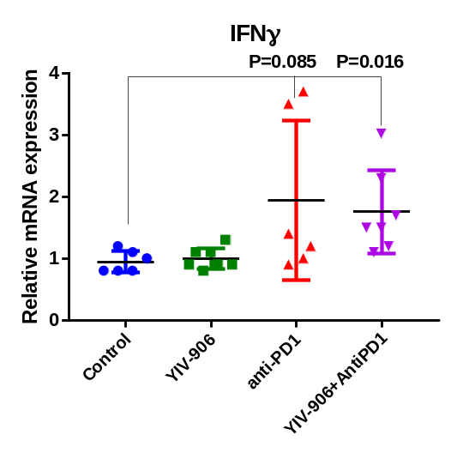
Supplementary figure 6.
A B C
Figure S6. Effect of YIV-906 and/or Anti-PD1 treatment on IFNα (A), IFNβ (B), IFNγ (C) mRNA expression in Hepa 1-6 tumor. The mRNA expression of IFNα, IFNβ and IFNγ were determined by RT-qPCR following treatment at day 4. T-test P values were shown in the graph. Details of experimental procedures are given in Materials and Methods.

Slide 7
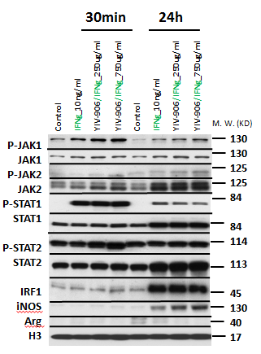
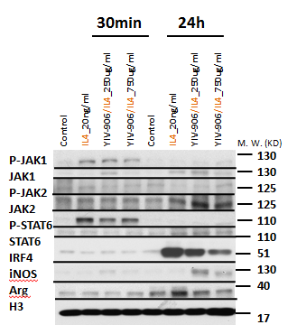
Supplementary figure 7
A B
Figure S7. Impact of YIV-906 on the proteins of the IFNg signaling pathway. (A) Western blot analysis for the effect of YIV-906GU on the action of IFNg on IFNg signaling of BMDMs. (B) Western blot analysis for the effect of YIV-906GU on the action of IL4 on IL4 signaling of BMDMs. Bone marrow cells were cultured in the presence of murine M-CSF (10ng/ml) for 7 days cultured and then IFNg 10ng/ml to induce polarization to M1-like macrophage while M2 like macrophage were induced by IL-4 20ng/ml for 24h with or without YIV-906. Portein expression or phosphorylation were detected with western blotting. Histone H3 was used for normalization of protein loading. Details of experimental procedures are given in Materials and Methods.

Slide 8
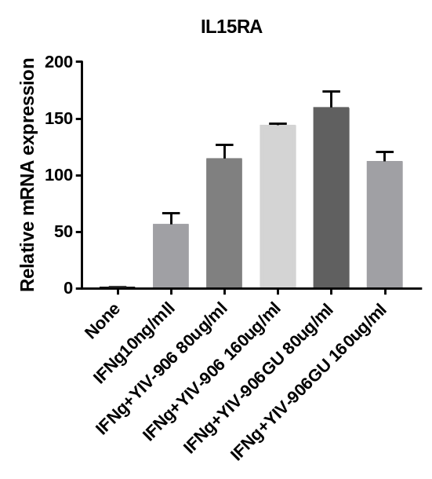
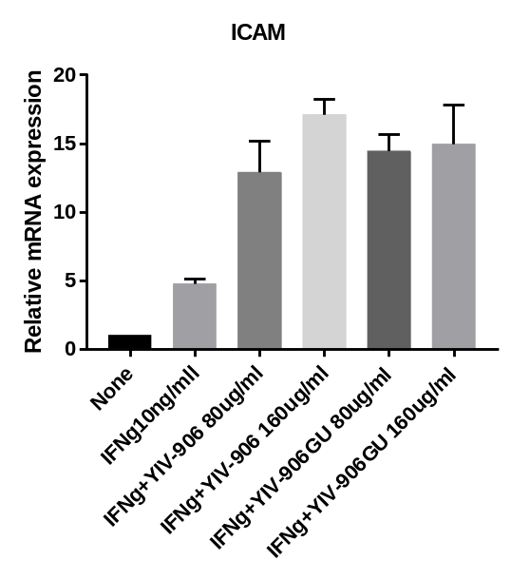
Supplementary figure 8
A B
Figure S8. Effect of YIV-906/GU on IFNb and target genes expression of IFNg. Effect of YIV-906/GU in the presence of IFNg on mRNA expression of IL15RA and ICAM (downstream of IFNg). Bone marrow cells were cultured in the presence of murine M-CSF (10ng/ml) for 7 days, and then cultured with YIV-906/GU in presence or absent of IFNg 10ng/ml The mRNA expression were determined by RT-qPCR following treatment at day 8. Details of experimental procedures are given in Materials and Methods.

Slide 9
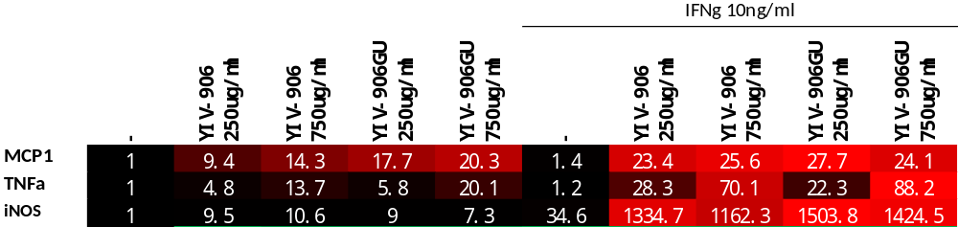
Supplementary figure 9
Raw cell 264.7
Figure S9. Effect of YIV-906 or YIV-906GU on the action of INFg to polarize Raw cell 264.7 into M1-like macrophage. 906 could potentiate IFNg to induce MCP1, TNFa and iNOS (M1 related genes). Raw cell 264.7 were cultured in the presence of murine M-CSF (10ng/ml) for 3 days, and then cultured in presence with IFNg 10ng/ml to induce polarization to M1-like macrophage for 24h. The mRNA expression were determined by RT-qPCR following treatment at day 8.

