Slide 1
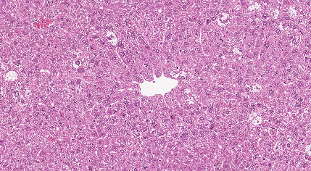
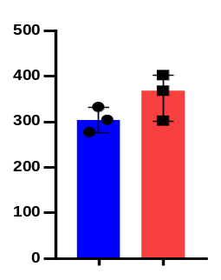
Fig. S1
A
IR
EF1α-Prom
Myr-Akt-HA
pA
IR
IR
MSCV
Notch-IC
IRES
IR
pCMV
HBS2
pA
IR
U6-Prom
p27 sgRNA
NLS
CAS9
NLS
pA
IR
B
C
H/E
HA
Notch/AKT
n.s.
HA⁺ cells/mm²
Notch/AKT/sgp27
Notch/
AKT
Notch/AKT
/sgp27

Slide 2
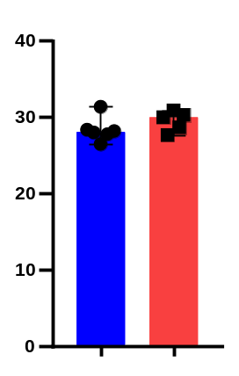
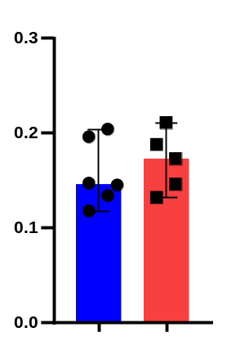
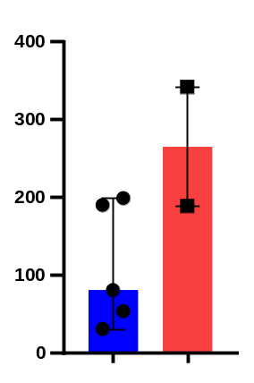
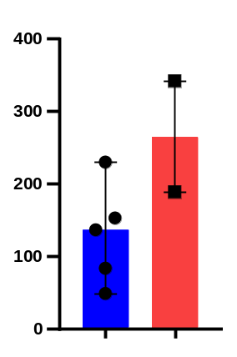
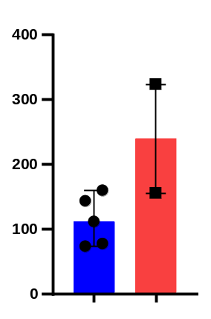
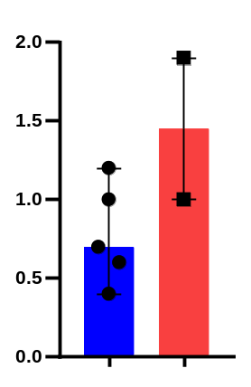
Fig. S2
A
B
C
10
8
6
Body weight
Liver weight
Liver/body weight ratio
4
2
0
Notch/
AKT
Notch/AKT
/sgp27
Notch/
AKT
Notch/AKT
/sgp27
Notch/
AKT
Notch/AKT
/sgp27
D
E
F
GOT
GPT
ALP
Notch/
AKT
Notch/AKT
/sgp27
Notch/
AKT
Notch/AKT
/sgp27
Notch/
AKT
Notch/AKT
/sgp27
G
TBIL
Notch/
AKT
Notch/AKT
/sgp27

Slide 3
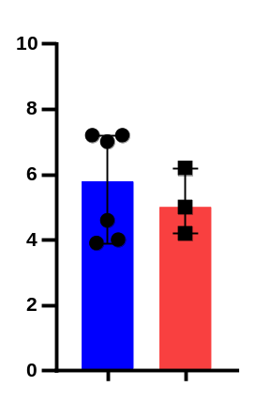
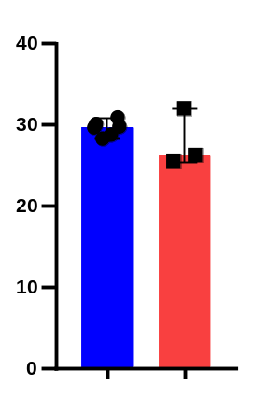
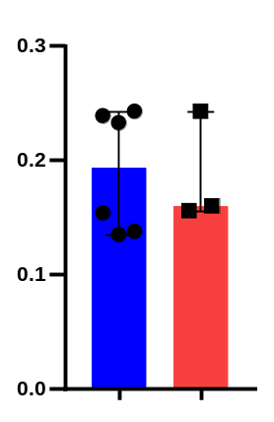
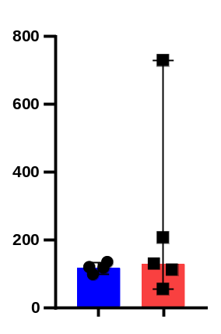
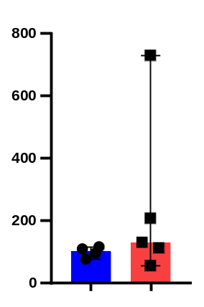
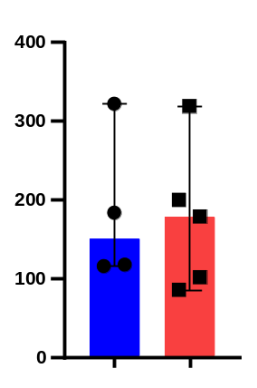
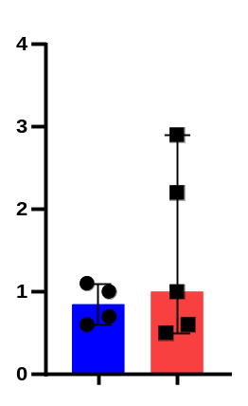
Fig. S3
A
B
C
Liver weight
Body weight
Liver/body weight ratio
Notch/
AKT
Notch/AKT
/sgp27
Notch/
AKT
Notch/AKT
/sgp27
Notch/
AKT
Notch/AKT
/sgp27
D
E
F
GOT
GPT
ALP
Notch/
AKT
Notch/AKT
/sgp27
Notch/
AKT
Notch/AKT
/sgp27
Notch/
AKT
Notch/AKT
/sgp27
G
TBIL
Notch/
AKT
Notch/AKT
/sgp27

Slide 4
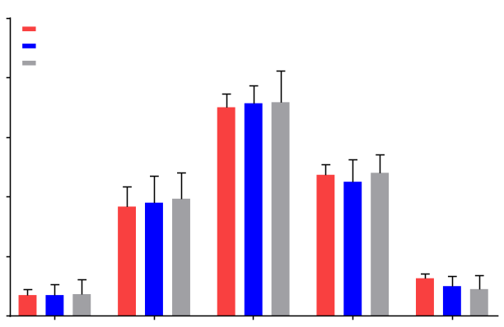
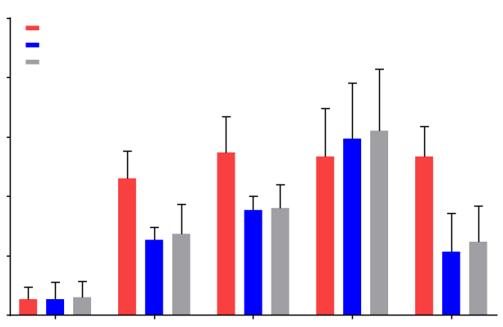
Fig. S4
A
100
80
60
40
20
0
p27^{-/-}
p27^{+/+}
p27^{c-k-}
Rad51 foci positive cells (%)
Control | 1 | 3 | 6 | 24
Time post irradiation in S phase (h)
B
50
40
30
20
10
0
p27^{-/-}
p27^{+/+}
p27^{c-k-}
*
*
Rad51 foci positive cells (%)
Control | 1 | 3 | 6 | 24
Time post irradiation in G1 phase (h)

Slide 5
Fig. S5
pDR-GFP: Inactive GFP (no signal)
A
Stop
Repair Template
SceIGFP
iGFP
pCBASceI: Induce DSB
SceI (endonuclease)
DSB
GFP
HR
GFP
DSB by HR
GFP
„active“ GFP
GFP
B
Seeding pDR-GFP-stable-experssed MEF
(KO, WT, C-K-)
Splite MEF cells to new plates with FCS and Thymidine
Starvation for 24h
Transfect with pCBASceI plasmid
Analyse GFP signal by FACS
-48h
-24h
0h
3h
27h

Slide 6
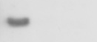
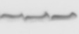
Fig. S6
Control
p27^{-/-} _2
p27^{-/-} _1
kDa
IB-p27
27
IB-vinculin
124

Slide 7
Fig. S7
Non irradiated
Irradiated
Caffeine
pre-treated
Rad17
Control
Control
635
645
Control
635
645
635
645
AA
WT
AA
WT
AA
WT
kDa
IP-p27
IB-Flag
80
Flag
80
IP-p27
IB-p27
27
Actin
46

Slide 8


Fig. S8
IGG- control
IGG- control
G0
G1
G1/S
p27
WT
WT
KD
WT
WT
KD
KD
KD
WT
AA
WT
WT
WT
AA
WT
WT
AA
AA
WT
WT
AA
AA
kDa
Rad17
IP-pATM(1981)
IB-FLAG
80
IP-ATM
IB-FLAG
80
IP-FLAG
IB-pRad17(635)
80
IP-FLAG
IB-pRAD17(645)
80
p27
27
FLAG
80
pATM(1981)
350
Actin
46

Slide 9



Fig.S9
RAD17
WT
HeLa
AA
p27
KD
WT
KD
WT
30 min
30 min
30 min
IGG-control
60min
60min
60min
30 min
con
con
con
con
60min
Input
kDa
IB
350
pATM
ATM
350
IP-MRE11
RAD17
80
pATM
350
ATM
IP-RAD50
350
Cgromatin fraction + nuclease+IP
80
RAD17
pATM
350
IP-NBS1
ATM
350
RAD17
80
γH2AX
15
Chromatin
fraction
ORC2
70
IP-pATM
IB-RAD17
80
IP-ATM
IB-RAD17
80
IP-p27
IB-RAD17
80
IB-p27
27
IB-Actin
46

Slide 10
Fig S10
Chromatin fraction
+ nuclease+IP-RAD17
MEF cells arrested in G0 phase
p27^{-/-}
p27^{+/+}
p27^{c-k-}
20 min
0 min
60 min
2 min
20 min
2 min
10 min
2 min
60 min
0 min
10 min
0 min
10 min
20 min
60 min
kDa
MRE11
81
NBS1
95
RAD50
155
RAD17
80
Chromatin fraction
+ nuclease+IP-RAD17
p27^{-/-}
MEF cells arrested in G1 phase
p27^{+/+}
p27^{c-k-}
20 min
0 min
60 min
2 min
20 min
2 min
10 min
2 min
60 min
0 min
10 min
0 min
10 min
20 min
60 min
kDa
MRE11
81
NBS1
95
RAD50
155
RAD17
80

Slide 11




Fig. S11
A
1Gy - + + + + + +
DMSO
DNA-PK
PARP
CHK1
ATM
CHK2
ATR
kDa
Cleaved cas3
17
Actin
46
B
GEM - + + + + + +
DMSO
DNA-PK
PARP
CHK1
ATM
CHK2
ATR
kDa
Cleaved cas3
17
Actin
46

Slide 12
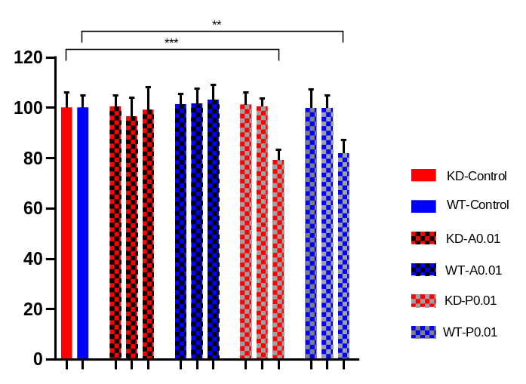
Fig. S12
% viability
0.01
0.10
0.01
0.01
0.10
0.10
0.01
1.00
1.00
0.10
1.00
Control
1.00
ATM
PARP

Slide 13
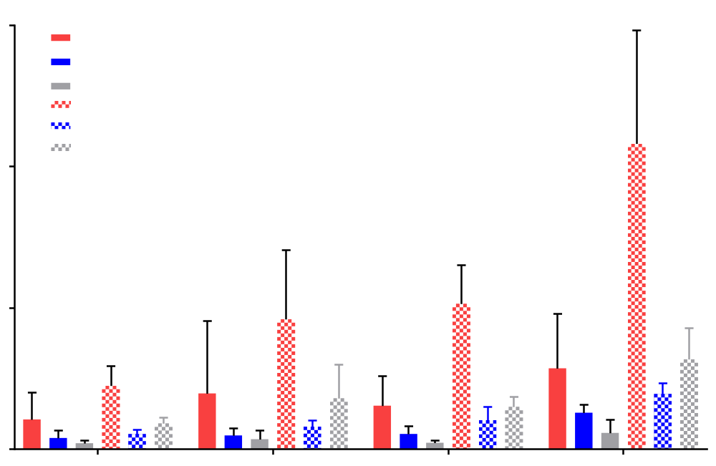
Fig. S13
60
****
p27^{-/-}
p27^{+/+}
p27^{c-k-}
p27^{-/-} + 4 Gy
p27^{+/+} + 4 Gy
40
p27^{c-k-} + 4 Gy
Annexin positive cells (%)
*
**
20
0
⁰
1
2
5
Olaparib Conc. μm

Slide 14
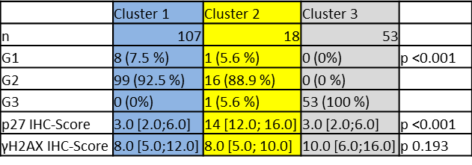
Tab. S1

