Slide 1
Policy Changes for selection of insecticide for IRS, in the Lake Zone, Tanzania

Slide 2
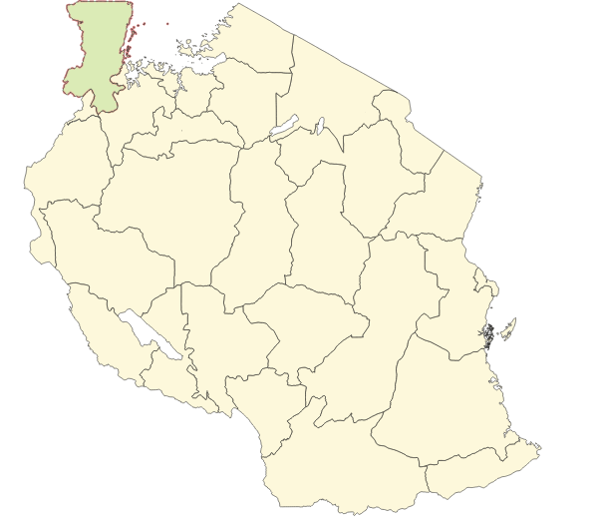

2006
Blanket
% Population Protected
Lambdacyhalothrin CS
Council / Spray coverage
Karagwe DC 98.5%
Muleba DC 98.7%

Slide 3
2007
Blanket
% Population Protected
Lambdacyhalothrin CS
Council / Spray coverage
Karagwe DC 98.5%
Muleba DC 98.7%

Slide 4
2008
Blanket
% Population Protected
Lambdacyhalothrin CS
Council / Spray coverage
Karagwe DC 98.5%
Muleba DC 98.7%

Slide 5
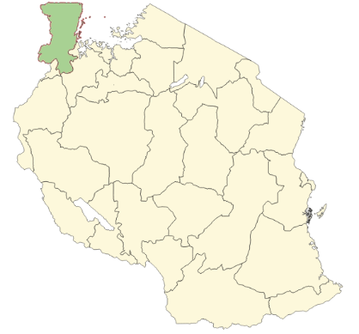
2009
Blanket
% Population Protected
Lambdacyhalothrin CS
Biharamulo DC
Bukoba DC
Karagwe DC
Missenyi DC
Muleba DC
Ngara DC
97.3%
95.5%
96.8%
95.2%
95.8%
89.1%

Slide 6
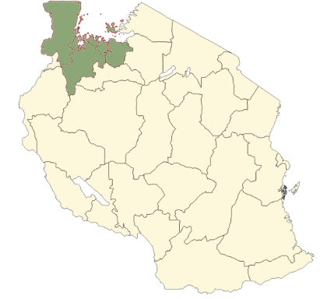
2010
Blanket
% Population Protected
Lambdacyhalothrin CS
Biharamulo DC
Bukoba DC
Karagwe DC
Missenyi DC
Ngara DC
Muleba DC
0.944
0.965
0.998
0.939
0.848
0.998

Slide 7
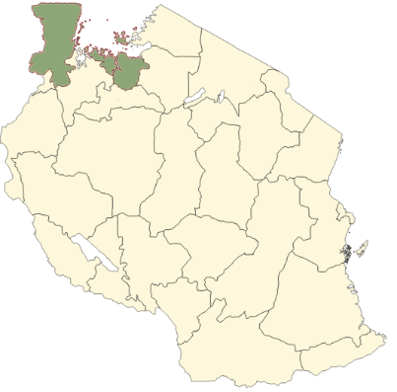
2011
Blanket
% Population Protected
Lambdacyhalothrin CS
Bukoba DC
Karagwe DC
Missenyi DC
Muleba DC
Muleba DC
0.960
0.997
0.920
0.999
0.932
Kwimba DC
Magu DC
Missungwi DC
Sengerema DC
Ukerewe DC
0.940
0.930
0.920
0.970
0.954
Bunda DC
Musoma DC
Rorya DC
Serengeti DC
Tarime DC
0.950
0.920
0.940
0.994
0.969

Slide 8
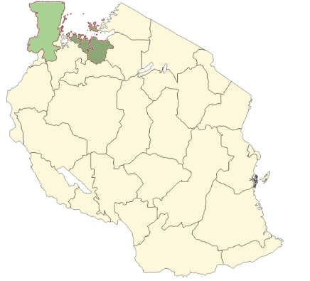
2012
Blanket
% Population Protected
Lambdacyhalothrin CS
Bendiocarb WP
Biharamulo DC
Karagwe DC
Karagwe DC
Muleba DC
Ngara DC
0.910
0.930
0.936
0.948
0.850
0.940
0.970
0.930
0.910
Sengerema DC
Ukerewe DC
Serengeti DC
Tarime DC

Slide 9
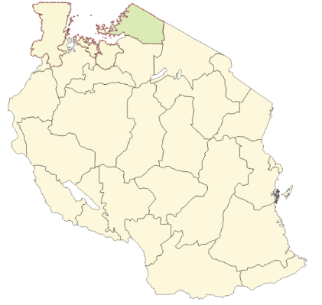
2013
Blanket
% Population Protected
Bendiocarb WP
Deltamethrin WP
Bunda DC
Bunda DC
Bunda DC
Musoma DC
Musoma DC
Musoma DC
Rorya DC
Rorya DC
Rorya DC
Serengeti DC
Serengeti DC
Serengeti DC
Tarime DC
Tarime DC
Tarime DC
0.955
0.917
0.941
0.967
0.990
0.775
0.963
0.867
0.885
0.913
0.960
0.914
0.982
0.942
0.952

Slide 10
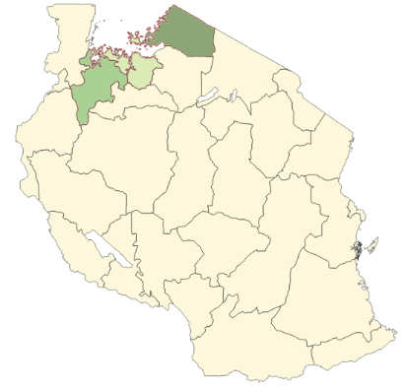
2014
Blanket
% Population Protected
Pirimiphos Methyl CS
Sengerema DC
Ukerewe DC
0.950
0.880
Bunda DC
Rorya DC
Serengeti DC
0.910
0.920
0.940

Slide 11
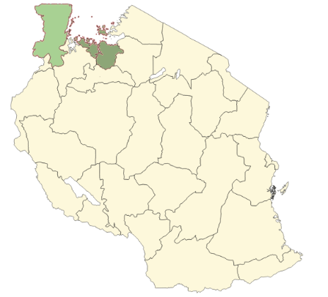
2015
Blanket
% Population Protected
Pirimiphos Methyl CS
Biharamulo DC
Muleba DC
Ngara DC
Magu DC
Missungwi DC
Rorya DC
0.933
0.986
0.987
0.918
0.924
0.916

Slide 12
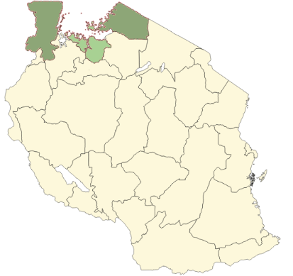
2016
Blanket
% Population Protected
Pirimiphos Methyl CS
Bukoba DC
Missenyi DC
Ngara DC
Kwimba DC
Sengerema DC
Butiama DC
Musoma DC
0.994
0.973
0.976
0.903
0.923
0.949
0.958

Slide 13
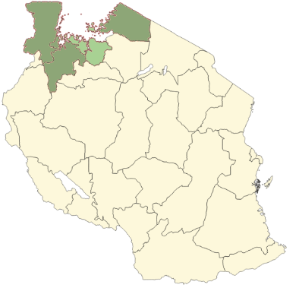
2017
Blanket
% Population Protected
Pirimiphos Methyl CS
Bukoba DC
Missenyi DC
Ngara DC
Kwimba DC
Sengerema DC
Butiama DC
Musoma DC
Chato DC
Nyang'hwale DC
0.985
0.973
0.973
0.959
0.946
0.943
0.934
0.907
0.955

Slide 14
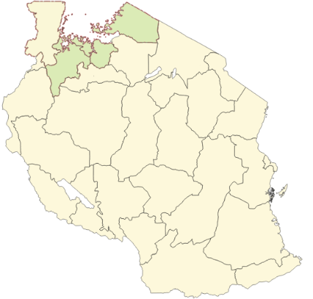
2018
Blanket
% Population Protected
Pirimiphos Methyl CS
Clothiandin/DeltaMethirin
Bukoba DC
Missenyi DC
Ngara DC
Kwimba DC
Sengerema DC
Butiama DC
Musoma DC
Chato DC
Nyang'hwale DC
0.980
0.976
0.971
0.972
0.963
0.923
0.941
0.931
0.943

Slide 15
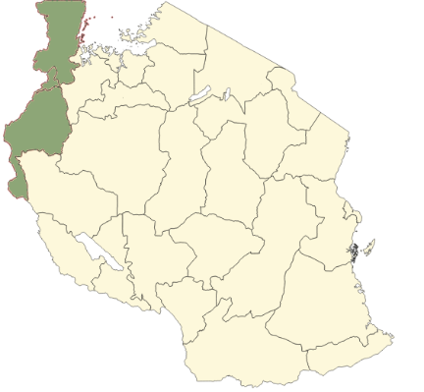
2019
Blanket
% Population Protected
Pirimiphos Methyl CS
Clothianidin/Deltamethirin
Biharamulo DC
Kakonko DC
Kasulu DC
Kibondo DC
Mtendeli Refugee Camp
Nduta Refugee Camp
Nyarugusu refugees camp
1.010
1.034
1.046
0.837
1.284
0.869
1.033

Slide 16
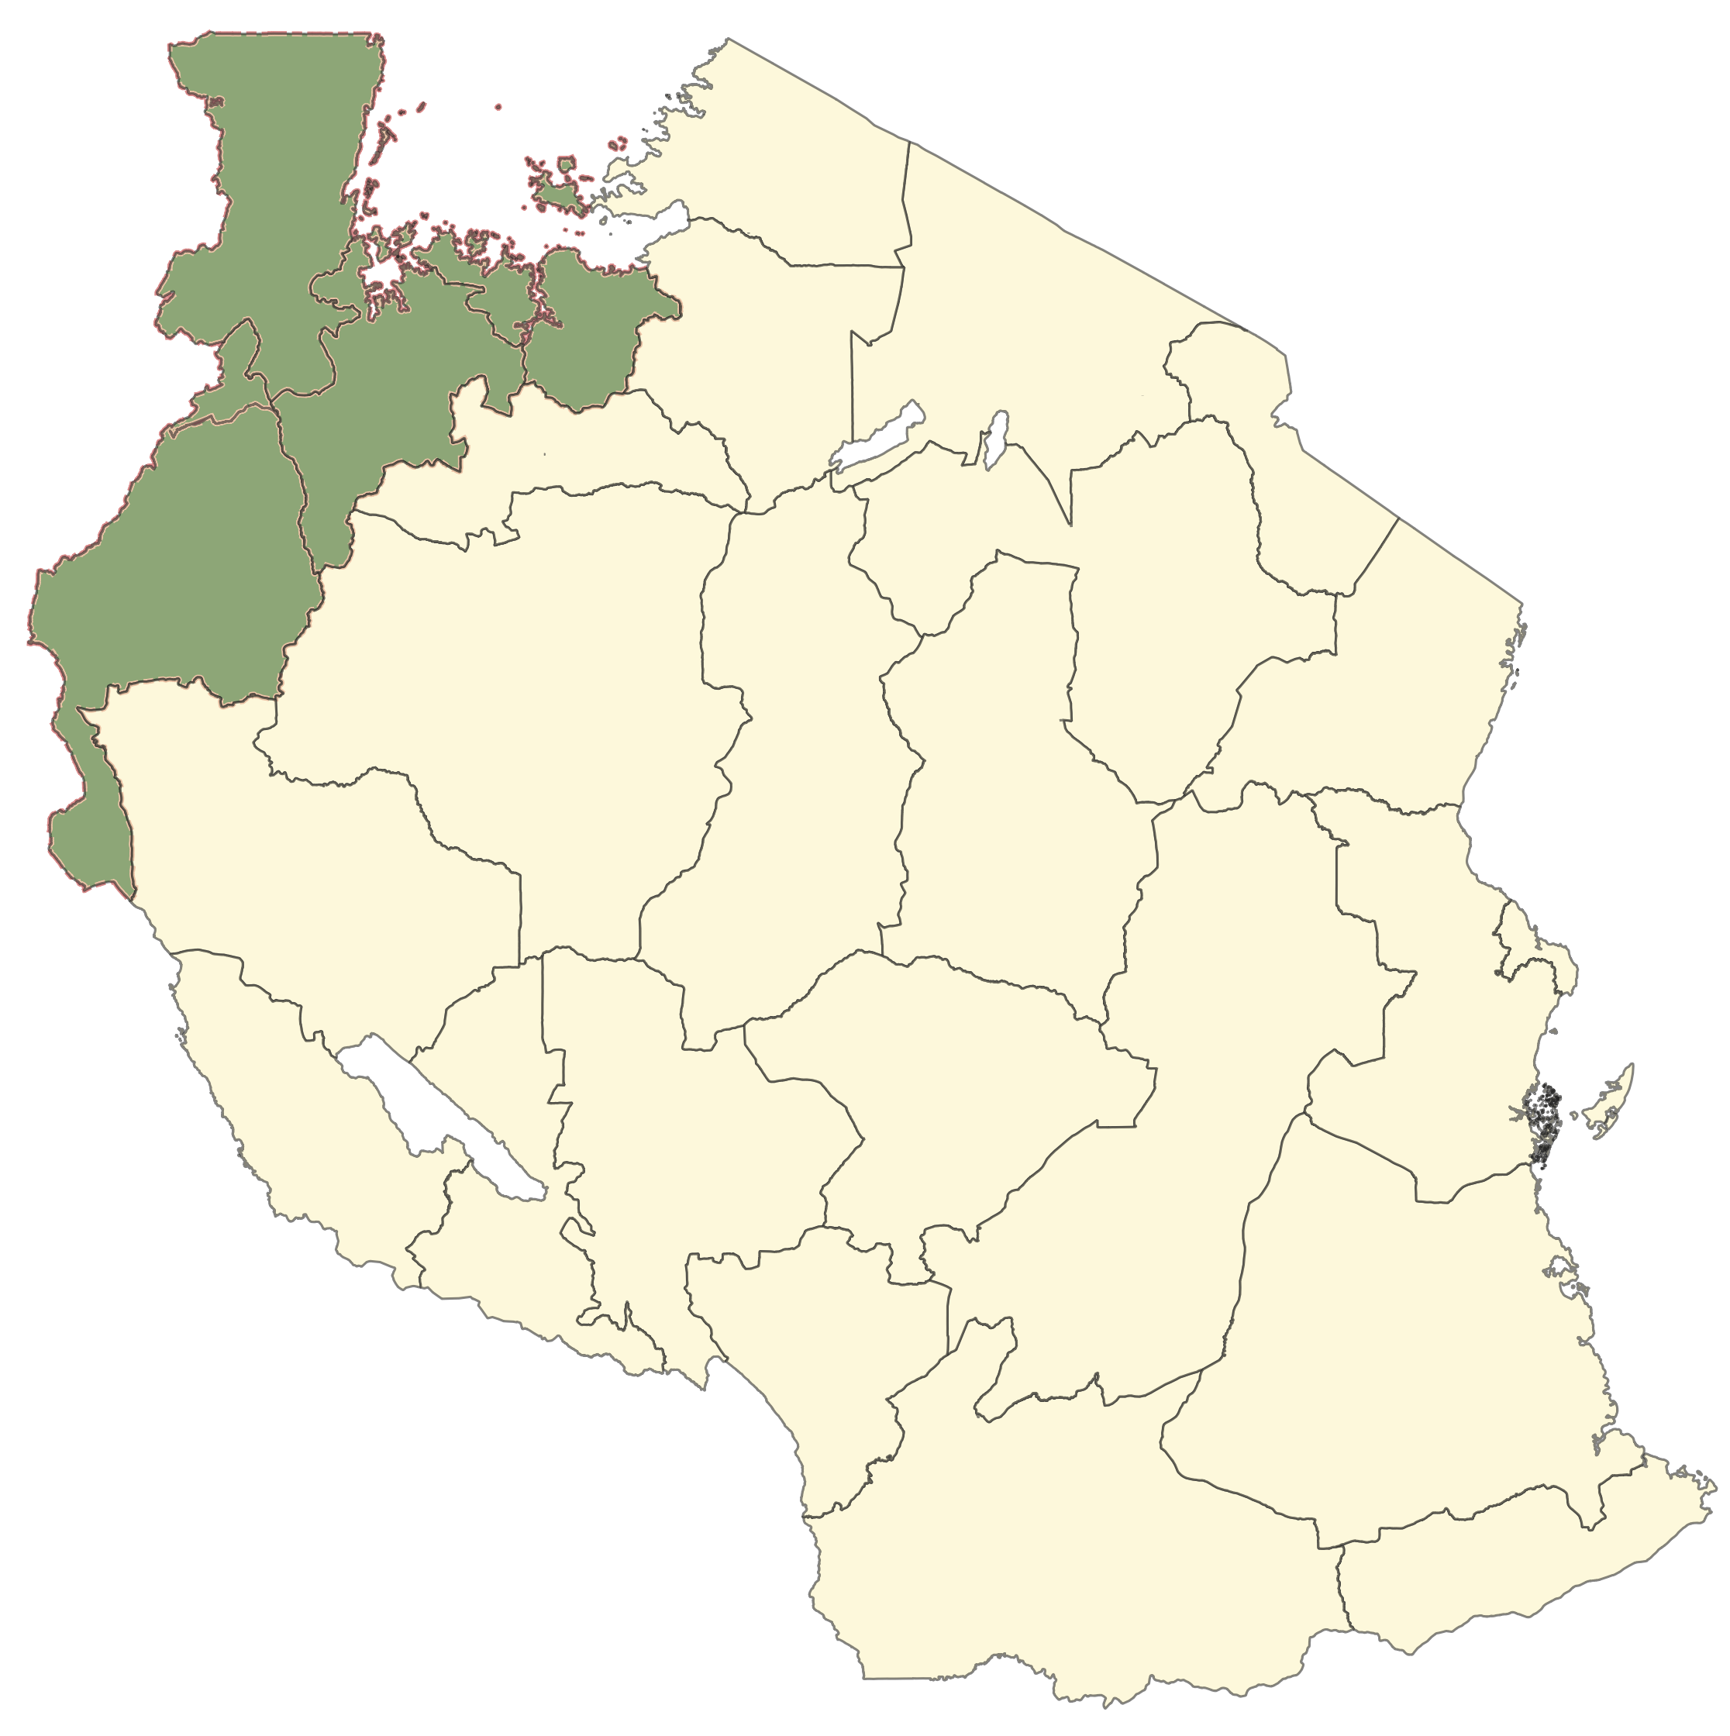
2020
Blanket
% Population Protected
Fludora Fusion
Clothianidin
Ukerewe DC
Bukombe DC
Biharamulo DC
Kakonko DC
Mtendeli Refugee Camp
Kasulu DC
Nyarugusu refugees camp
Kibondo DC
Nduta Refugee Camp
0.943
0.868
0.940
0.955
0.99
0.932
0.971
0.932
0.976

