Slide 1
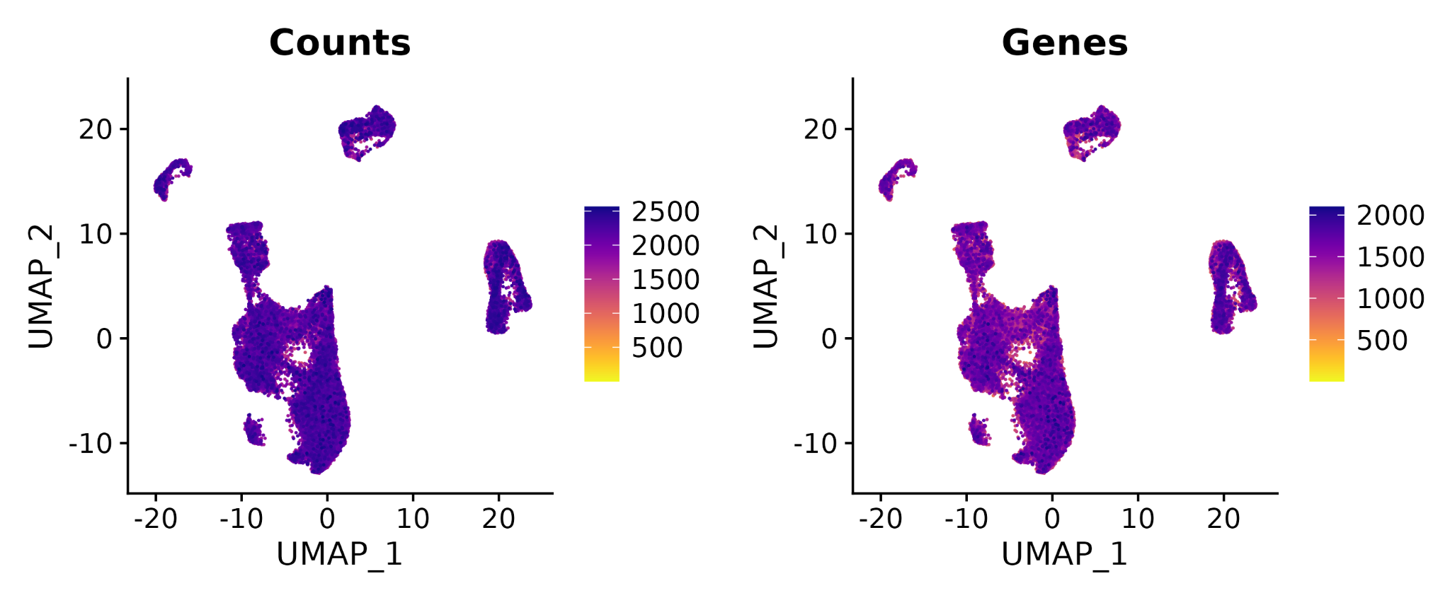
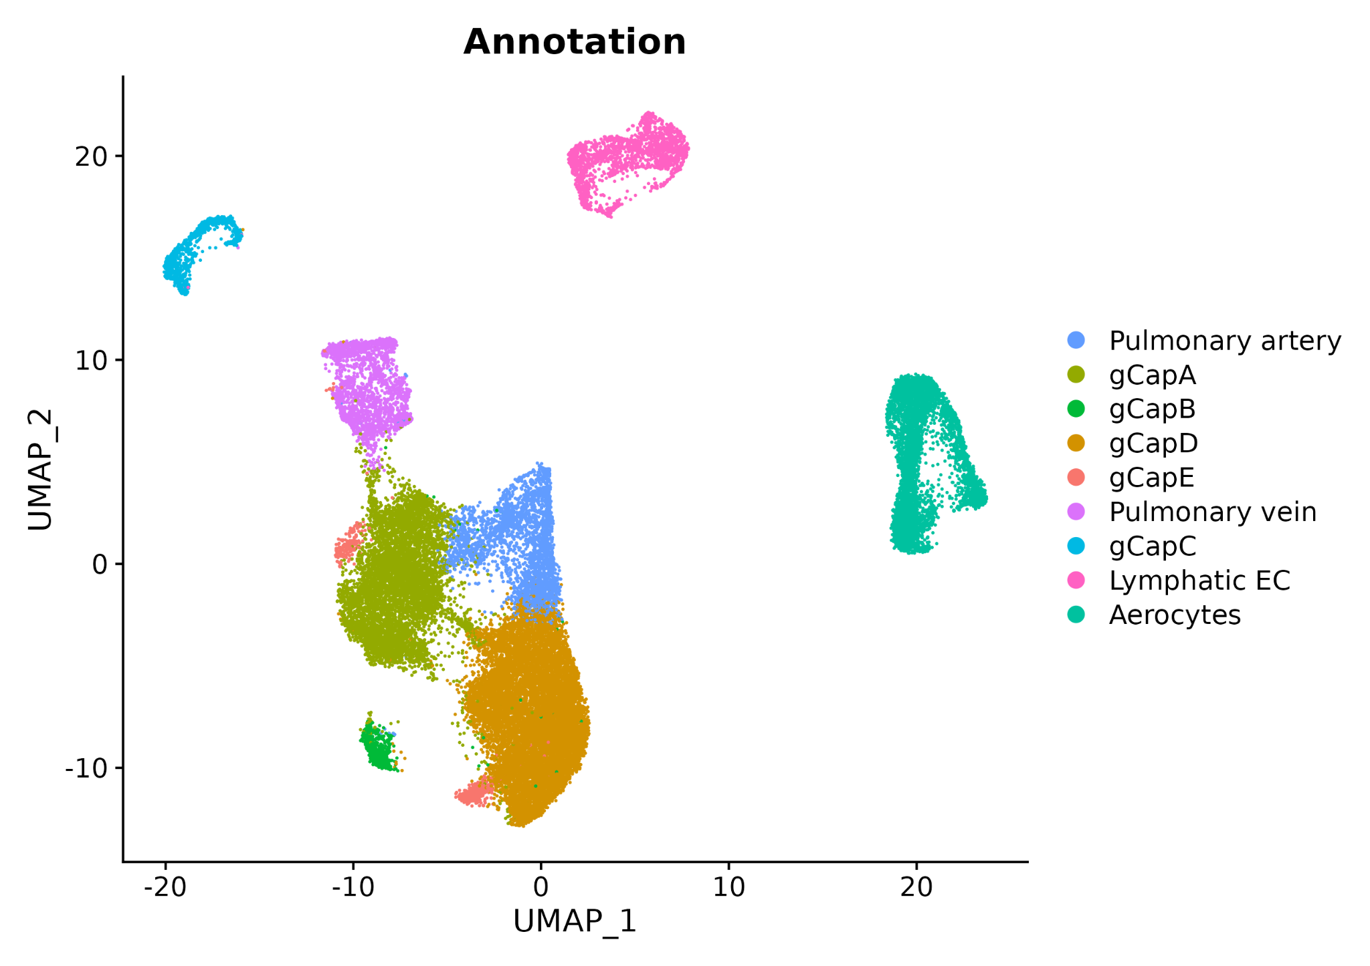
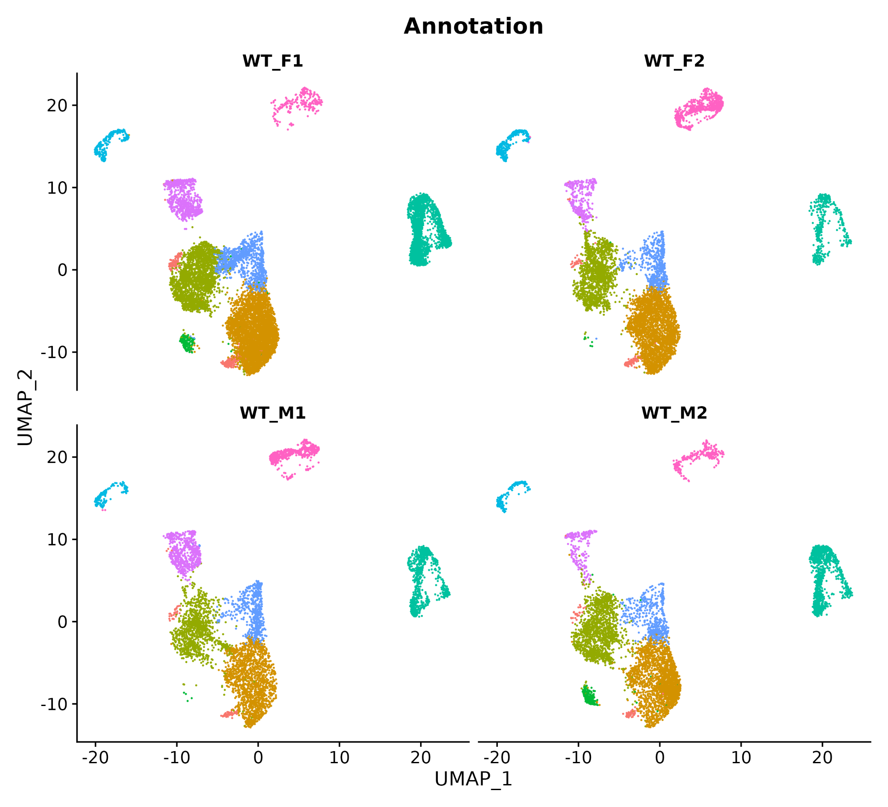
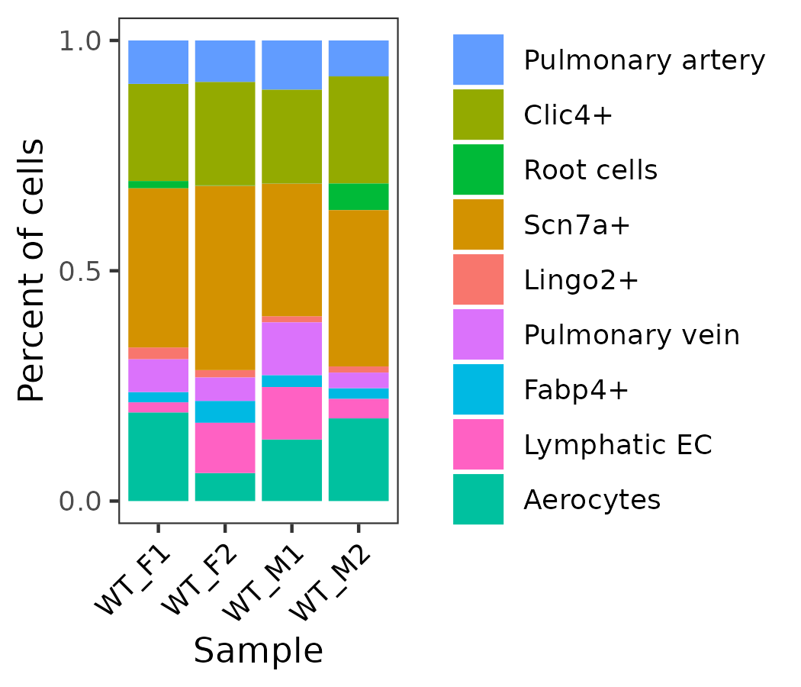
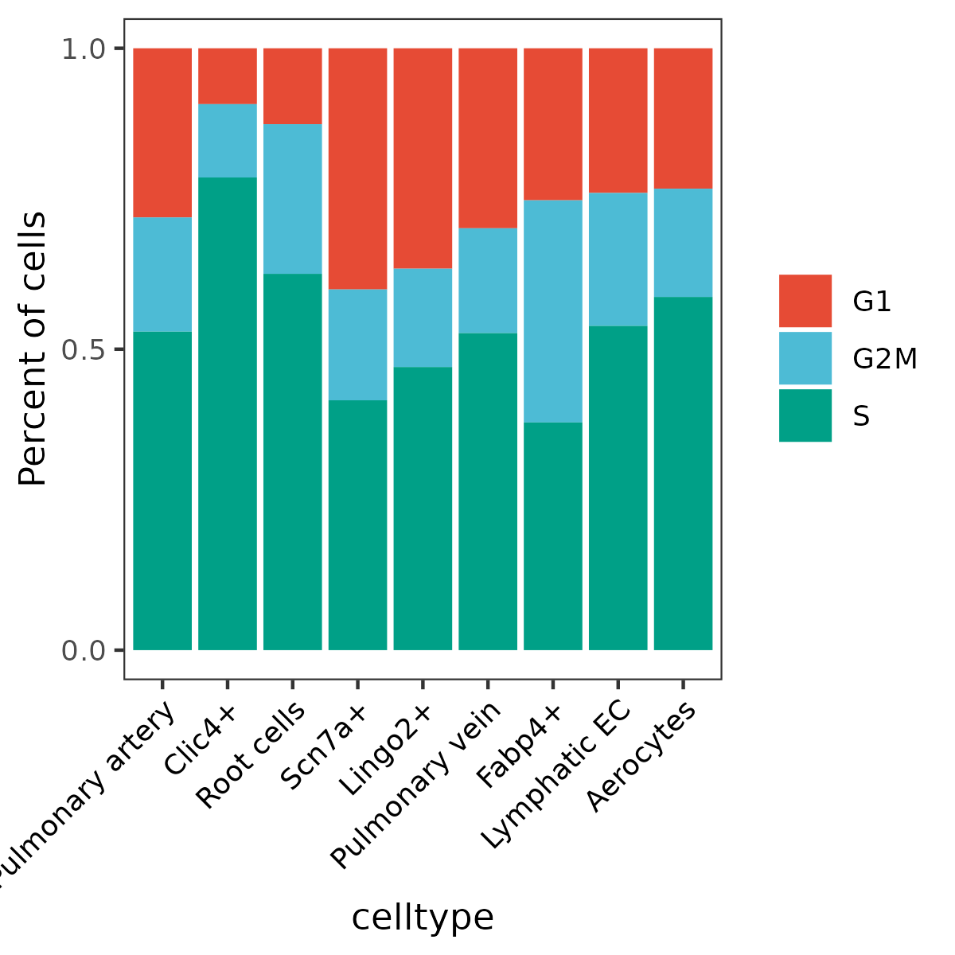
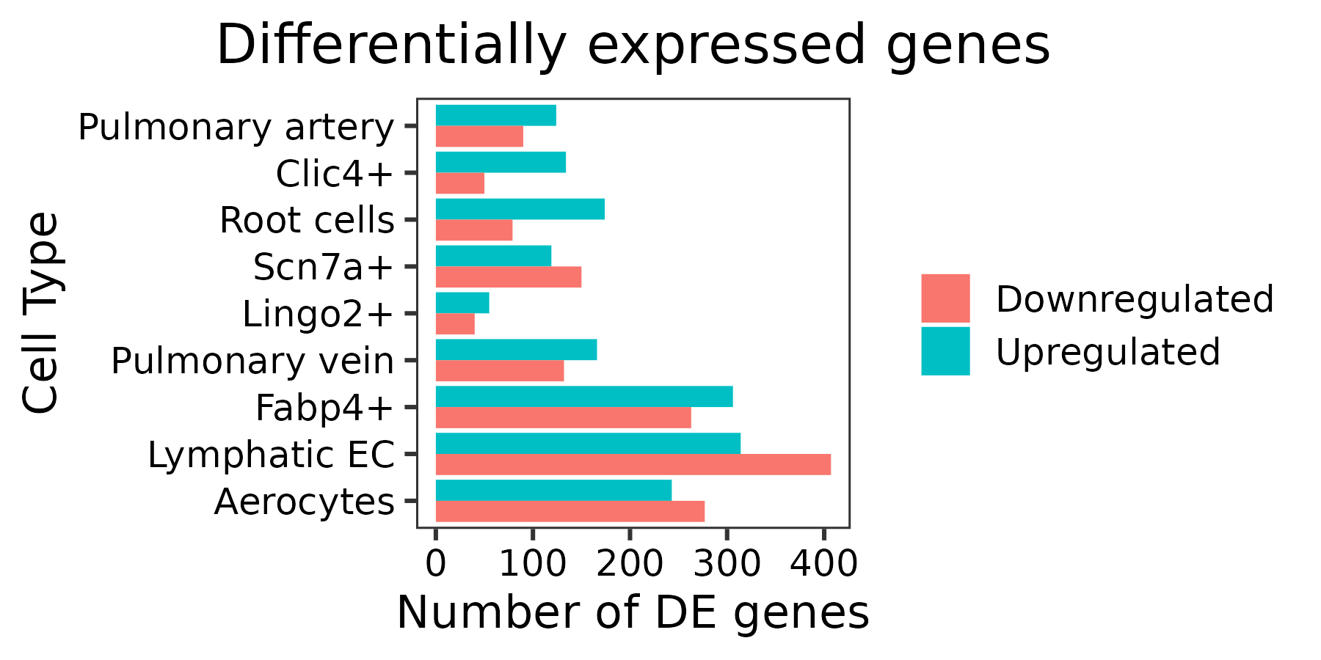
Supplementary Figure 1
a
UMI Counts
b
Genes
c
d
e
f
g

Slide 2
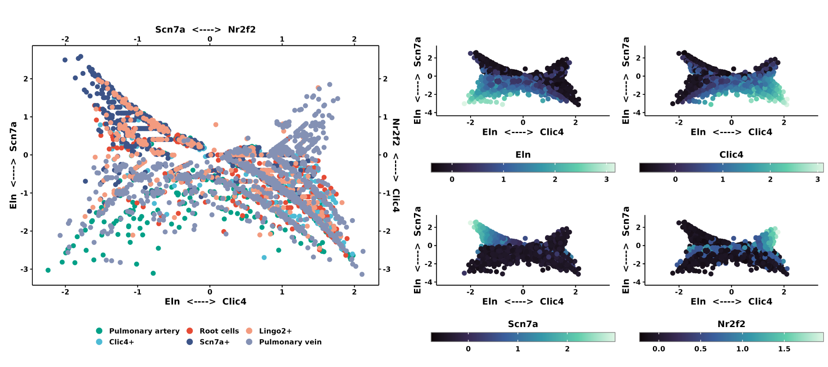
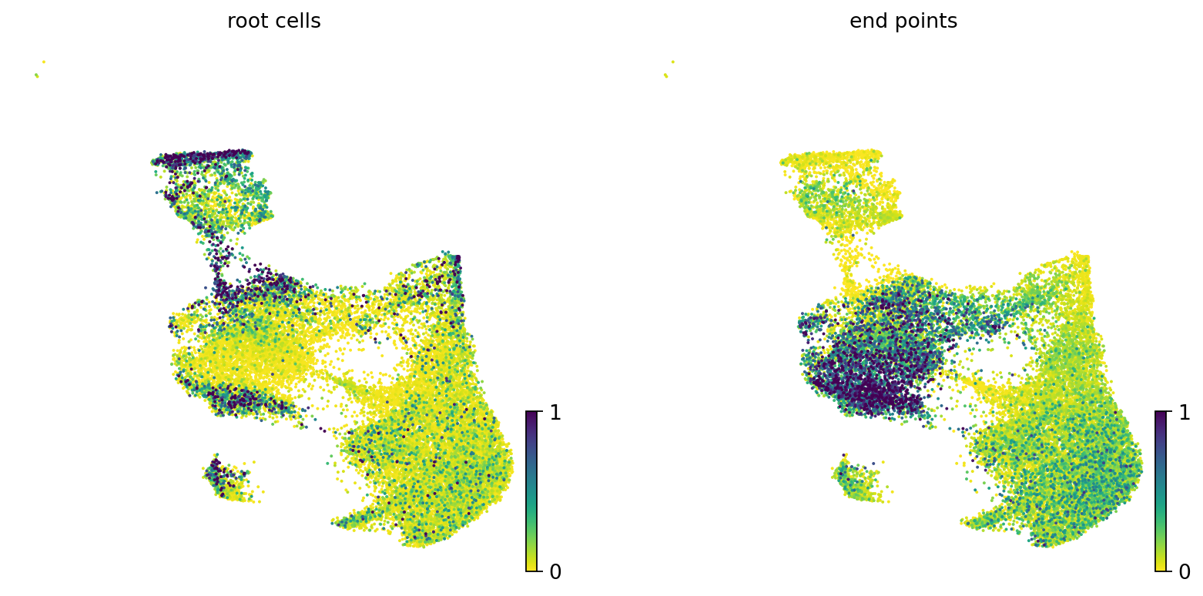
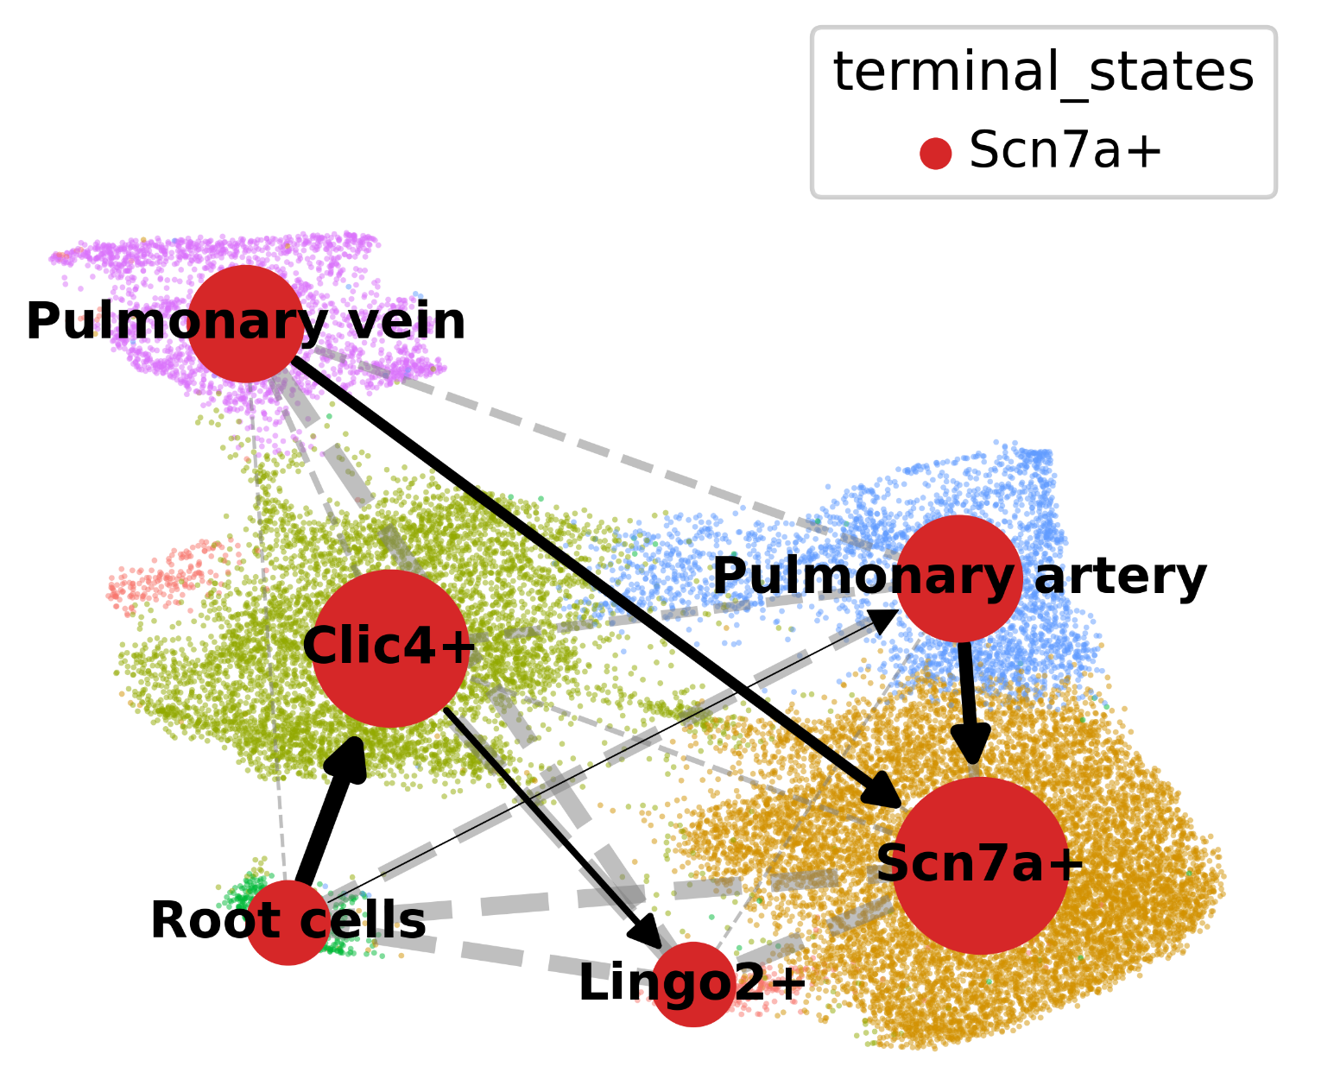
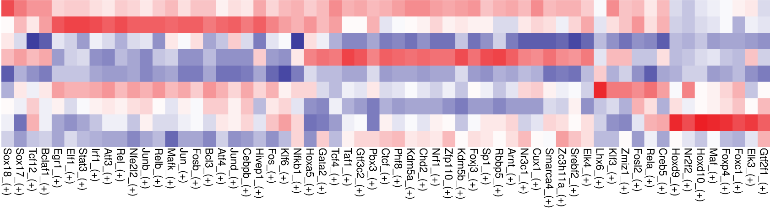
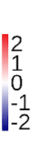
h
i
Root cells
i'
Directed PAGA
End points
j
Transcription factors activity
Pulmonary Artery
Clic4+
Root cells
Scn7a+
Lingo2+
Pulmonary Vein
Fabp4+
Lymphatic EC
Aerocytes

Slide 3
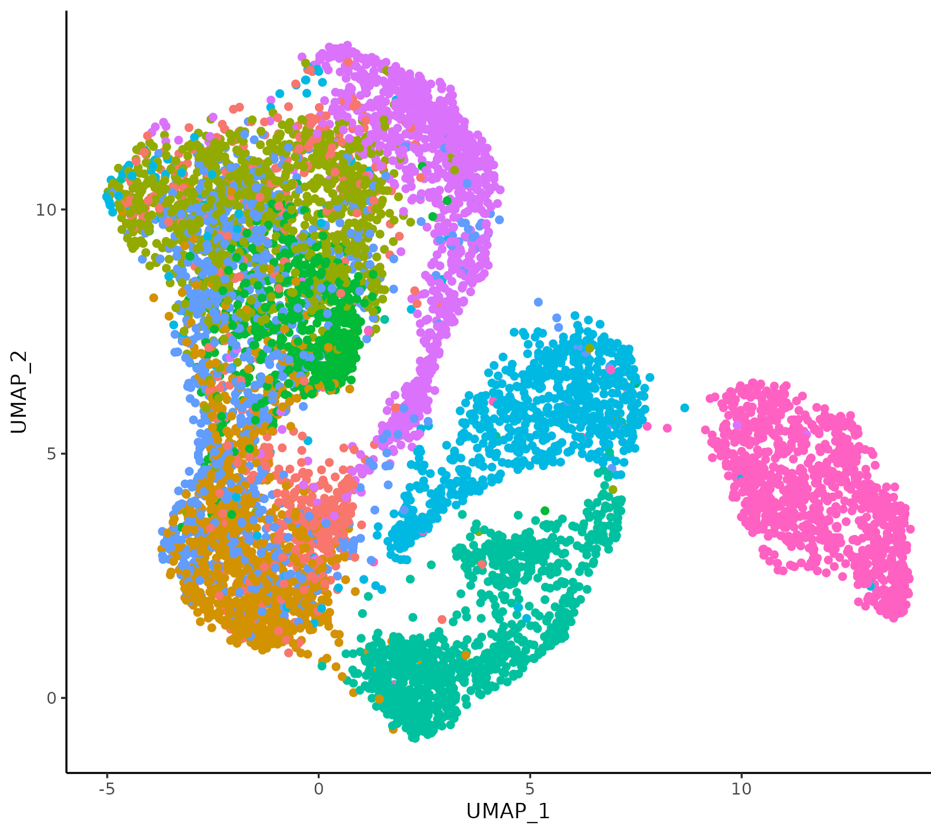
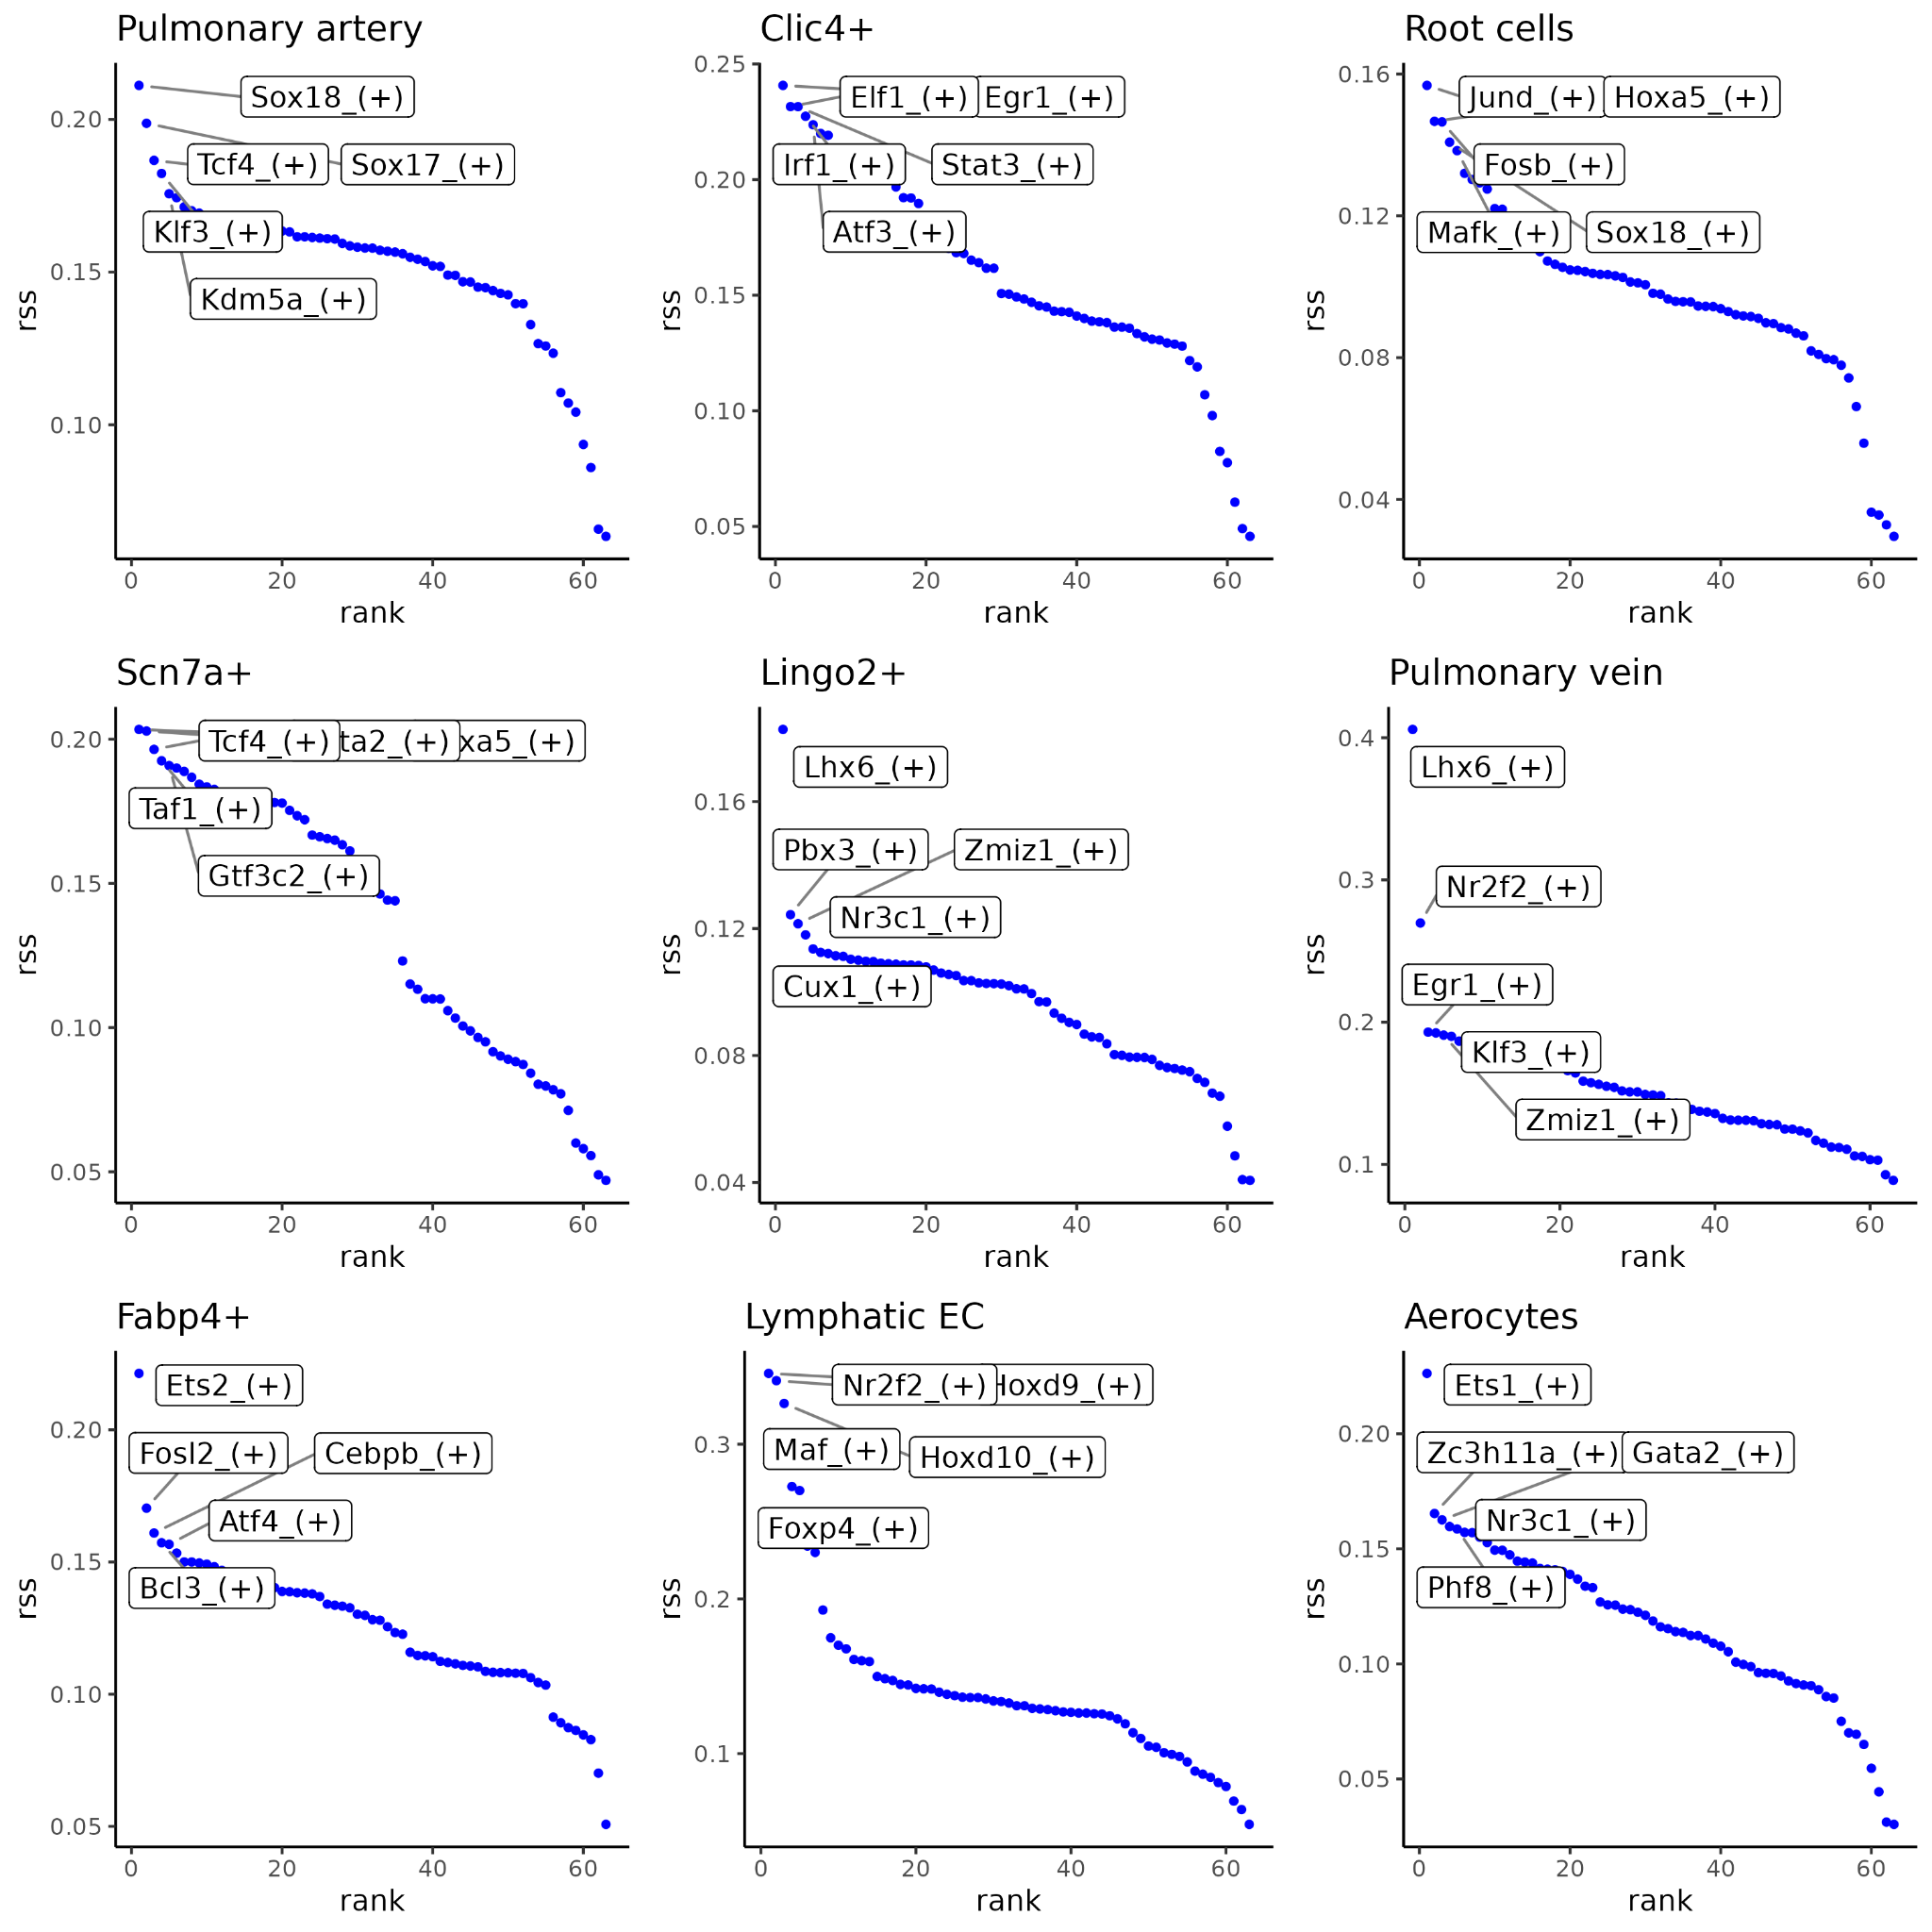
Supplementary Figure 1
k
UMAP using TF’s
Pulmonary Artery
Clic4+
Root cells
Scn7a+
Lingo2+
Pulmonary Vein
Fabp4+
Lymphatic EC
Aerocytes
l

Slide 4
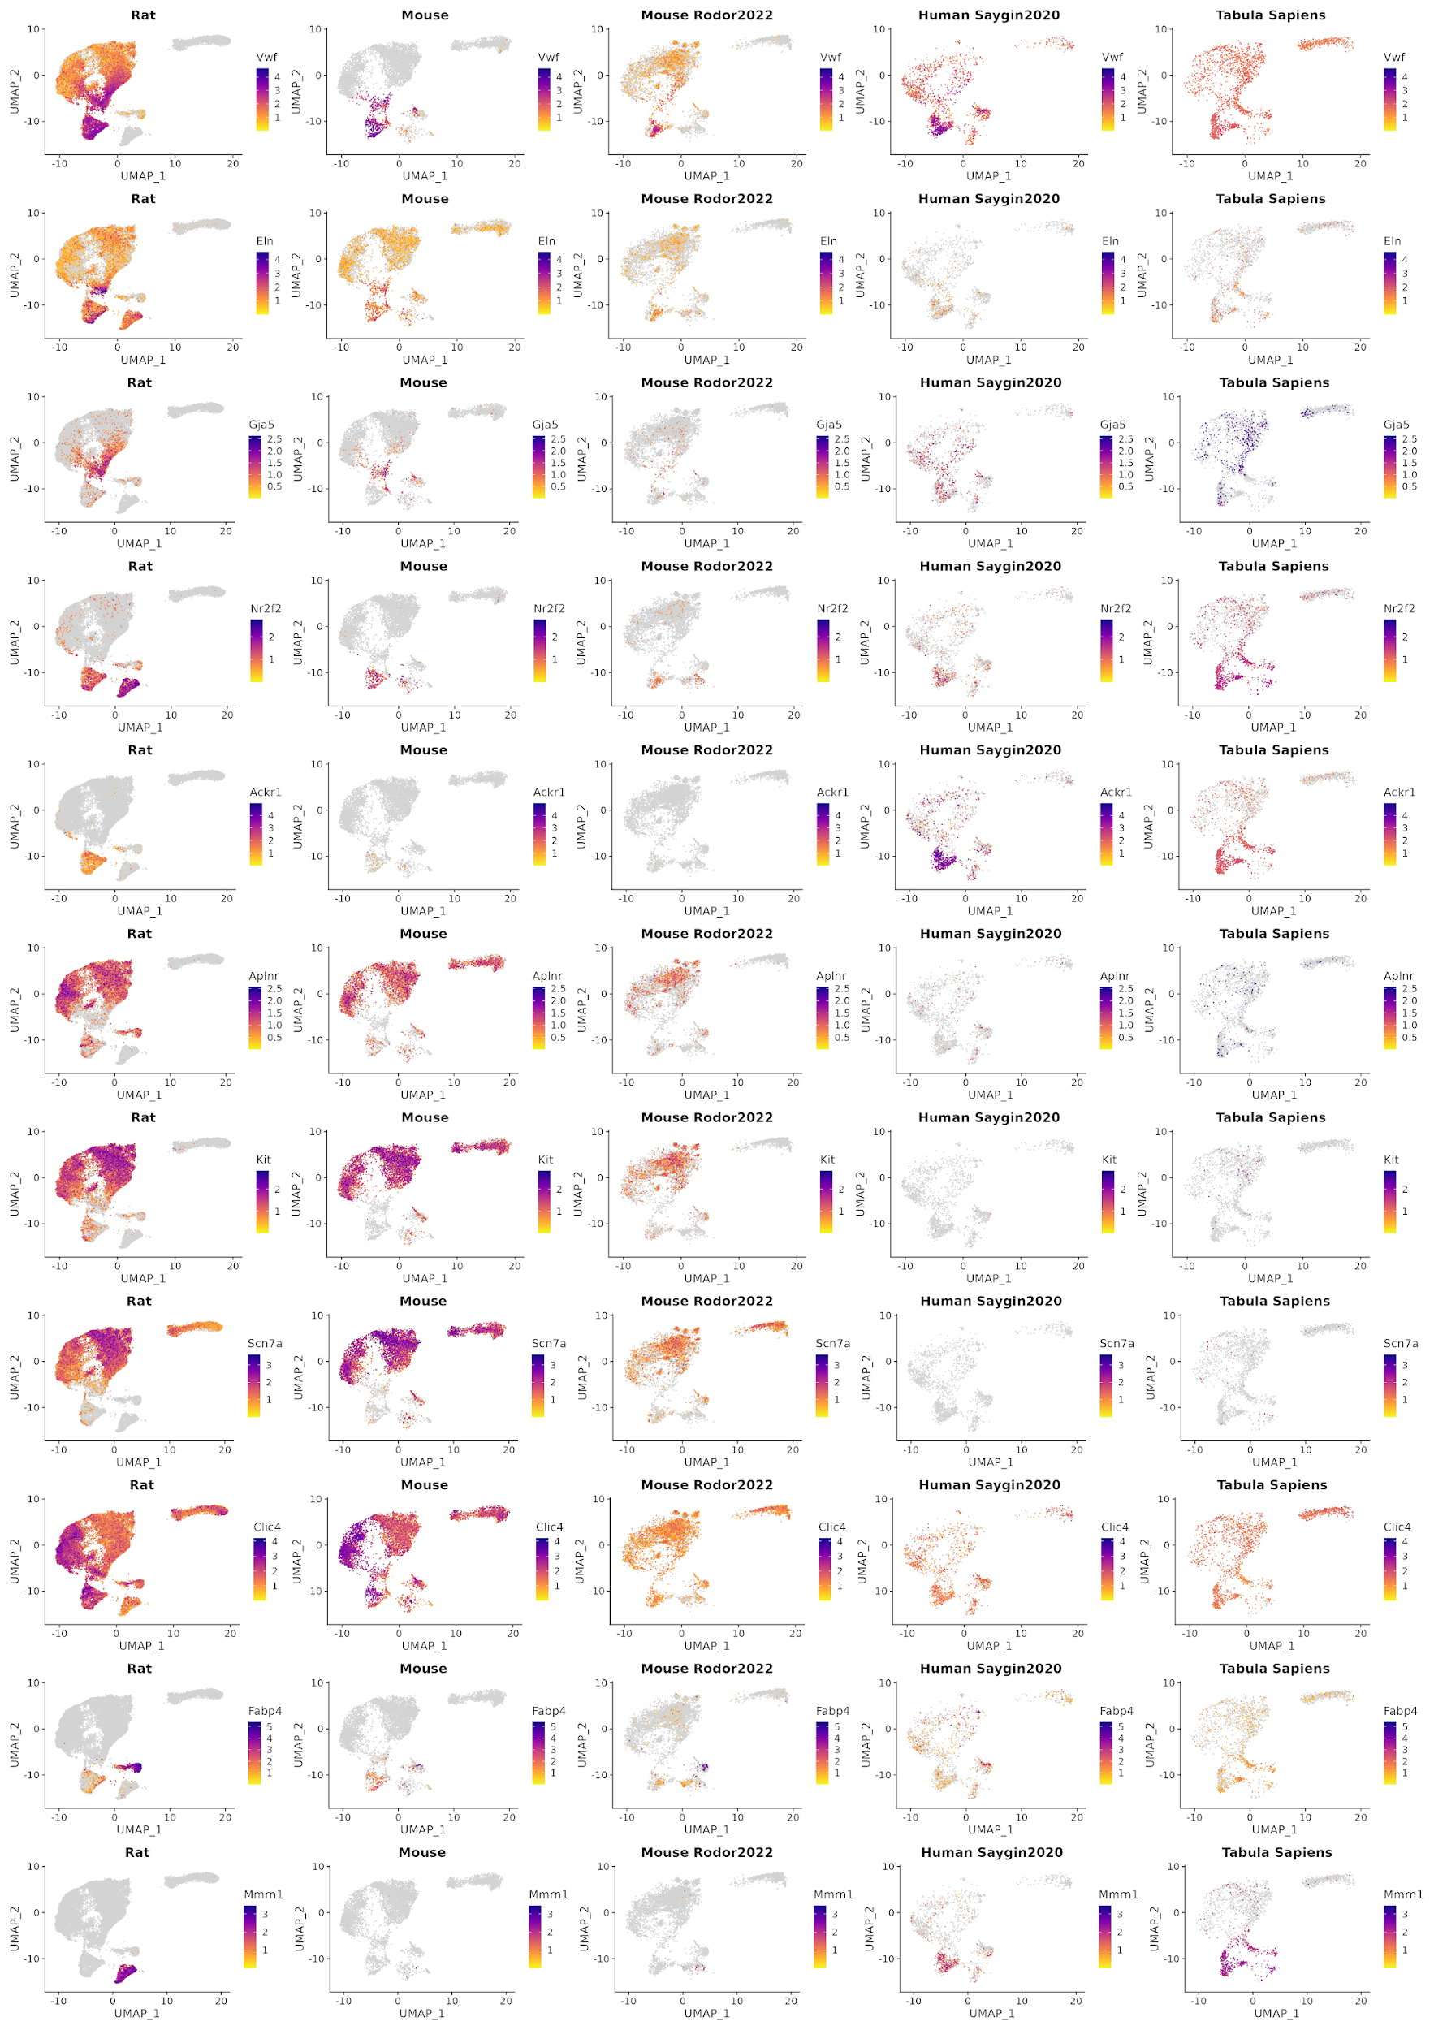
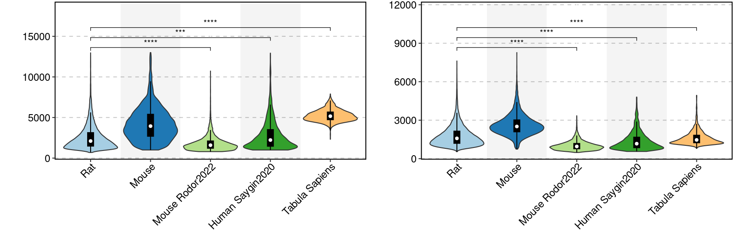
Supplementary Figure 2
a
UMI Counts
Genes
b

Slide 5
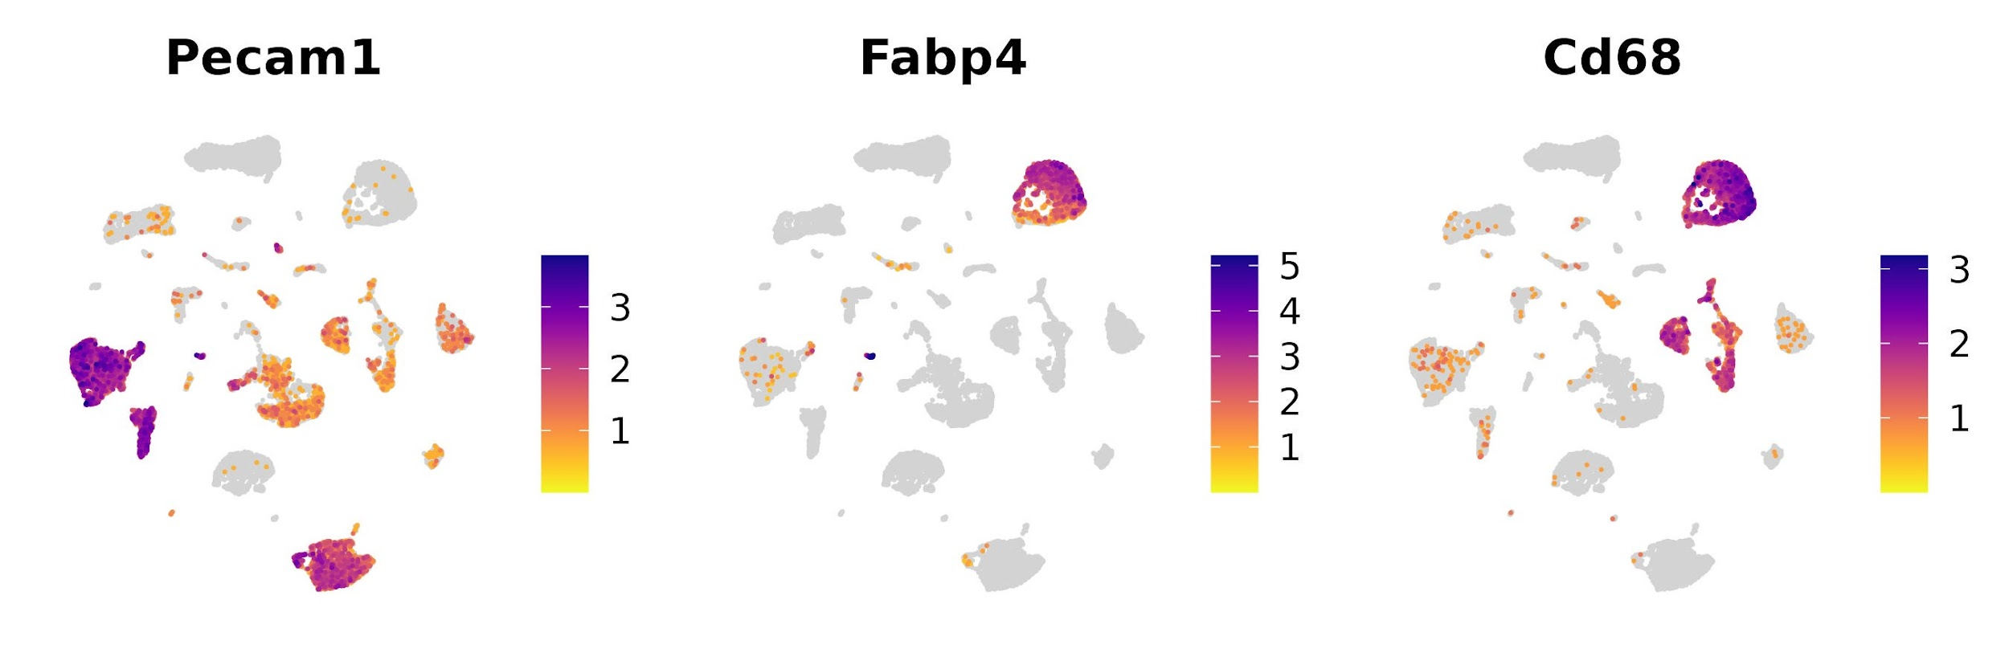
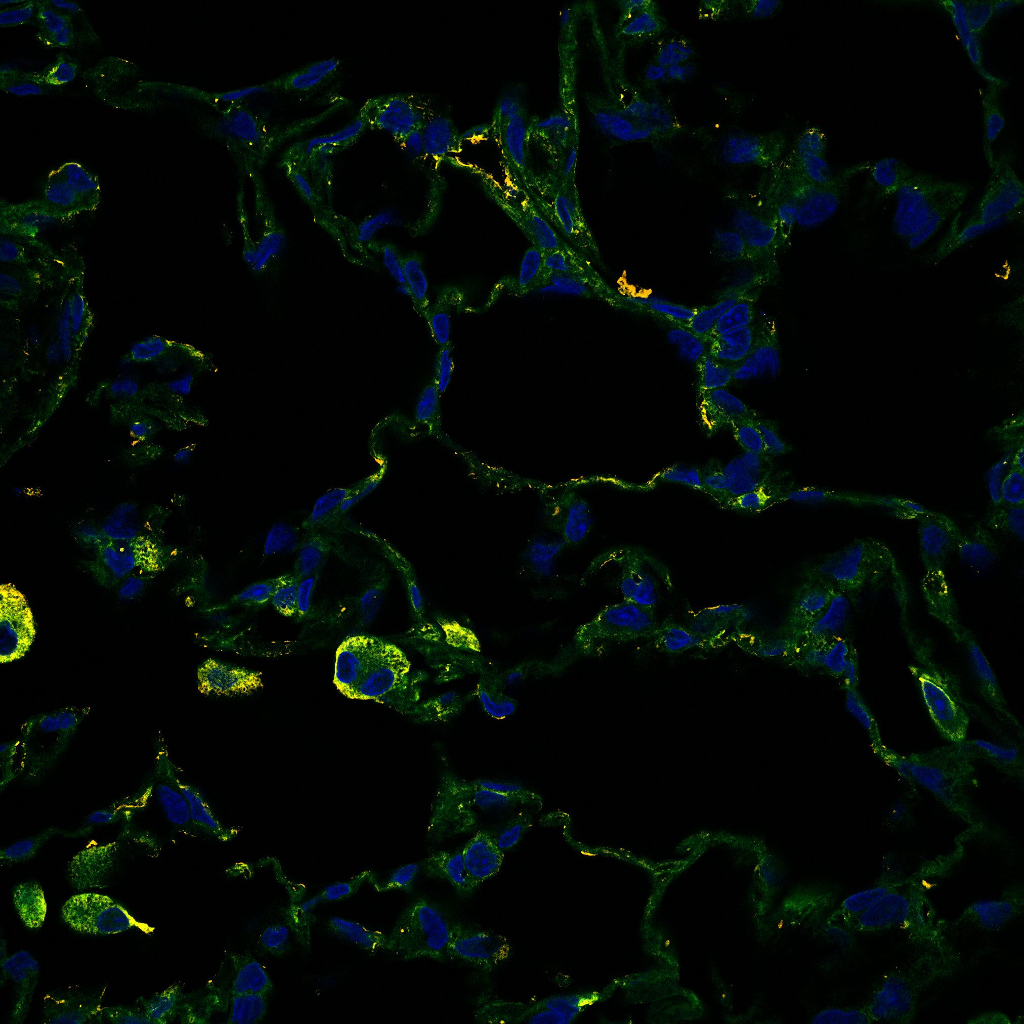
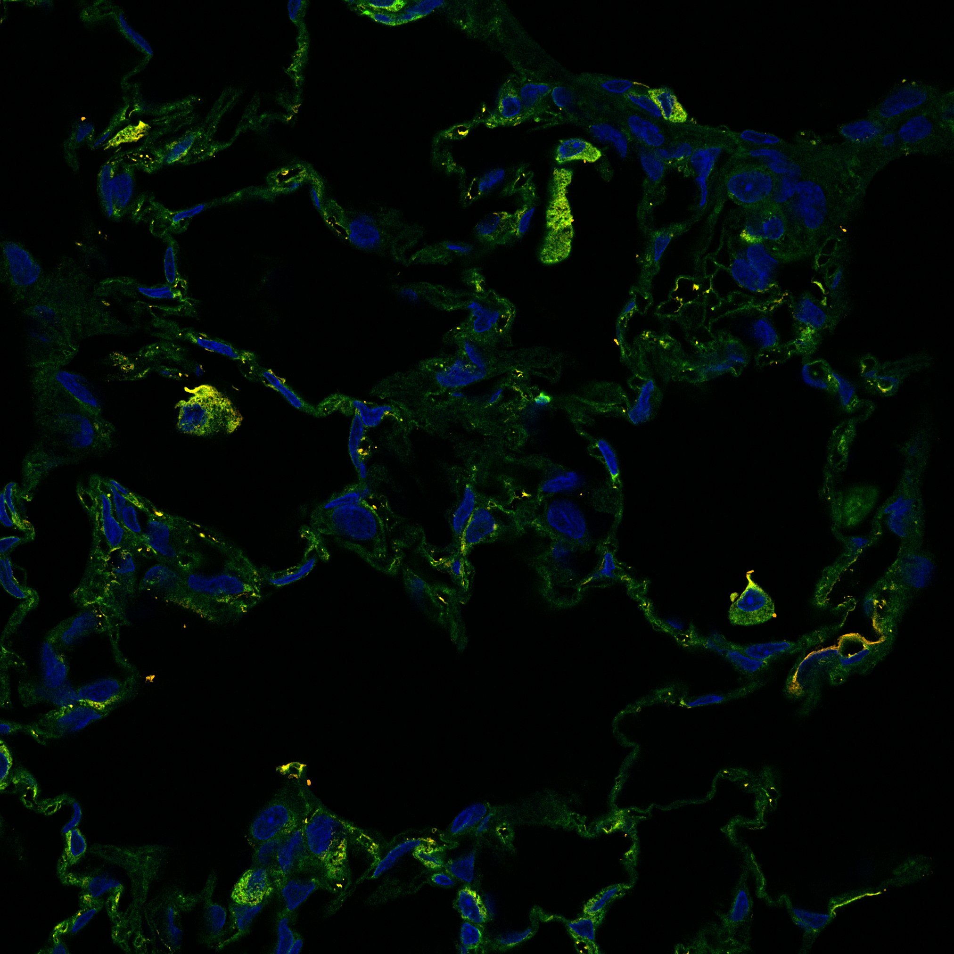
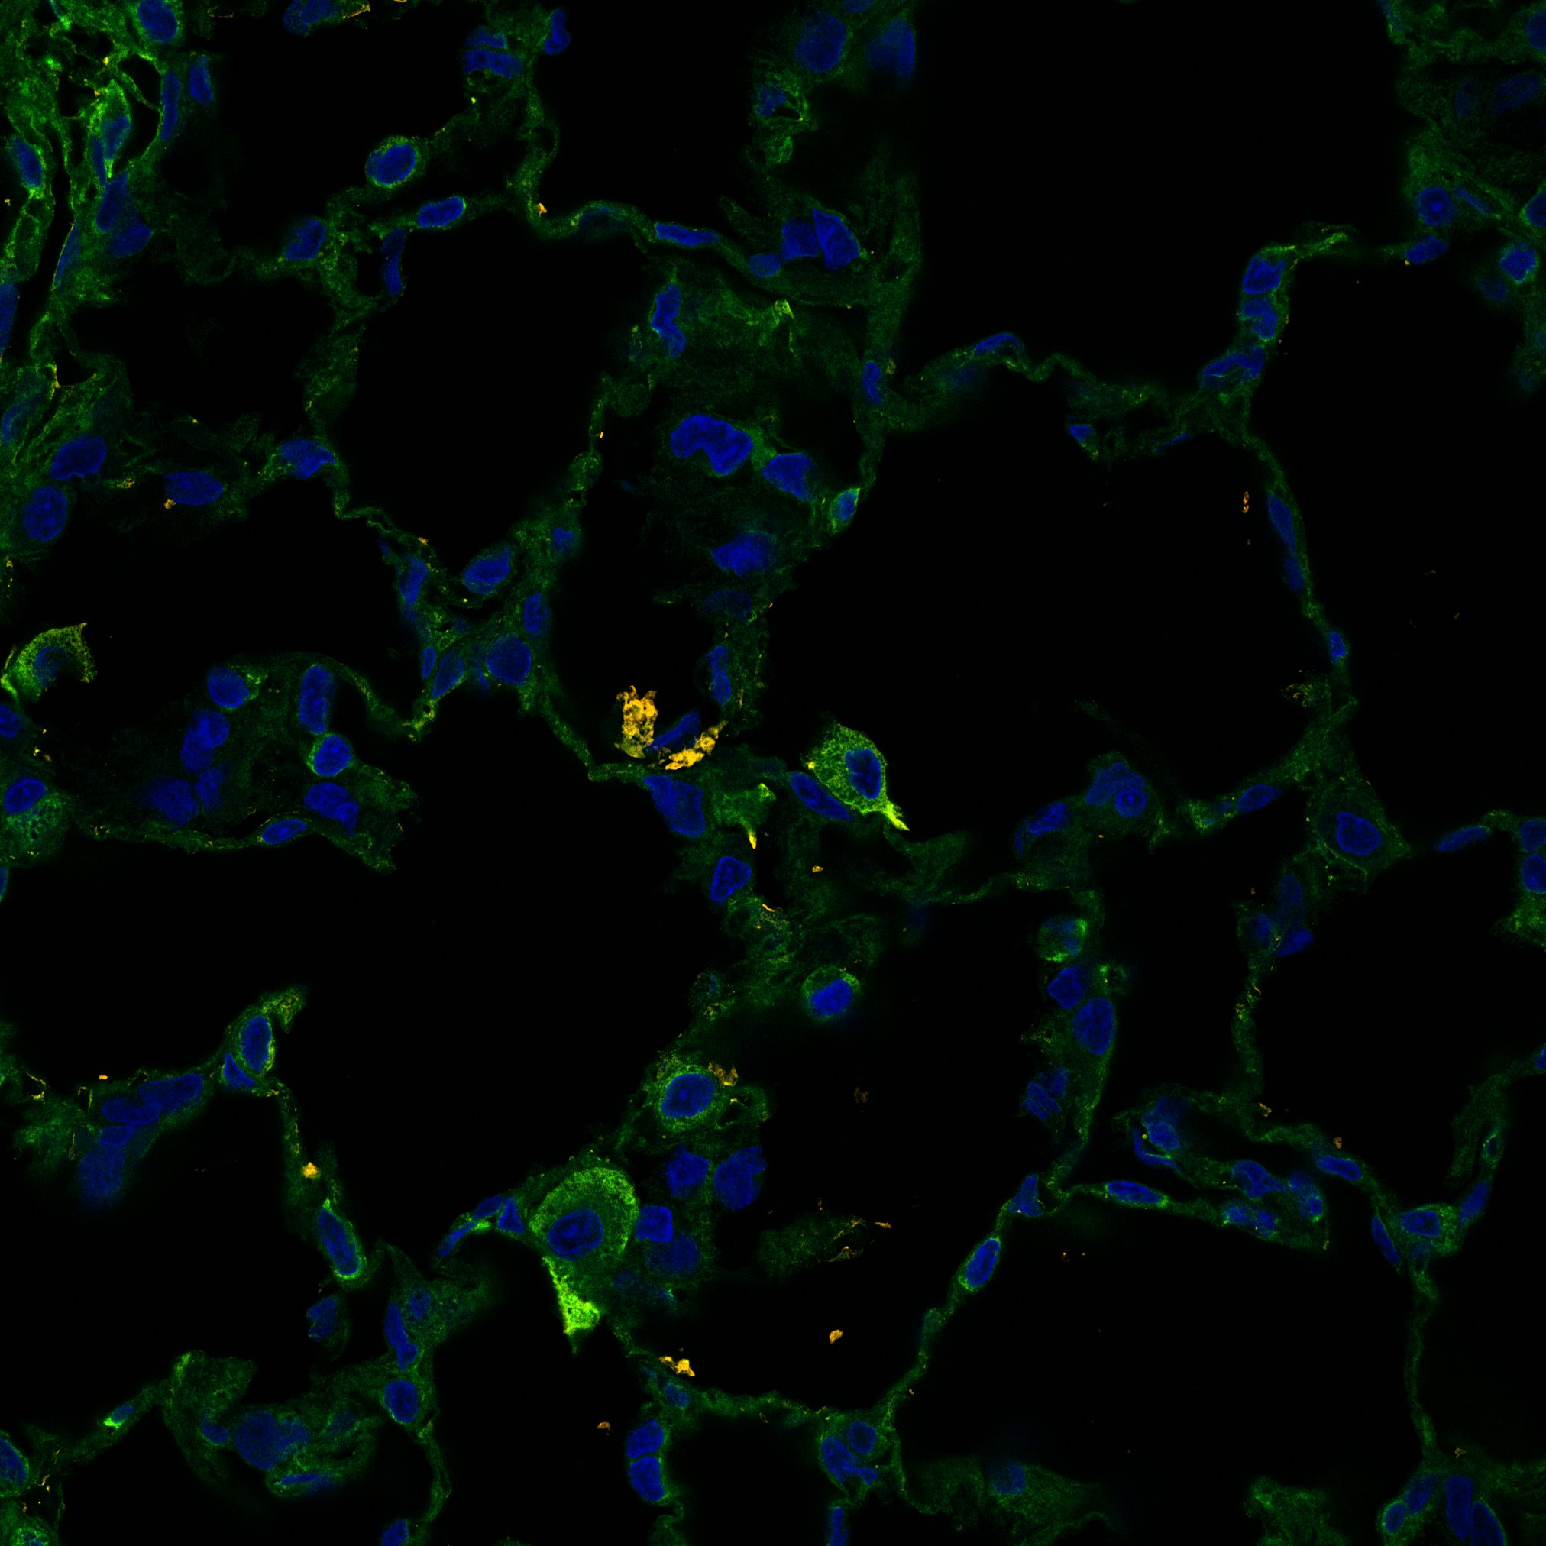
Supplementary Figure 3
a
gCapC in red circle
b
Negative Stain
Live/Dead
Singlets
P1
FABP4+ PE
P2
CD31+ FITC
P3
P2
P3
P4
P1
CD31+ (FITC), FABP4+ (PE) Stain
Live/Dead
Singlets
P1
FABP4+ PE
P2
CD31+ FITC
P3
P2
P3
P4
P1
Gates
P3= FABP4 positive Cells, PE positive
P4= Double Stain, FABP4+/CD31+
P1= Live Cells
P2= Singlet Selection
c
DAPI
CD31
FABP4
DAPI
CD31
FABP4
DAPI
CD31
FABP4
gCapC
gCapC
gCapC
gCapC

Slide 6
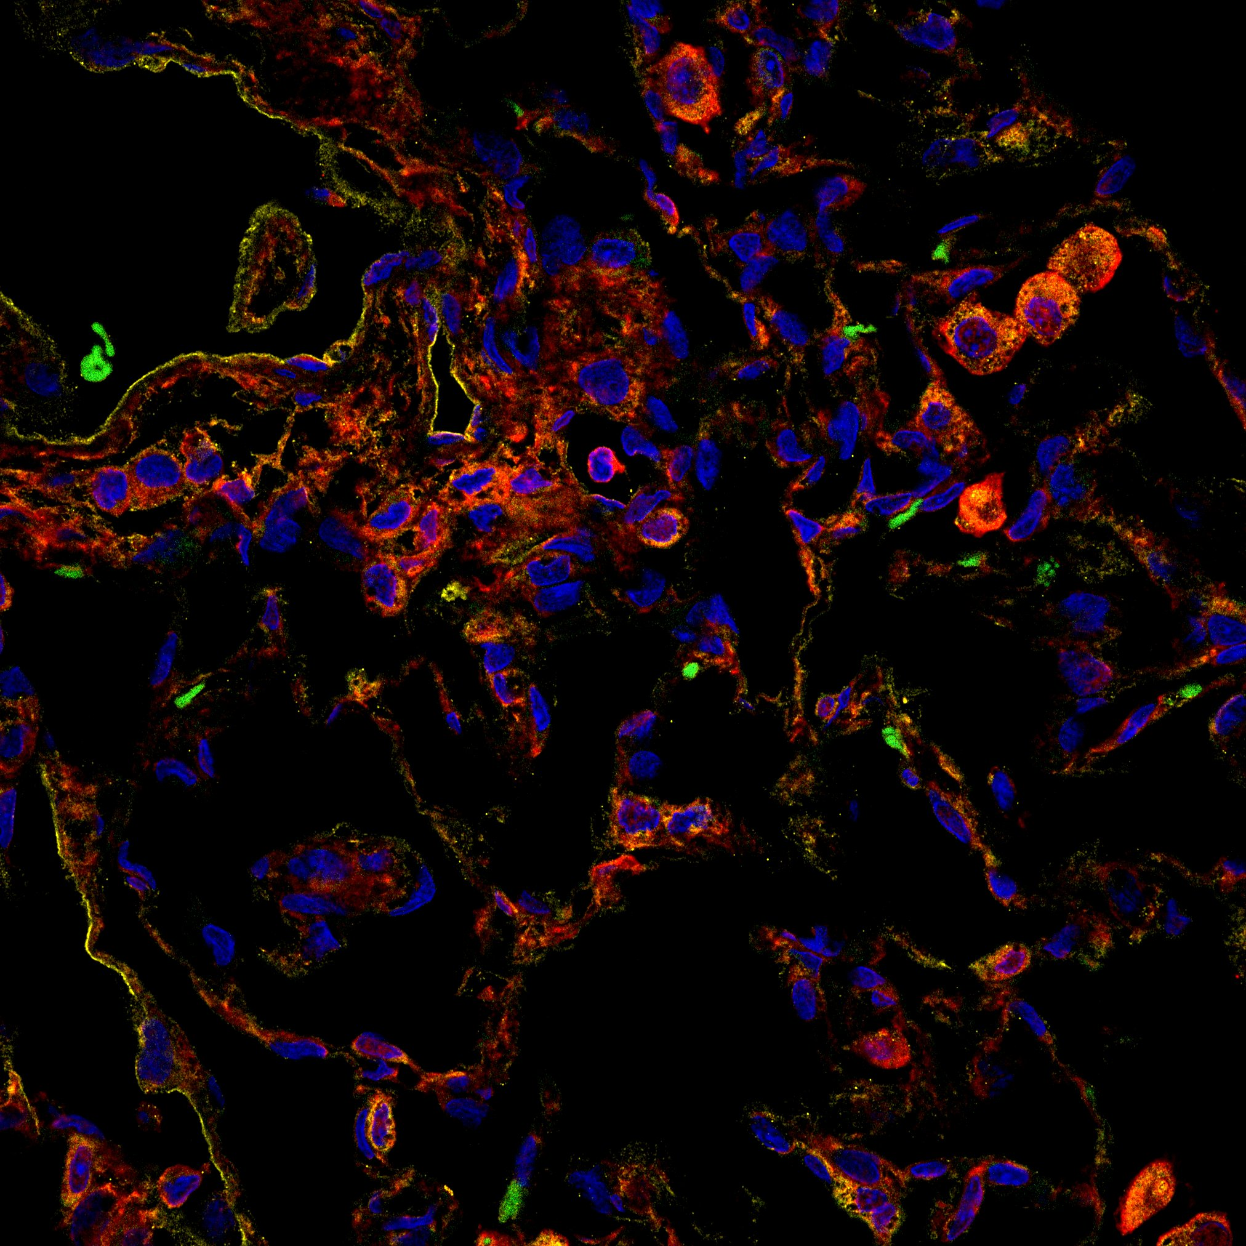
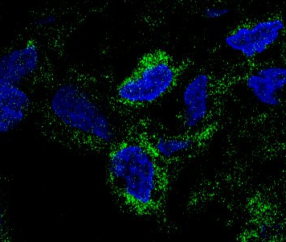
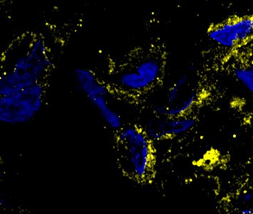
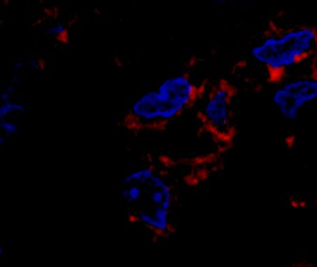
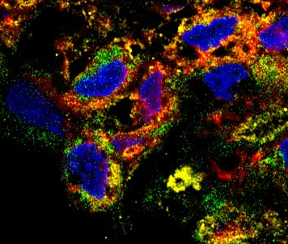
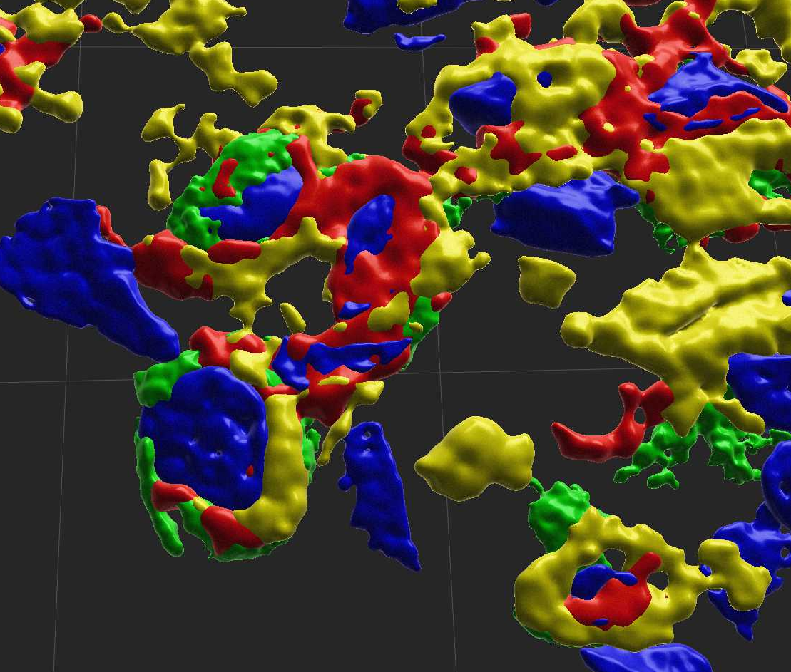
Supplementary Figure 4
a
DAPI
SCN7A
CLIC4
gCapA
5µm
gCapD
25µm
b
Aerocyte
gCapA
DAPI
APLN
5µm
DAPI
CLIC4
5µm
5µm
gCapD
Composite
DAPI
SCN7A
5µm
3D Render
5µm
Aerocyte
gCapD
gCapA

Slide 7
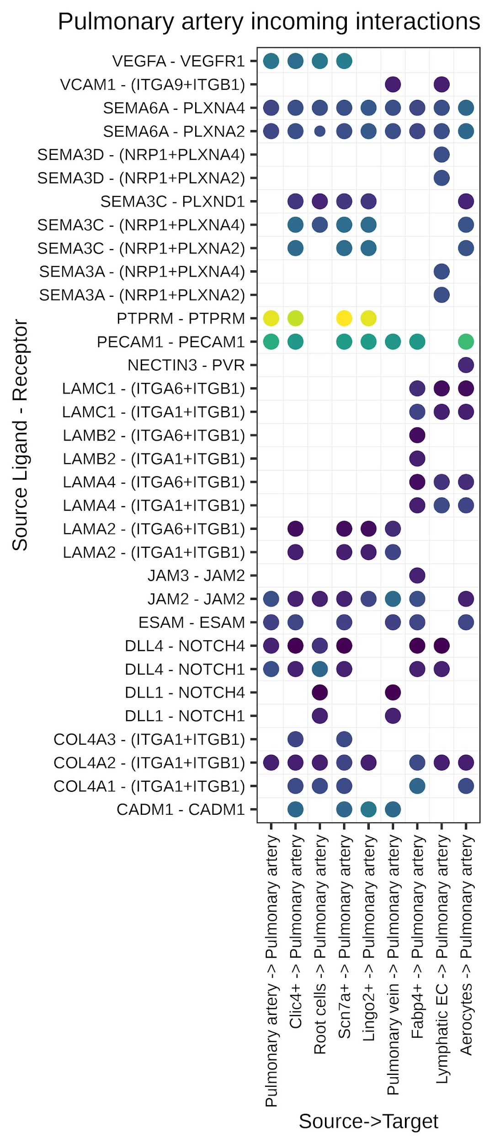
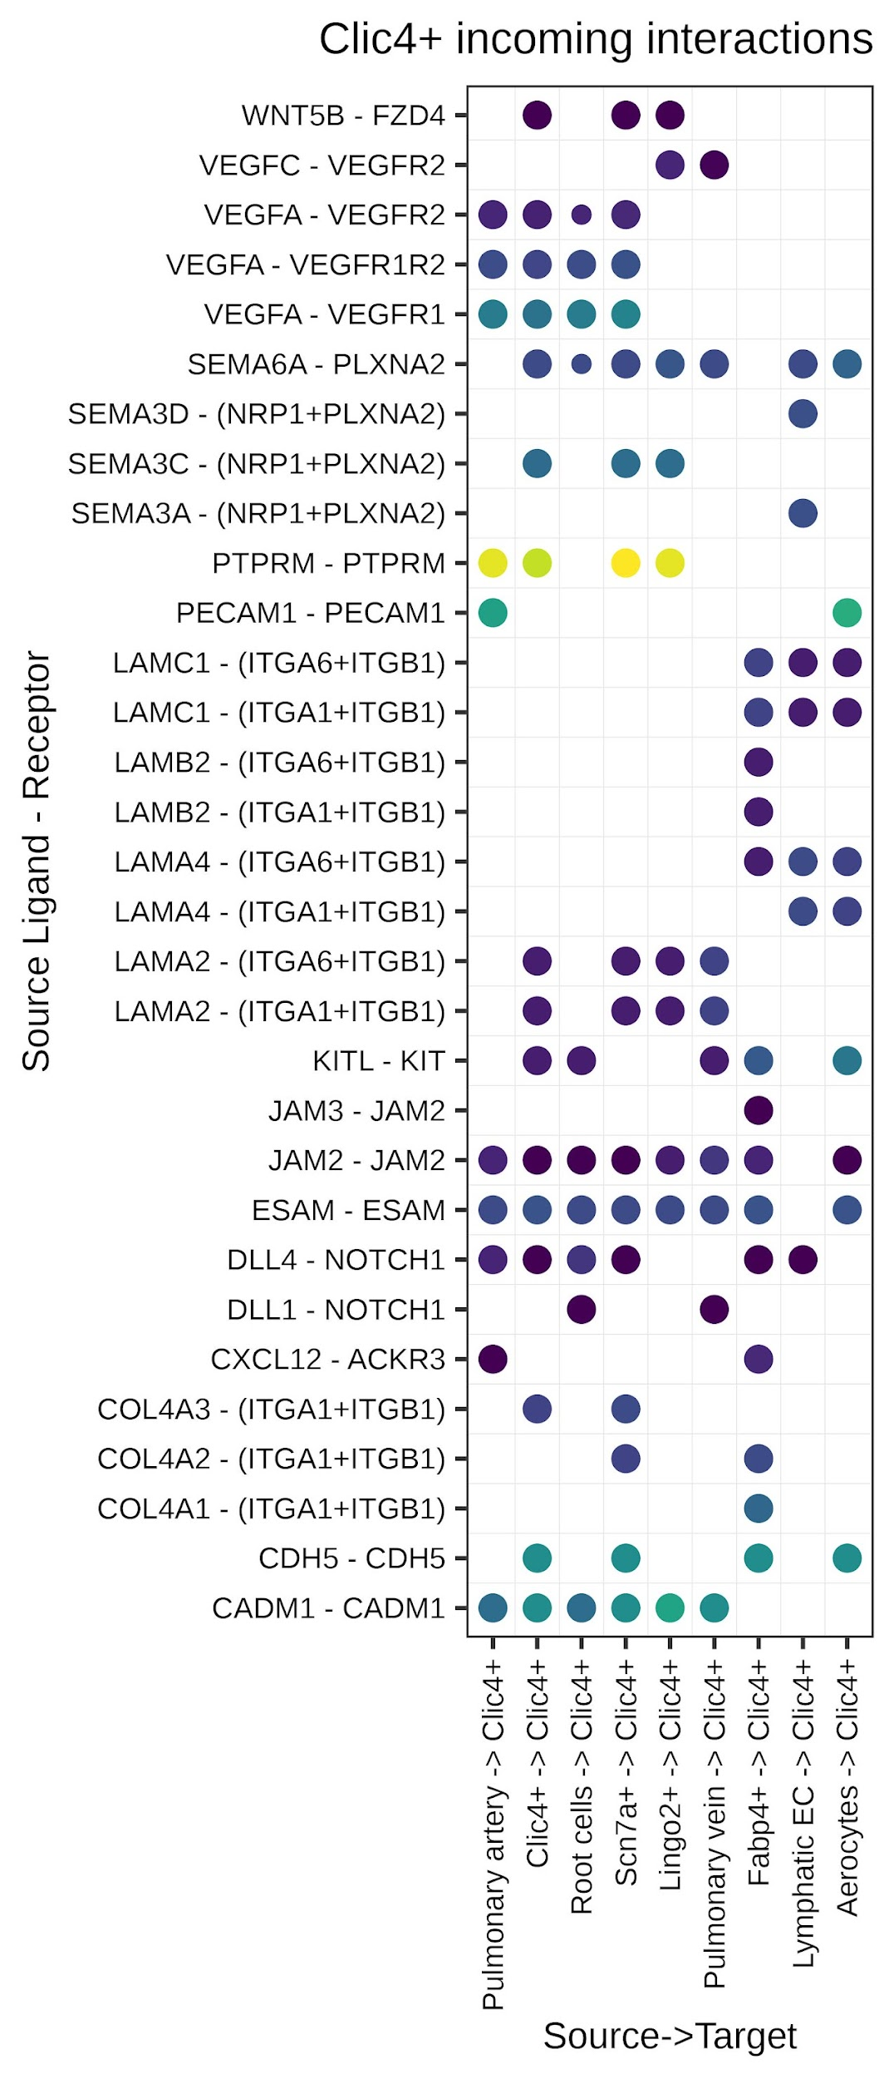
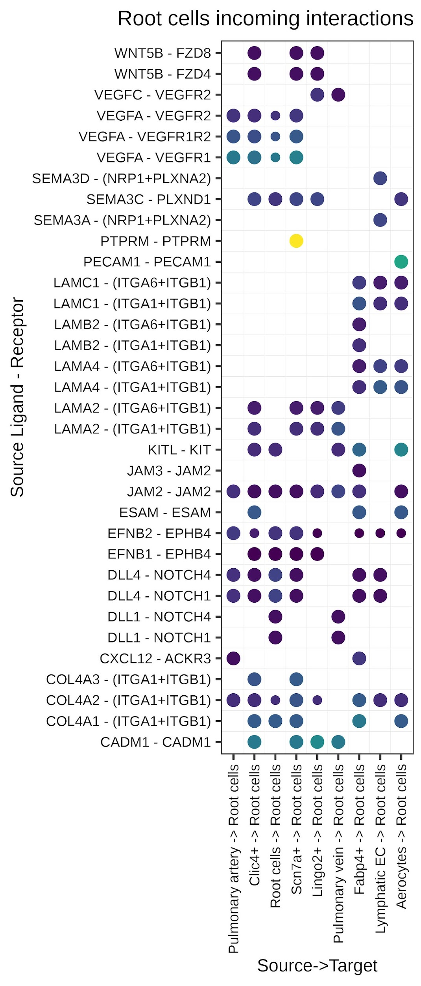
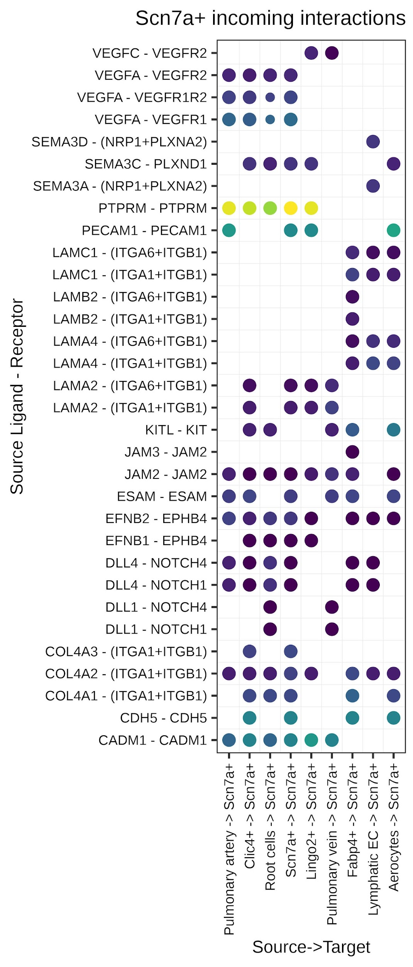
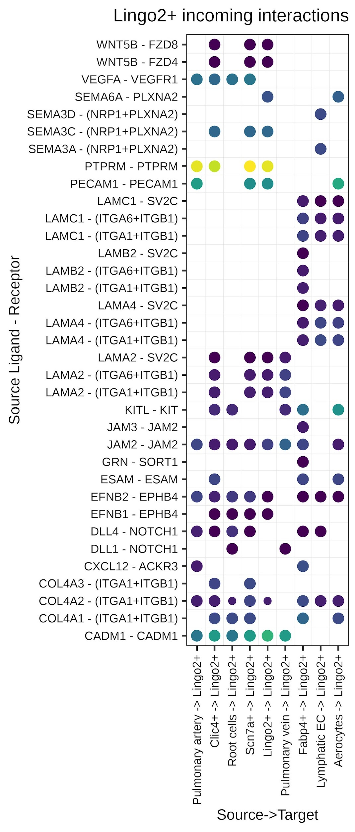
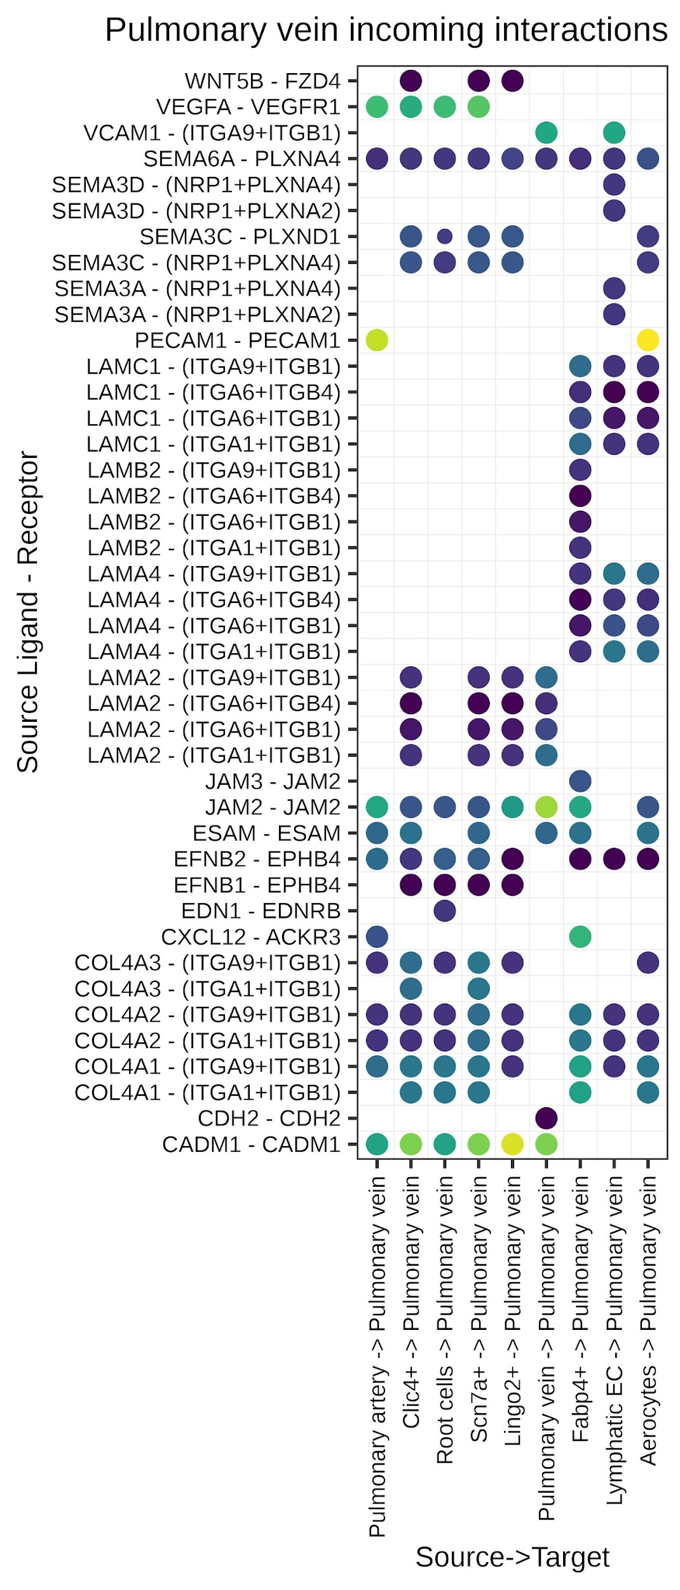
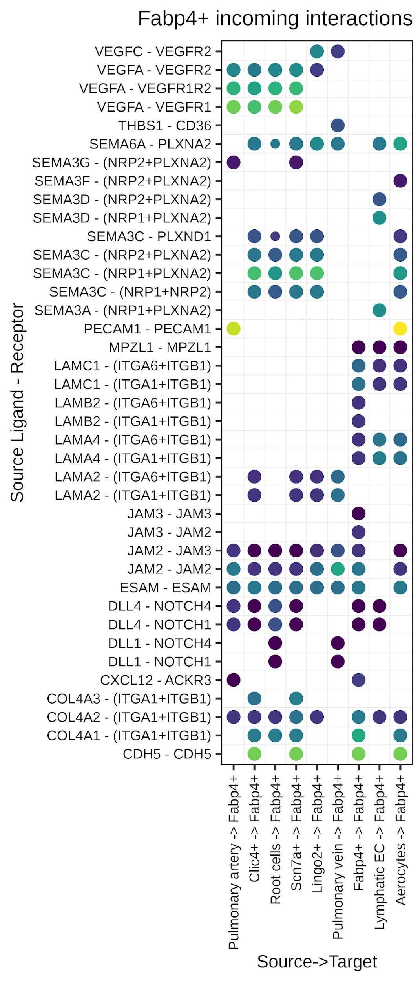
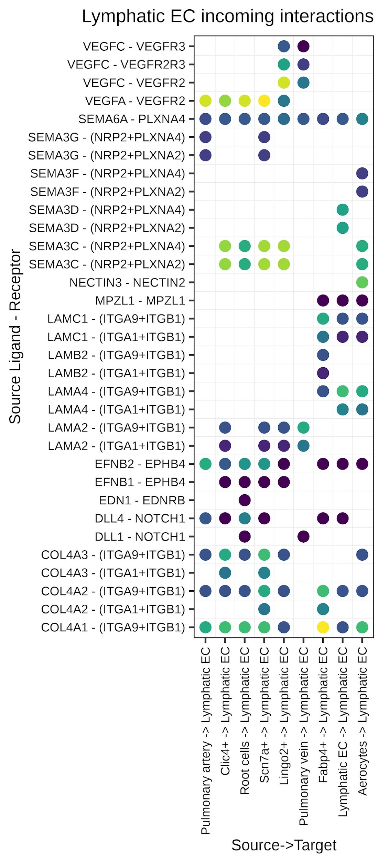
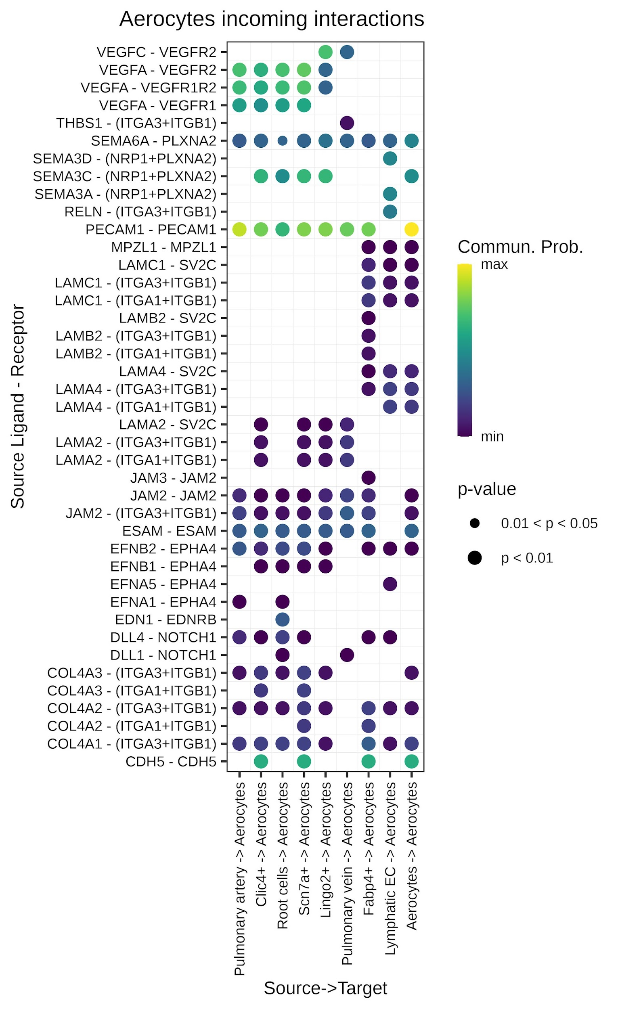
Supplementary Figure 5
a
b
c
d
e
f
g
h
i

Slide 8
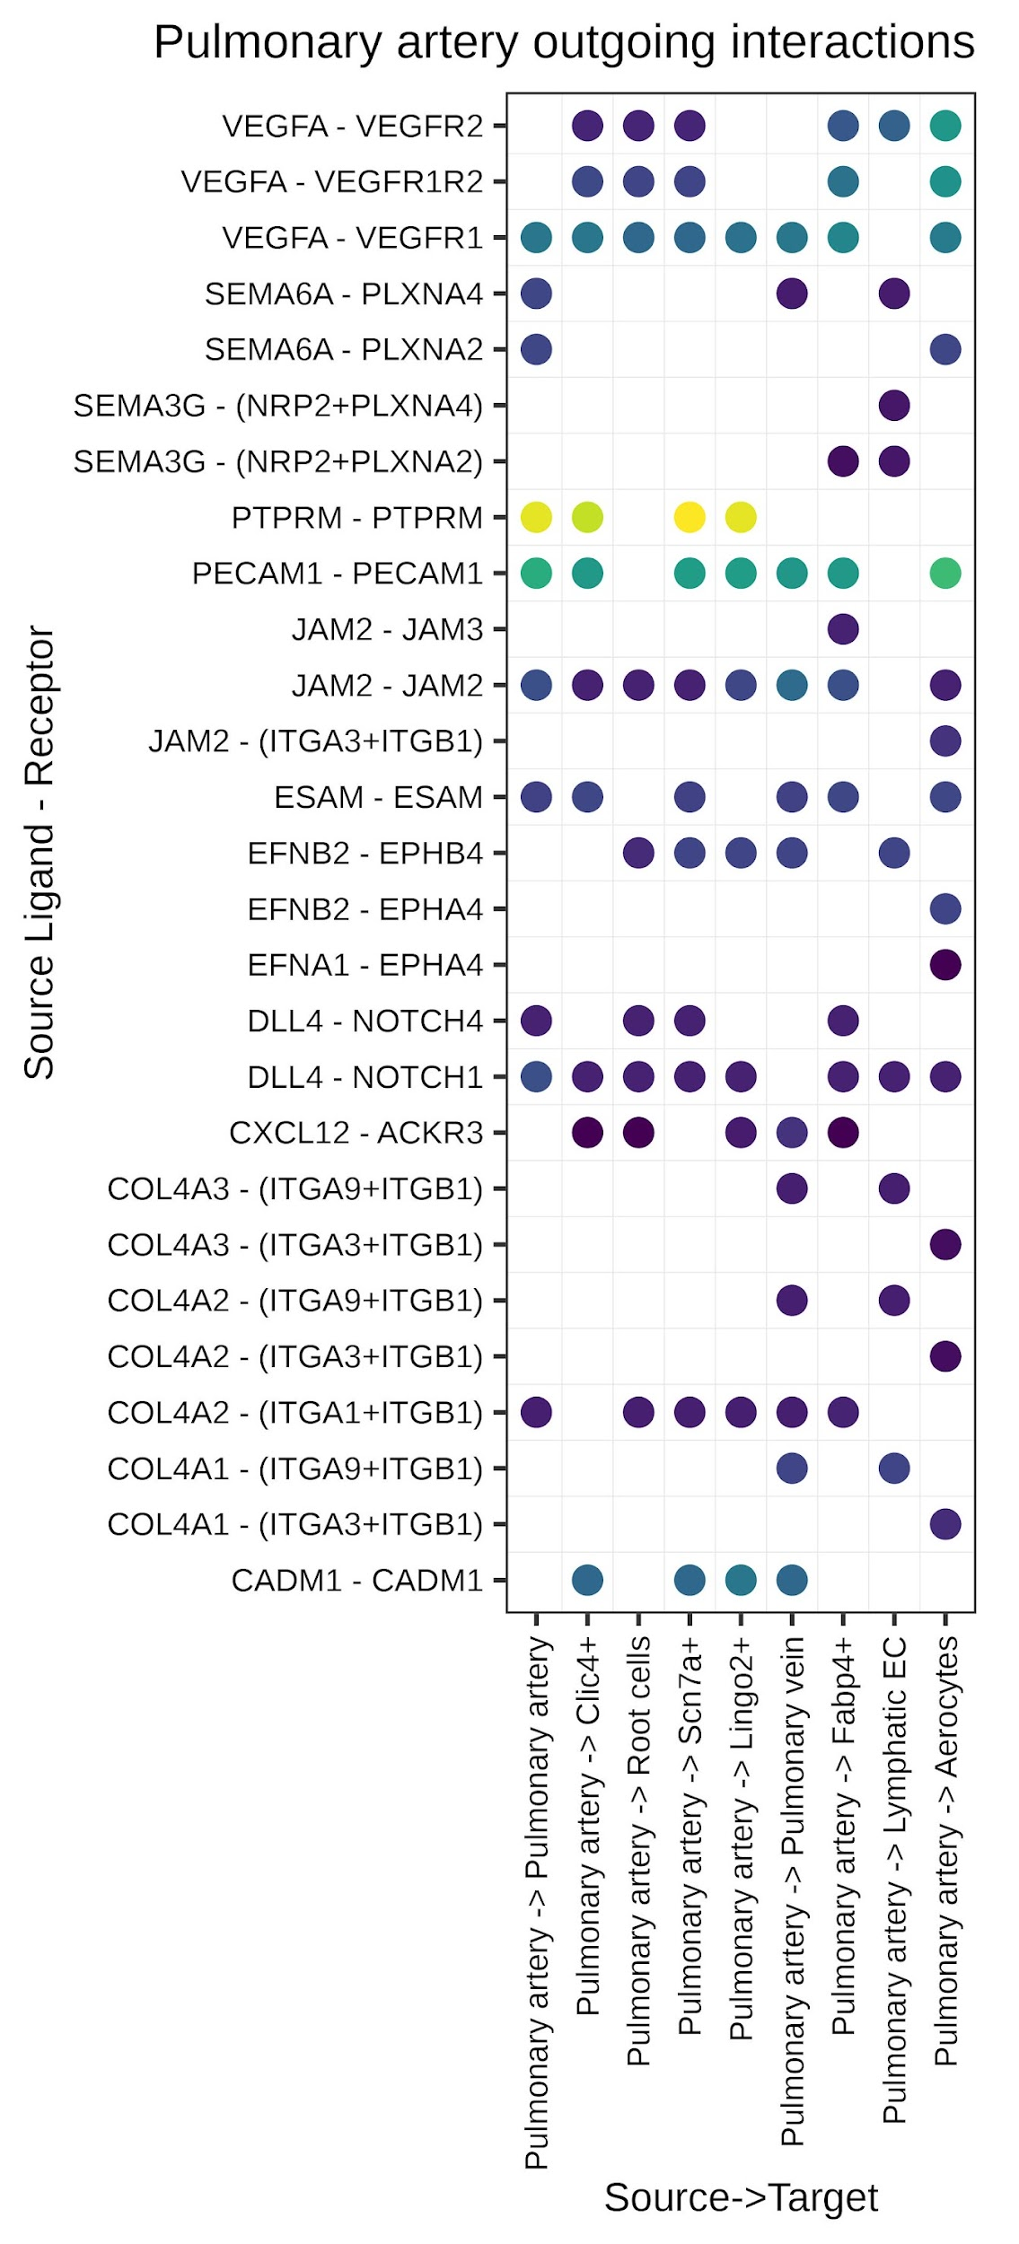
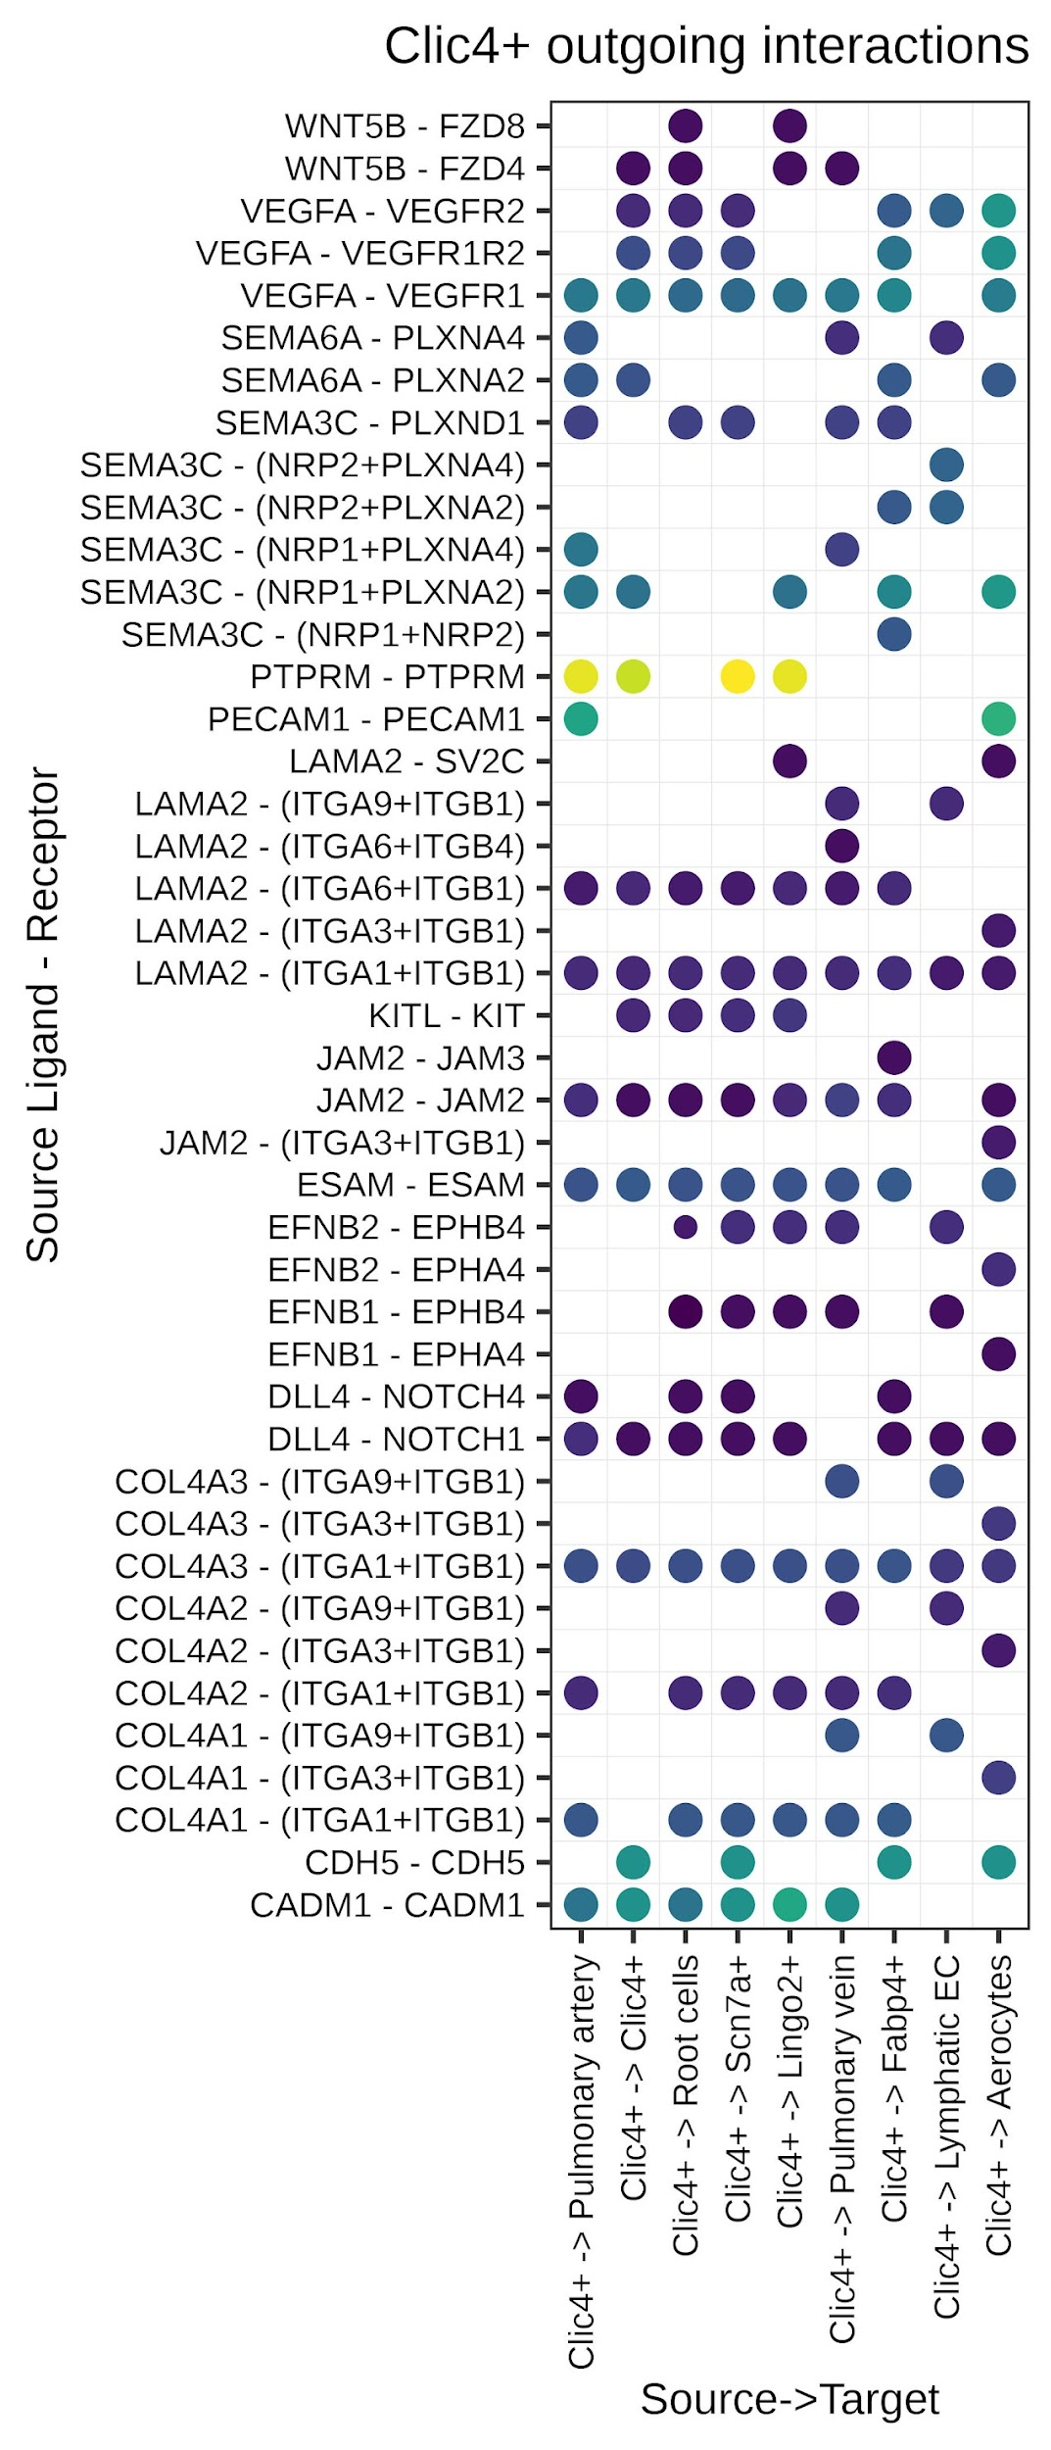
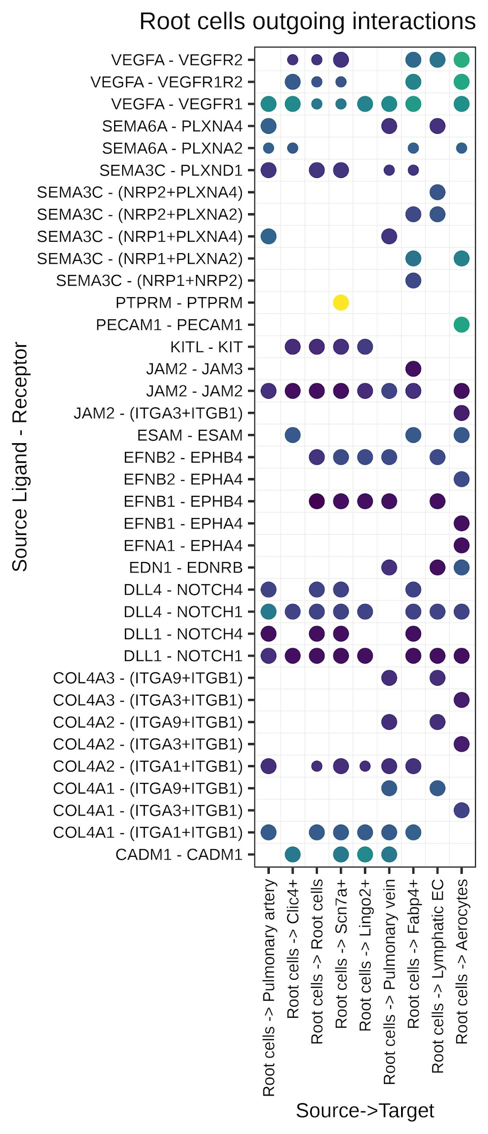
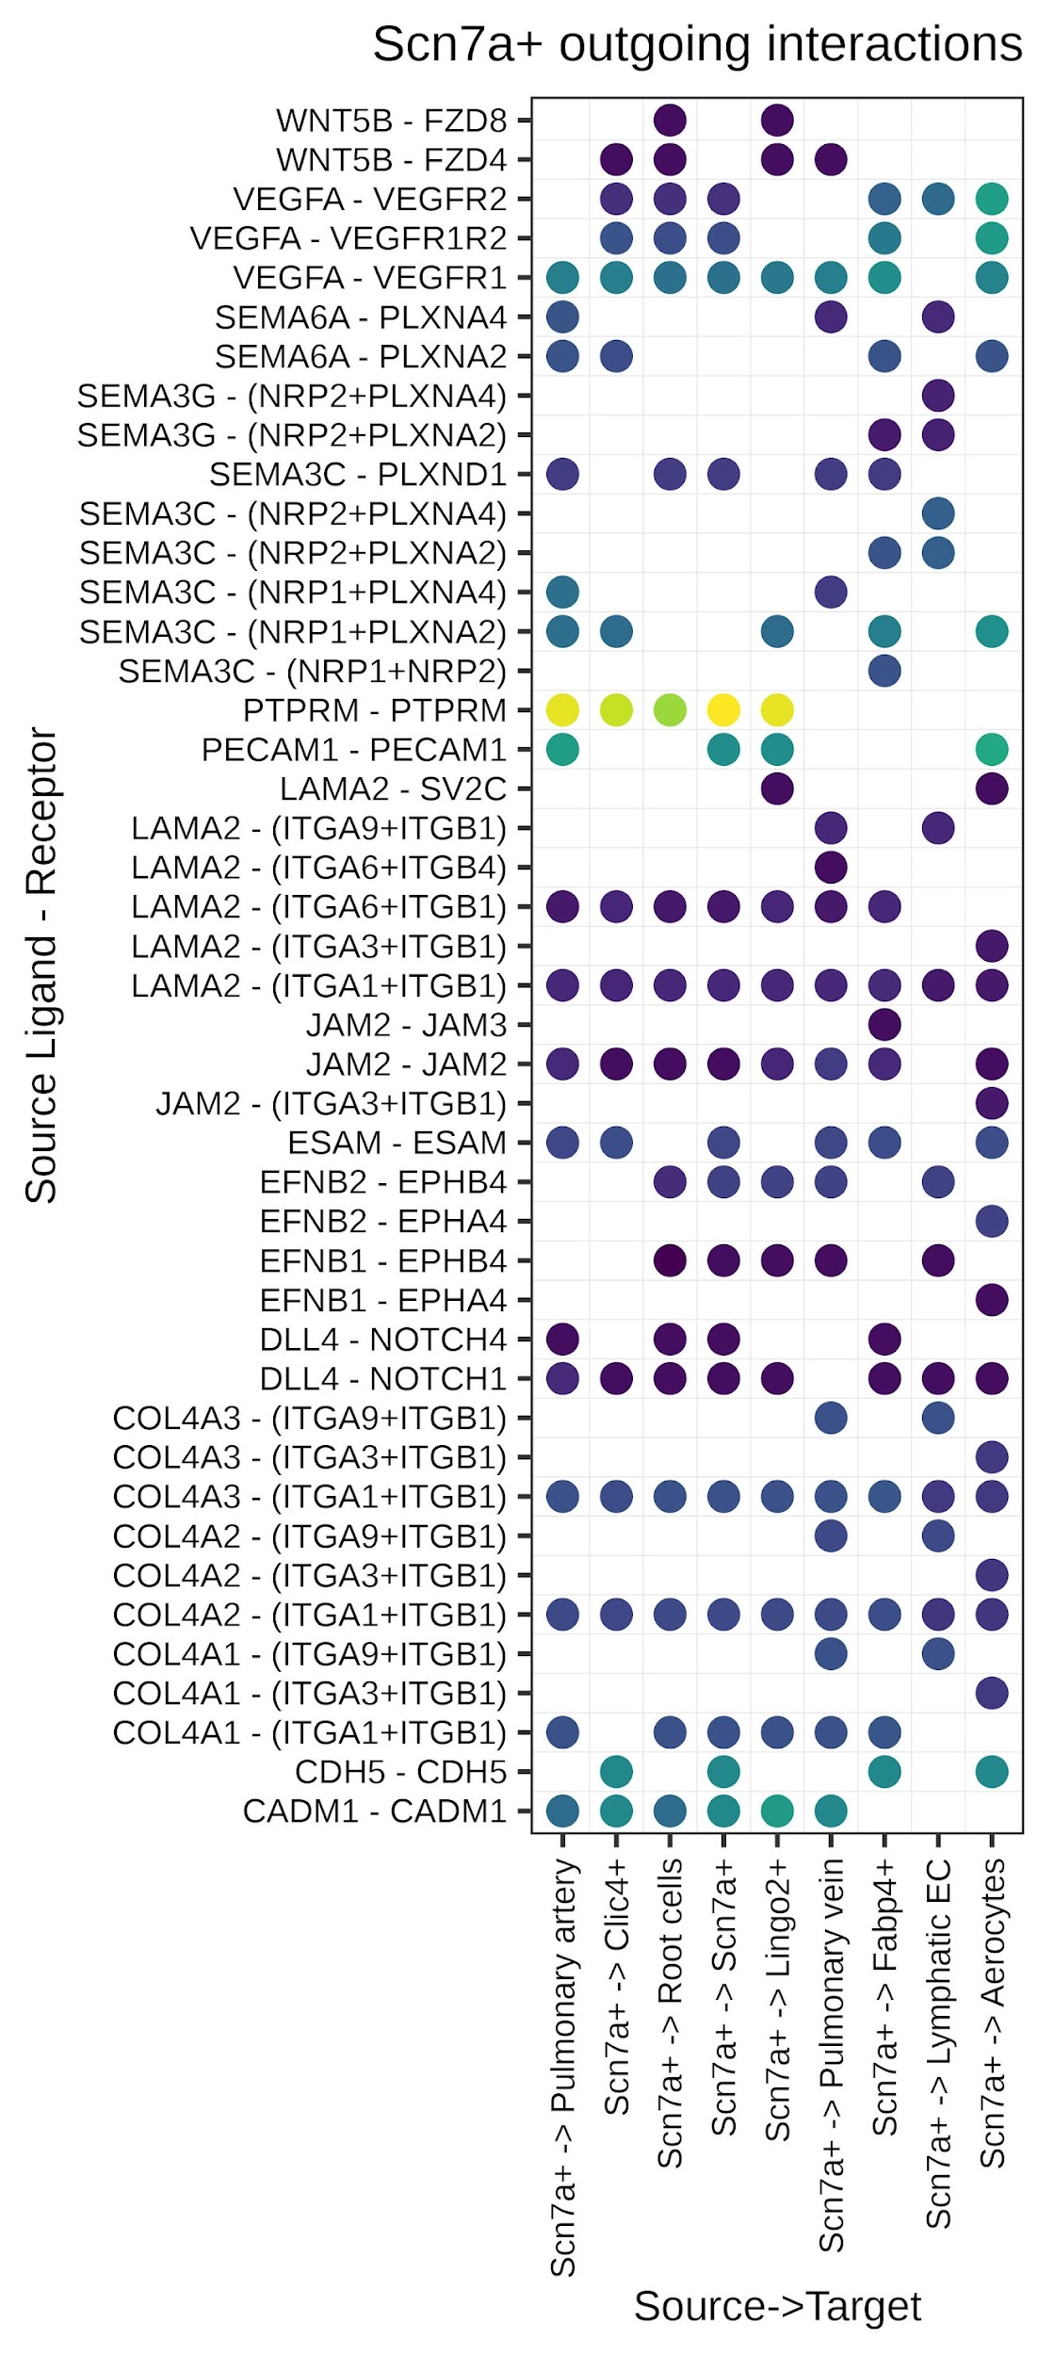
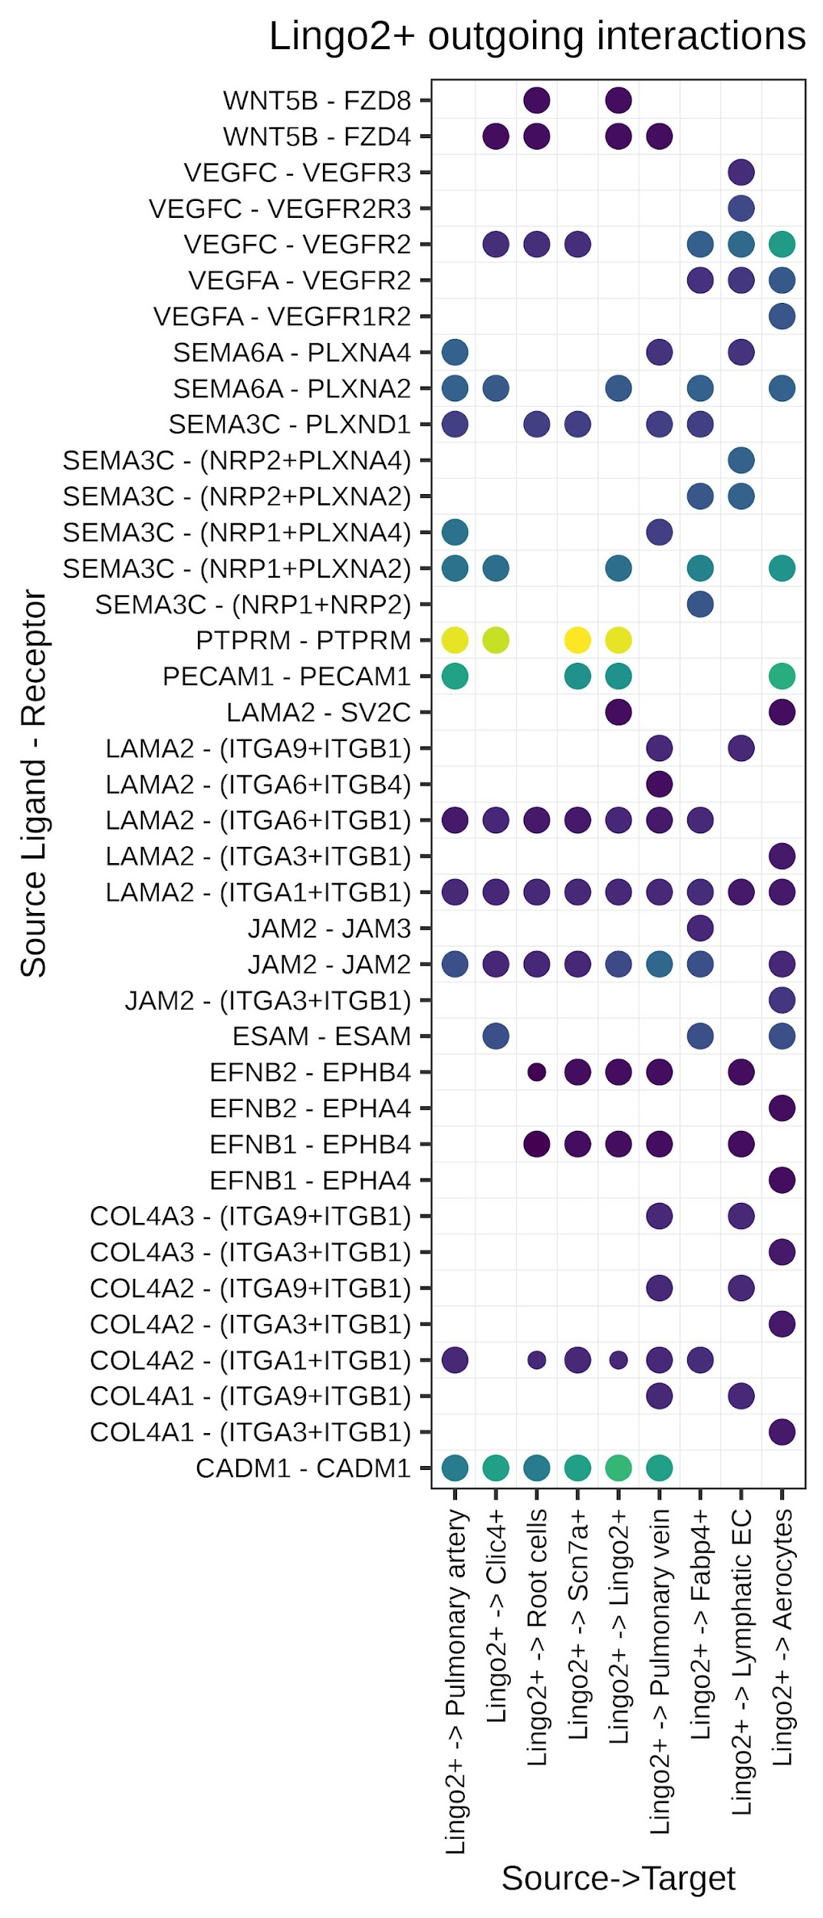
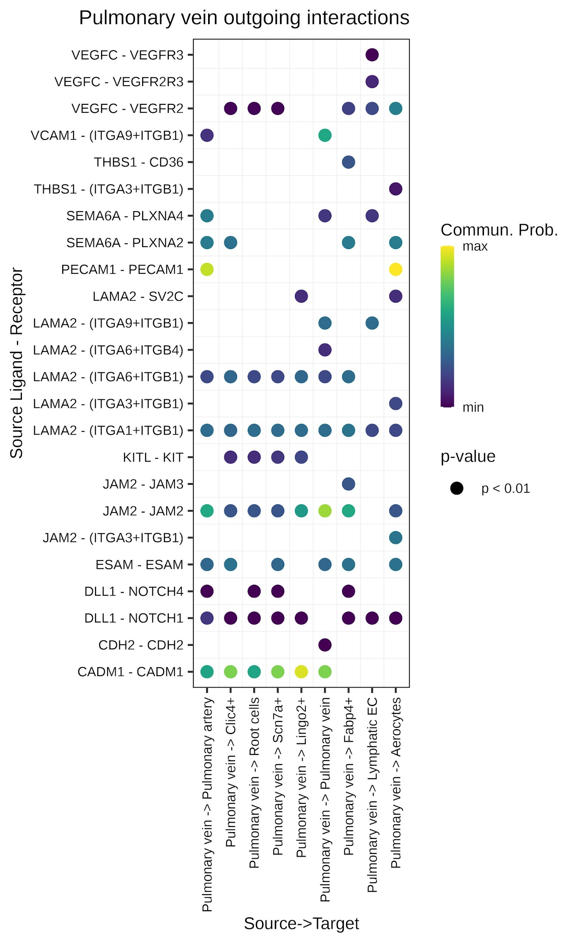
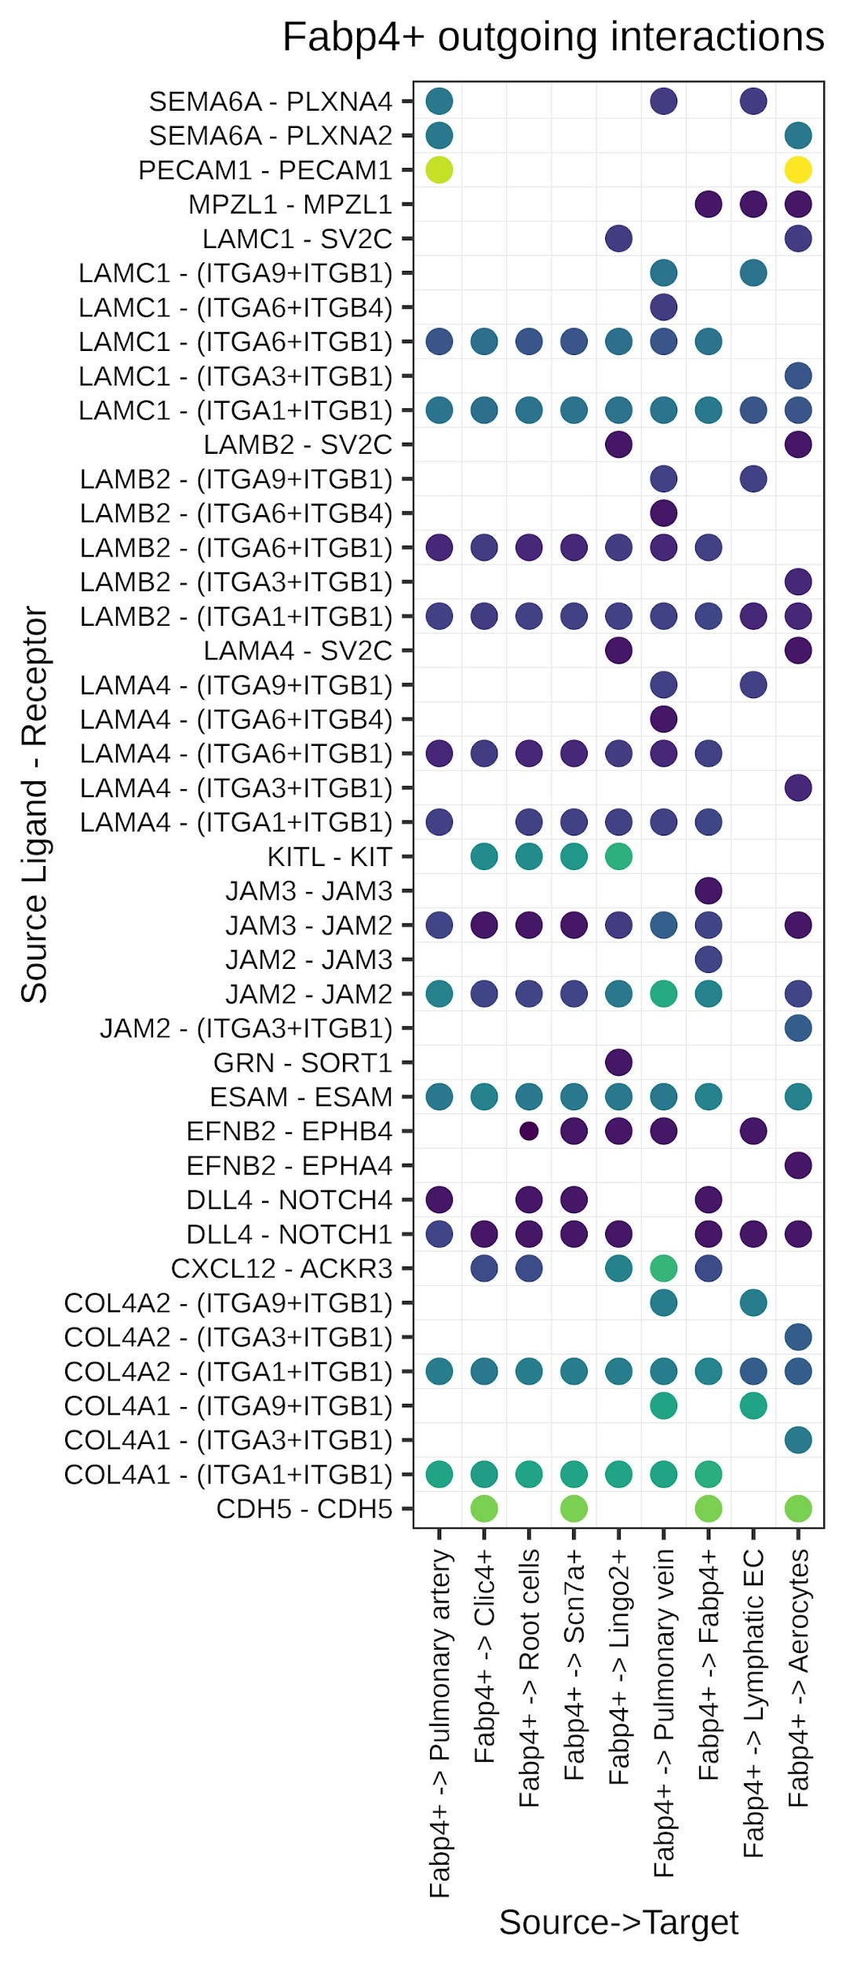
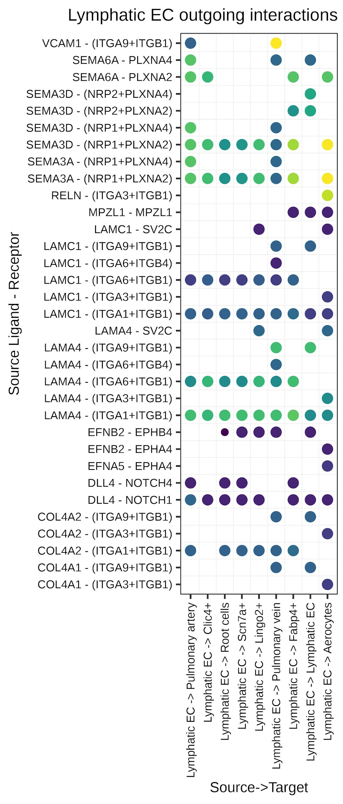
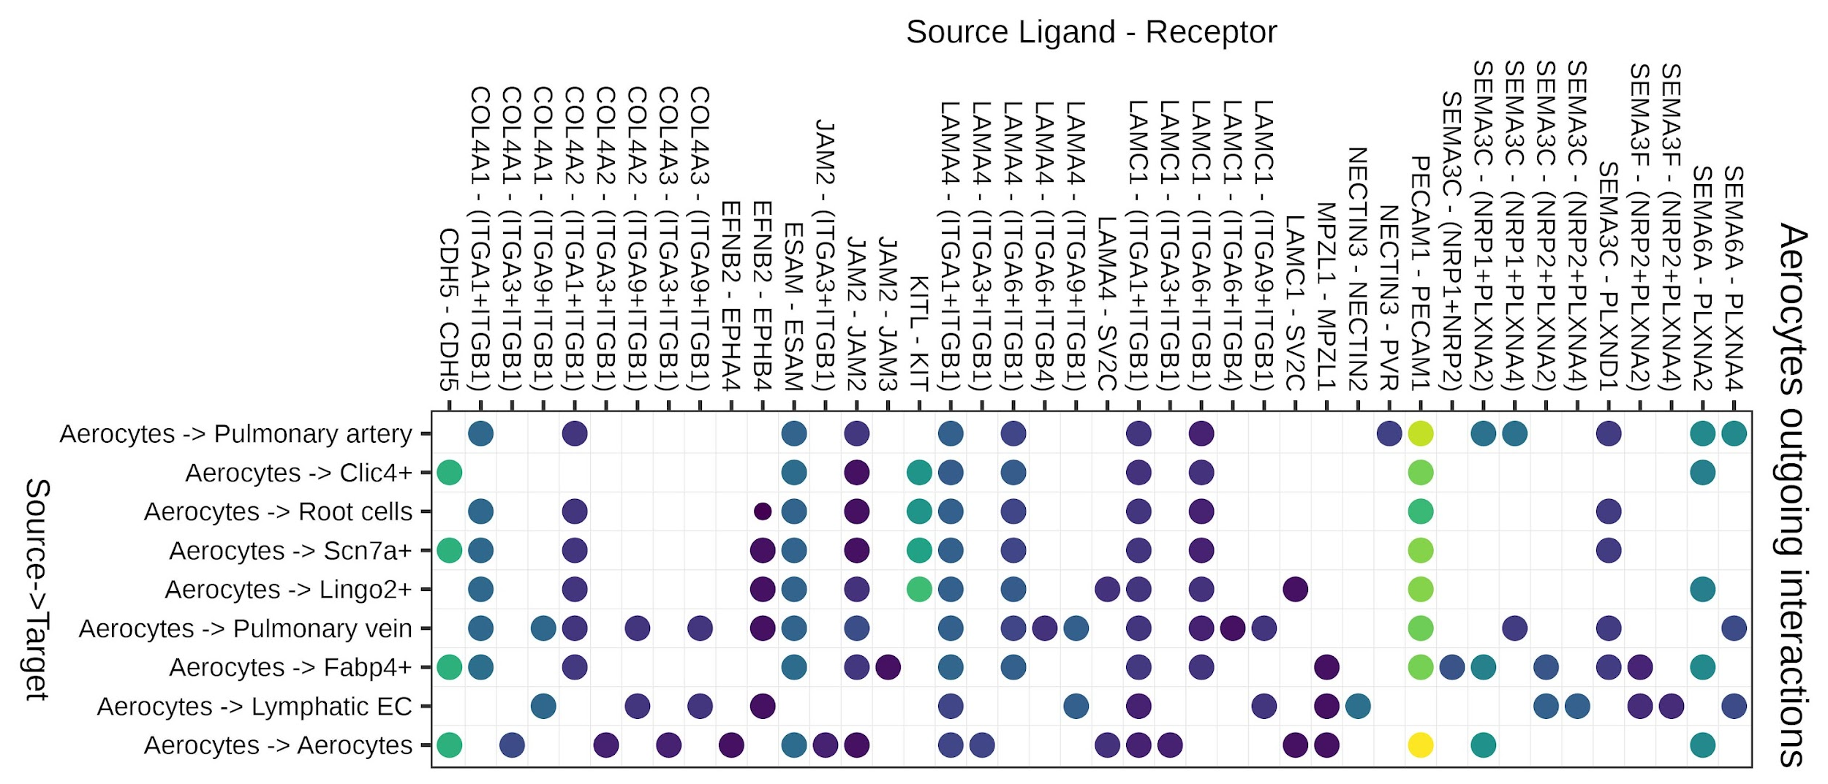
Supplementary Figure 5
j
k
l
m
n
o
p
q
r

Slide 9
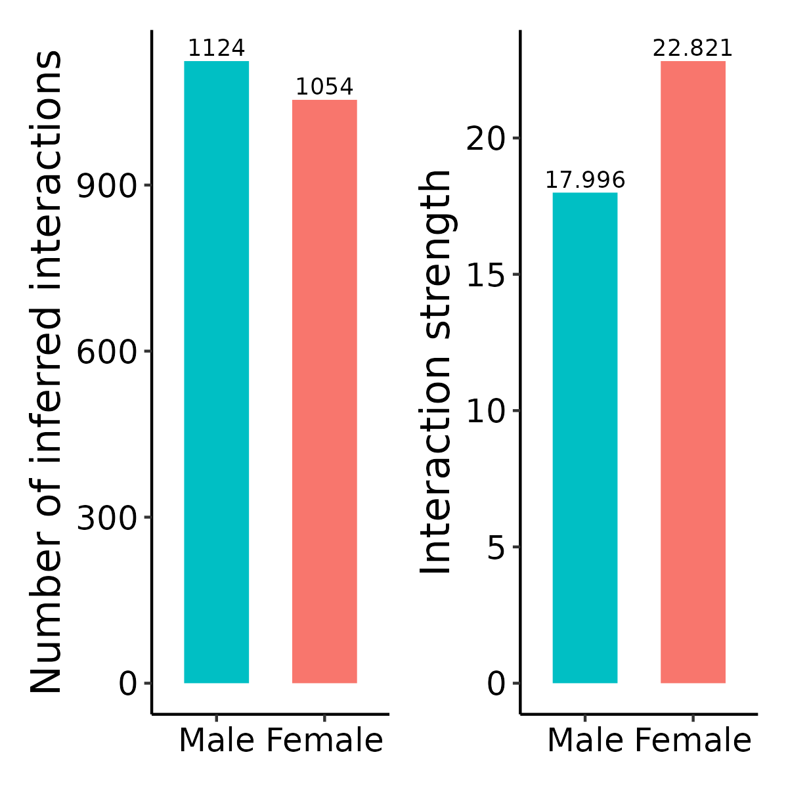


Supplementary Figure 6
a
b
c
Upregulated Female
Pathways
d
Upregulated Male
Pathways

Slide 10
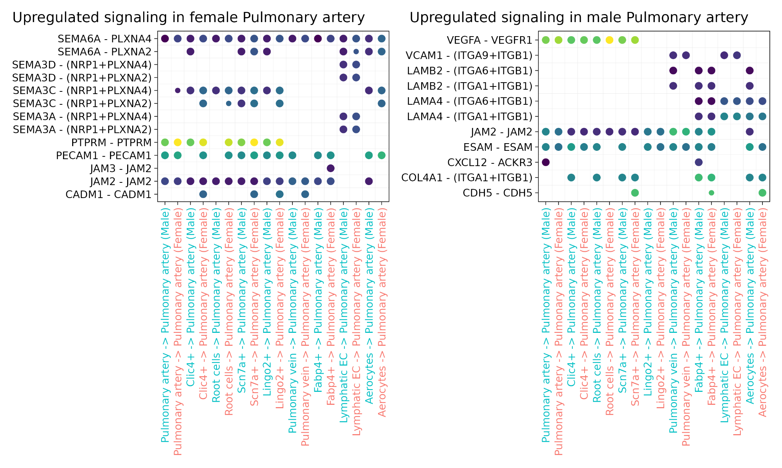
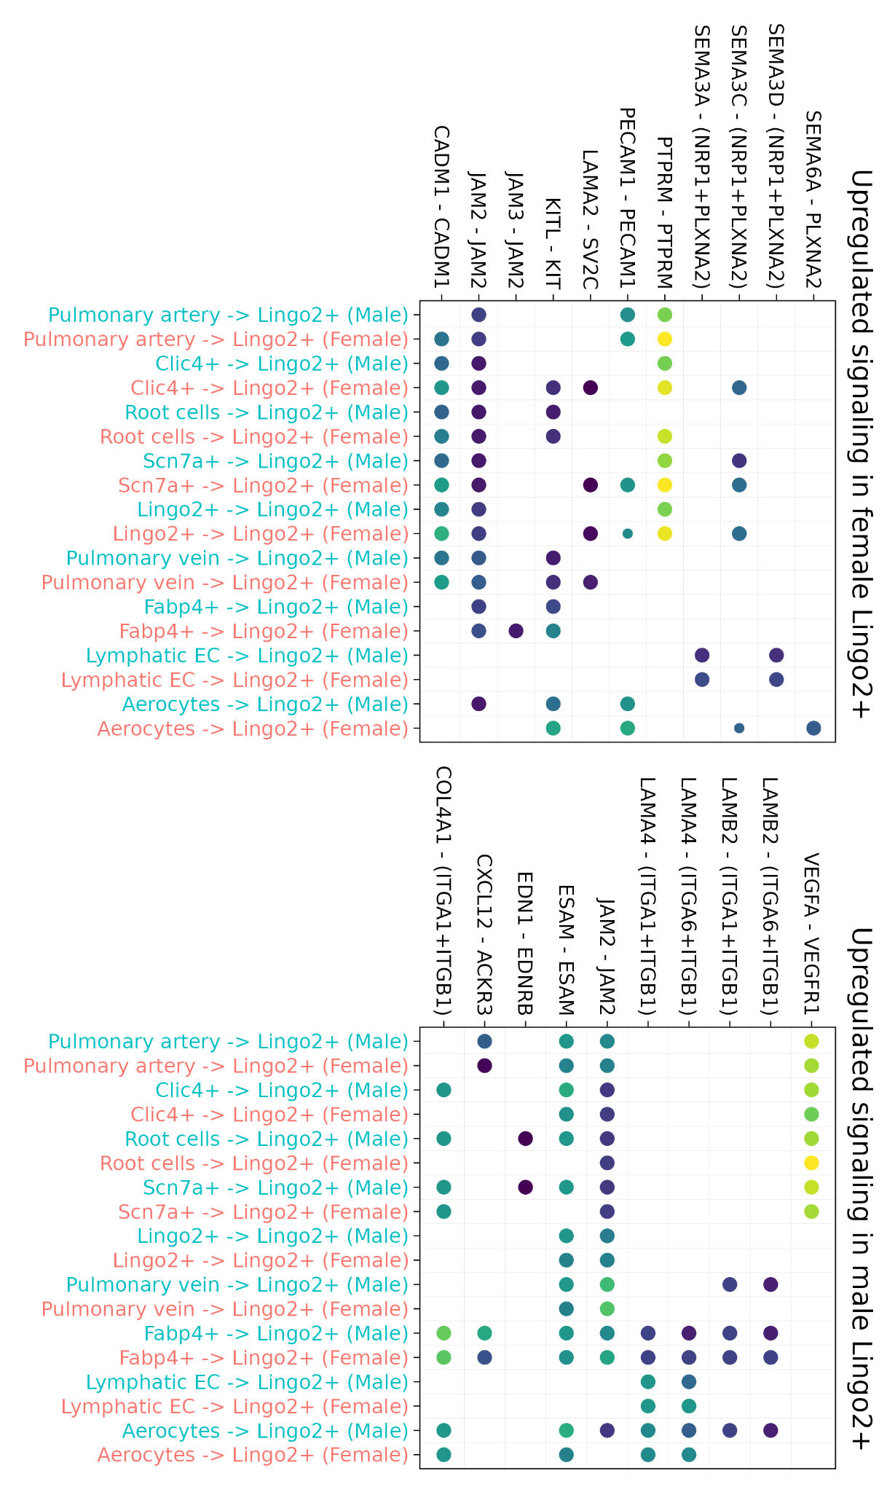
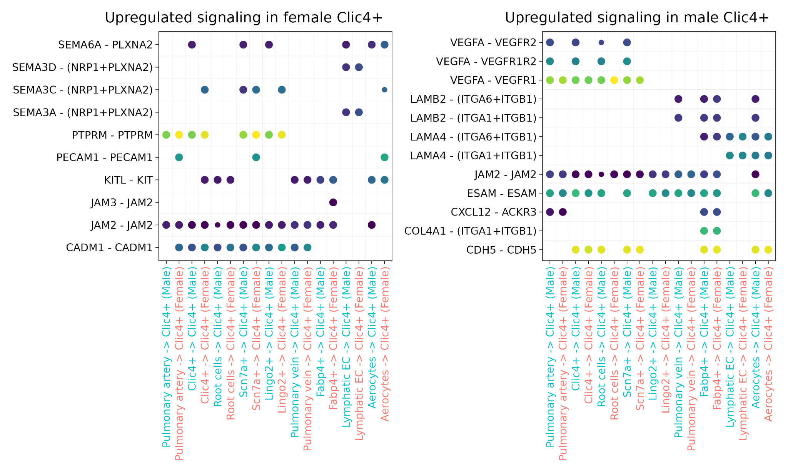
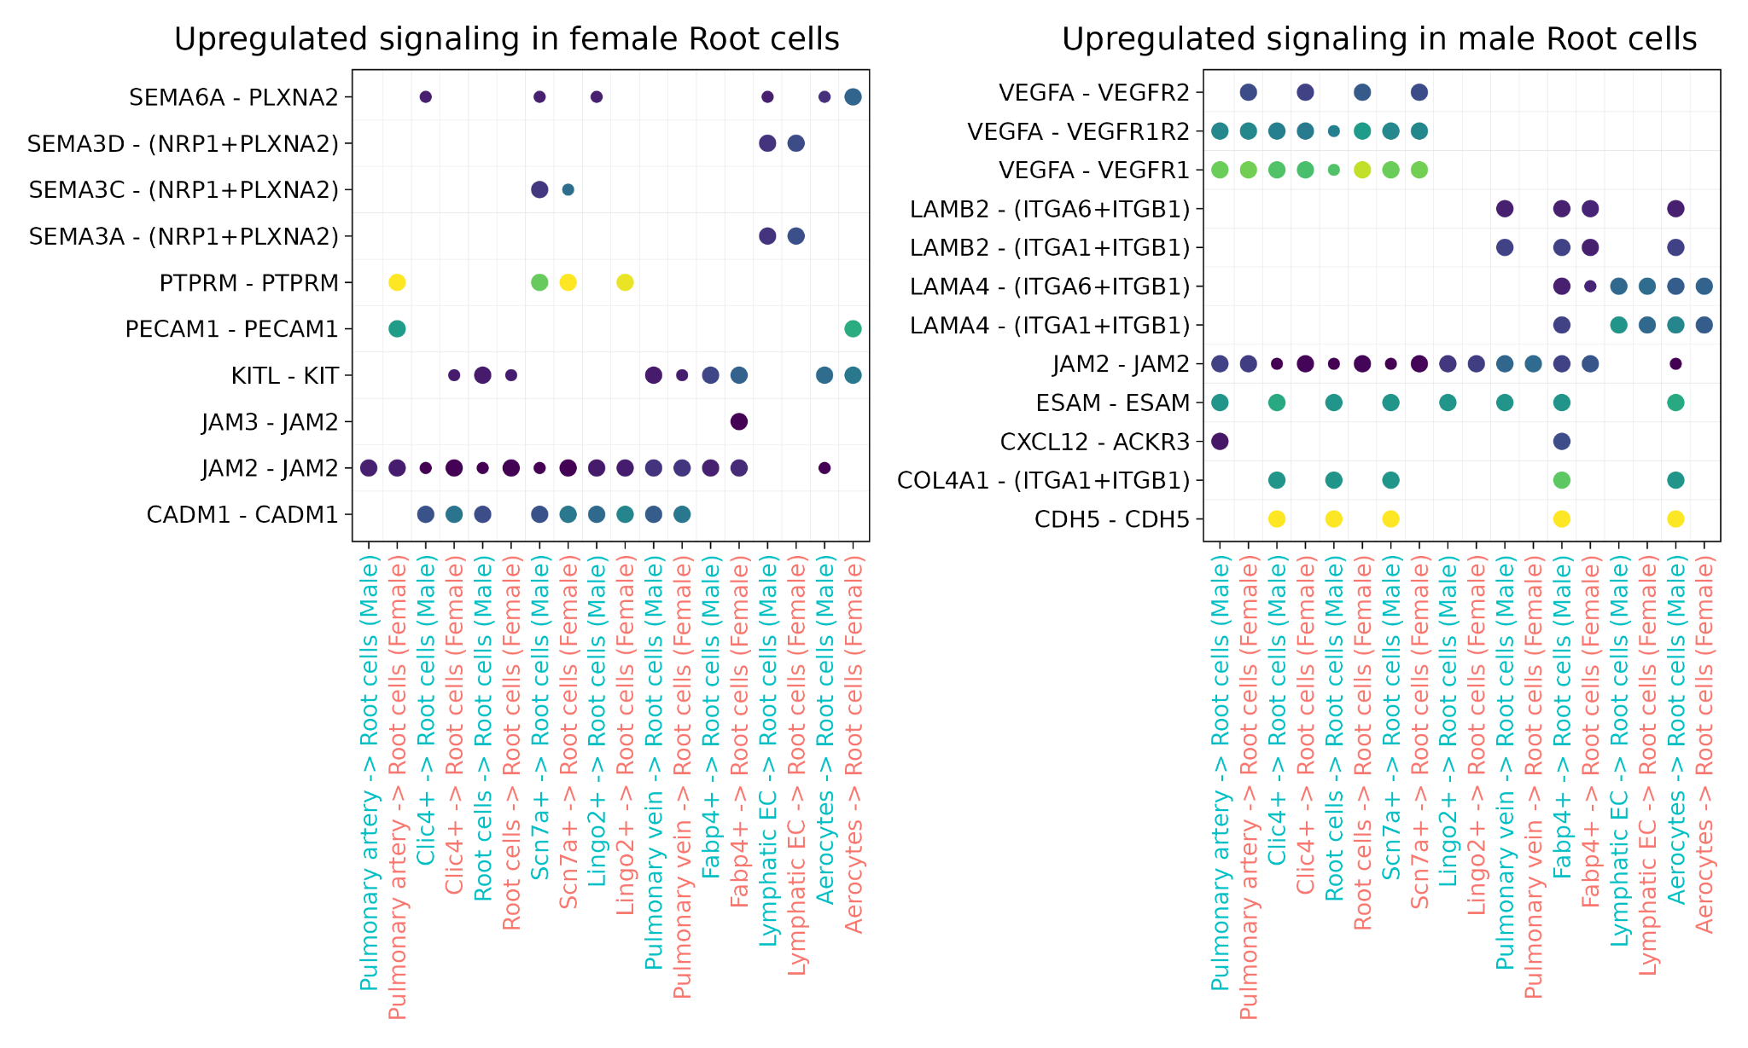
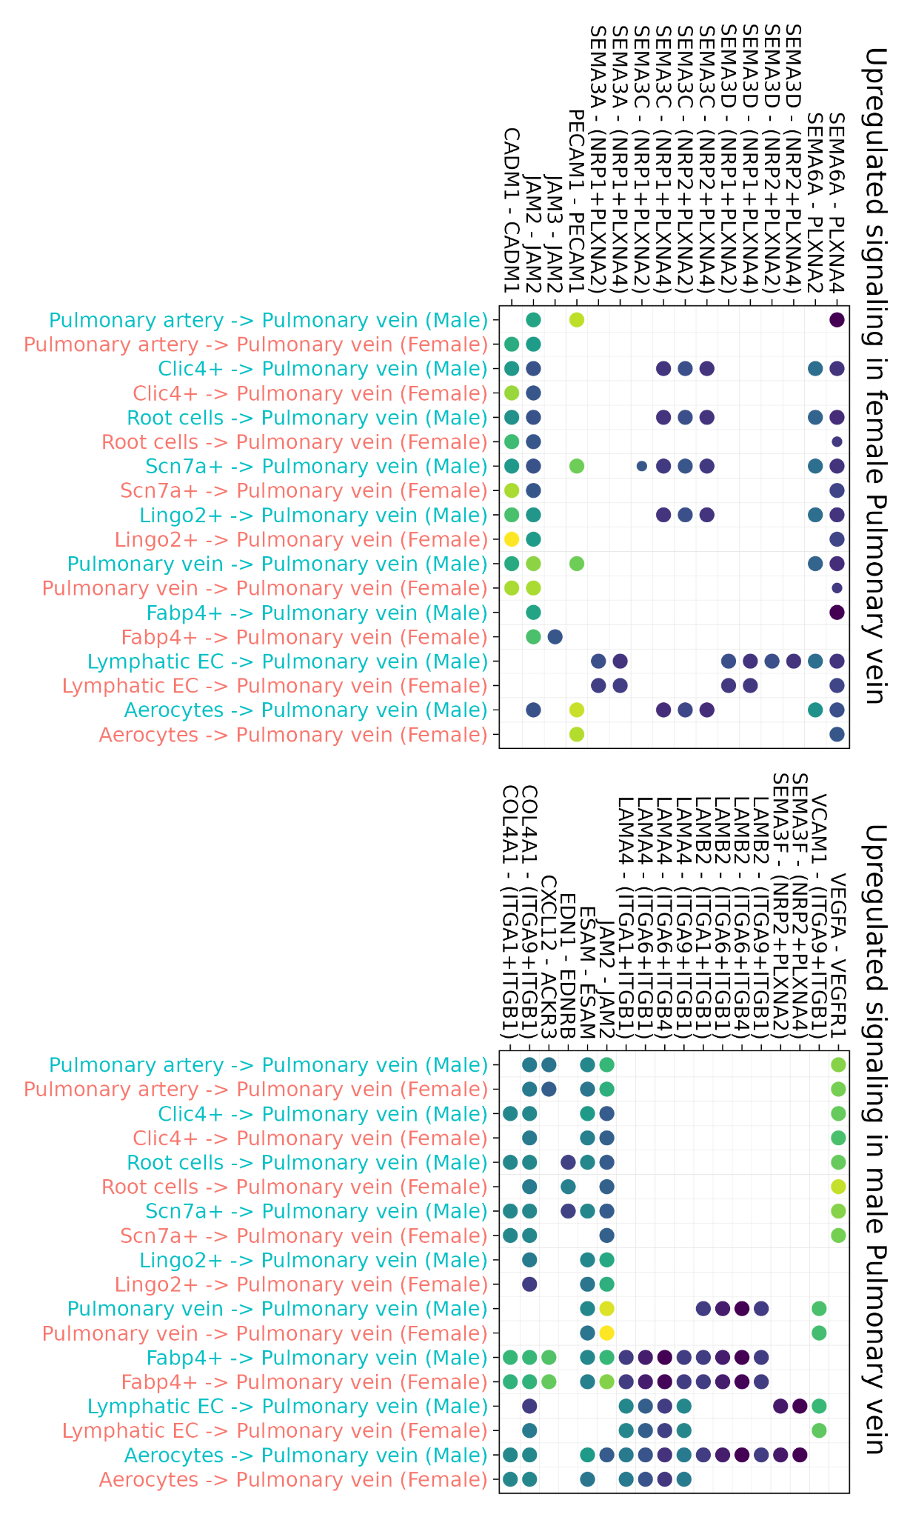
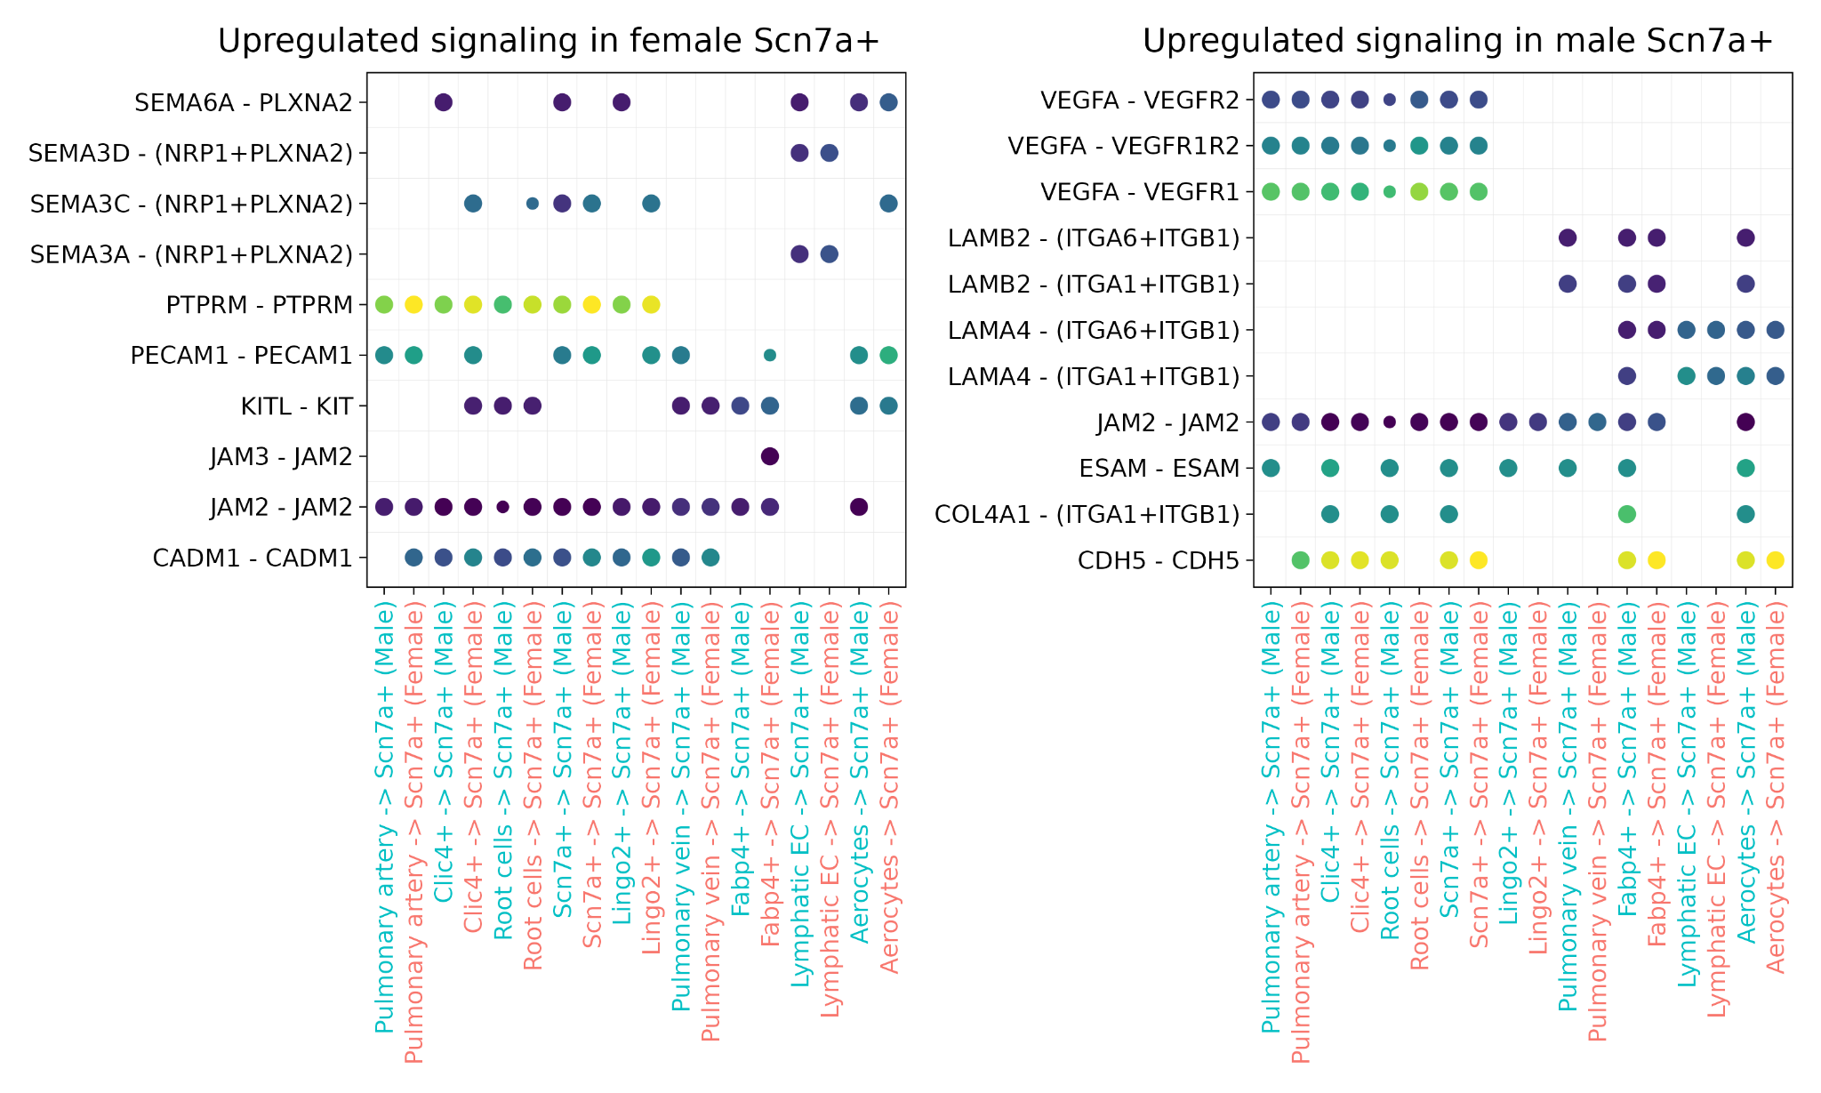
Supplementary Figure 7
a
e
b
c
f
d

Slide 11



g
h
i

Slide 12






Supplementary Figure 8
a
e
b
c
f
d

Slide 13



g
h
i

