Slide 1
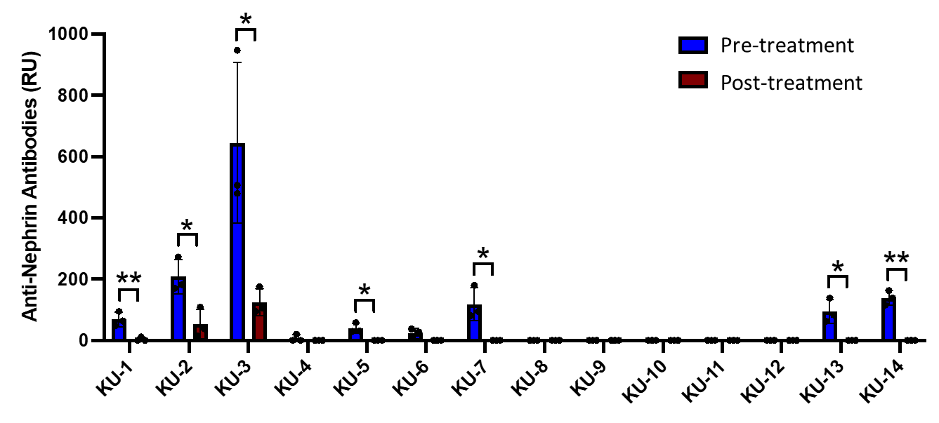
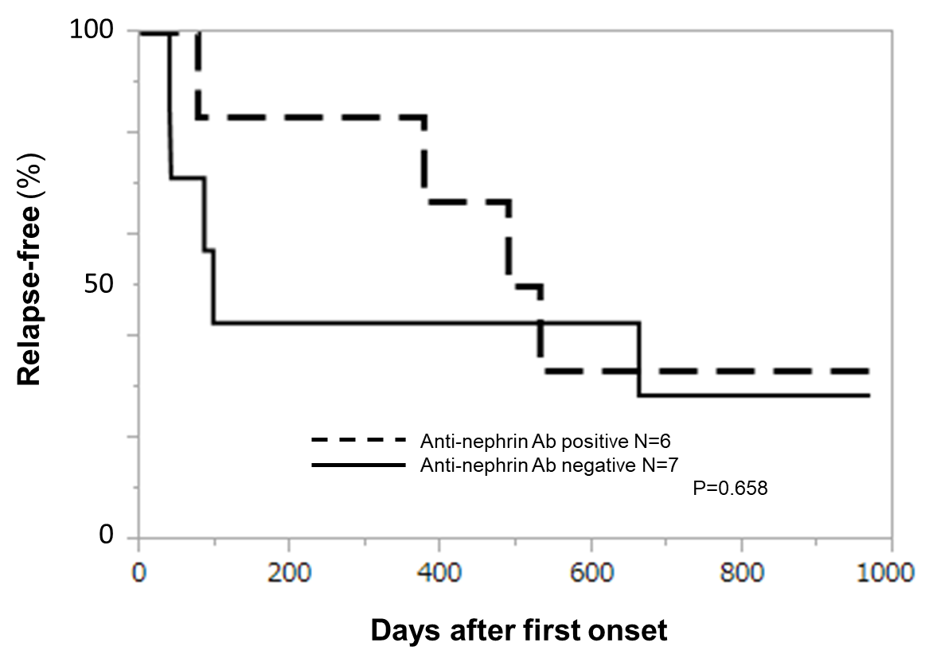
Anti-nephrin antibodies in idiopathic nephrotic syndrome
in Japanese children
HYPOTHESIS: Are circulating anti-nephrin antibodies detected in Japanese pediatric patients with idiopathic nephrotic syndrome ?
DESIGN & OUTCOMES:
14 patients with INS
Anti-nephrin antibody
Relapse-free time
CONCLUSION: We identified circulating anti-nephrin antibodies in half of Japanese pediatric patients with INS at initial presentation, which is higher than has been previously reported in a North American cohort.
Horinouchi, Watts et al. 2023

