Slide 1
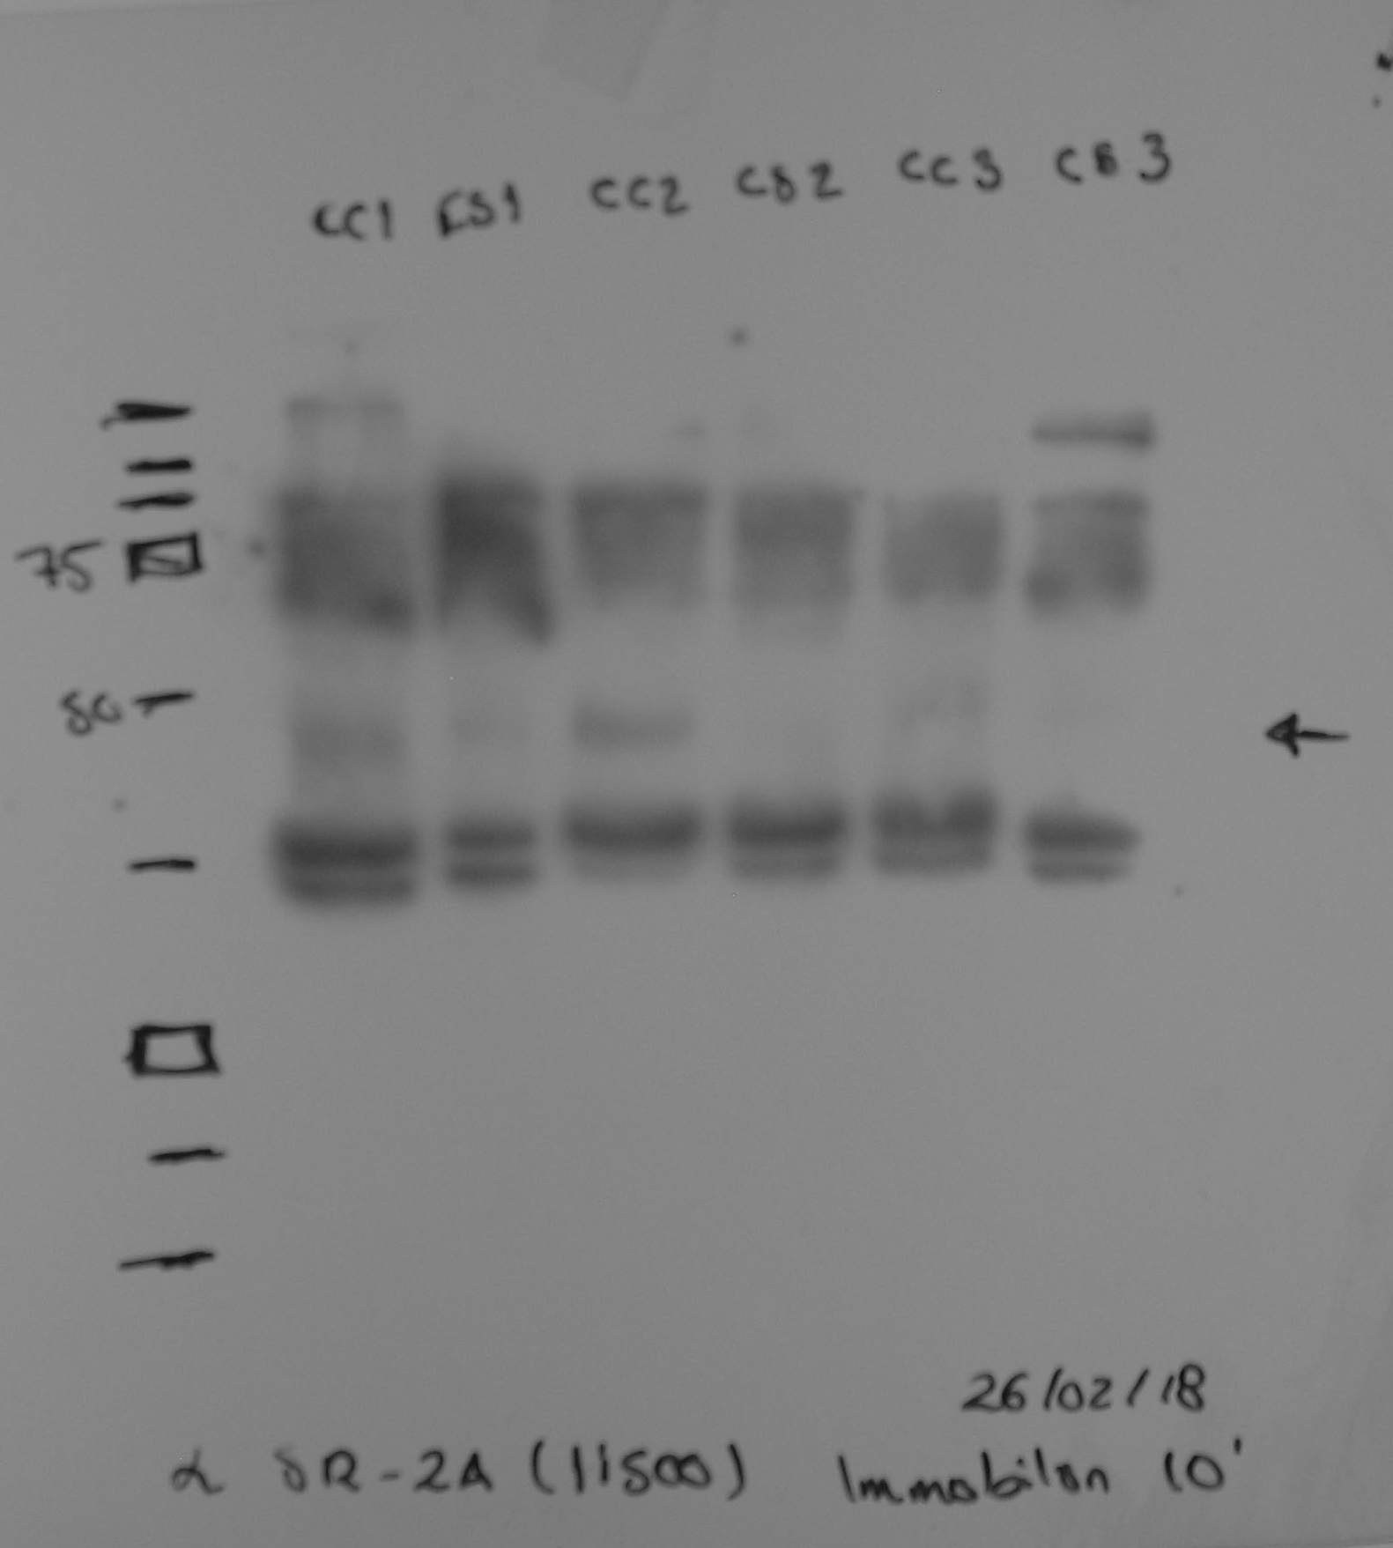
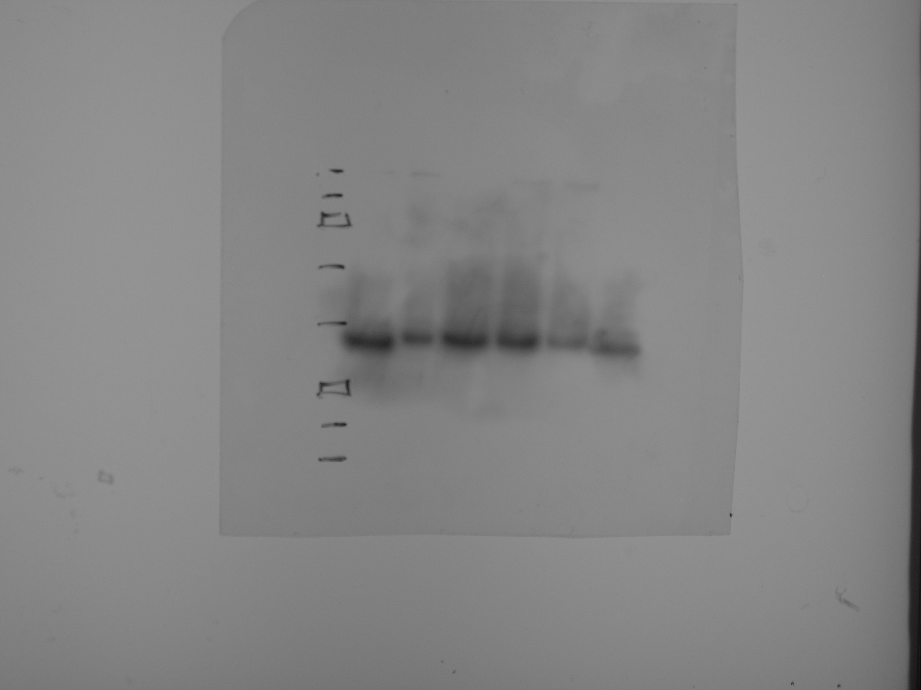
αSR-2A
αGAPDH
CC1
CS1
CC2
CS2
CC3
CS3
CC1
CS1
CC2
CS2
CC3
CS3
250
250
100
100
75
75
50
50
37
37
25
25
20
20
15
15

Slide 2
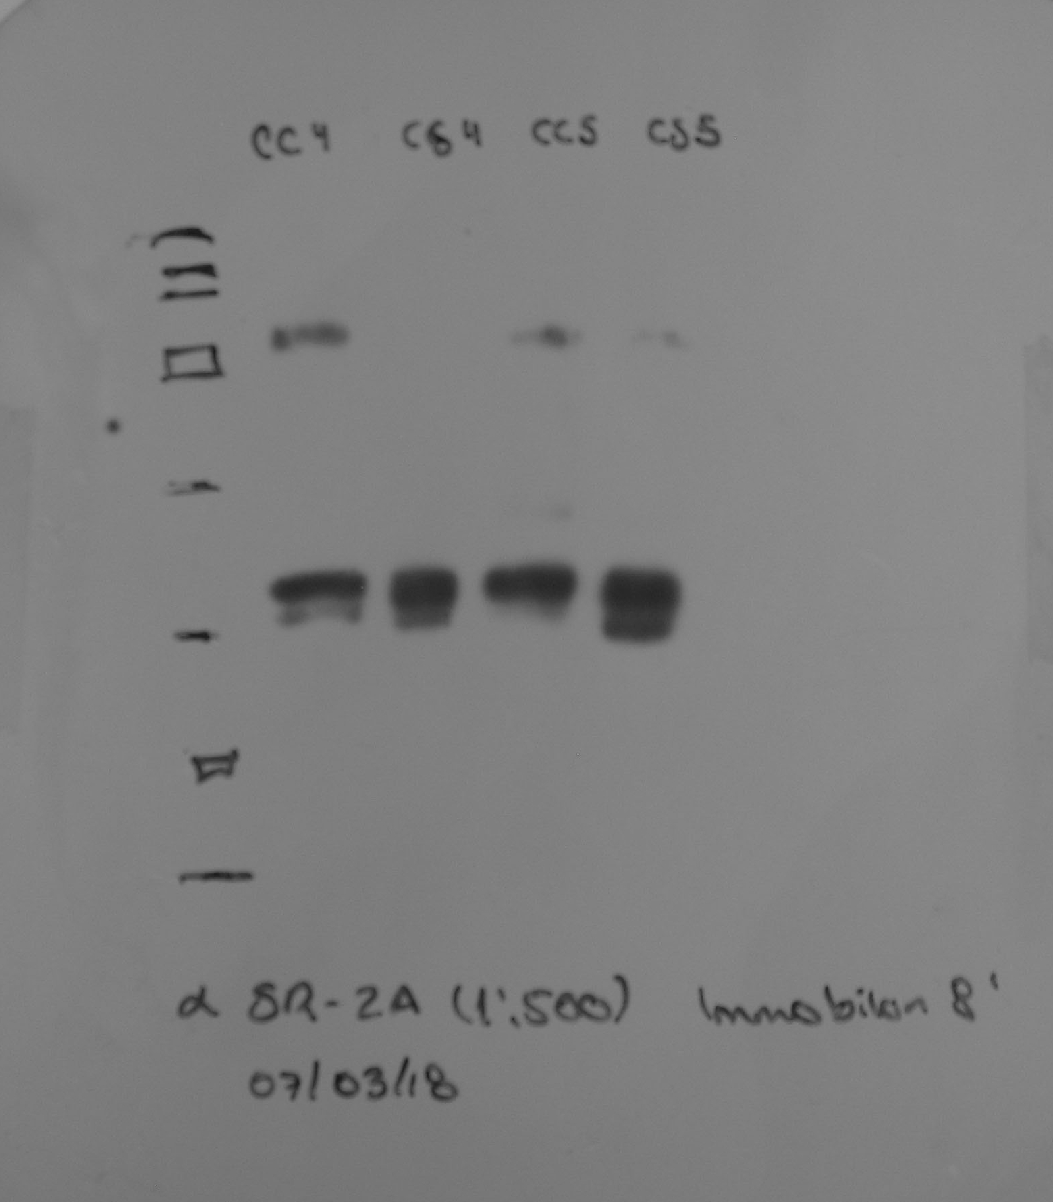
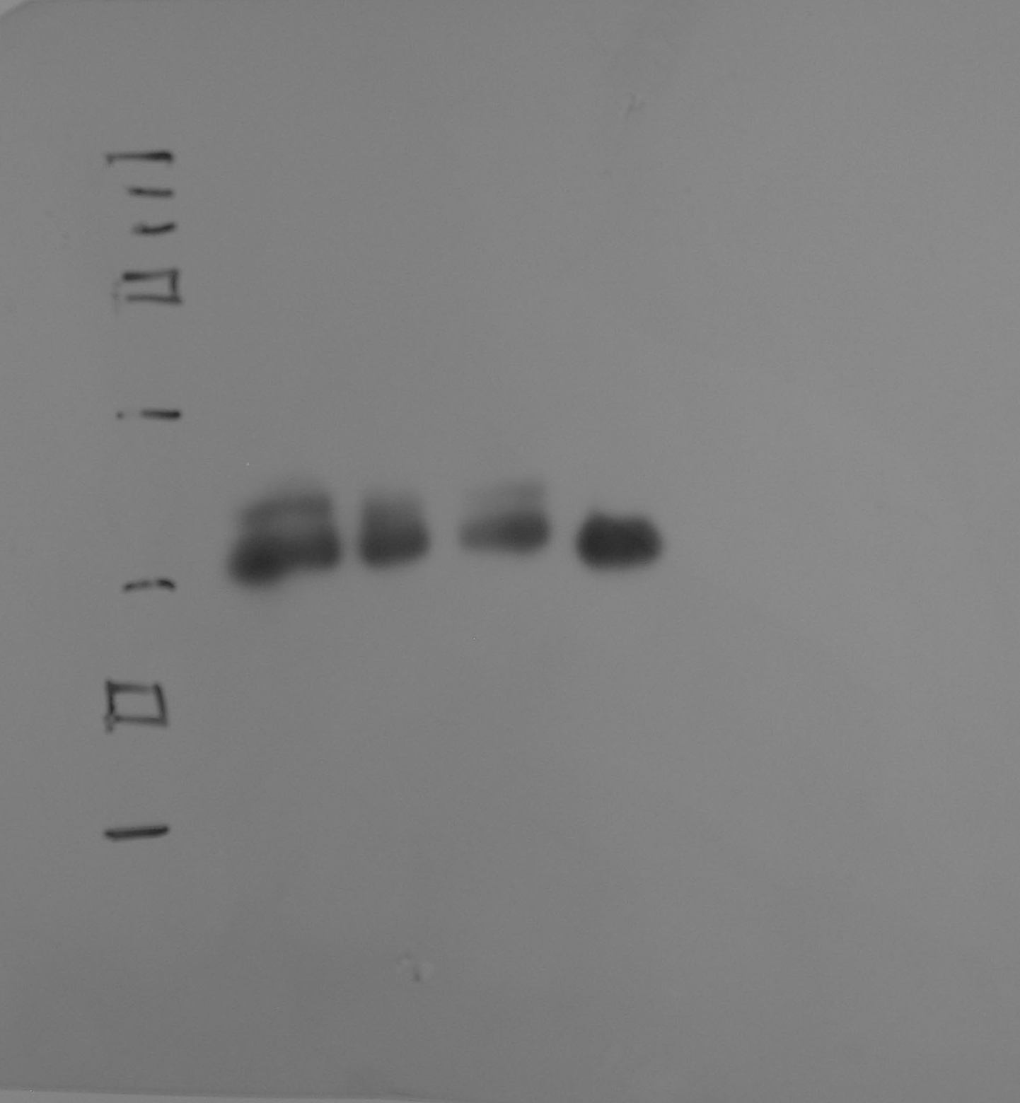
αSR-2A
αGAPDH
CC4
CS4
CC5
CS5
CC4
CS4
CC5
CS5
250
250
100
100
75
75
50
50
37
37
25
25
20
20

Slide 3
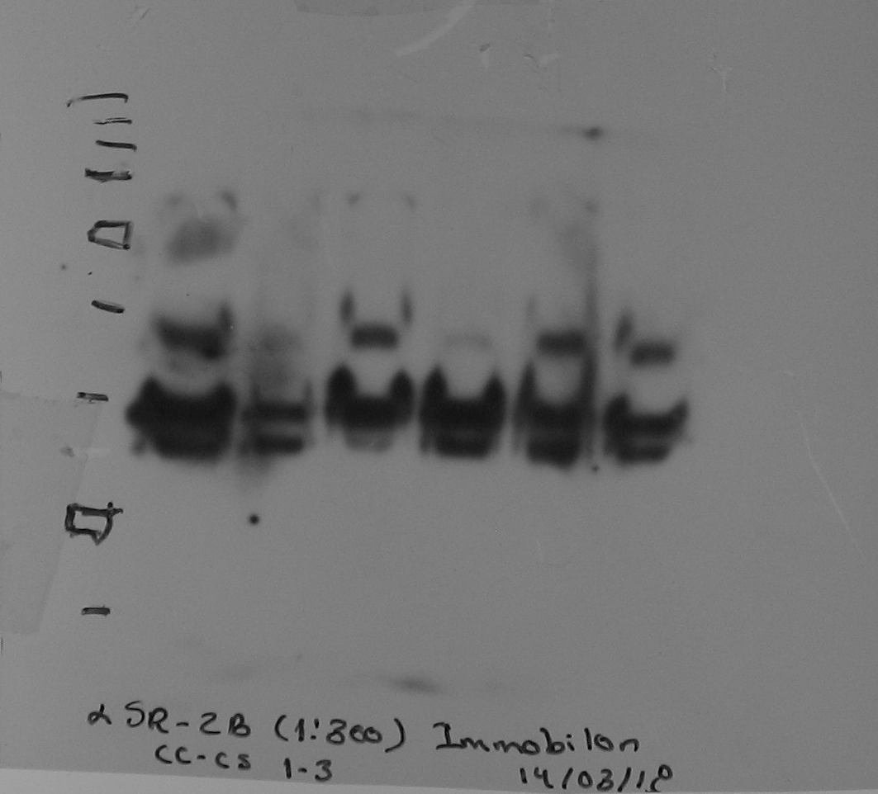
αSR-2B
αGAPDH
CC1
CS1
CC2
CS2
CC3
CS3
CC1
CS1
CC2
CS2
CC3
CS3
250
250
75
75
50
50
37
37
25
25
20
20
15

Slide 4
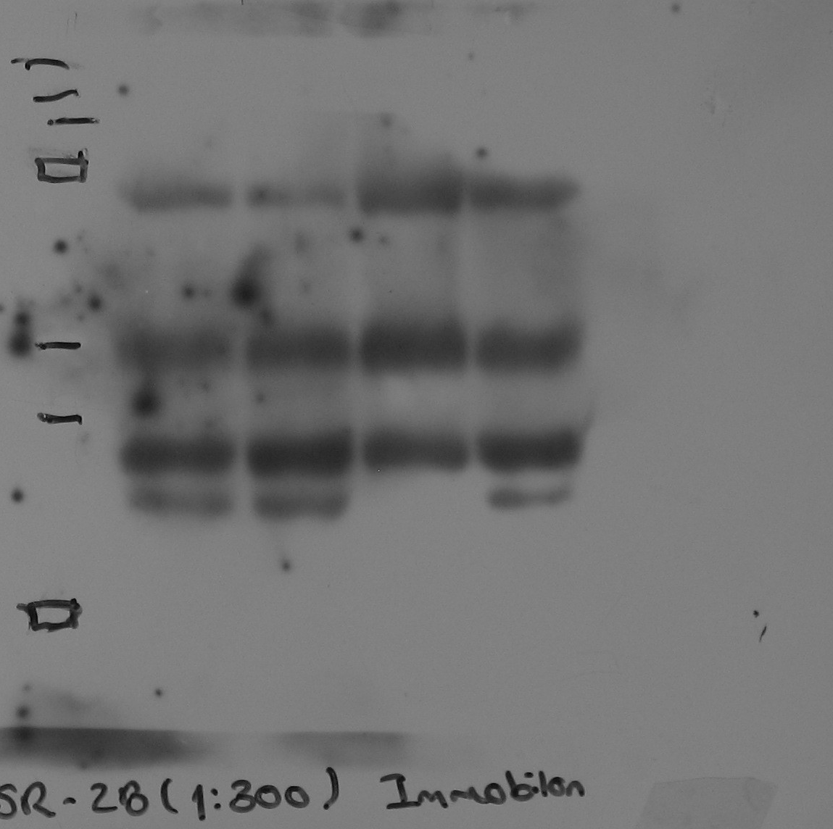
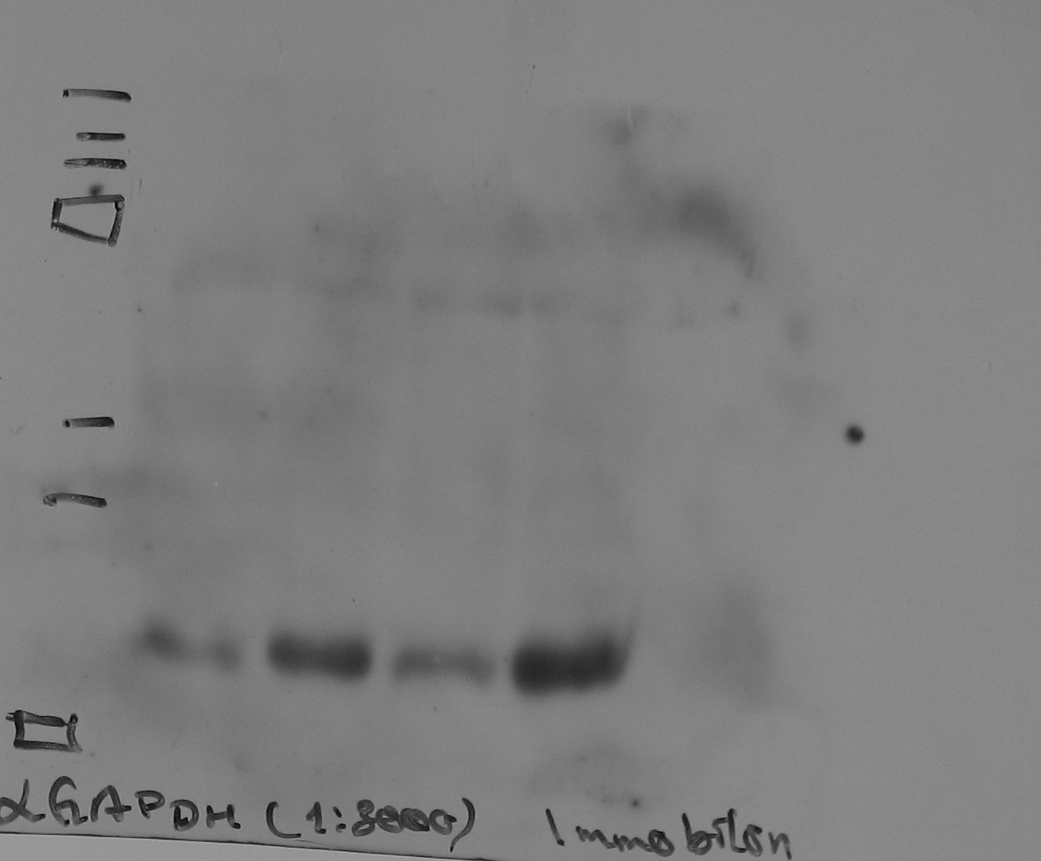
αSR-2B
αGAPDH
CC4
CS4
CC5
CS5
CC4
CS4
CC5
CS5
250
250
100
100
75
75
50
50
37
37
25
25

Slide 5
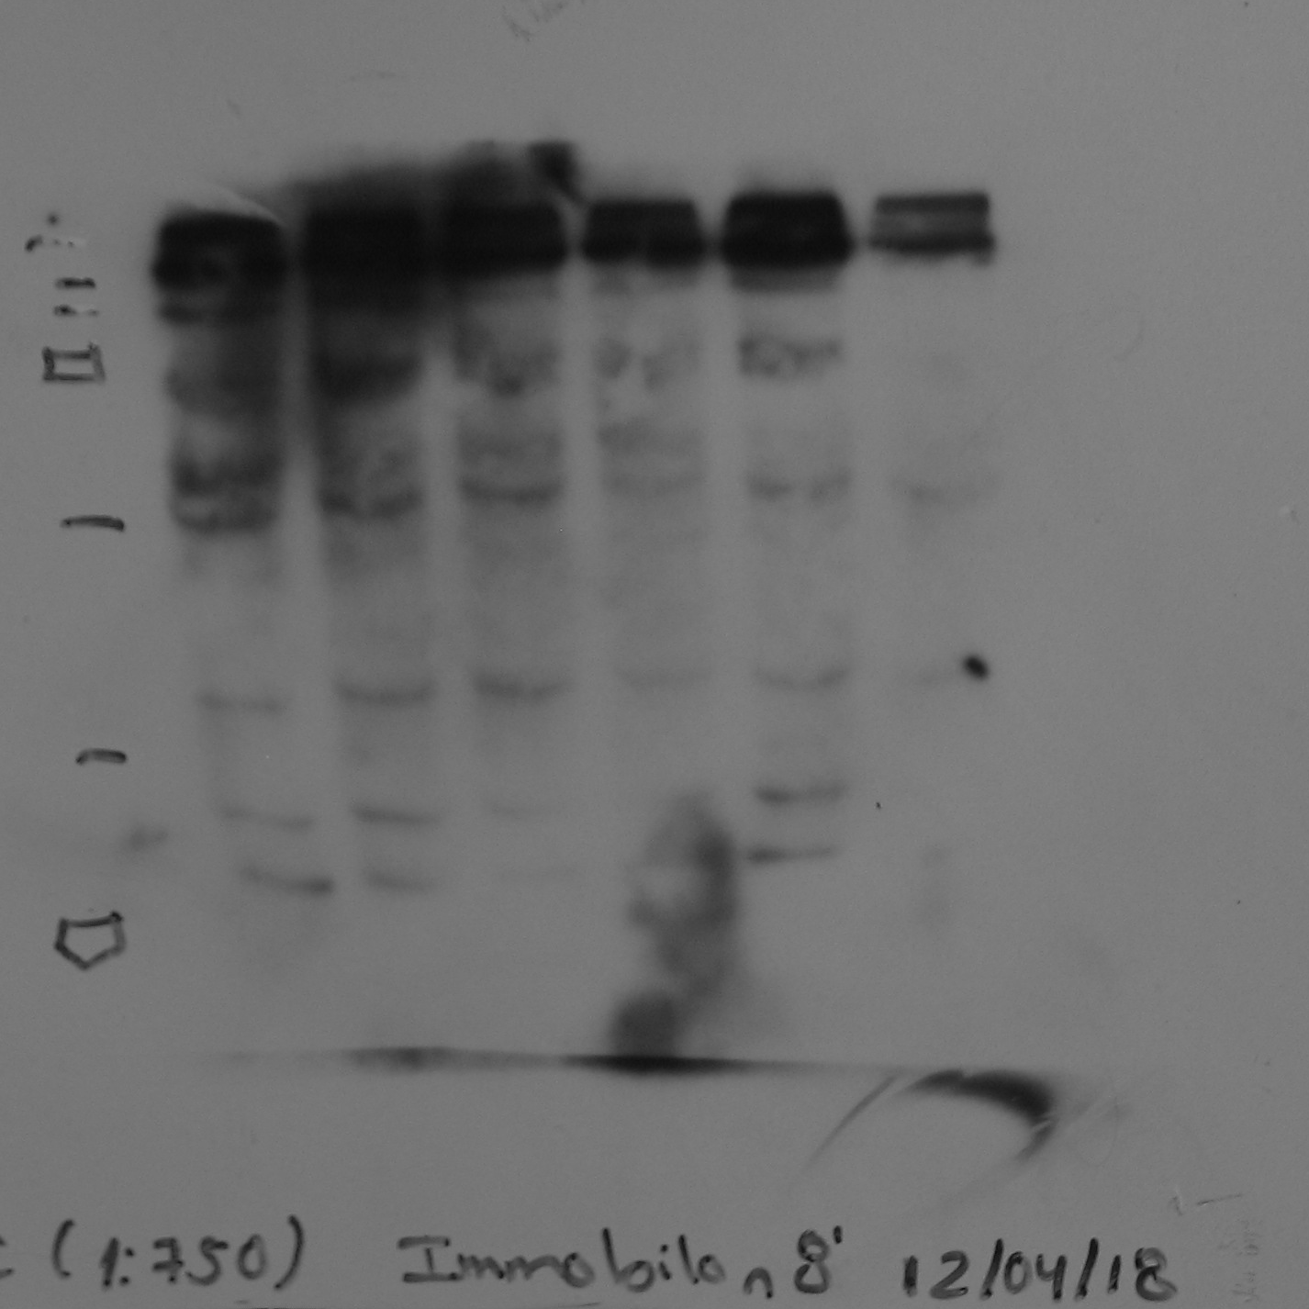
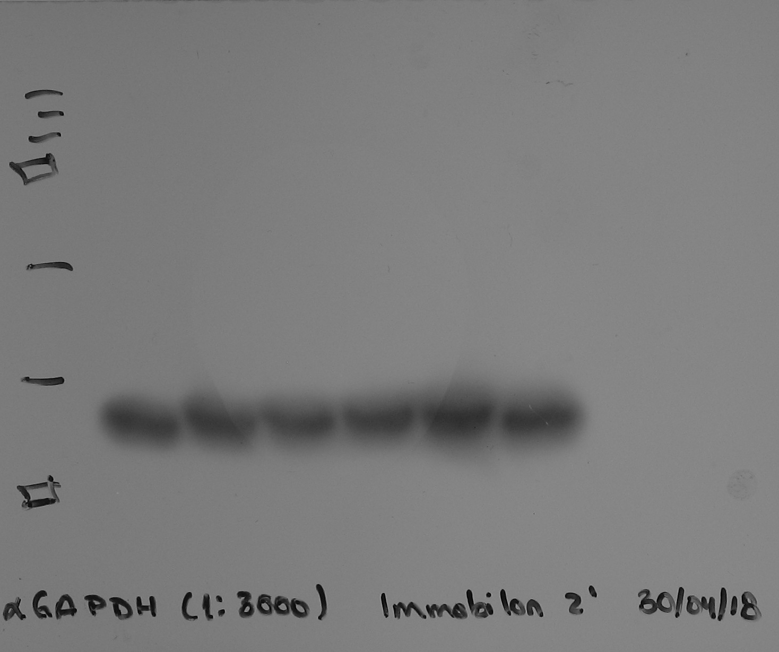
αSR-2C
αGAPDH
CC1
CS1
CC2
CS2
CC3
CS3
CC1
CS1
CC2
CS2
CC3
CS3
250
250
100
100
75
75
50
50
37
37
25
25

Slide 6
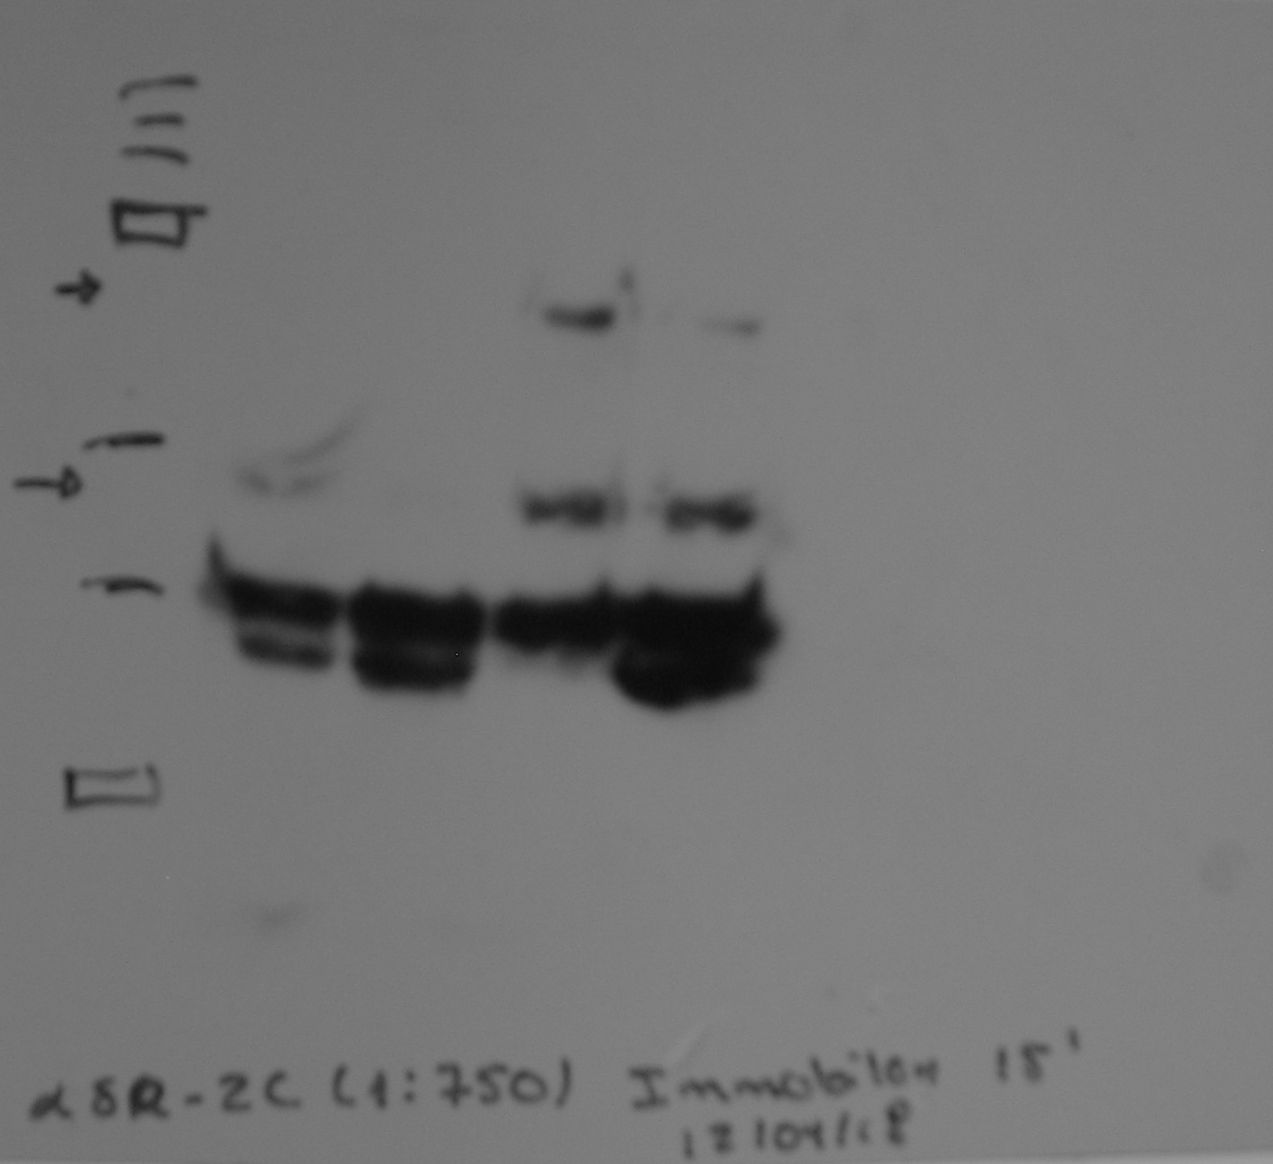
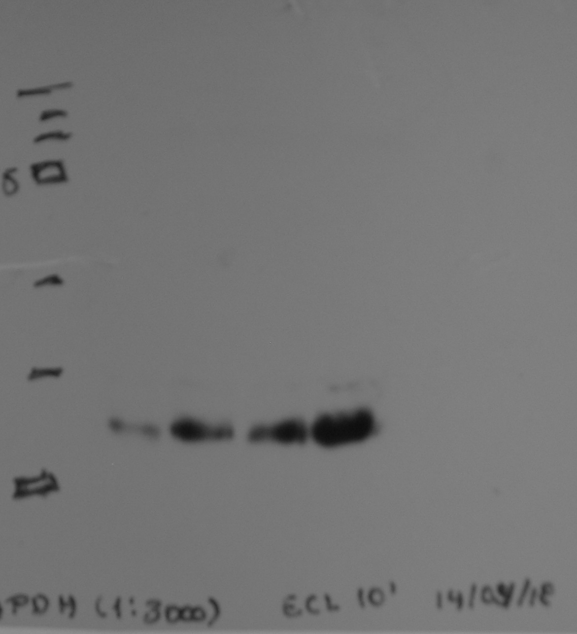
αSR-2C
αGAPDH
250
CC4
CS4
CC5
CS5
CC4
CS4
CC5
CS5
75
250
75
50
37
50
37
25
25

