Slide 1
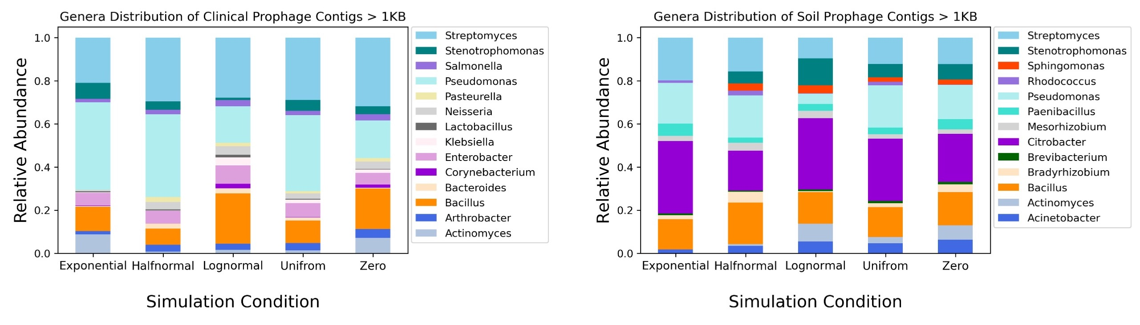
Supplemental Figure 1
A
B

Slide 2
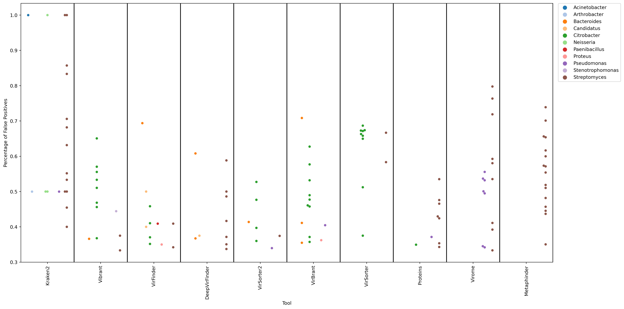
Supplemental Figure 2

Slide 3
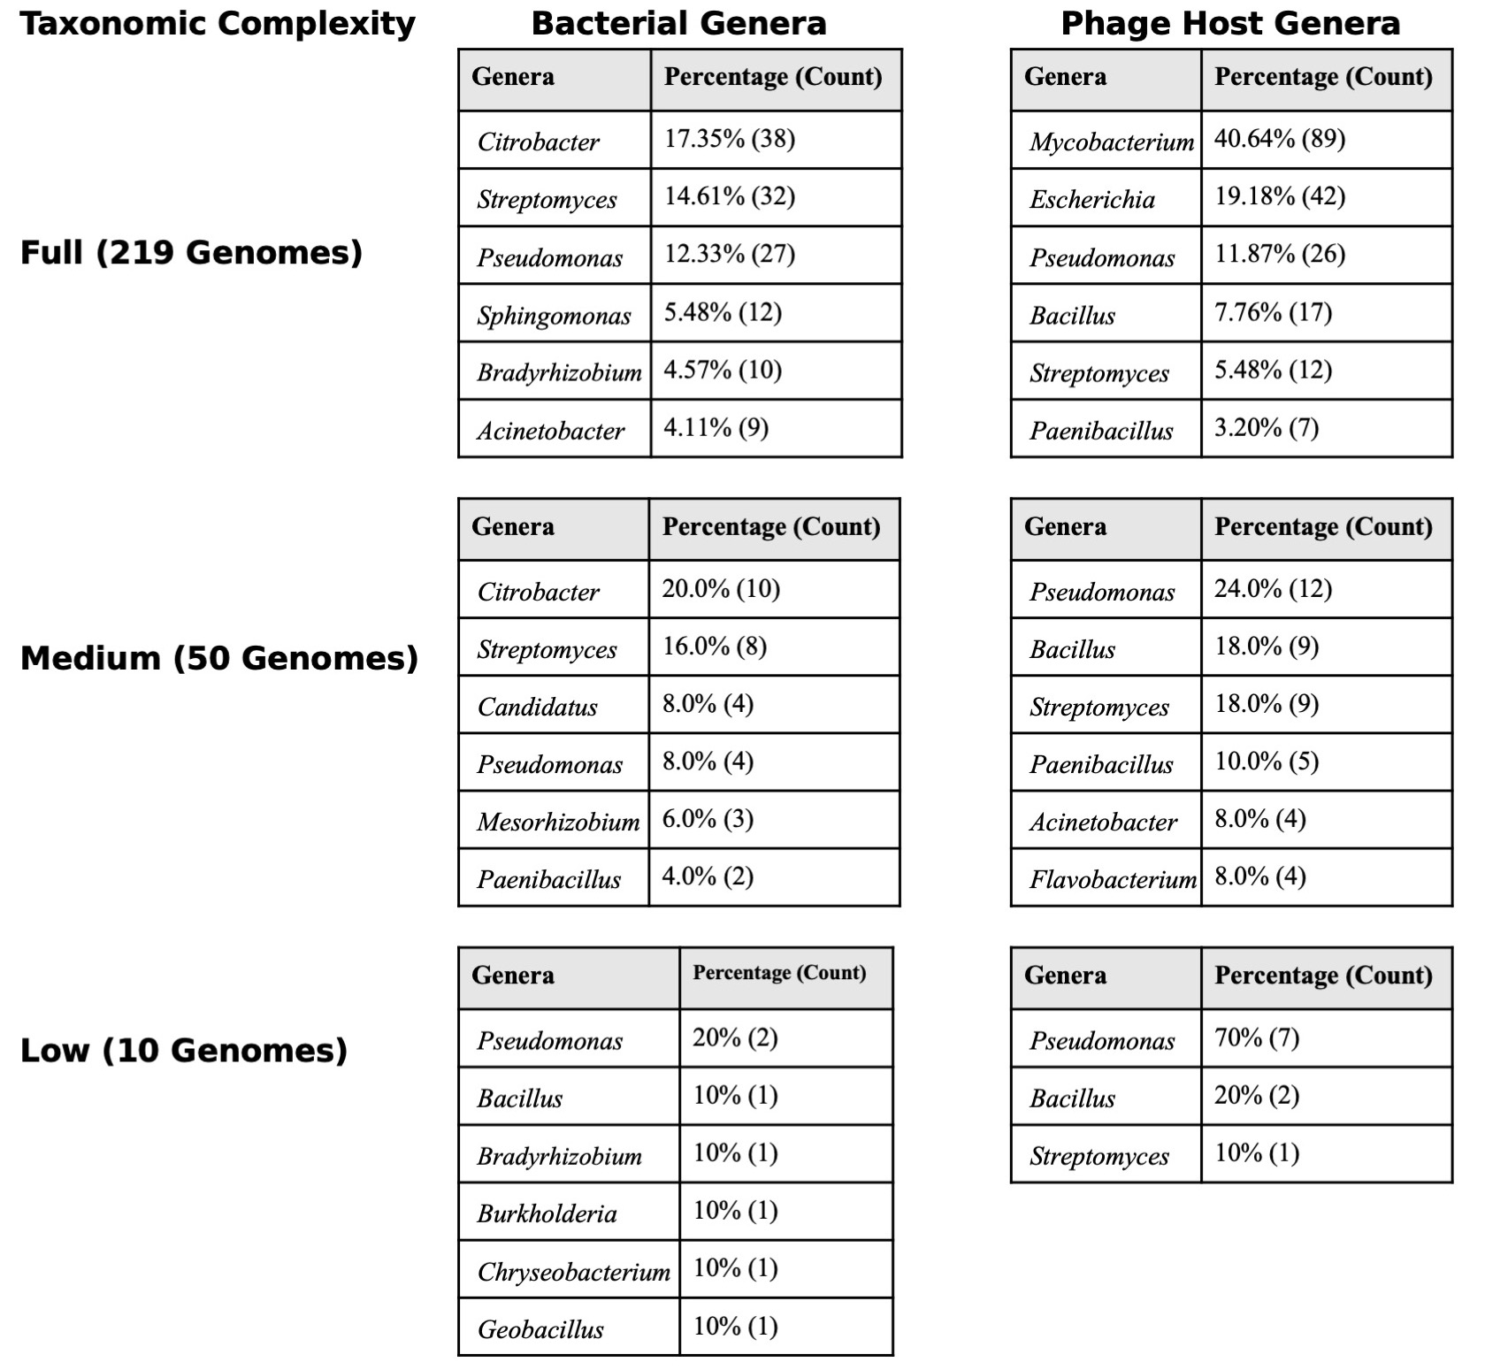
Supplemental Table 1
Supplementary Table 1: Genera distributions of soil microbe simulations by taxonomic level and kingdom. These tables show only the top 6 genera in each condition of the clinical simulations. Bacterial genera are shown on the left and the host genera representing phage genomes are shown on the right.

Slide 4
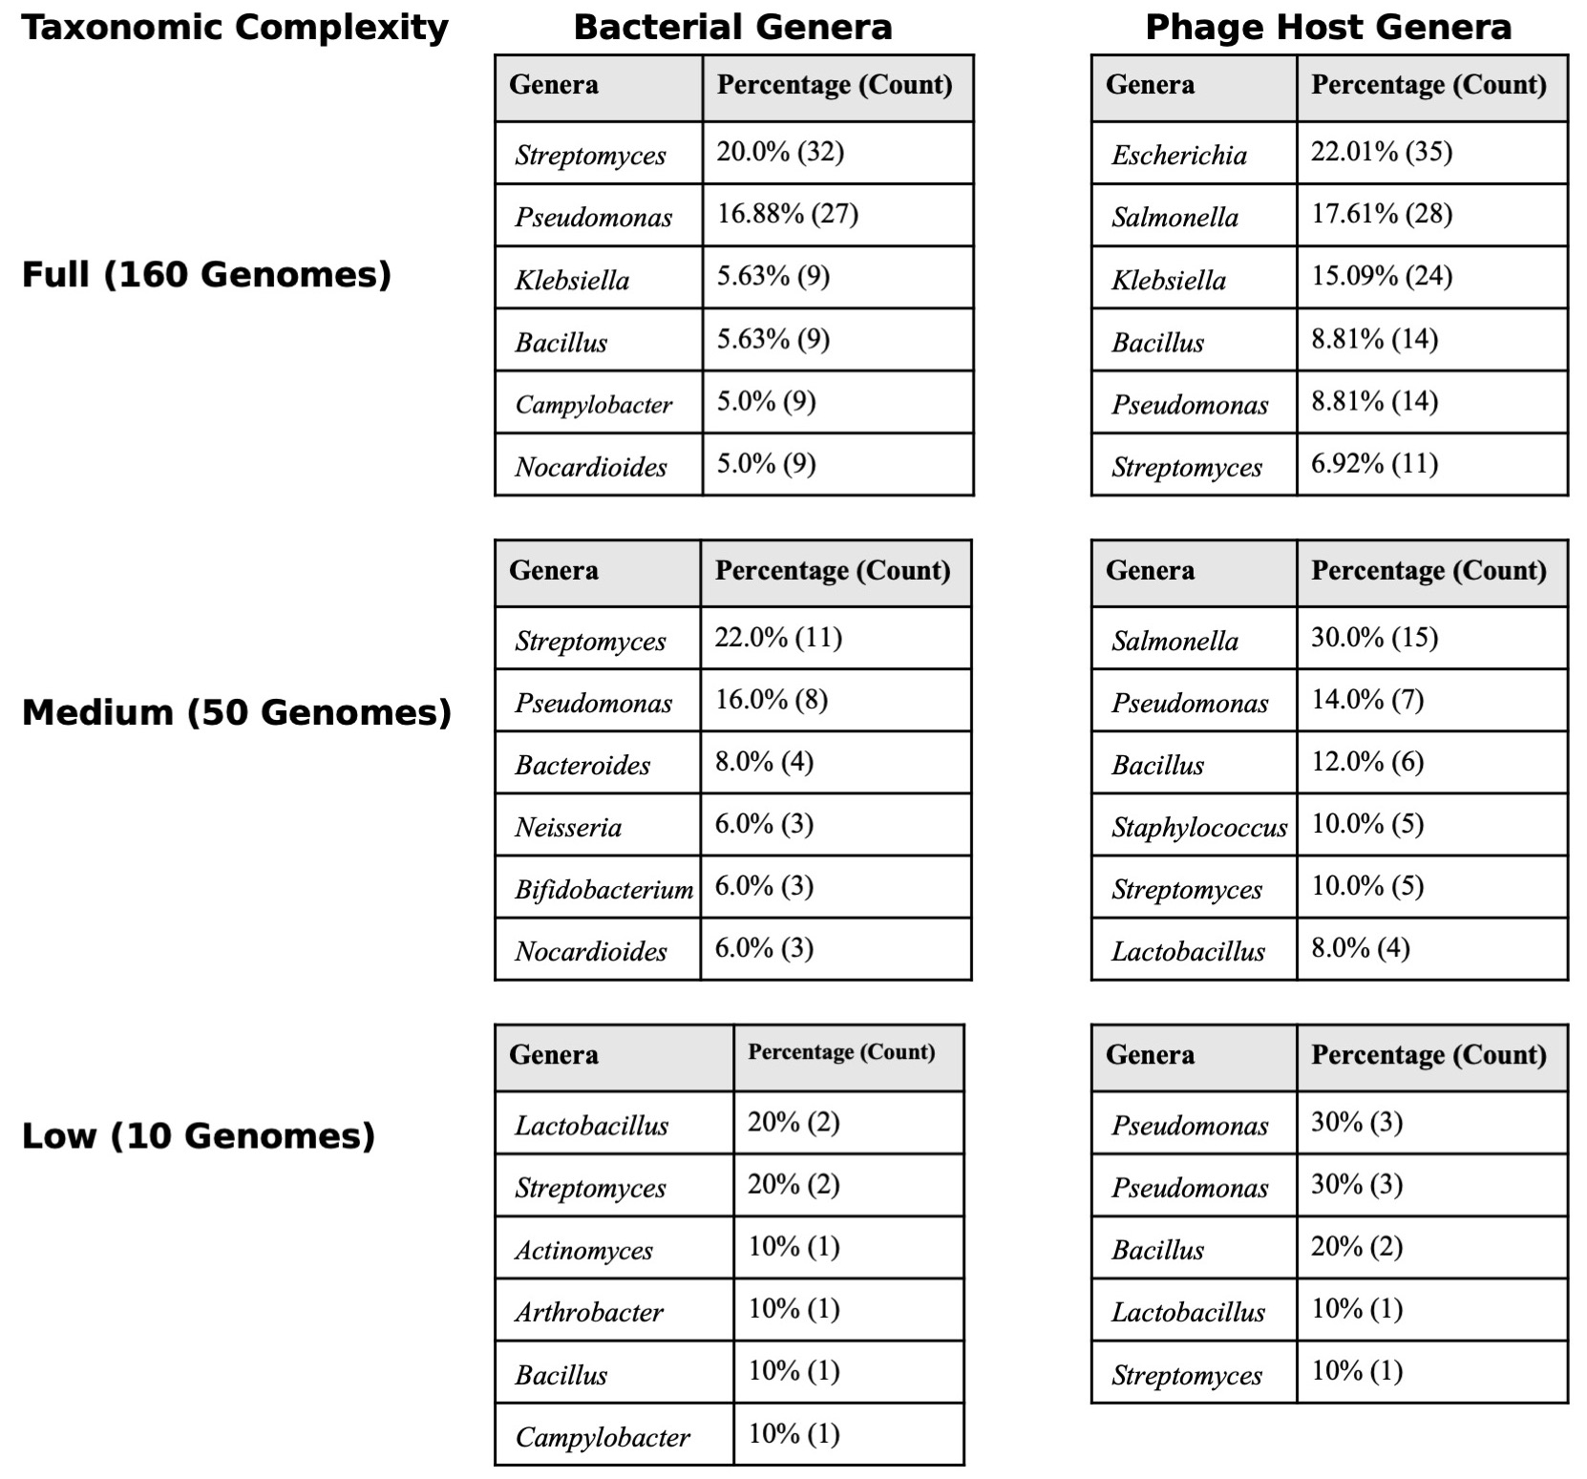
Supplemental Table 2
Supplementary Table 2: Genera distributions of clinical microbe simulations by taxonomic level and kingdom. These tables show only the top 6 genera in each condition of the clinical simulations. Bacterial genera are shown on the left and the host genera representing phage genomes are shown on the right.

