Slide 1
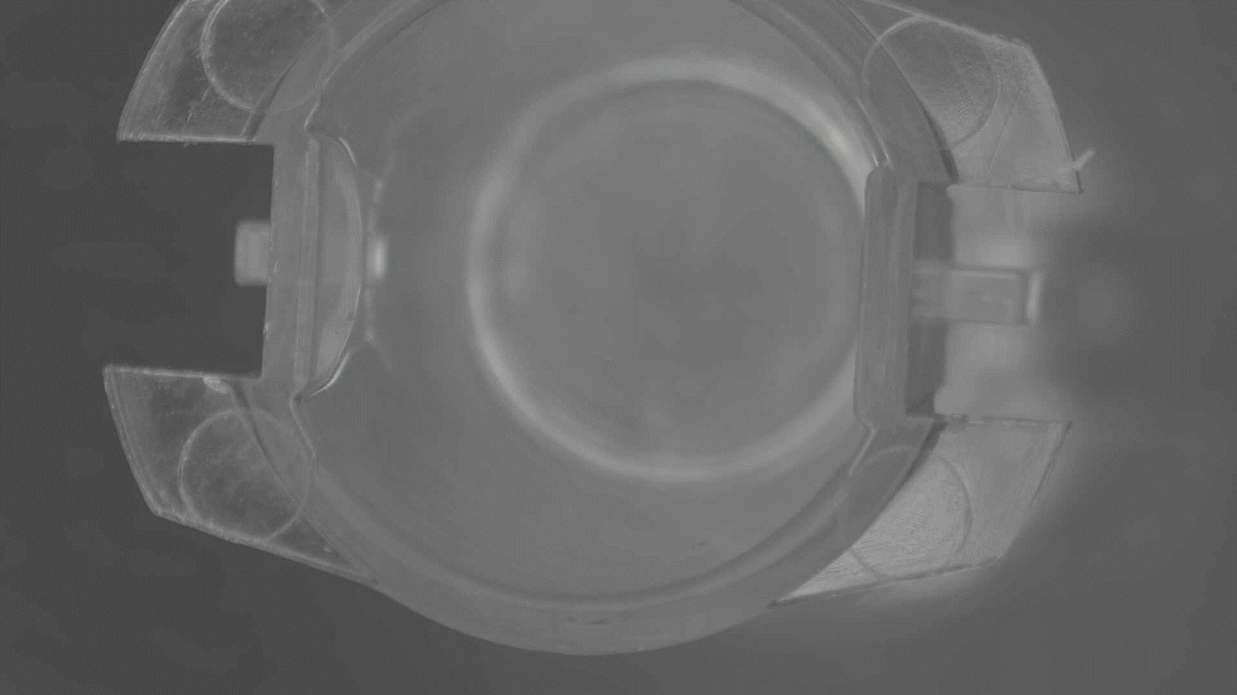
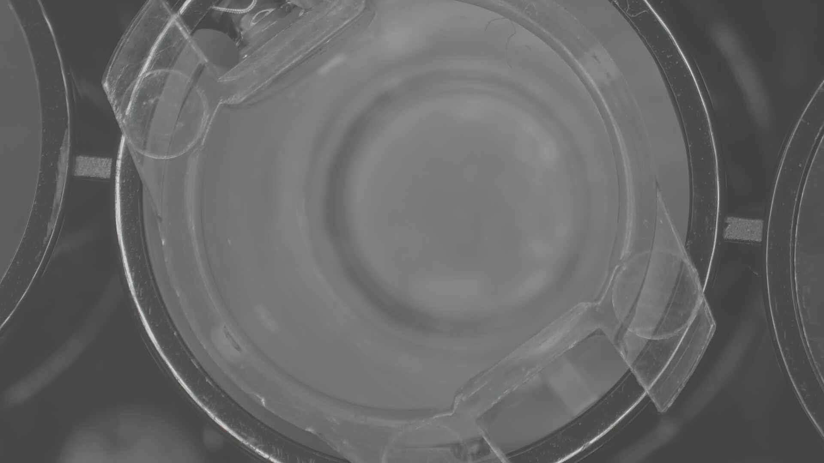

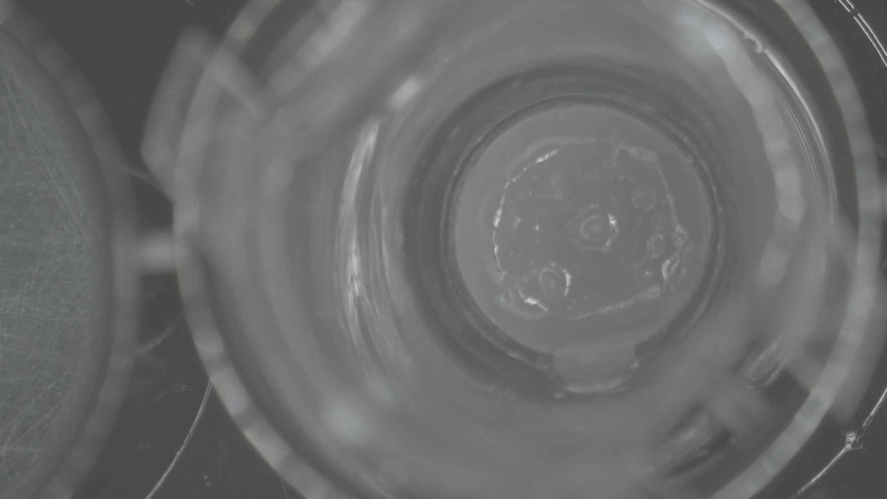
(a)
(c)
(b)
(d)
(A) A cell culture insert in which the SLIC is placed. (B) The insert was placed in a well of a 24-well assay dish. (C) Luciferin containing medium was poured in the outer side of the insert. (D) An oil suspended hydrophobic compound was added to inner side of the insert.
Supplementary movie

