Slide 1
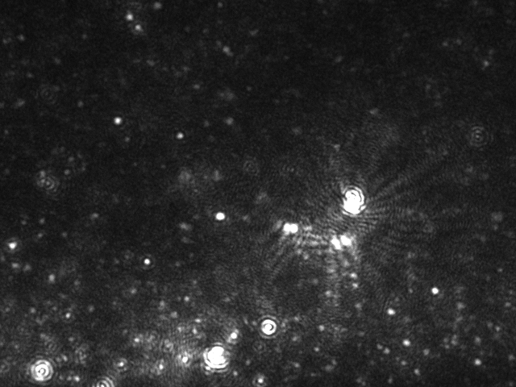
Morphology of hPLMSC-derived Exosomes
Nanoparticle tracking analysis
The white refraction particles are exosomes

Slide 2
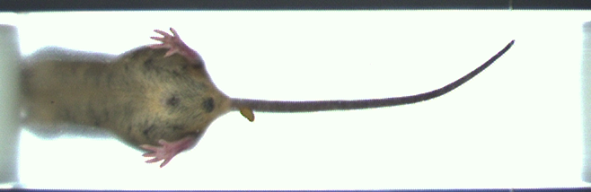
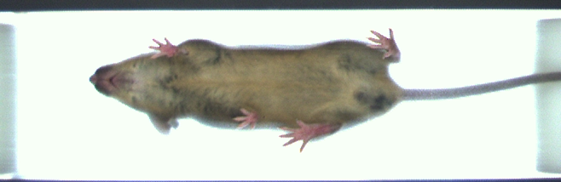
Gait analysis on Day 42
IDD + PBS
IDD +
EXO-AntagomiR-4450
The videos above showed very specific records. EXO-AntagomiR-4450 could alleviate the gait abnormality of IDD mouse as compared to PBS treatment.

