Slide 1
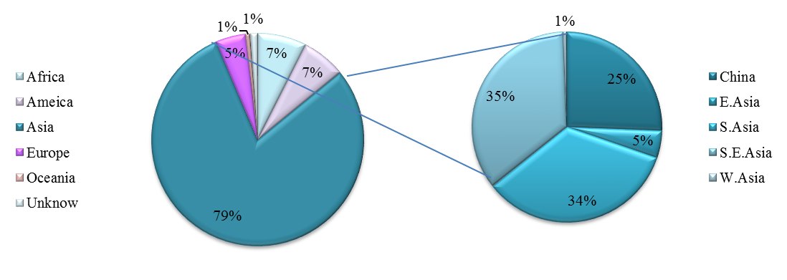
Fig. S1 Geographical distribution of the 2,445 rice accessions collected from 88 countries

Slide 2
Fig. S2 Distribution of SNPs on rice 12 chromosomes.

Slide 3
Fig. S3 PCA plot based on the screen plot in the rice diversity panel.

Slide 4
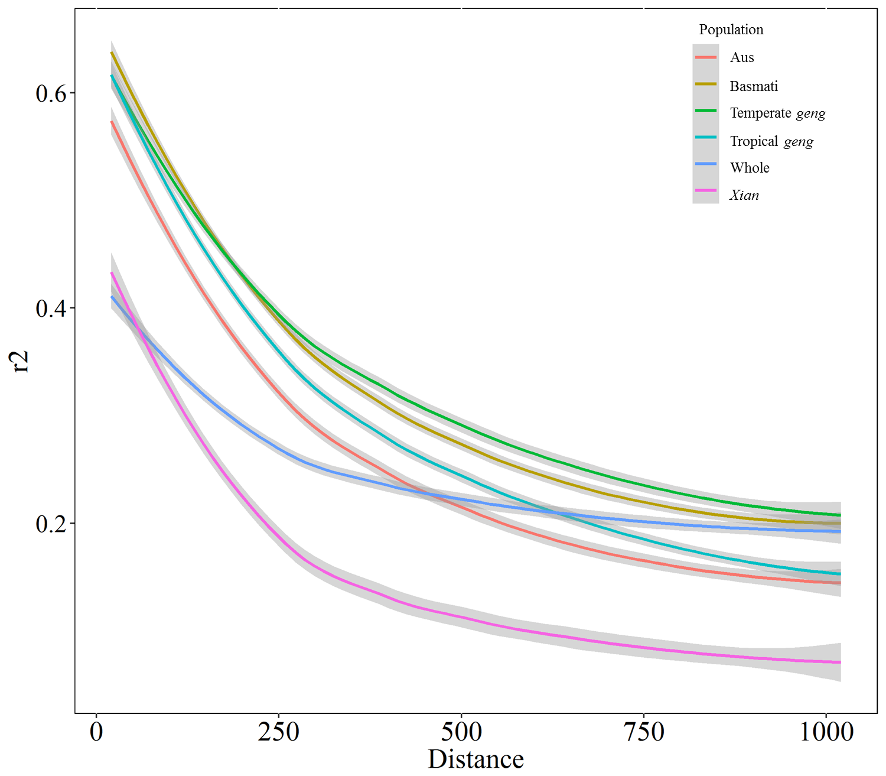
Fig. S4 Comparison of LD decay in the whole and five sub-populations. Y axis was the average r² value of each 1 Mb region and X axis was physical distance between markers in unit of Mb.

Slide 5
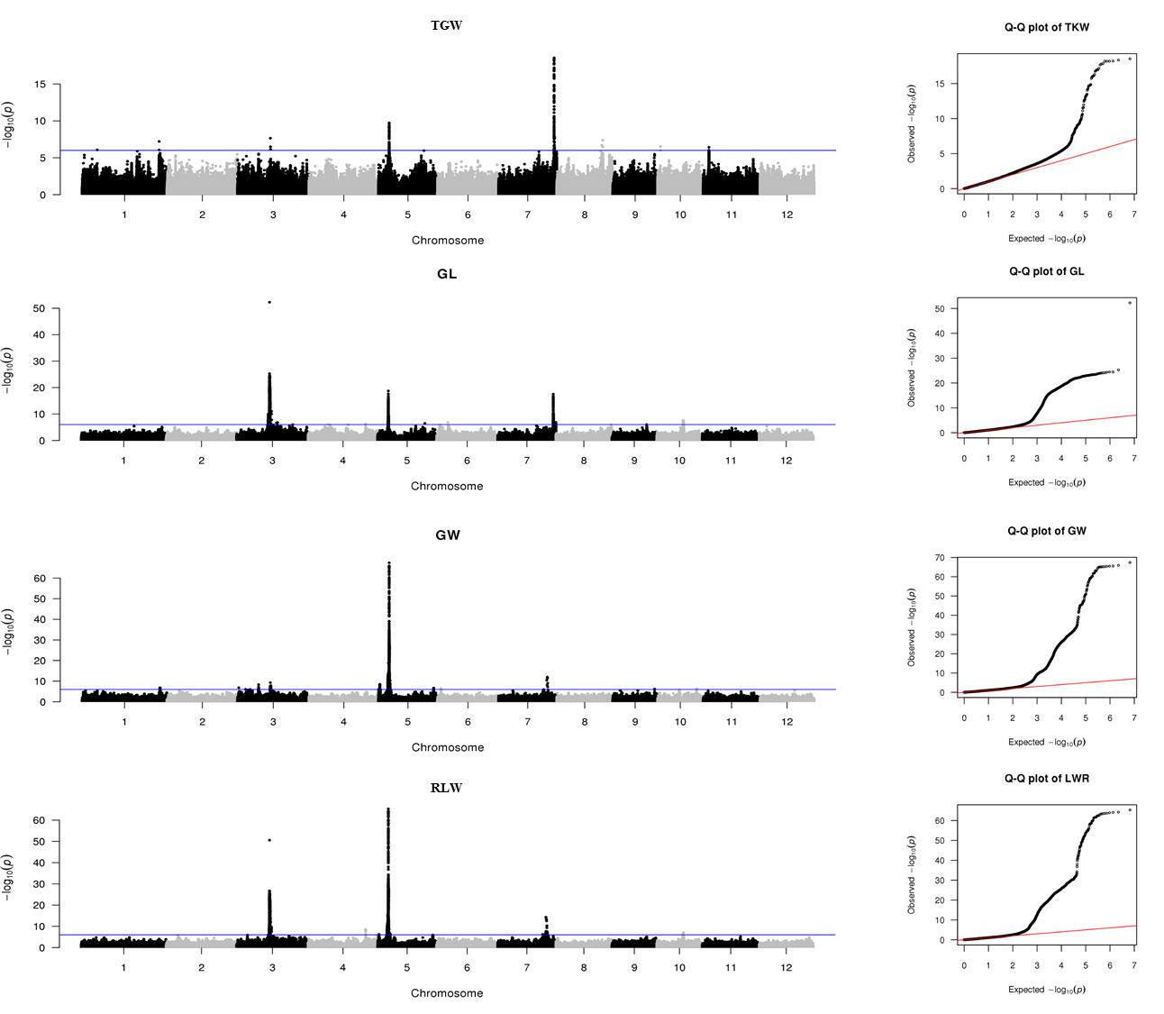
Fig. S5A The Manhattan and QQ plots for TGW, GL, GW and RLW of the whole panel in 2015

Slide 6
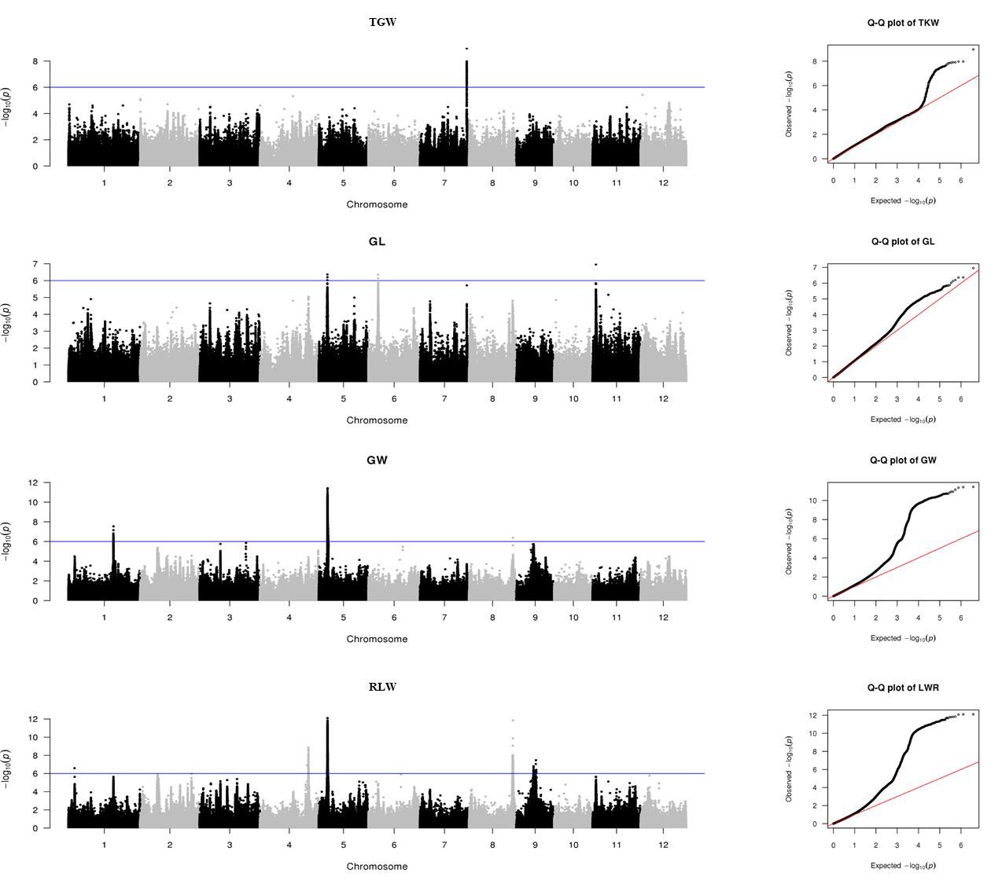
Fig. S5B The Manhattan and QQ plots for TGW, GL, GW and RLW of the aus/boro panel in 2015

Slide 7
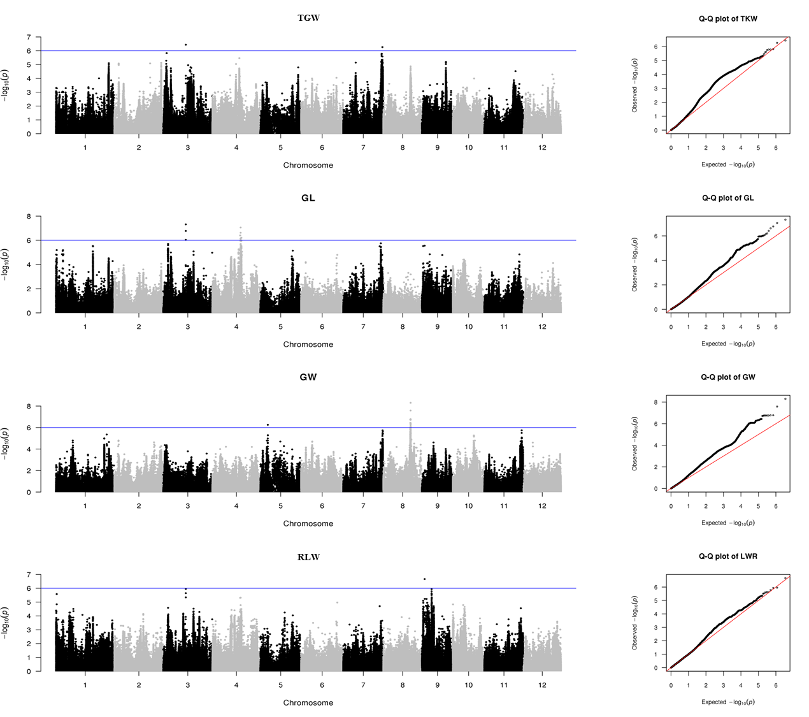
Fig. S5C The Manhattan and QQ plots for TGW, GL, GW and RLW of the basmati/sadri panel in 2015

Slide 8
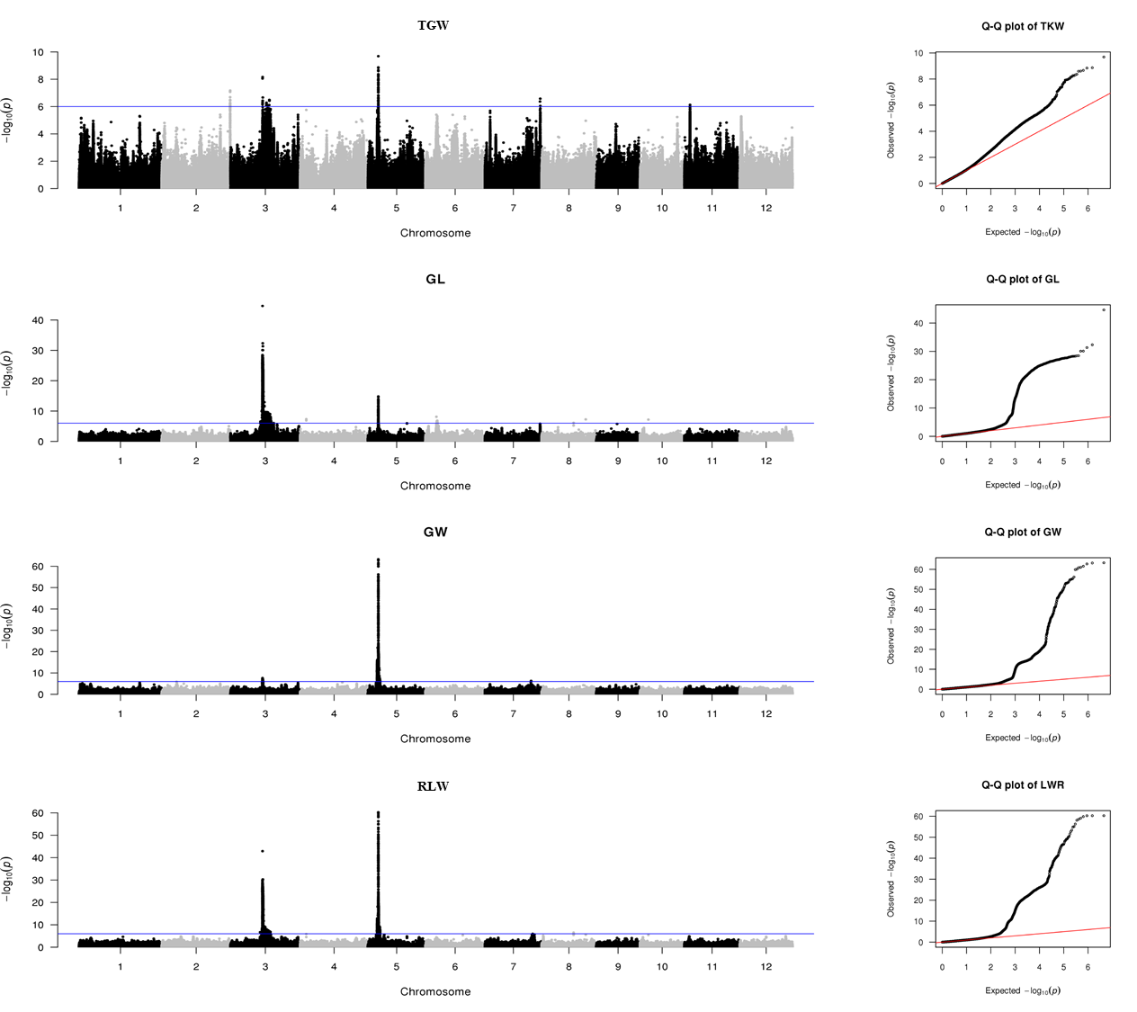
Fig. S5D The Manhattan and QQ plots for TGW, GL, GW and RLW of the xian panel in 2015

Slide 9
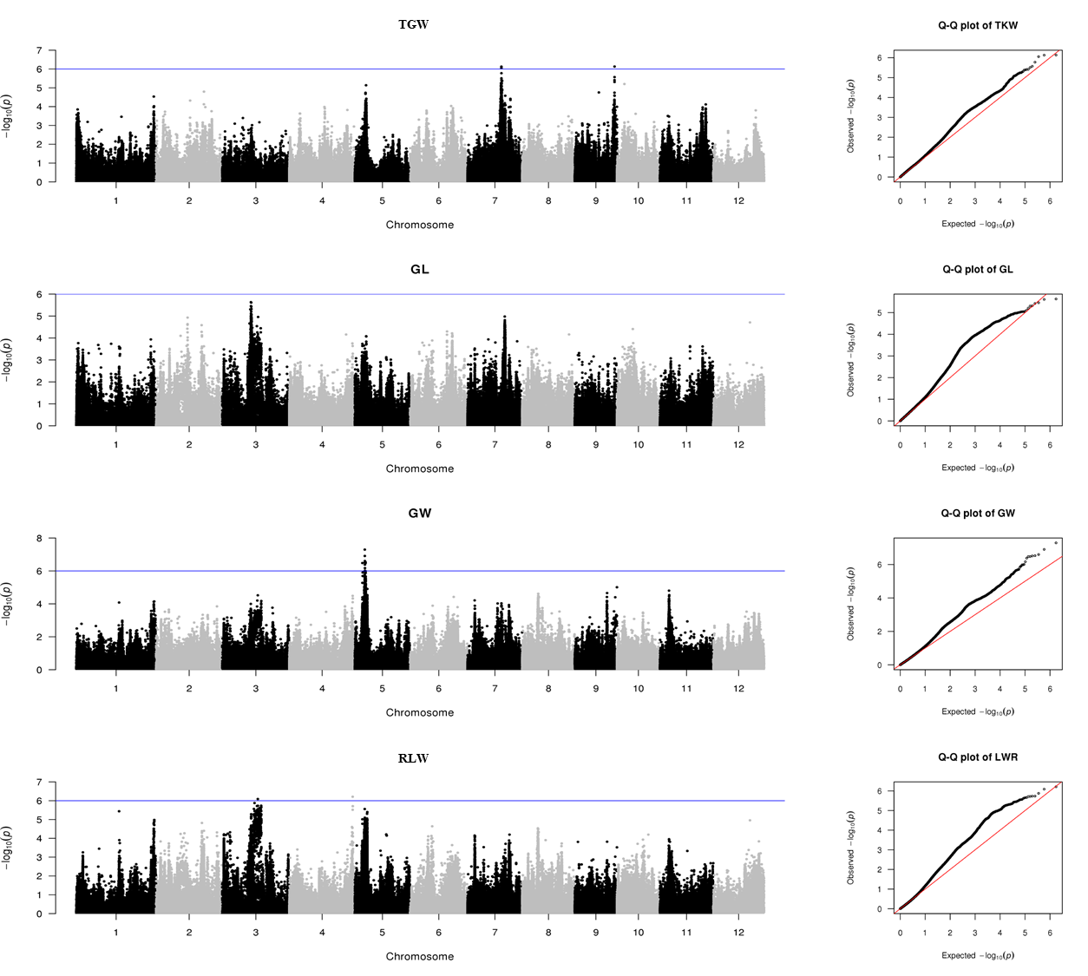
Fig. S5E The Manhattan and QQ plots for TGW, GL, GW and RLW of the temperate geng panel in 2015

Slide 10
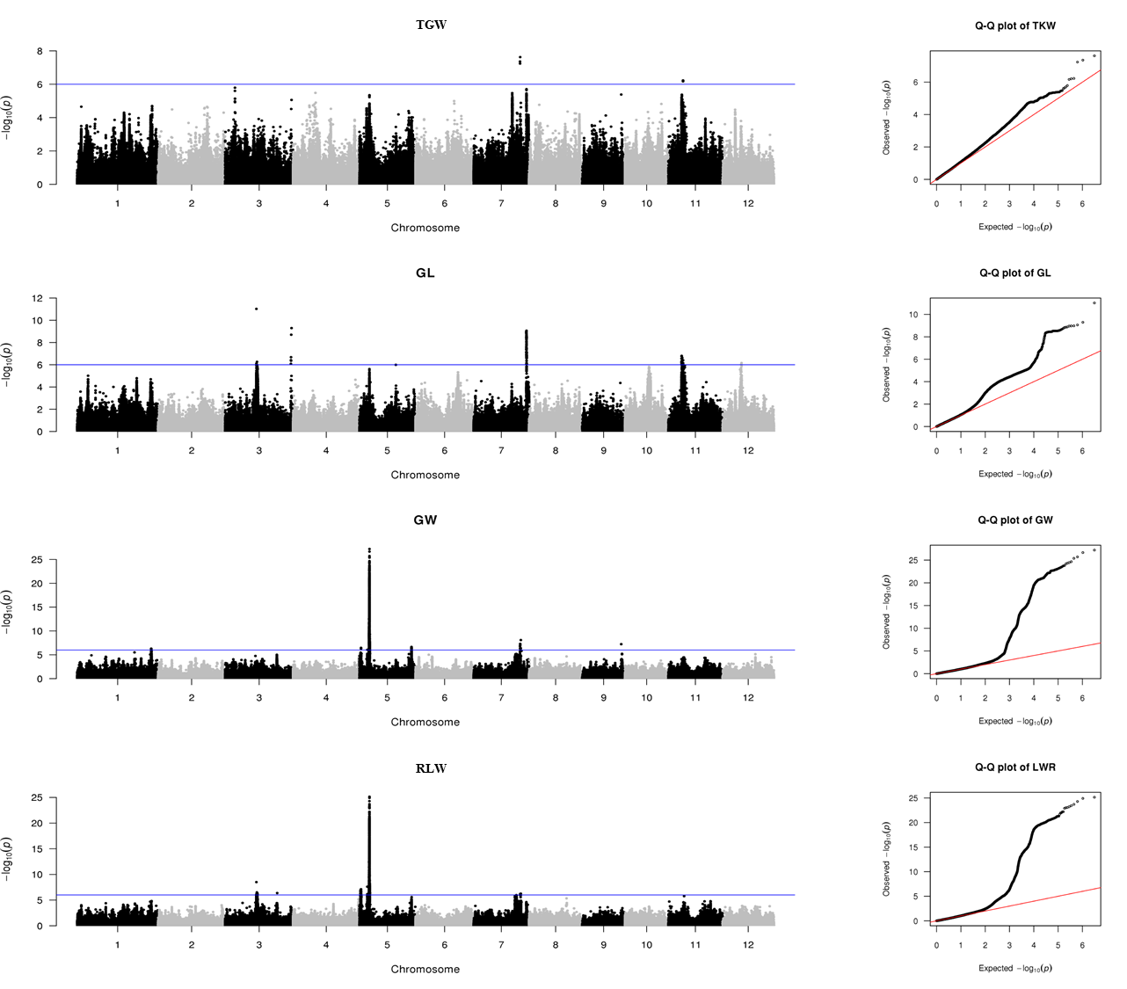
Fig. S5F The Manhattan and QQ plots for TGW, GL, GW and RLW of the tropical geng panel in 2015

Slide 11
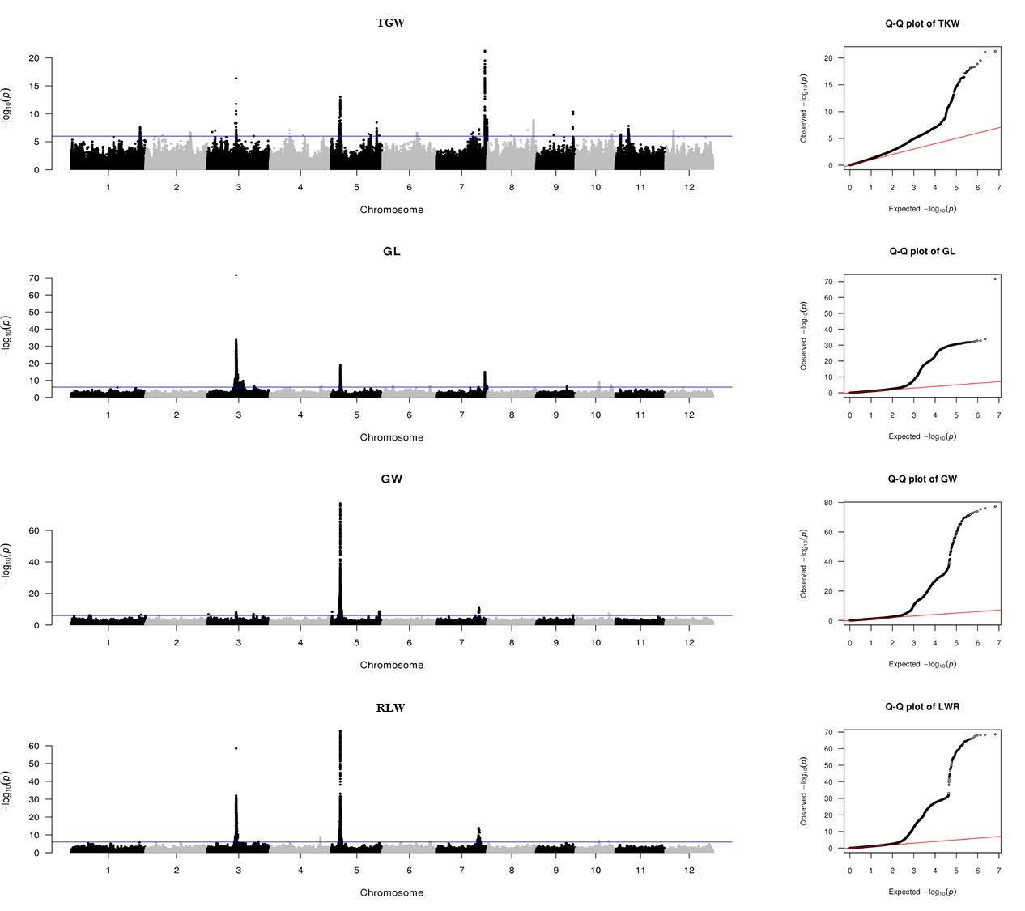
Fig. S6A The Manhattan and QQ plots for TGW, GL, GW and RLW of the whole panel in 2016

Slide 12
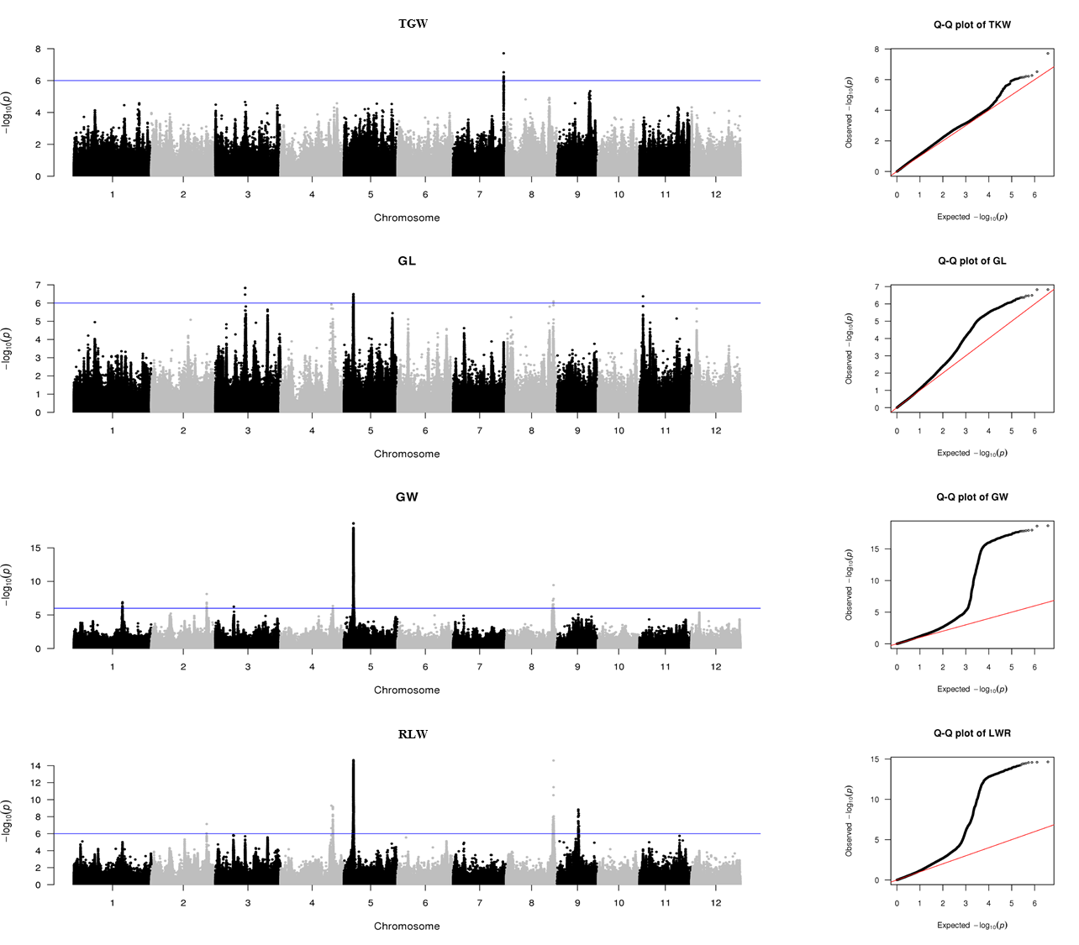
Fig. S6B The Manhattan and QQ plots for TGW, GL, GW and RLW of the aus/boro panel in 2016

Slide 13
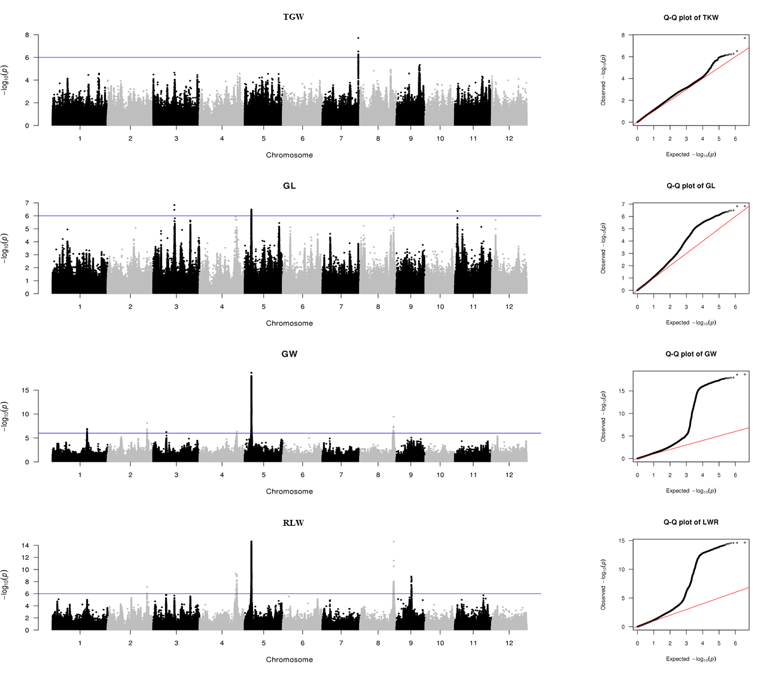
Fig. S6C The Manhattan and QQ plots for TGW, GL, GW and RLW of the basmati/sadri panel in 2016

Slide 14
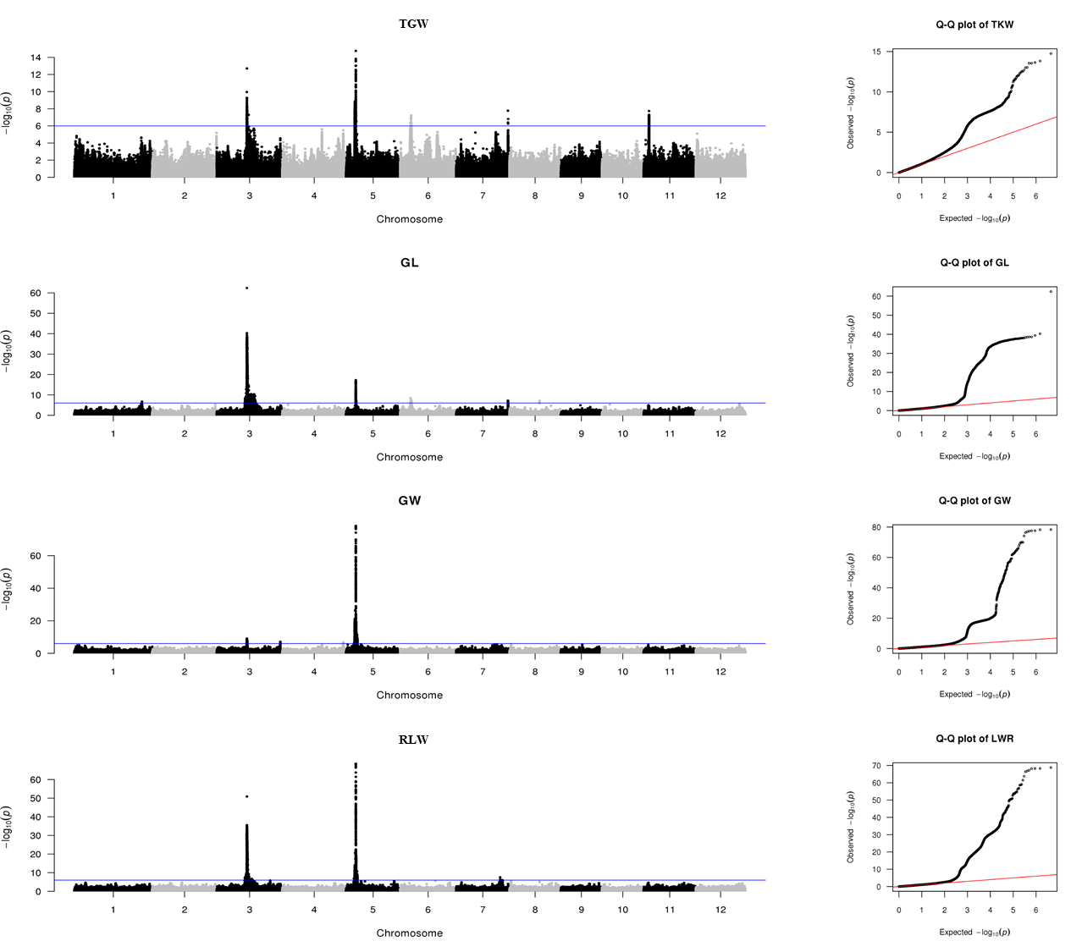
Fig. S6D The Manhattan and QQ plots for TGW, GL, GW and RLW of the xian panel in 2016

Slide 15
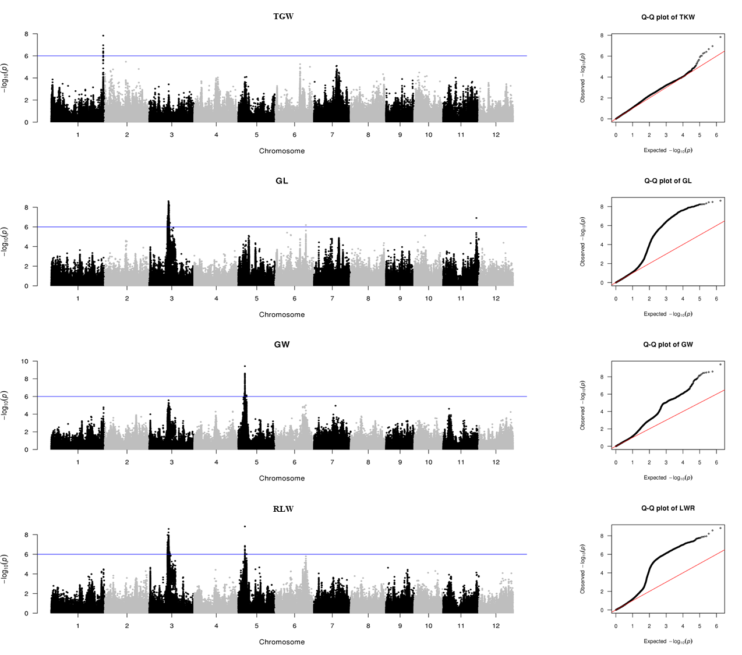
Fig. S6E The Manhattan and QQ plots for TGW, GL, GW and RLW of the temperate geng panel in 2016

Slide 16
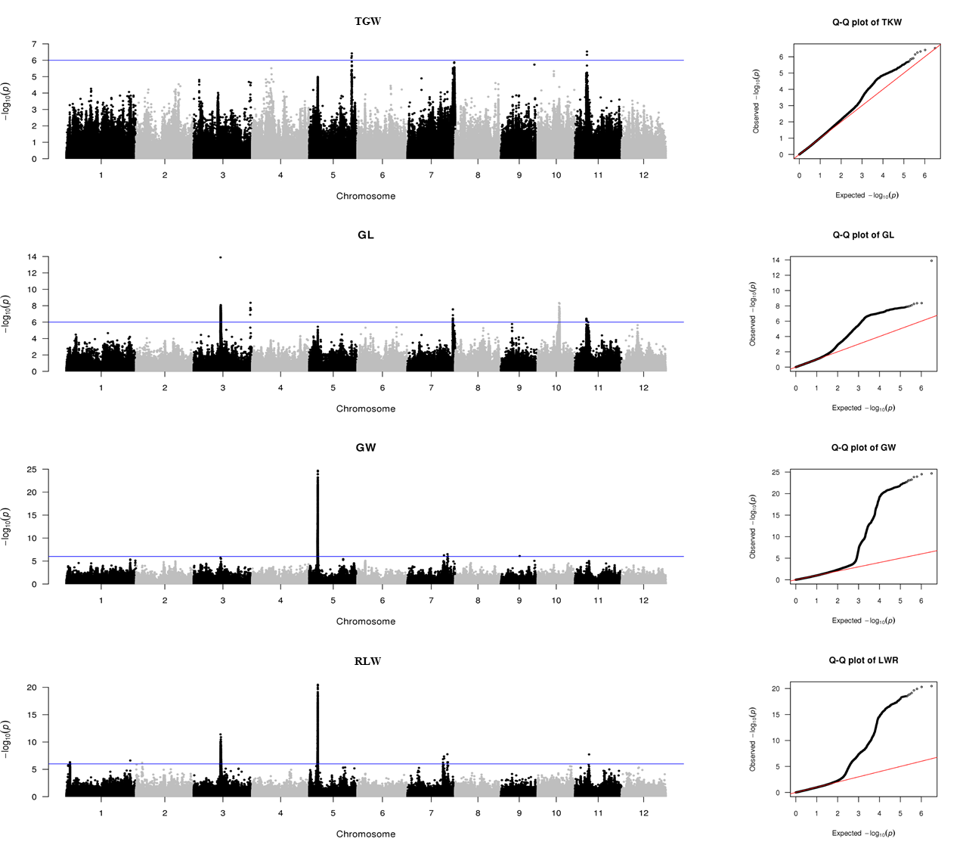
Fig. S6F The Manhattan and QQ plots for TGW, GL, GW and RLW of the tropical geng panel in 2016

Slide 17
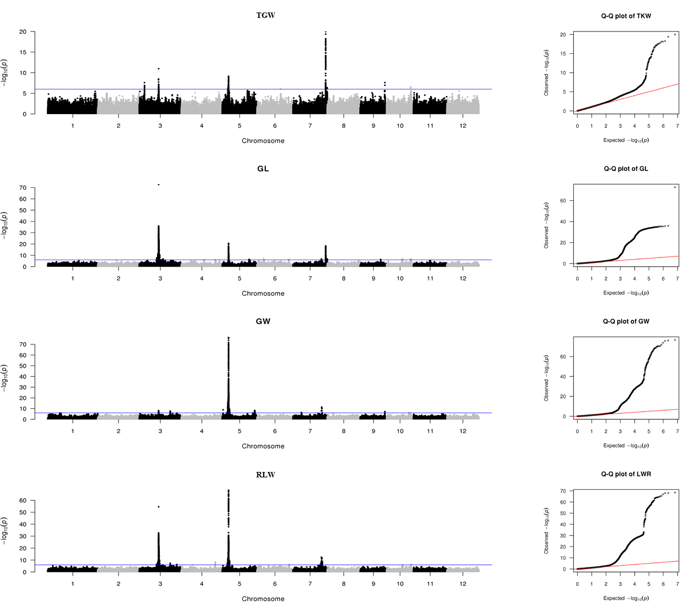
Fig. S7A The Manhattan and QQ plots for TGW, GL, GW and RLW of the whole panel in 2017

Slide 18
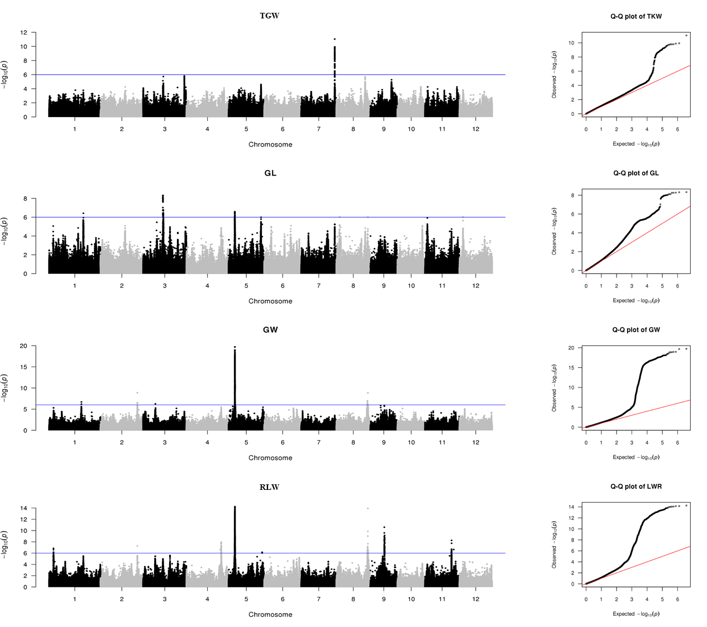
Fig. S7B The Manhattan and QQ plots for TGW, GL, GW and RLW of the aus/boro panel in 2017

Slide 19
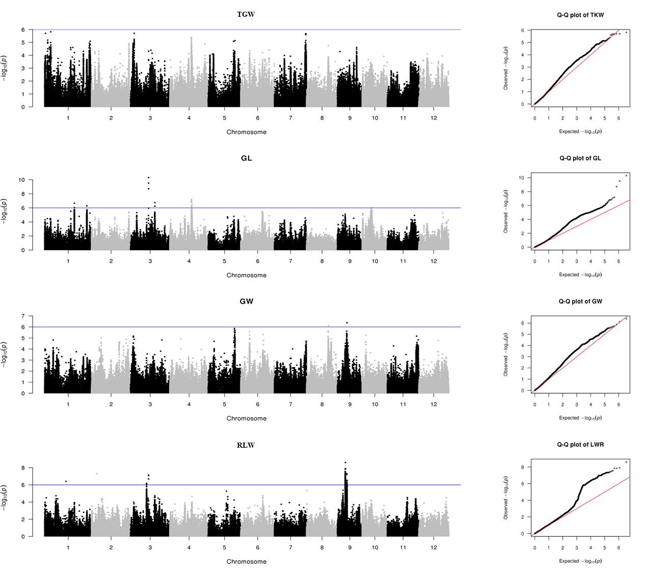
Fig. S7C The Manhattan and QQ plots for TGW, GL, GW and RLW of the basmati/sadri panel in 2017

Slide 20
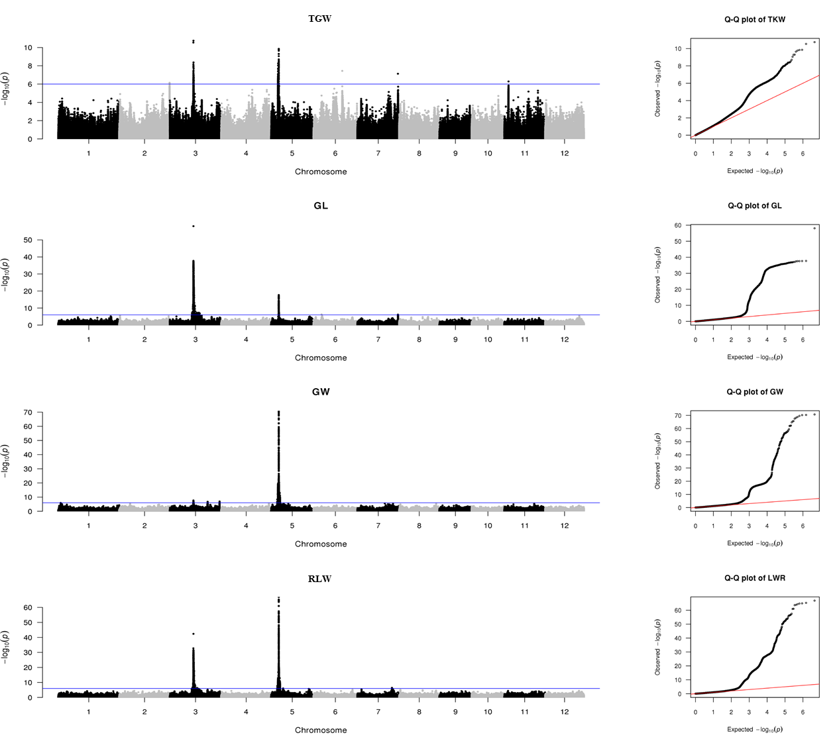
Fig. S7D The Manhattan and QQ plots for TGW, GL, GW and RLW of the xian panel in 2017

Slide 21
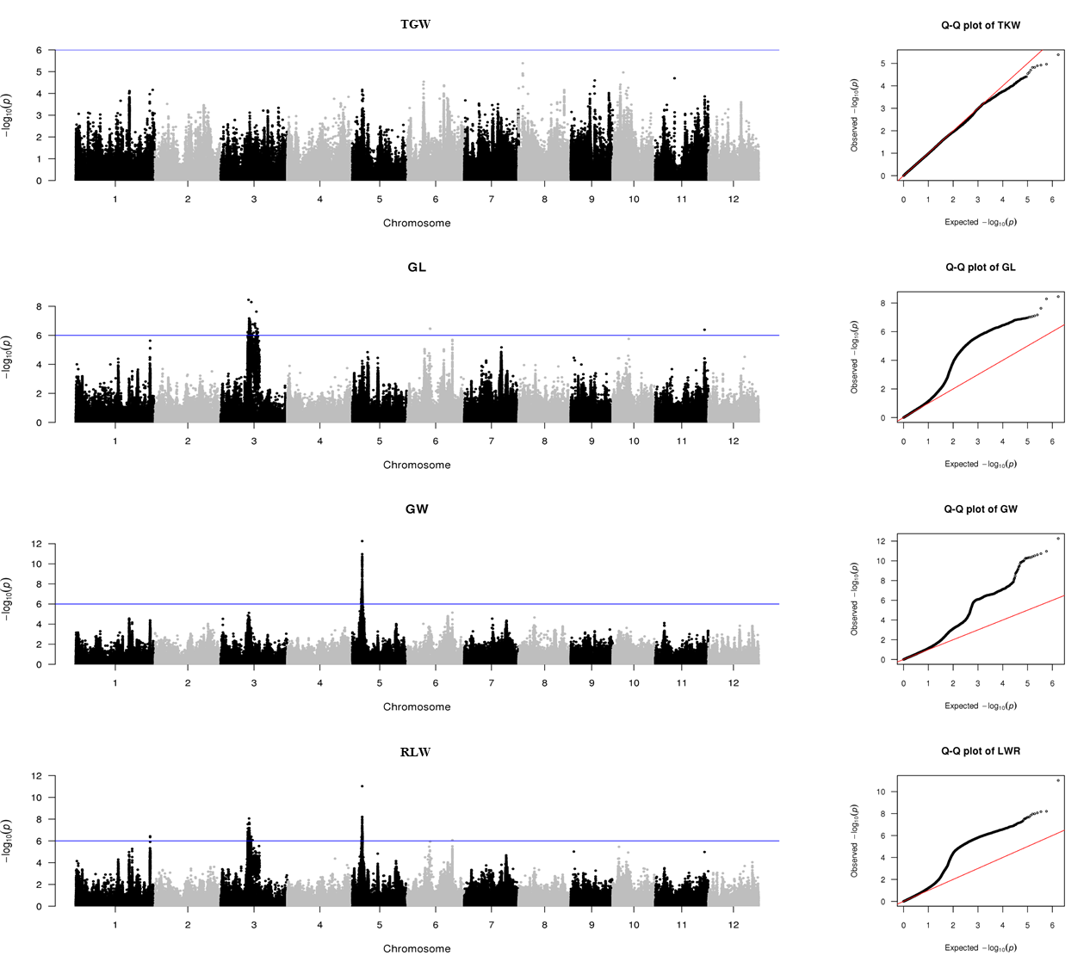
Fig. S7E The Manhattan and QQ plots for TGW, GL, GW and RLW of the temperate geng panel in 2017

Slide 22
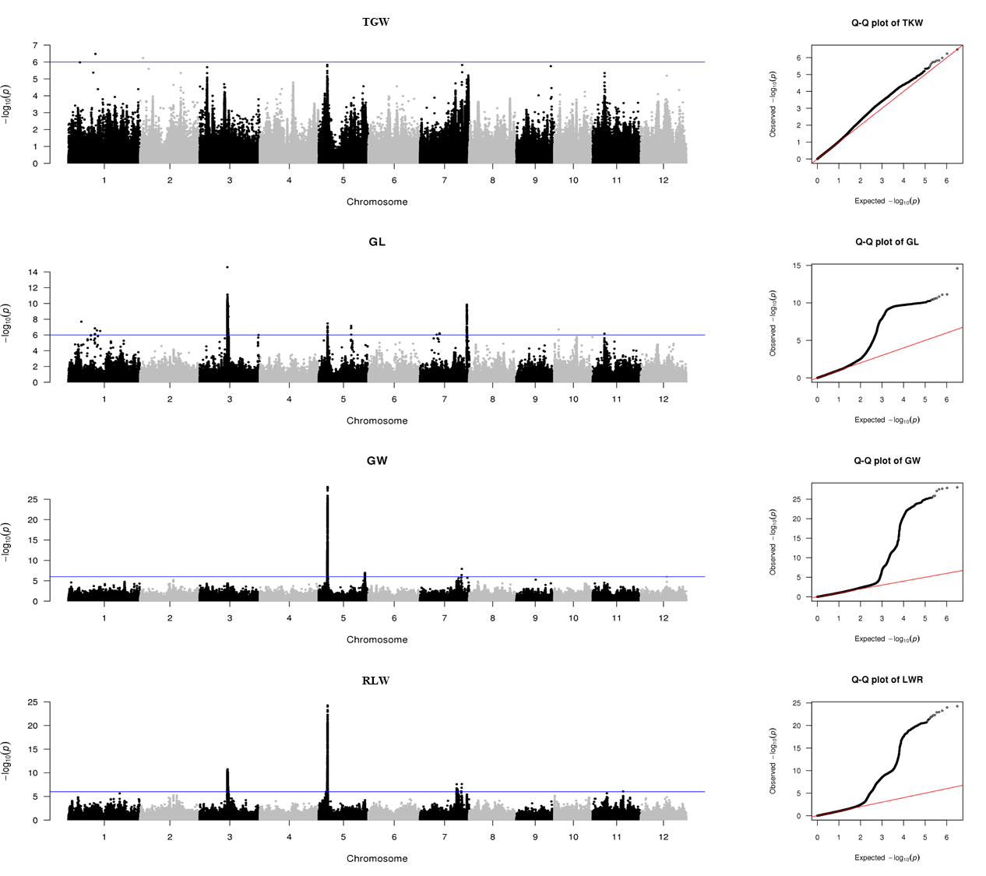
Fig. S7F The Manhattan and QQ plots for TGW, GL, GW and RLW of the tropical geng panel in 2017

Slide 23
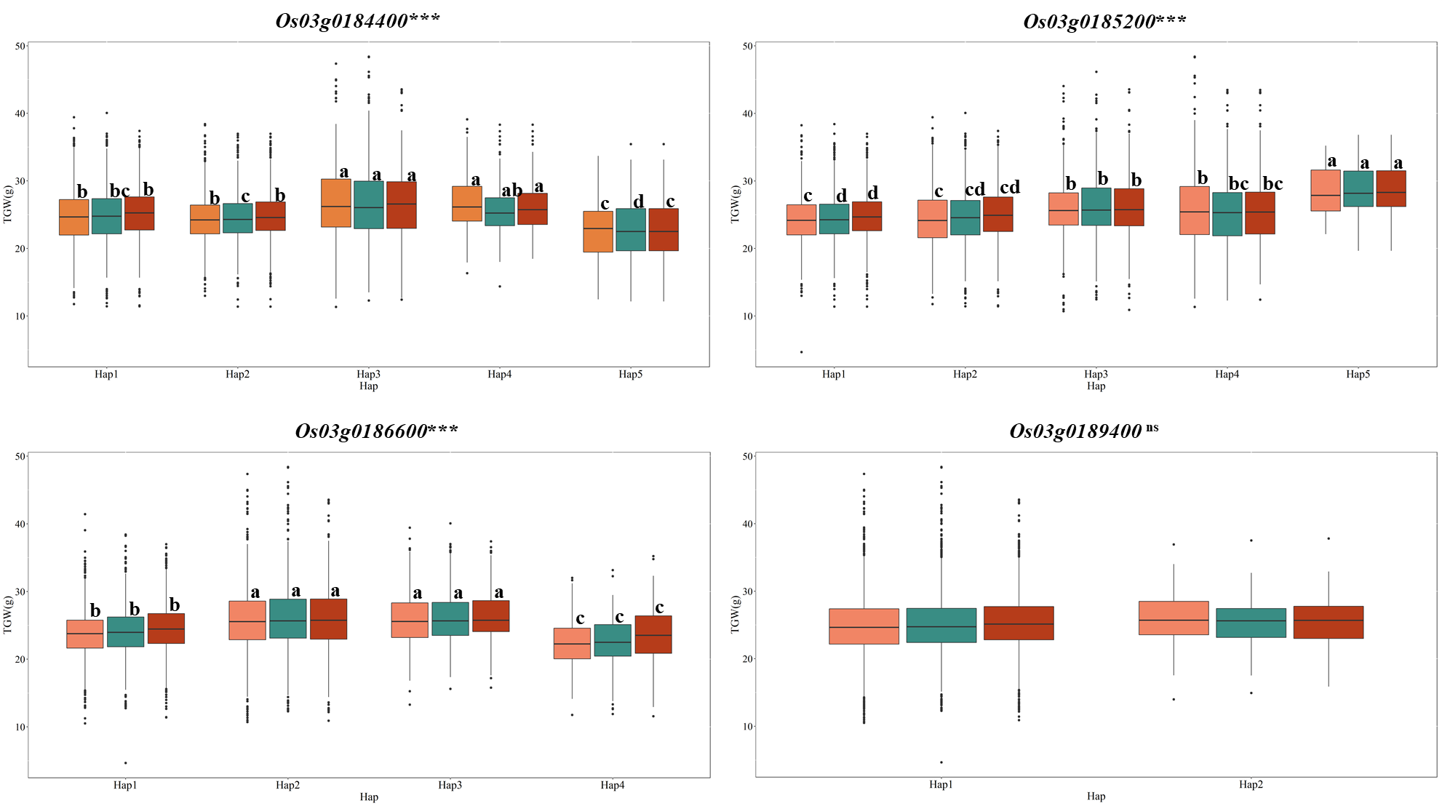
Fig. S8 Haplotypes analysis of targeted genes Os03g0184400, Os03g0185200, Os03g0186600 and Os03g0189400 for TGW in the whole panel. *** indicates significance at p < 0.001 level, ns indicates no significant differences.

Slide 24
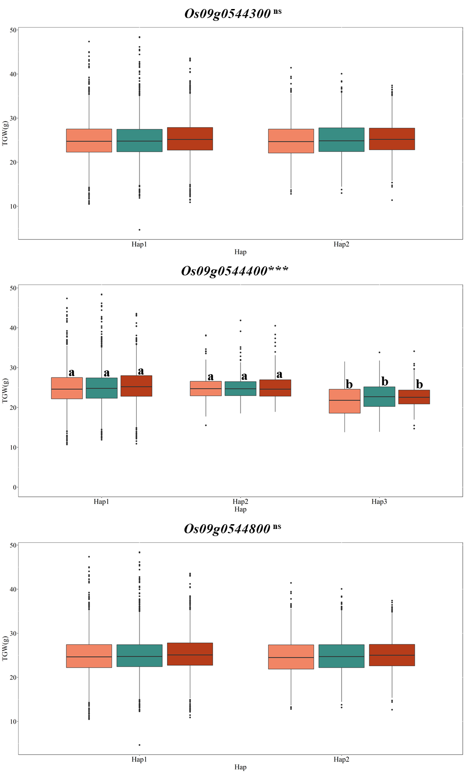
Fig. S9 Haplotypes analysis of targeted genes Os09g0544300, Os09g0544400, and Os09g0544800 for TGW in the whole panel. *** indicates significance at p < 0.001 level, ns indicates non-significant differences.

Slide 25
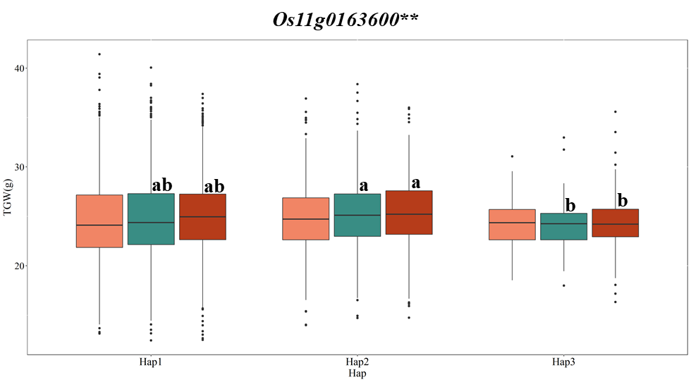
Fig. S10 Haplotypes analysis of targeted gene Os11g0163600 for TGW in the xian panel. ** indicates significance at p < 0.01 level.

Slide 26
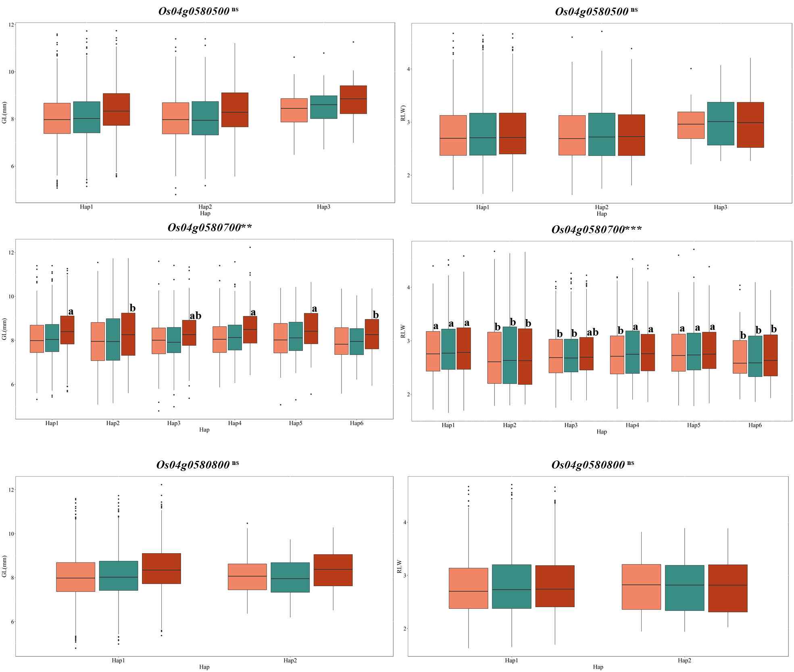
Fig. S11 Haplotypes analysis of targeted genes Os04g0580500, Os04g0580700, and Os04g0580800 for GL and RLW in the whole panel. *** indicates significance at p < 0.001 level, ns indicates non-significant differences.

Slide 27
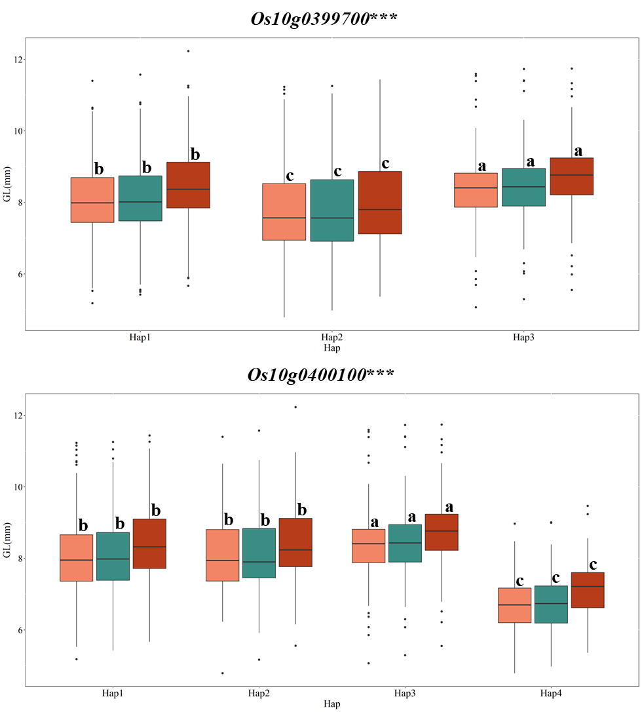
Fig. S12 Haplotypes analysis of targeted genes Os10g0399700 and Os10g0400100 for GL in the whole panel. *** indicates significance at p < 0.001 level.

Slide 28
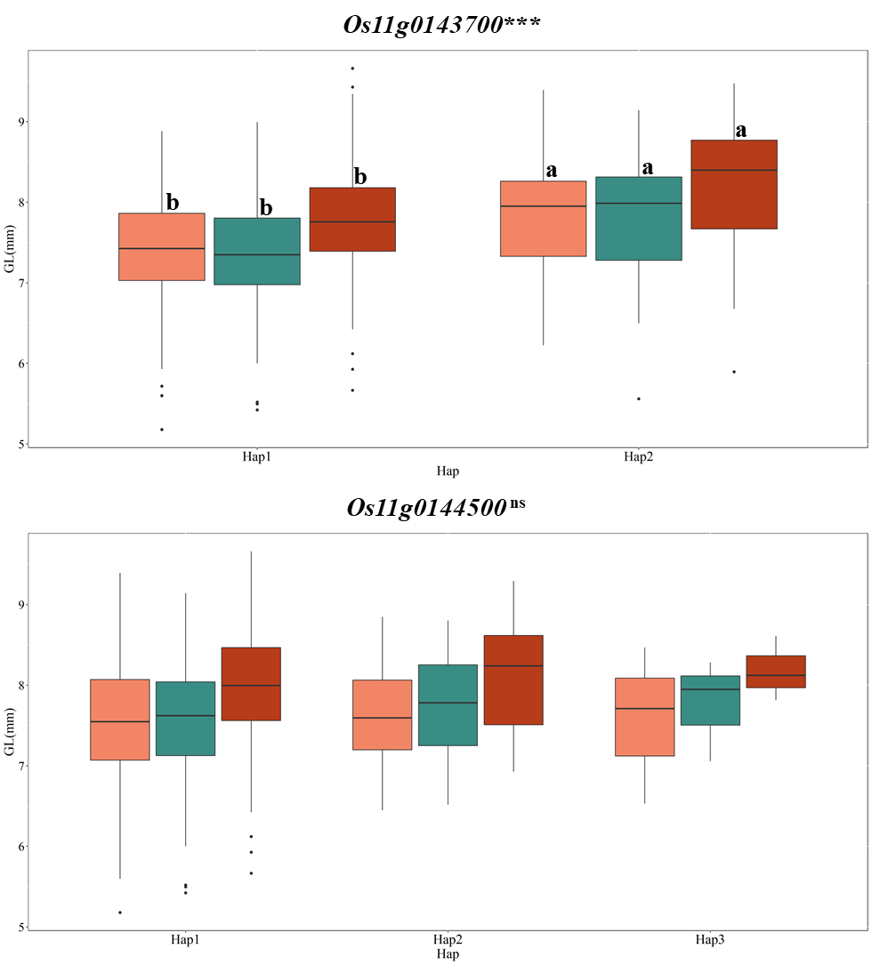
Fig. S13 Haplotypes analysis of targeted genes Os11g0143700 and Os11g0144500 for GL in the aus/boro panel. *** indicates significance at p < 0.001 level, ns indicates non-significant differences.

Slide 29
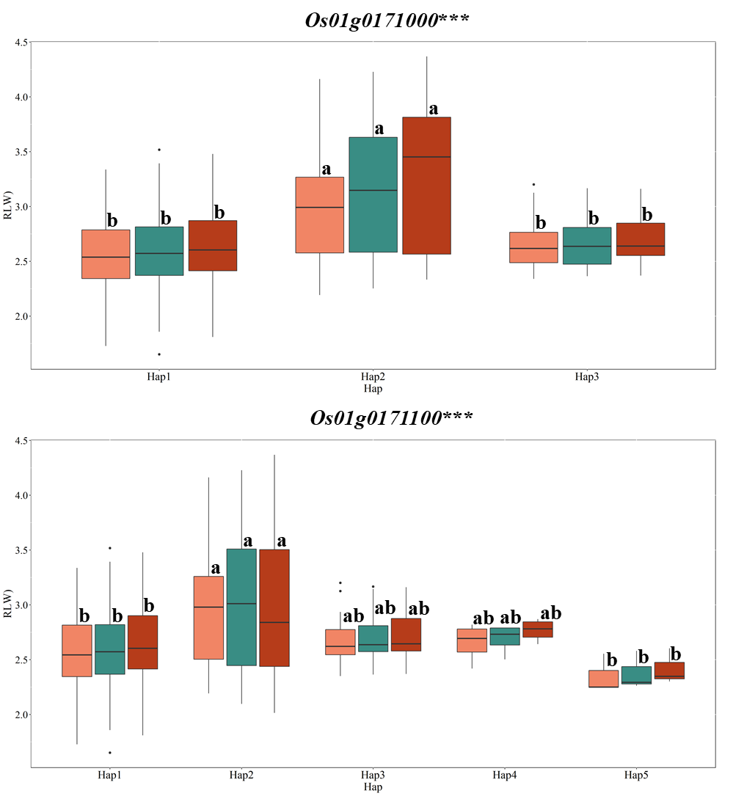
Fig. S14 Haplotypes analysis of targeted genes Os01g0171000 and Os01g0171100 for RLW in the aus/boro panel. *** indicates significance at p < 0.001 level.

Slide 30
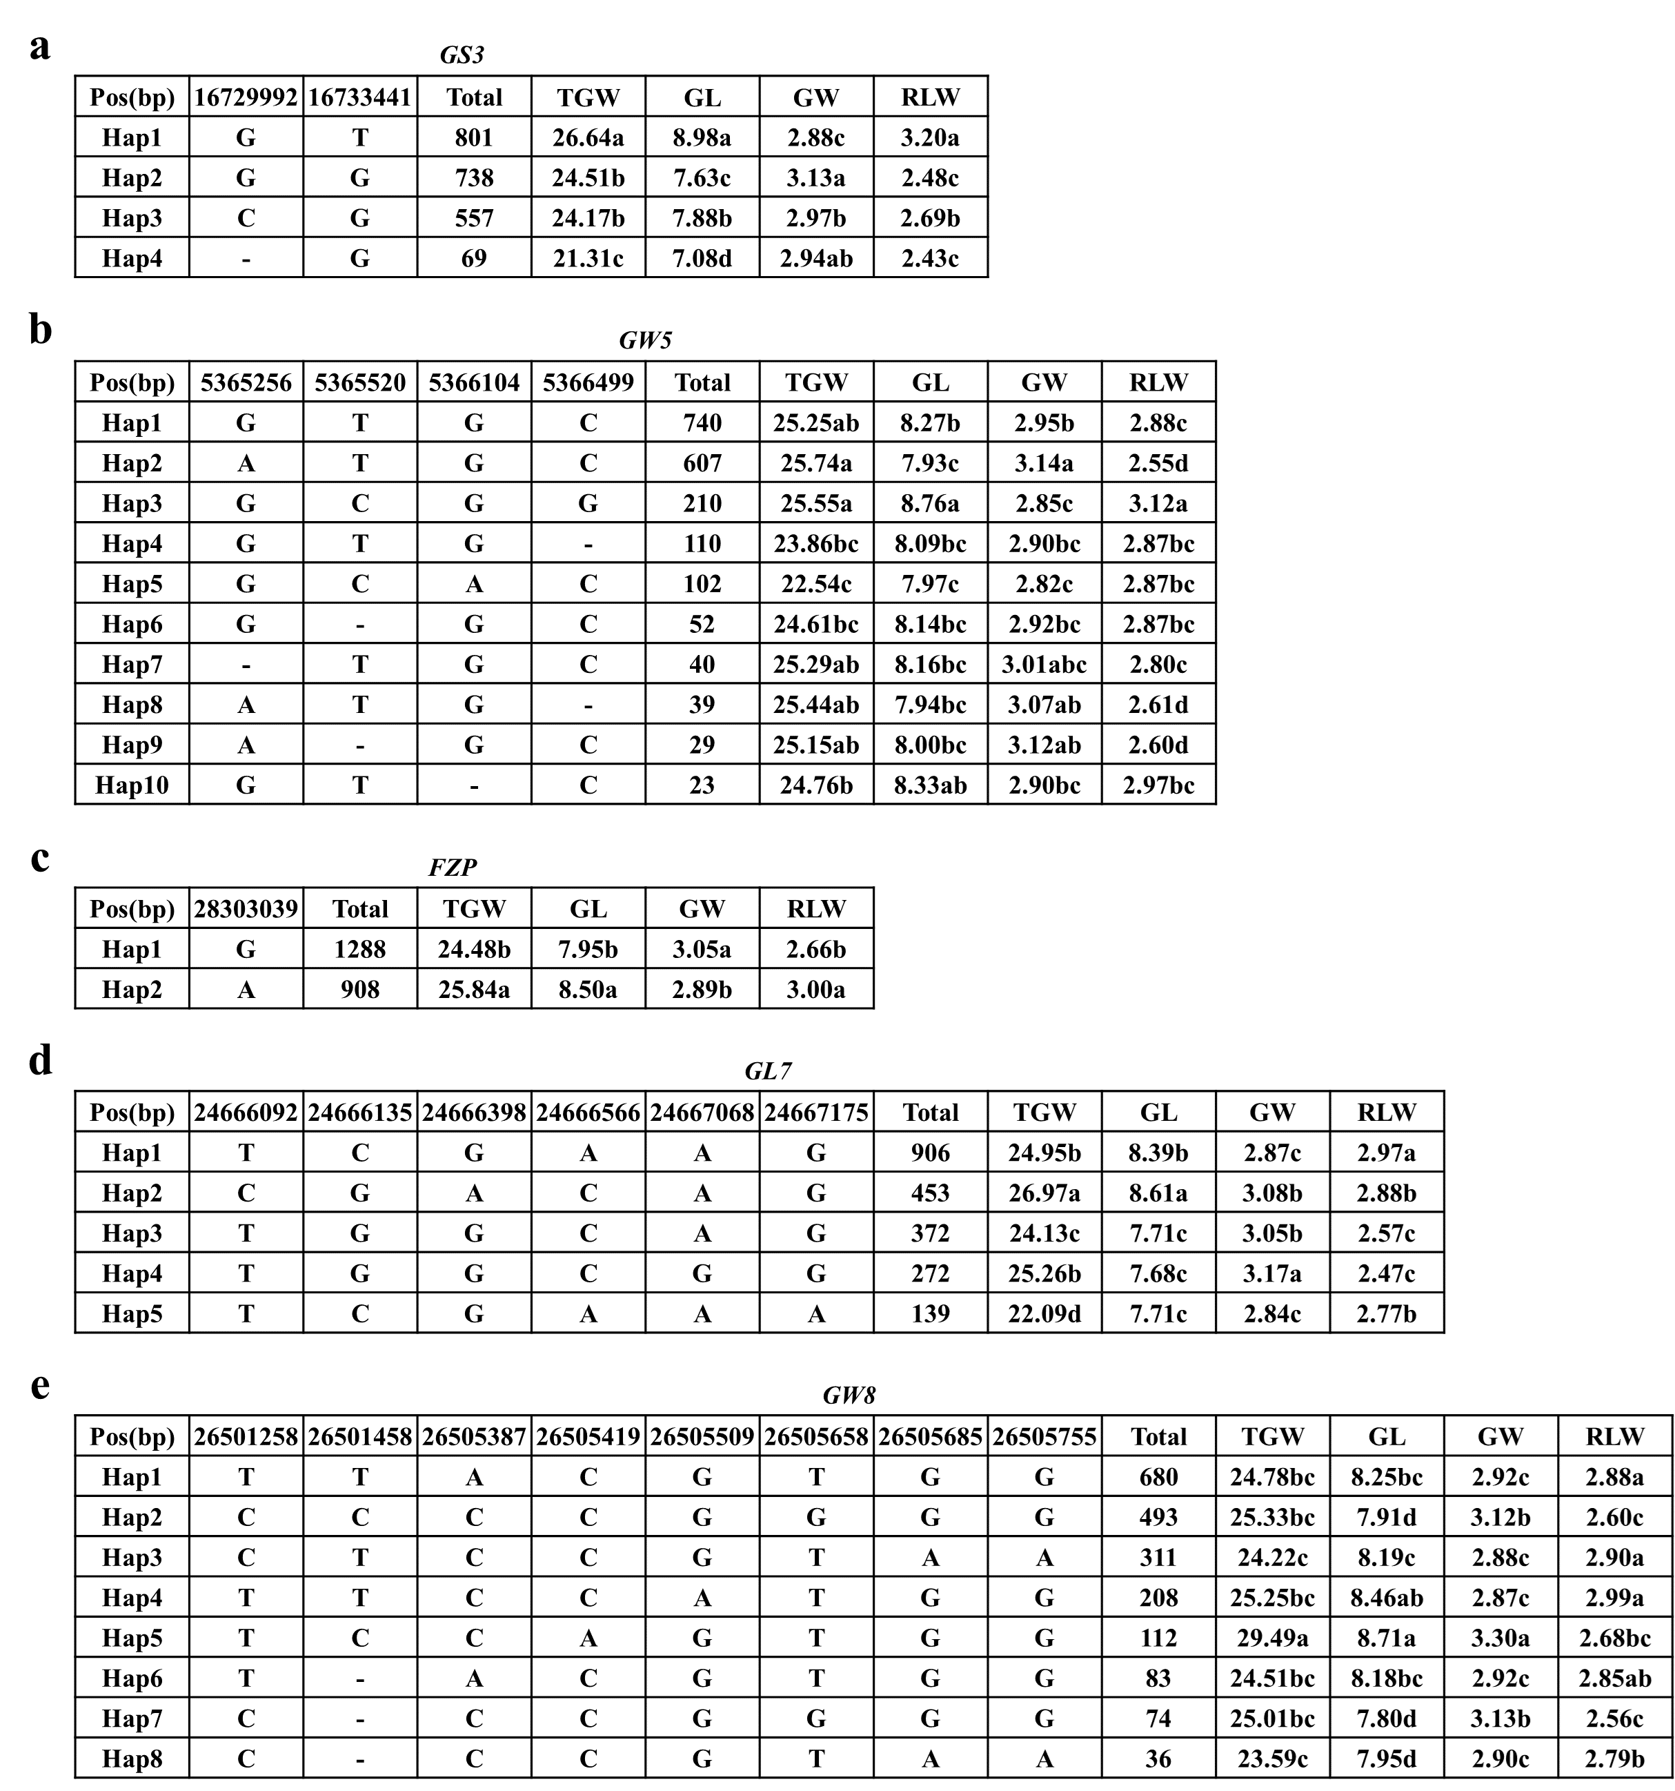
Fig. S15 Haplotypes analysis of GS3 (a) , GW5 (b), FZP (c), GL7 (d), GW8 (e).

