Slide 1
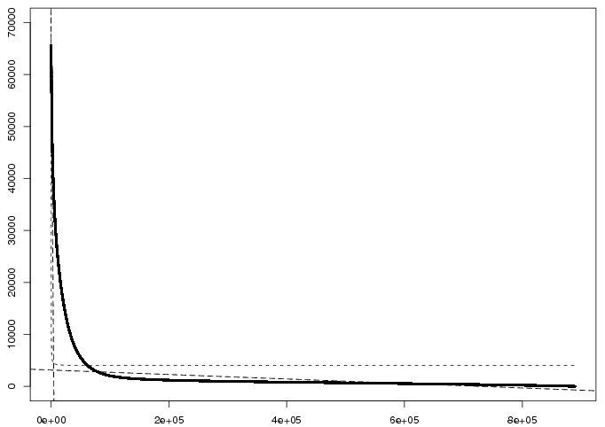
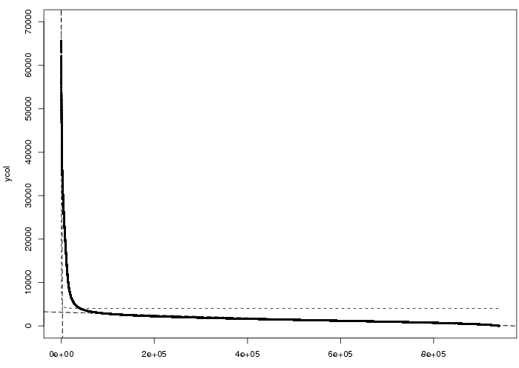
a
b
Intensity
Intensity
3144
3137
Rank
Rank
Figure S1. Rank-ordered signal distribution of OsWOX13 (a) and OsSMF1 (b) a) Two independent linear models, y = ax+b, were applied in the steep (b1=66570.6, slope=-14.7) and heavy right (b1= 3144.4, slope=- 0.0043) tail regions. Spots (34,778) with intensity higher than 3144 were used for further analysis. b) Two independent linear models, y = ax+b, were applied in the steep (b1= 64924.8, slope=-25.1) and heavy right (b1= 3,137.8, slope= -0.0032) tail regions. Spots (38,654) with intensity higher than 3137 were used for further analysis.

Slide 2
1
10
20
30
40
TTCTATGATTGATTGGTCGATAGGAAGACATATAACAGCG
Figure S2. A 40 bp long probe (Os04g0664600_8) was split into 9-mers, and each oligomer was given the pseudointensity of the probe. The process was repeated with a base shift, and finally, a probe gave 32 9-mers.

Slide 3
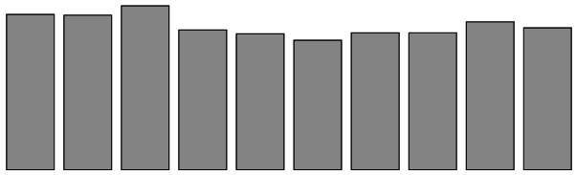
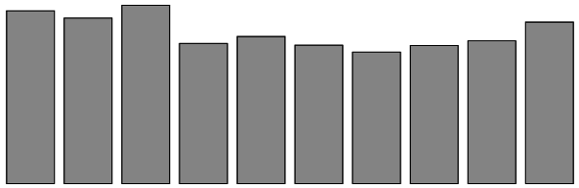
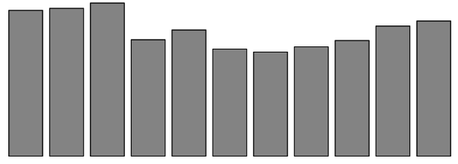
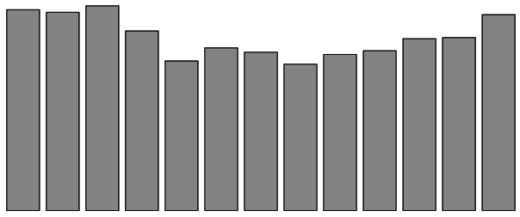
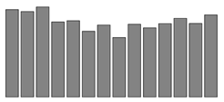
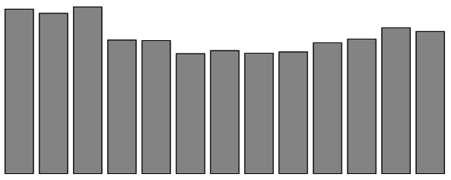
5-mer
6-mer
7-mer
10⁴
.....GATTG.....
10⁴
.....TGATTG....
10⁴
.....TGATTGA....
3
...TTGATTGGC...
3
...ATTGATTGG...
...ATTGATTGAC...
3
2
2
2
0
0
-2
-1
Wt
T G A T T
+1
+2
-2
-1
Wt
T T G A T T
+1
0
-2
-1
Wt
T G A T T G A
+1
Position of mutation
Position of mutation
Position of mutation
8-mer
9-mer
10-mer
.....ATTGATTG.....
10⁴
.....GATTGATTG....
10⁴
.....ATTGATTGAT....
10⁴
...TGATTGATTGGT...
...TTGATTGATTGG...
...TGATTGATTGATA...
4
4
4
2
2
2
0
0
0
-2
-1
Wt
A T T G A T T G
+1
+2
-2
-1
Wt
G A T T G A T T G
+1
-2
-1
Wt
A T T G A T T G A T
+1
Position of mutation
Position of mutation
Position of mutation
* P0 : Intenisty of the highest
Figure S3. Comparison of the intensities of oligomers for OsWOX13 with point mutations at distinct positions.

Slide 4
A | 932 | 829 | 963 | 3243 | 0 | 0 | 0 | 3243 | 0 | 0 | 0 | 1240 | 784 | 791
C | 573 | 553 | 491 | 0 | 0 | 0 | 0 | 0 | 0 | 0 | 0 | 562 | 467 | 616
G | 625 | 543 | 1068 | 0 | 0 | 0 | 3243 | 0 | 0 | 0 | 3243 | 734 | 623 | 593
T | 1111 | 1317 | 721 | 0 | 3243 | 3243 | 0 | 0 | 3243 | 3243 | 0 | 707 | 1368 | 1240
Base | -3 | -2 | -1 | A | T | T | G | A | T | T | G | +1 | +2 | +3
Figure S4. Sequences flanking ATTGATTG. A and T are preferable at -3 and -2, and G and A are preferable at the -1 position. In contrast, A is preferable at the +1 position, and T is preferable at the +2 and +3 positions.

Slide 5
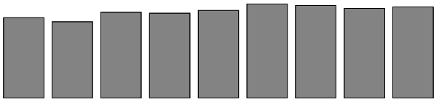
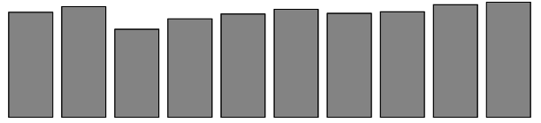
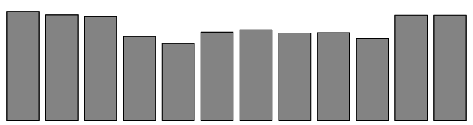


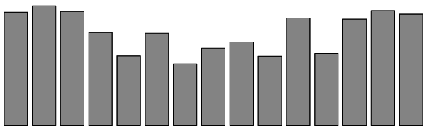
5-mer
6-mer
7-mer
10⁴
.....CACGT....
10⁴
....CCACGT.....
10⁴
.....GCCACGT.....
4
...GACACGTA...
4
...ACCACGTCA...
...TTGCCACGTCA...
4
2
2
2
0
0
0
-2
-1
Wt
C A C G T
t2
-1
Wt
CCACGT
+1
+2
-1
Wt
GCCACGT
-2
+1
+2
Position of mutation
Position of mutation
Position of mutation
8-mer
9-mer
10-mer
10⁴
.....CCACGTCA.....
10⁴
.....GCCACGTCA.....
10⁴
.....GCCACGTCAG.....
...TGCCACGTCAGC...
...GCGCCACGTCAGC...
...GCGCCACGTCAGCA...
4
4
4
2
2
2
0
0
0
-2
GCCACGTCAG
+2
-1
Wt
GCCACGTCA
+2
+1
-2
+1
-2
C C A C G T C A
-1
Wt
-1
Wt
+2
+1
Position of mutation
Position of mutation
Position of mutation
*P0 : Intenisty of the highest
Figure S5. Comparison of the intensities of oligomers for OsSMF1 with point mutations at distinct positions.

