Slide 1
Supplementary Table 1.
Control Sample ID | Raw Read Pairs | Host Removed Read Pairs | Percent Reads Retained | Cryptospo-ridium-Positive Sample ID | Raw Read Pairs | Host Removed Read Pairs | Percent Reads Retained
Calf_1 | 218,061,876 | 46,171,908 | 21.17 | Calf_31 | 125,090,574 | 49,935,214 | 39.92
Calf_2 | 141,167,542 | 17,948,554 | 12.71 | Calf_32 | 241,911,600 | 13,596,682 | 5.62
Calf_3 | 203,028,326 | 25,872,990 | 12.74 | Calf_33 | 149,754,880 | 36,332,604 | 24.26
Calf_4 | 88,212,248 | 36,545,154 | 41.43 | Calf_34 | 130,348,134 | 46,720,046 | 35.84
Calf_5 | 195,524,050 | 13,489,012 | 6.90 | Calf_35 | 231,365,470 | 51,043,868 | 22.06
Calf_6 | 127,250,612 | 23,997,404 | 18.86 | Calf_36 | 239,190,362 | 237,754,458 | 99.40
Calf_7 | 187,926,772 | 79,344,426 | 42.22 | Calf_37 | 194,960,382 | 117,131,338 | 60.08
Calf_8 | 155,309,410 | 64,025,188 | 41.22 | Calf_38 | 204,759,512 | 62,323,598 | 30.44
Calf_9 | 122,833,838 | 74,322,042 | 60.51 | Calf_39 | 283,362,060 | 46,892,810 | 16.55
Calf_10 | 214,297,772 | 150,220,520 | 70.10 | Calf_40 | 514,080,216 | 207,510,158 | 40.37
Calf_11 | 215,681,956 | 119,179,340 | 55.26 | Calf_41 | 156,589,396 | 41,185,190 | 26.30
Calf_12 | 256,316,142 | 244,308,394 | 95.32 | Calf_42 | 176,218,116 | 172,341,514 | 97.80
Calf_13 | 413,438,588 | 249,059,228 | 60.24 | Calf_43 | 193,189,332 | 117,191,178 | 60.66
Calf_14 | 267,729,450 | 194,782,656 | 72.75 | Calf_44 | 250,156,106 | 43,149,508 | 17.25
Calf_15 | 206,212,776 | 141,097,132 | 68.42 | Calf_45 | 127,173,770 | 39,147,312 | 30.78
Calf_16 | 171,899,880 | 95,808,006 | 55.73 | Calf_46 | 212,963,190 | 155,612,502 | 73.07
Calf_17 | 155,578,726 | 78,158,446 | 50.24 | Calf_47 | 179,207,084 | 170,532,938 | 95.16
Calf_18 | 235,165,050 | 221,086,914 | 94.01 | Calf_48 | 140,583,536 | 130,948,262 | 93.15
Calf_19 | 251,236,524 | 41,463,656 | 16.50 | Calf_49 | 381,267,066 | 56,904,460 | 14.93
Calf_20 | 180,736,612 | 124,446,134 | 68.85 | Calf_50 | 221,248,256 | 97,174,600 | 43.92
Calf_21 | 198,013,594 | 21,576,508 | 10.9 | Calf_51 | 217,158,226 | 115,155,482 | 53.03
Calf_22 | 209,331,870 | 172,680,400 | 82.49 | Calf_52 | 160,881,622 | 126,044,232 | 78.35
Calf_23 | 154,269,216 | 136,820,038 | 88.69 | Calf_53 | 187,498,174 | 108,393,760 | 57.81
Calf_24 | 219,937,872 | 110,997,832 | 50.47 | Calf_54 | 196,628,610 | 30,121,504 | 15.32
Calf_25 | 229,403,800 | 18,010,526 | 7.85 | Calf_55 | 176,935,042 | 102,352,814 | 57.85
Calf_26 | 137,558,756 | 70,176,362 | 51.02 | Calf_56 | 284,175,816 | 111,401,826 | 39.20
Calf_27 | 165,493,284 | 110,523,948 | 66.78 | Calf_57 | 143,377,582 | 65,901,276 | 45.96
Calf_28 | 140,442,898 | 128,892,152 | 91.78 | Calf_58 | 260,200,392 | 114,058,944 | 43.84
Calf_29 | 129,952,136 | 75,442,116 | 58.05 | Calf_59 | 149,272,194 | 104,604,694 | 70.08
Calf_30 | 191,665,476 | 97,073,226 | 50.65 | Calf_60 | 129,634,518 | 44,802,328 | 34.56

Slide 2
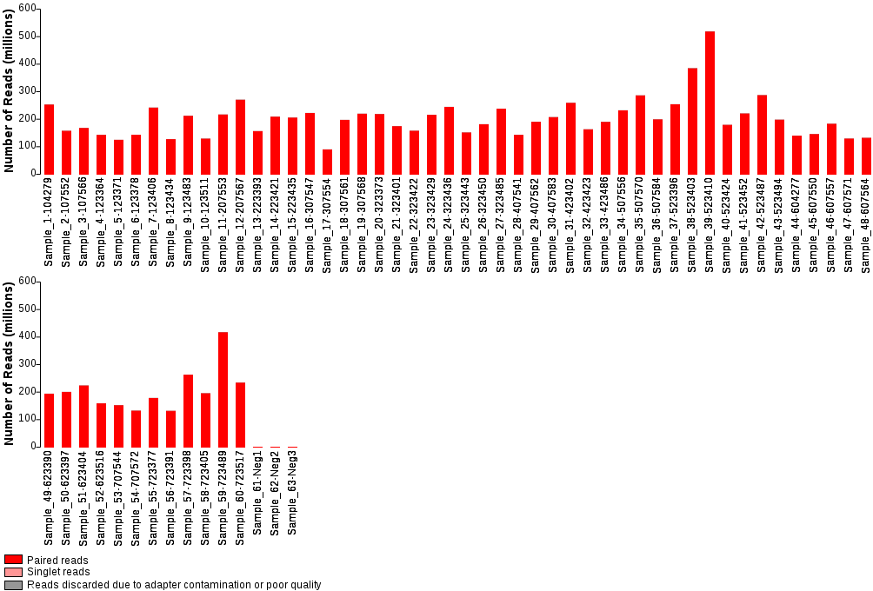
Supplementary Figure 1.

Slide 3
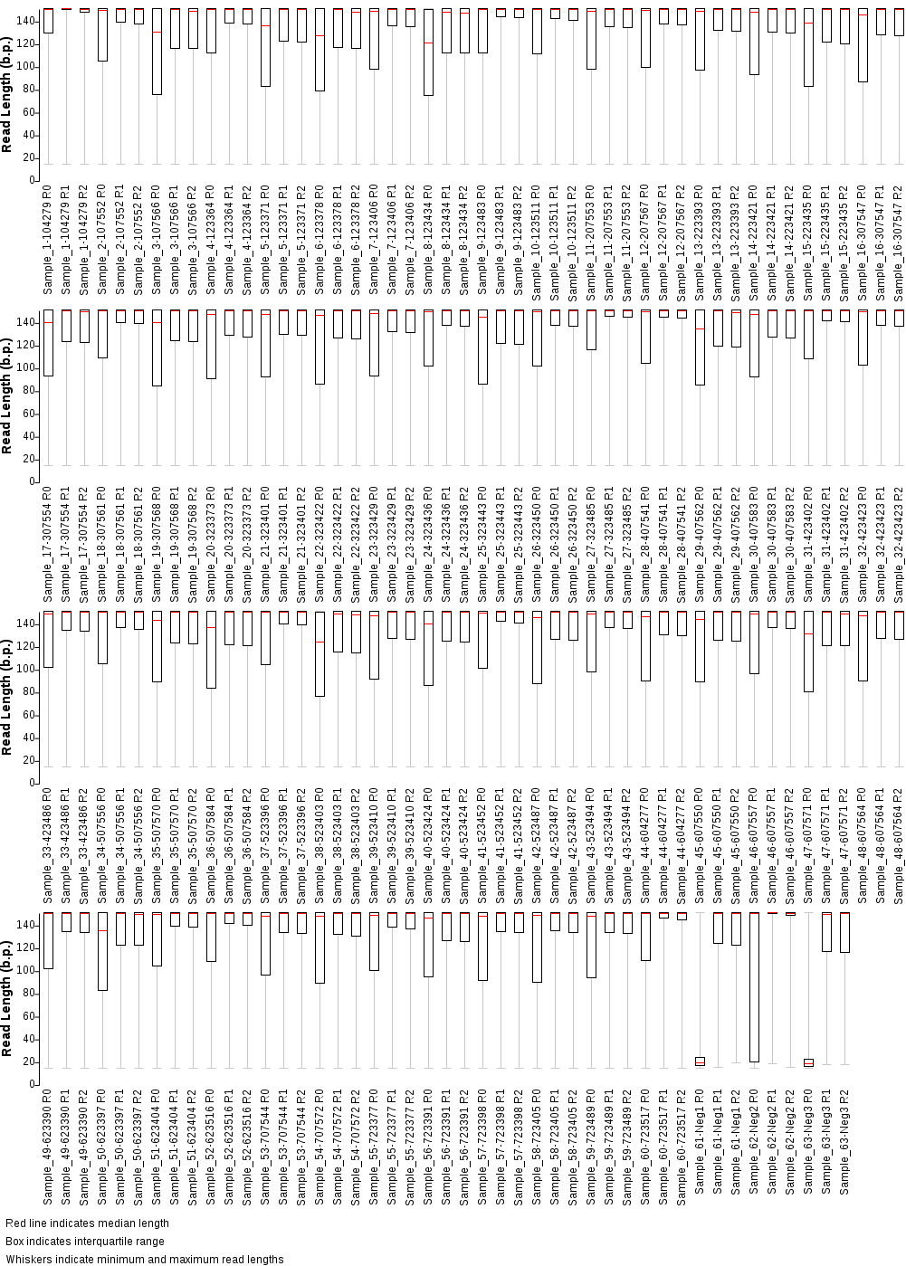
Supplementary Figure 2.

Slide 4
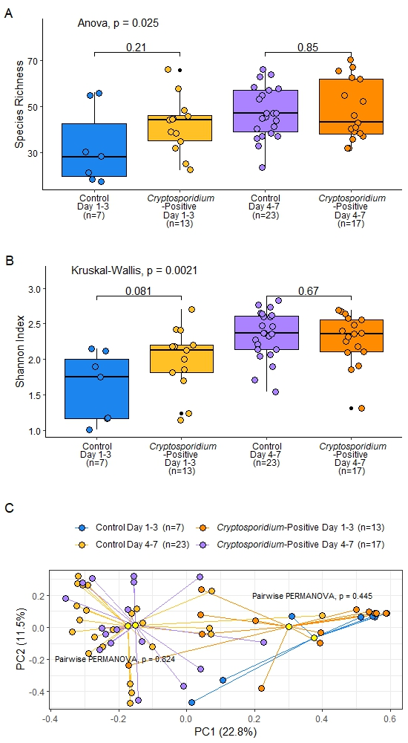
Supplementary Figure 3.

Slide 5
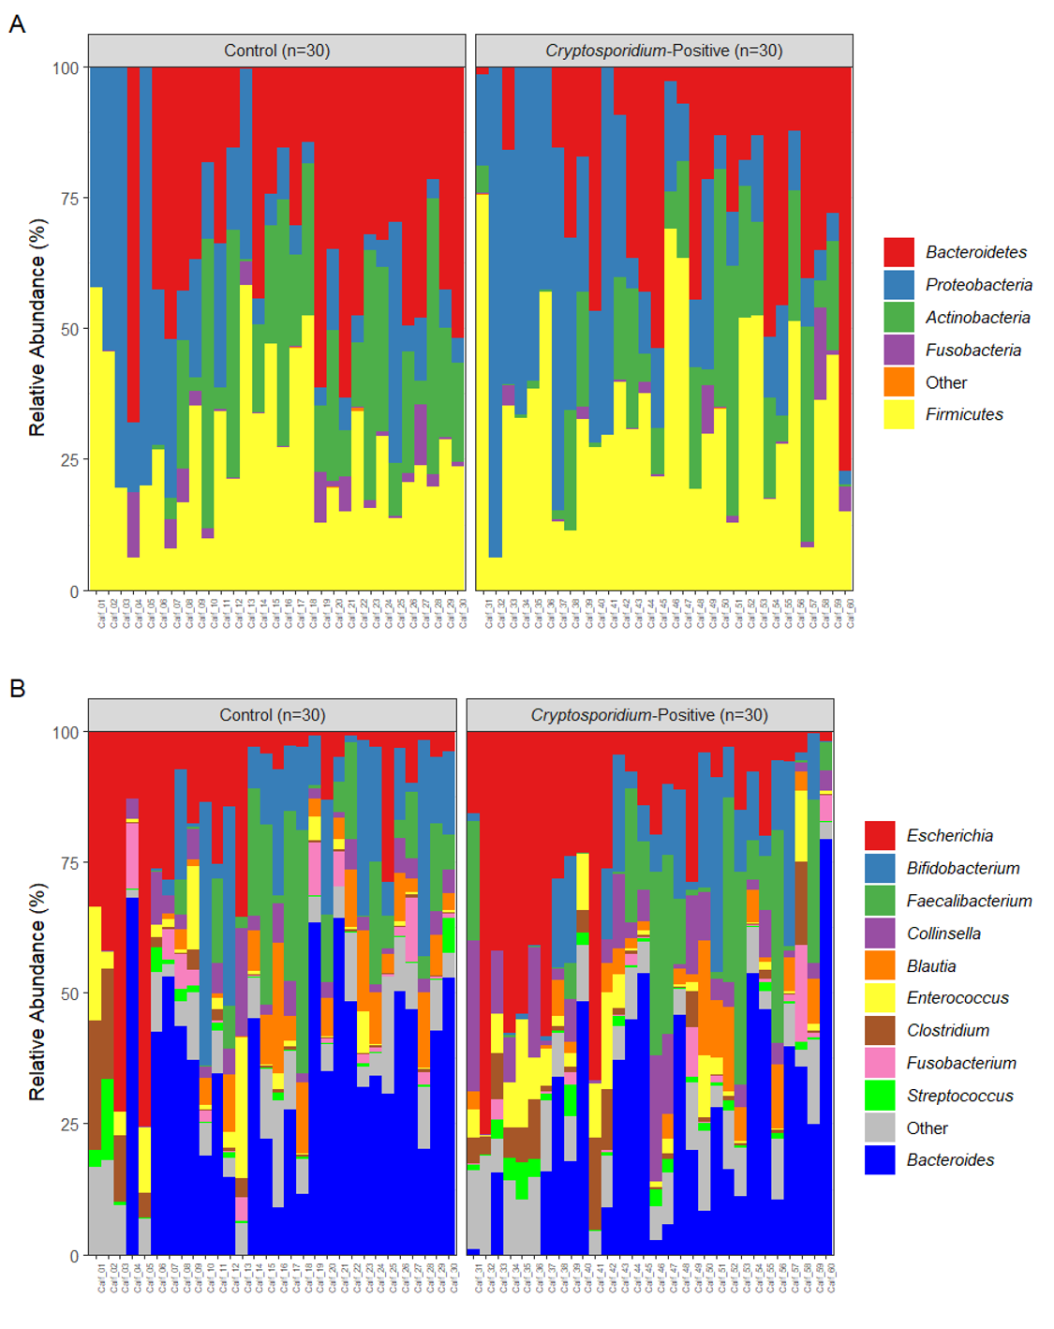
Supplementary Figure 4.

Slide 6
Supplementary Figure 5.

Slide 7
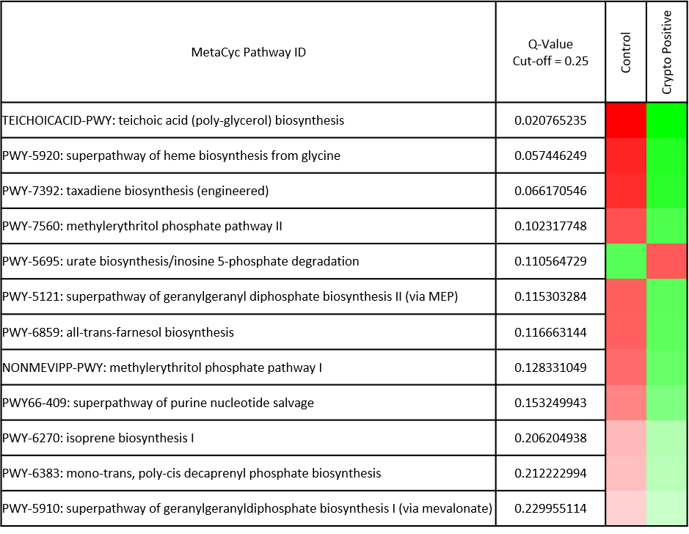
Supplementary Figure 6.

Slide 8
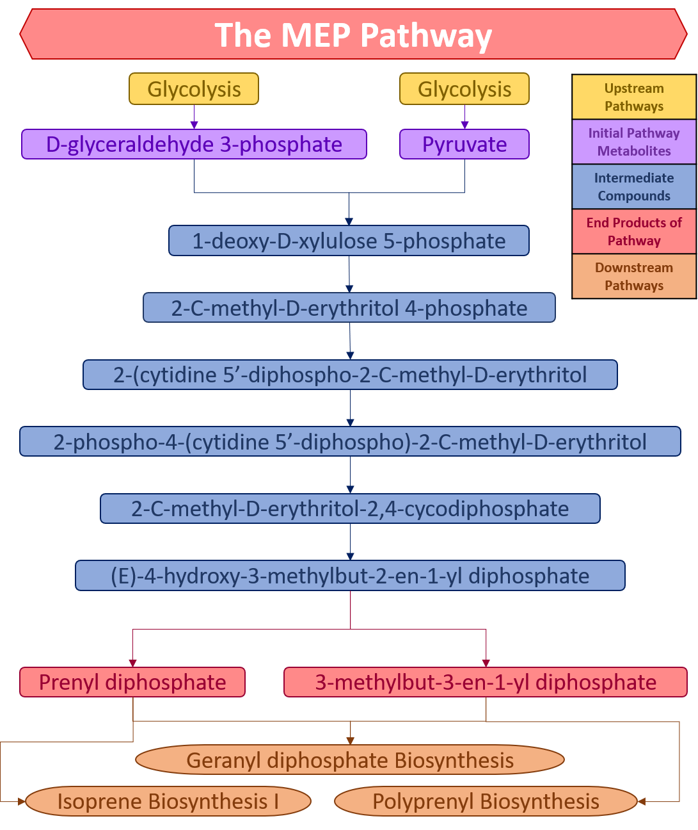
Supplementary Figure 7.

Slide 9
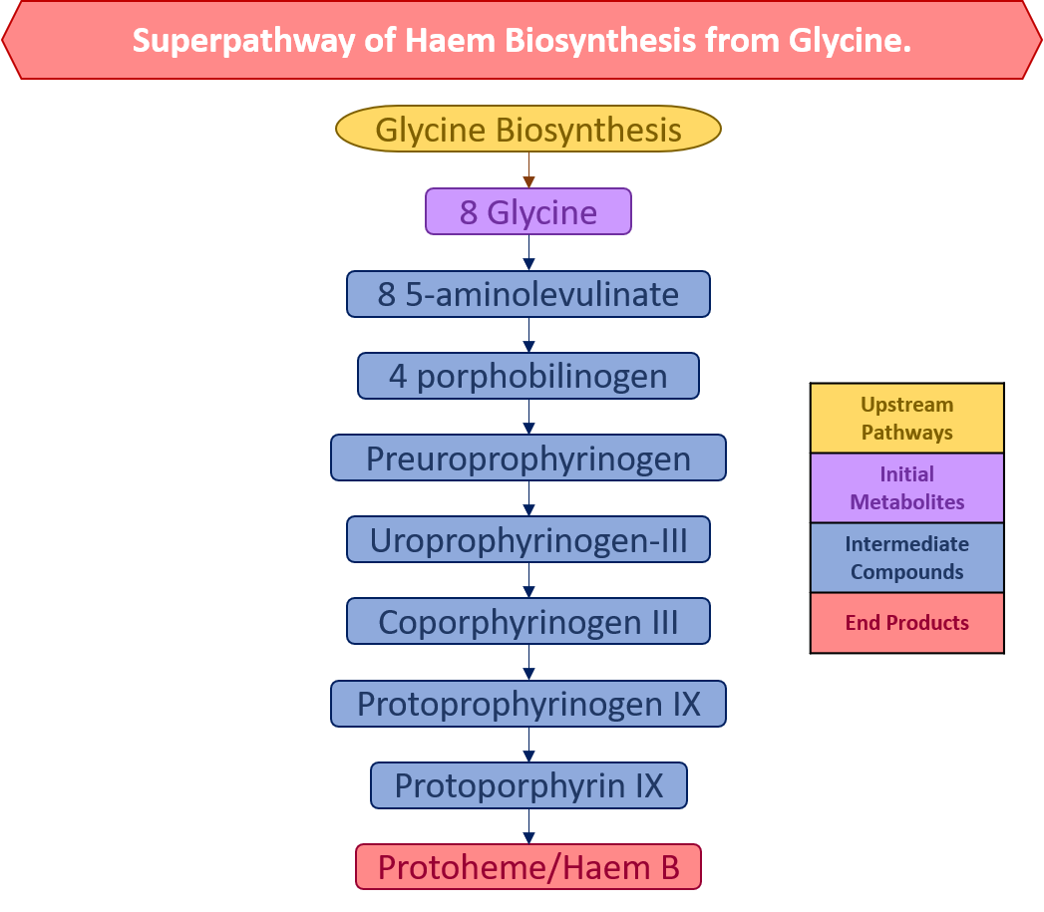
Supplementary Figure 8.

Slide 10
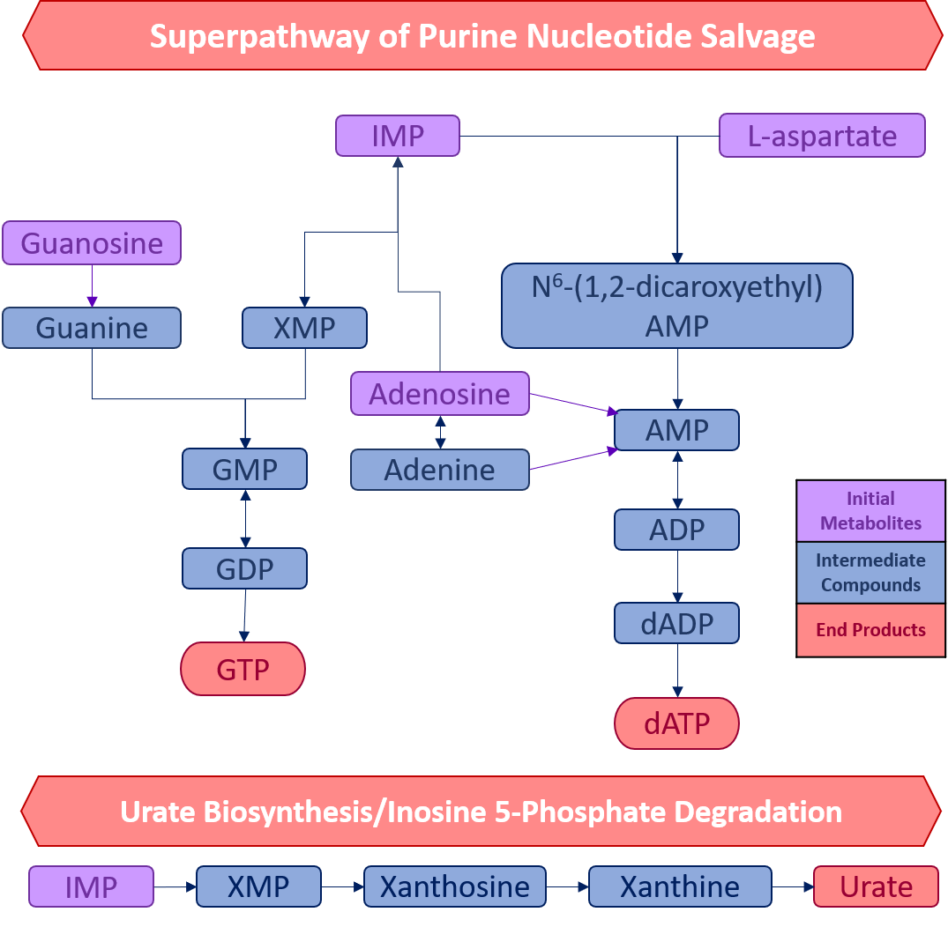
Supplementary Figure 9.

