Slide 1
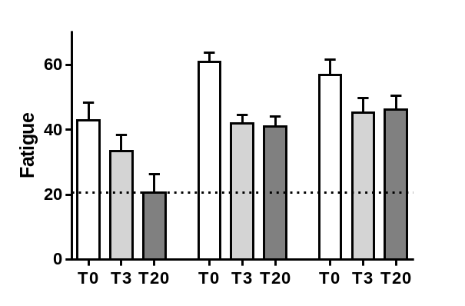
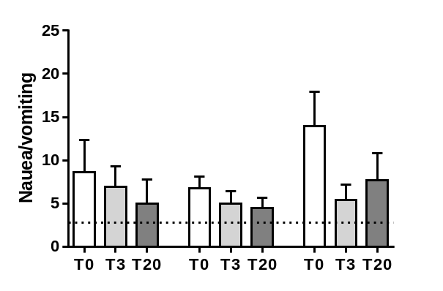
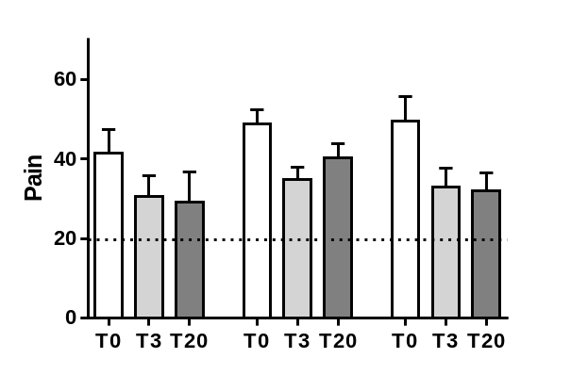
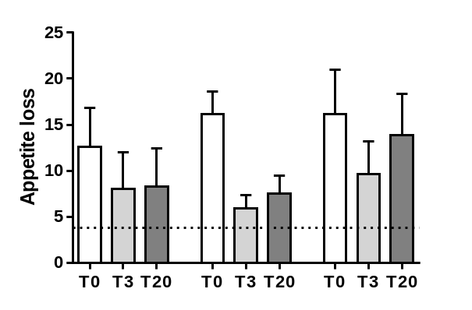
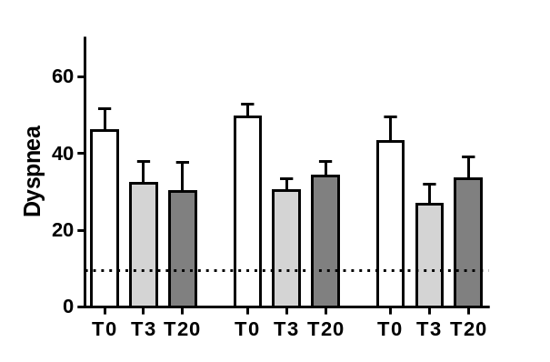
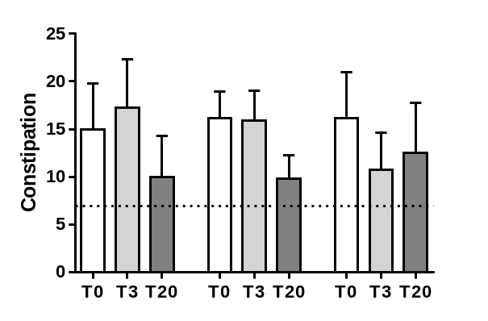
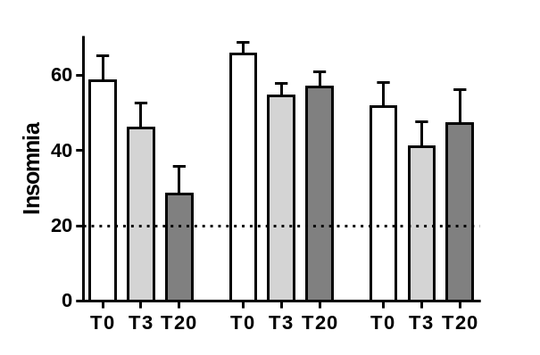
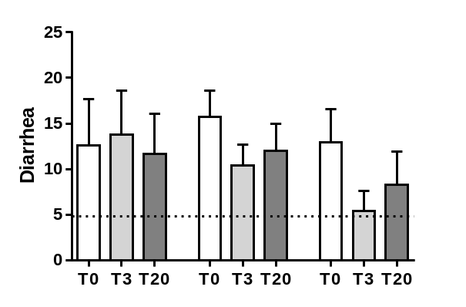
Supplementary Figure S1
Symptoms
Psychosomatic
Gastrointestinal
KD LCD SD
KD LCD SD

Slide 2
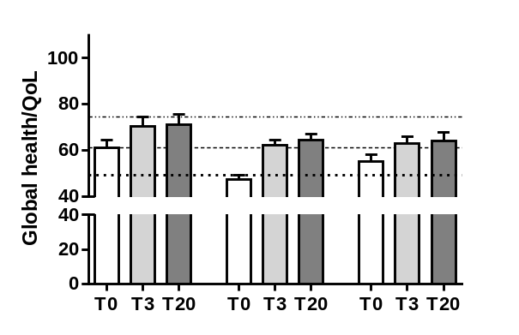
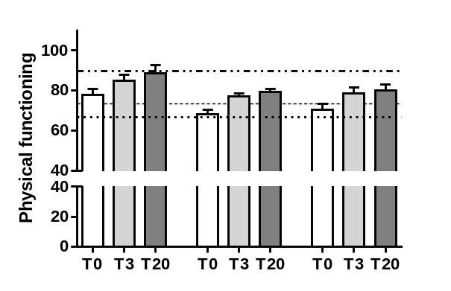
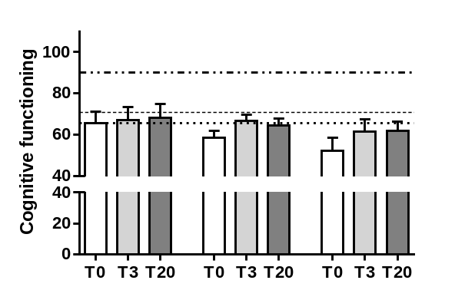
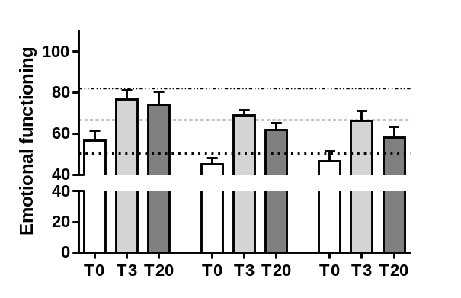
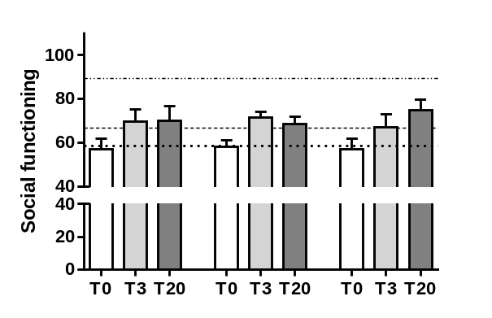
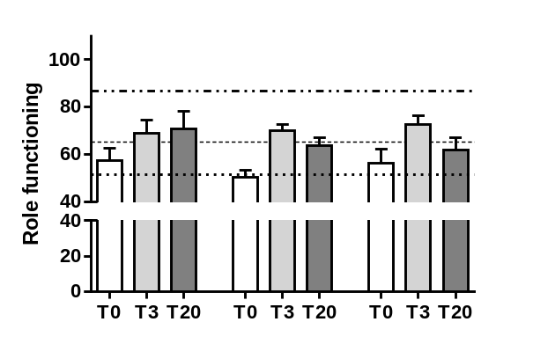
Supplementary Figure S1
Functioning scales
KD LCD SD
KD LCD SD
Supplemental Figure S1 shows results of the EORTC-QLQC30 and BR23 questionnaires comparing
the aspects of Quality of Life (Qol) before (T0), after 3 weeks of stationary intervention (T3) and after
16 successive weeks of outpatient intervention (T20)
European reference values in general population (Hinz A, 2014)
Mean QoL scores of cancer patients after 3 weeks rehabilitation (Peters E, 2016)
Mean QoL scores of cancer patients before rehabilitation (Peters E, 2016)

