Slide 1
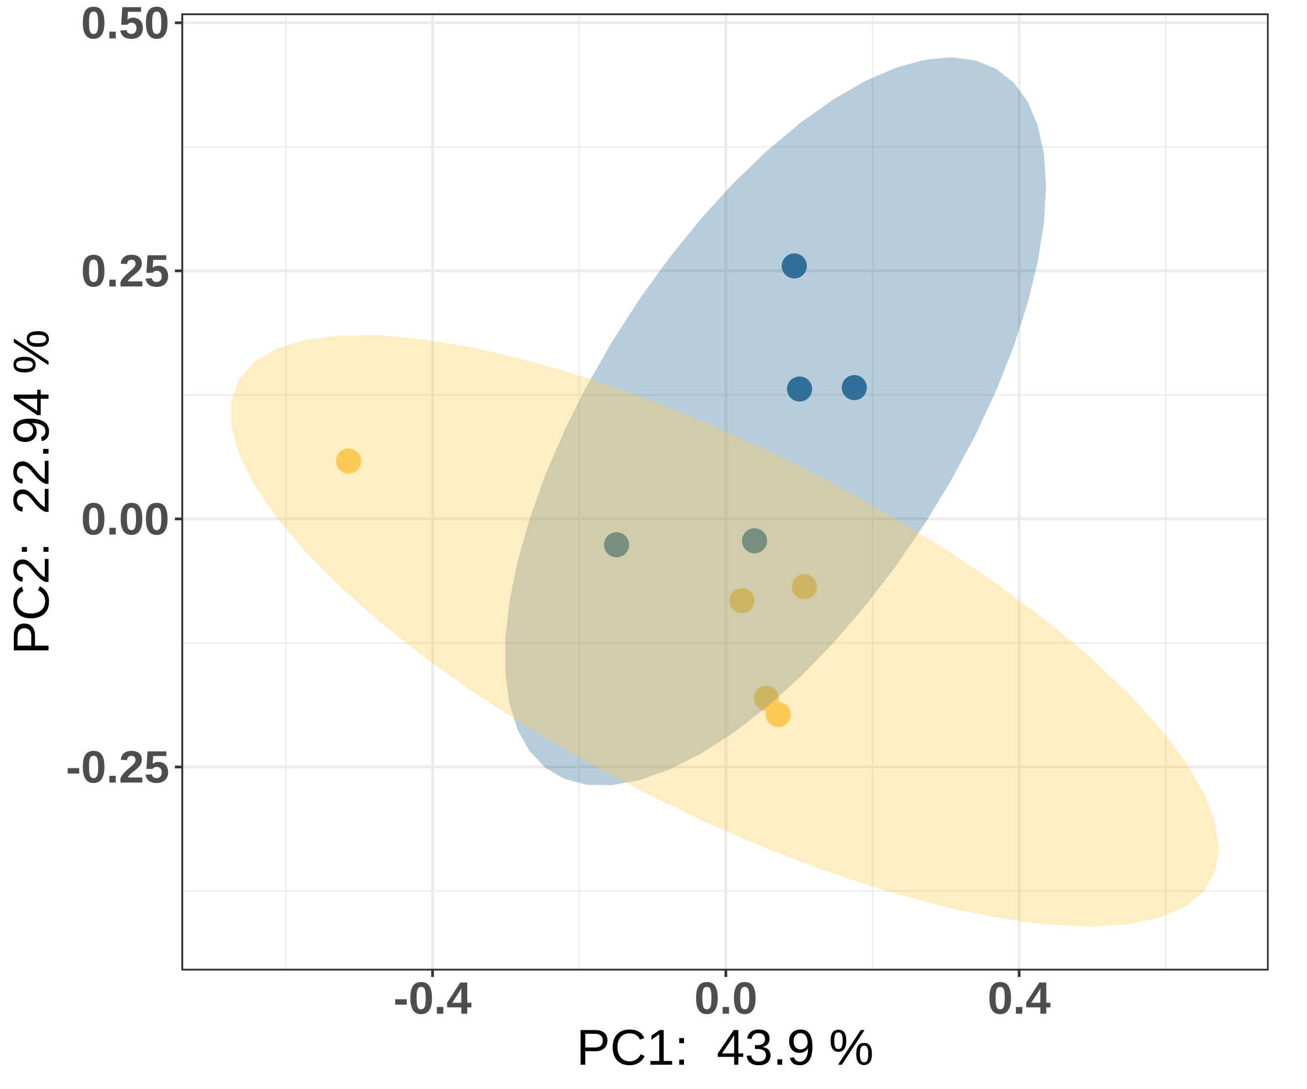
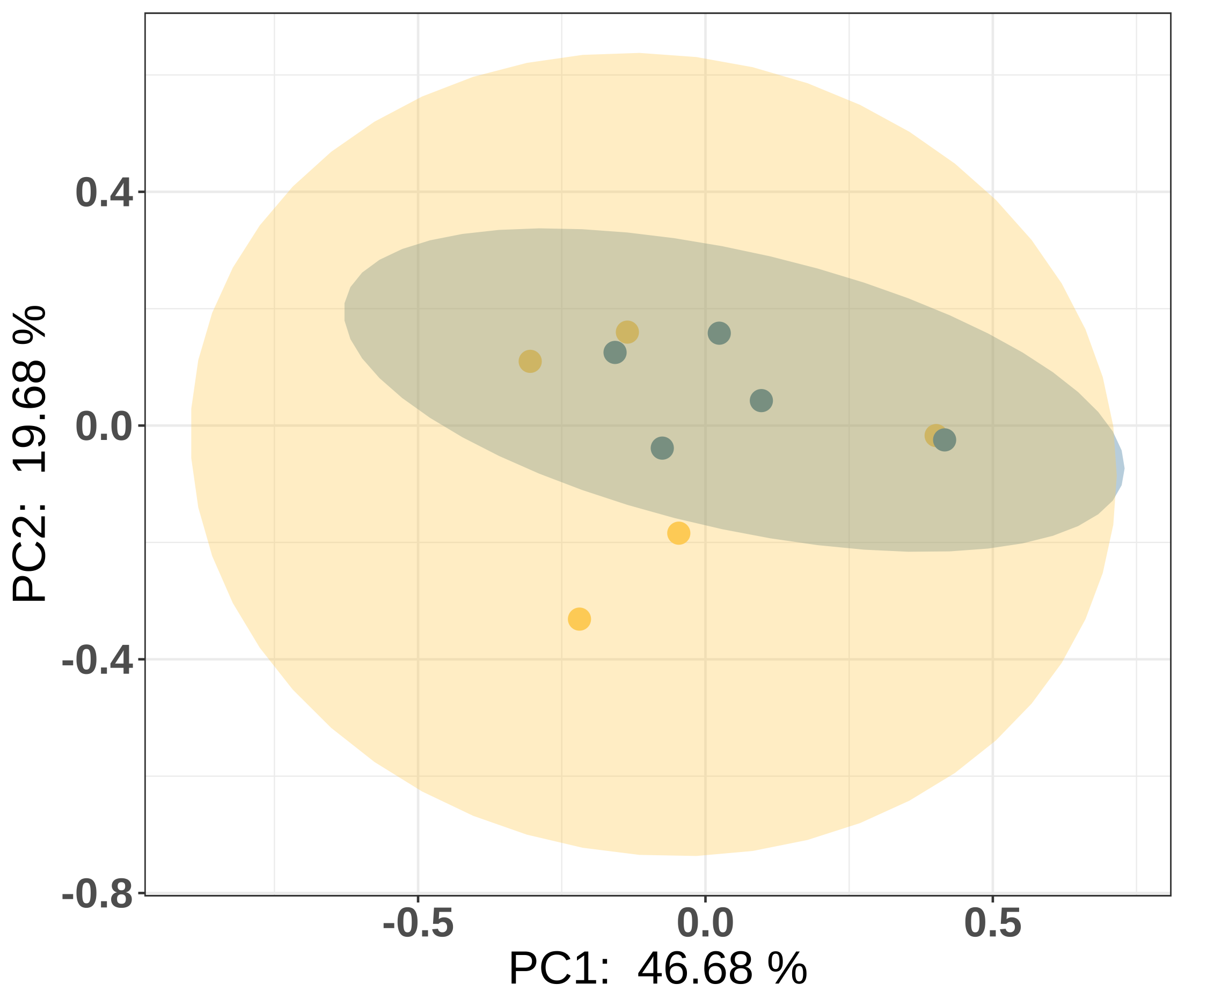
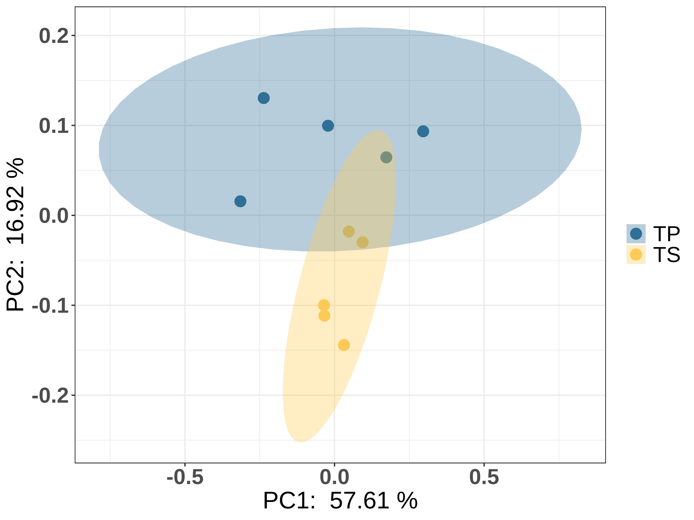
A)
B)
C)
Notes:
Figure S1: PCoA based on the weighted Unifrac metric, representing the microbiota composition at D7 (A), D21 (B), and D49(C) between the TS and TP group.

