Slide 1
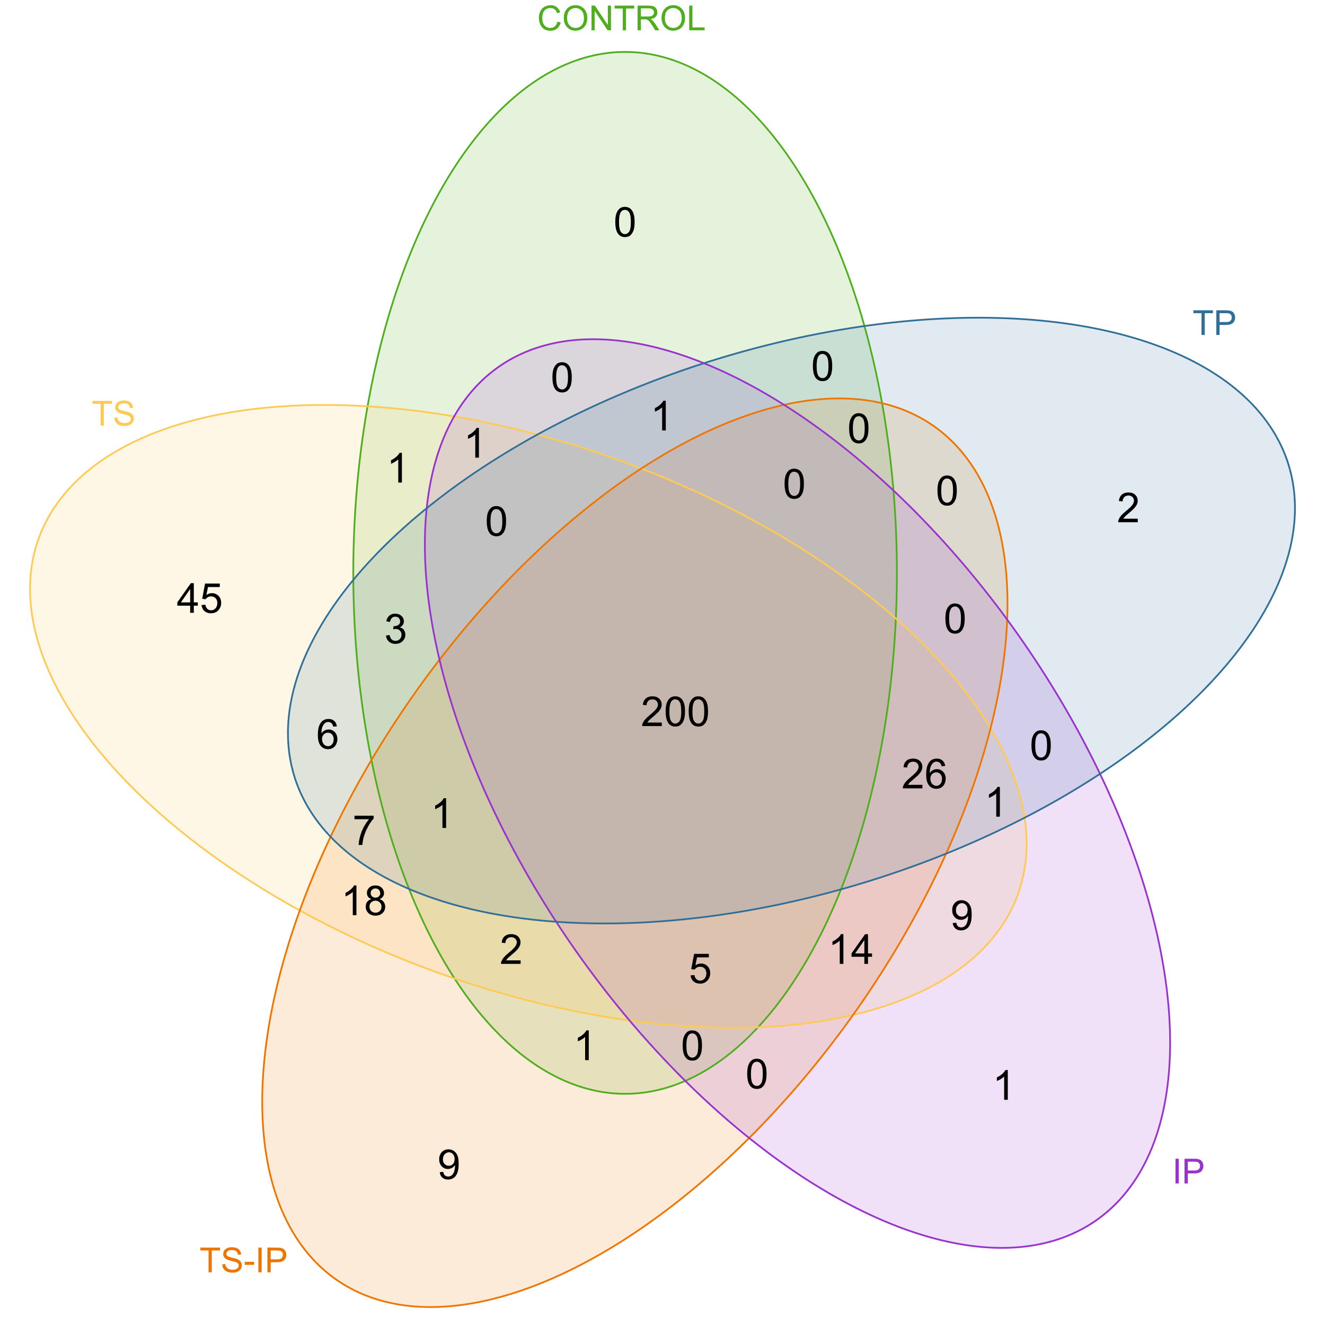

PATHWAYS
Weaning
End of nursery
A)
B)
Notes:
Figure S3. Venn diagrams representing the pathways presence and absence at weaning (A) and the end of nursery (B) in the different study groups.

