Slide 1
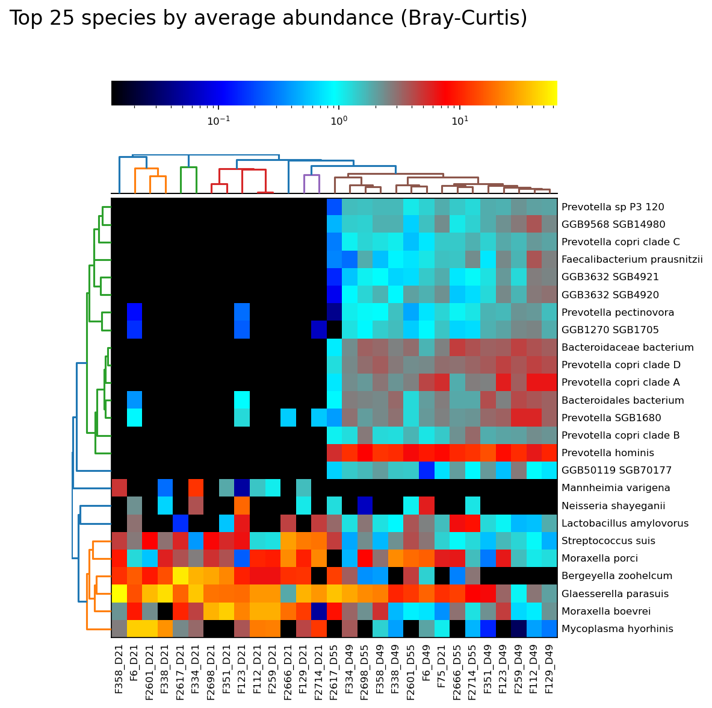
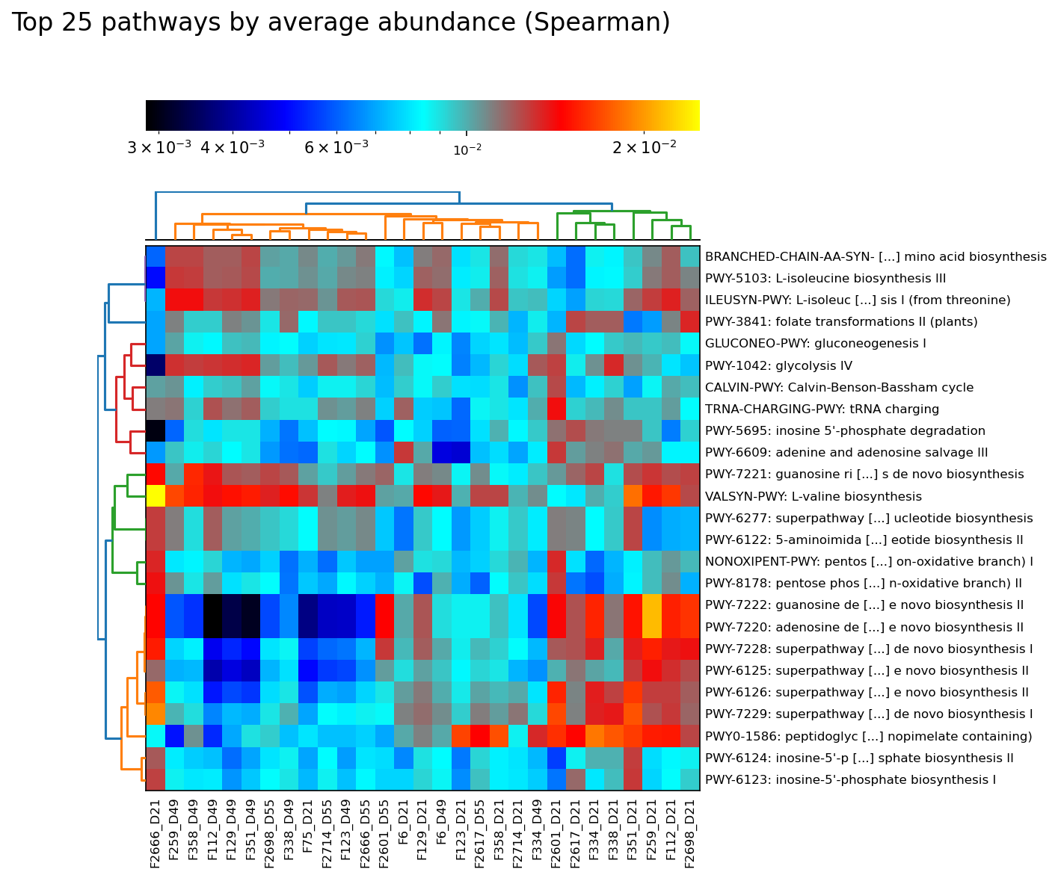
A)
B)
CONTROL – D21
TS – D21
TP – D21
CONTROL – D21
TP – D21
CONTROL – D21
TP – D21
CONTROL – D21
TS – D21
TS – D21
CONTROL – D21
TP – D21
TS – D21
TP – D21
TP – D49
CONTROL – D49
TP – D49
CONTROL – D49
CONTROL – D49
TP – D49
TS – D49
TS – D21
TP – D49
TP – D49
CONTROL – D49
TS – D49
CONTROL – D49
TS – D49
TS – D49
TP – D21
CONTROL – D49
CONTROL – D49
TS – D49
TS – D49
CONTROL – D49
TP – D49
CONTROL – D49
TS – D21
TP – D49
TS – D49
TP – D49
TP – D49
TS – D21
TS – D21
TS – D49
TS – D21
TP – D49
CONTROL – D21
TP – D21
CONTROL – D49
TP – D21
TP – D21
CONTROL – D21
CONTROL – D21
CONTROL – D21
CONTROL – D21
TS – D21
TP – D21
Notes:
Figure S2. Heatmap representing the top 25 species by average abundance clustering with Bray-Curtis (A ), top 25 pathways with Spearman (B) from the TS, TP and control groups. the top 25 species by average abundance clustering with Bray-Curtis (C), top 25 pathways with Spearman (D) from the IP, TS-IP and control groups.

Slide 2
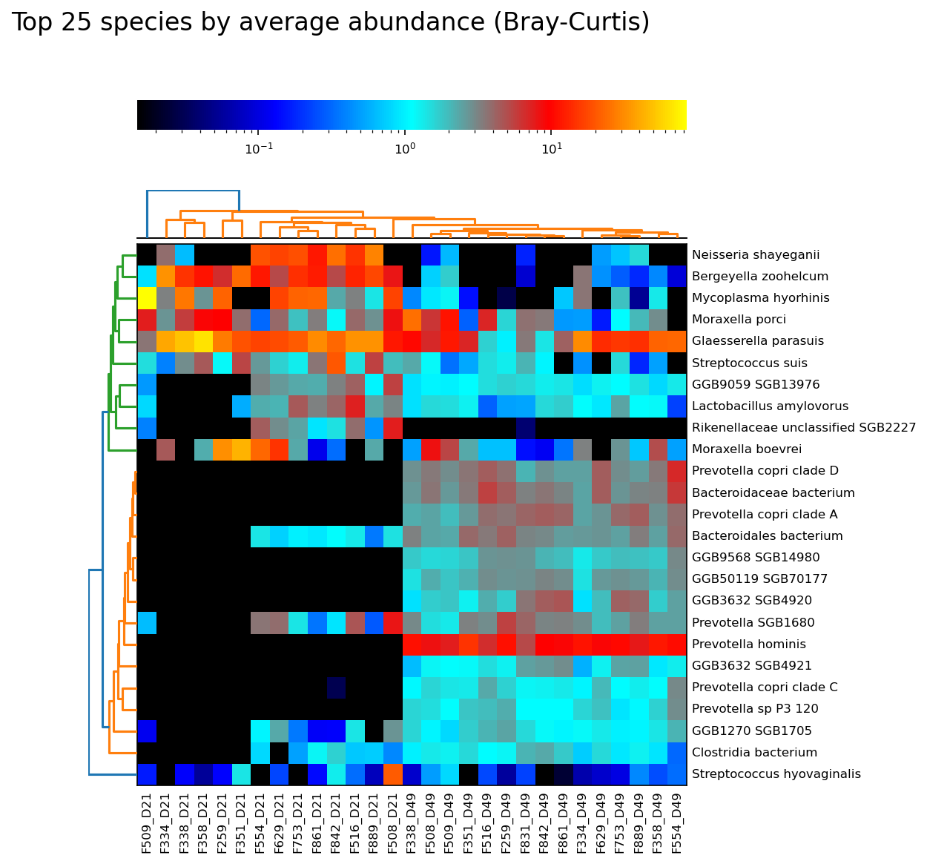
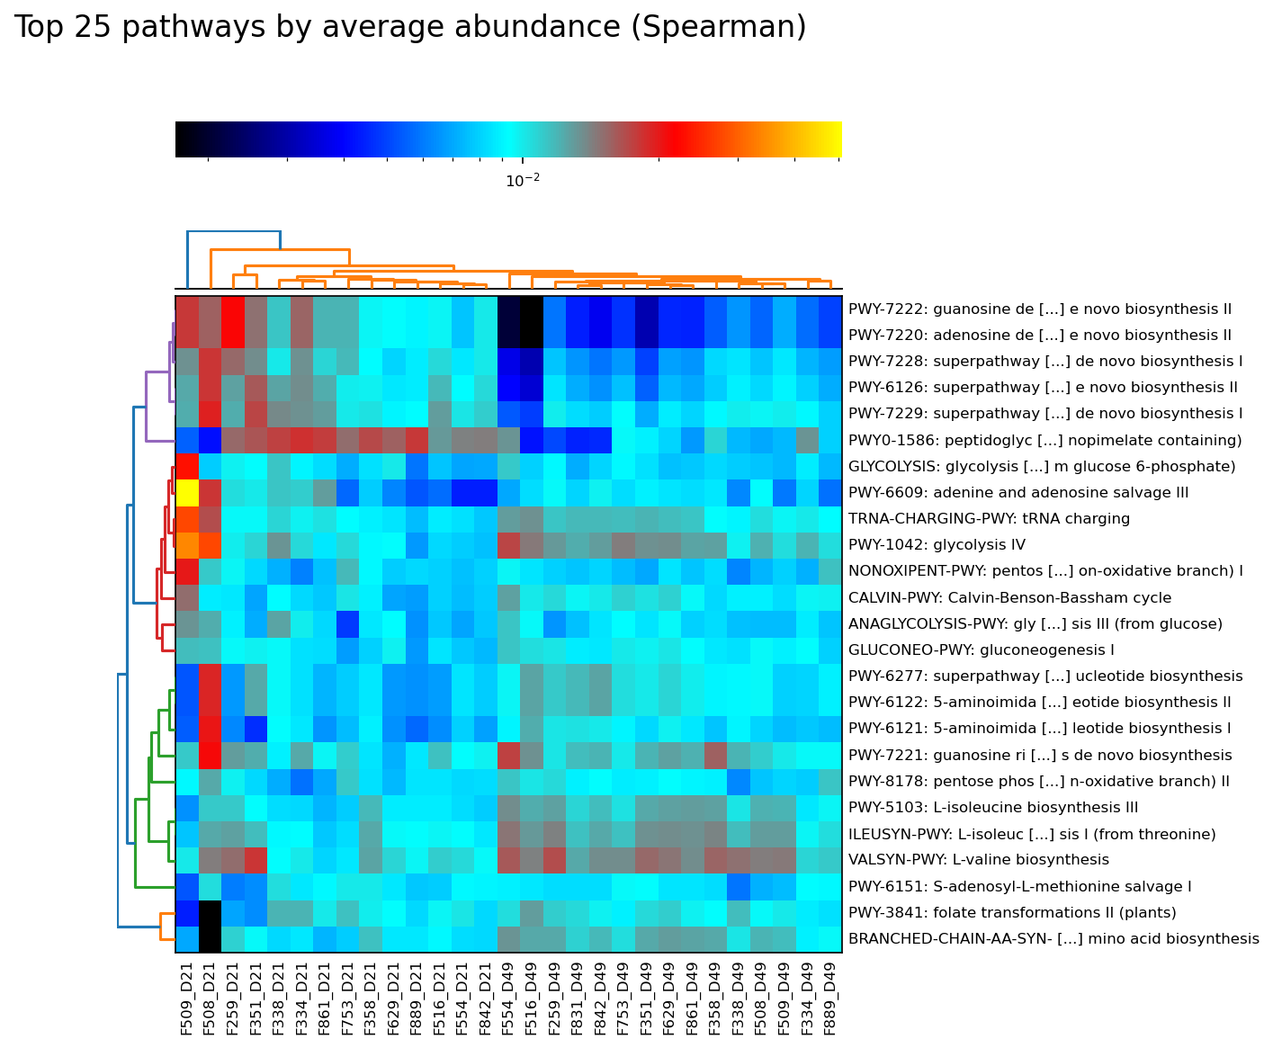
C)
D)
TS-IP – D21
CONTROL – D21
CONTROL – D21
CONTROL – D21
CONTROL – D21
CONTROL – D21
TS-IP – D21
TS-IP – D21
IP – D21
IP – D21
IP – D21
TS-IP – D21
IP – D21
TS-IP – D21
CONTROL – D49
TS-ÌP – D49
TS-IP – D49
CONTROL – D49
TS-IP – D49
CONTROL – D49
IP – D49
IP – D49
IP – D49
CONTROL – D49
TS-IP – D49
IP – D49
IP – D49
CONTROL – D49
TS-IP – D49
TS-IP – D21
TS-IP – D21
CONTROL – D21
CONTROL – D21
CONTROL – D21
CONTROL – D21
IP – D21
IP – D21
CONTROL – D21
TS-IP – D21
IP – D21
TS-IP – D21
TS-IP – D21
IP – D21
TS-IP – D49
TS-IP – D49
CONTROL – D49
IP – D49
IP – D49
IP – D49
CONTROL – D49
TS-IP – D49
IP – D49
CONTROL – D49
CONTROL – D49
TS-IP – D49
TS-IP – D49
CONTROL – D49
IP – D49
Notes:
Figure S2. Heatmap representing the top 25 species by average abundance clustering with Bray-Curtis (A ), top 25 pathways with Spearman (B) from the TS, TP and control groups. the top 25 species by average abundance clustering with Bray-Curtis (C), top 25 pathways with Spearman (D) from the IP, TS-IP and control groups.

