Slide 1
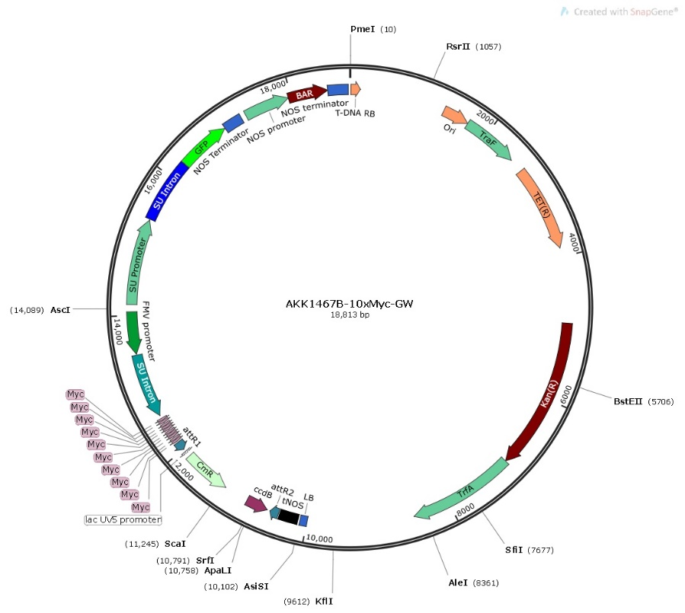
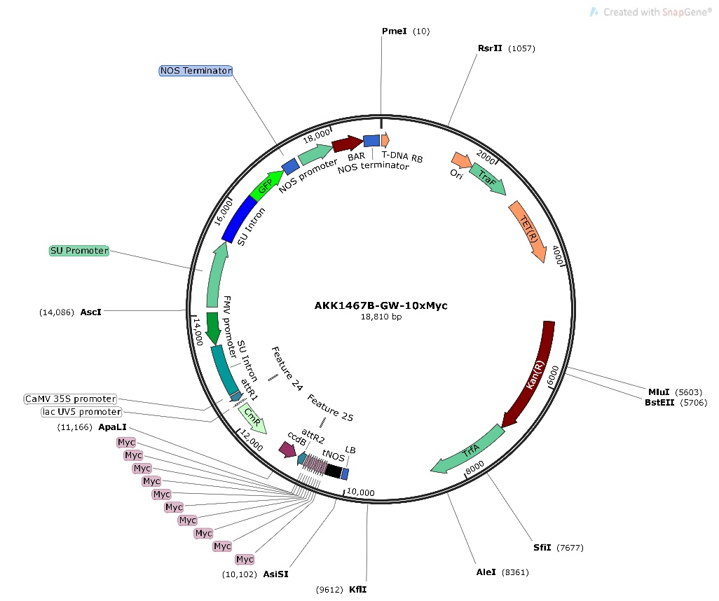
Figure S27. Maps of the modified AKK1467B-GW-myc and AKK1467B-myc-GW plasmids used for functional studies. Plasmid maps were created with Snapgene (GSL Biotech LLC)

