Slide 1
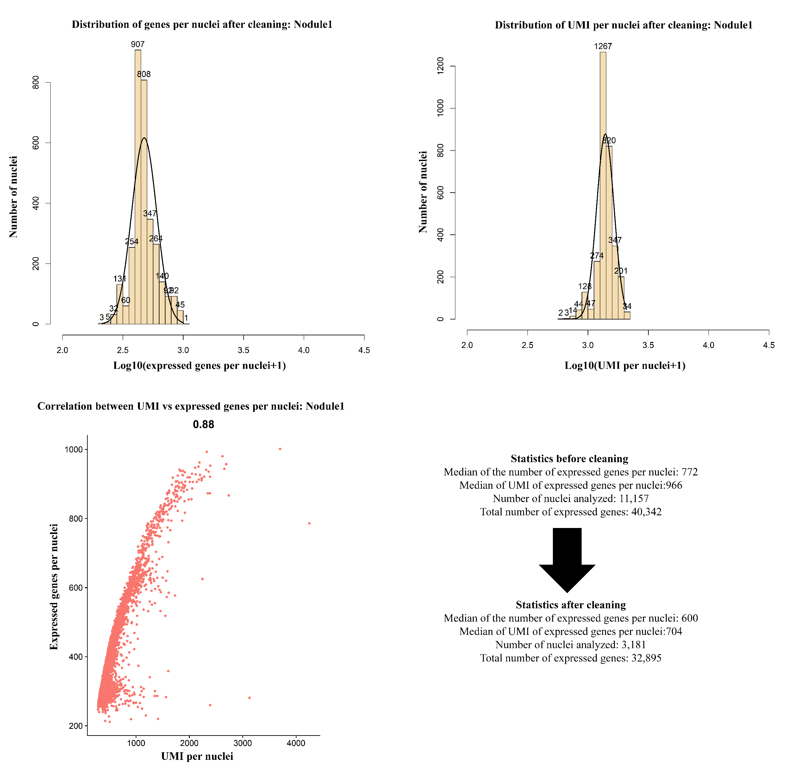
Figure S8. Metrics of the Nodule replicate 1 sNucRNA-seq library. Top panels: Distribution of the number of genes and UMI per nucleus after data processing. Bottom: Correlation plot between the number of UMI and the number of expressed genes per nucleus; summary of the metrics before and after data processing.

