Slide 1
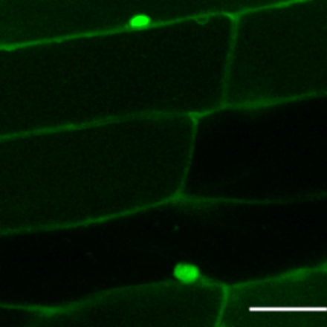
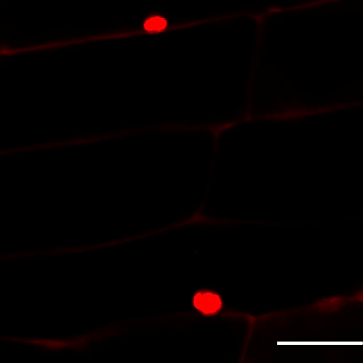
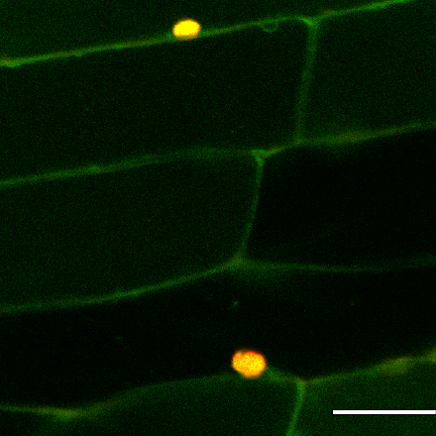
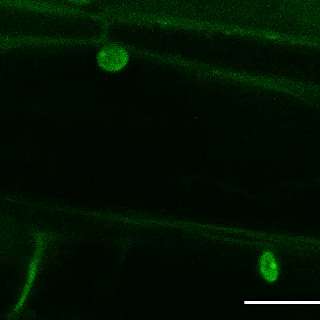
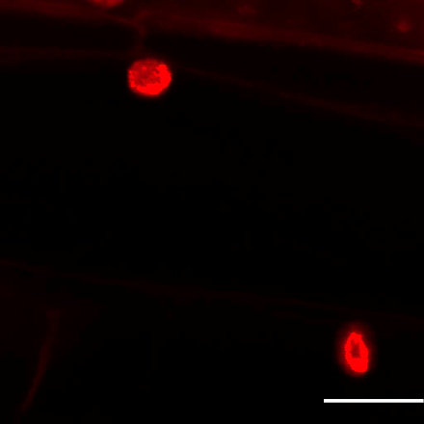
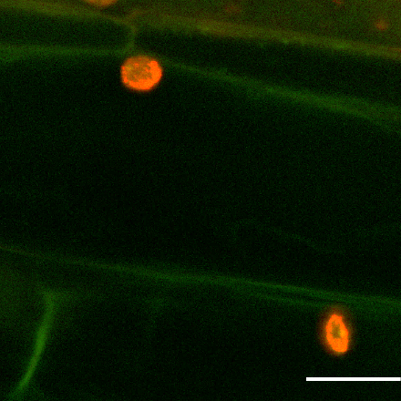
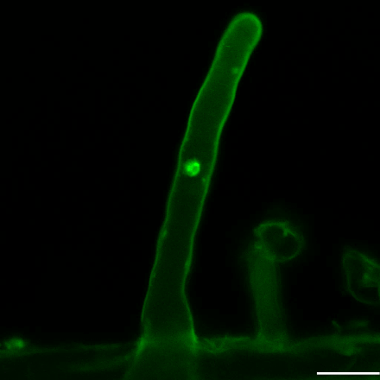
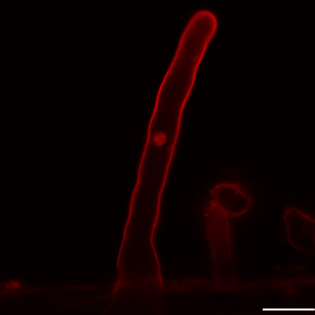
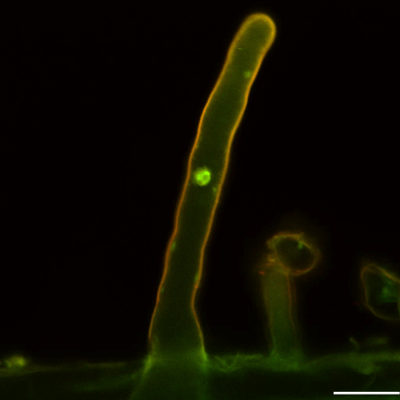
GFP
PI
Merged
A
B
C
p35S: GFP
D
E
F
p35S: GmFWL3-GFP
G
H
I
G
H
I
G
H
I
p35S: GmFWL3-GFP
Figure.S22. Subcellular localization of GmFWL3 in soybean root and root hairs. Optical cross sections of soybean roots transformed with p35S::GFP (A-C) and p35S::GmFWL3-FWL3 (D-F). Maximum intensity (MaxIP) projection of soybean root hairs transformed with p35S:GmFWL3-GFP (G-H) revealed the plasma membrane and nuclear localization of the GFP-GmFWL3 chimeric proteins. Propidium iodide (PI) was used to counter stain nuclei (B, E, H). Scale Bar: 20uM.

