Slide 1
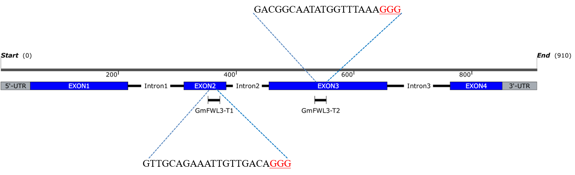
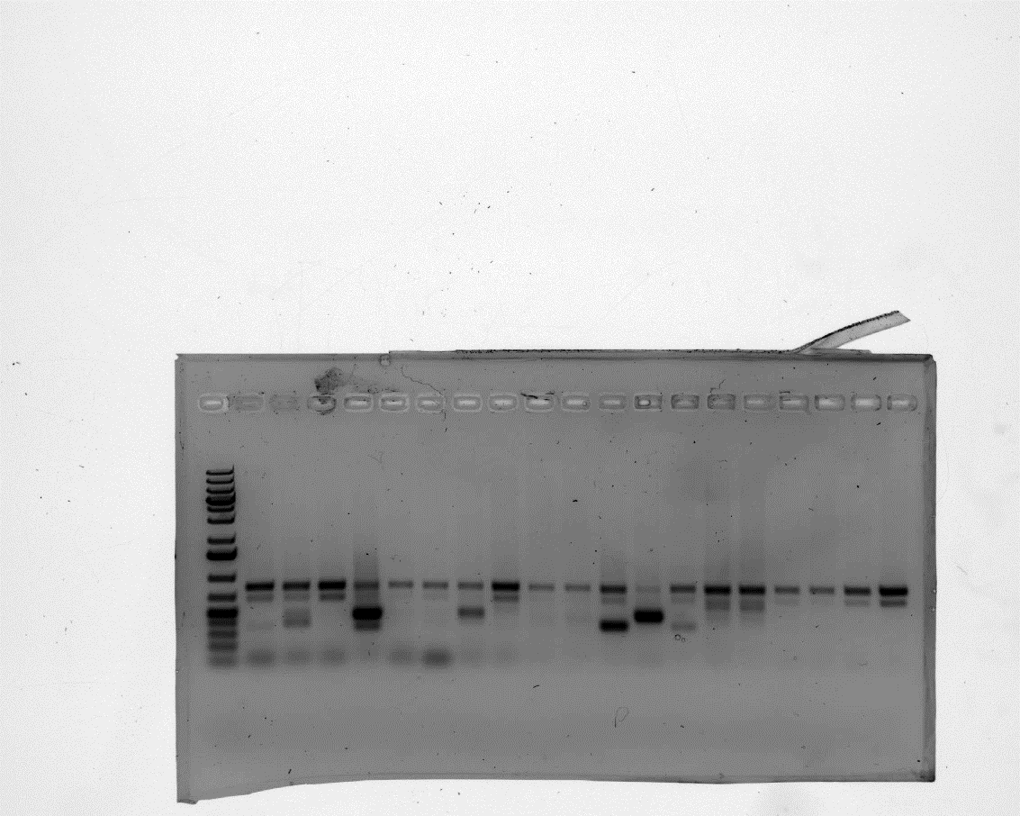
A
RP
5’utr-FP
B
#28-R1
#54-R1
#60-R1
#62-R1
#64-R1
#65-R1
#33-R2
#34-R2
#35-R2
#36-R2
#37-R2
#56-R2
#57-R2
#58-R2
#59-R2
#26-R1
#60-R2
C-R1
C-R2
Figure S18. Mutagenesis of GmFWL3 using CRISPR-Cas9 technology. (A) Location of the GmFWL3-T1 and –T2 CRISPR/Cas9 target sites. GmFWL3 exonic and intronic sequences are highlighted with blue stripes and black lines, respectively. The PAM sequences of the guide RNAs are highlighted with underlined red characters. The location of the 5’UTR-FP and RP screening primers is also highlighted. (B) Molecular analysis of the GmFWL3 mutagenesis induced by CRISPR-Cas9. Using PCR technology, we amplified the GmFWL3 gDNA sequence using the 5’utr-FP and RP primers. We observed the predominance of heterozygote genotypes (presence of wild-type band~817bp and mutant band ~450-500 bp). CAS9/GmFWl3-T1-T2 roots #26-28, #54, #60-65 and #33-37, #56-60 were isolated from two independent biological replicates. C1 and C2 are transgenic roots from CAS9/pAH595 control hairy roots. R1=Replicate1, R2=Replicate 2, C=control. The white arrow points to the bands processed for sequencing upon a second PCR.

