Slide 1
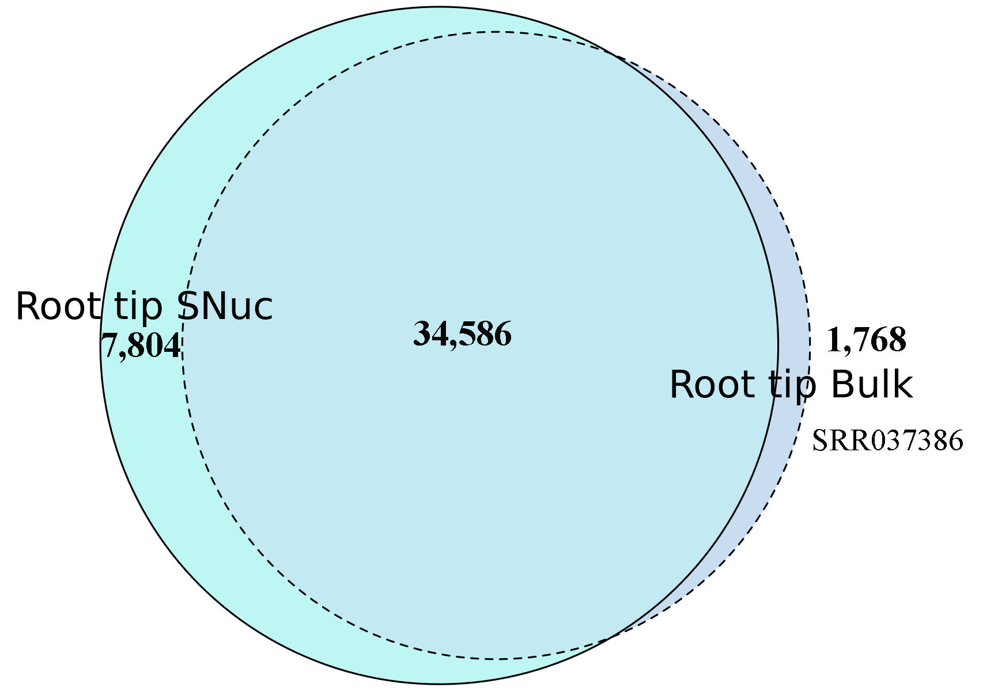
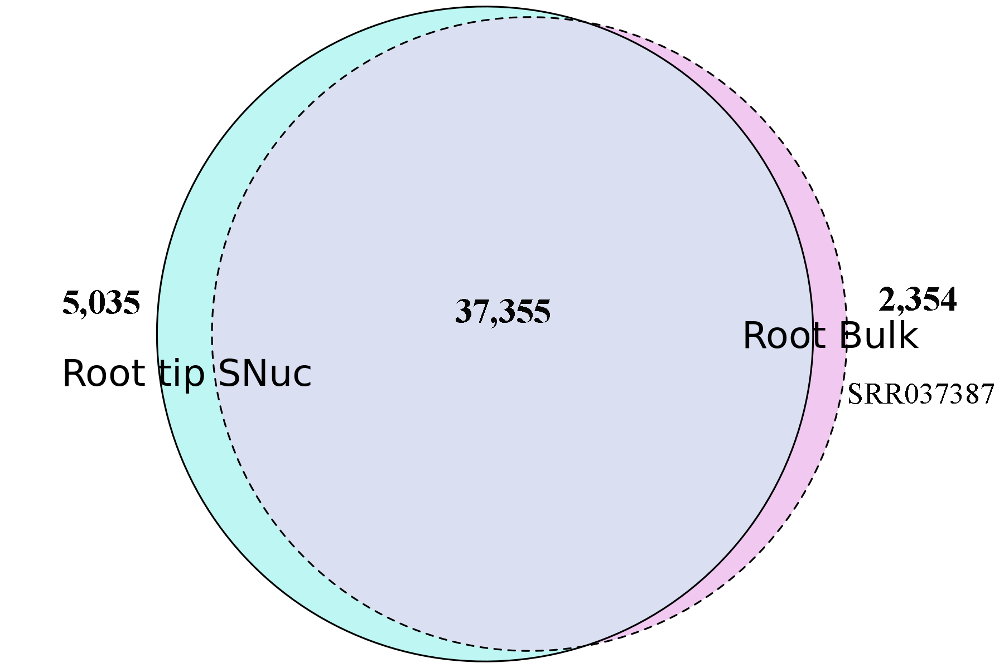
a
b
Figure S5. Venn-diagrams showing the number of expressed genes between the single-nuclei root tip transcriptome and the bulk root tip (a; SRR037386) and bulk root transcriptomes (b; SRR037387) (Libault et al., 2010).

