Slide 1
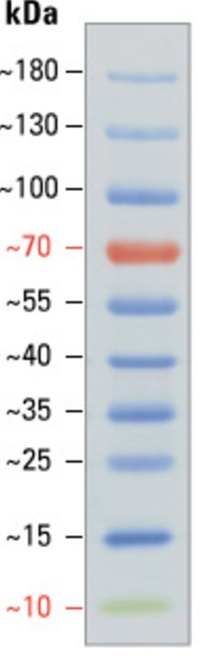
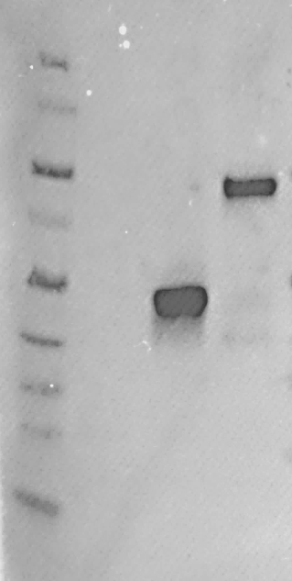
Total protein
Co-IP
10Myc-GmFWL3-GFP
10Myc-GmFWL3-GFP
AKK1467B-Myc-GW
AKK1467B-Myc-GW
Ladder
GmFWL3-10Myc
Ladder
GmFWL3-10Myc
Figure S24. Western blots of the GmFWL3-Myc tag chimeric proteins expressed in transgenic soybean nodules before and after co-immunoprecipitations. The expressions of the GmFWL3-myc tag (~38kDa) and Myc-GmFWL3-GFP (~68kDA) fusion proteins in soybean nodules were validated using an anti-myc tag-HRP conjugated primary antibody. The myc-tag alone (i.e., AKK1467B-Myc-GW) was used as negative control.

