Slide 1
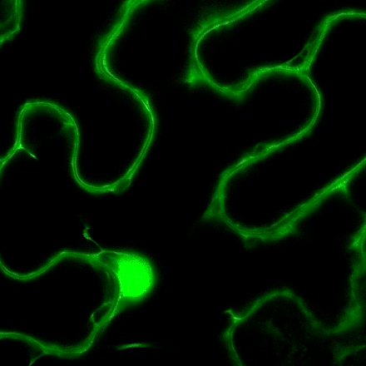
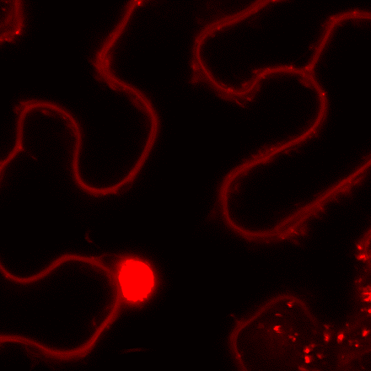
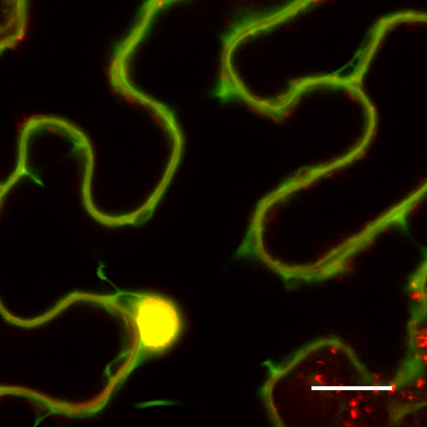
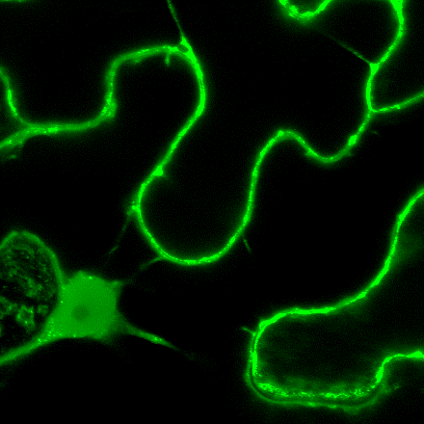
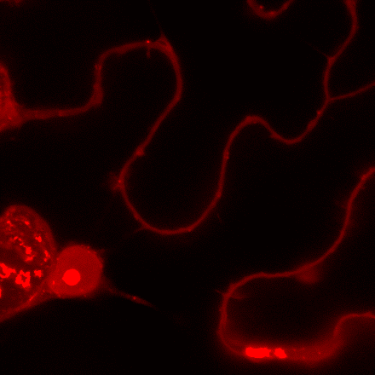
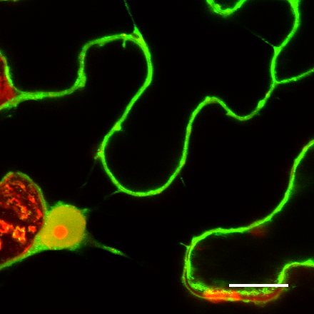
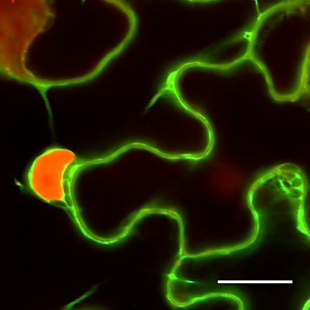
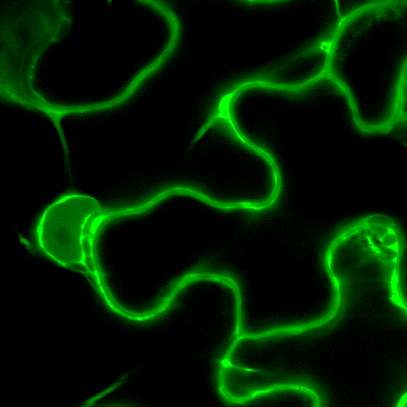
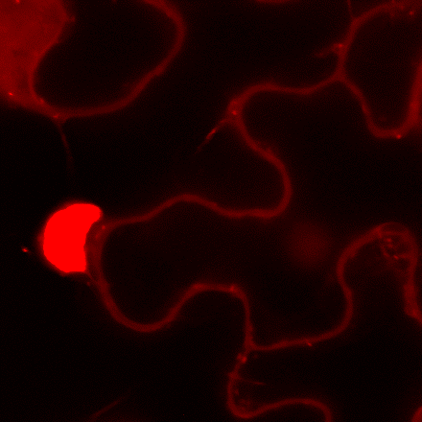
GFP
PI
Merged
a
B
C
b
c
p35S: GFP
d
e
f
F
p35S:GFP-GmFWL3
G
H
I
G
H
I
g
h
i
p35S: GmFWL3-GFP
Figure S19. Subcellular localization of GmFWL3 in tobacco leaf cell nucleus. Cross sections of tobacco leaf cells transiently expressing p35S::GFP (a-c), p35S::GFP-GmFWL3 (d-f) and p35S::GmFWL3-GFP (g-i) revealed the cytosolic and nuclear localization of the GFP alone, and the nuclear plasma membrane localization of the GFP-GmFWL3 chimeric proteins in tobacco leaf cells. Propidium iodide (PI) was used to stain the nucleus of the cells. Scale Bar: 20uM.

