Slide 1
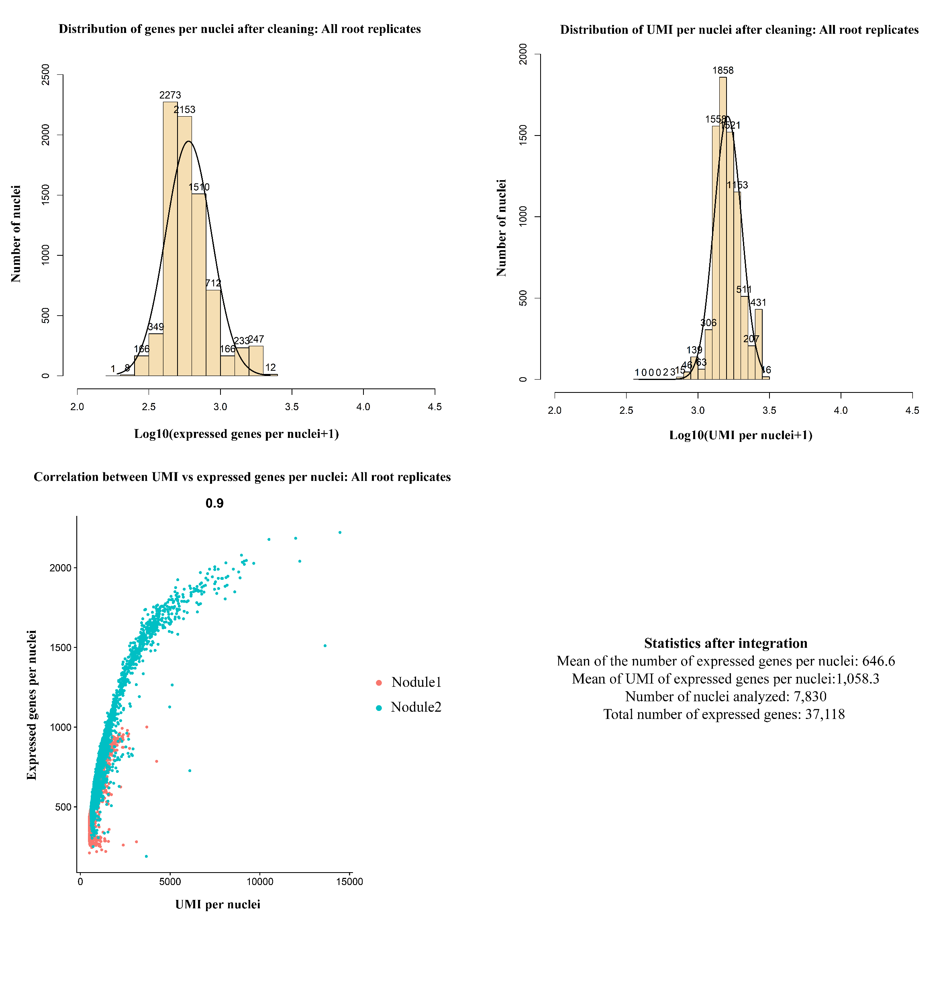
Figure S10. Integrated sNucRNA-seq metrics of the Nodule replicates 1 and 2 libraries. Top panels: Distribution of the number of genes and UMI per nucleus after data processing. Bottom: Correlation plot between the number of UMI and the number of expressed genes per nucleus; summary of the metrics after data processing.
Notes:
transparency

