Slide 1
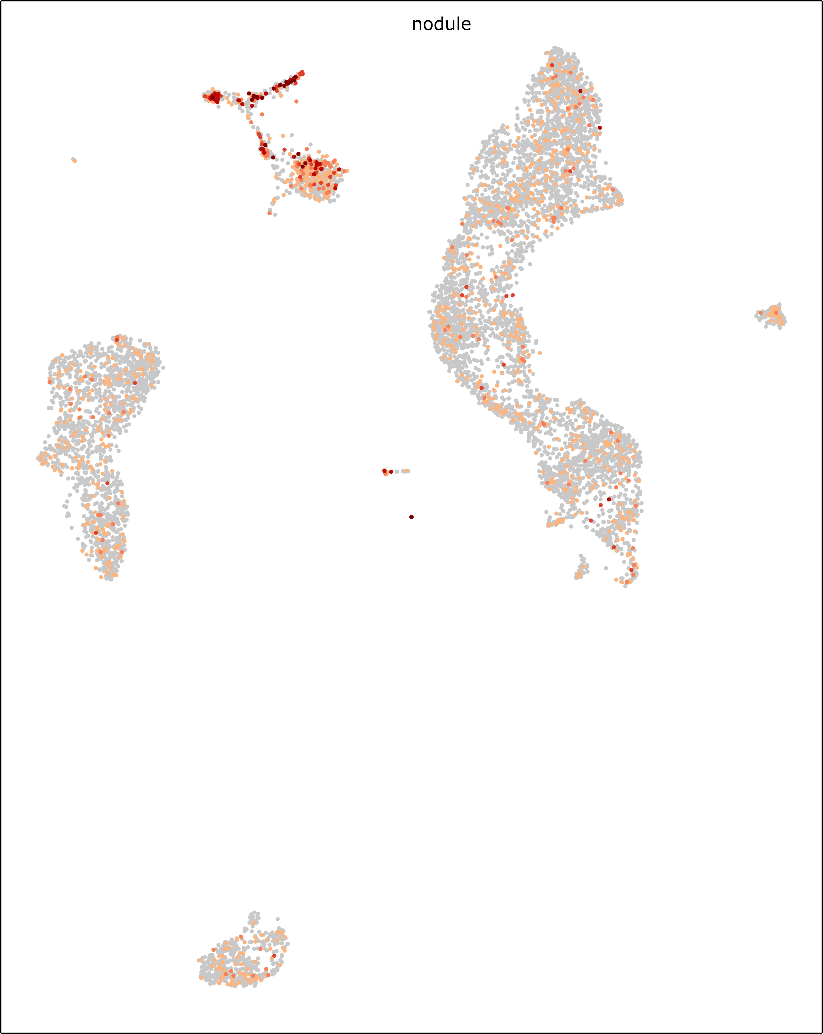
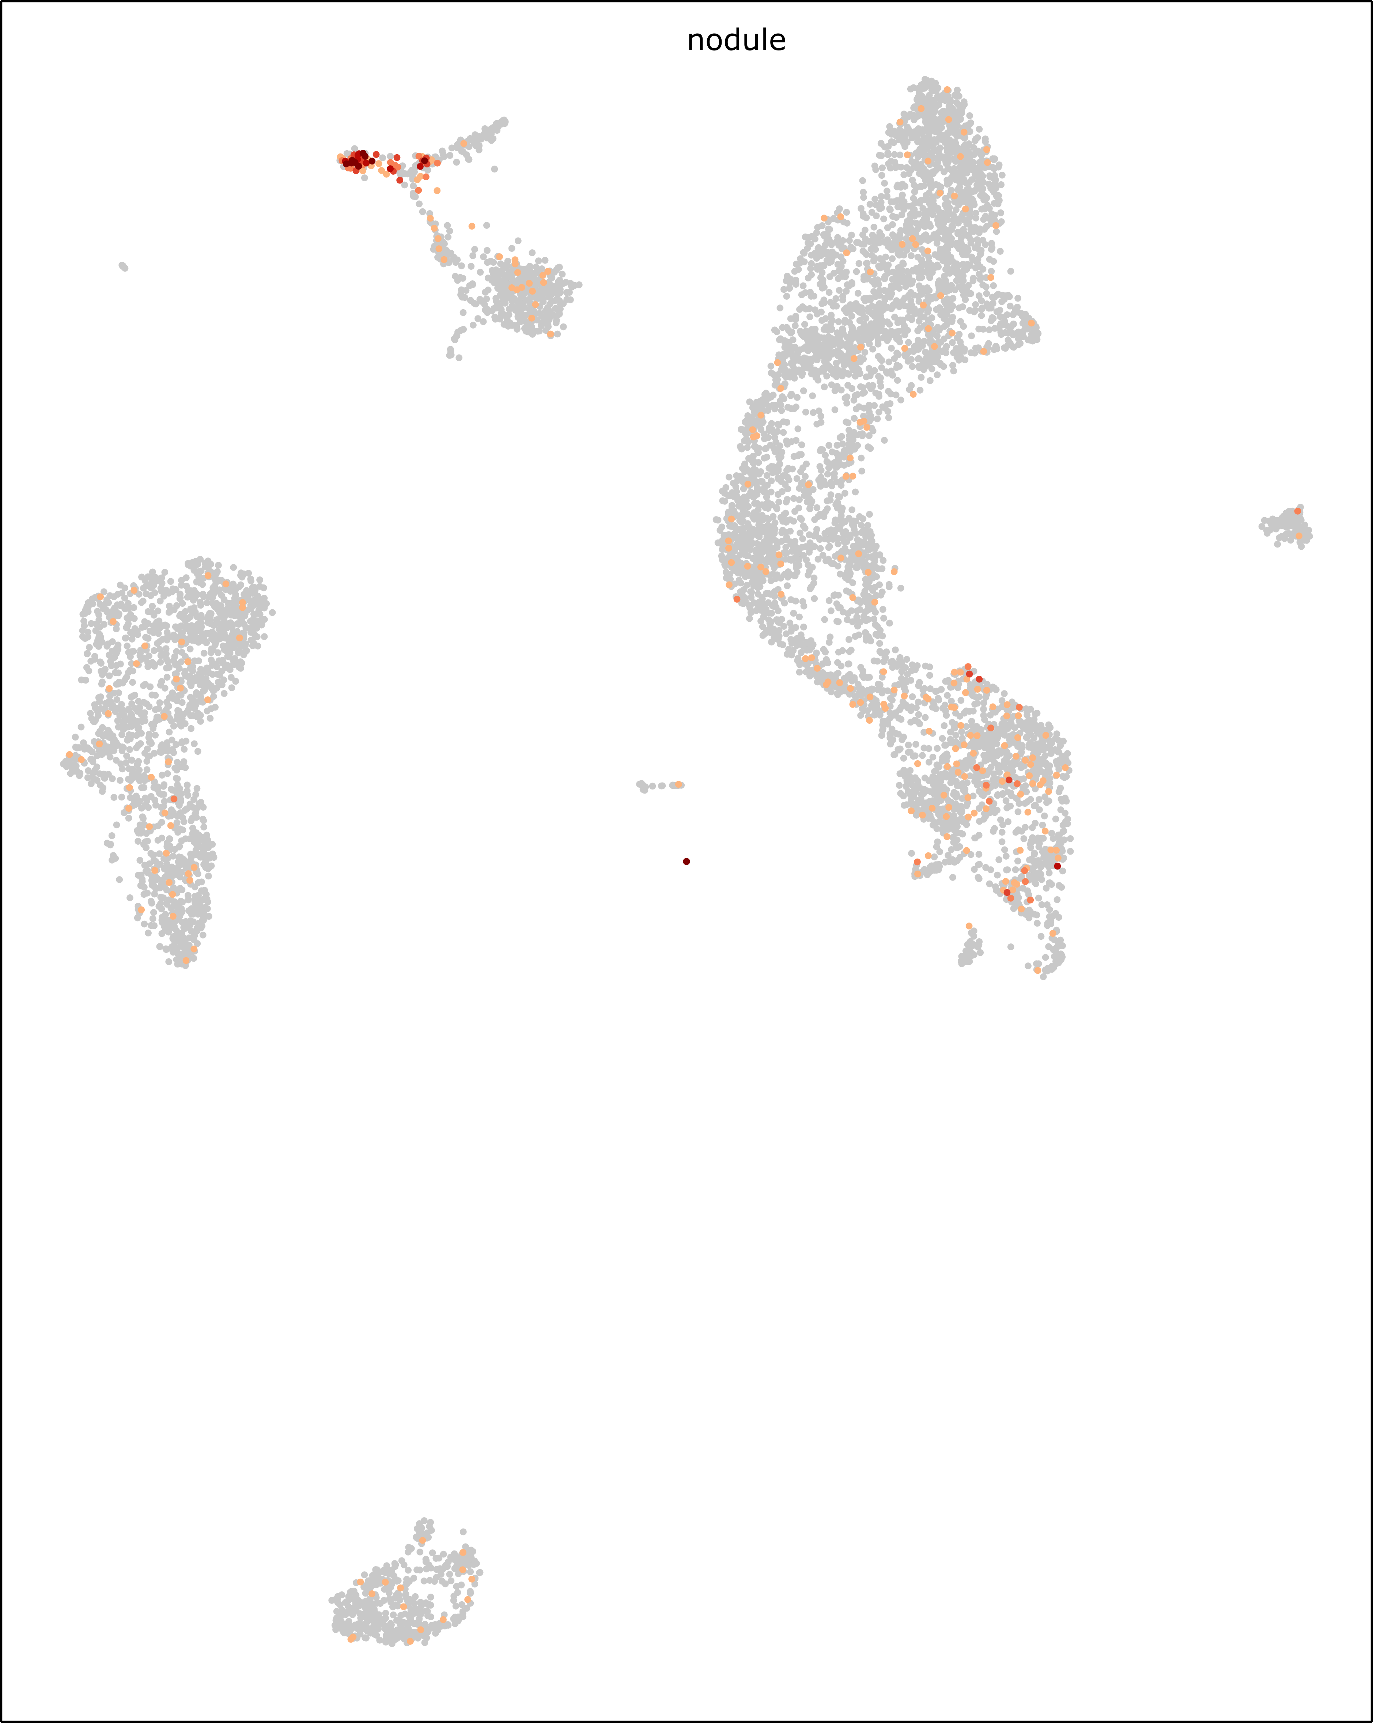
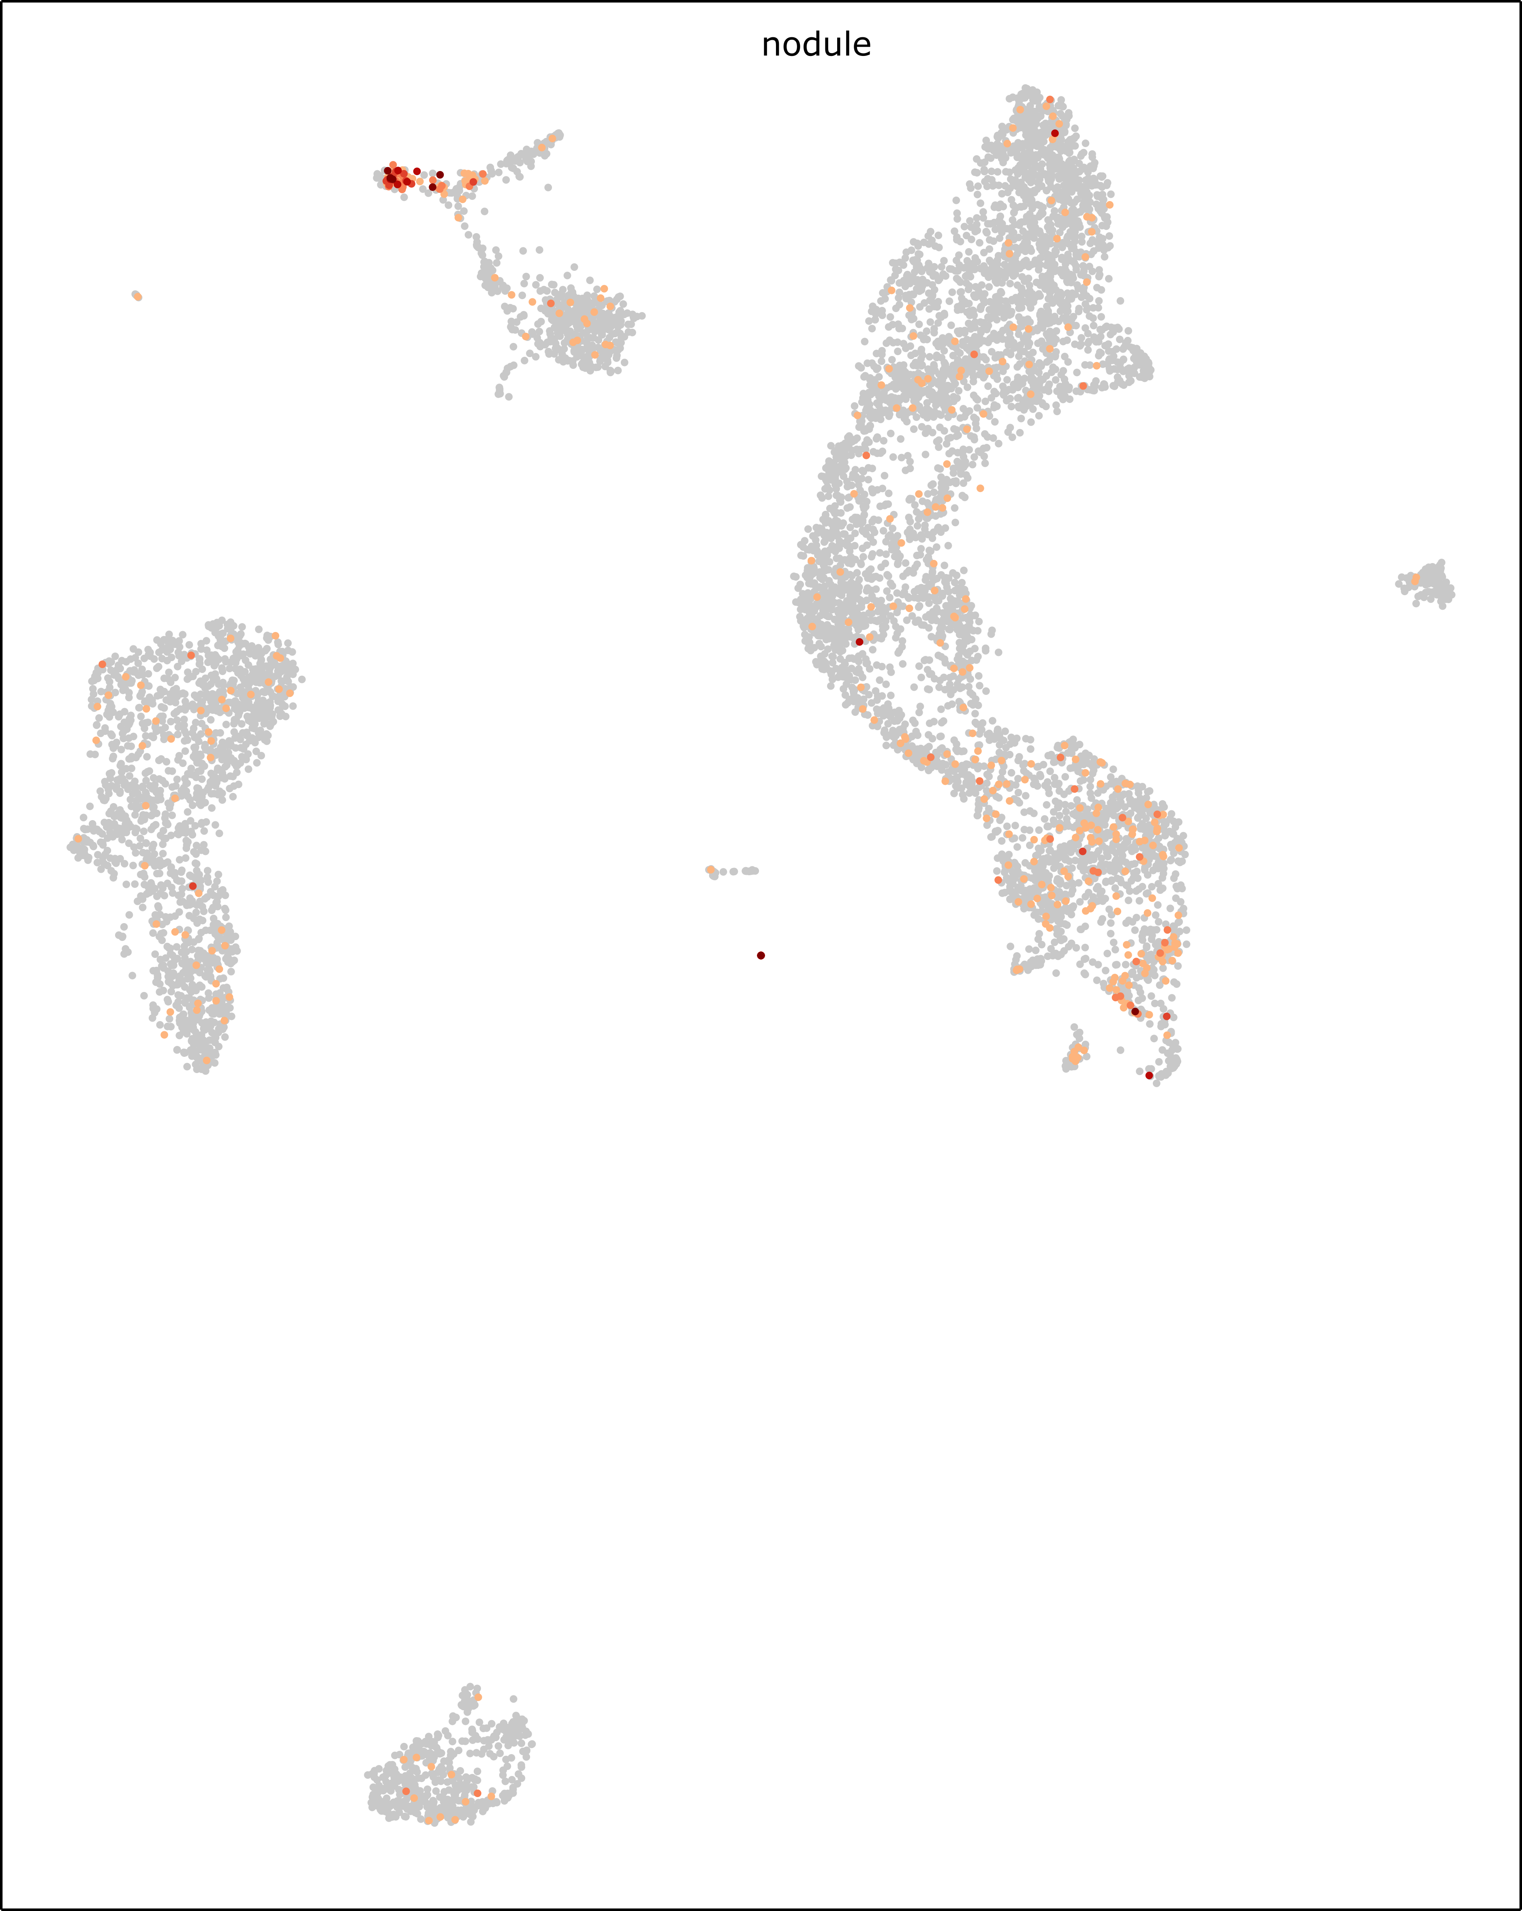

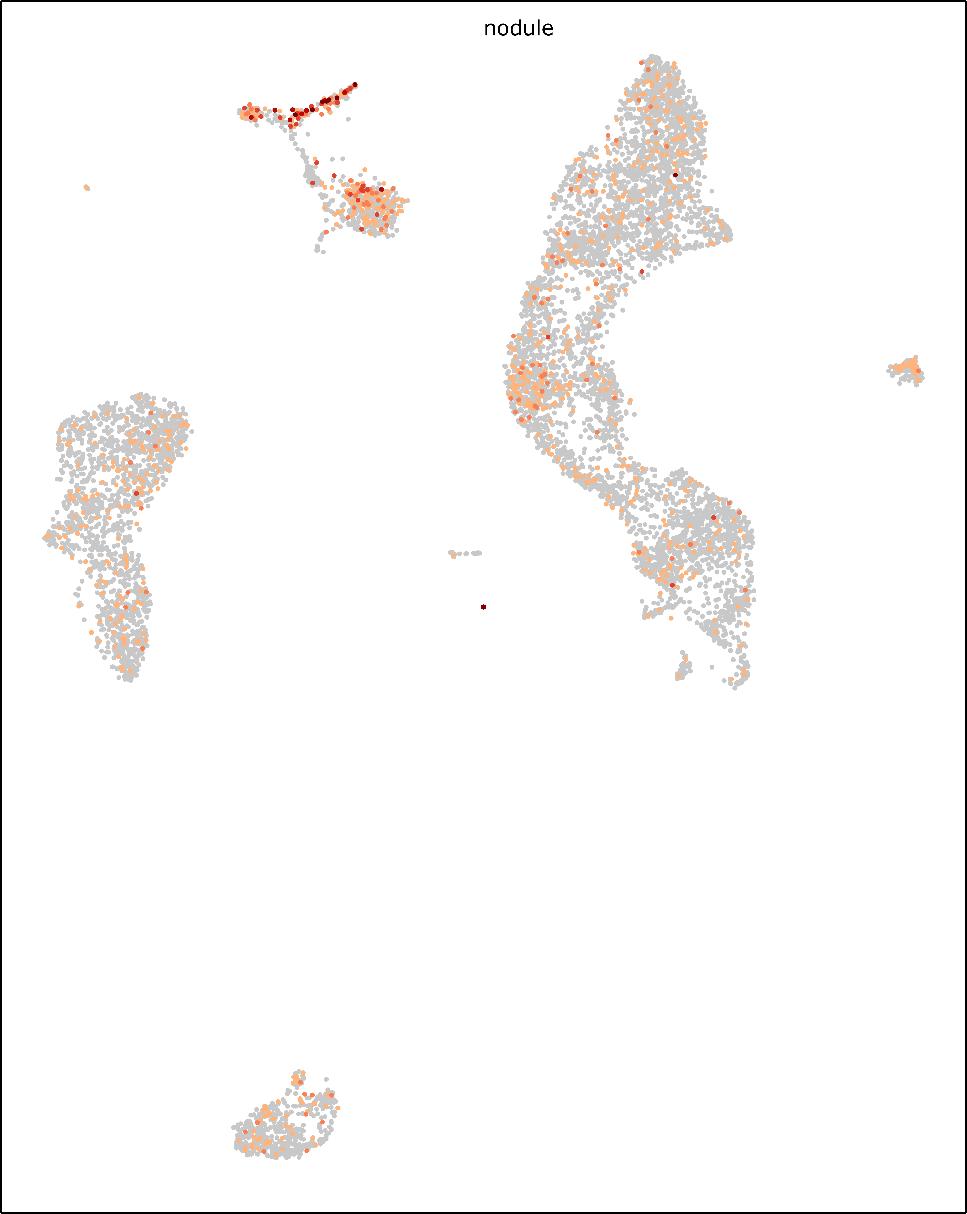
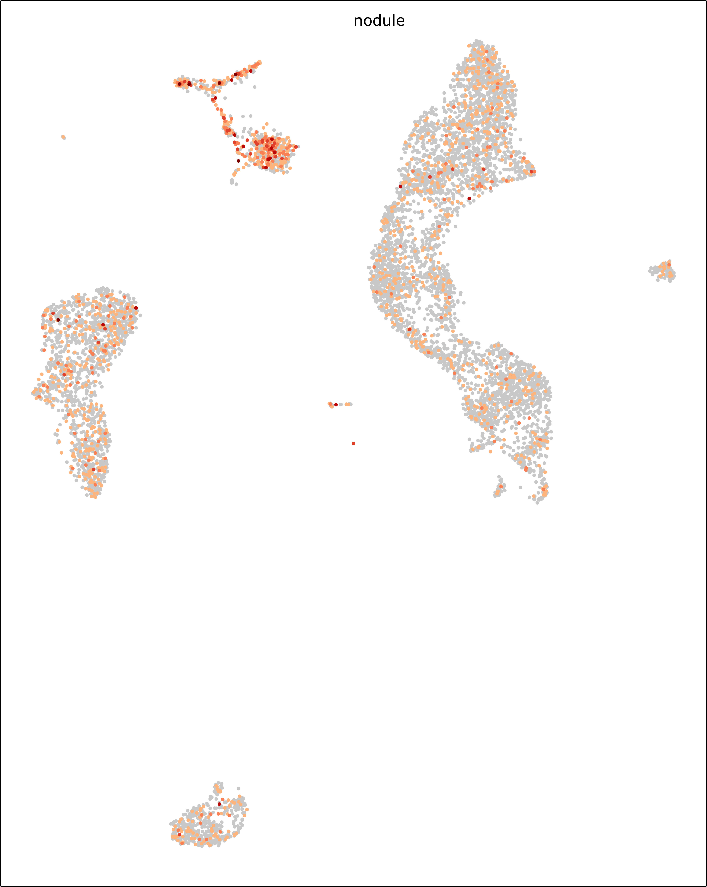
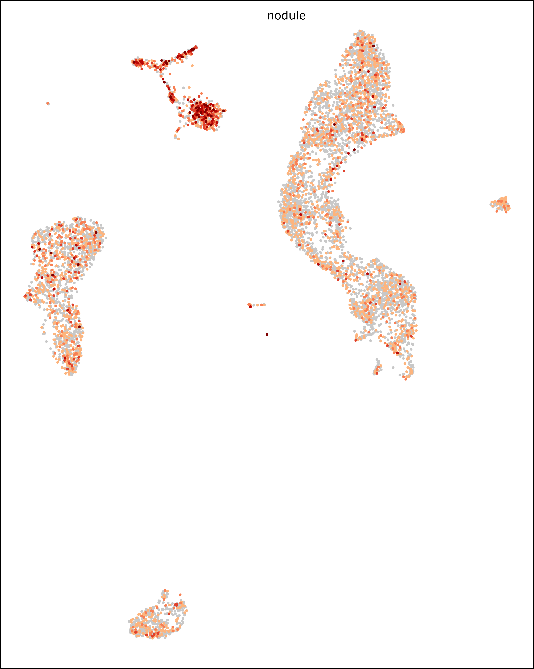
GLYMA_18G180800
GLYMA_13G252600
GLYMA_15G062300
5
GLYMA_16G100400
GLYMA_15g148900
TCTP (GLYMA_09G044200)
0
Figure S16. UMAP projection of the expression of the 6 marker genes of cluster I of the soybean nodules. The color scale reflect the level of activity of the genes and is linear.

