Slide 1
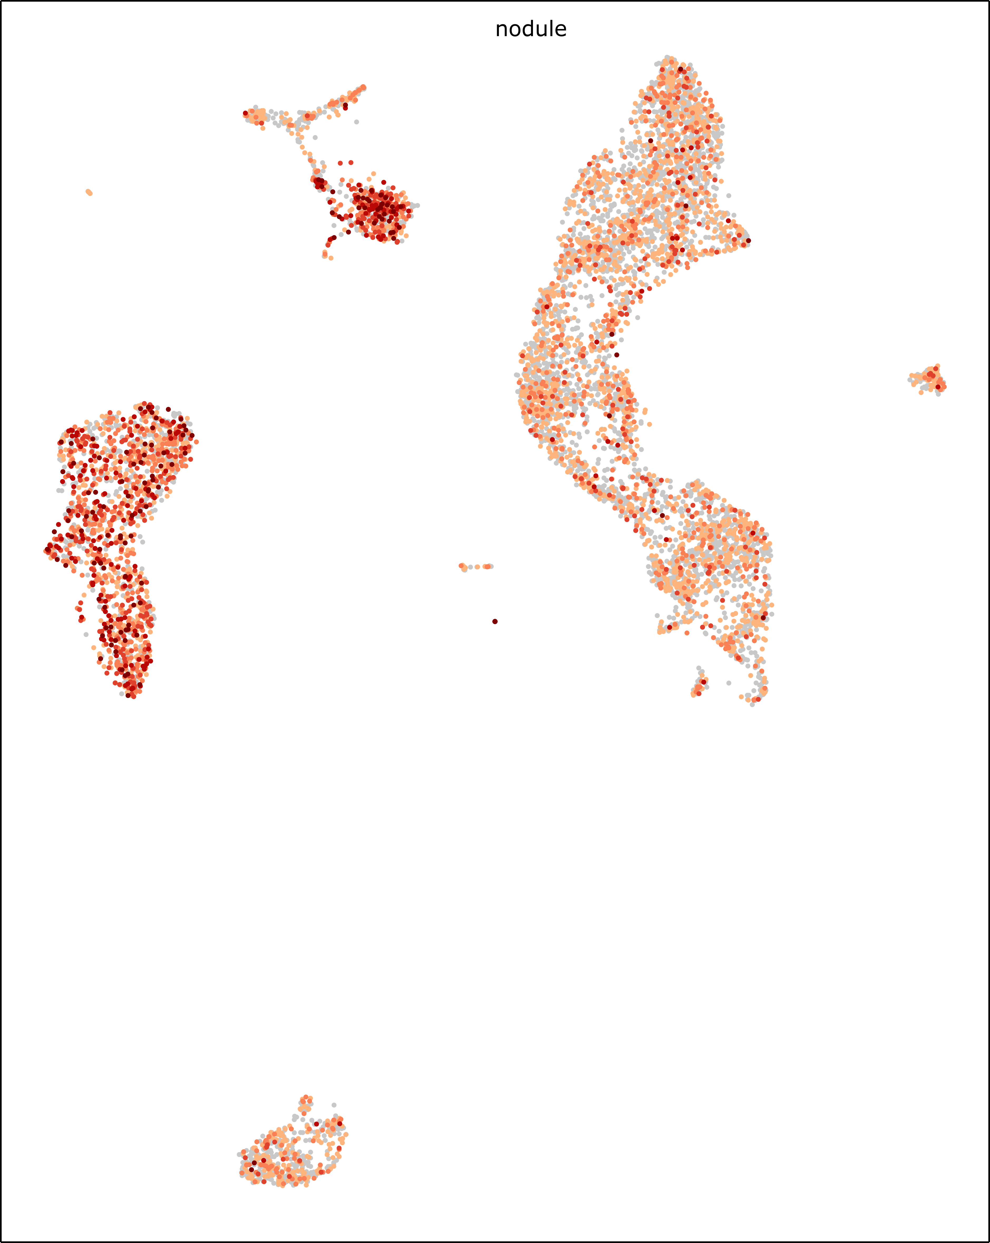
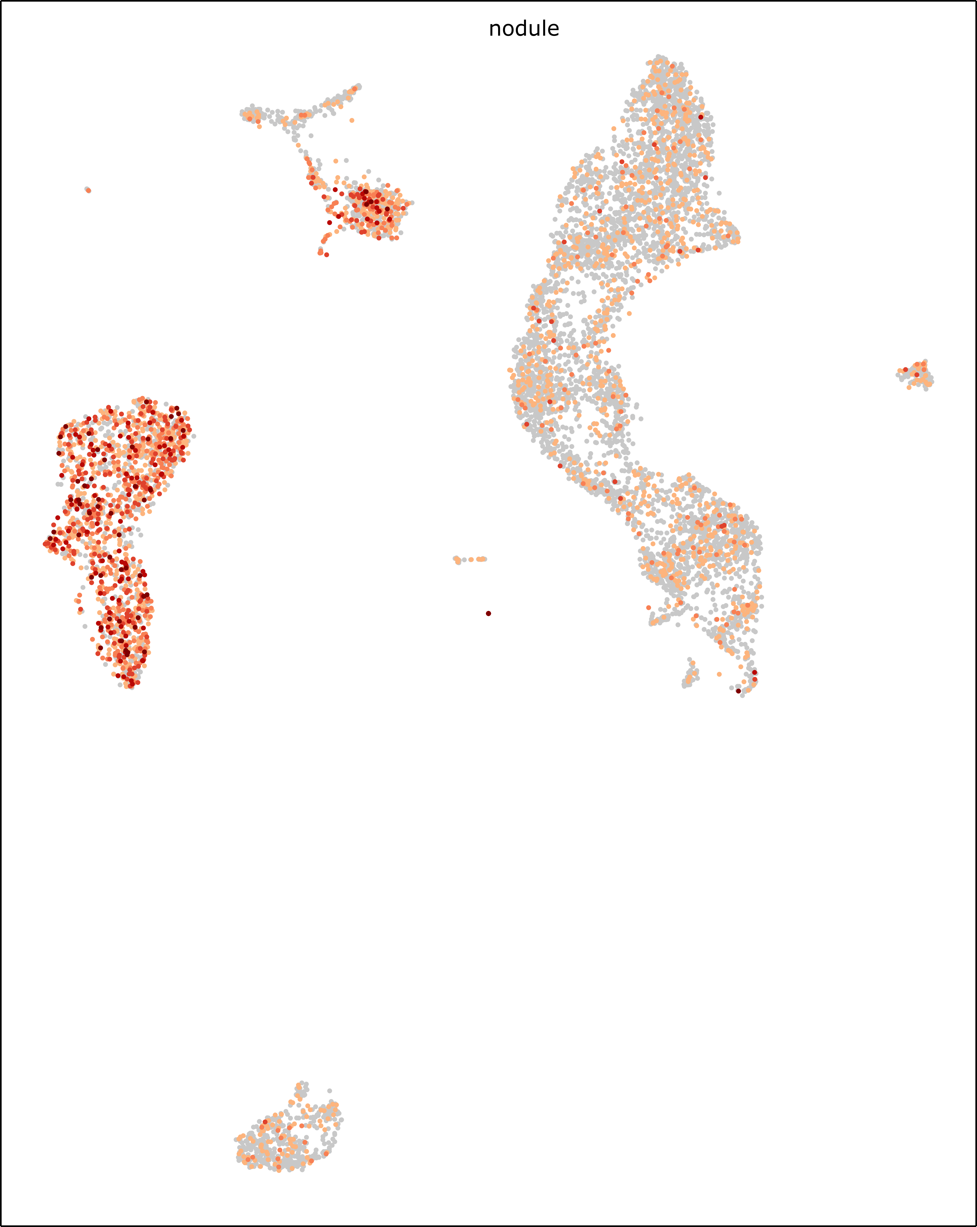
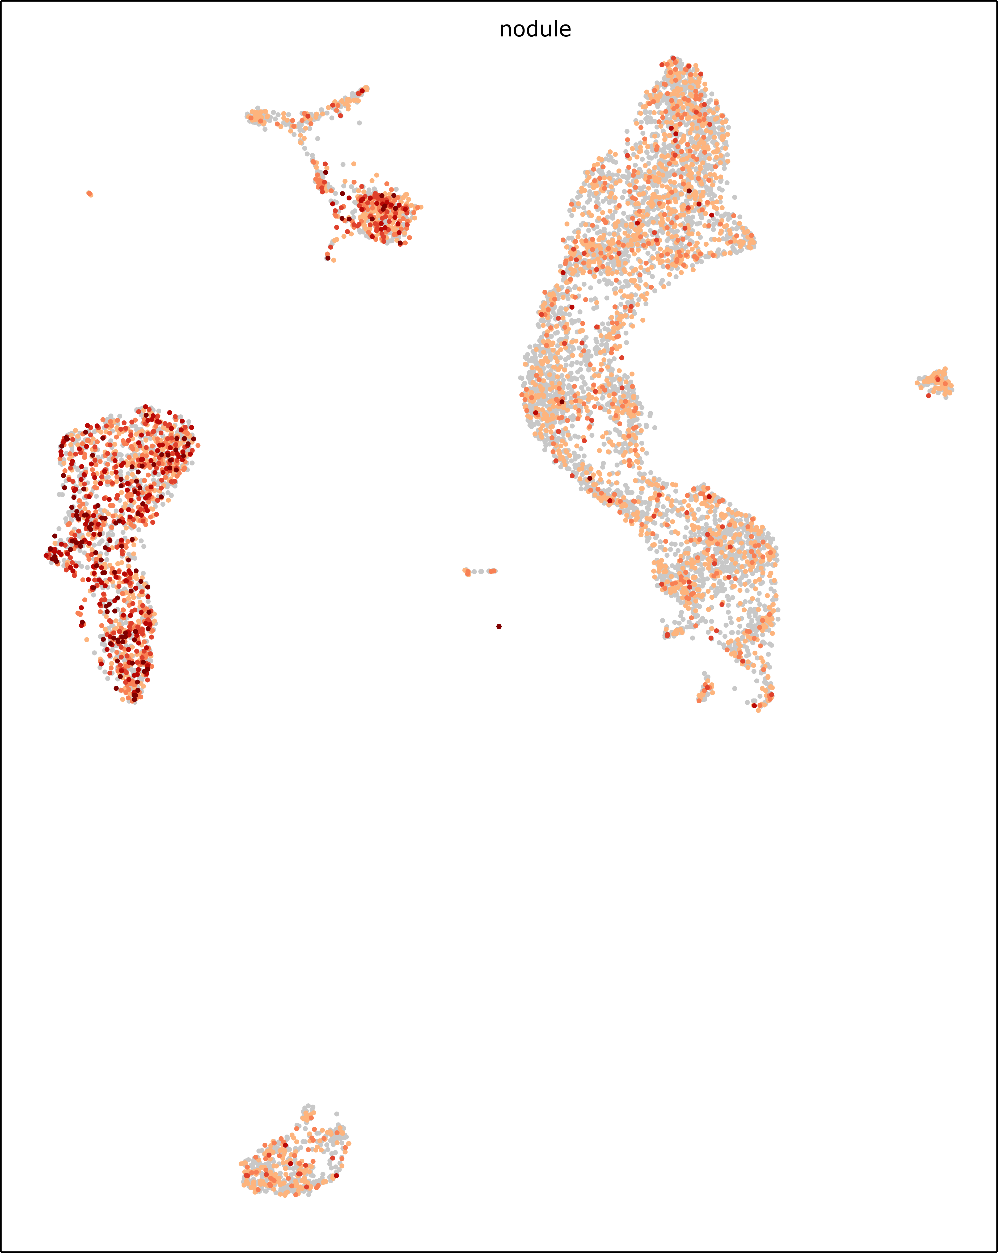
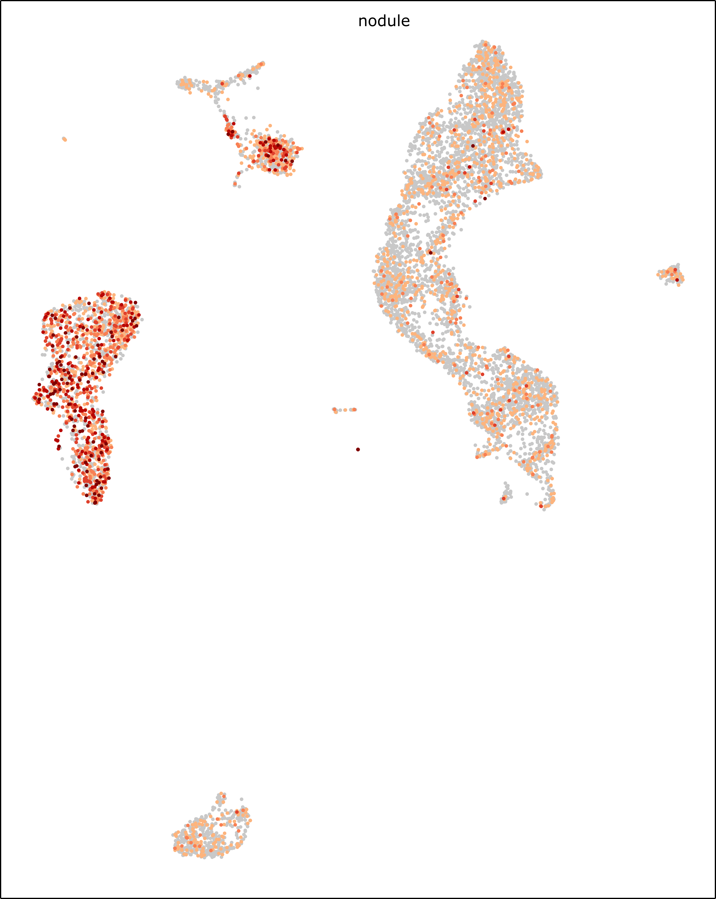
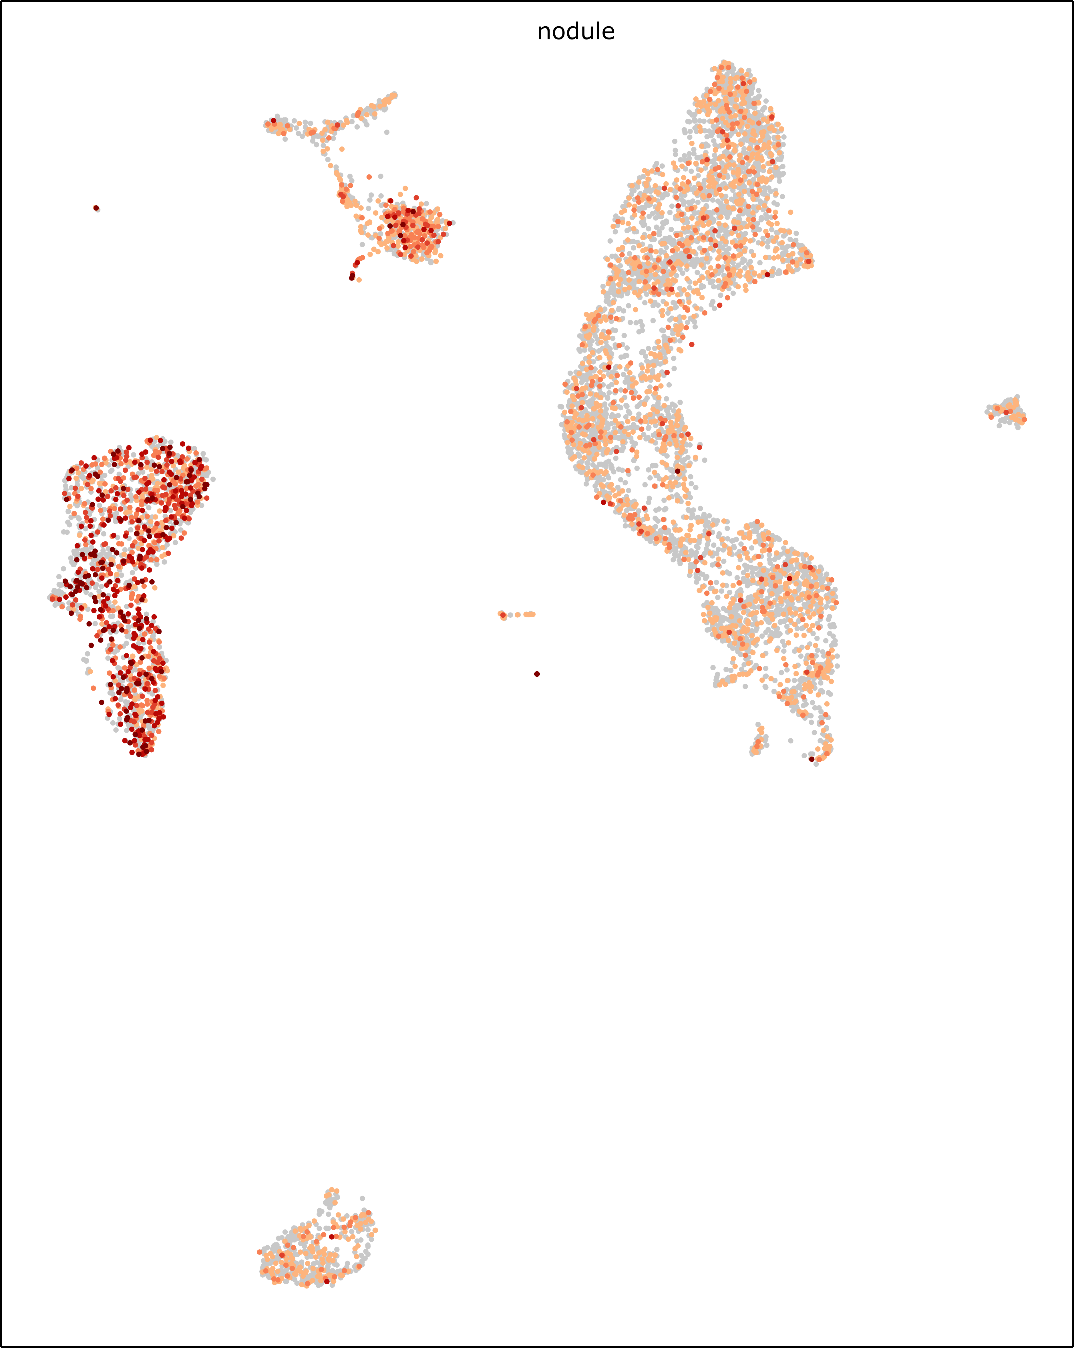
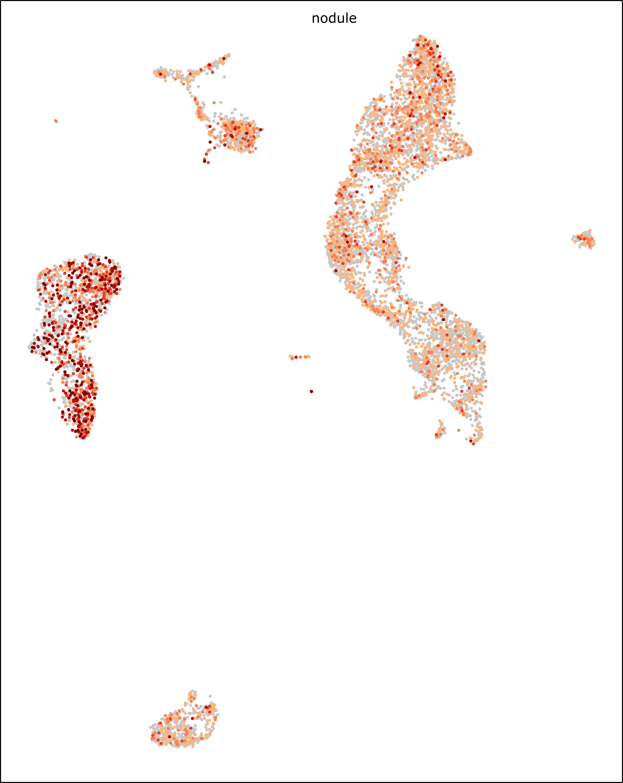

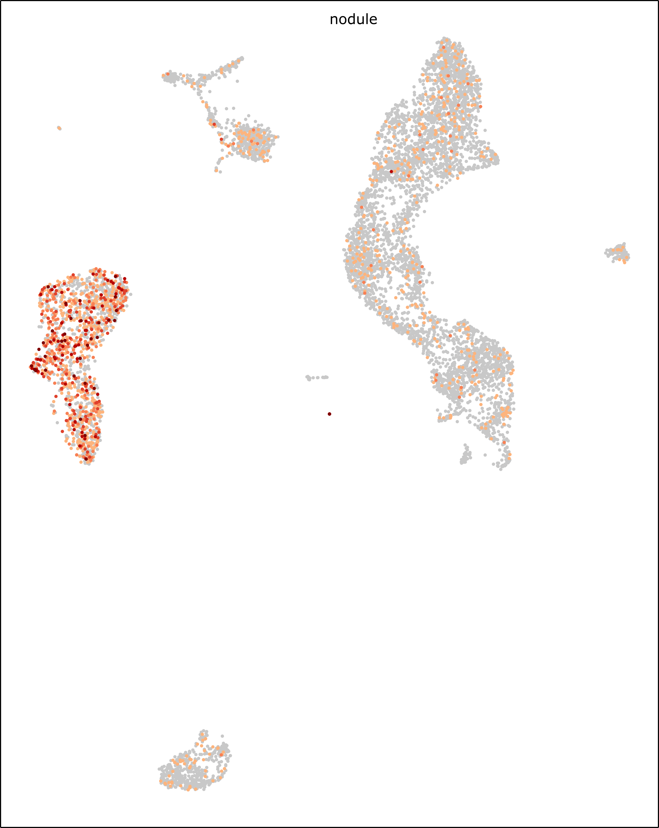
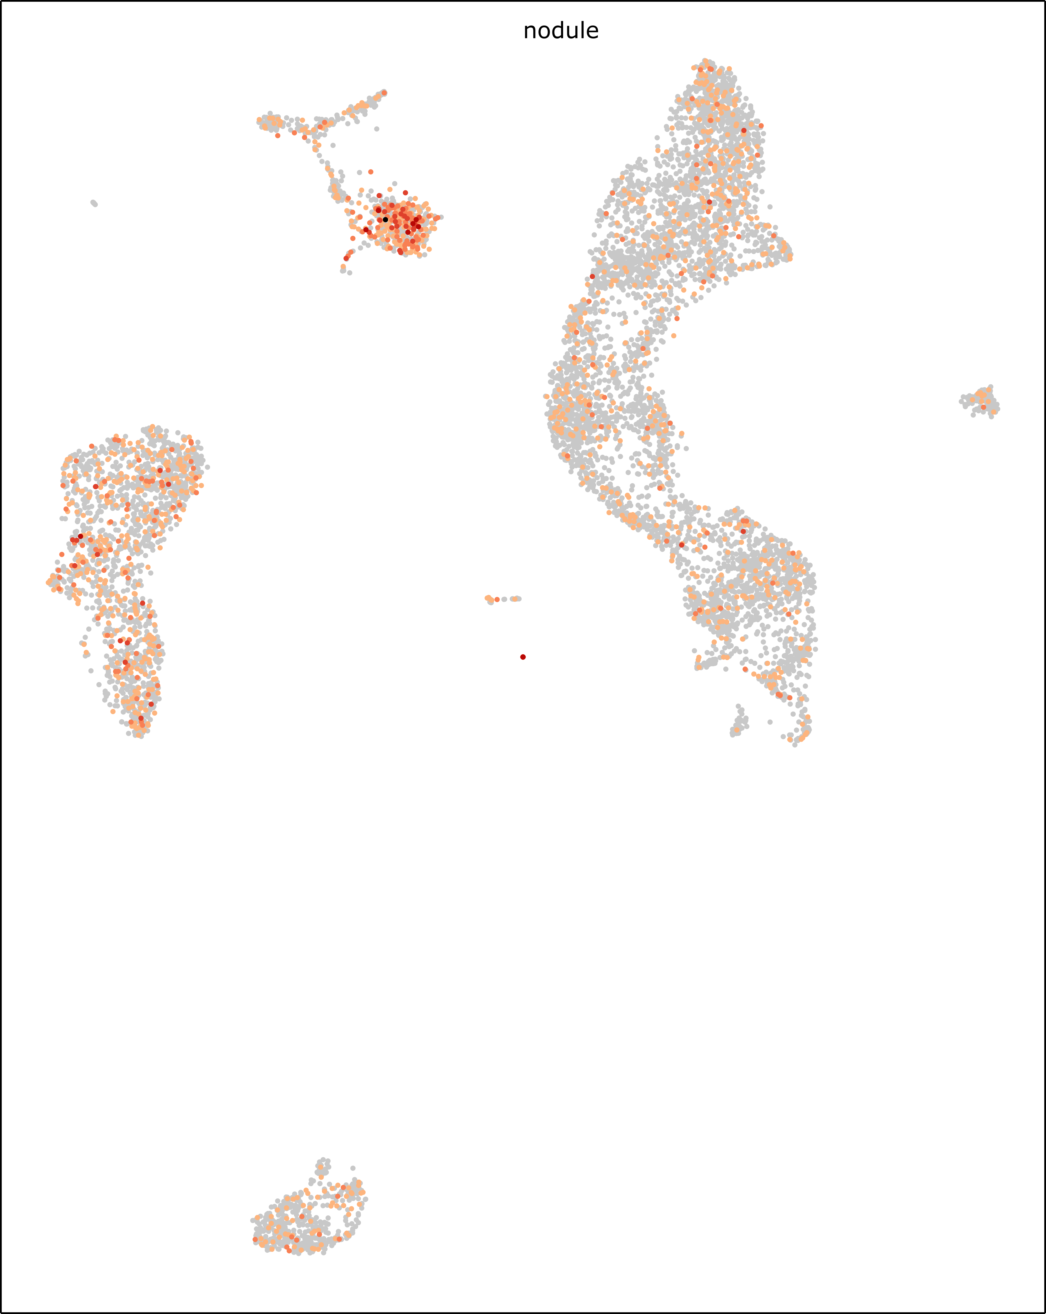
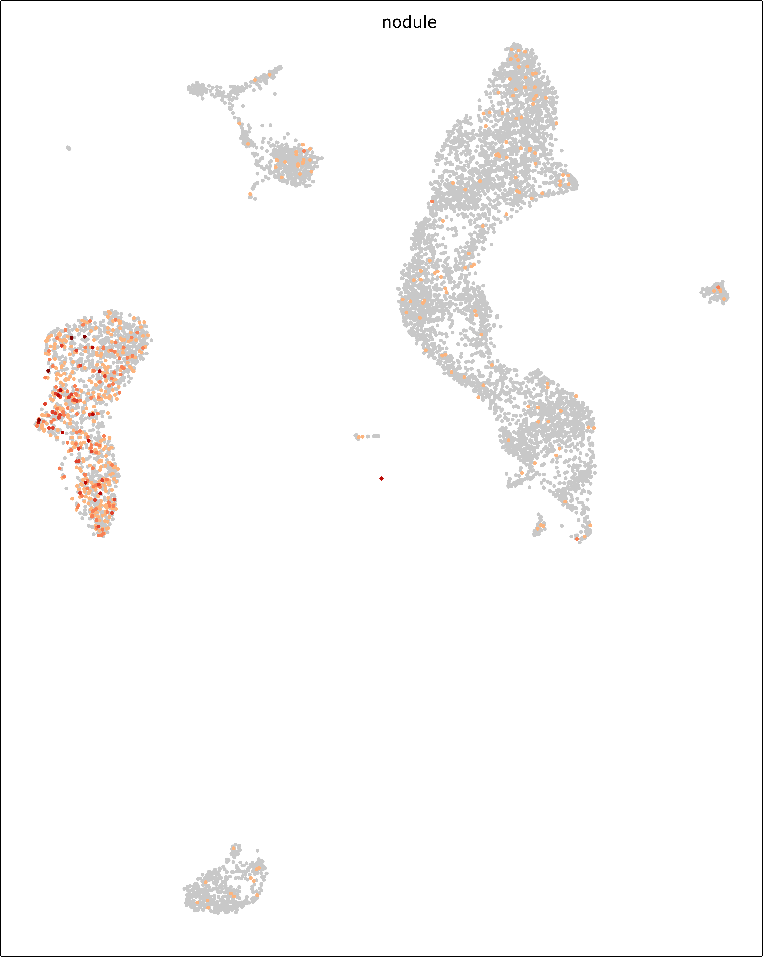
GmFWL1
(Glyma09G187000)
Flotillin
(Glyma06G065600)
Prohibitin
(Glyma05G029800)
Remorin
(Glyma08G012800)
CASP-like
(Glyma03G042800)
PLAC8
(Glyma05G209900)
5
Sulfate transporter 3;5
(Glyma07G088200)
Vesicle-associated membrane protein
(Glyma09G019800)
Receptor-like kinase 1
(Glyma14G214700)
0
Figure S25. UMAP projection of the expression of the nine micro-domain associated protein-encoding genes of the soybean nodule . The color scale reflect the level of activity of the genes and is linear.

