Slide 1
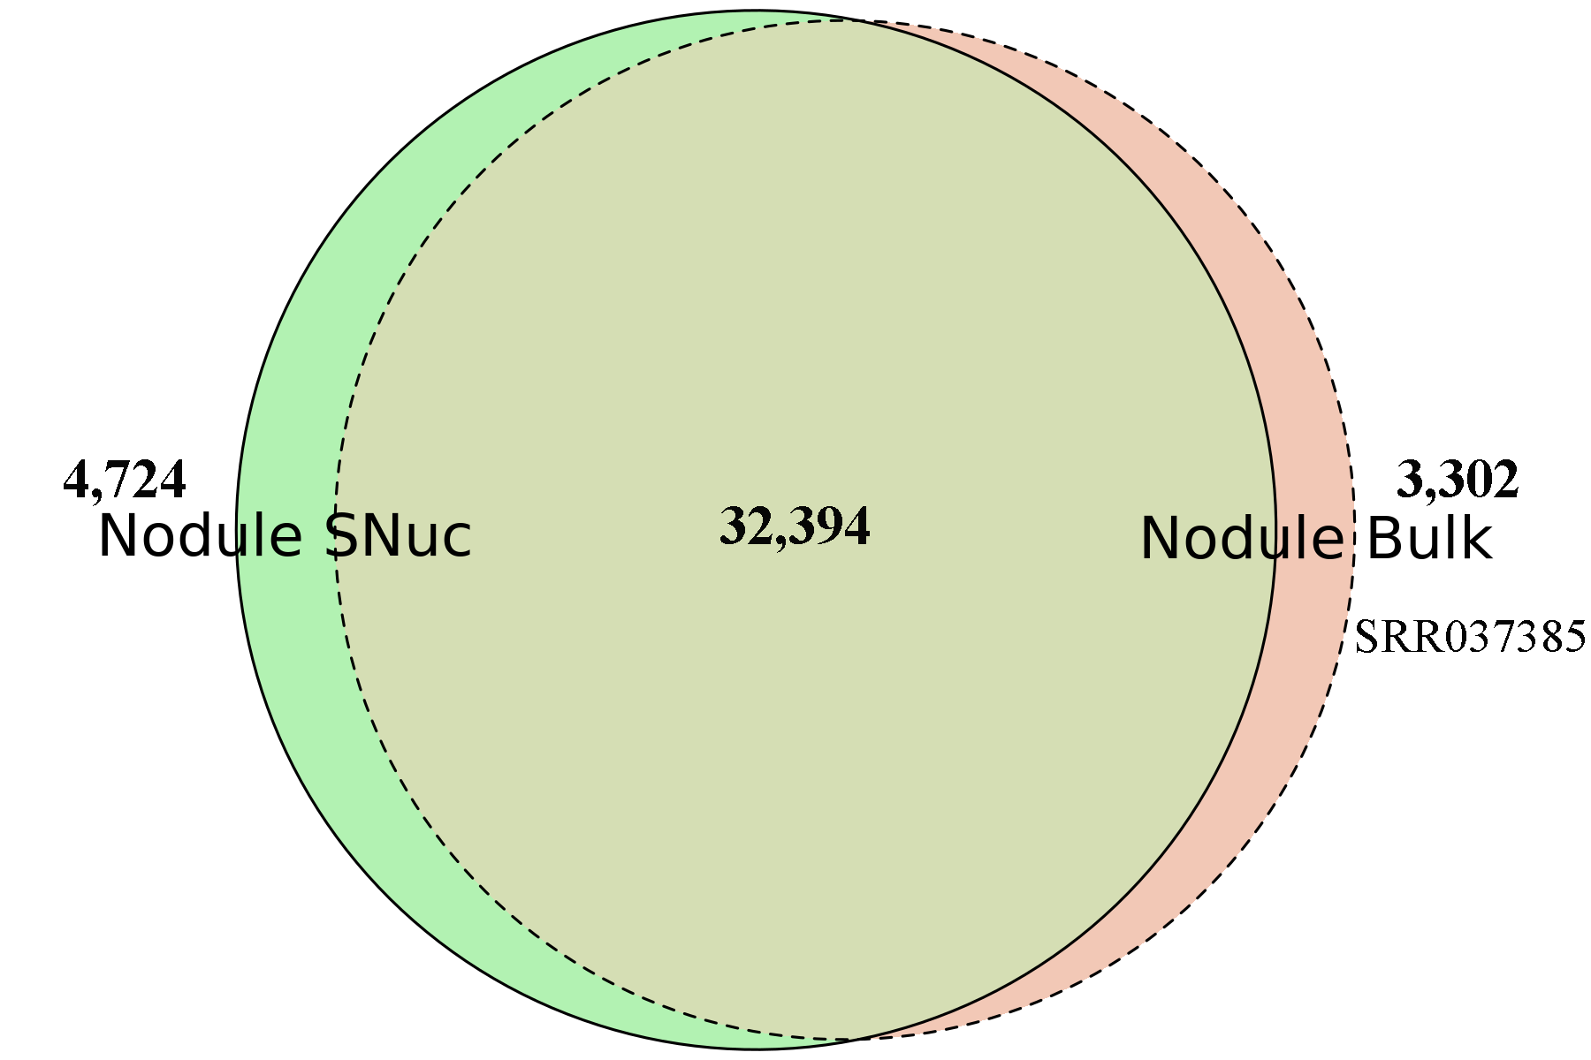
Figure S11. Venn-diagrams showing the number of expressed genes between the single-nuclei nodule transcriptome and the bulk nodule transcriptome (SRR037385) (Libault et al., 2010).

