Slide 1
Molecular Cartography Master List
Figure.S14. Functional annotation of the soybean nodule cell clusters using Molecular Cartography technology

Slide 2
Molecular Cartography Master List
Cluster F/G
Infection Zone Cells

Slide 3
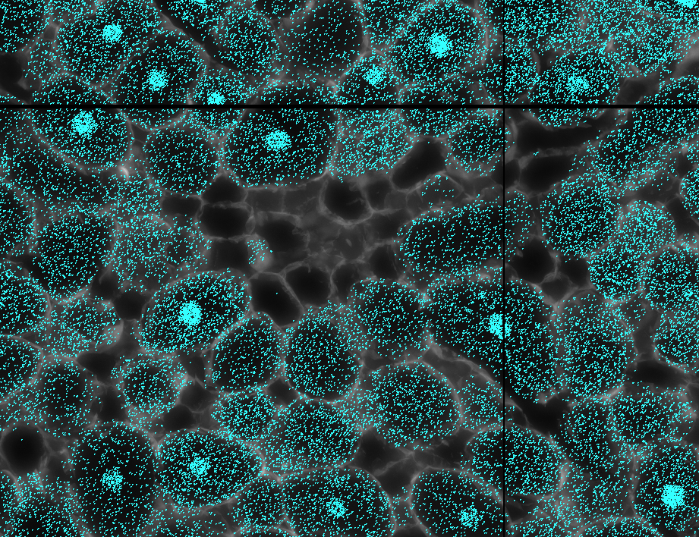
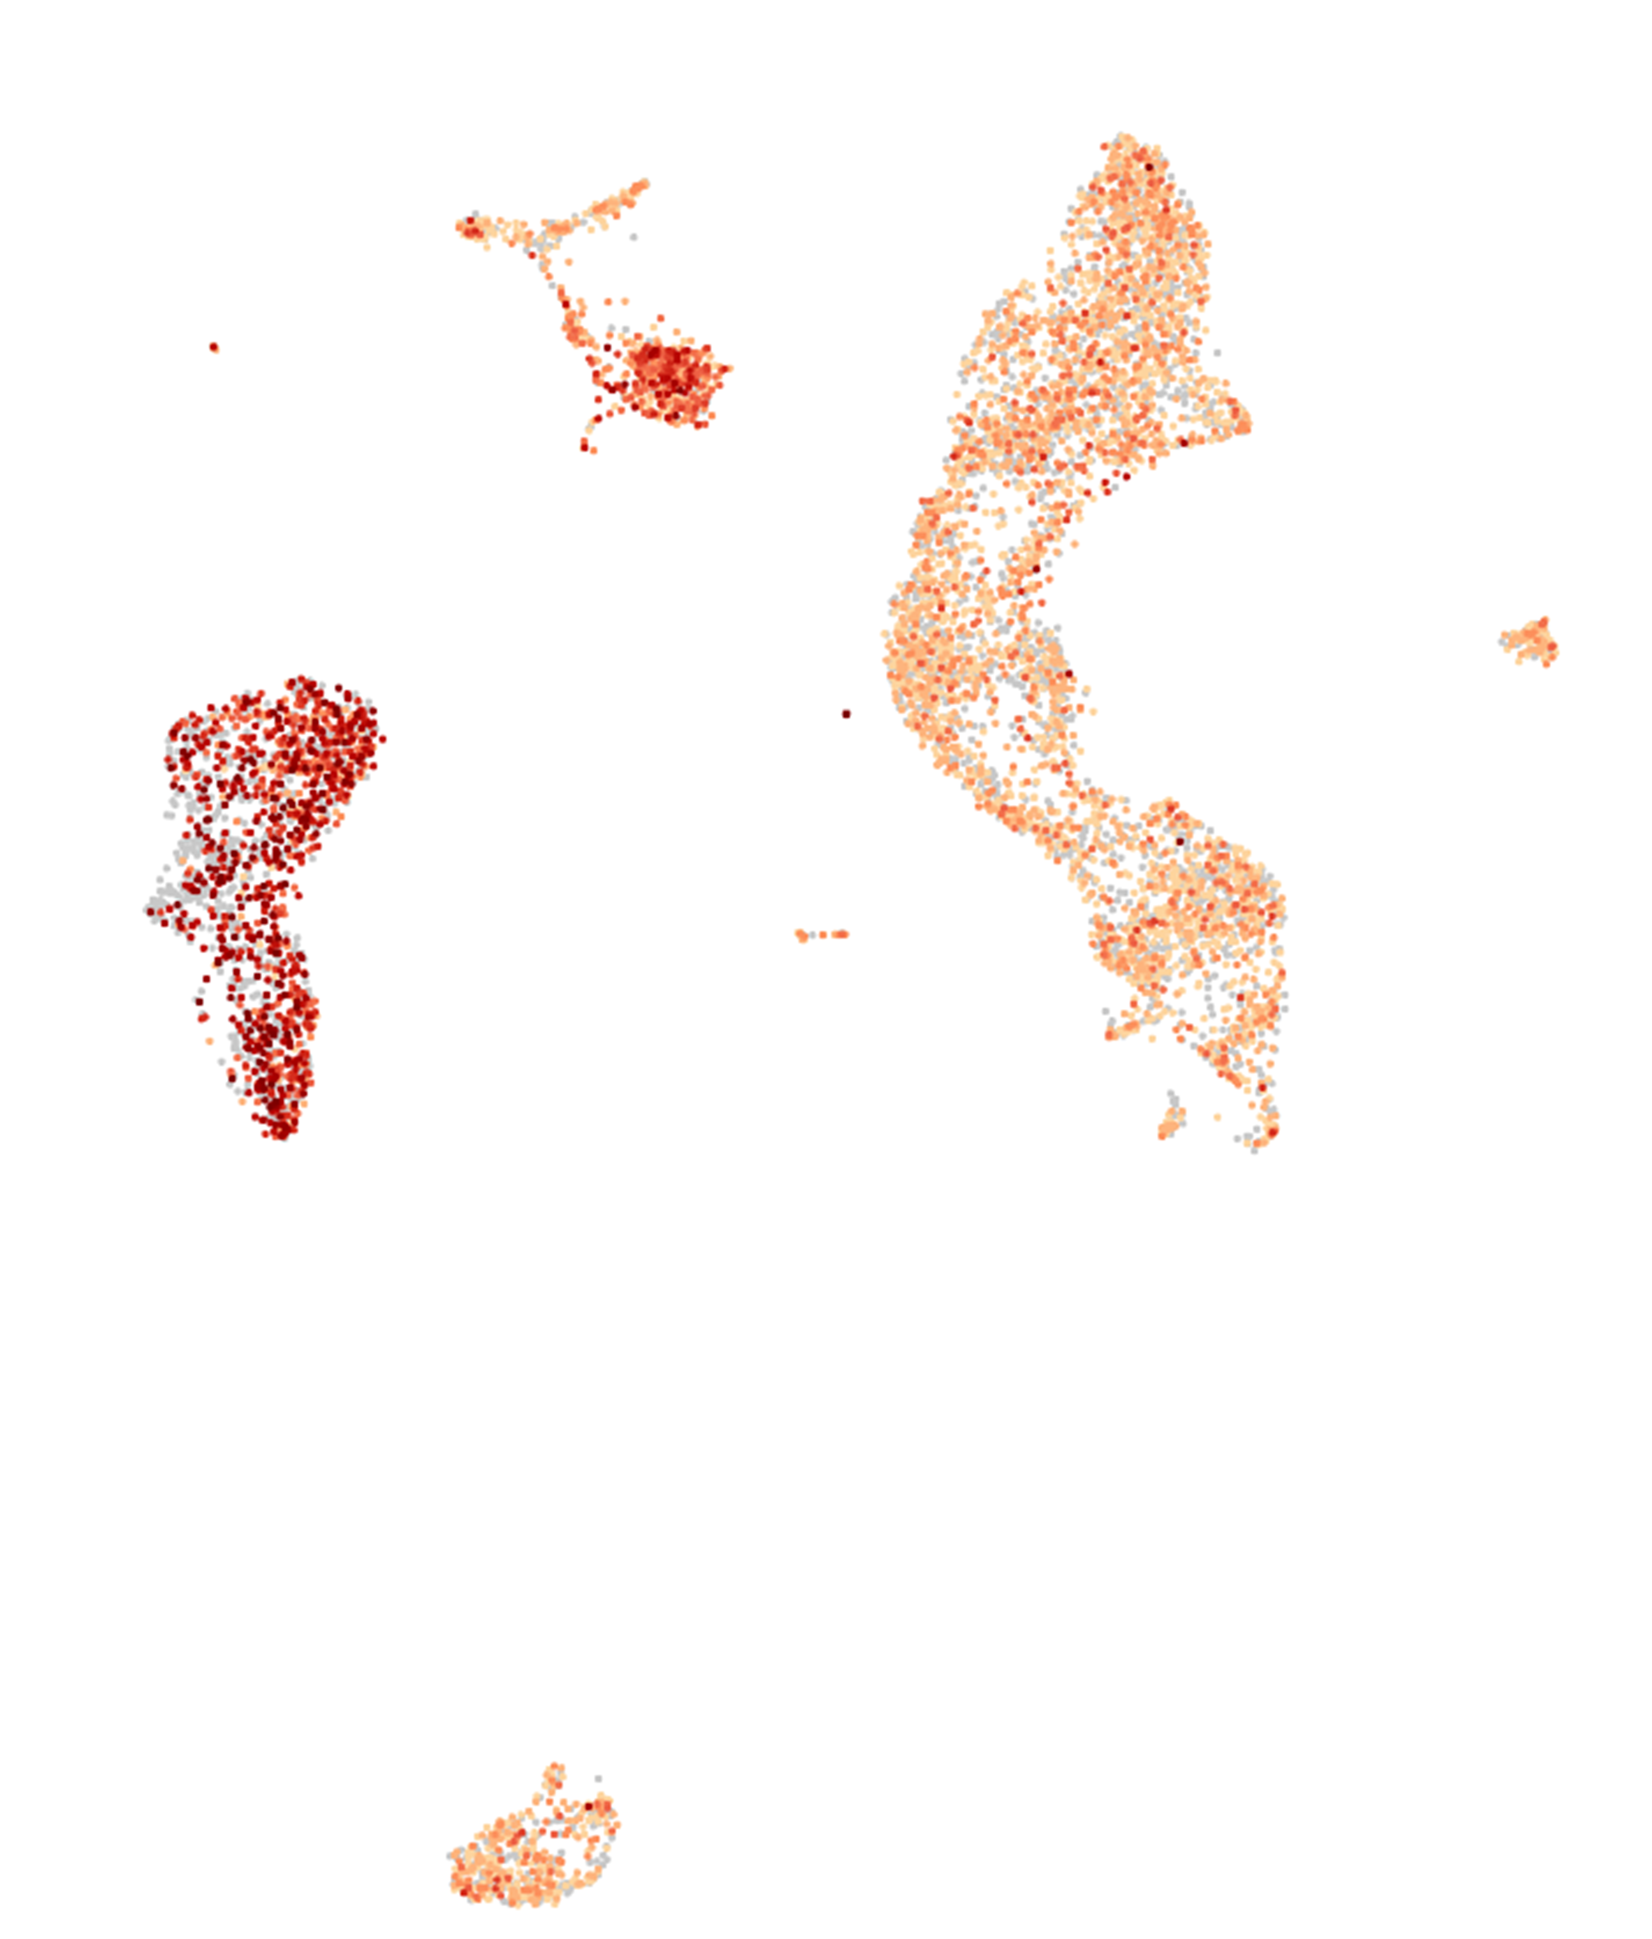
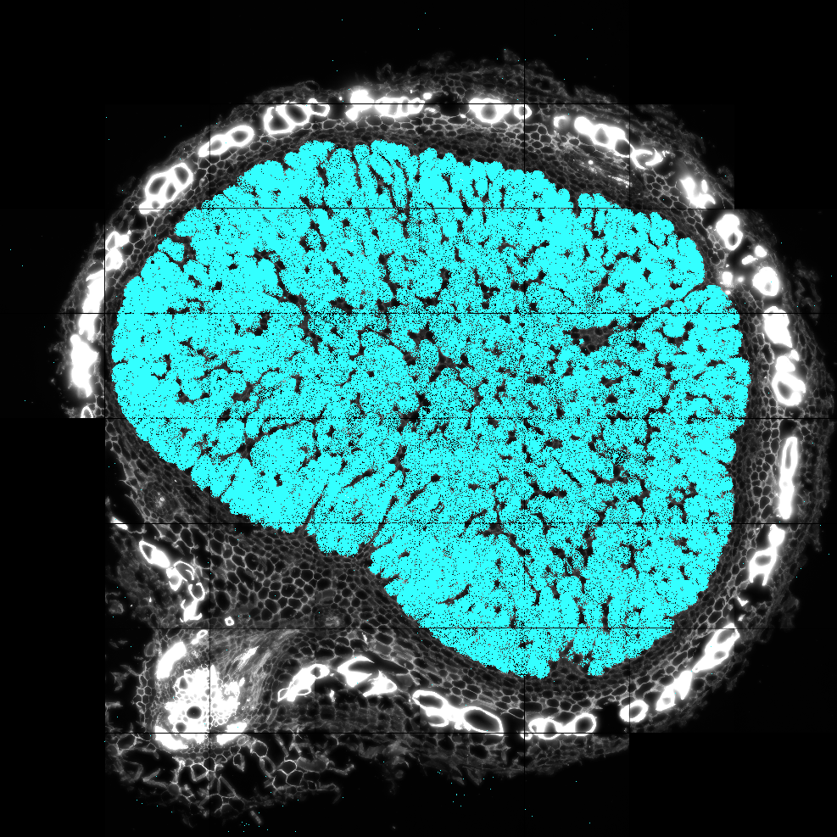
Glyma.17G195900
Infected Cells
Large, infected cells
Small, uninfected cells

Slide 4
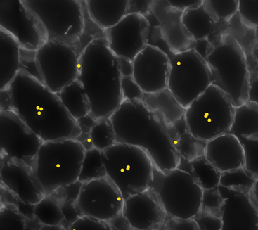
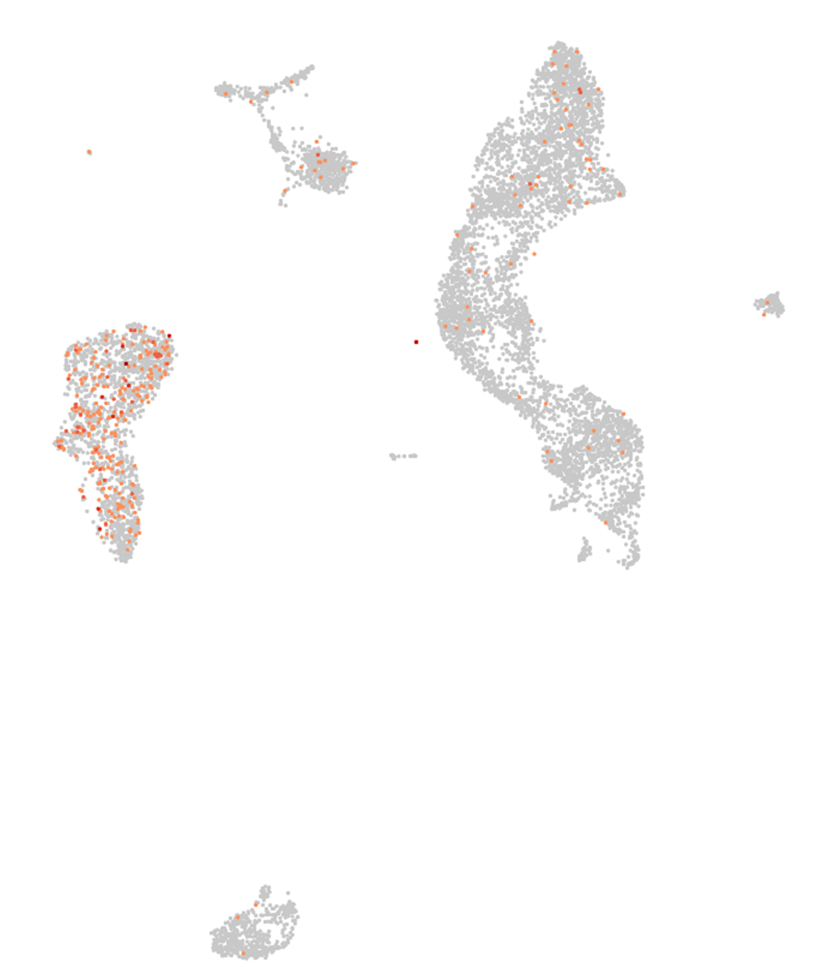
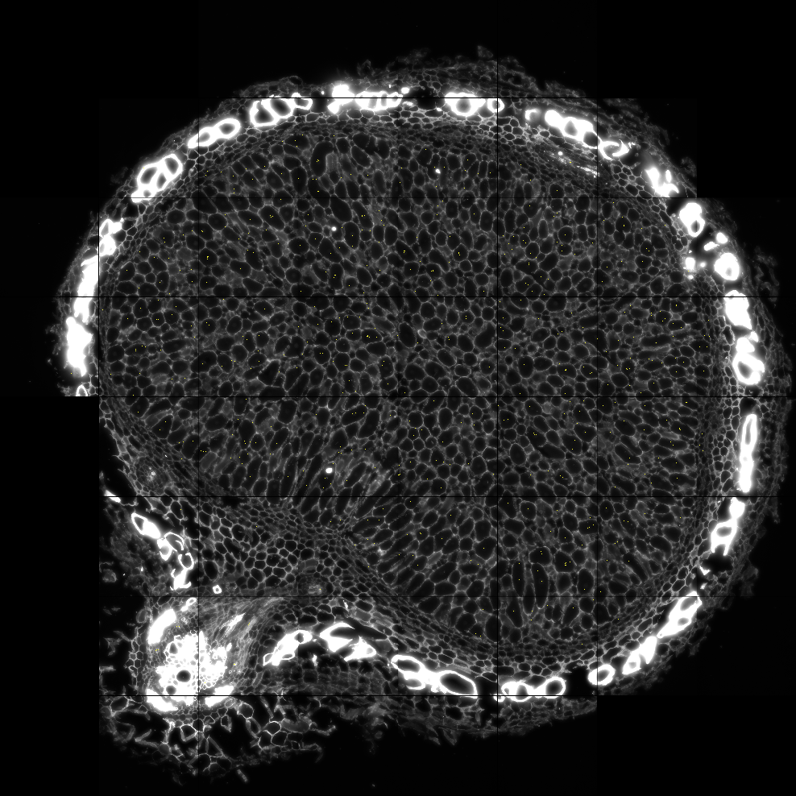
Glyma.01G164600
Infected Cells

Slide 5
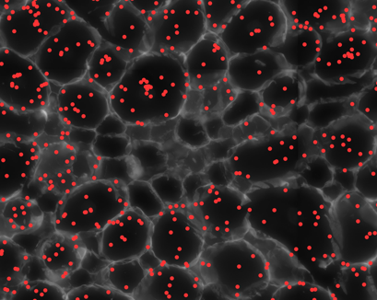
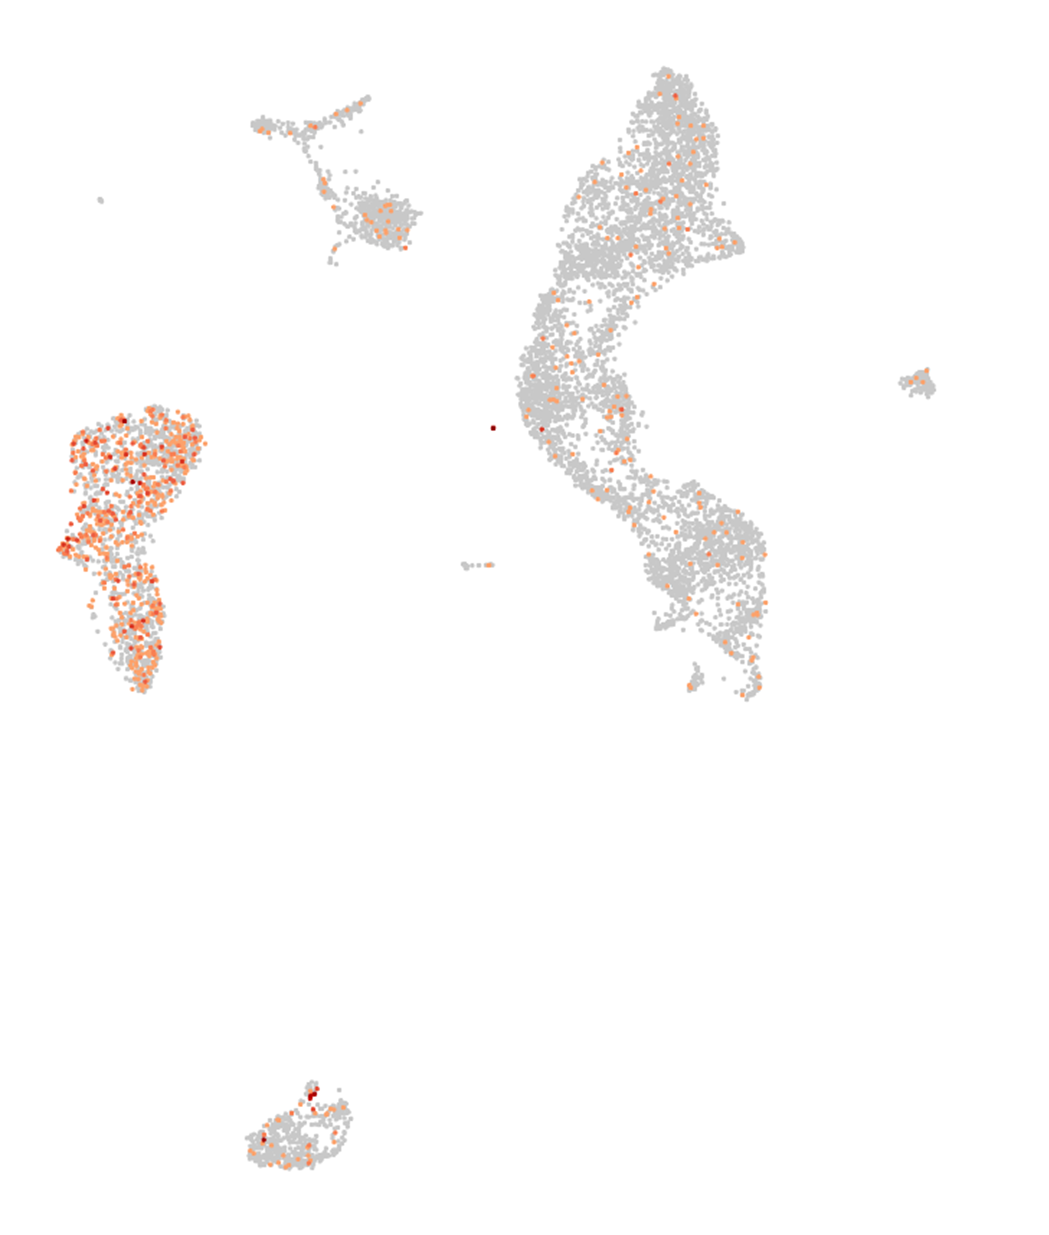
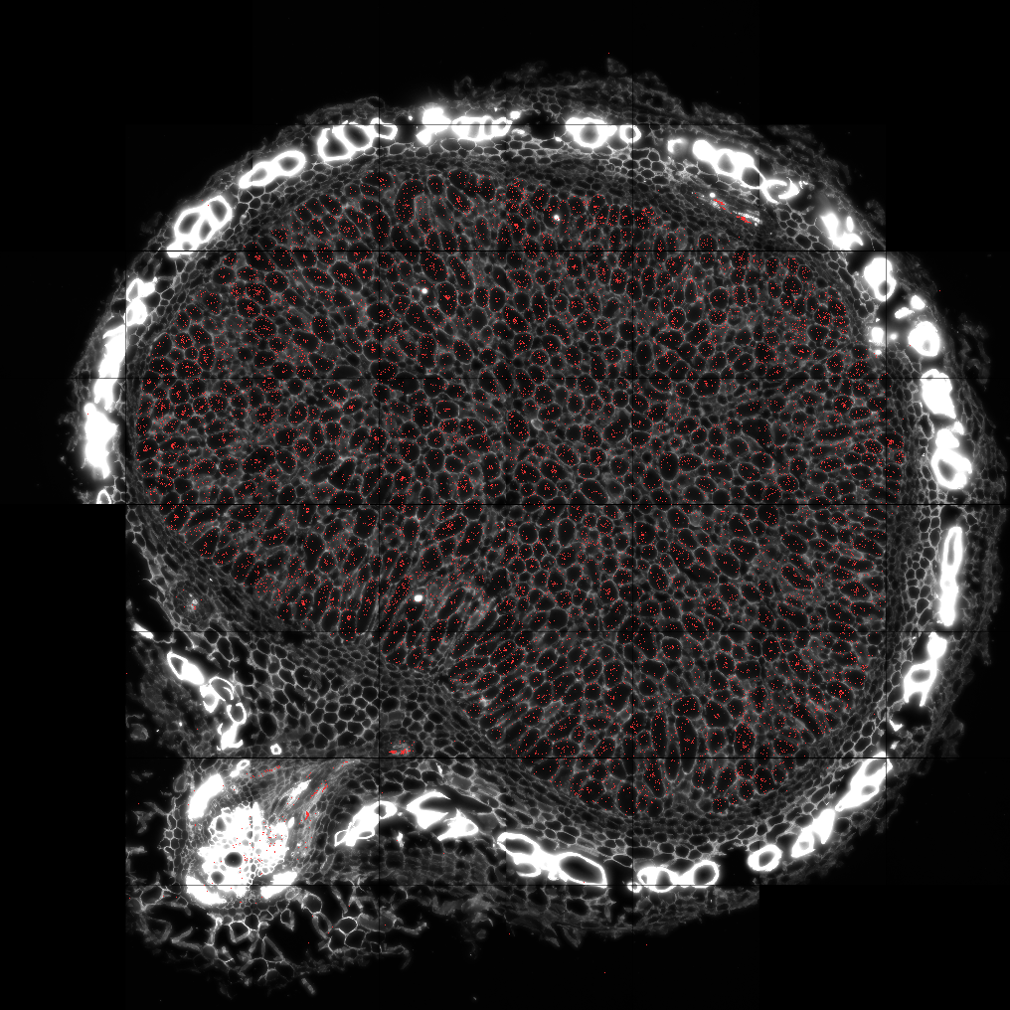
Glyma.15G210100
Infected Cells
Note: Glyma.15G210100 is expressed in both IZ cell cluster (F&G) and Vascular Bund cluster (E)

Slide 6
Molecular Cartography Master List
Cluster H
Nitrogen fixation

Slide 7
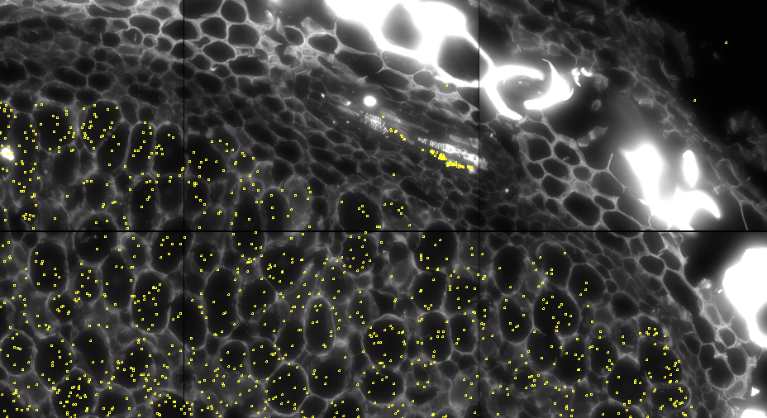
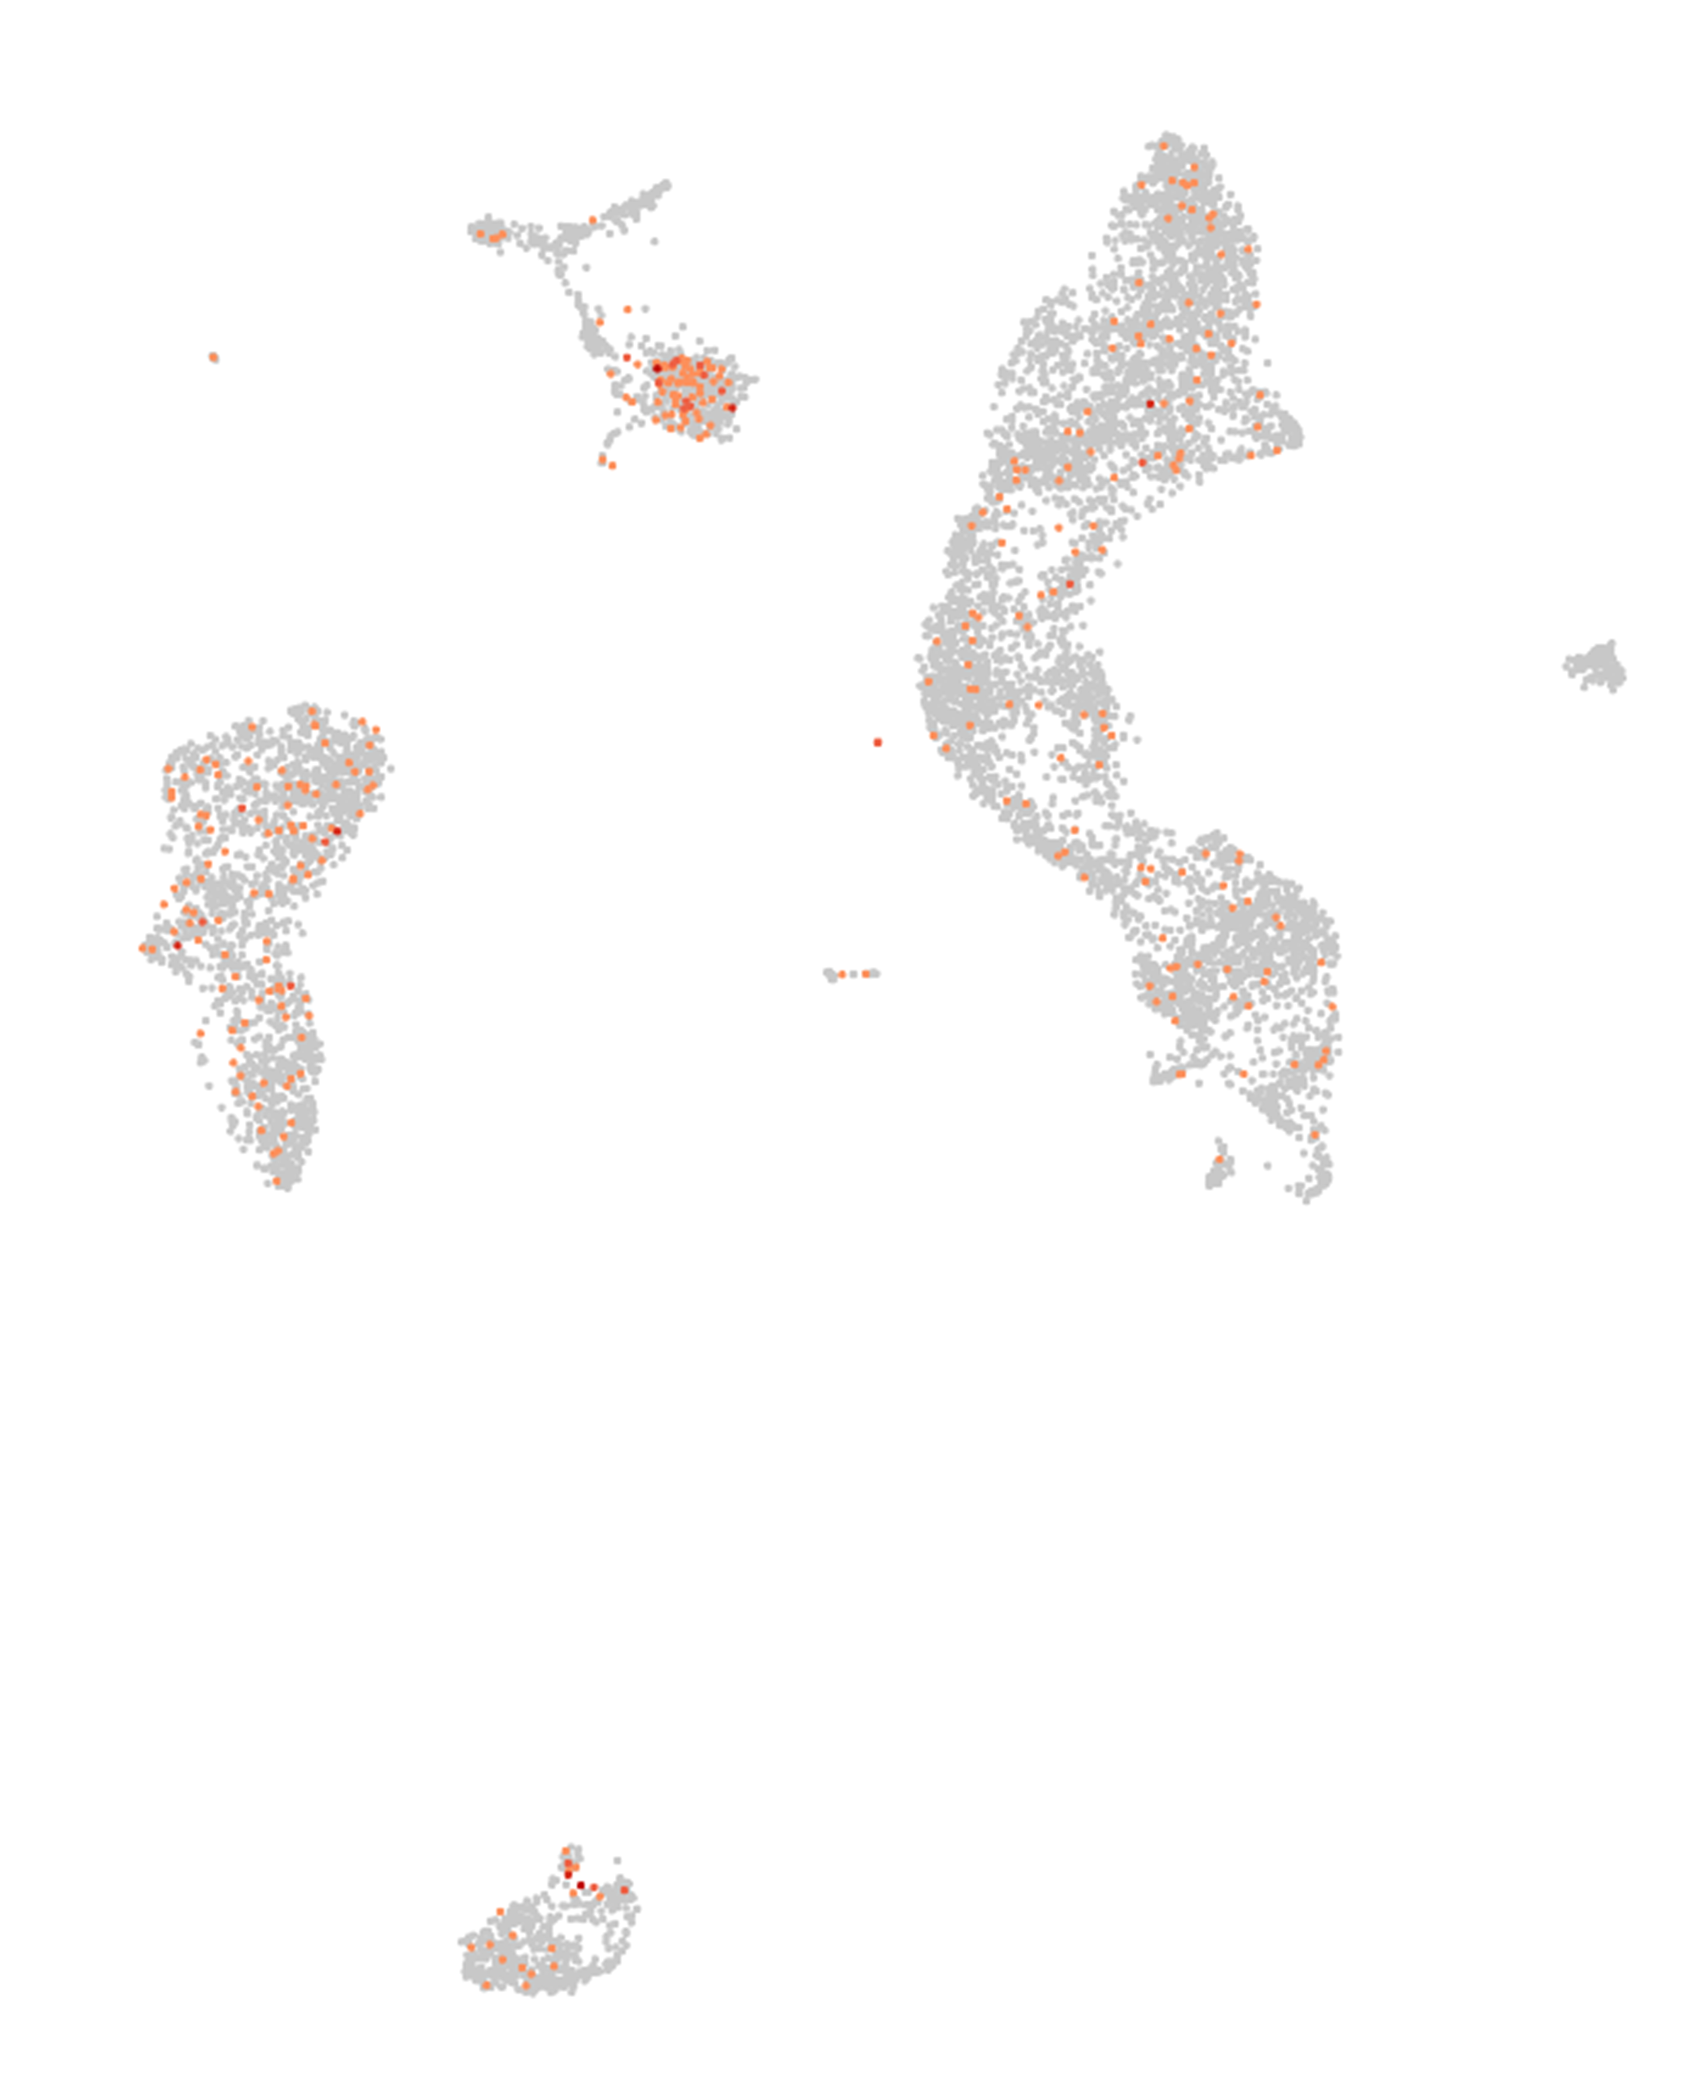
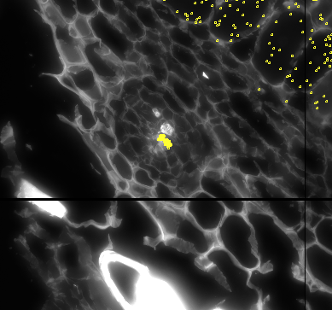
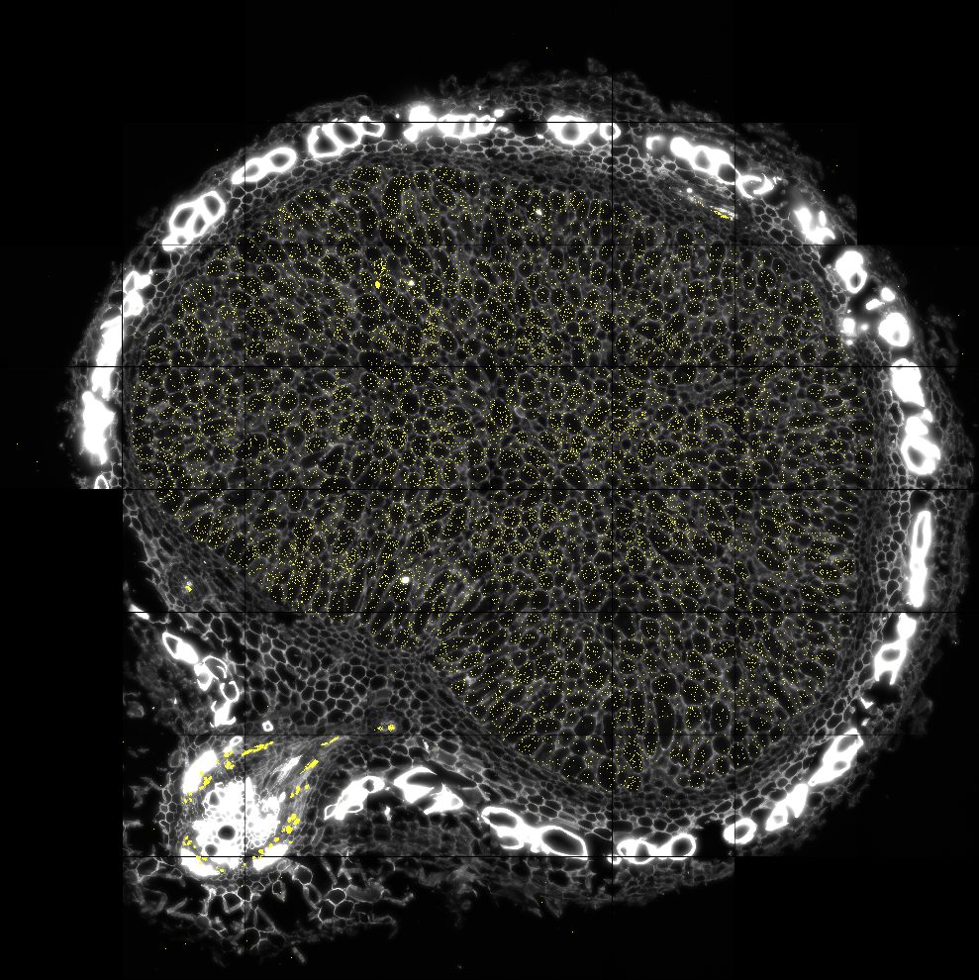
Glyma.05G216000

Slide 8
Molecular Cartography Master List
Cluster J and K
Un-infected Infection Zone Cells

Slide 9
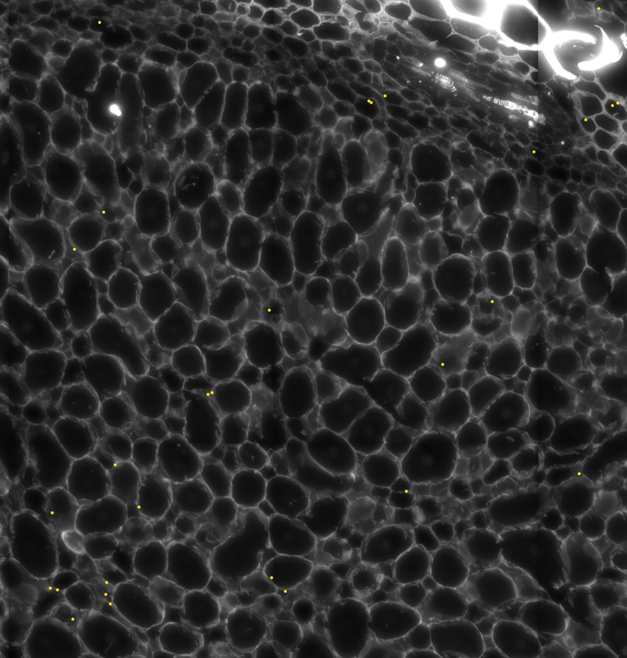
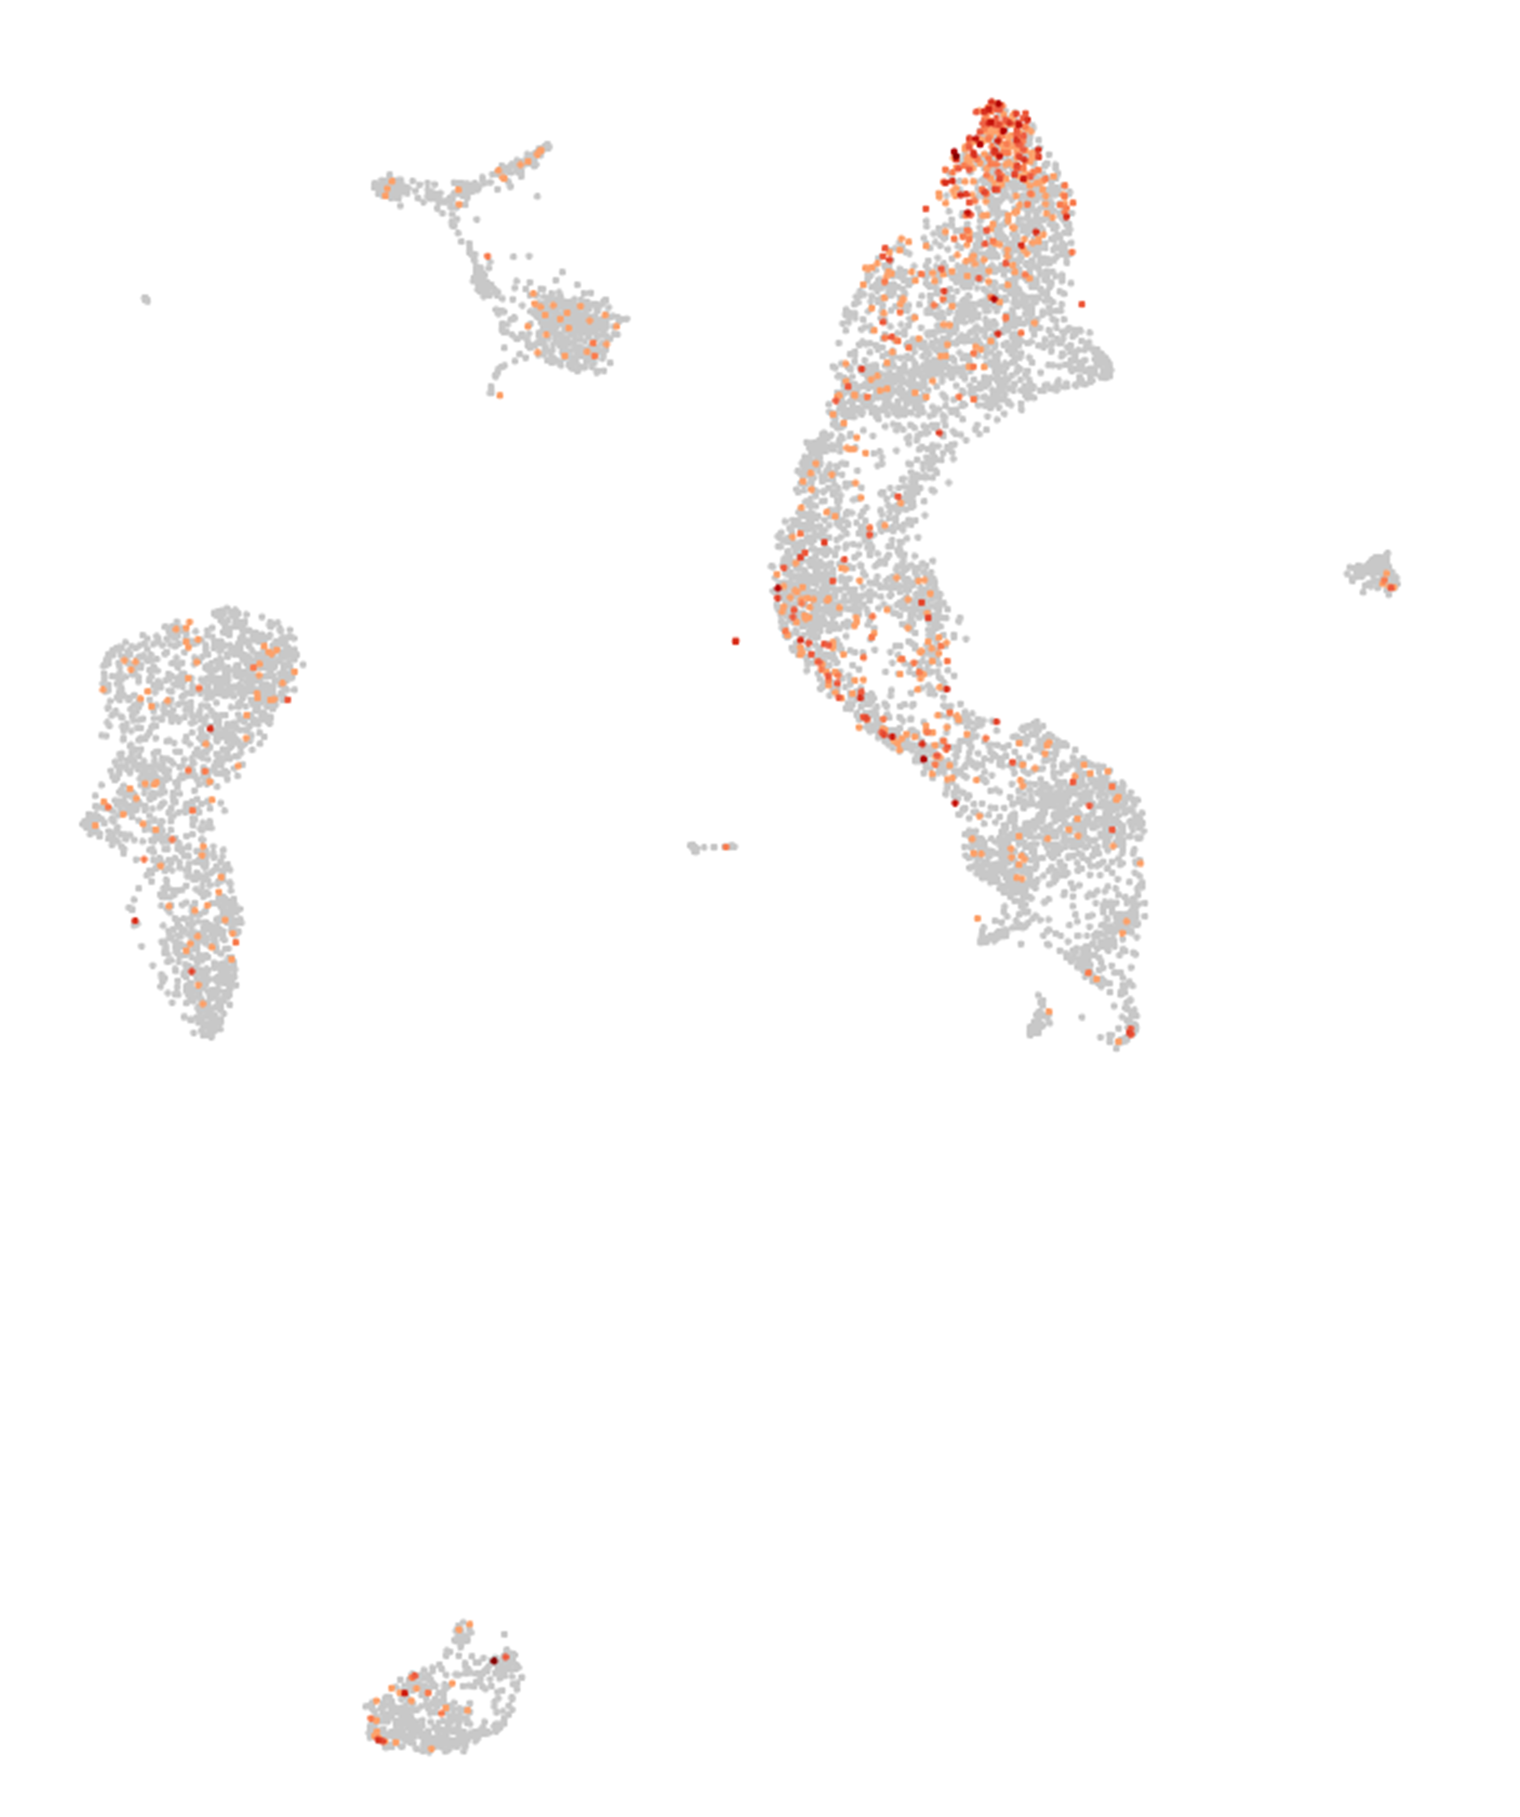
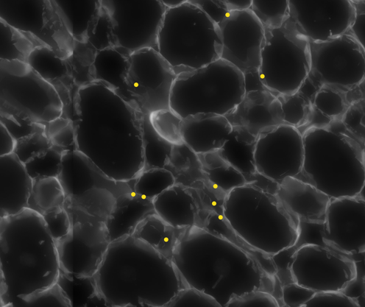
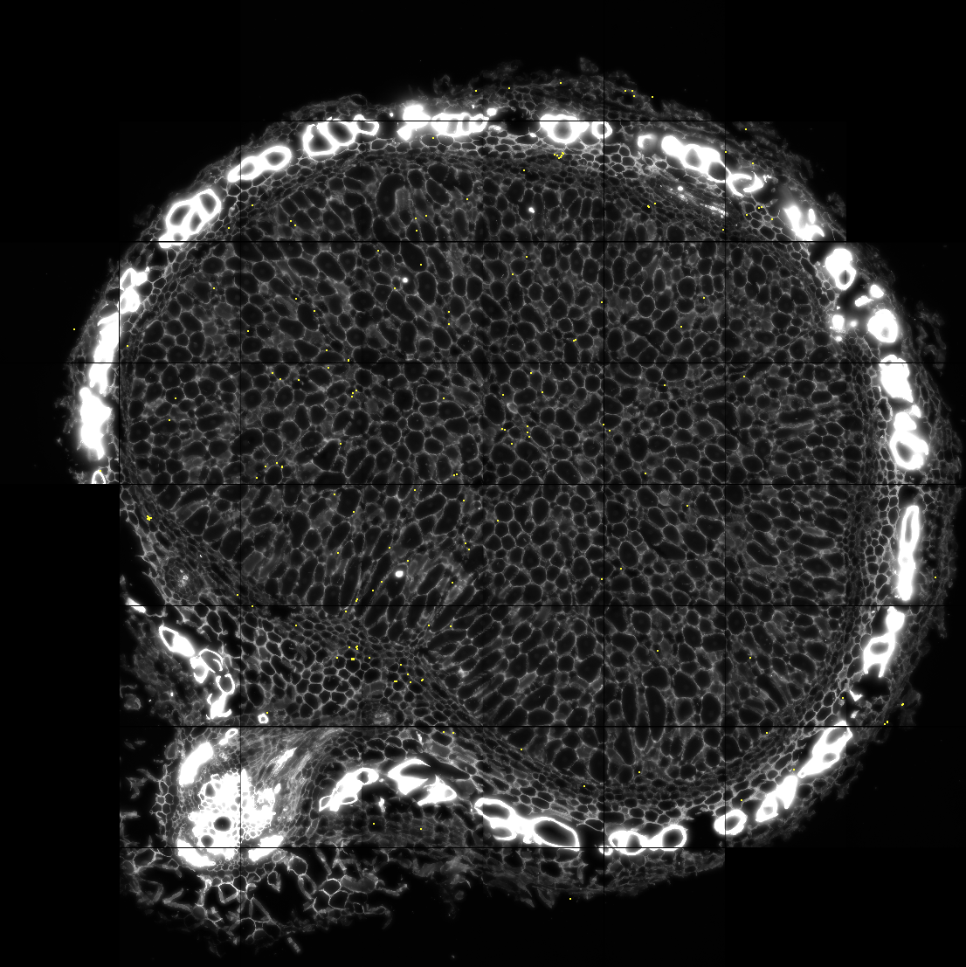
Glyma.06G235500
Un-infected Cells
1
2
2
Large, infected cells
1
Small, uninfected cells

Slide 10
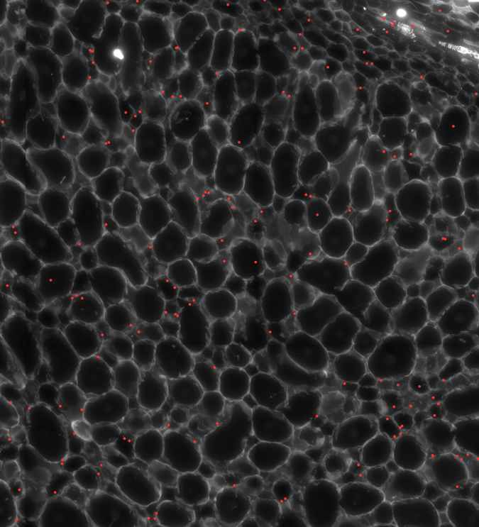
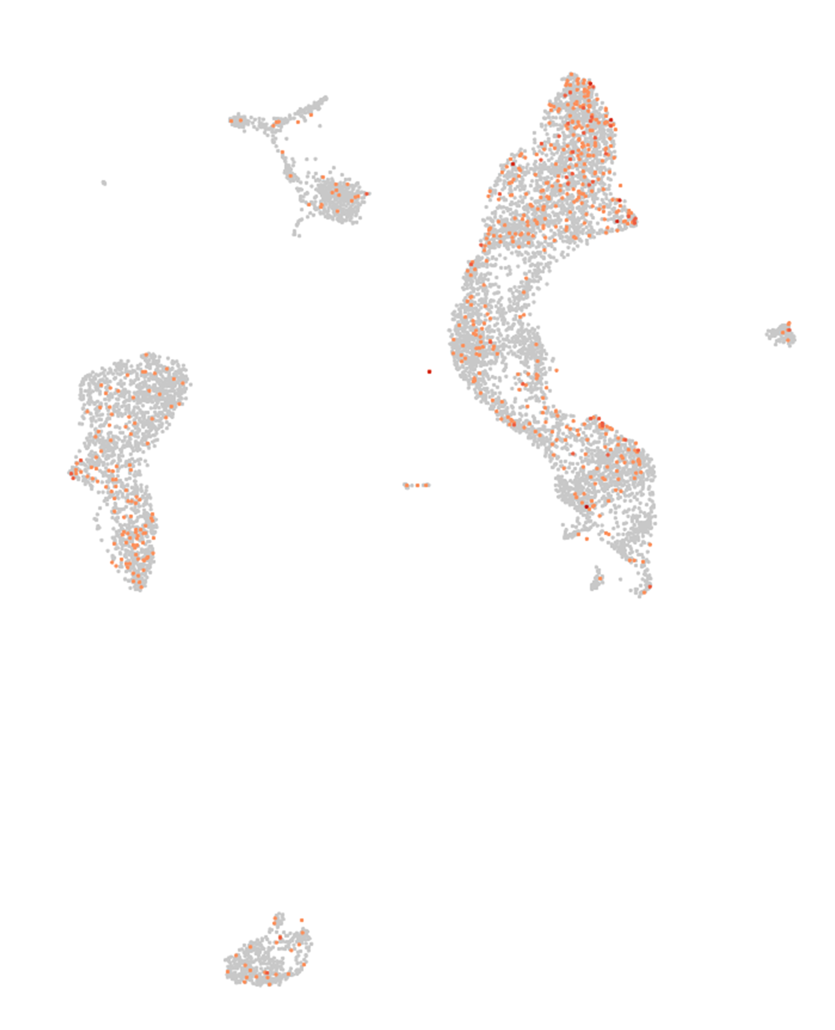
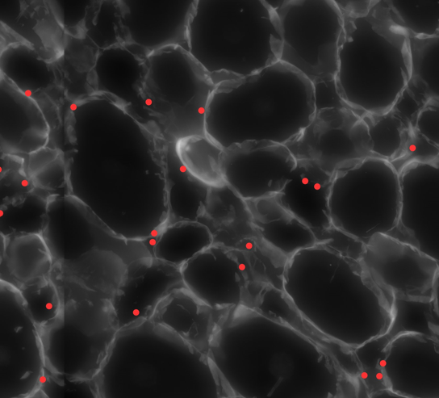
Glyma.06G002000
Un-infected Cells
1
2
2
Large, infected cells
1
Small, uninfected cells

