Slide 1
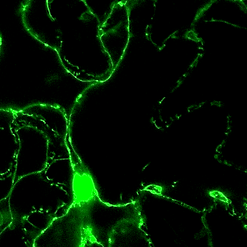
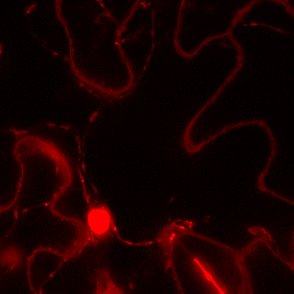
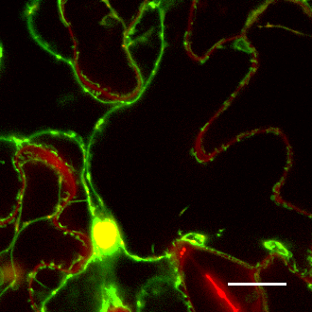
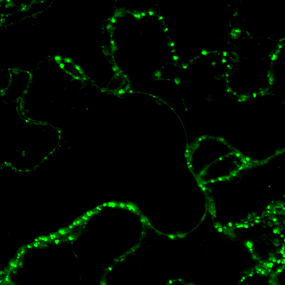
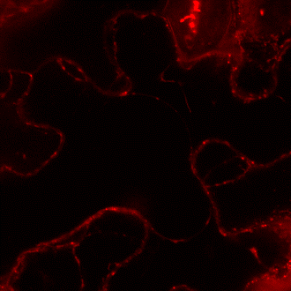
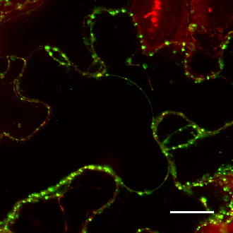
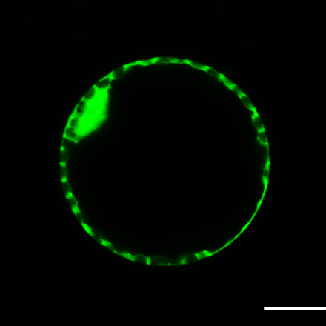
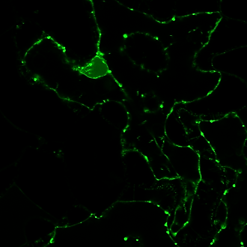
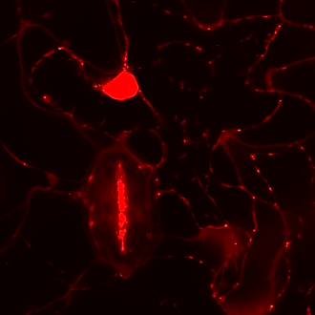
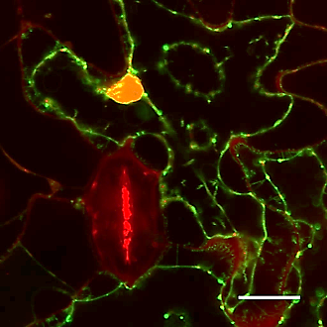
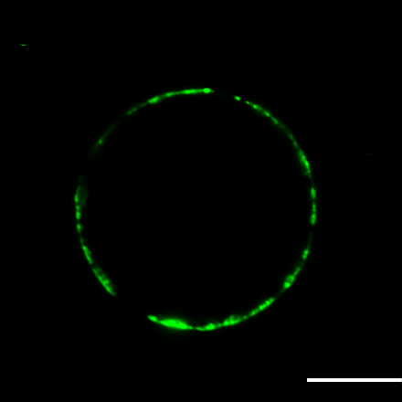
GFP
PI
MERGED
PROTOPLAST
a
b
c
j
p35S:GFP
p35S:GFP
d
e
f
k
p35S:GFP-GmFWL3
p35S:GFP-GmFWL3
g
h
i
l
p35S:GmFWL3-GFP
p35S:GmFWL3-GFP
Figure.S20. Plasmolysis of tobacco leaf cells transiently expressing GmFWL3-GFP proteins confirms its punctuate localization in the plasma membrane. Optical cross sections of tobacco leaf cells transiently expressing p35S::GFP, revealed the cytosolic and nuclear localization of the GFP alone (A-C). Leaf cells expressing p35S::GFP-GmFWL3 (D-F) and p35S::GmFWL3-GFP (G-I) show the localization of the GFP-GmFWL3 fusion proteins in the plasma membrane, and nucleus (D-I). Similar to GmFWL1, we saw punctate localization of GmFWL3 in the membranes. Propidium iodide (PI) was used to counter stain nuclei (B, E, H). A cross section of tobacco cell protoplast transiently expressing p35S::GFP (J), p35S::GFP-GmFWL3 (K) and p35S::GFP-FWL3 (L) further revealed the predominant localization of GmFWL3 in the plasma membrane. Scale Bar: 20uM.

