Slide 1
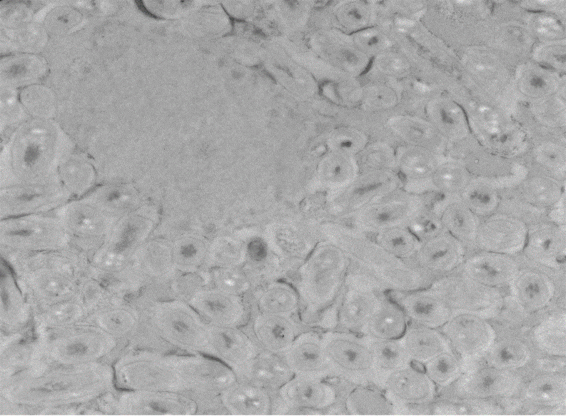
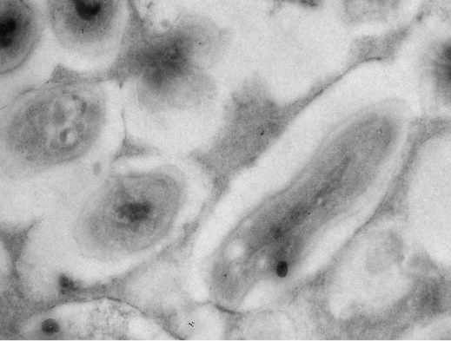
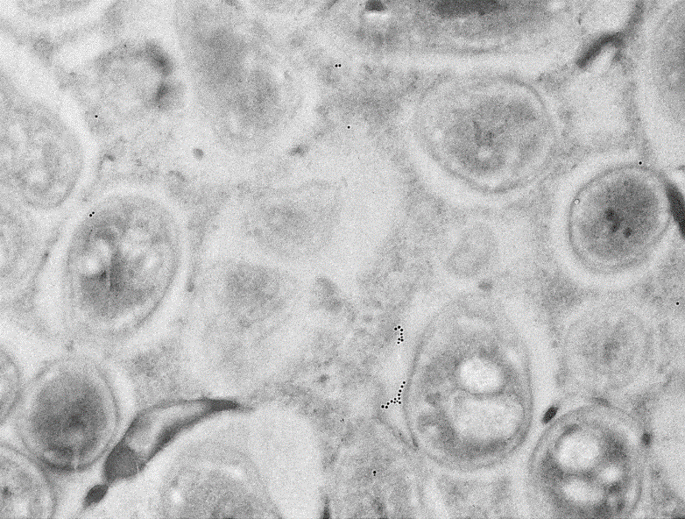
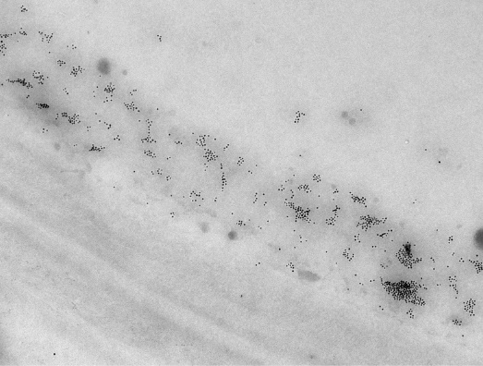
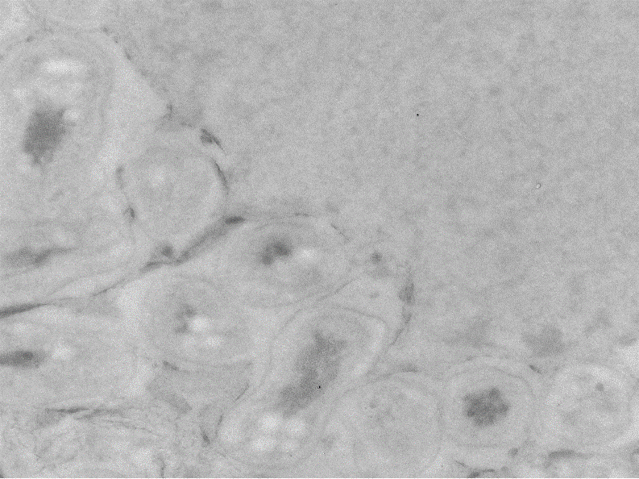
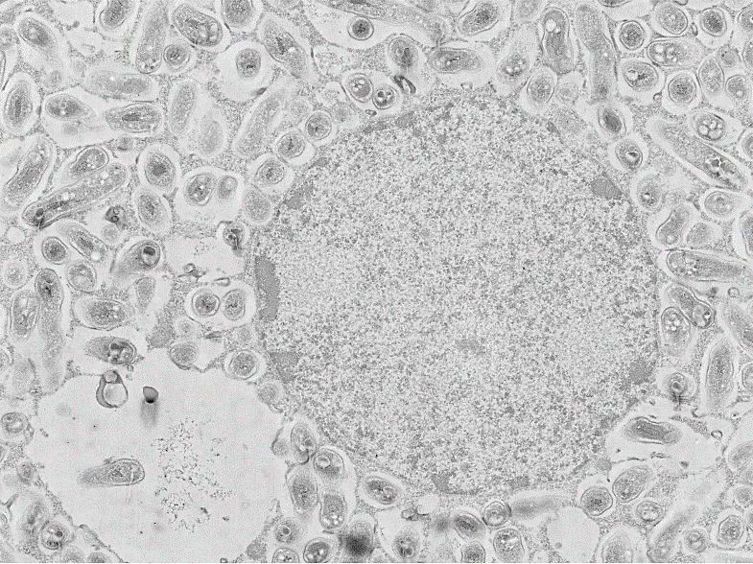
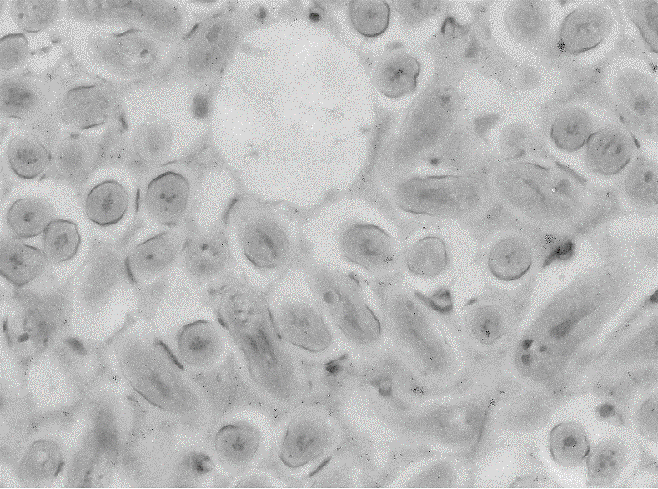
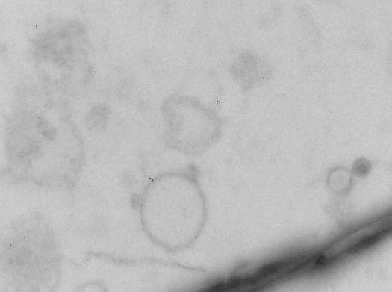
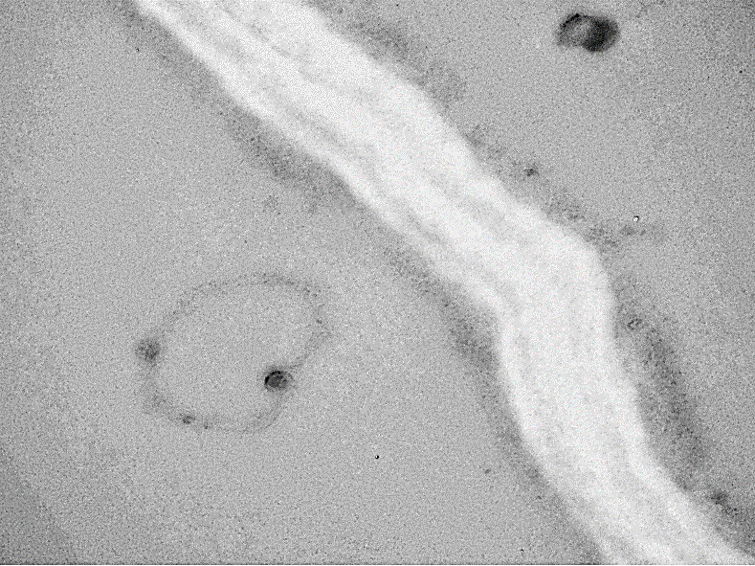
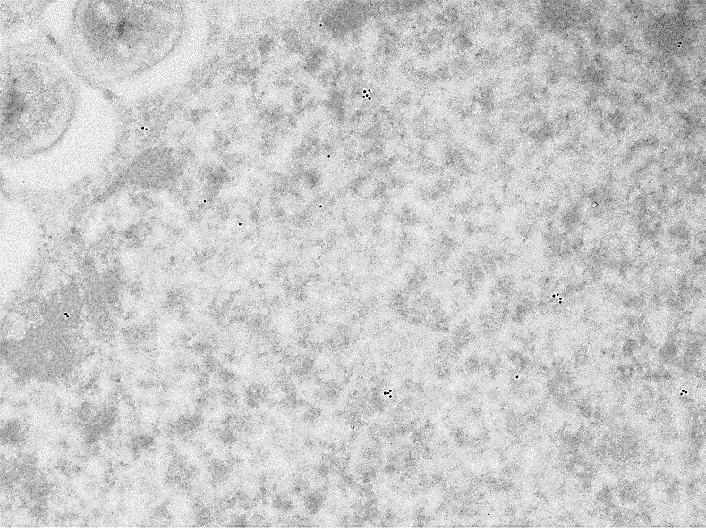
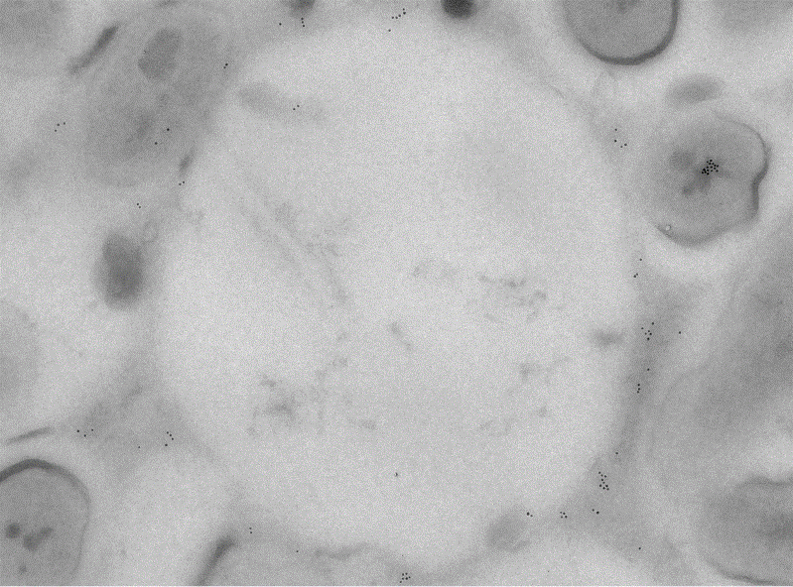
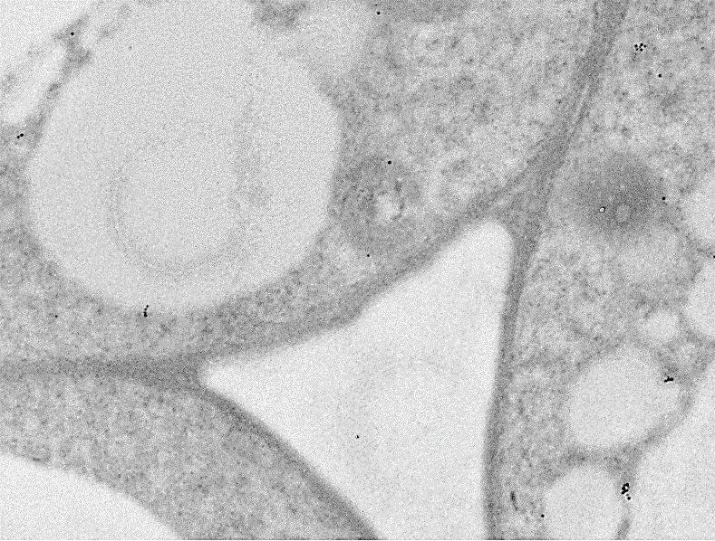
A
D
G
SM
J
N
S
S
s
S
S
PM
S
CW
B
E
H
K
N
s
Va
N
Ve
S
Ve
C
F
I
L
s
PM
CW
NE
O
CW
VM
Va
Ve
ICS
O
VM
Figure S23. Subcellular localization of GmFWL3 in soybean nodules using transmission electron micrograpy after immunogold Labeling. Representative images of gold particle distribution in the plasma membrane (PM), symbiosome (S), Vacuole (Va), Vesicles (Ve), membrane bound organelles (O), Nuclear envelop (NE) and nucleus (N) after immunogold Labeling against c-myc epitope tag alone control (A-D) and myc-tagged GmFWL3 chimeric protein (E-L). Compared to c-myc alone, which had no or few randomly distribution gold particle(A-D), the myc-GmFWL3 protein was strongly detected in the nucleus (E-F), nuclear envelope (F), symbiosome membranes (G), vacuolar membrane (H-I), plasma membrane (J), and in vesicular and other membrane bound organelles (K-L). White arrow heads point to the gold particles. CW, cell wall; PM, plasma membrane; S, symbiosome; SM, symbiosome membrane, Va, Vacuole; VM, Vacuolar membrane, Ve, Vesicle, N, Nucleus, NE, Nuclear envelop, ICS, intercellular space. Scale bar: 400nm in all except 1 µm in A, H and 2µm in E.

