Slide 1
Molecular Cartography Master List
Figure.S7. Functional annotation of the soybean root cell clusters
Ortholog genes with functional validation on Arabidopsis thaliana or Medicago truncatula
Promoter expression functional validation in Glycine max

Slide 2
Molecular Cartography Master List
Epidermal cells
Cluster 1-4

Slide 3
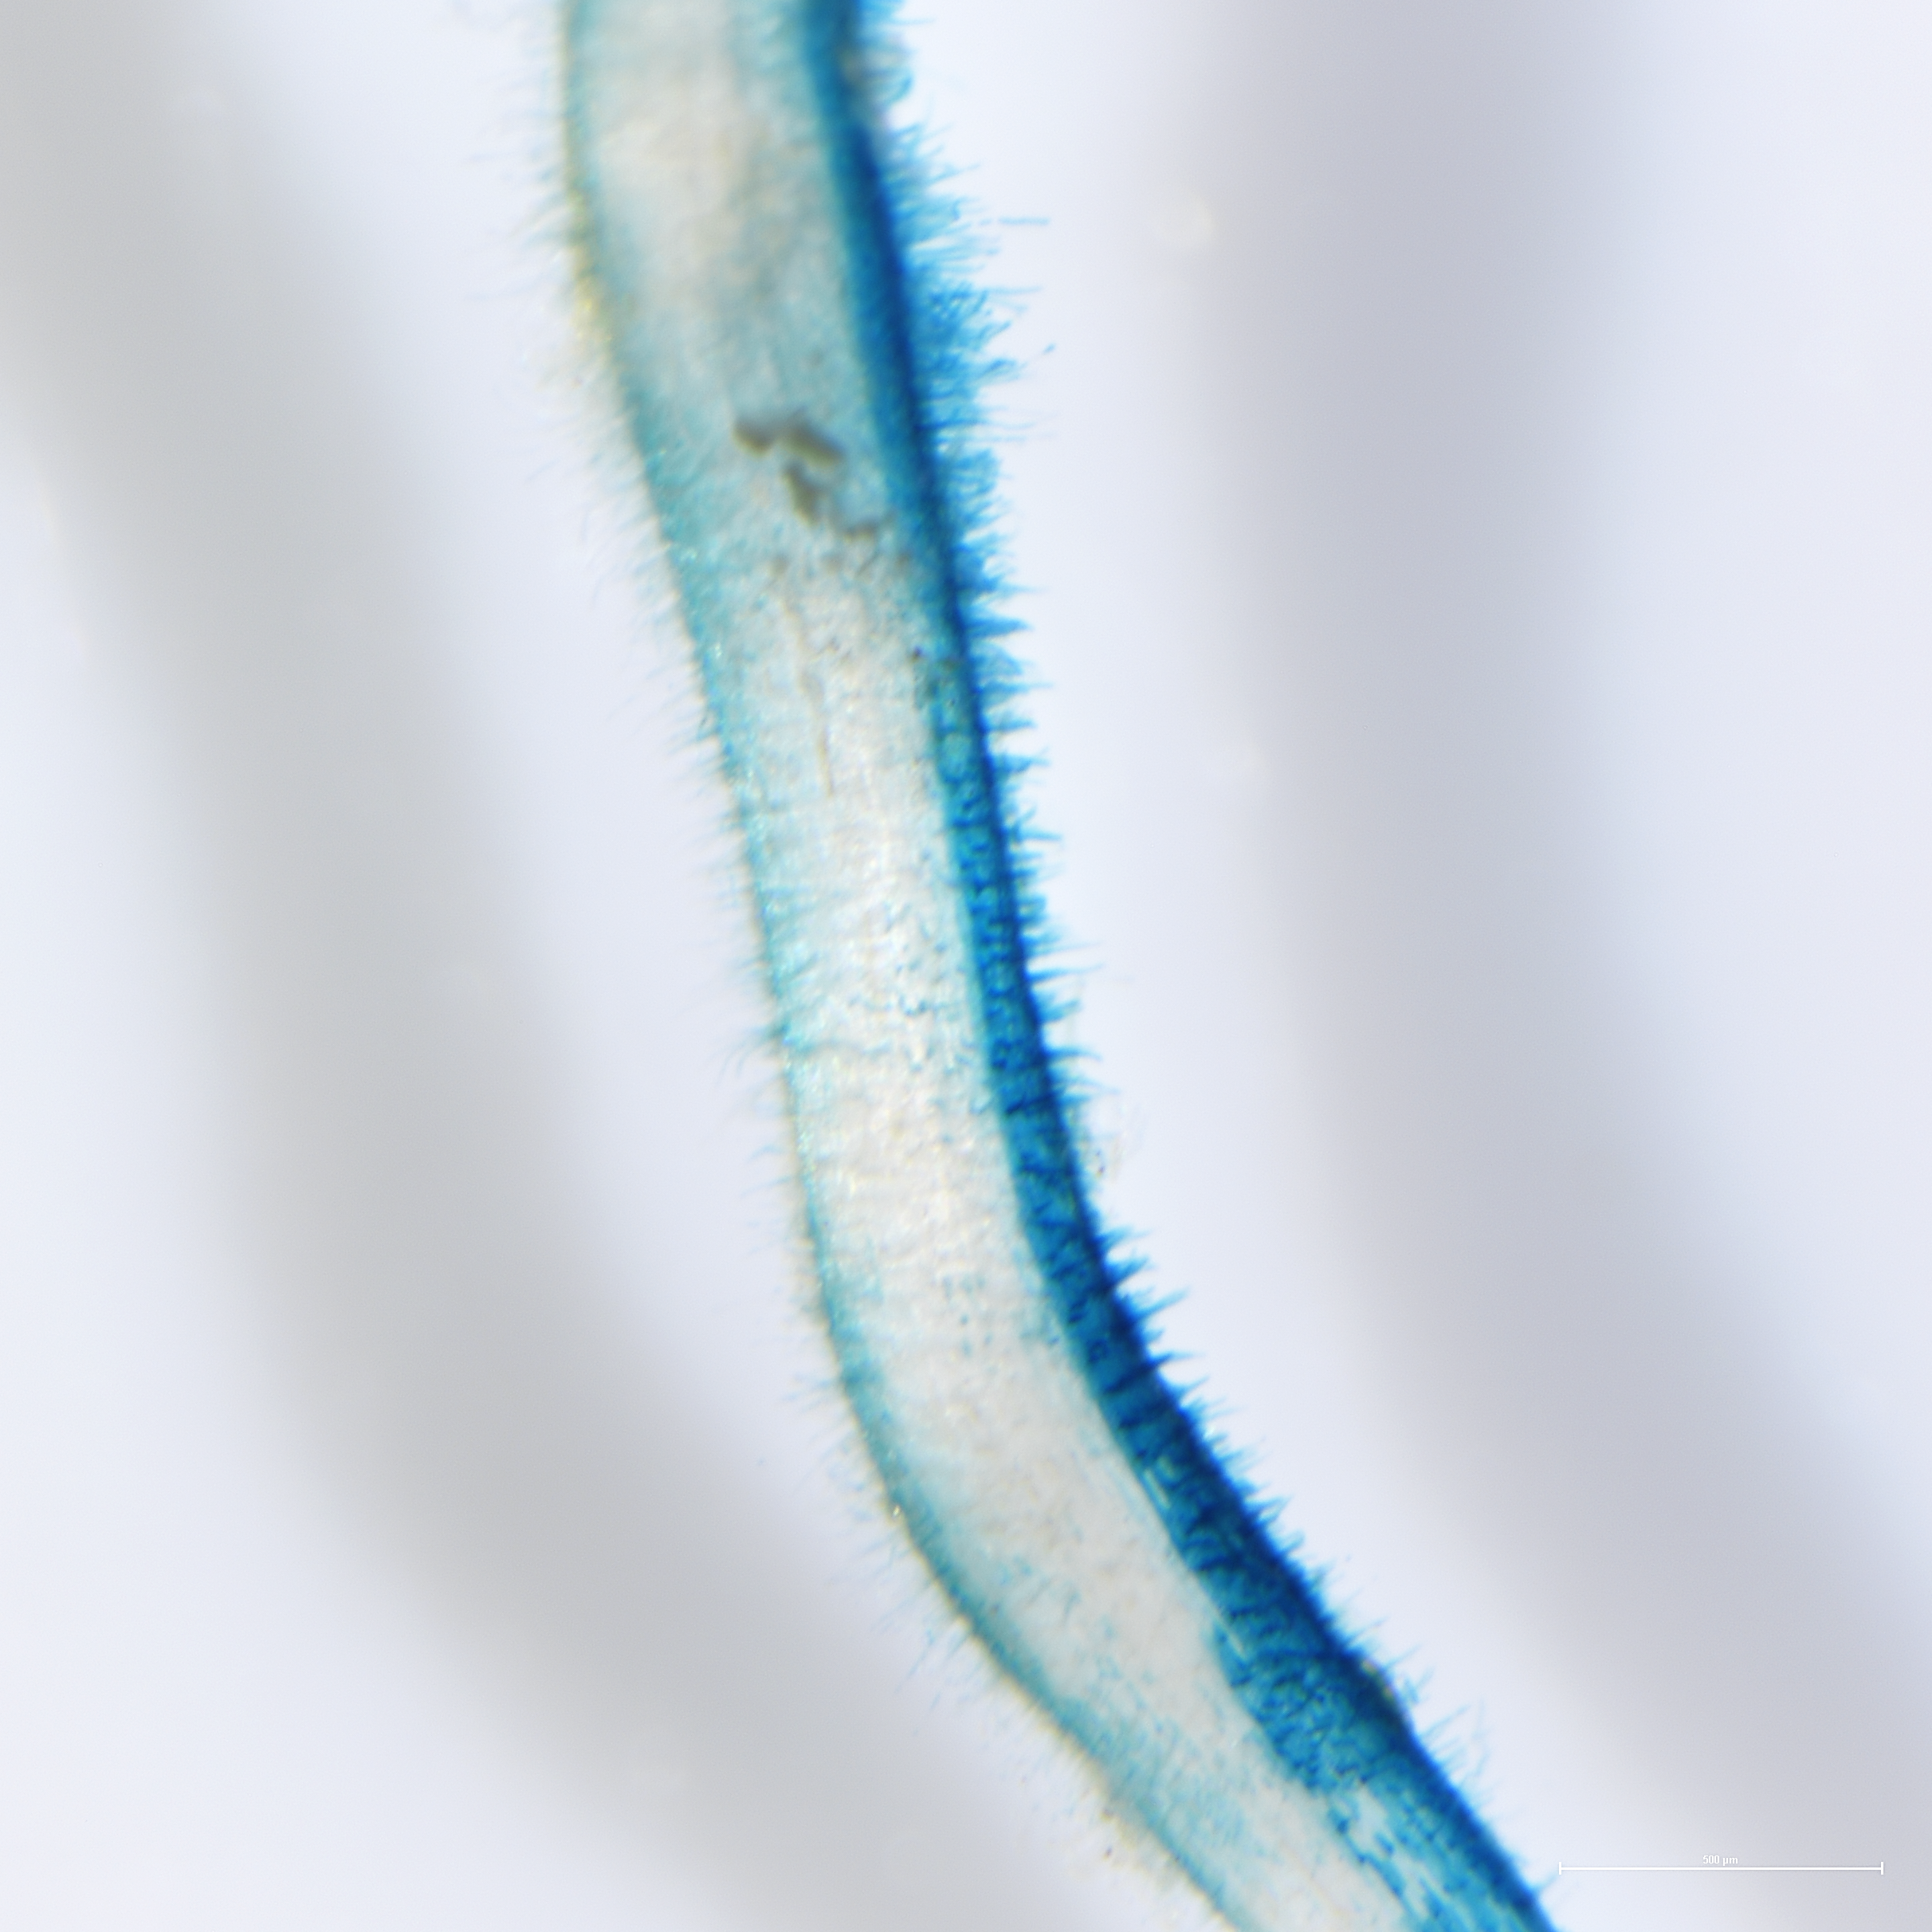
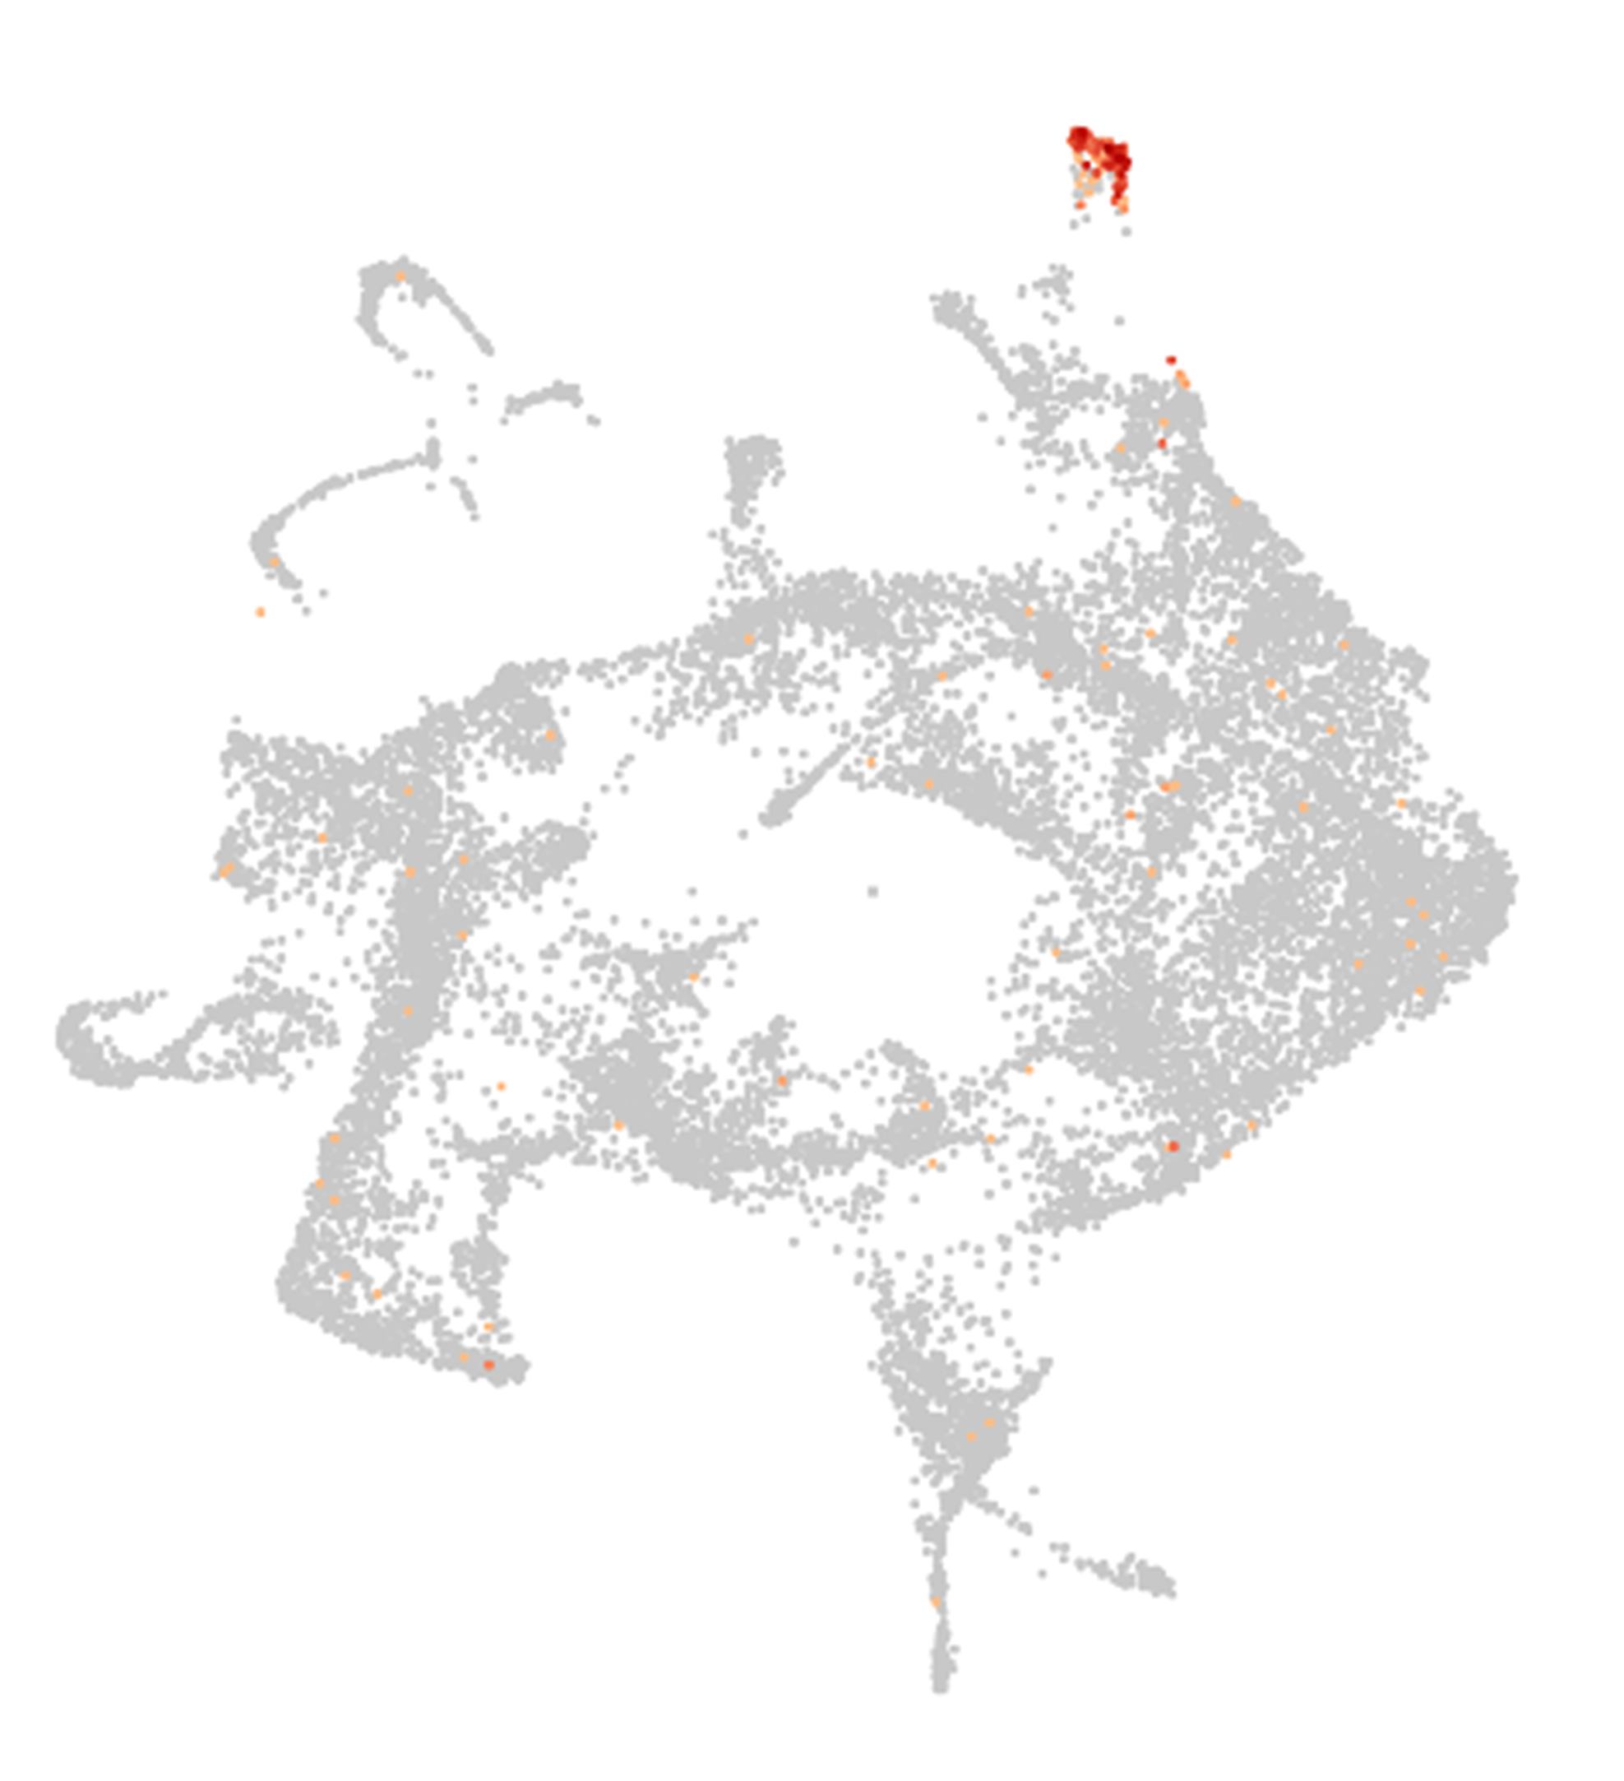
Glyma.17G133100
Promoter expression functional validation in Glycine max
3

Slide 4
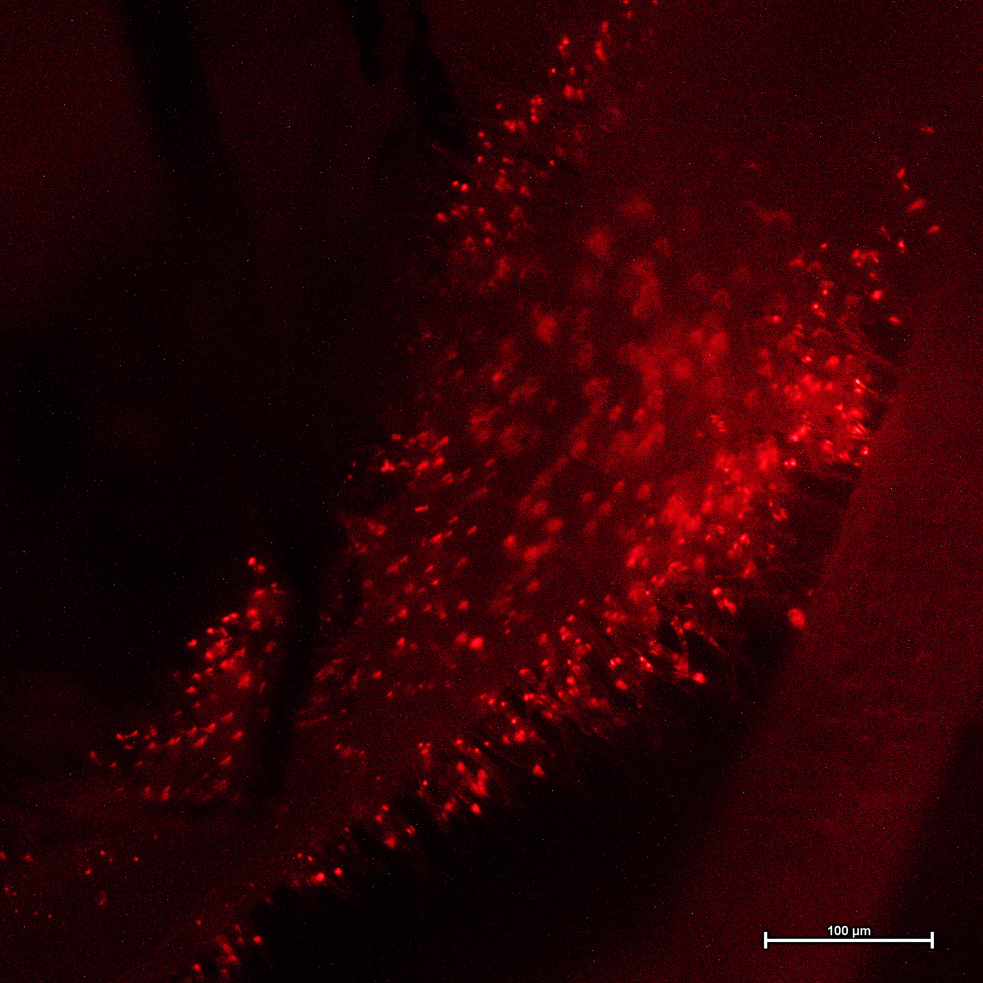
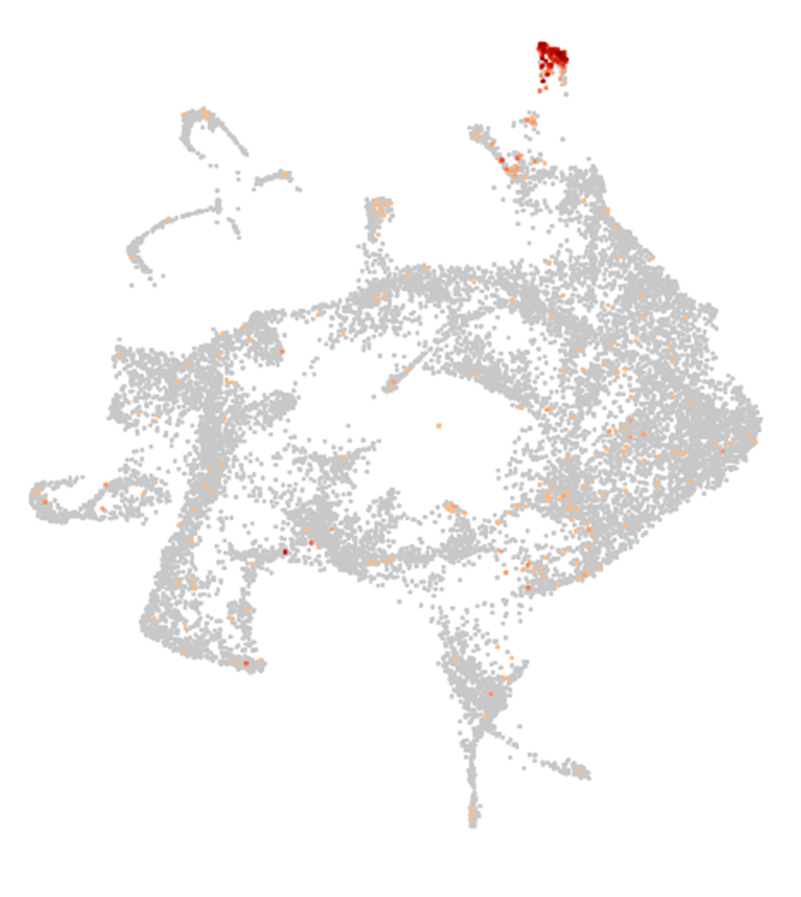
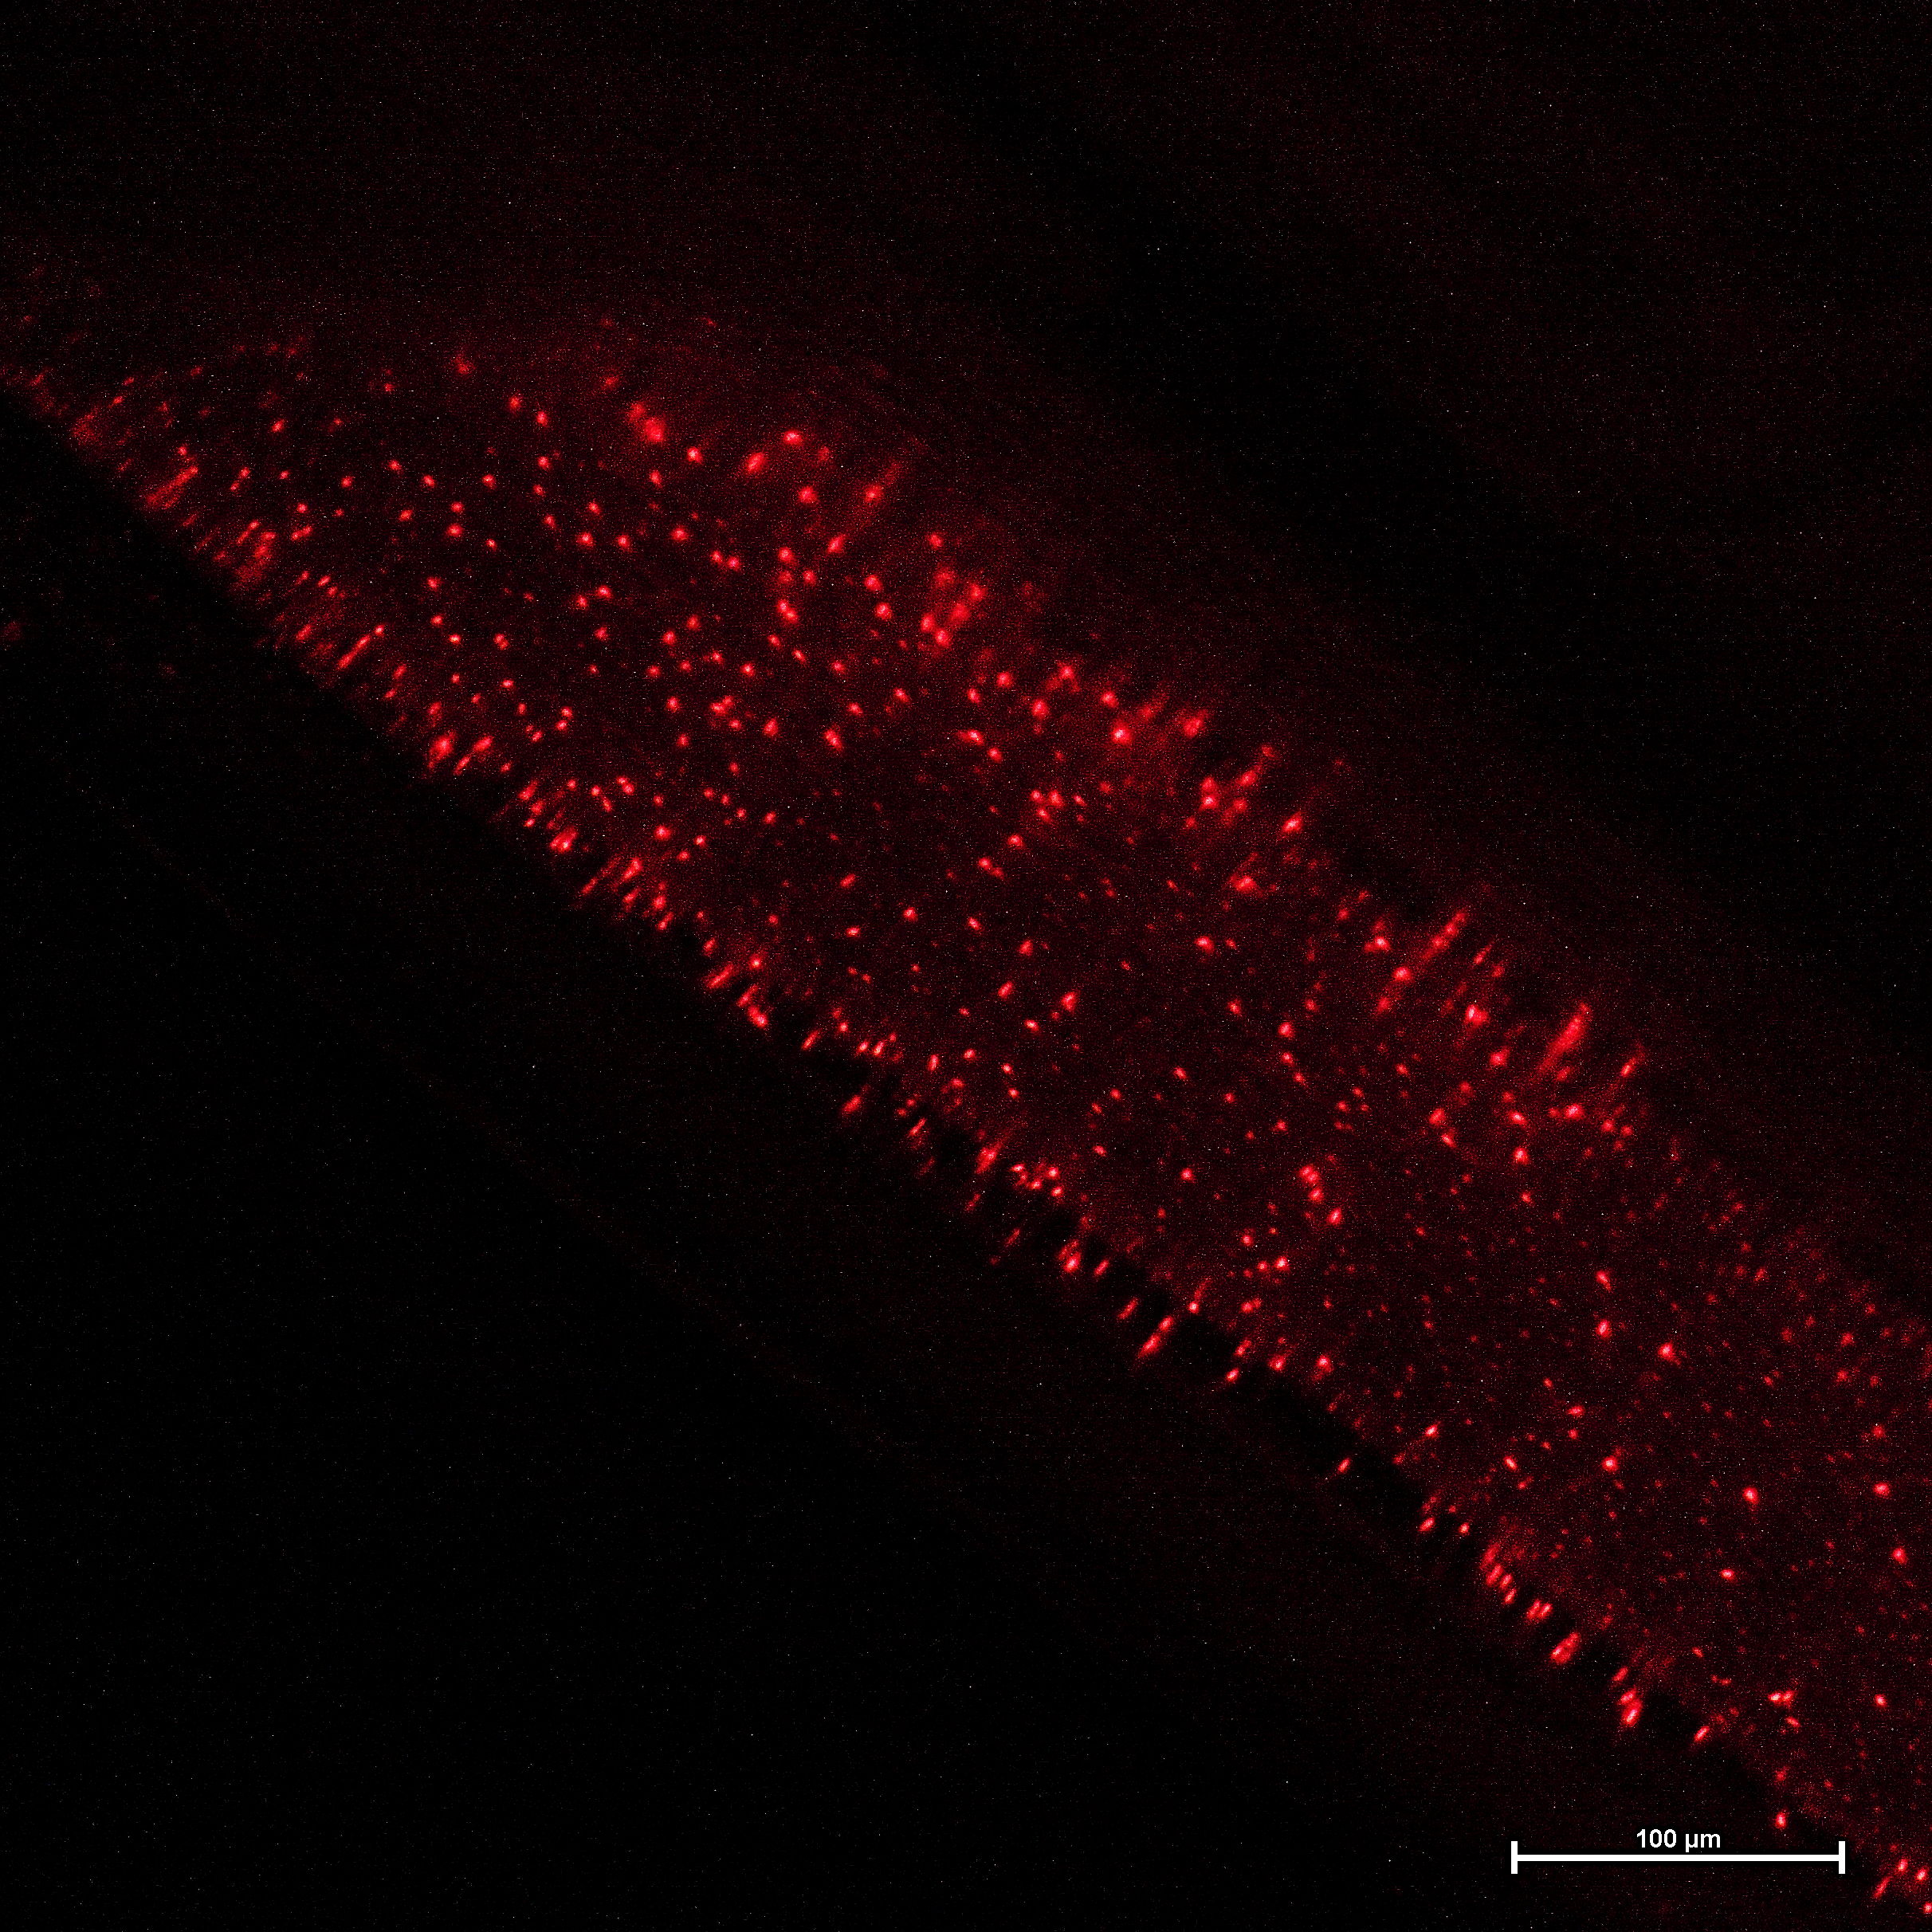
Glyma.10G024600
Promoter expression functional validation in Glycine max
4

Slide 5
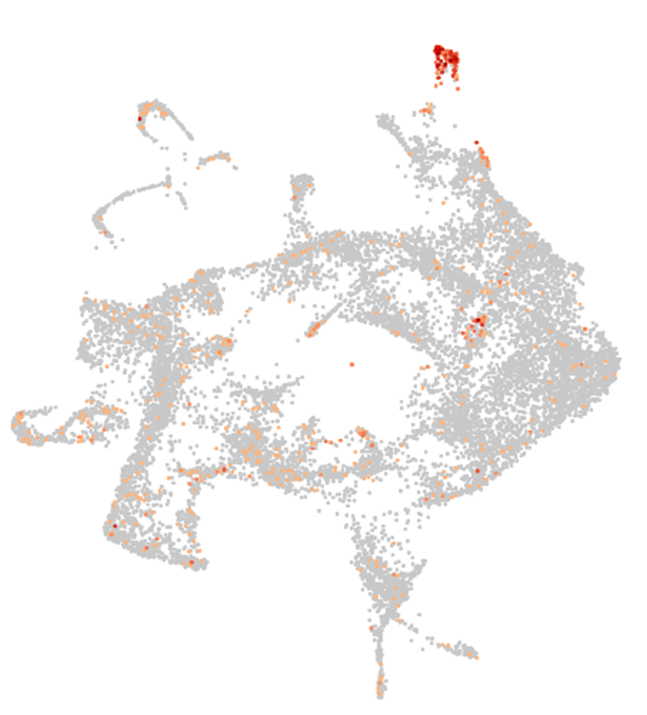
Glyma.10G024600 + Glyma.10G209200
Promoter expression functional validation in Glycine max
5

Slide 6
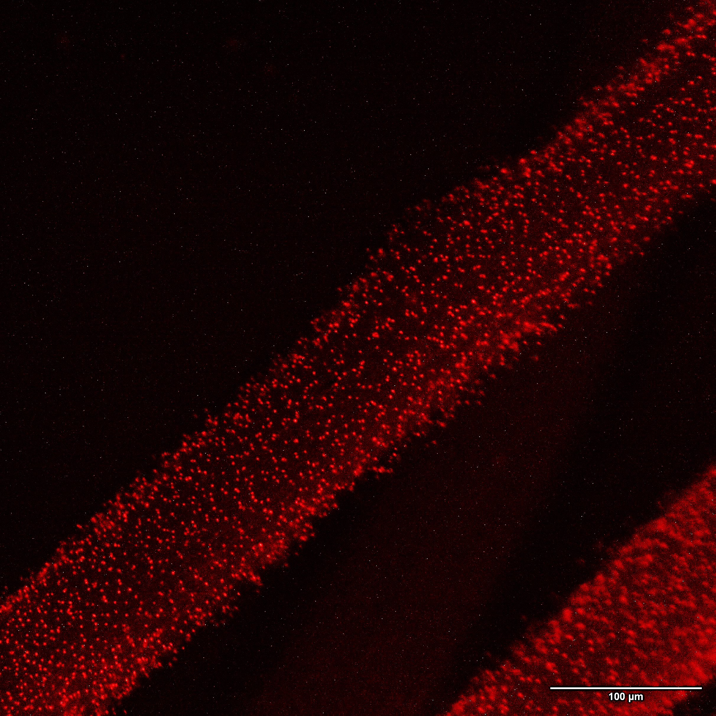
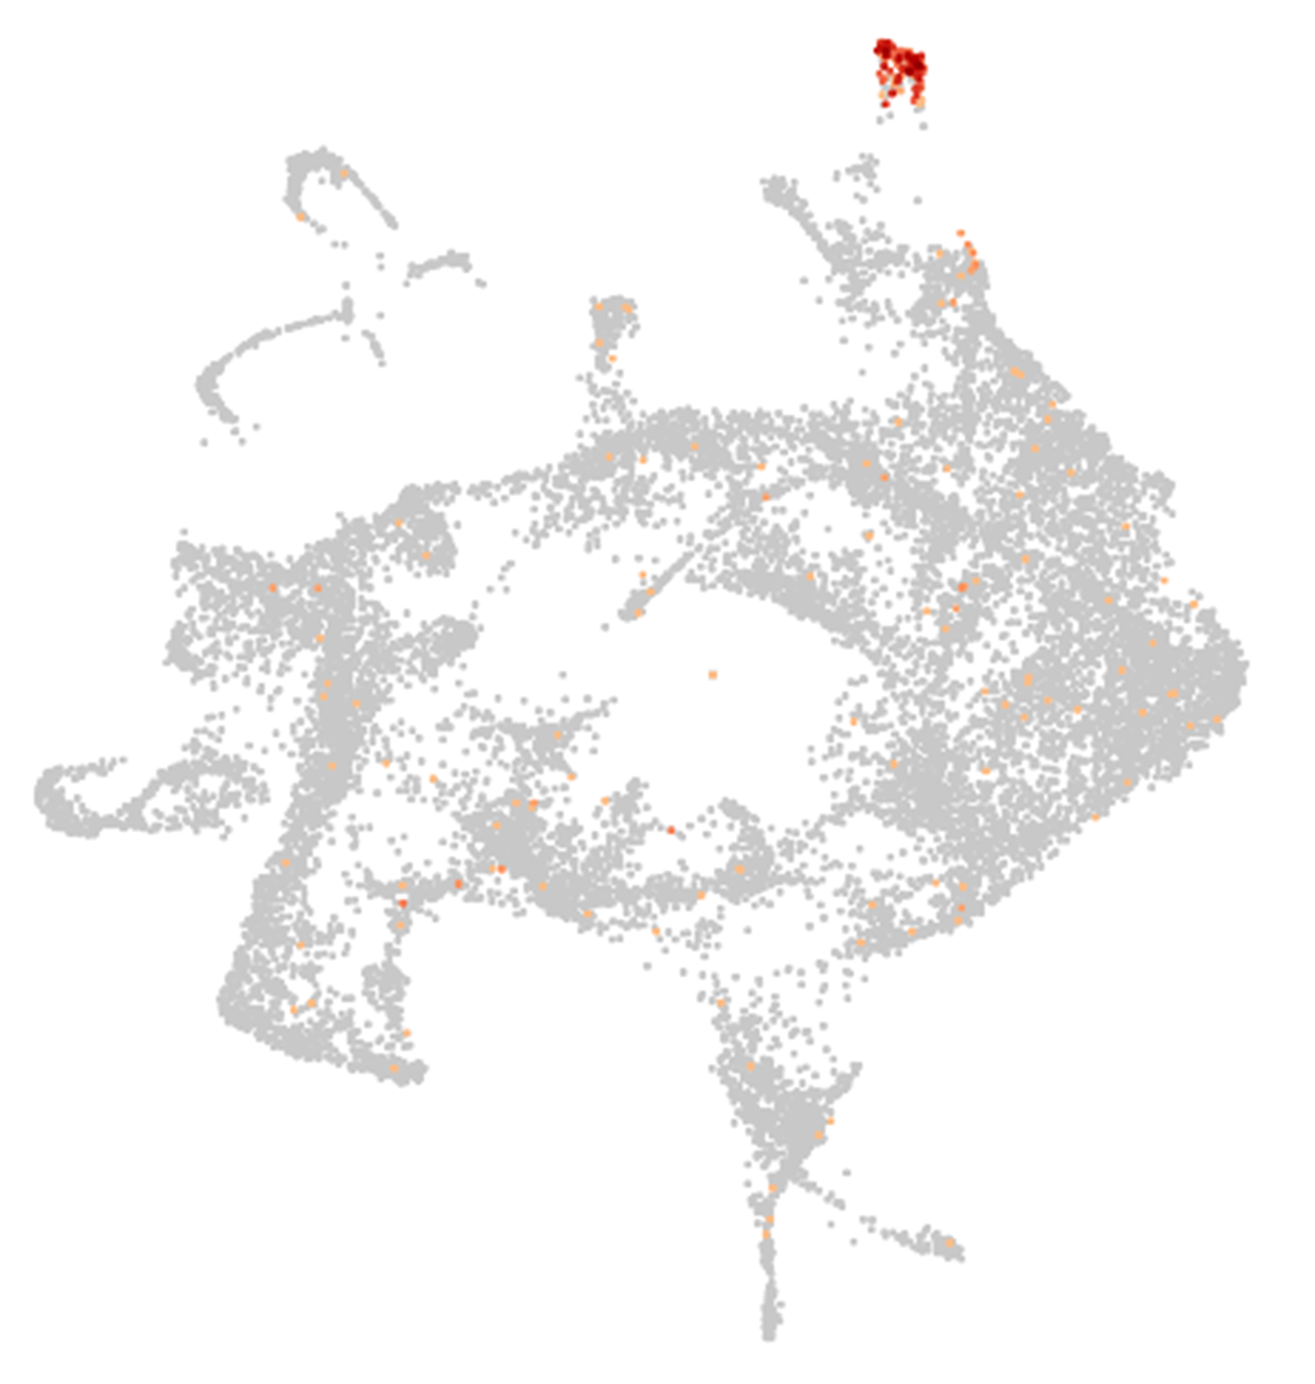
Glyma.12G027200
Promoter expression functional validation in Glycine max
6

Slide 7
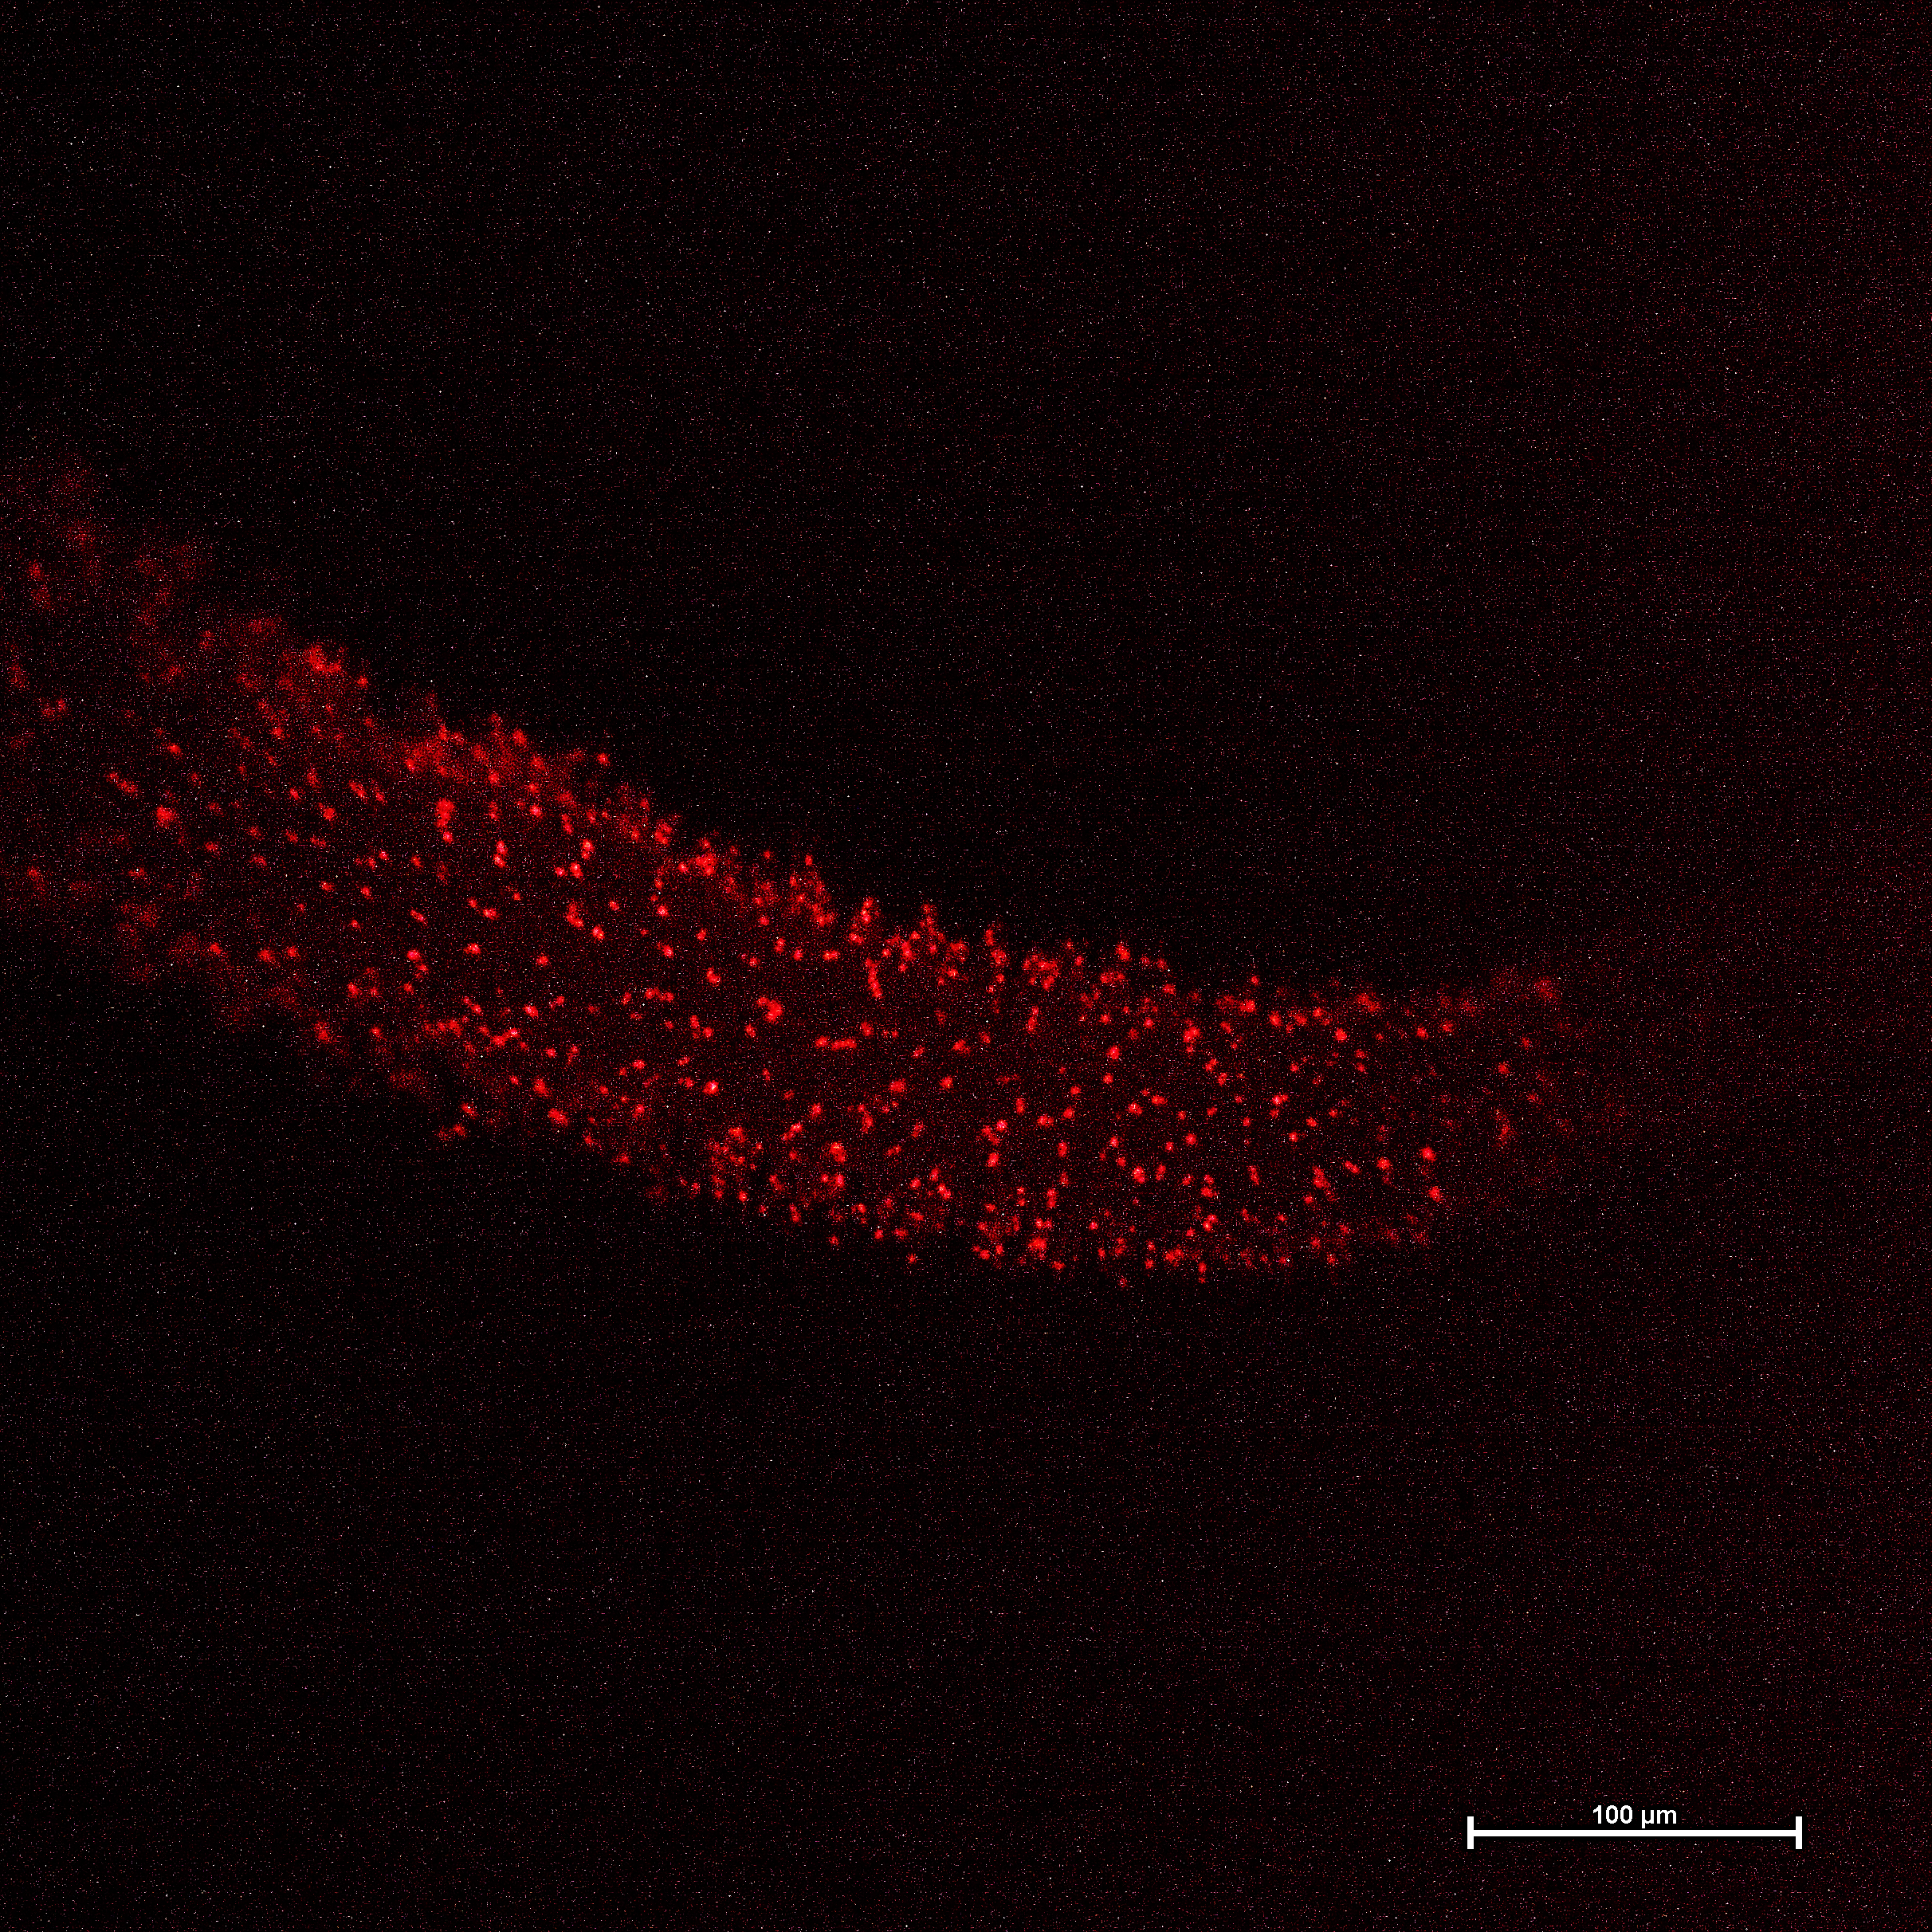
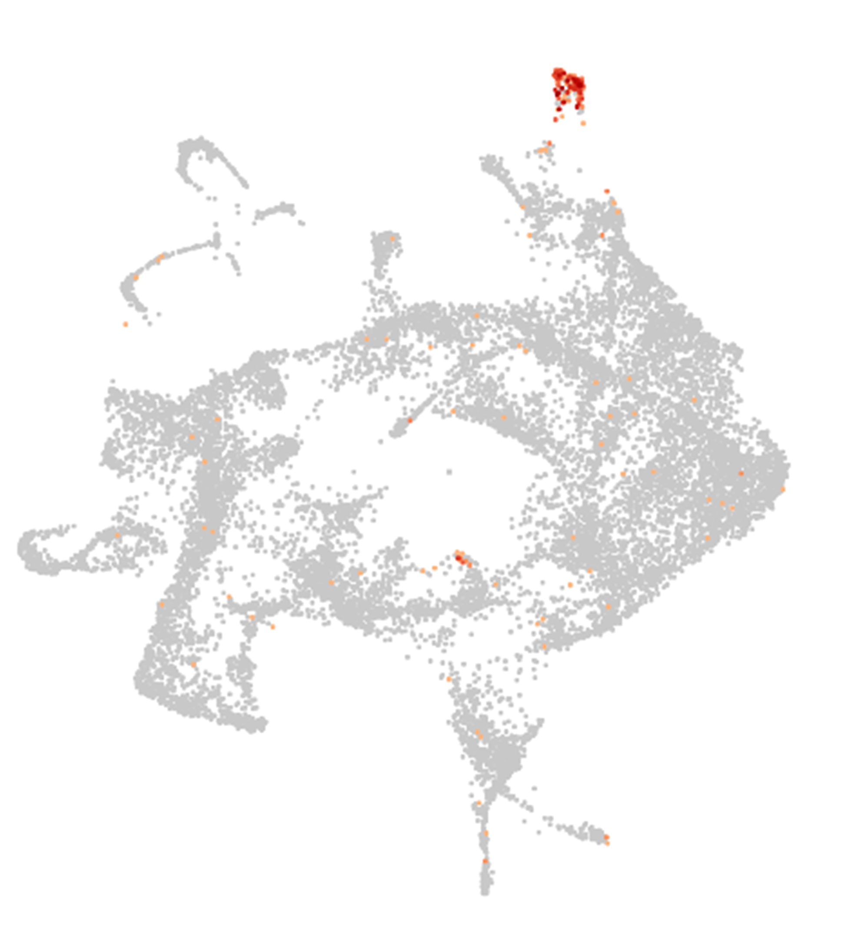
Glyma.10G016600
Promoter expression functional validation in Glycine max
7

Slide 8
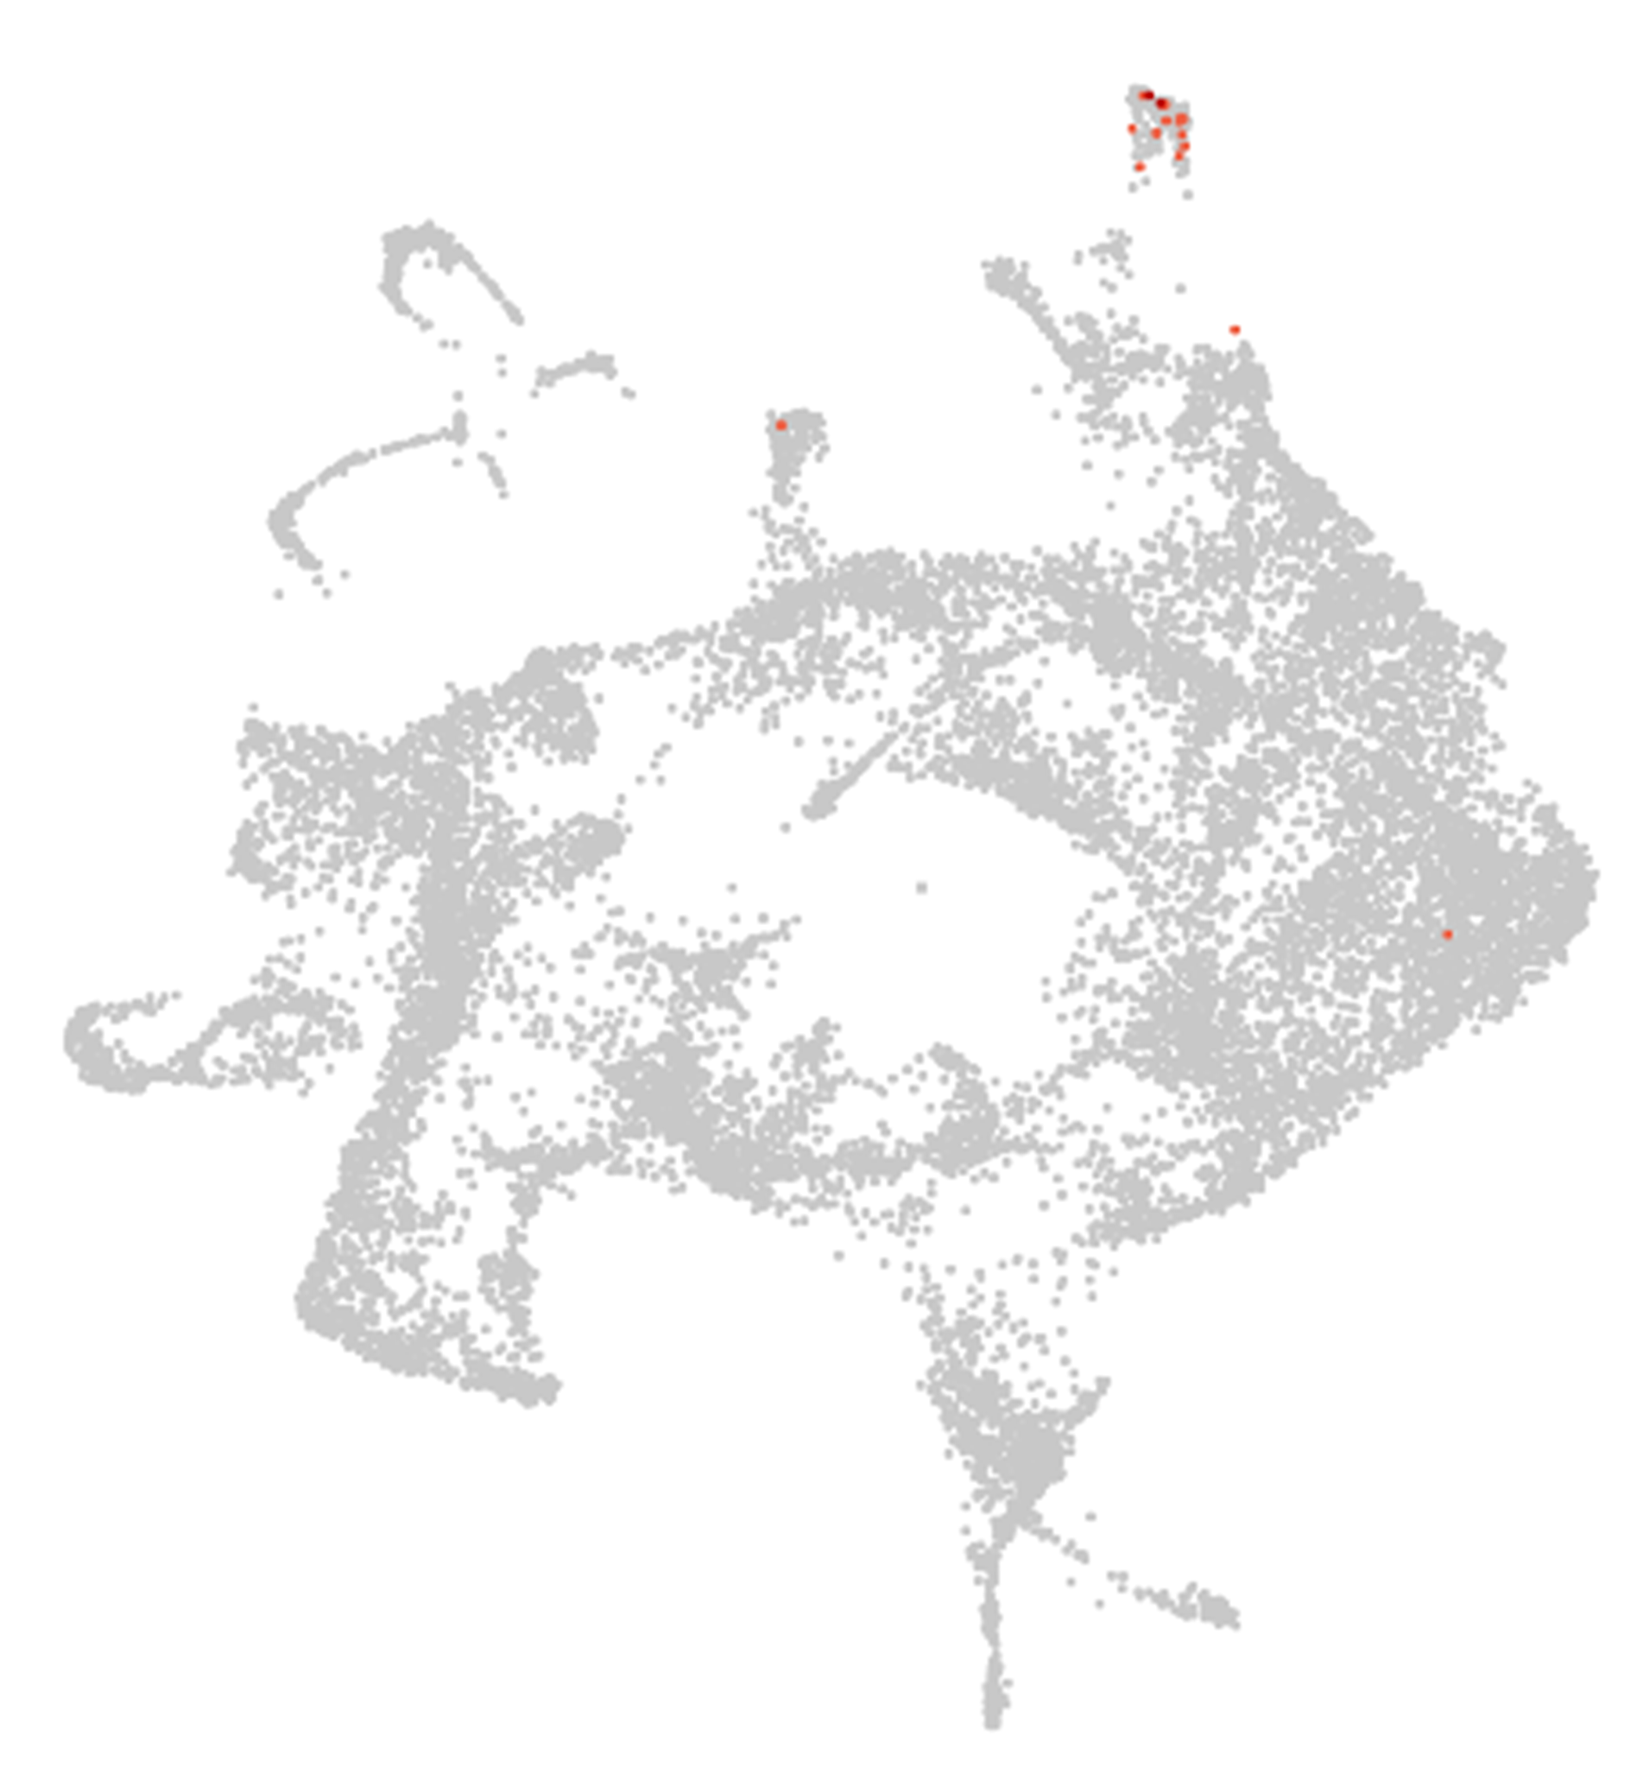
Glyma.18G025200
Soybean gene previously functionally validated as root hair-specific (Qiao et al. 2017)
Functionally validates in Glycine max
8

Slide 9

Glyma.05G157400
Soybean gene previously functionally validated as root hair-specific (Qiao et al. 2017)
Functionally validates in Glycine max
9

Slide 10
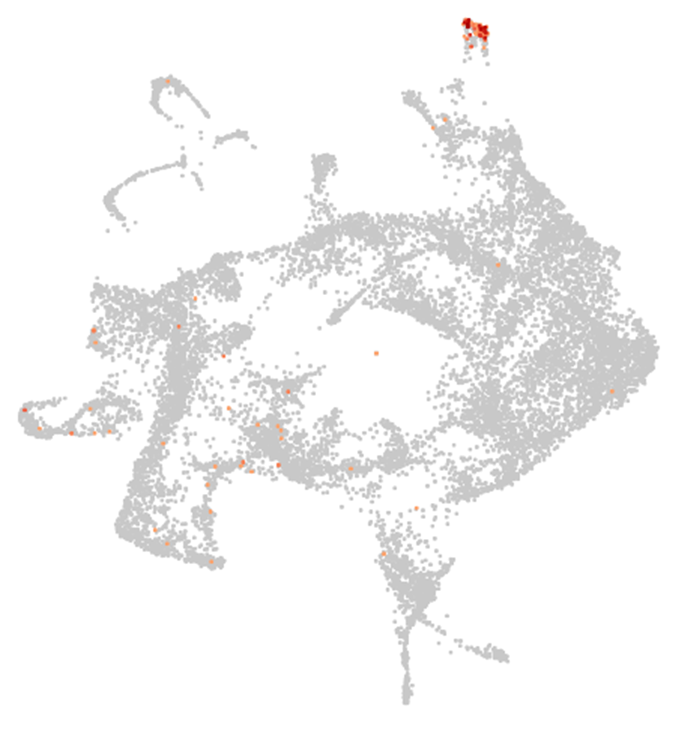
Glyma.15G020700
Soybean gene previously functionally validated as root hair-specific (Qiao et al. 2017)
Functionally validates in Glycine max
10

Slide 11
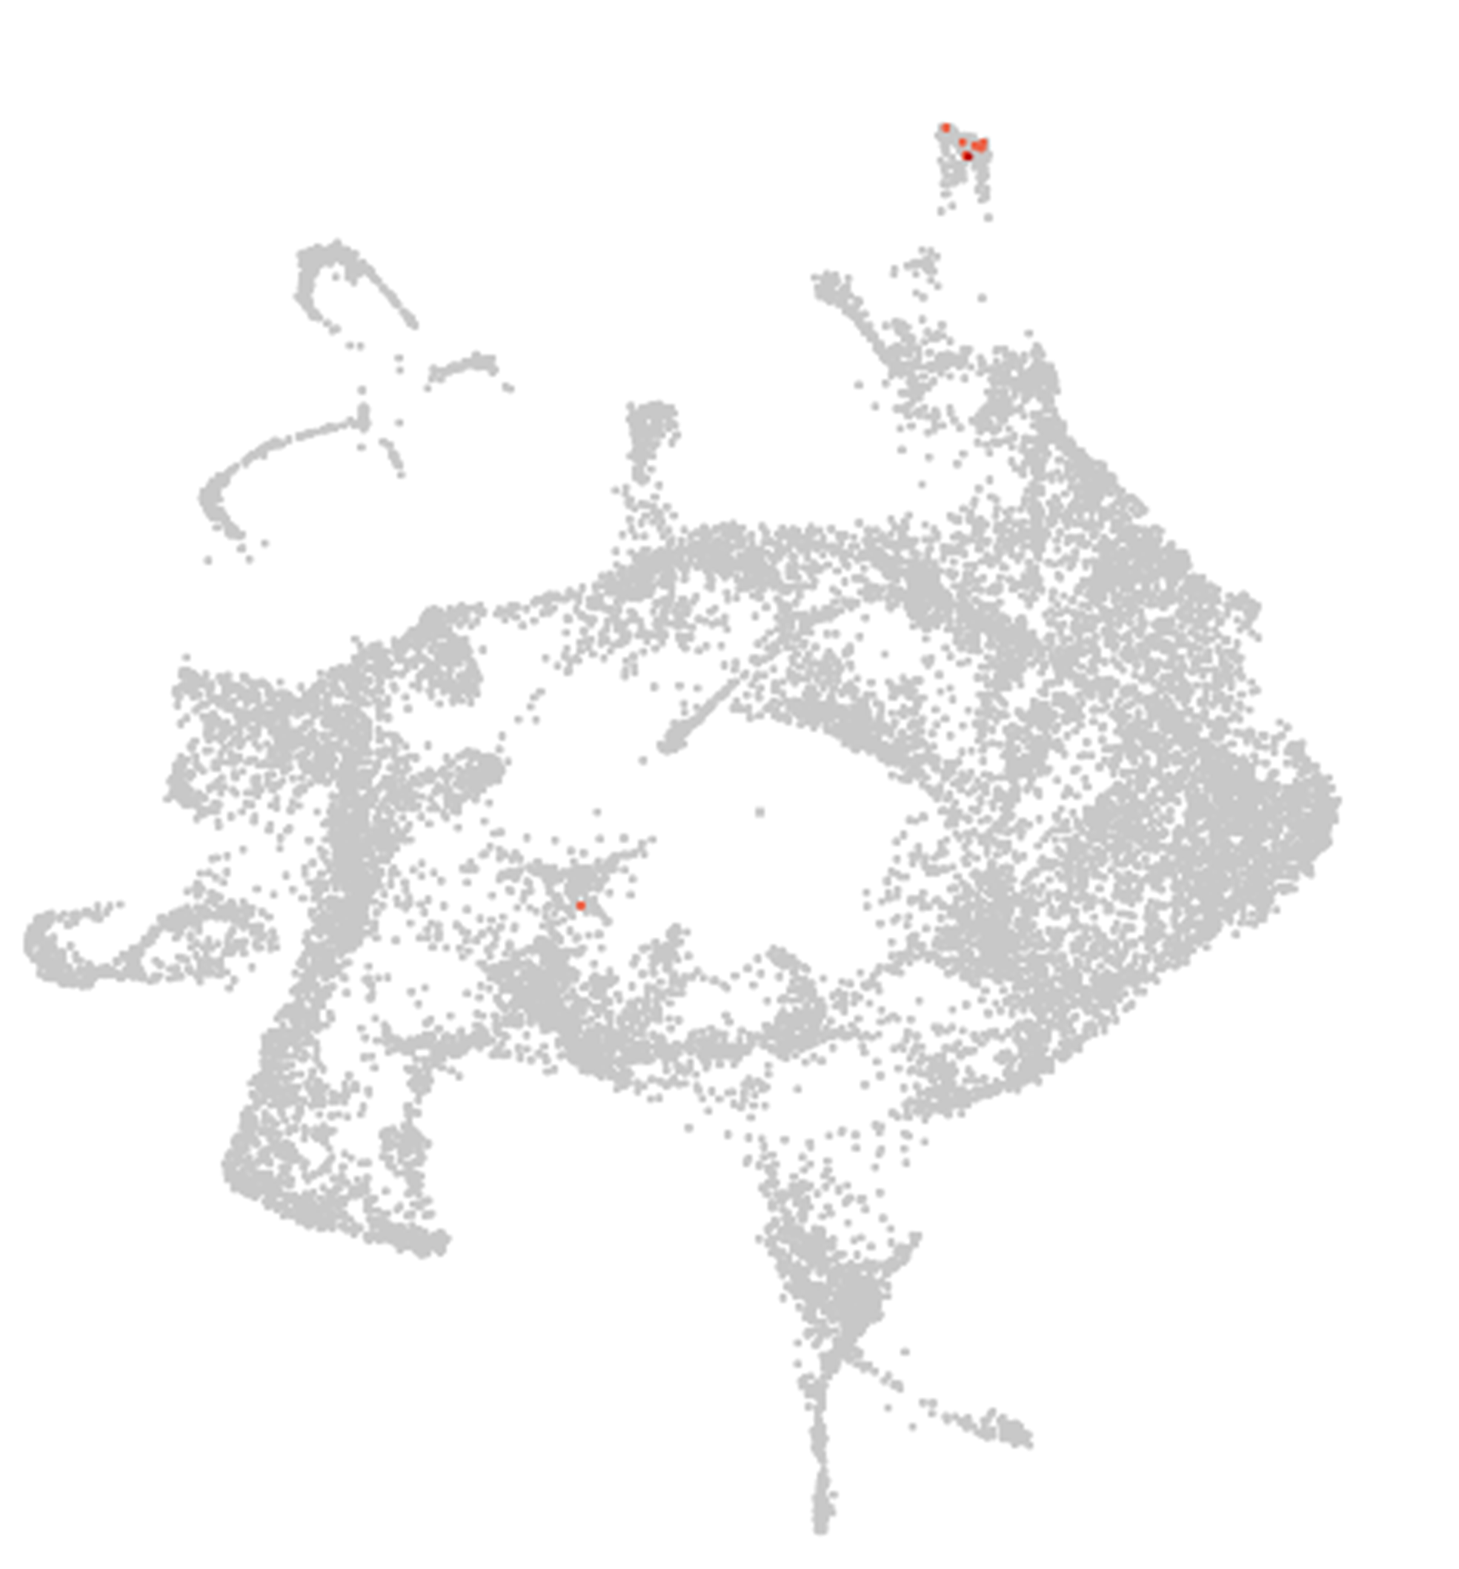
Glyma.08G115000
Soybean gene previously functionally validated as root hair-specific (Qiao et al. 2017)
Functionally validates in Glycine max
11

Slide 12
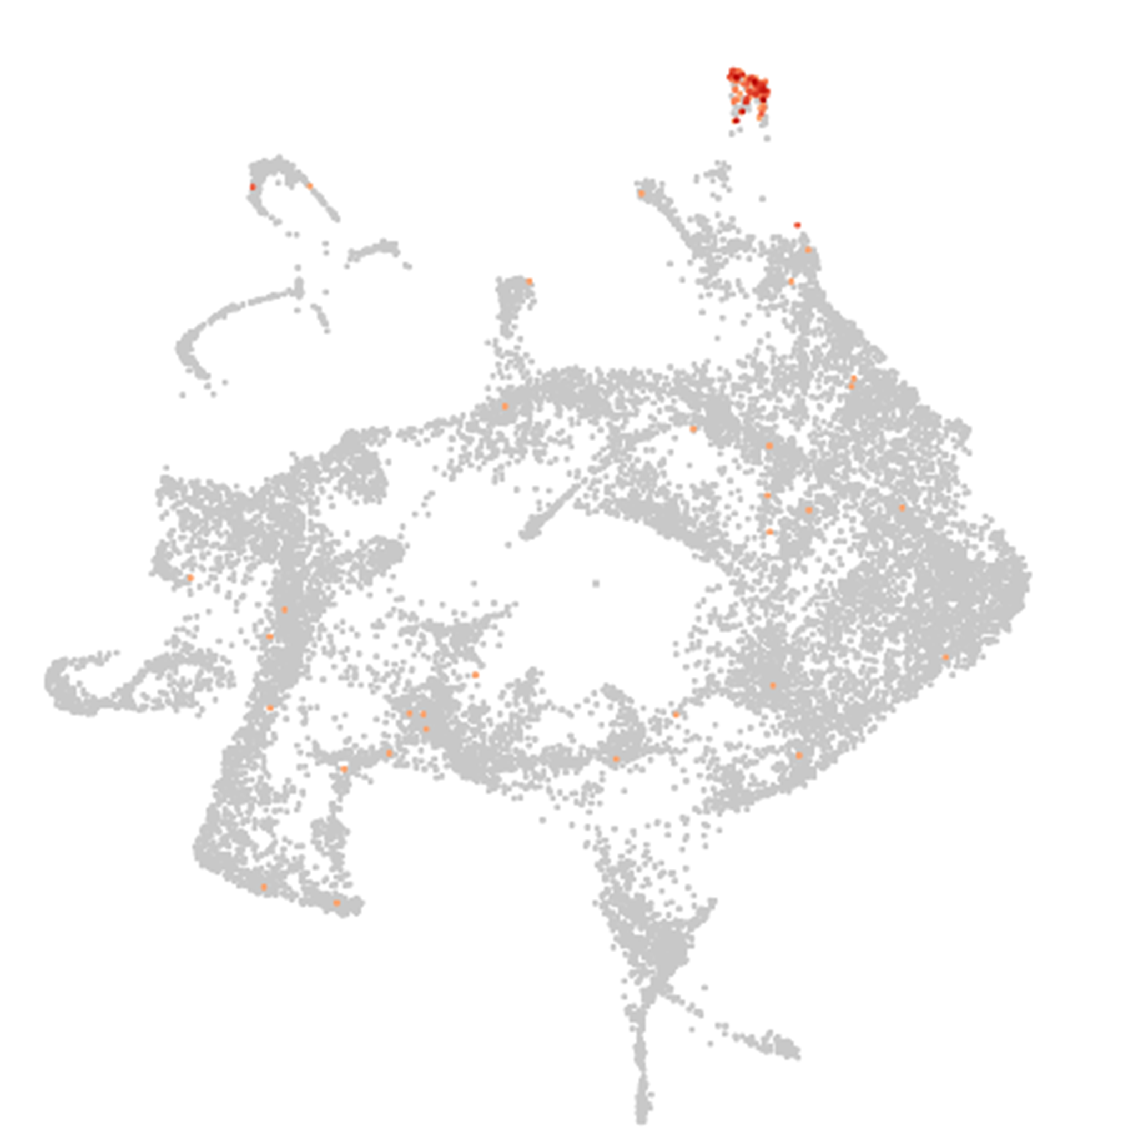
Glyma.03G188300
Soybean gene previously functionally validated as root hair-specific (Qiao et al. 2017)
Functionally validates in Glycine max
12

Slide 13
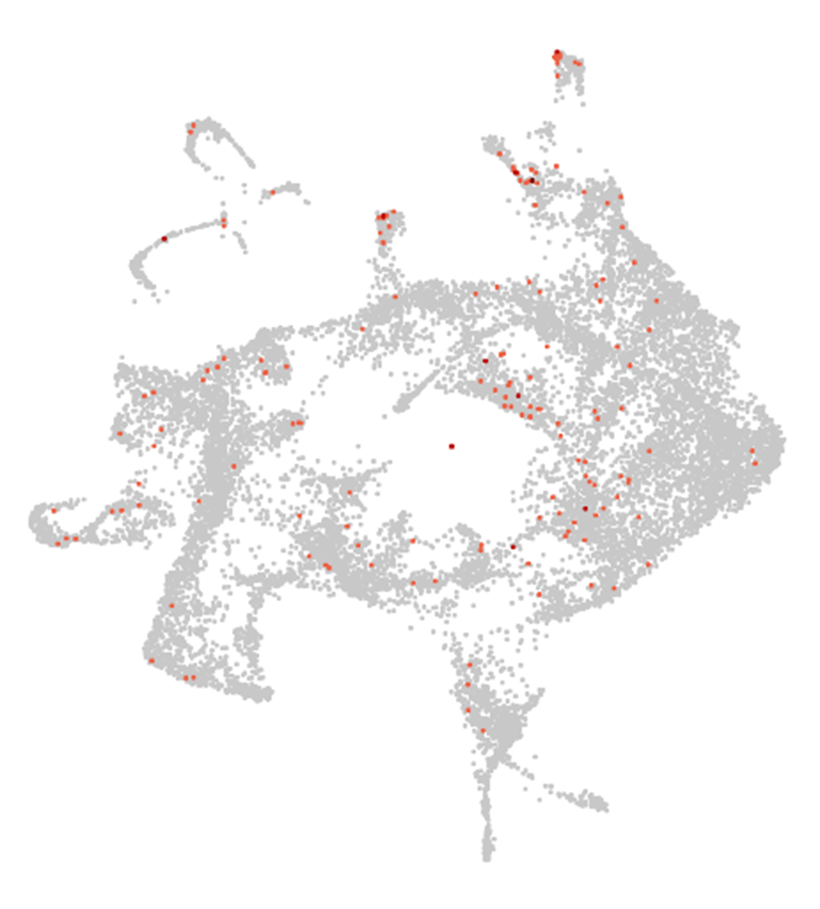
Glyma.17G030700
Ortholog of CBL9. CBL9 shows evidence in the
the epidermal cells in Arabidopsis (Janes et al., 2018)
Ortholog genes with functional validation on Arabidopsis thaliana or Medicago truncatula
13

Slide 14
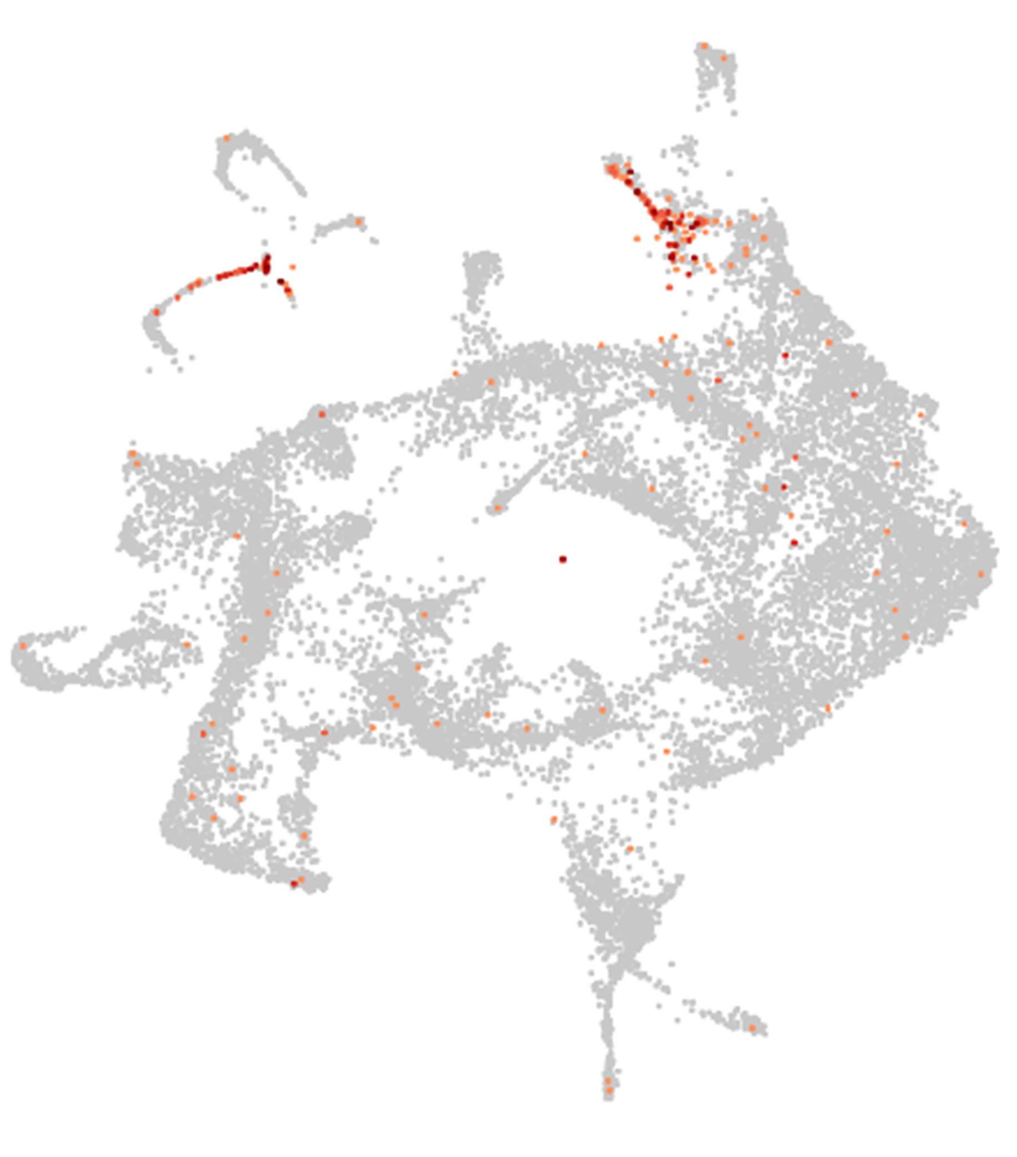
Glyma.15G068600
Ortholog of BFN1. BFN1 shows evidence as
Root cap cell death marker (Fendrych et al., 2014)
Ortholog genes with functional validation on Arabidopsis thaliana or Medicago truncatula
14

Slide 15
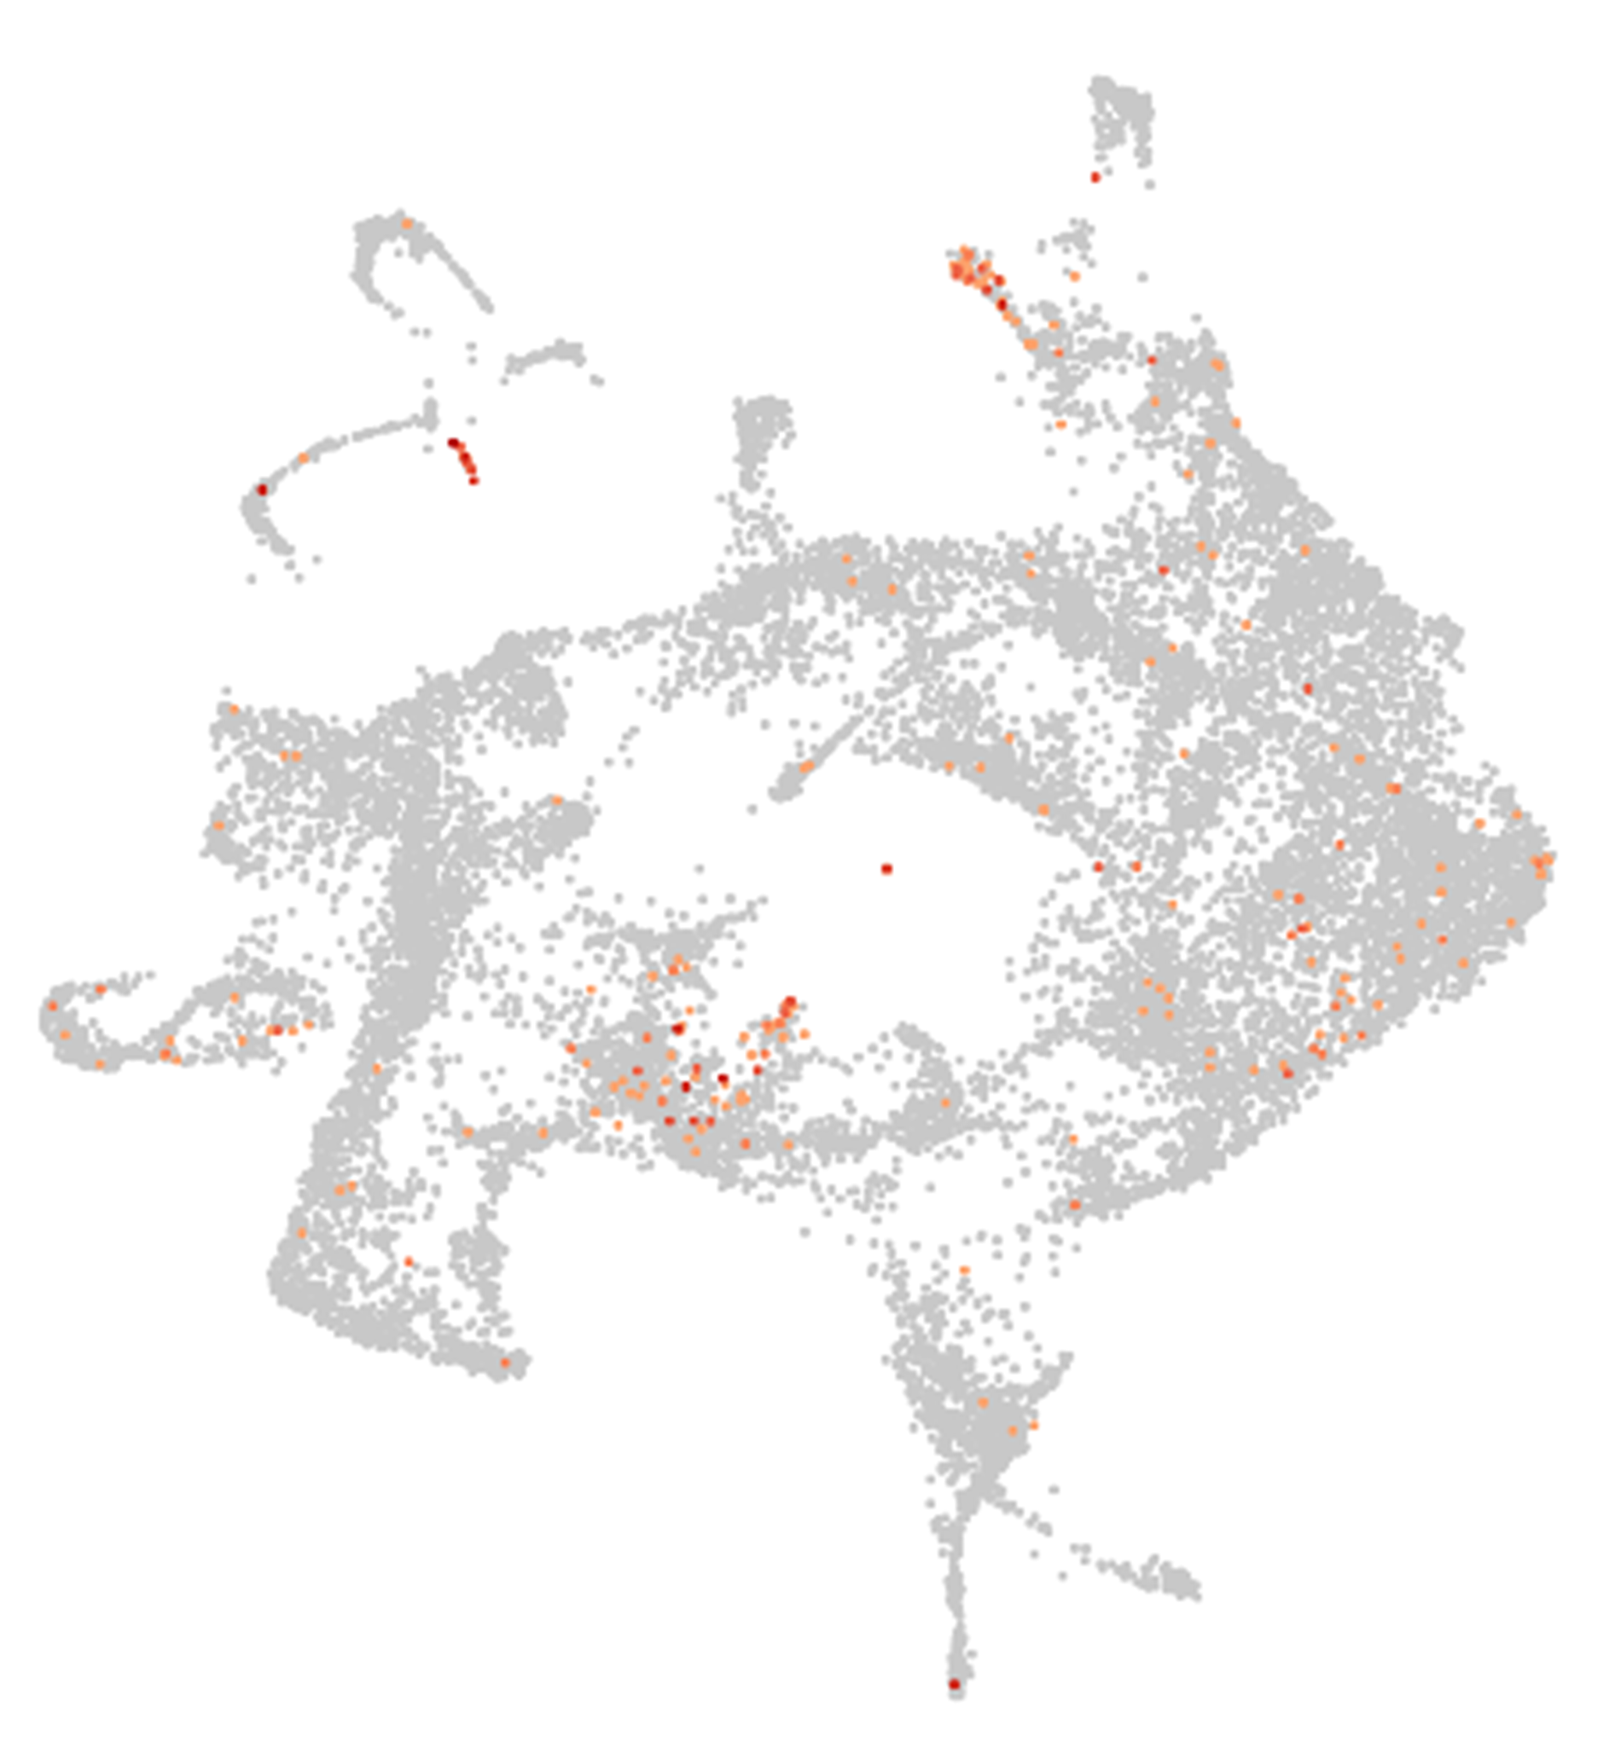
Glyma.15G266500
Ortholog of SMB. SMB shows evidence as
Root cap cell death marker (Fendrych et al., 2014)
Ortholog genes with functional validation on Arabidopsis thaliana or Medicago truncatula
15

Slide 16
Niche cells
Cluster 6

Slide 17
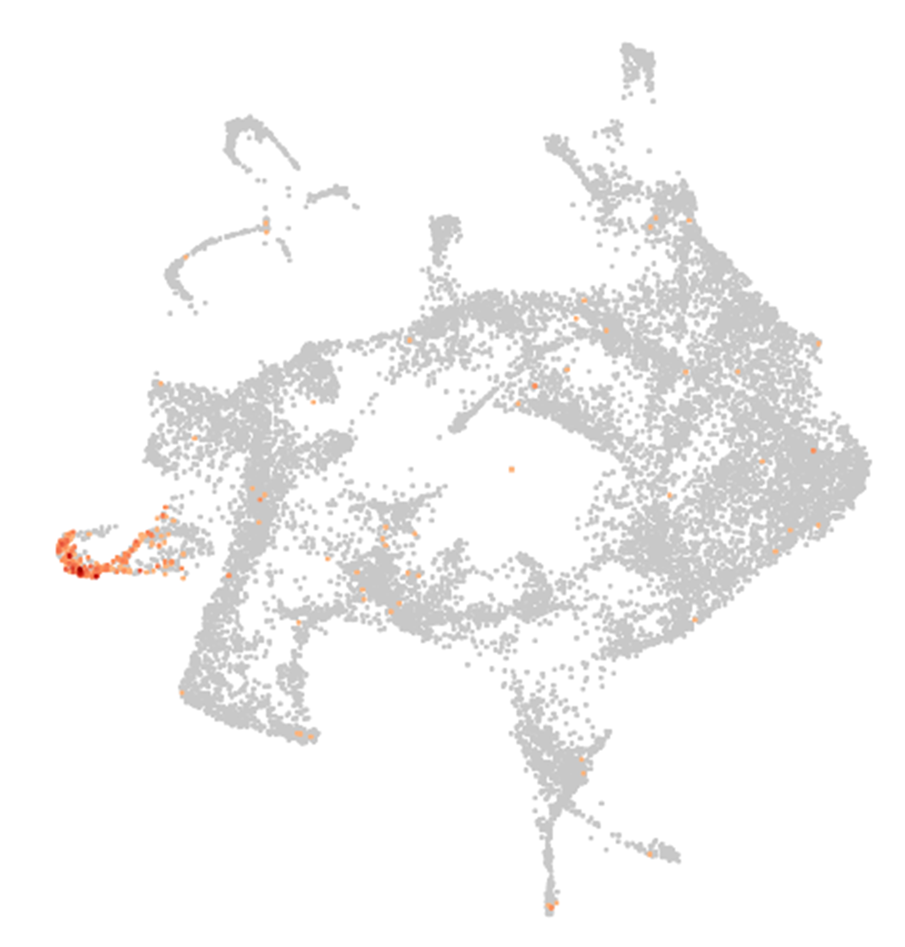
Glyma.08G325200
Ortholog of AT5G55520. AT5G55520 was reported as specifically expressed in the niche cells in Arabidopsis (Jean-Baptiste et al., 2019, Denyer et al., 2019).
Ortholog genes with functional validation on Arabidopsis thaliana or Medicago truncatula
17

Slide 18
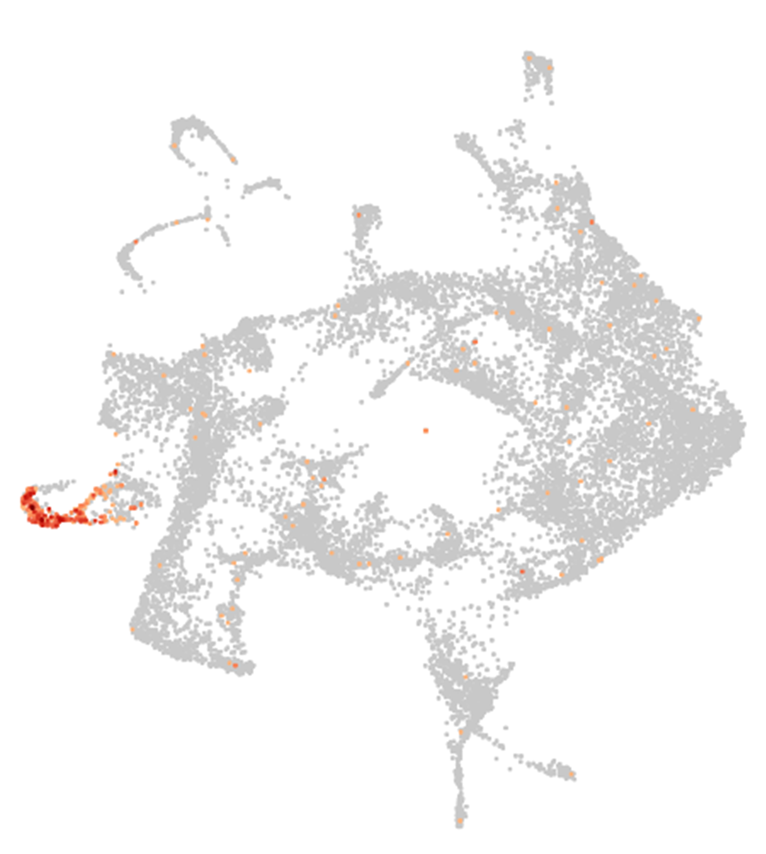
Glyma.05G215500
Ortholog of AT4G23800. AT4G23800 was reported as specifically expressed in the niche cells in Arabidopsis (Denyer et al., 2019; Schulse et al., 2019).
Ortholog genes with functional validation on Arabidopsis thaliana or Medicago truncatula
18

Slide 19
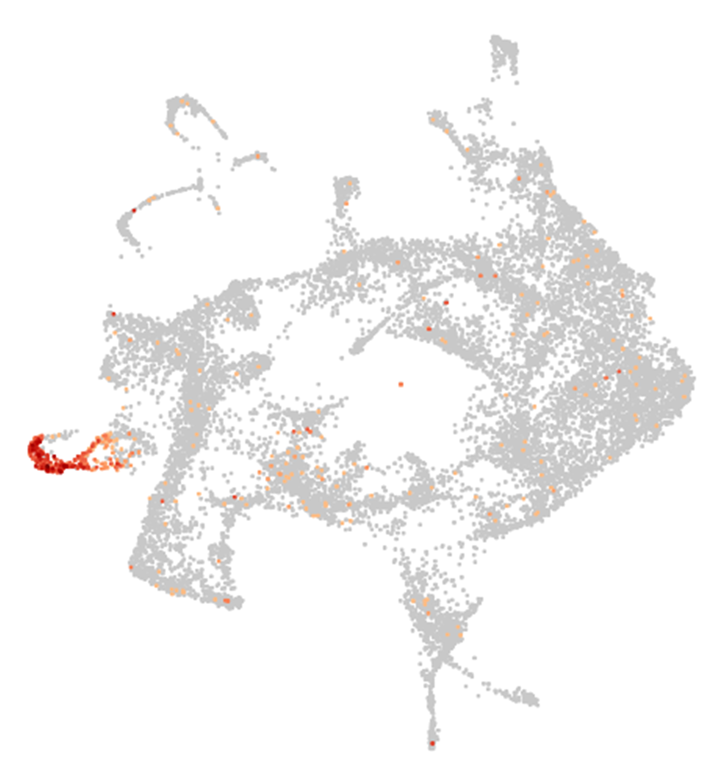
Glyma.08G021700
Ortholog of AT4G23800. AT4G23800 was reported as specifically expressed in the niche cells in Arabidopsis (Denyer et al., 2019; Schulse et al., 2019).
Ortholog genes with functional validation on Arabidopsis thaliana or Medicago truncatula
19

Slide 20
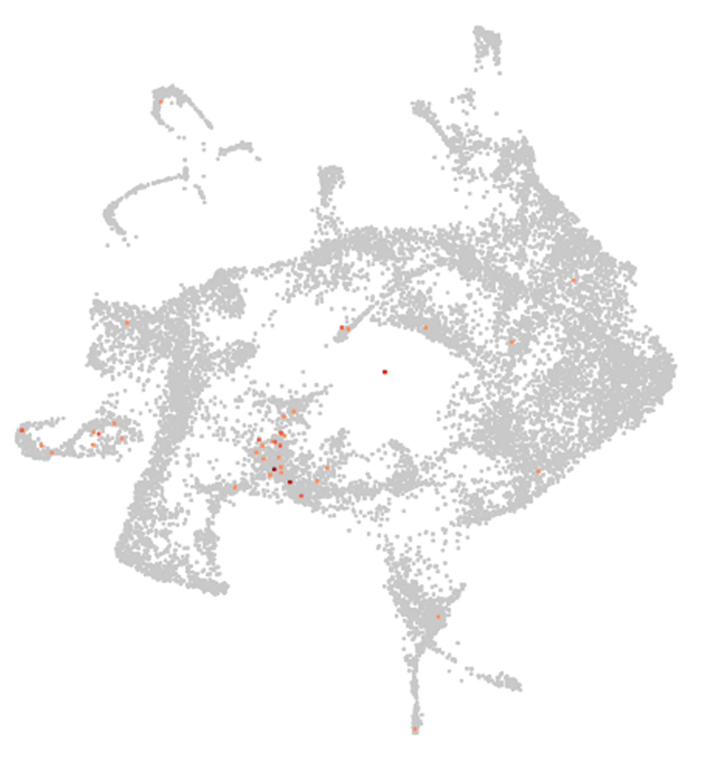
Glyma.11G131900
Ortholog of MtPLT1. MtPLT1 shows evidence in the
quiescent center and niche cells (Franssen et al., 2015)
Ortholog genes with functional validation on Arabidopsis thaliana or Medicago truncatula
20

Slide 21
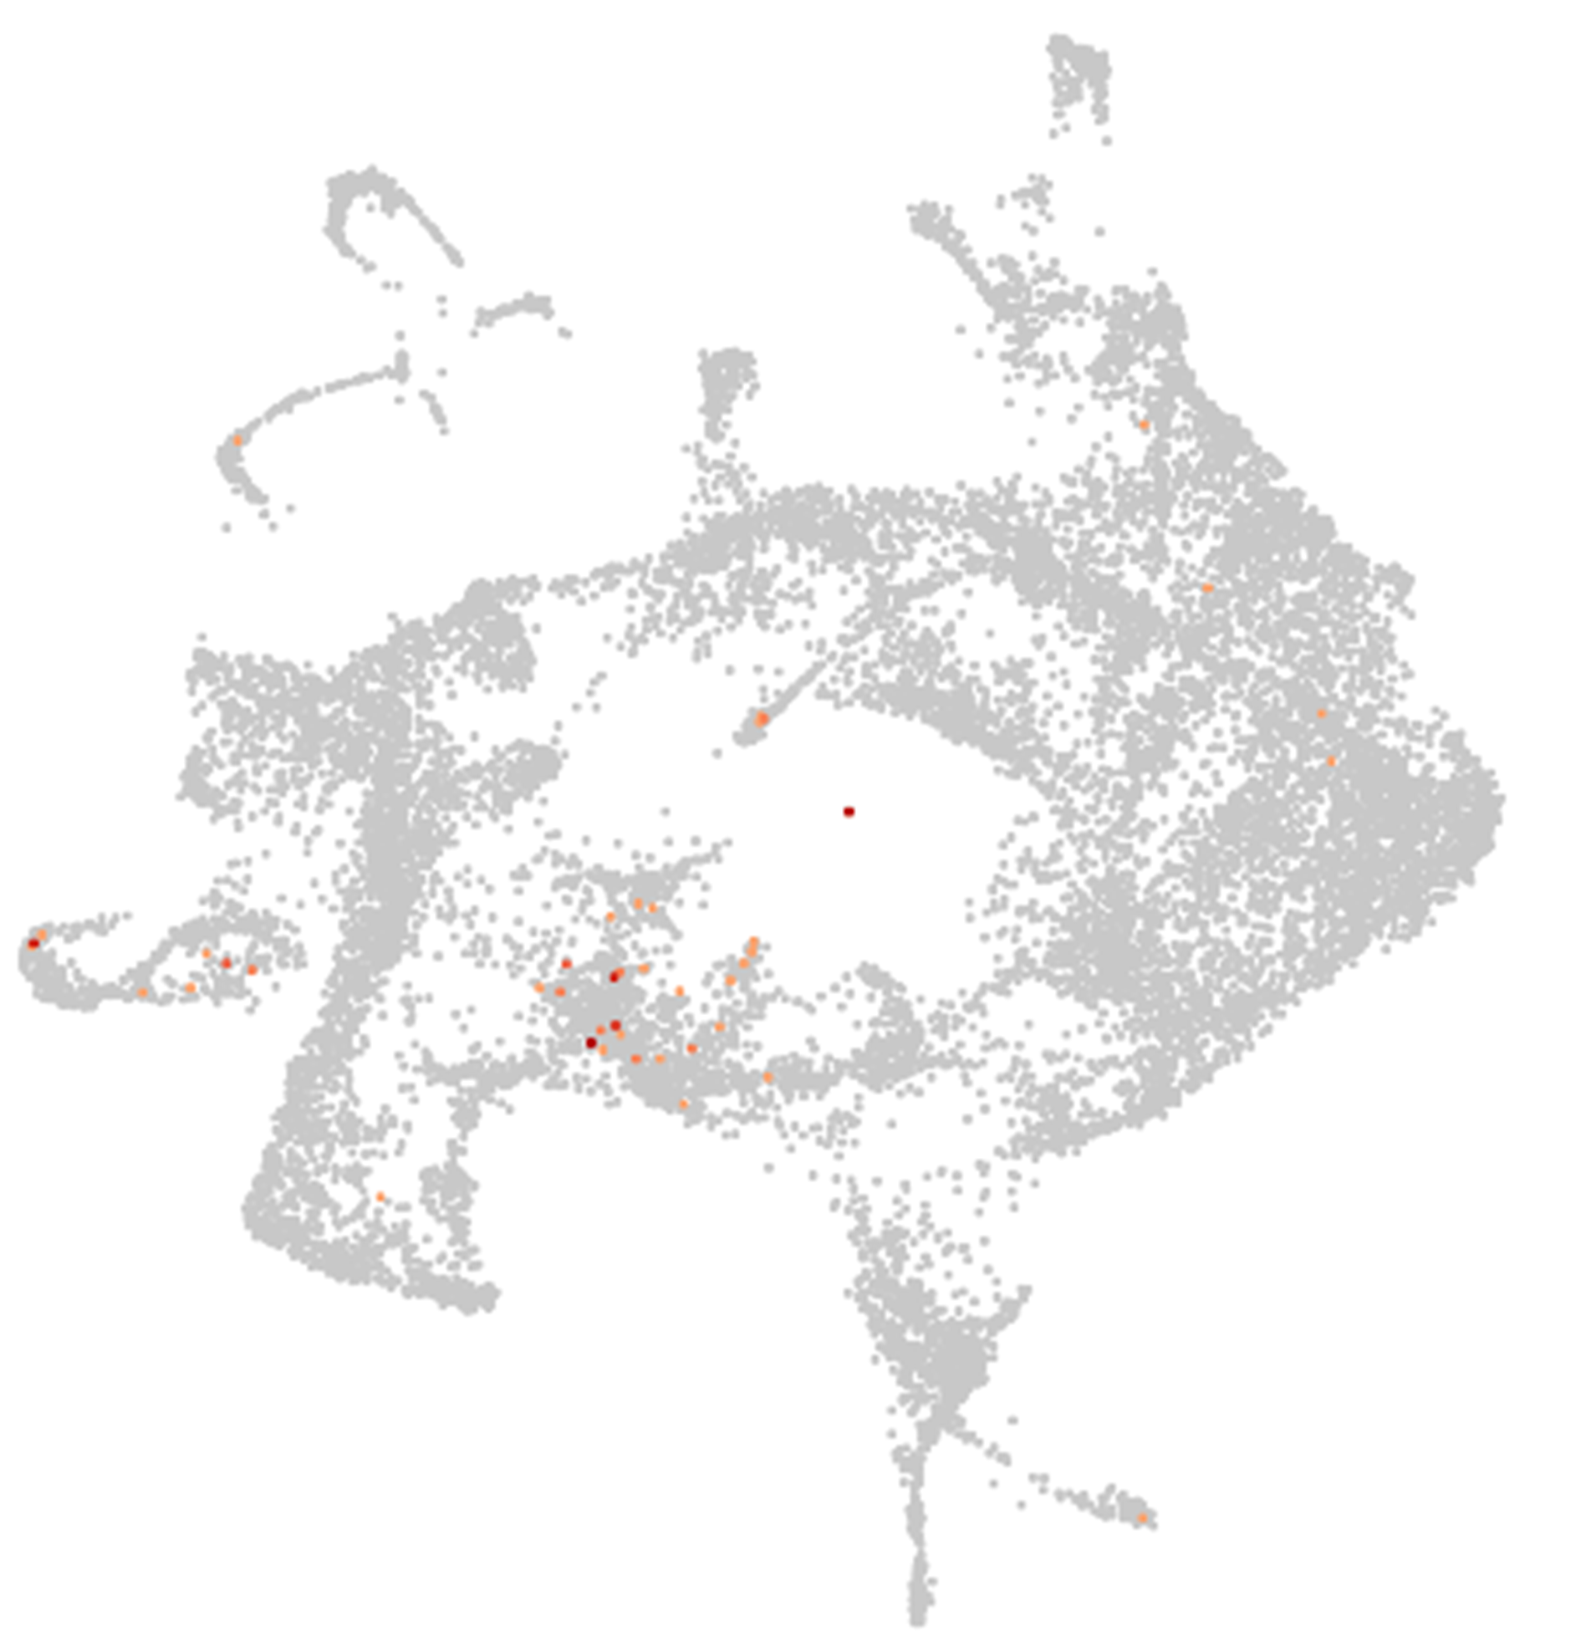
Glyma.12G056300
Ortholog of MtPLT2. MtPLT2 shows evidence in the
quiescent center and niche cells (Franssen et al., 2015)
Ortholog genes with functional validation on Arabidopsis thaliana or Medicago truncatula
21

Slide 22
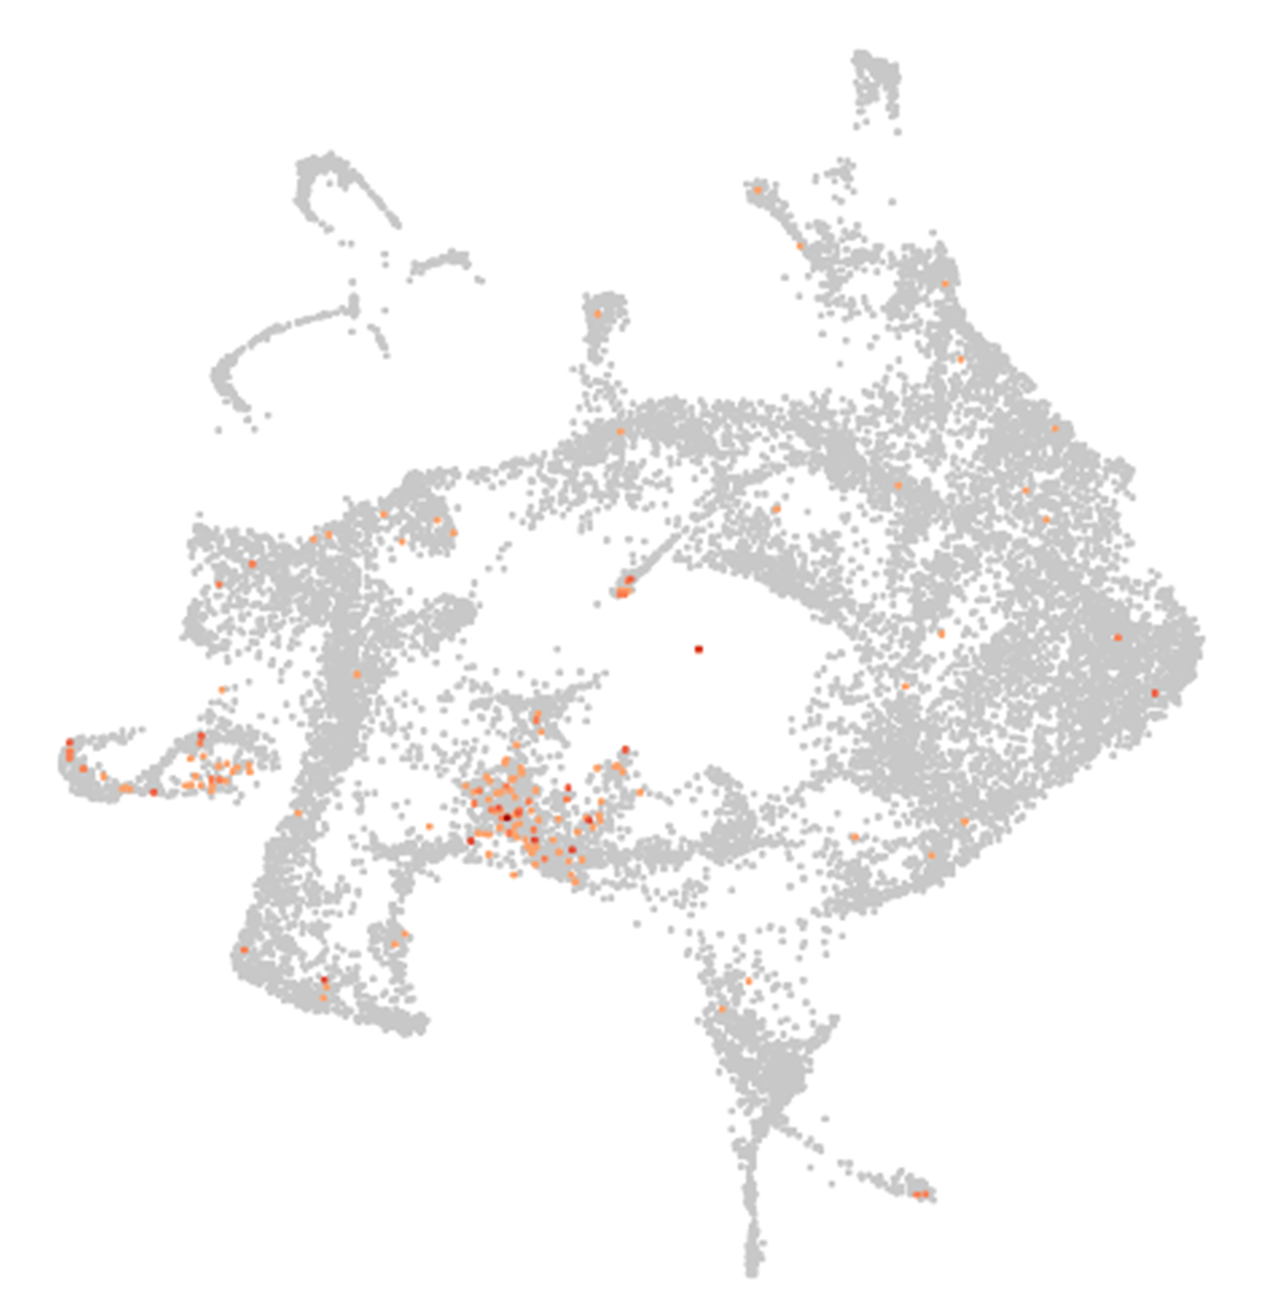
Glyma.09G248200
Ortholog of MtPLT4. MtPLT4 shows evidence in the
quiescent center and niche cells (Franssen et al., 2015)
Ortholog genes with functional validation on Arabidopsis thaliana or Medicago truncatula
22

Slide 23
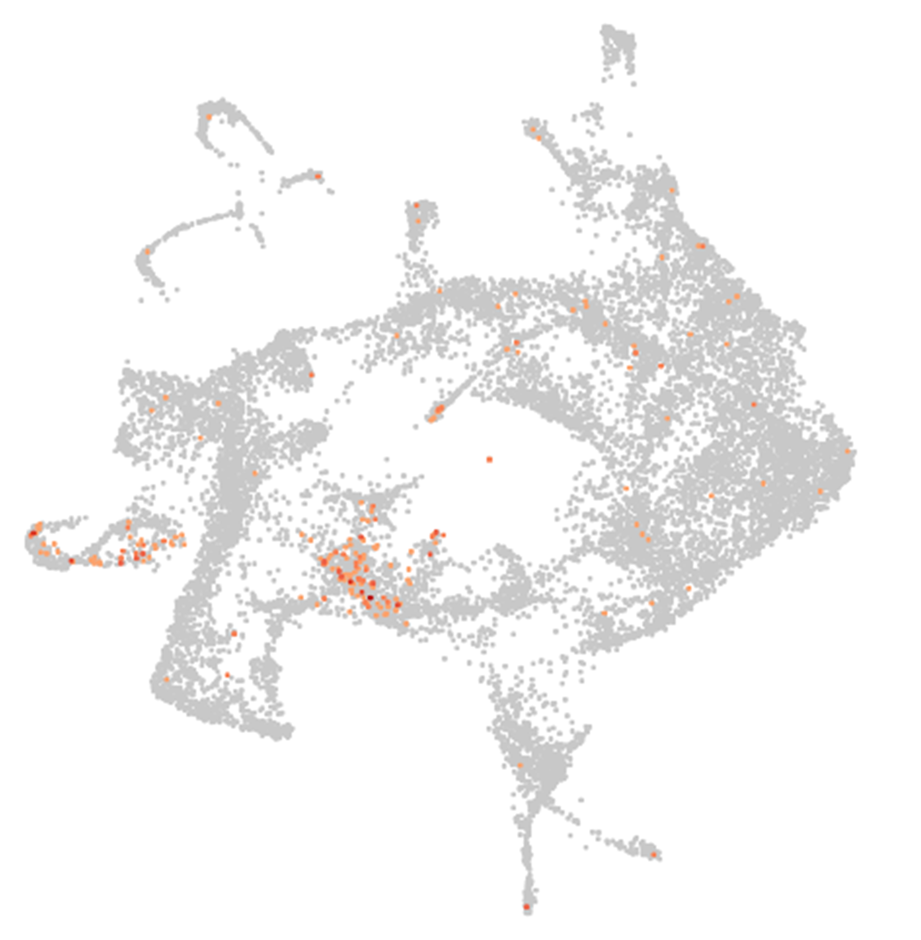
Glyma.18G244600
Ortholog of MtPLT4. MtPLT4 shows evidence in the
quiescent center and niche cells (Franssen et al., 2015)
Ortholog genes with functional validation on Arabidopsis thaliana or Medicago truncatula
23

Slide 24
Endodermal cells
Cluster 10 and 11

Slide 25
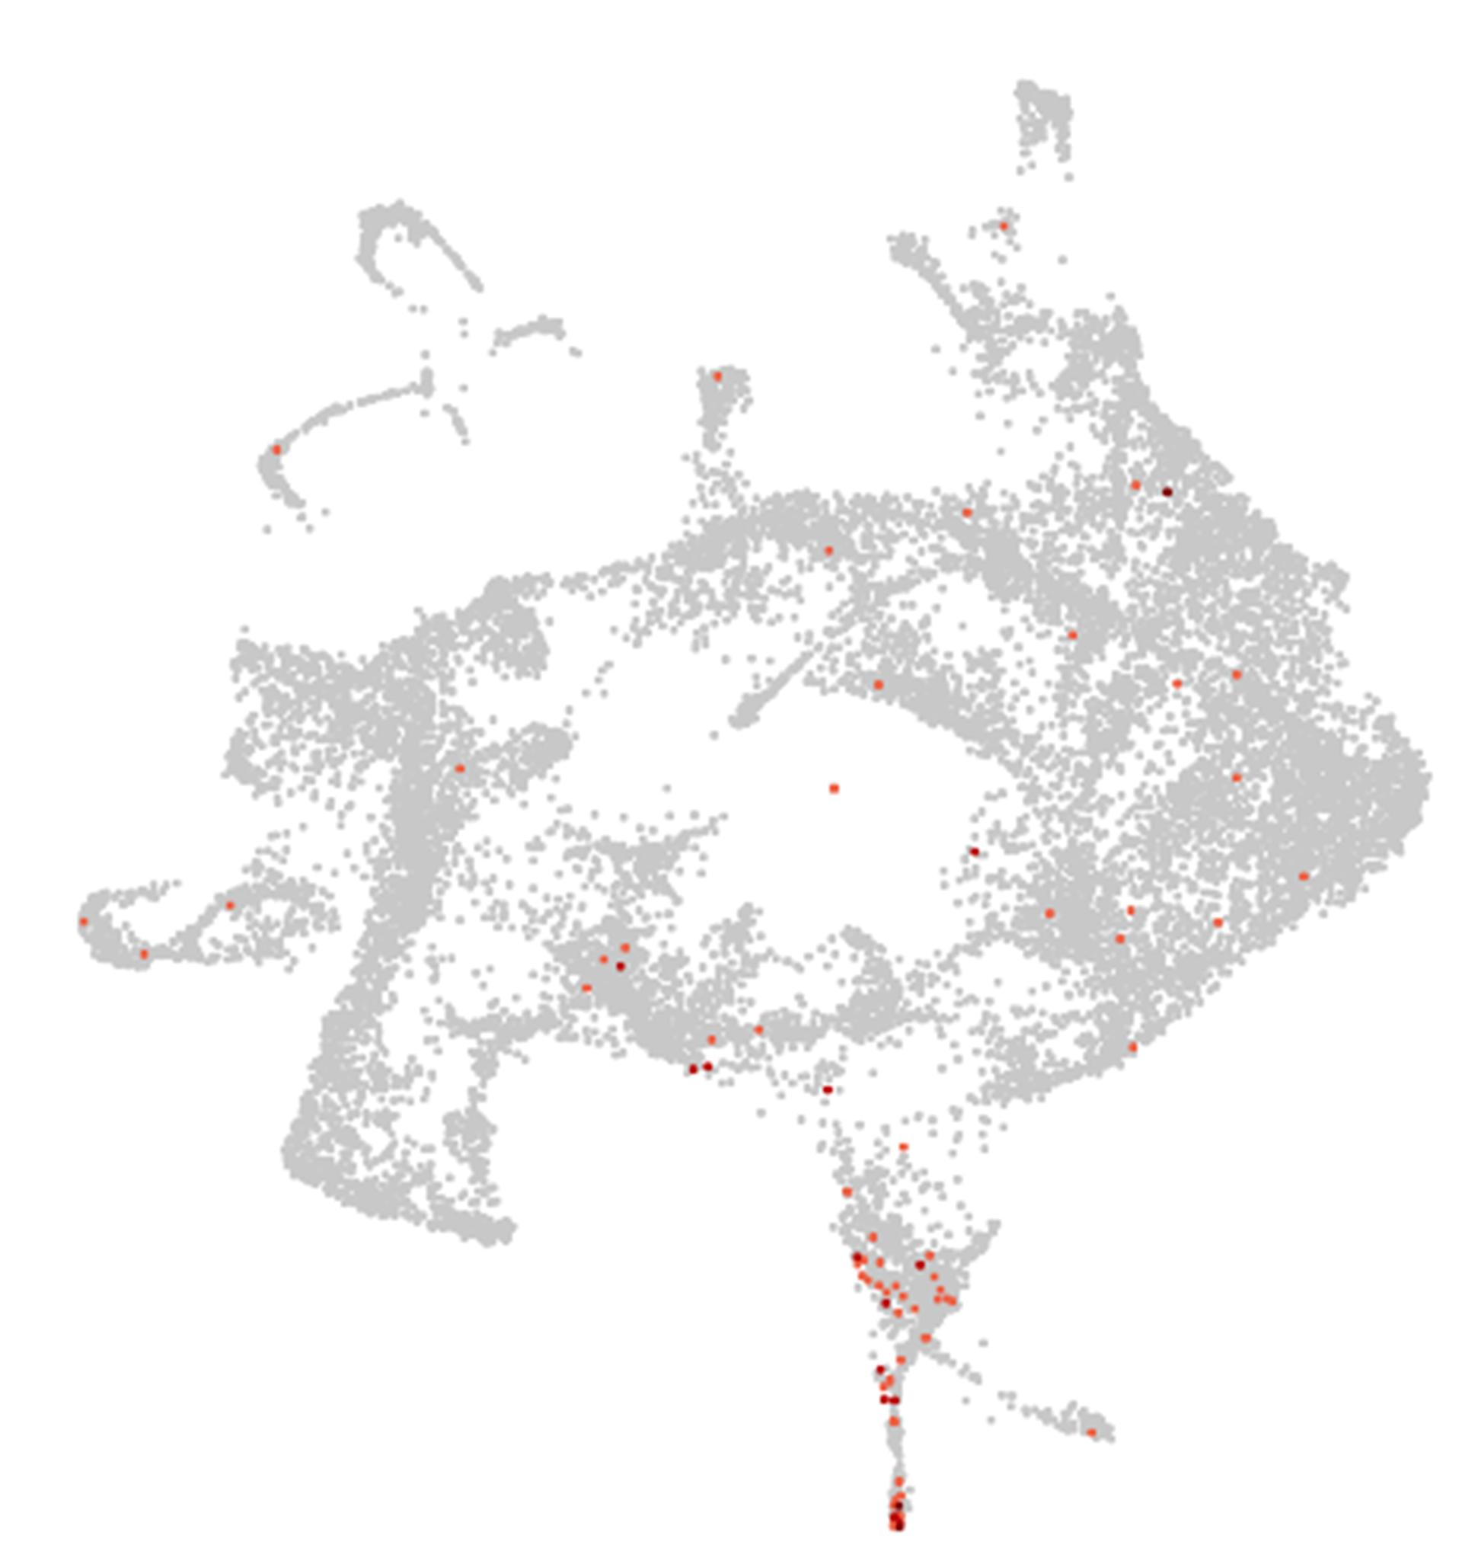
Glyma.13G094400
Ortholog of AT5G57620 (MYB36). MYB36 is expressed in endodermal cells in Arabidopsis (Kamiya et al., 2015).
Ortholog genes with functional validation on Arabidopsis thaliana or Medicago truncatula
25

Slide 26
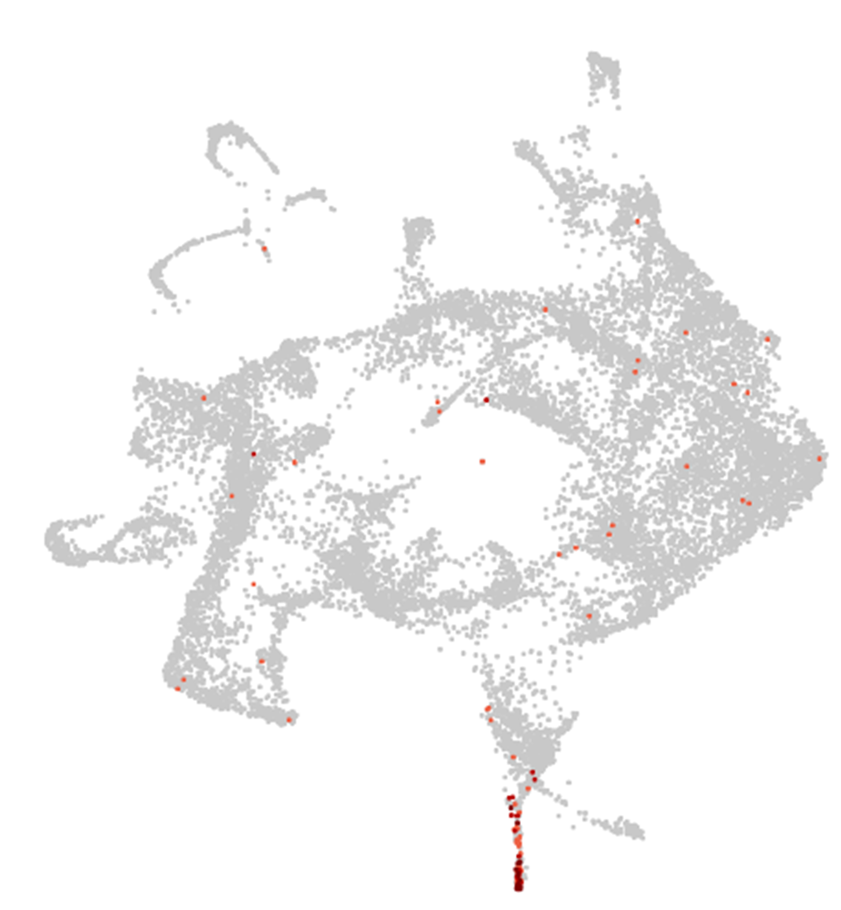
Glyma.12G186500
Ortholog of AT2G27370. AT2G27370 is specifically expressed in endodermal cells in Arabidopsis (Ryu et al., 2015).
Ortholog genes with functional validation on Arabidopsis thaliana or Medicago truncatula
26

Slide 27
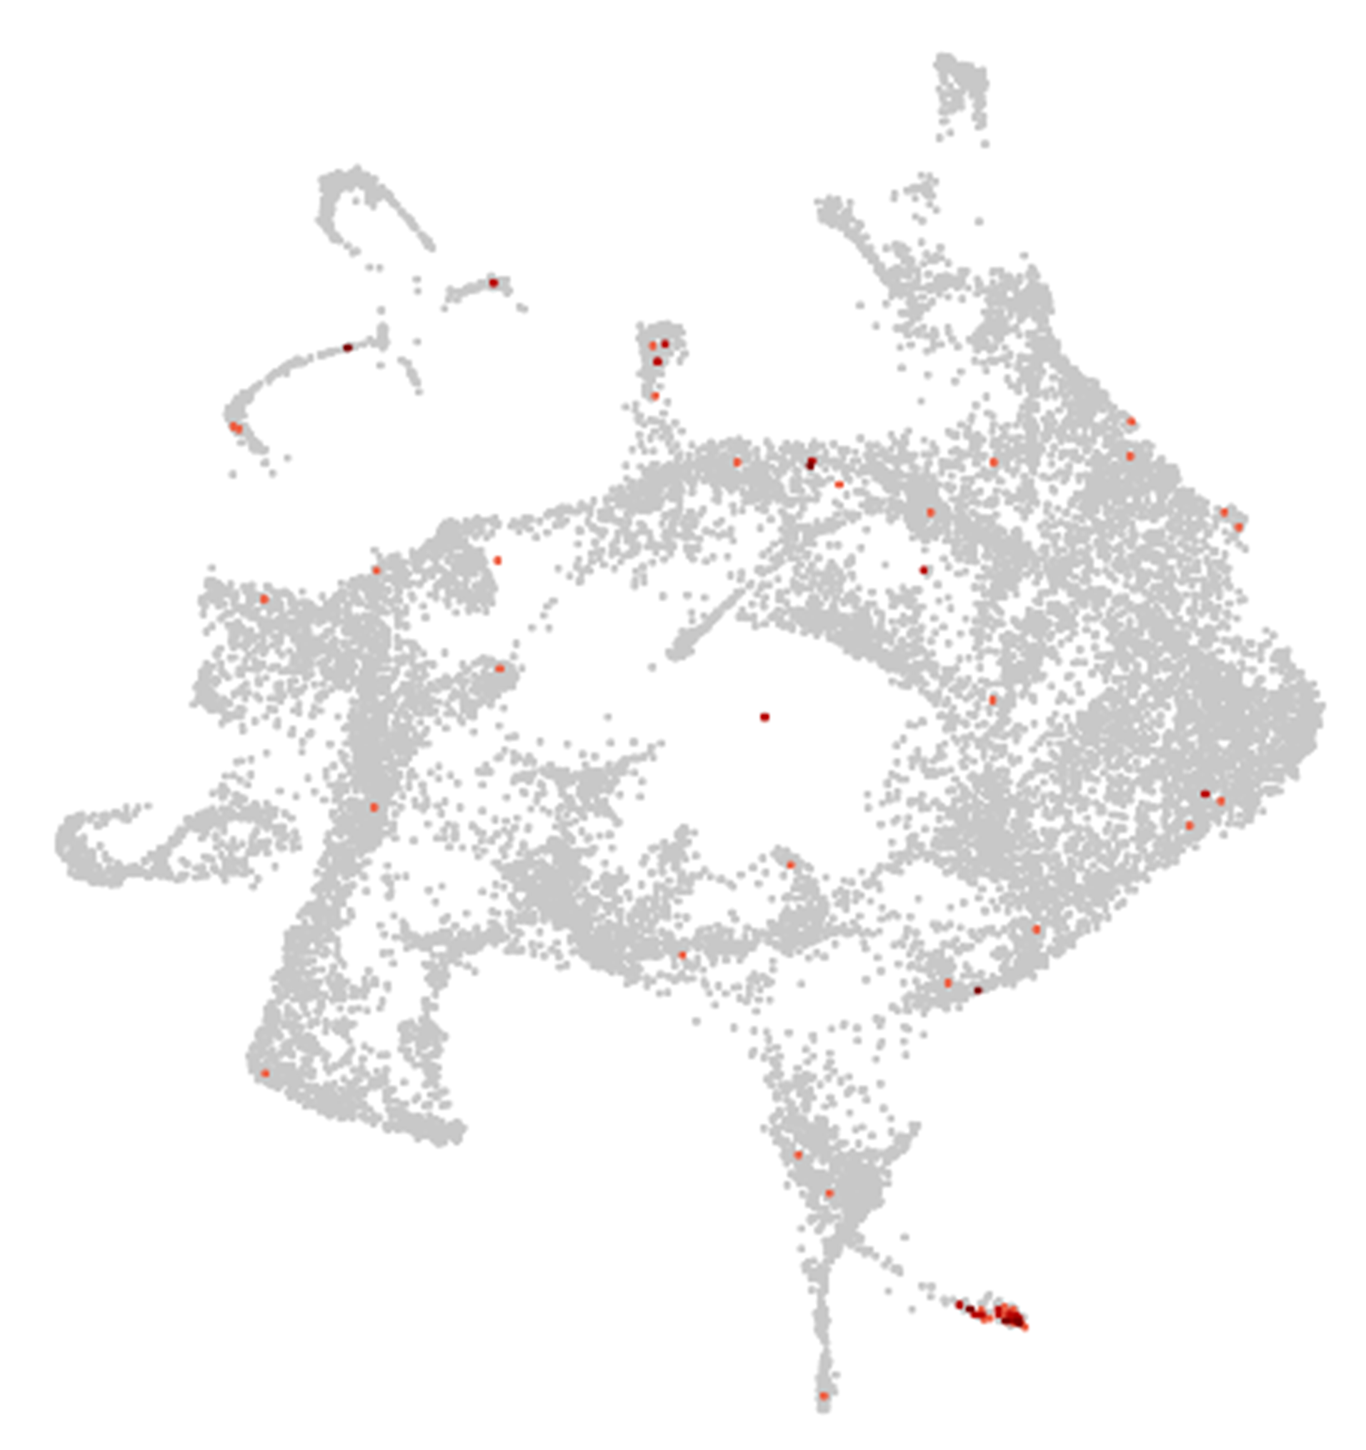
Glyma.02G261600
Ortholog of AT2G38110 (GPAT6 ). AT2G38110 is expressed in endodermal cells (suberized) in Arabidopsis root (Feng et al., 2015).
Ortholog genes with functional validation on Arabidopsis thaliana or Medicago truncatula
27

Slide 28
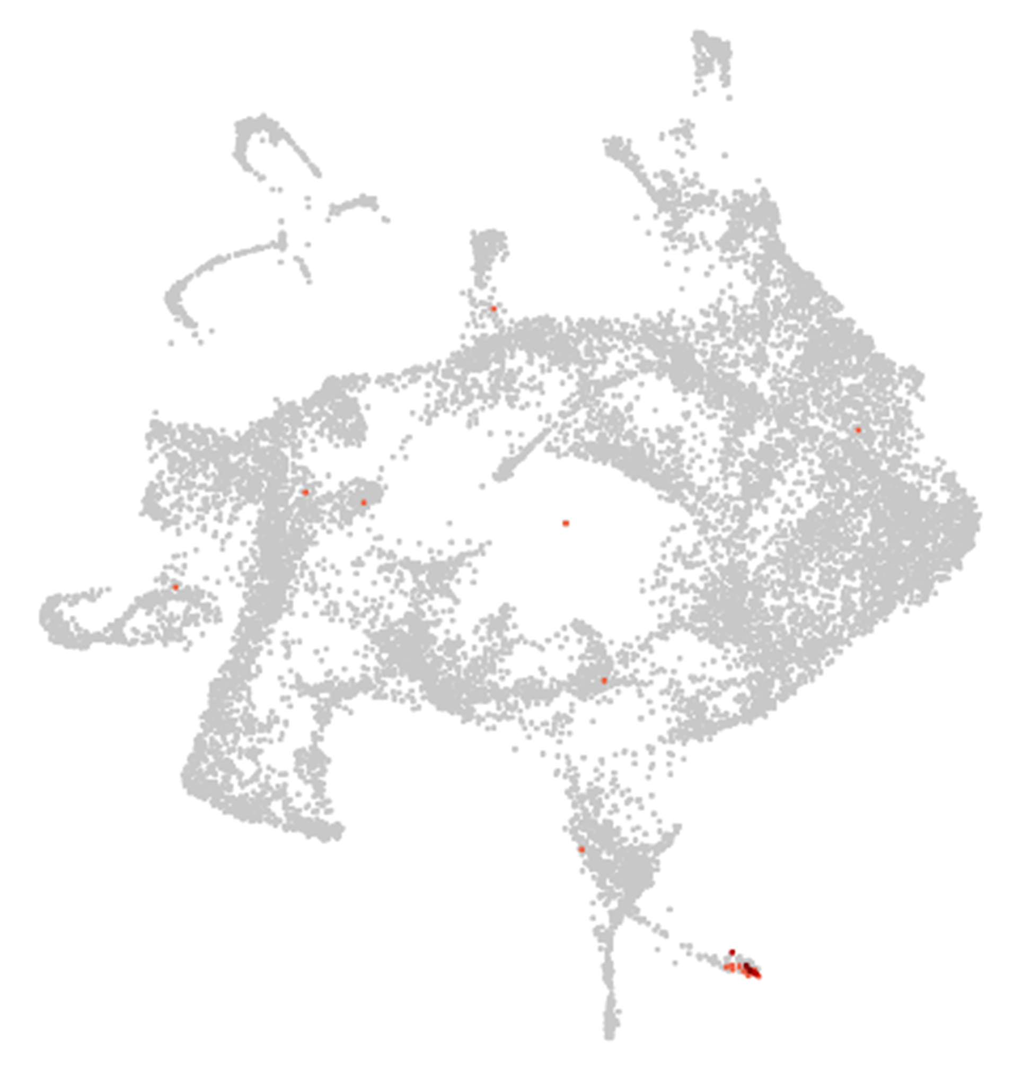
Glyma.08G129300
Ortholog of AT4G20390 (CASPL1B2). AT4G20390 is expressed in endodermal cells (suberized) in Arabidopsis root (Champeyroux et al., 2019).
Ortholog genes with functional validation on Arabidopsis thaliana or Medicago truncatula
28

Slide 29
Pericycle/cambium cells
Cluster 13

Slide 30
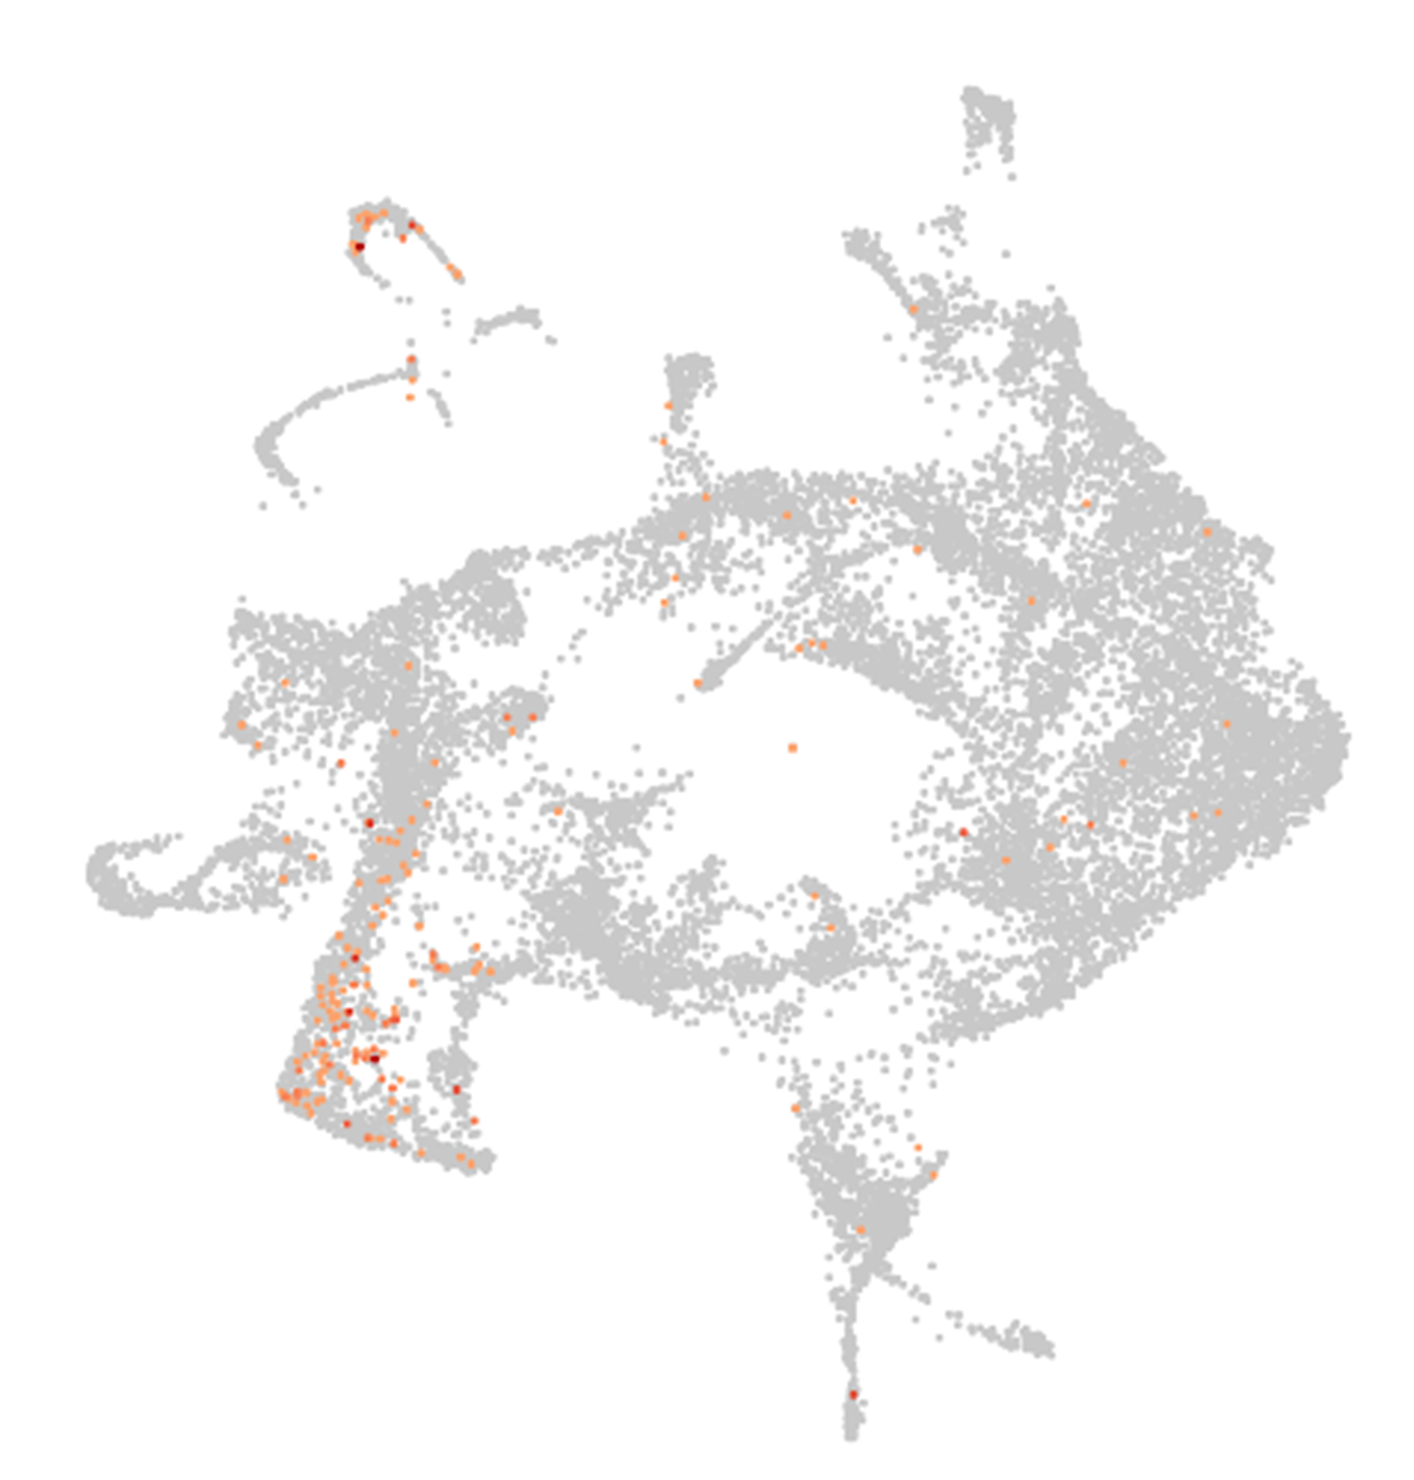
Glyma.12G063800
Ortholog of AT2G28810 (DOF2.2). DOF2.2 is expressed in cambium cells in Arabidopsis root (Shi et al., 2021).
Ortholog genes with functional validation on Arabidopsis thaliana or Medicago truncatula
30

Slide 31
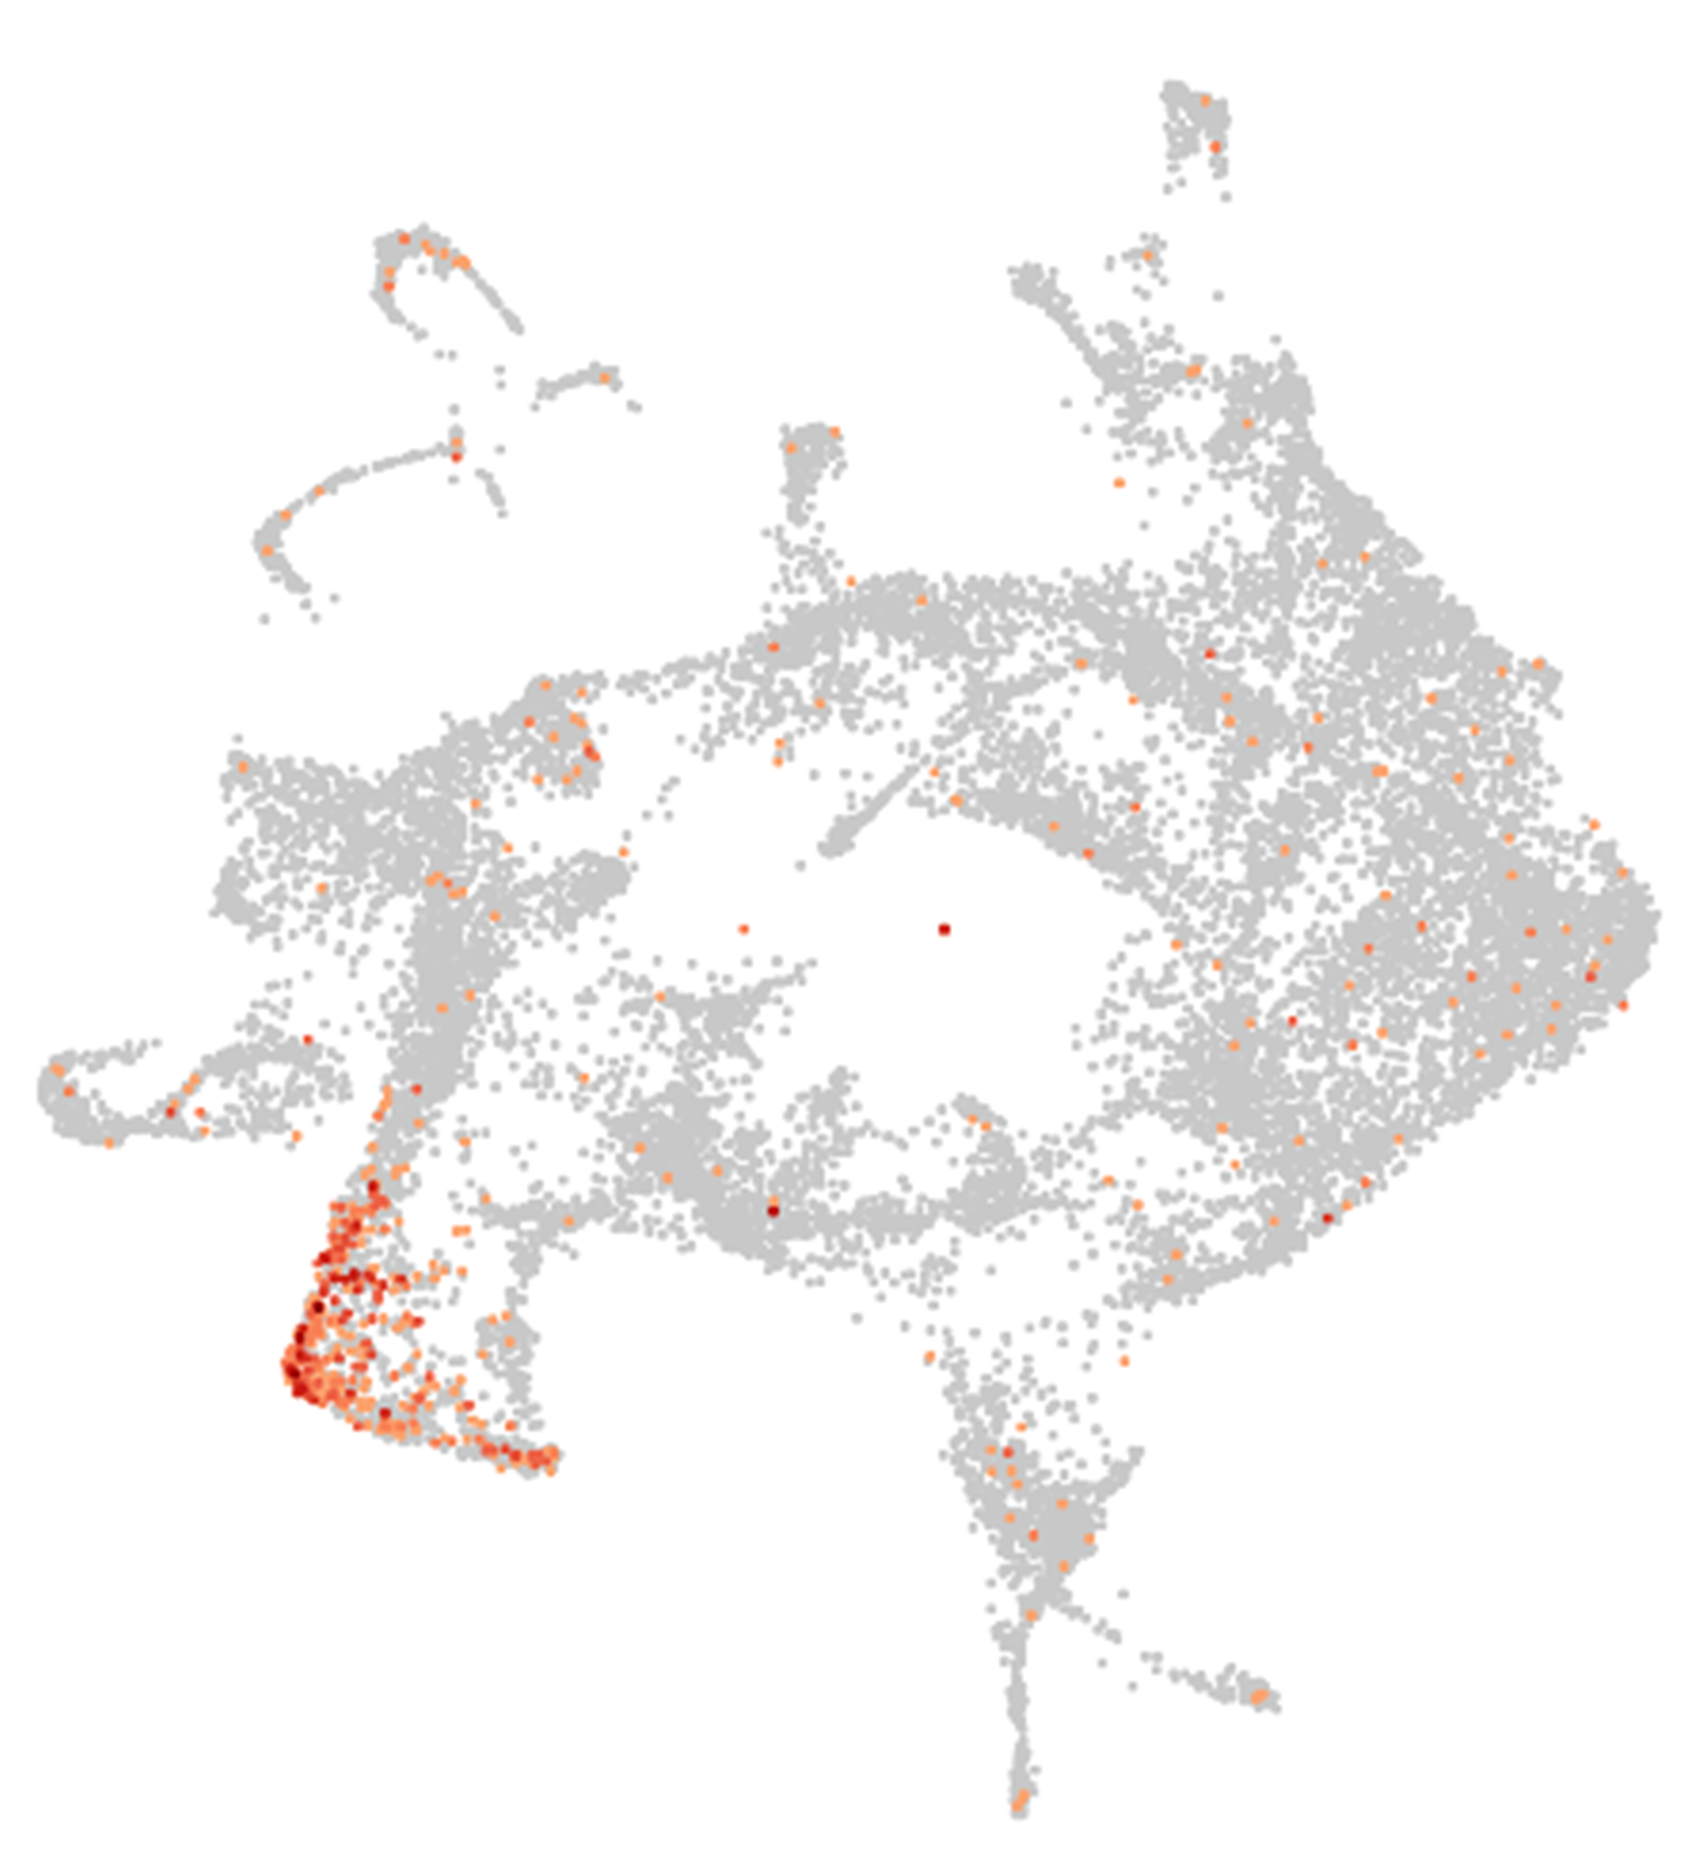
Glyma.19G126400
Ortholog of AT2G40900 (UMAMIT11). UMAMIT11 is expressed in the stele/vascular cells in the Arabidopsis root (Muller et al., 2015).
Ortholog genes with functional validation on Arabidopsis thaliana or Medicago truncatula
31

Slide 32
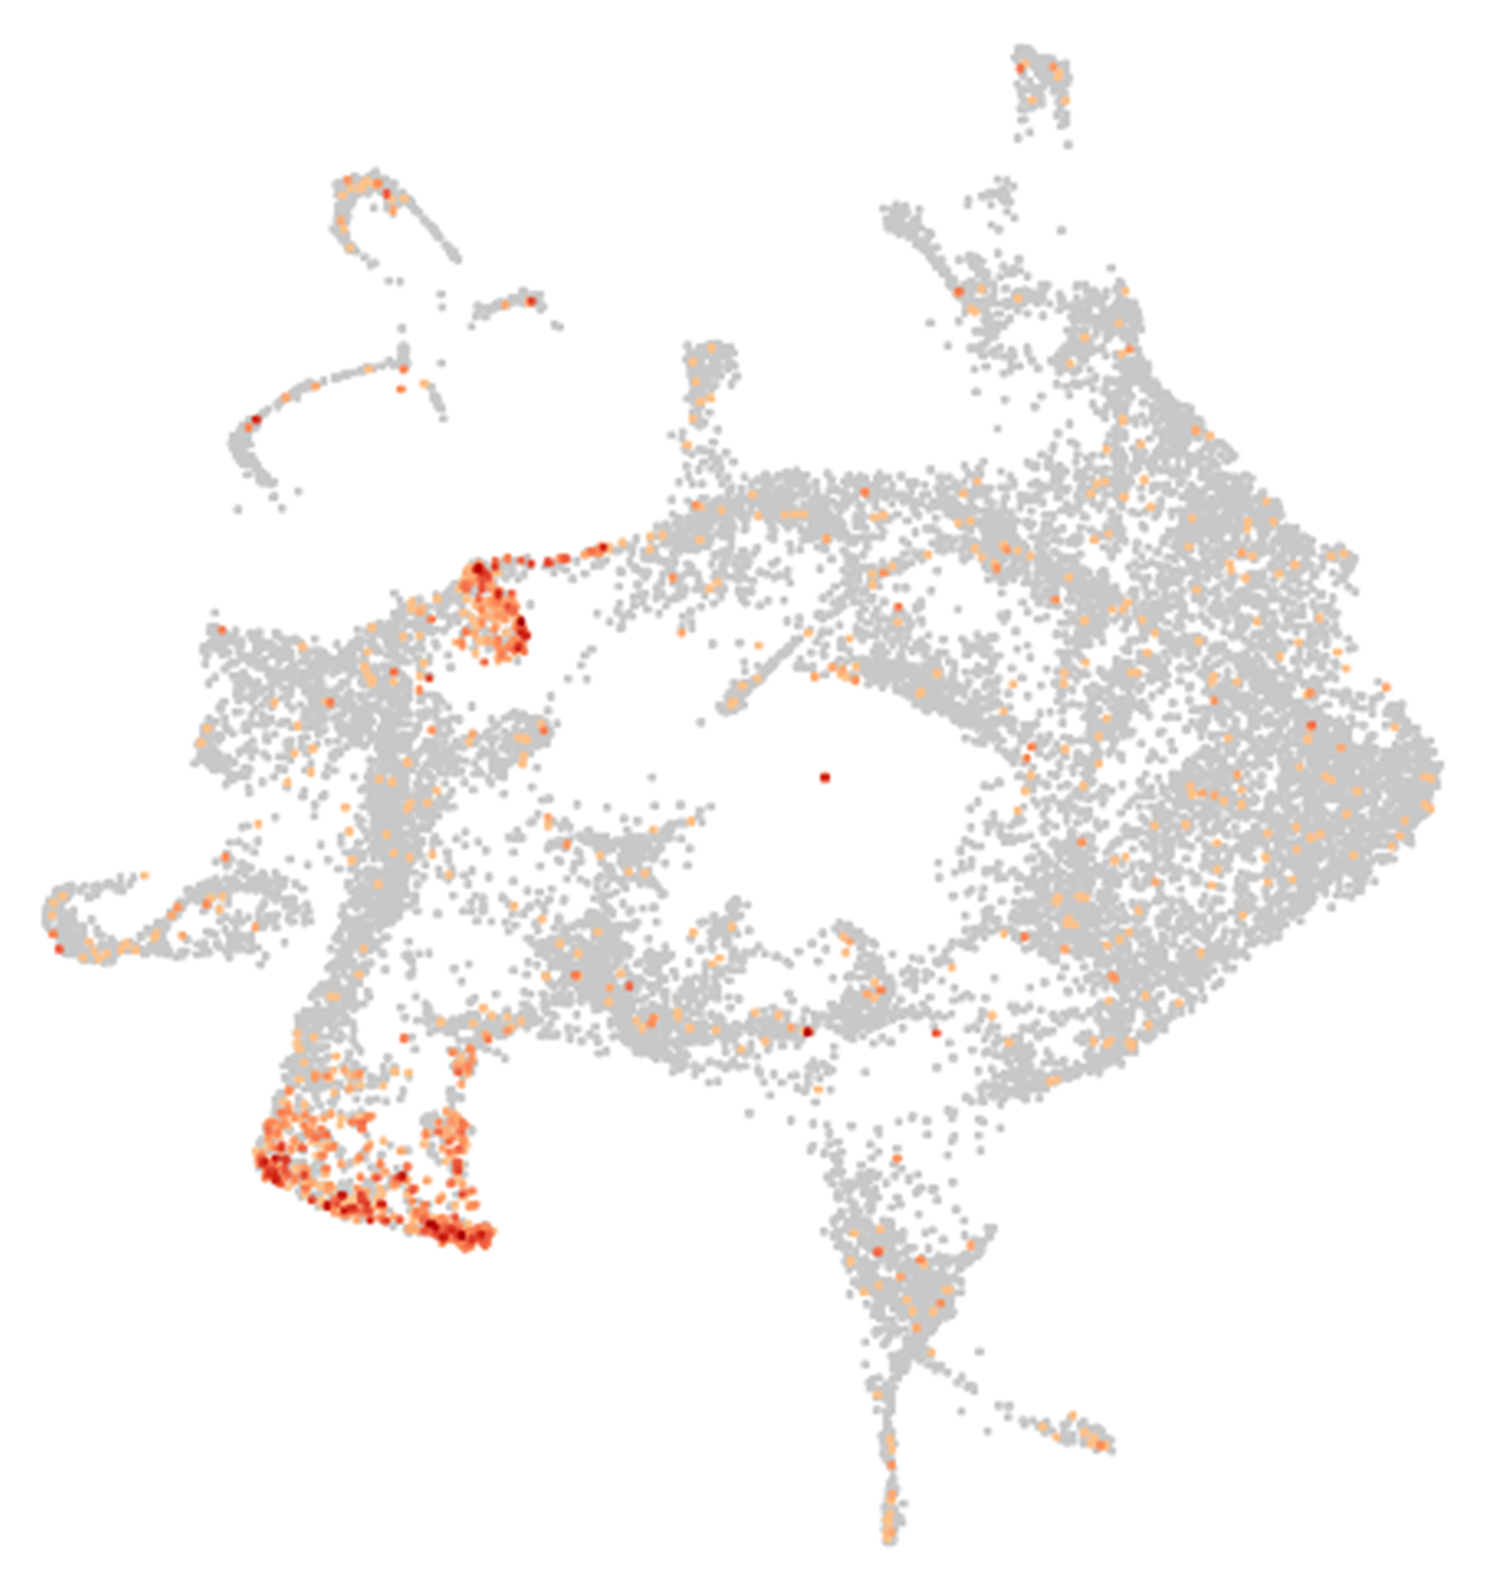
Glyma.02G003700
Ortholog of MtrunA17Chr1g0166651 (MtPHO1.1). MtPHO1.1 is expressed in the central cylinder and pericycle cells in the Medicago root (Nguyen et al., 2020).
Ortholog genes with functional validation on Arabidopsis thaliana or Medicago truncatula
32

Slide 33
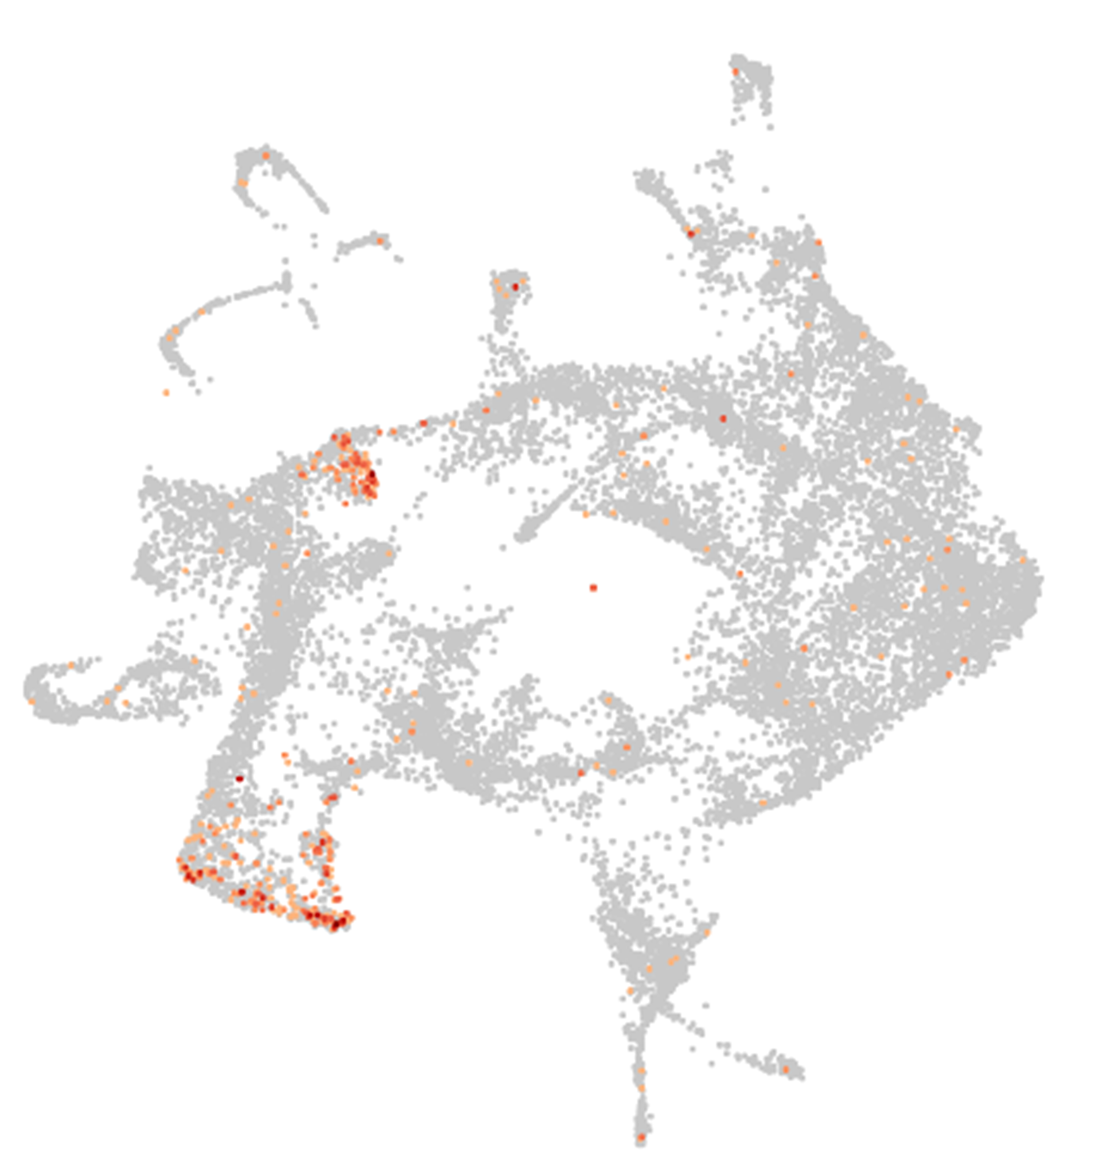
Glyma.10G004800
Ortholog of MtrunA17Chr1g0166651 (MtPHO1.1). MtPHO1.1 is expressed in the central cylinder and pericycle cells in the Medicago root (Nguyen et al., 2020).
Ortholog genes with functional validation on Arabidopsis thaliana or Medicago truncatula
33

Slide 34
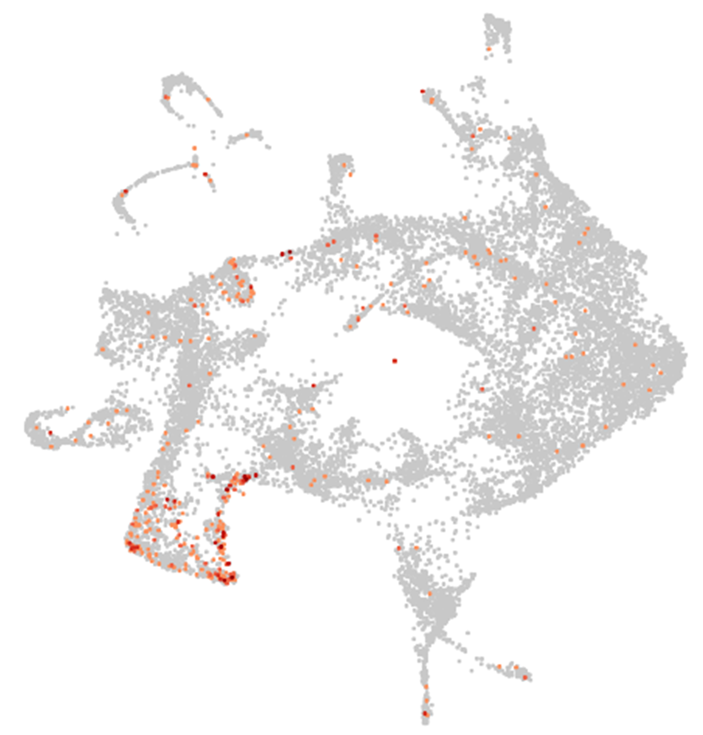
Glyma.20G206900
Ortholog of MtrunA17Chr1g0187381 (MtPHO1.2). MtPHO1.2 is expressed in the central cylinder and pericycle cells in the Medicago root (Nguyen et al., 2020).
Ortholog genes with functional validation on Arabidopsis thaliana or Medicago truncatula
34

