Slide 1
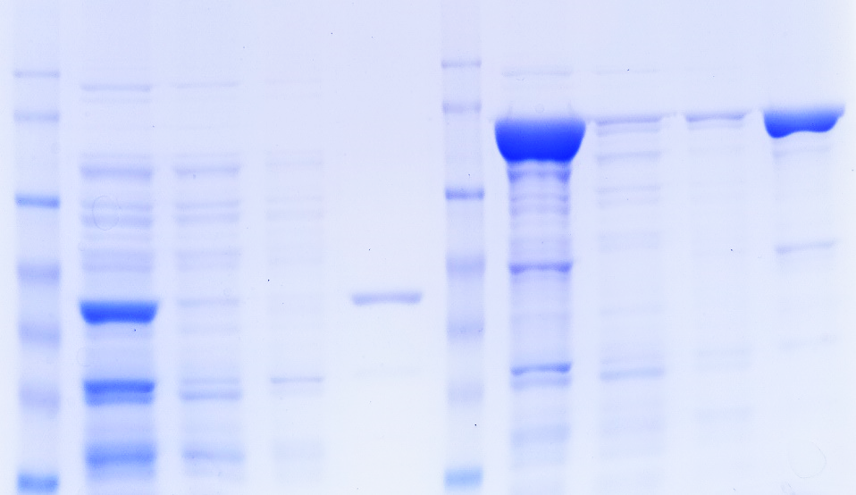
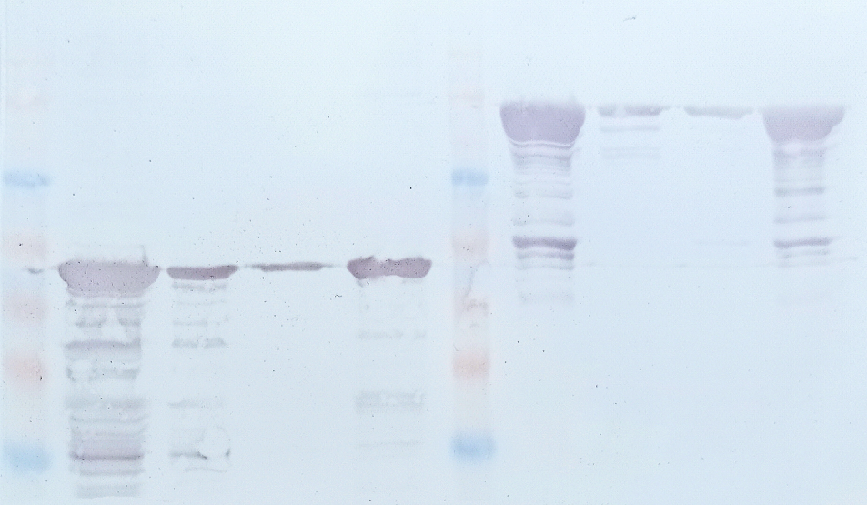
(A)
I-CAB_{A-04} at 15°C TF-CAB_{A-04} at 15°C
kDa
M Ly FL W E M Ly FL W E
175-
115 kDa
130-
95-
70-
67 kDa
62-
51-
42-
I-CAB_{A-04} at 15°C TF-CAB_{A-04} at 15°C
kDa
M Ly FL W E M Ly FL W E
175-
130-
115 kDa
95-
70-
67 kDa
62-
51-
42-
Figure S1. Boontip et al.

Slide 2
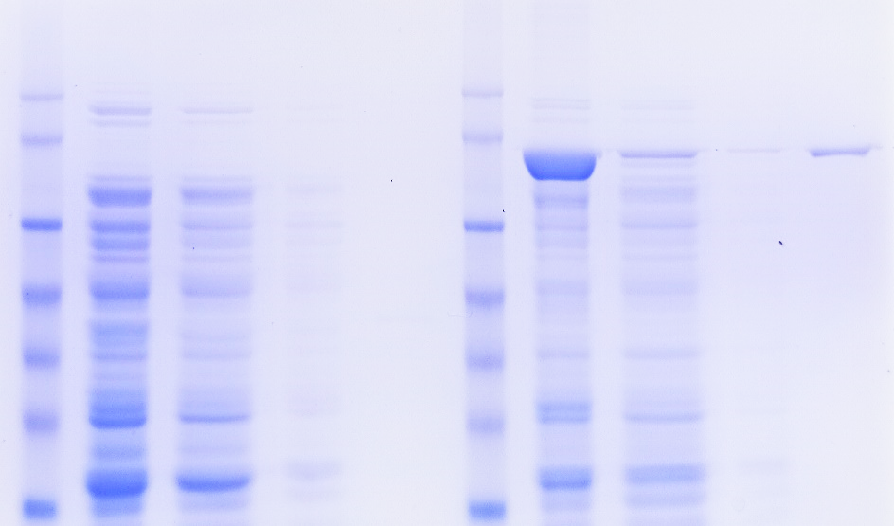
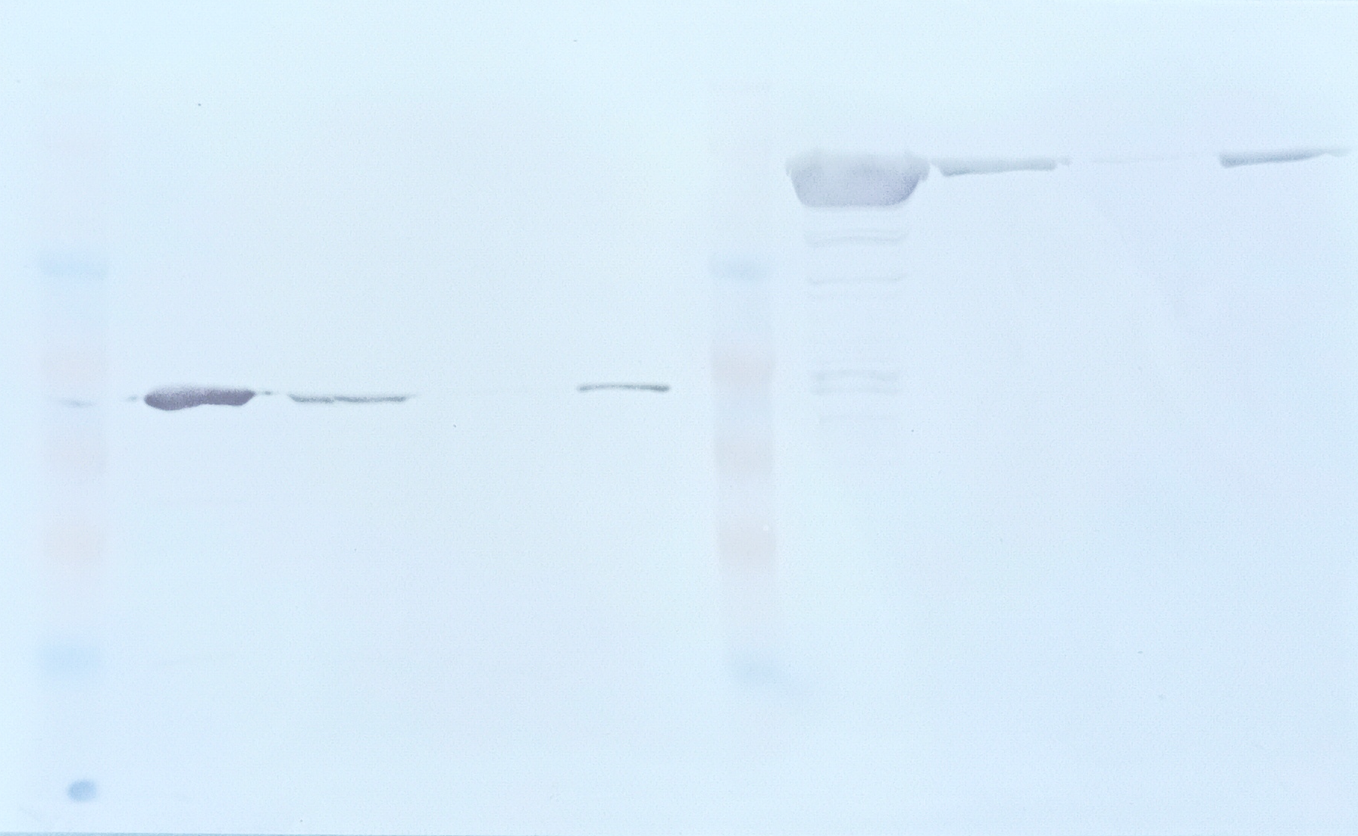
(B)
I-CAB_{A-04} at 37°C TF-CAB_{A-04} at 37°C
kDa
M Ly FL W E M Ly FL W E
175-
130-
115 kDa
95-
70-
67 kDa
62-
51-
42-
I-CAB_{A-04} at 37°C TF-CAB_{A-04} at 37°C
kDa
M Ly FL W E M Ly FL W E
175-
130-
115 kDa
95-
70-
67 kDa
62-
51-
42-
Figure S1. Boontip et al.

