Slide 1
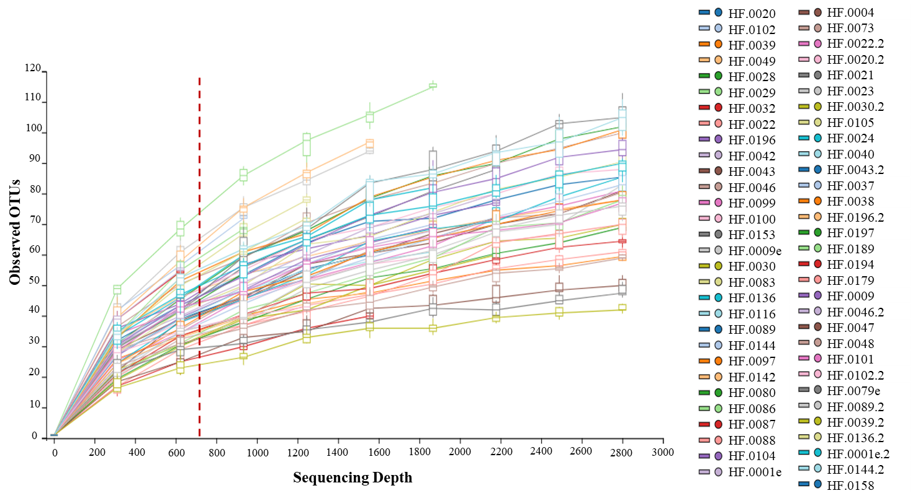
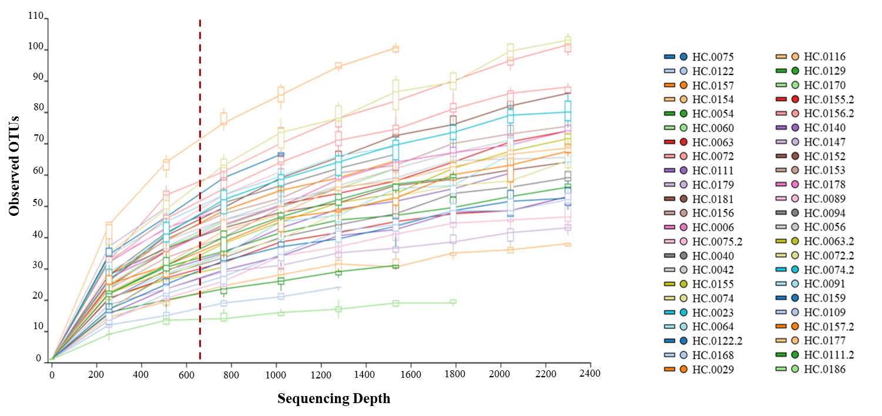
A
Figure S1. Diversity as function of sample size.
Rarefaction curves based on the cumulative number of observed OTUs of [A] Haliotis fulgens (HF) and [B] Haliotis corrugata (HC). Chao 1 estimation and total operational taxonomic units (OTUs) for each abalone species [C].
C
B

