Slide 1
Supplementary Figure S1
WE-68
SK-ES-1
A673
Supplementary Figure S1 Cell cycle effects of VE821 and triapine in Ewing’s sarcoma cells. One hour after administration of VE821, cells were exposed to triapine for another 48 h; z-VAD-fmk was applied 1 h before treatment with VE821. Cell cycle distribution was determined by flow-cytometric analysis of PI-stained ethanol-fixed cells. Means ± SEM of each three independent measurements are shown (*p<0.05, **p<0.01).

Slide 2
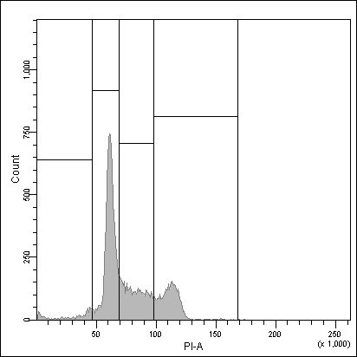
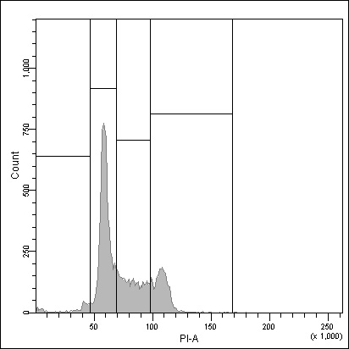
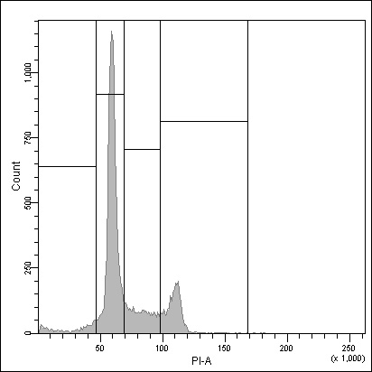
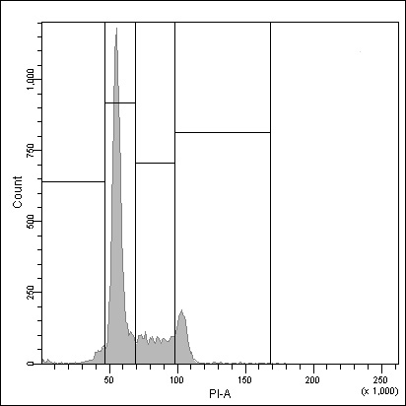
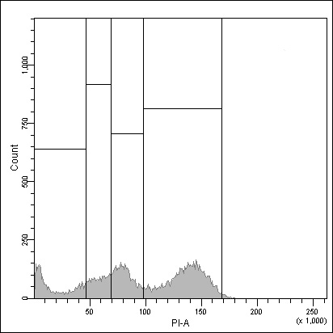
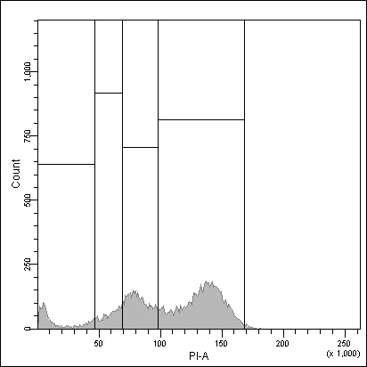
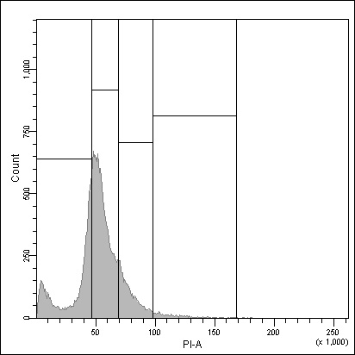
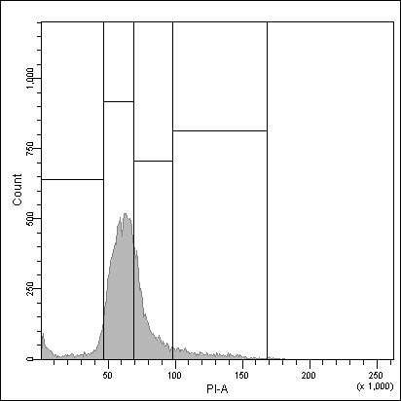
Supplementary Figure S2
WE-68
20 µM z-VAD-fmk
G1
G2/M
sub-
G1
S
Control
2 µM
VE821
1 µM
triapine
2 µM
VE821
+
1 µM
triapine
See the page after next for caption.

Slide 3
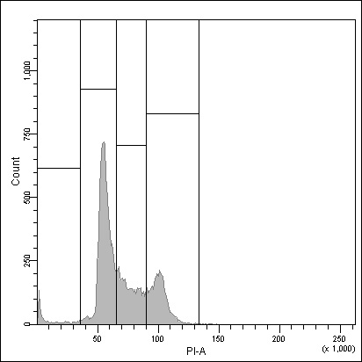

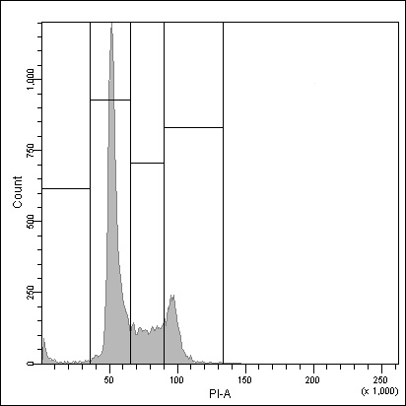
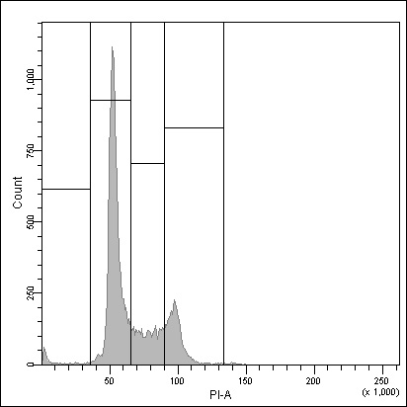
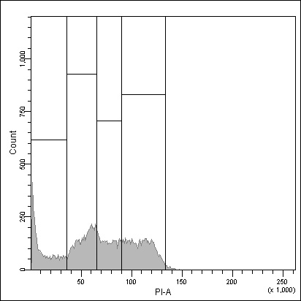
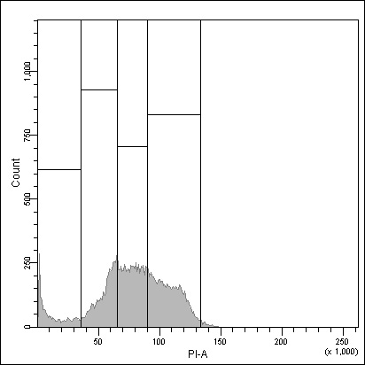
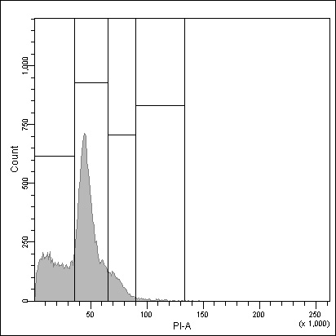
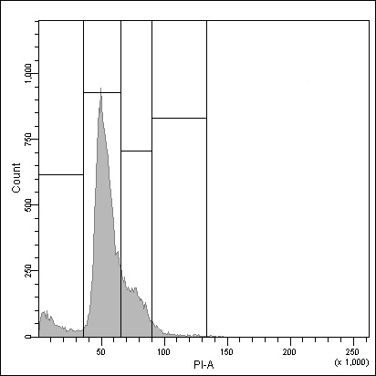
Supplementary Figure S2
SK-ES-1
20 µM z-VAD-fmk
Control
2 µM
VE821
1 µM
triapine
2 µM
VE821
+
1 µM
triapine
See next page for caption.

Slide 4
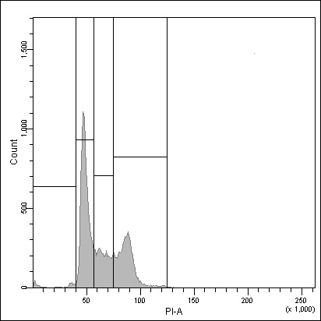
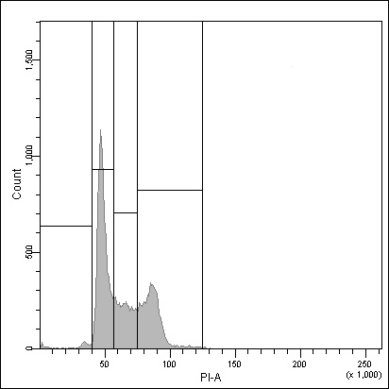
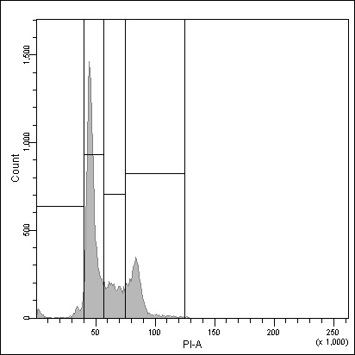

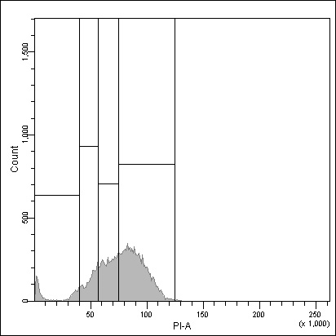
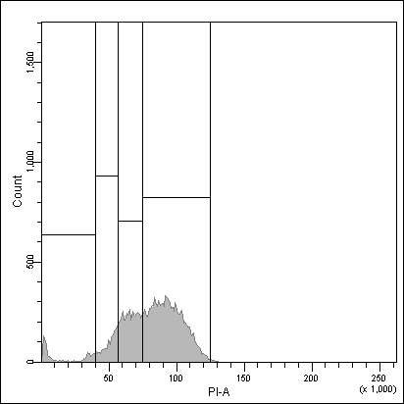
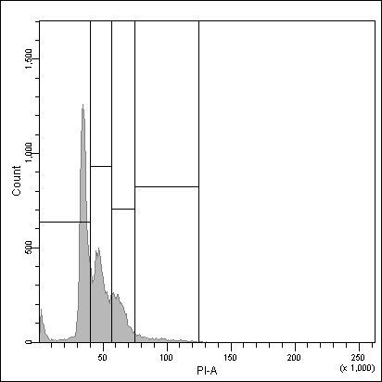
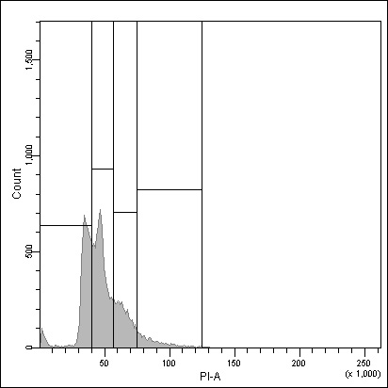
Supplementary Figure S2
A673
20 µM z-VAD-fmk
Control
2 µM
VE821
1 µM
triapine
2 µM
VE821
+
1 µM
triapine
Supplementary Figure S2 Cell cycle effects of VE821 and triapine in Ewing’s sarcoma cells. One hour after administration of VE821, cells were exposed to triapine for another 48 h; z-VAD-fmk was applied 1 h before treatment with VE821. Cell cycle distribution was determined by flow-cytometric analysis of PI-stained ethanol-fixed cells. Histograms are representative of each three independent measurements.

