Slide 1
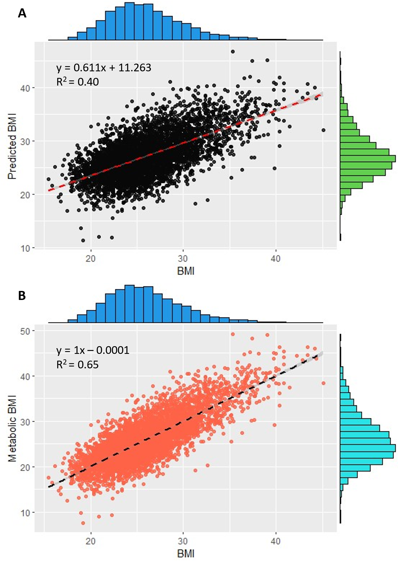
Supplementary Fig 1. Validation of the ridge model for the prediction of BMI in the BHS cohort (n=4,492). (A) The ccorrelation between true BMI (x-axis) and predicted BMI using lipidomic data (y-axis). (B) The ccorrelation between true BMI (x-axis) and metabolic BMI (y-axis)

Slide 2
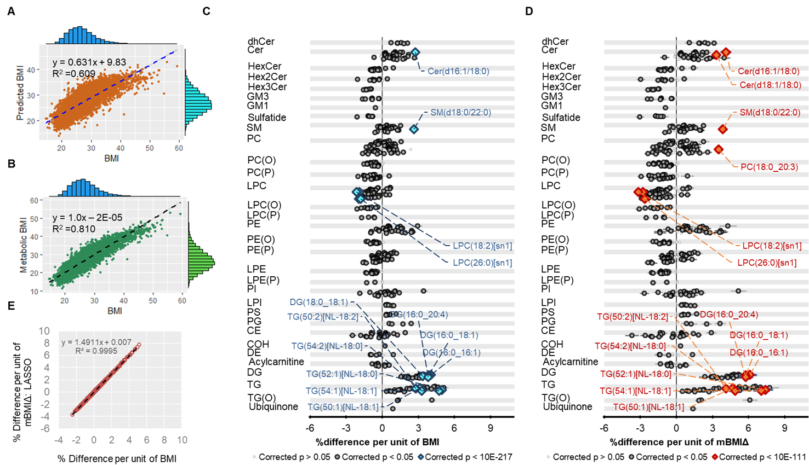
Supplementary Fig. 2 Modelling of the metabolic BMI score and comparison of the captured lipid biology with BMI using LASSO. (A) Correlation between measured BMI and predicted BMI in the AusDiab cohort (n = 10,339). (B) Correlation between measured BMI and metabolic BMI (mBMI) in the AusDiab cohort (n = 10,339). (C) Associations of BMI with plasma lipid species and (D) Association of mBMIΔ with plasma lipid species using linear regression analysis adjusting for age and sex. Grey open circles show species (p>0.05), grey and dark closed circles show species with p<0.05 after correction for multiple comparisons using the method of Benjamini and Hochberg. Blue circles and brown diamonds represent the top 15 most significant lipids associated with BMI (p<10E-217) and mBMIΔ (p<10-111) respectively. The whiskers represent 95% confidence intervals. (E) The correlation between effect sizes of each lipid associated with BMI, x-axis and with mBMIΔ, y-axis. AC = acylcarnitine, CE = cholesteryl ester, Cer = ceramide, COH = cholesterol, DE = dehydrocholesterol, dhCer = dihydroceramide, DG = diacylglycerol, GM1 = GM1 ganglioside, GM3 = GM3 ganglioside, HexCer = monohexosylceramide, Hex2Cer = dihexosylceramide, Hex3Cer = trihexosylceramide, LPC = lysophosphatidylcholine, LPC(O) = lysoalkylphosphatidylcholine, LPC(P) = lysoalkenylphosphatidylcholine, LPE = lysophosphatidylethanolamine, LPE(P) = lysoalkenylphosphatidylethanolamine, LPI = lysophosphatidylinositol, PC = phosphatidylcholine, PC(O) = alkylphosphatidylcholine, PC(P) = alkenylphosphatidylcholine, PE = phosphatidylethanolamine, PE(O) = alkylphosphatidylethanolamine, PE(P) = alkenylphosphatidylethanolamine, PG = phosphatidylglycerol, PI = phosphatidylinositol, PS = phosphatidylserine, SHexCer = sulfatide, SM = sphingomyelin, TG = triacylglycerol, TG(O) = alkyl-diacylglycerol.

Slide 3
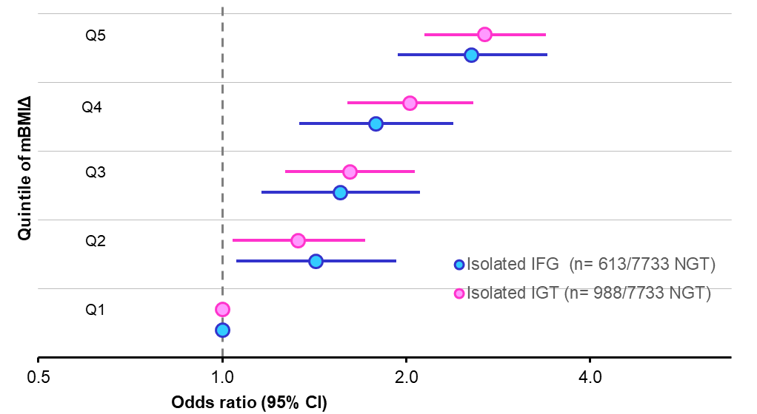
Supplementary Fig 3. The relationship between mBMIΔ and IGT or IFG. Depicted on the x-axis are the odds ratio (95% Cis) for the isolated IGT (pink circles) and IFG (sky-blue circles) across the quintiles of mBMIΔ (y-axis). The odds ratios were computed using a logistic regression between isolated IGT, n = 988/7, 733 NGT or IFG, n = 613/7,733 NGT and quintile of the mBMIΔ adjusting for age, sex, and BMI.

Slide 4
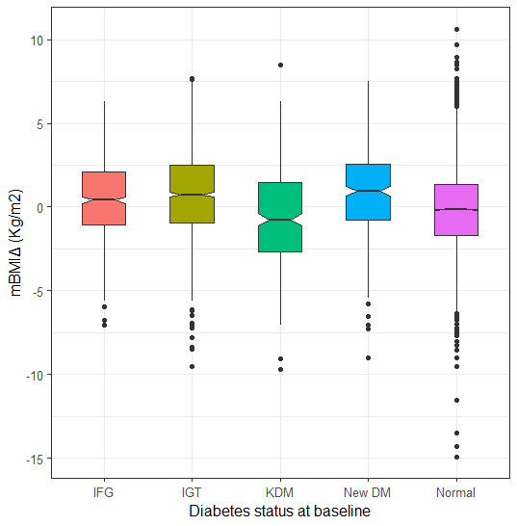
Supplementary figure 4. The relationship between mBMIΔ and type 2 diabetes status at baseline in the AusDiab cohort (n=10,339). Box plots represent the distribution of mBMIΔ (y-axis) stratified by diabetes status (x-axis). Abbreviations: IFG, impaired fasting glucose; IGT, impaired glucose tolerant; KDM, known diabetes mellitus; New DM, new diabetes mellitus.

Slide 5
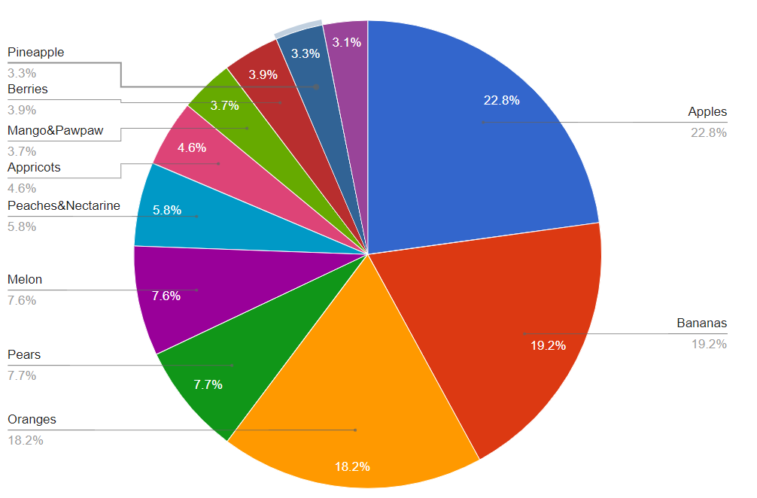
Supplementary Fig 5. Percentage contribution of of individual fruits to the total fruit intake

