Slide 1



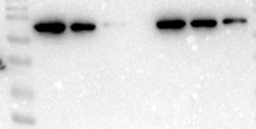
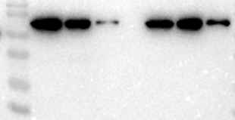
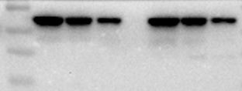
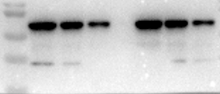
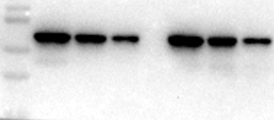
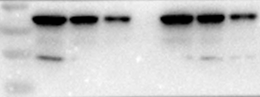
Supplementary Figures
Figure 4B and Figure 8. Example of original western blot for three repeats
This figure shows the whole blot after cutting membrane at molecular weight 100 kDa, 75 kDa, and 25~75 kDa for p-PI3K (85 kDa), p-AKt (60 kDa), RXRa (54 kDa).
Repeat 1
Repeat 2
Repeat 3
250
150
100
75
250
150
100
75
150
100
75
p-PI3K 85kD
p-AKt 60kD
RXRa 54kD
100
75
50
37
25
20
100
75
50
37
25
20
75
50
37
25
100
75
50
37
25
100
75
50
37
25
75
50
37
25
60μg/ml
0μg/ml
60μg/ml
20μg/ml
0μg/ml
20μg/ml
0μg/ml
0μg/ml
60μg/ml
20μg/ml
0μg/ml
20μg/ml
20μg/ml
0μg/ml
60μg/ml
60μg/ml
20μg/ml
60μg/ml
THC8307 HCT116
THC8307 HCT116
THC8307 HCT116

Slide 2
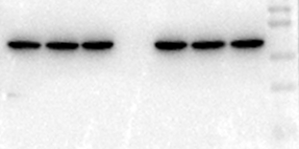
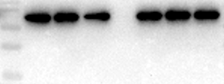



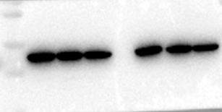
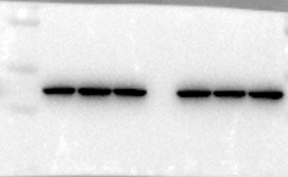
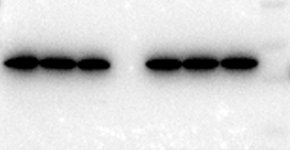
This figure shows the whole blot after cutting membrane at molecular weight 100 kDa, 75 kDa, and 25~75 kDa for PI3K (85 kDa), AKt (60 kDa), β-actin (43 kDa).
Repeat 1
Repeat 2
Repeat 3
AKt 60kD
PI3K 85kD
β-actin 43kD
100
75
50
37
25
100
75
50
37
25
100
75
50
37
25
150
100
75
150
100
75
150
100
75
100
75
50
37
100
75
50
37
75
50
37
60μg/ml
60μg/ml
0μg/ml
0μg/ml
20μg/ml
20μg/ml
0μg/ml
0μg/ml
60μg/ml
20μg/ml
20μg/ml
60μg/ml
20μg/ml
20μg/ml
0μg/ml
0μg/ml
60μg/ml
60μg/ml
THC8307 HCT116
THC8307 HCT116
THC8307 HCT116

