Slide 1
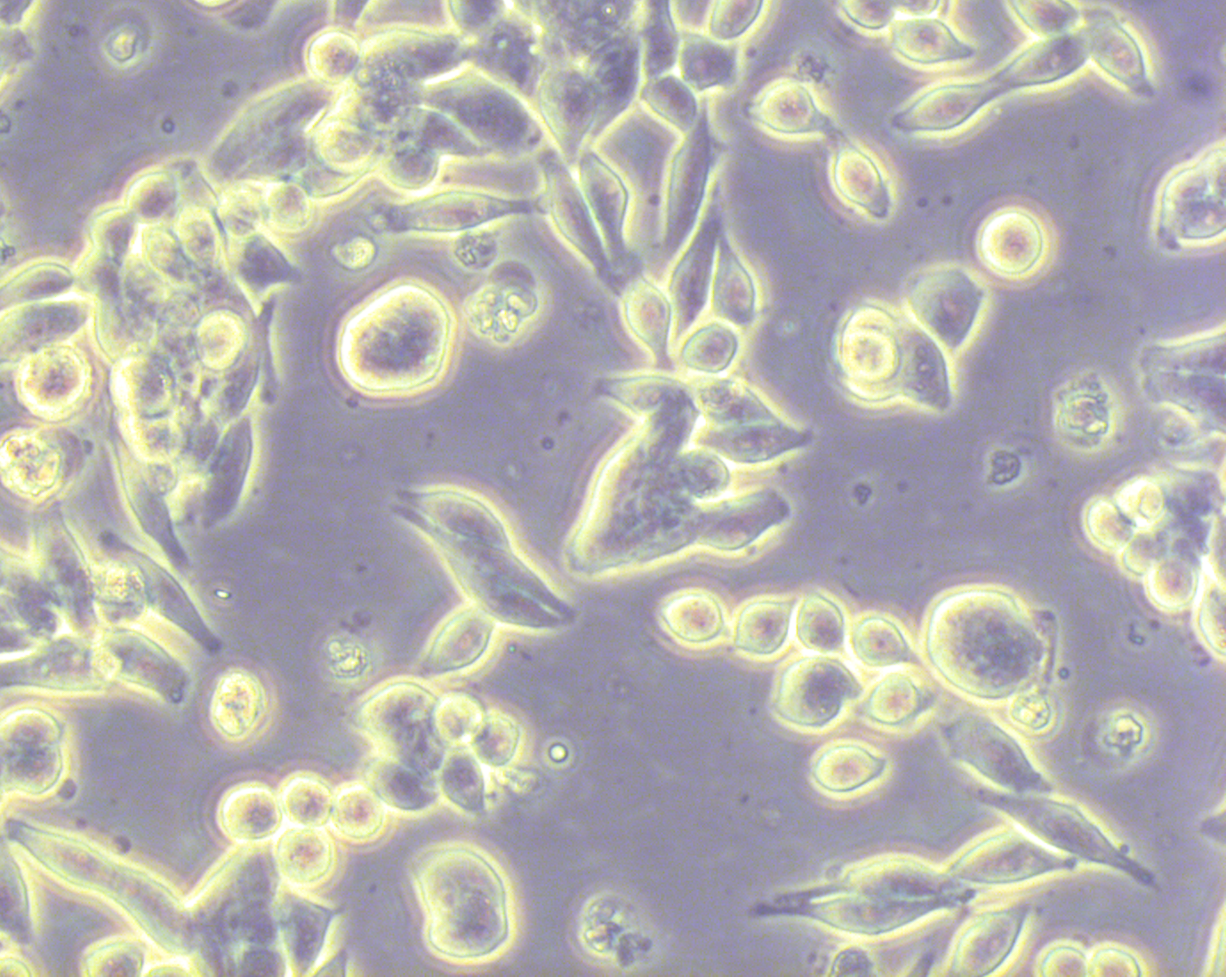
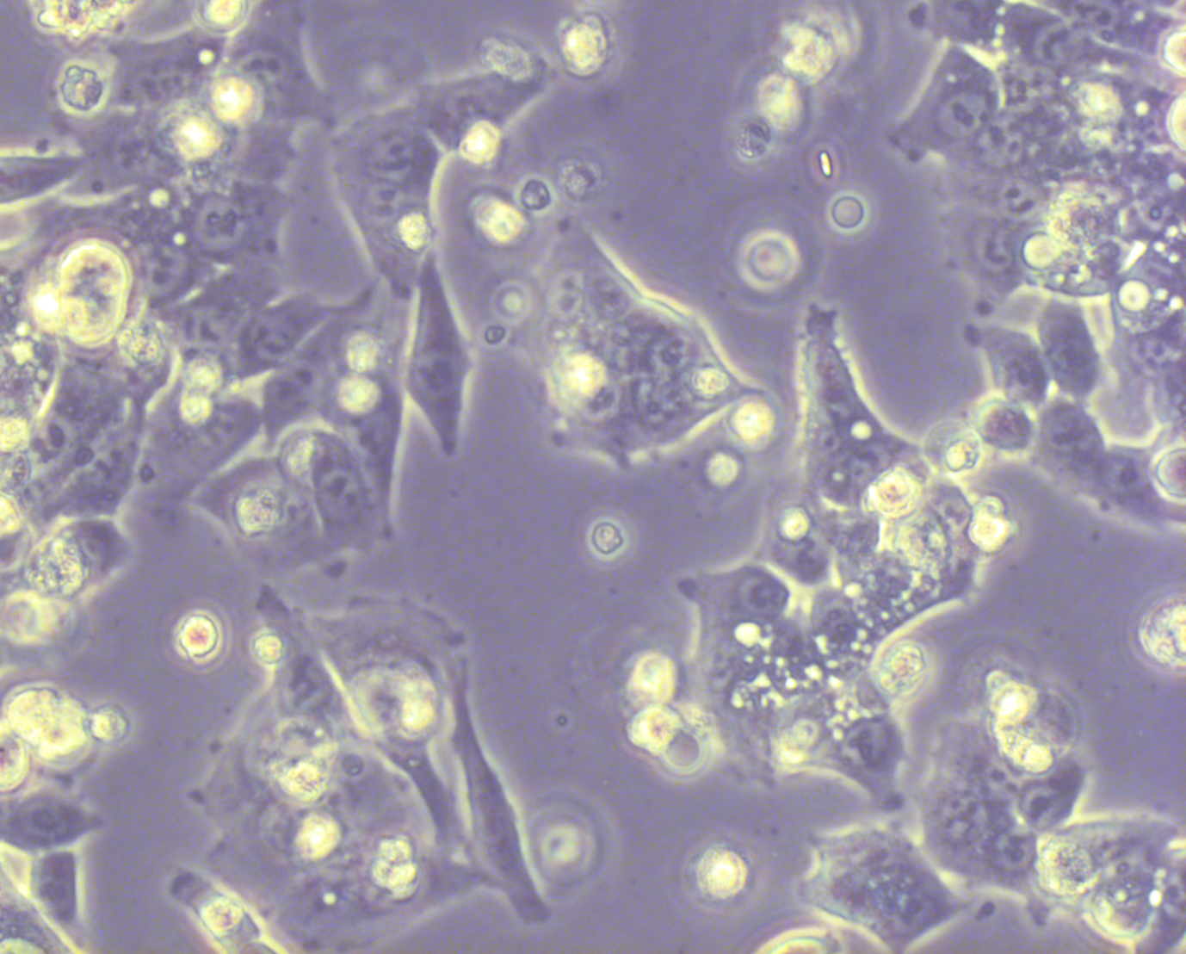
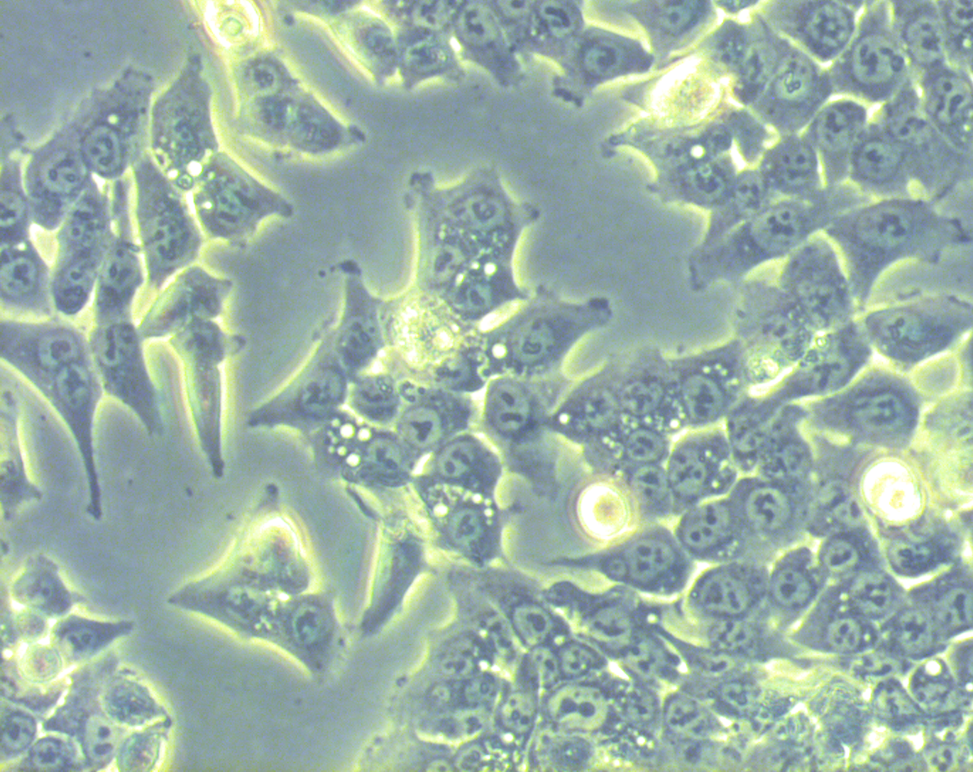
Figure 6 Supplementary
Morphology of HCT116 and THC8307 cells following treatment with or without Elemene for 72 hours. Scale bar, 100 μm.
Elemene(μg/ml)
0
20
60
THC8307
100μm
100μm
100μm
HCT116
100μm
100μm
100μm

