Slide 1
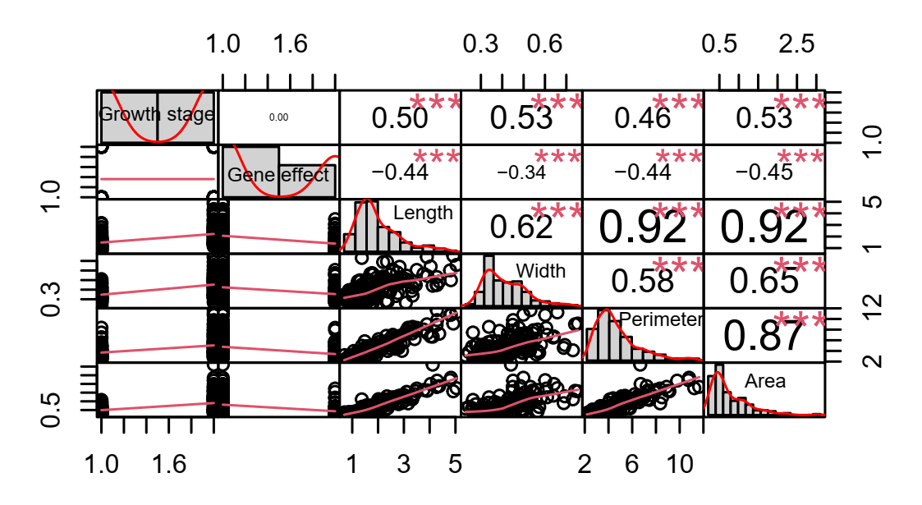
Figure S1: Correlation matrix of phenotypic traits Tsn1/tsn1 gene effect on inoculation with ToxA1 isolate.

Slide 2
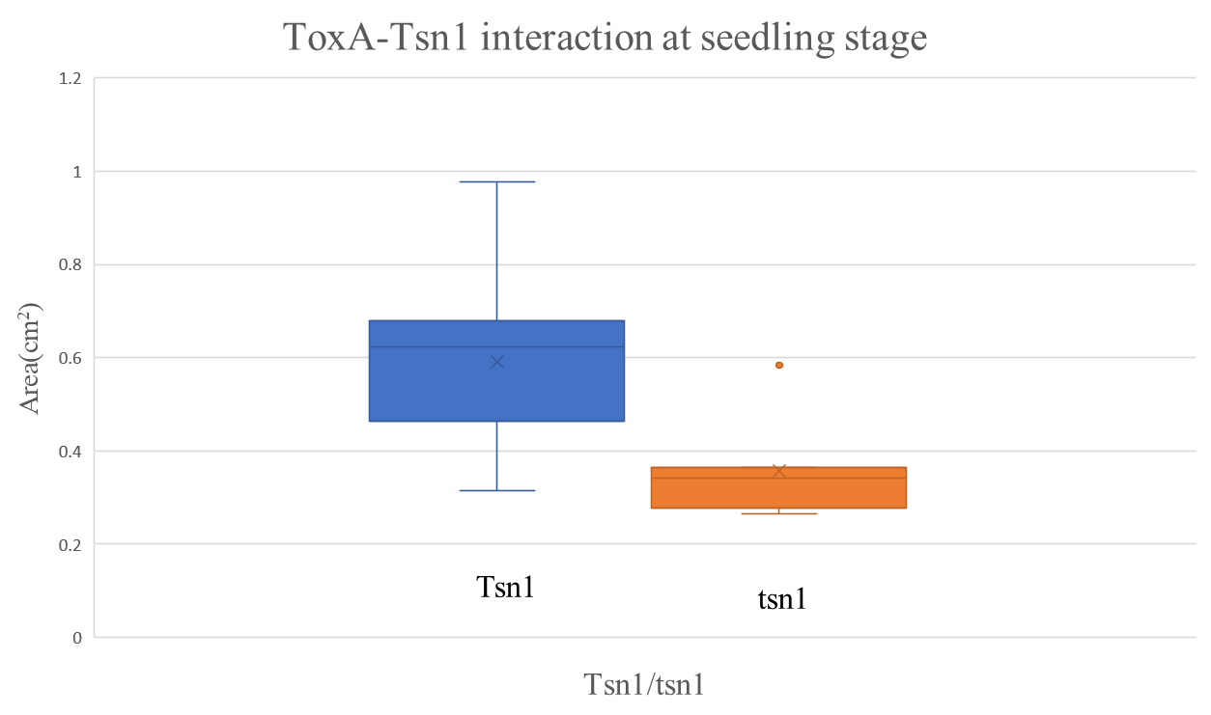
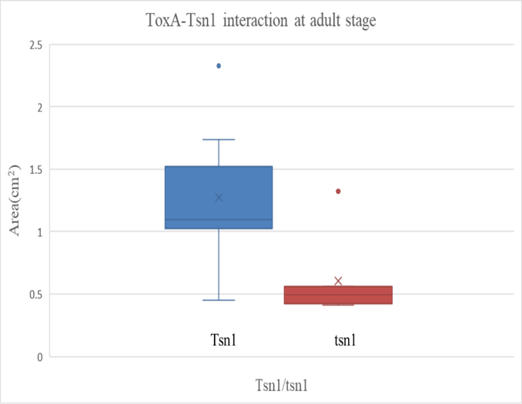
Seedling Stage B. Adult stage
Figure S2: Necrotrophic area developed due to ToxA1–Tsn1 interaction at both seedling and adult stage of wheat genotypes

Slide 3
Figure S3. Symptom of spot blotch after infiltration ToxA1 protein at both seedling and adult stage of wheat genotypes harboring Tsn1

Slide 4
Figure S4. Symptom of spot blotch after infiltration ToxA1 protein at both seedling and adult stage of wheat genotypes harbouring tsn1

