Slide 1
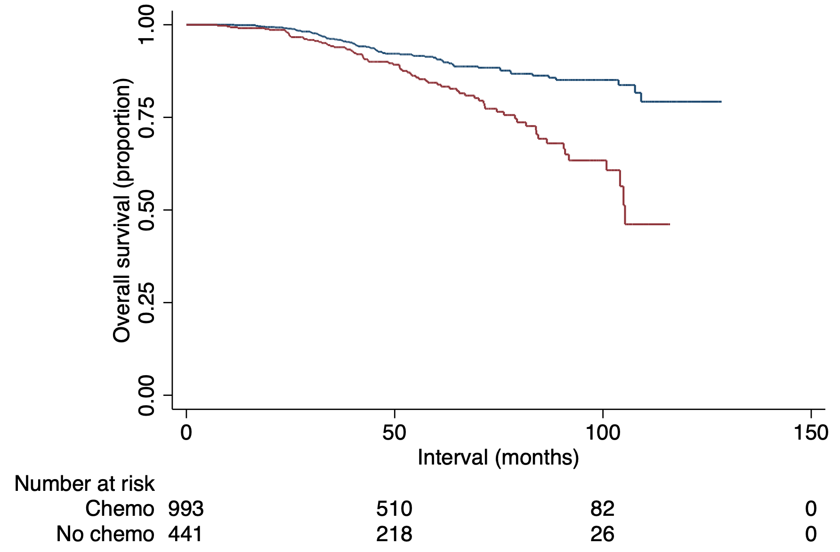

P= 0.6542
Notes:
120 23 1030 671 Screen Shot 2017-05-16 at 5.52.26 PMScreen Shot 2017-05-16 at 5.52.26 PM

