Slide 1
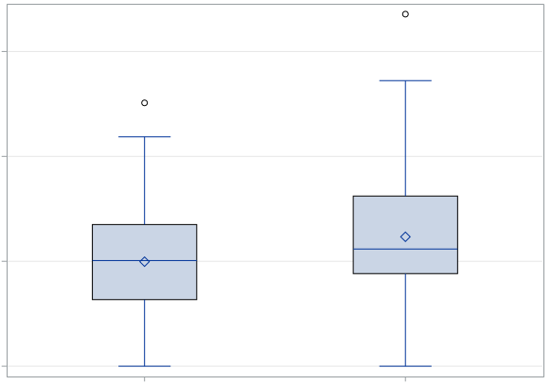
p = 0.0562
1.5
1.0
Age-adjusted Tr aberration frequency
/100 CE
0.5
0.0
Females
Males

