Slide 1
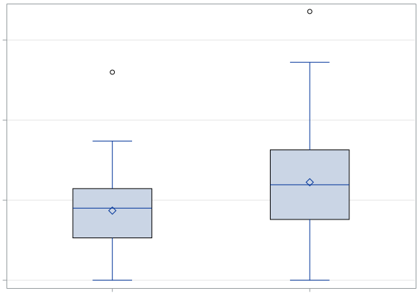
1.5
p = 0.005
1.0
Age-adjusted Tr aberration frequency
/100 CE
0.5
0.0
(-)
(+)
History of CT examination

