Slide 1
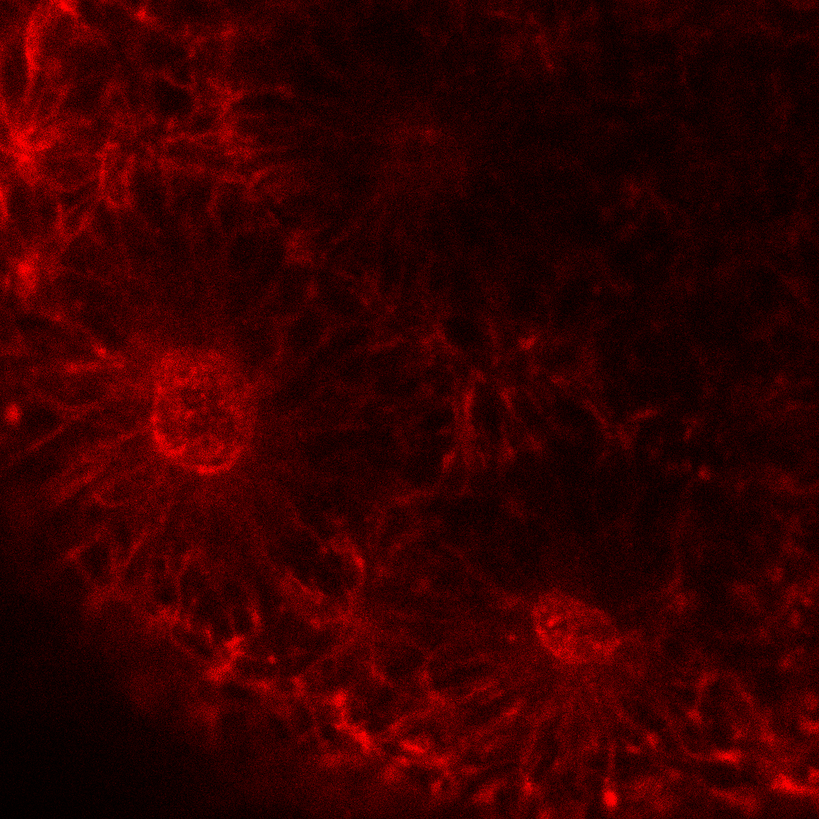
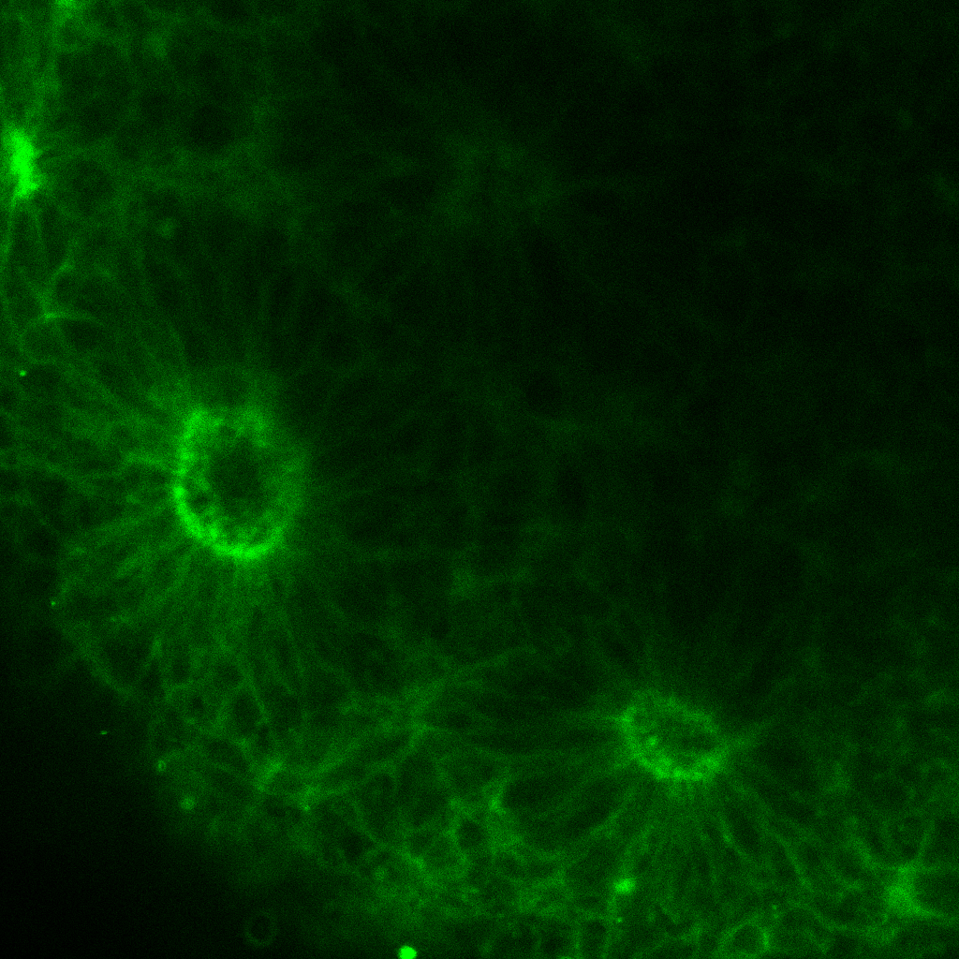
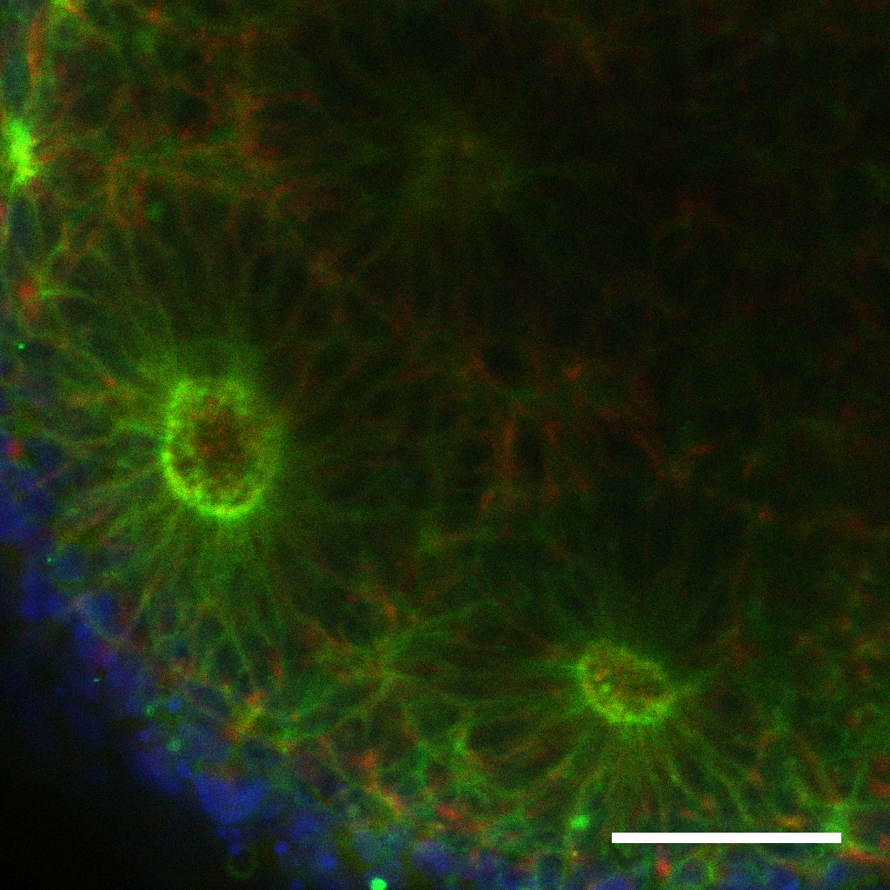
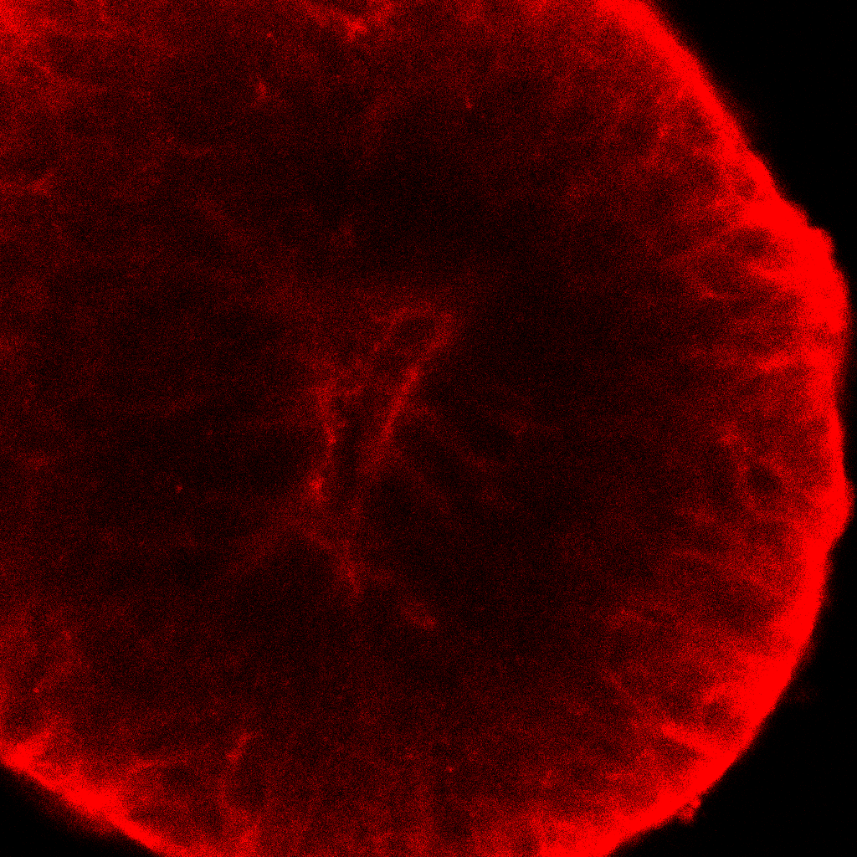
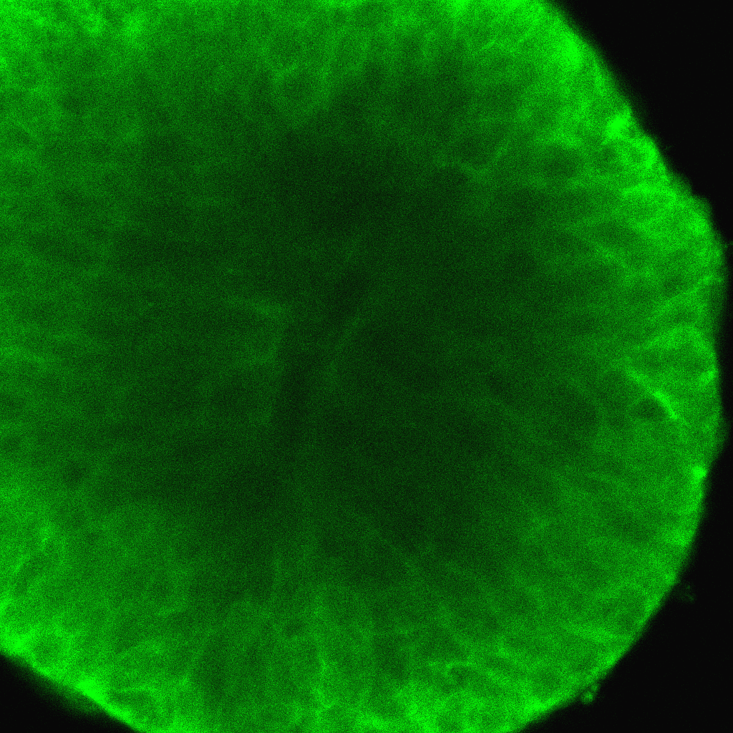
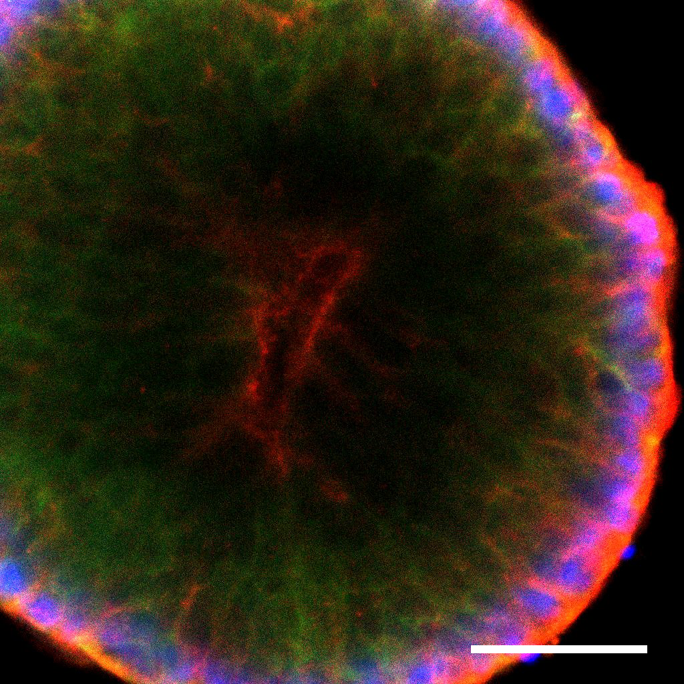
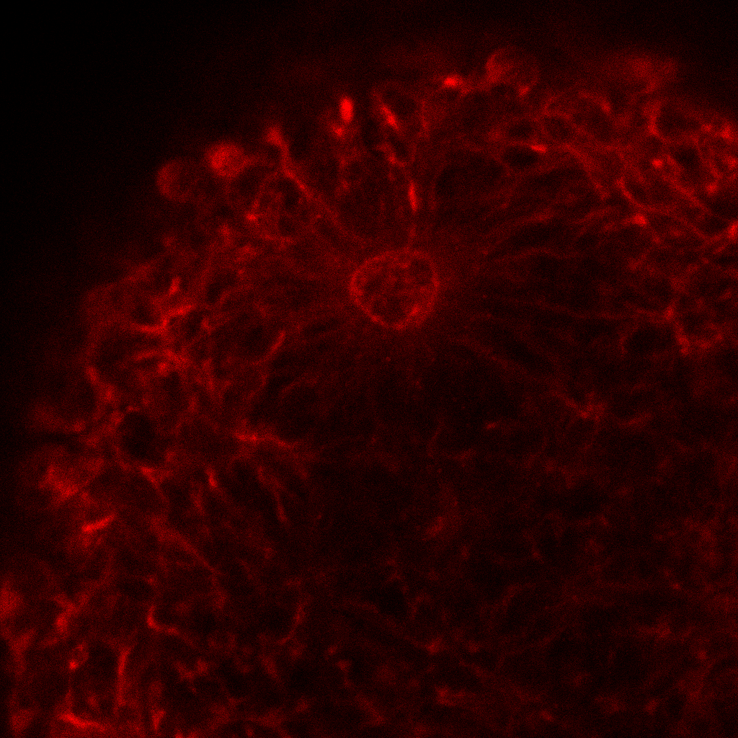
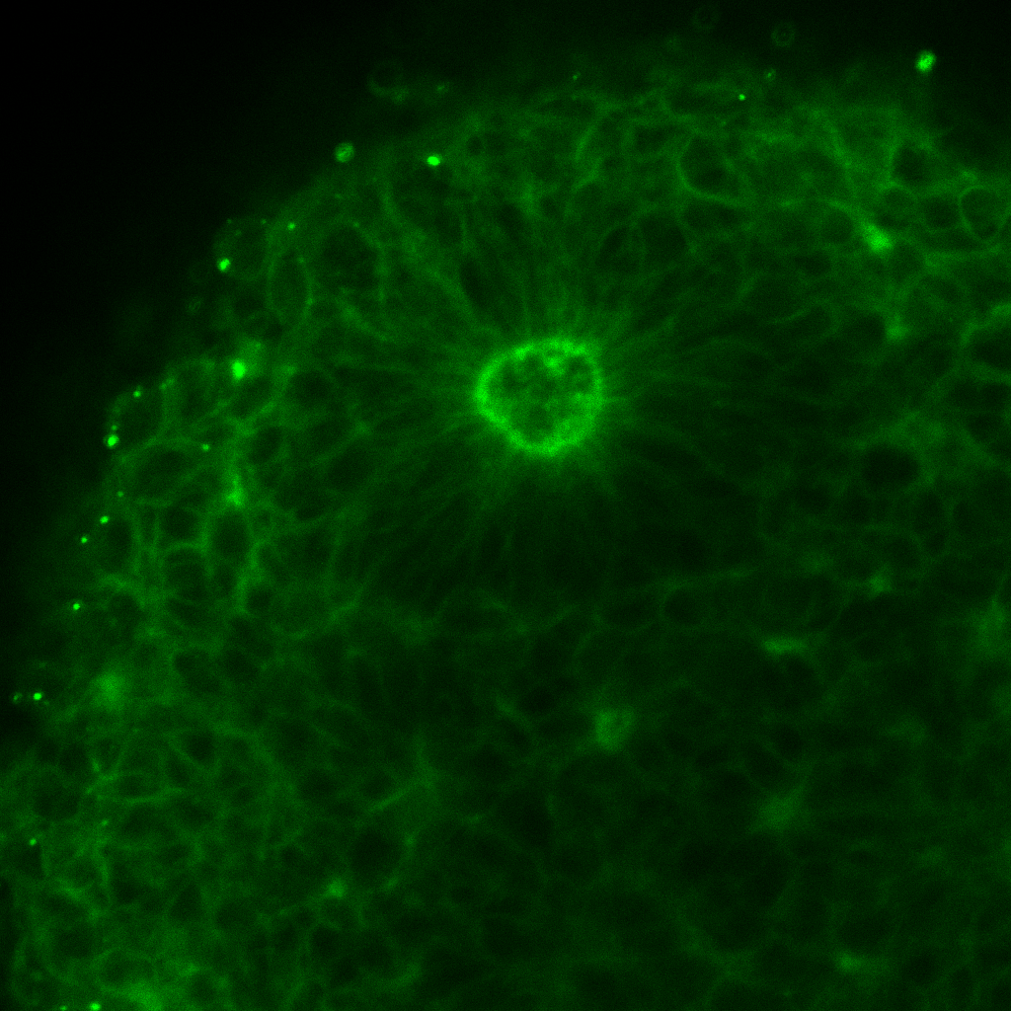
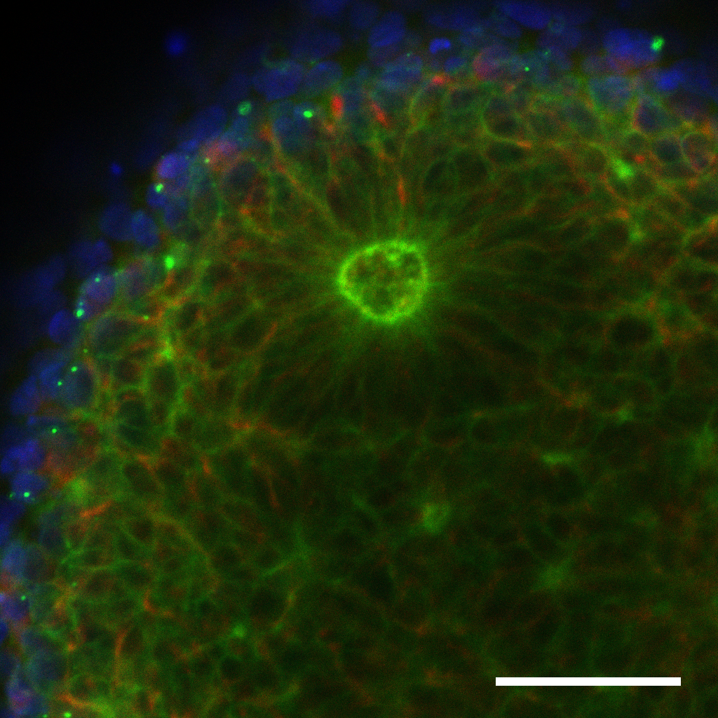
Supplementary Figure 1
ZO-1 𝛃-CATENIN
ZO-1 𝛃-CATENIN DAPI
PTEN^{M134R/WT} PTEN^{G132D/WT} PTEN^{WT/WT}
Supplementary Figure 1. VZ-like lumen morphology, co-expressing of ZO-1 and β-Catenin in the lumen surface. IF staining of ZO-1 and β-Catenin in PTEN^{WT/WT}, PTEN^{G132ED/WT}, and PTEN^{M134R/WT} organoids at day 7, related to Fig 4a. Scale bars indicate 50 µm.

Slide 2
Supplementary Figure 2
pGSK𝛃 /GSK𝛃
PTEN^{WT/WT} PTEN^{G132D/WT} PTEN^{M134R/WT}
Day 0 3 5 6 7 0 3 5 6 7 0 3 5 6 7
pGSK3𝛃
GSK3𝛃
GAPDH
Day
Supplementary Figure 2. The change of GSK3 β signaling at the early stage of forebrain organoids, related to Fig 4d.
(a) Representative Western blot for GSK3 β signaling at the early stage of forebrain organoid development.
(b) Quantification Western blots for pGSK β; PTEN^{WT/WT} (WT/WT), PTEN^{G132D/WT}(GD/WT), PTEN^{M134R/WT} (MR/WT).

Slide 3
Supplementary Figure 3
Arbitrary unit
Day
Supplementary Figure 3. Quantification Western blots for E-CDH and N-CDH during organoid induction at days 0, 3, 5, 6, and 7, related to Fig 4g; PTEN^{WT/WT} (WT/WT), PTEN^{G132D/WT}(GD/WT), PTEN^{M134R/WT} (MR/WT).

Slide 4
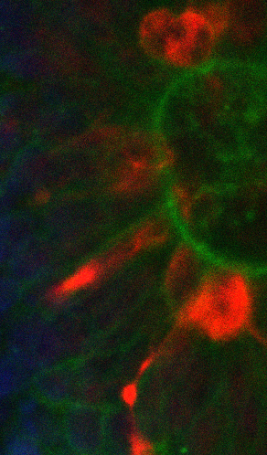
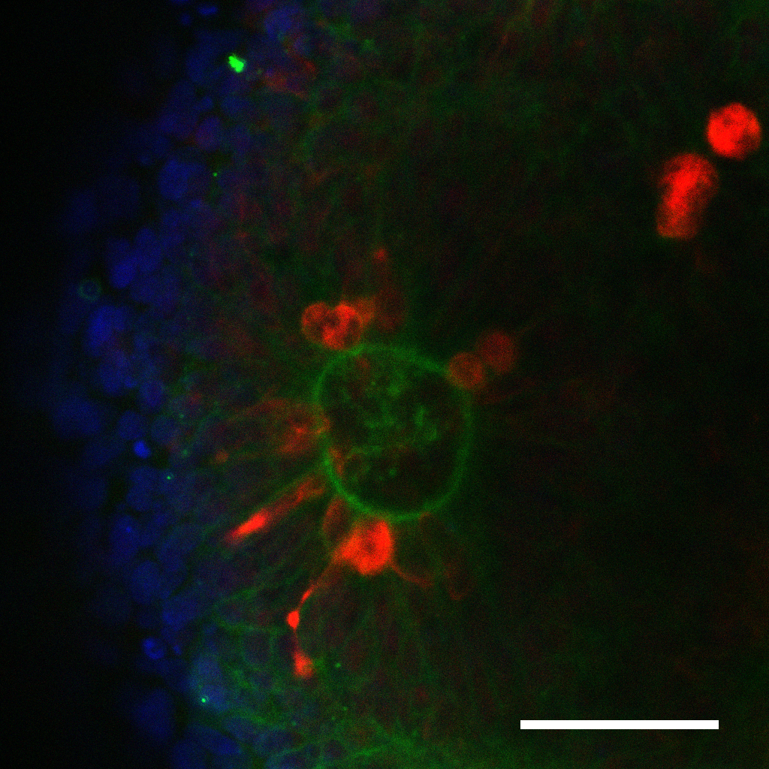
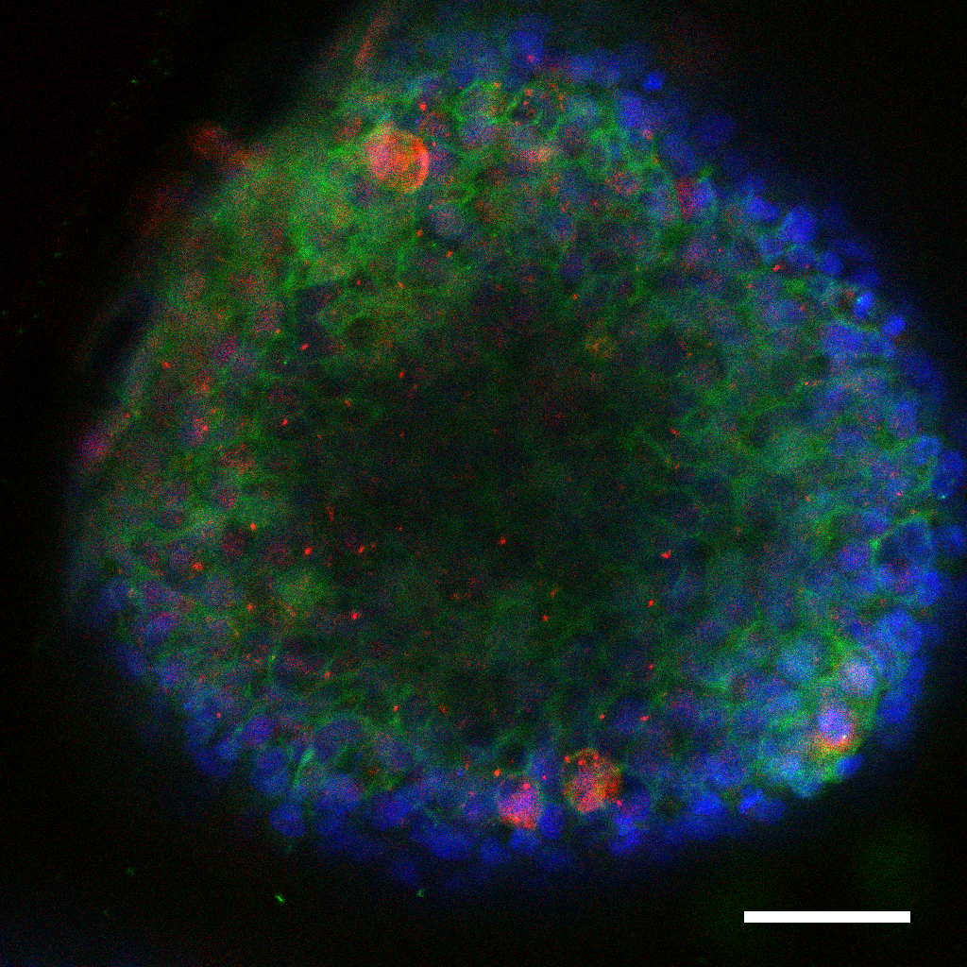
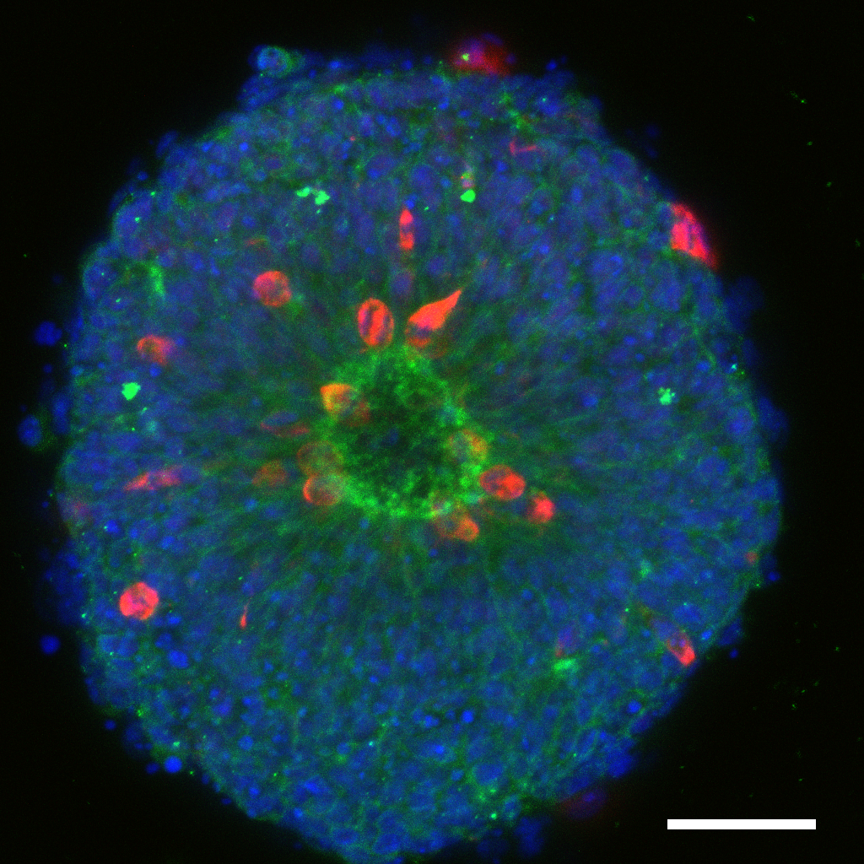
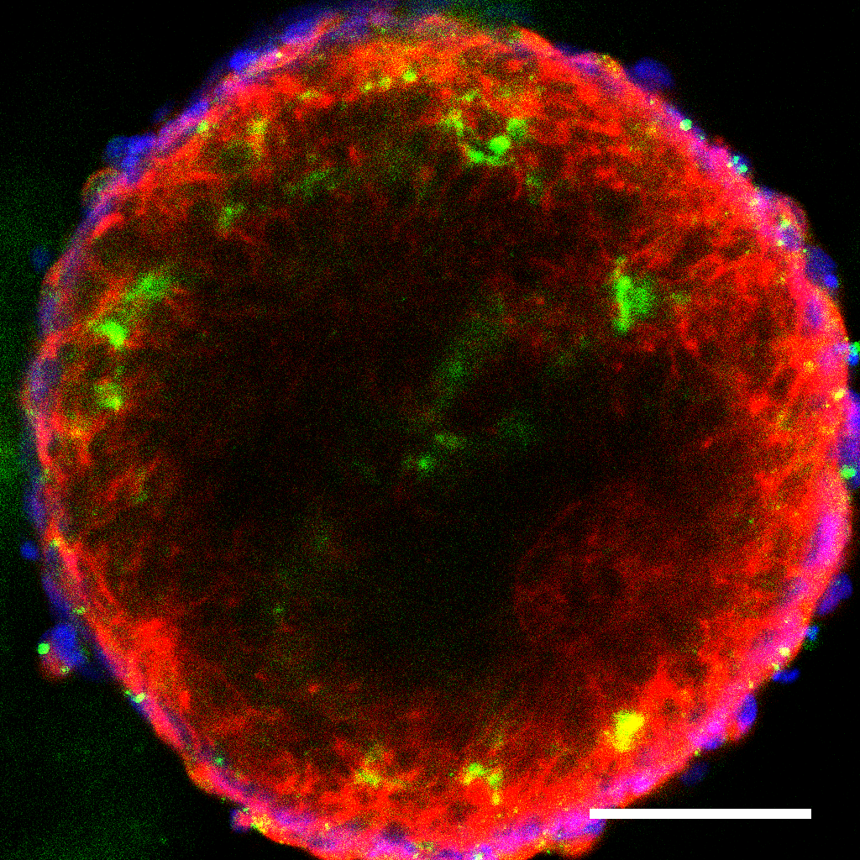
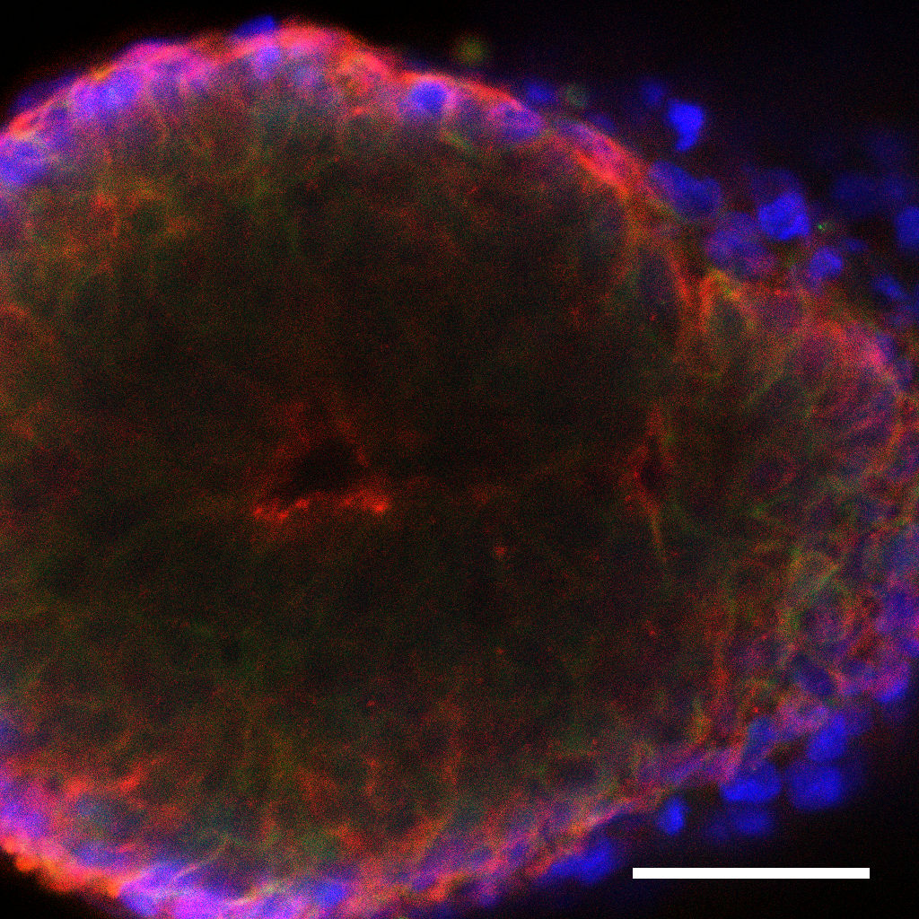
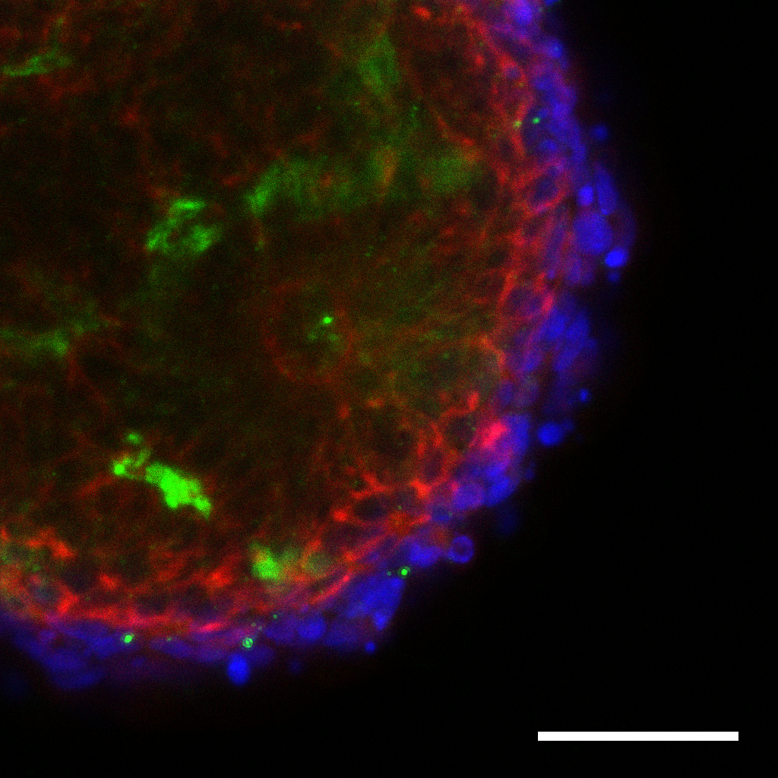
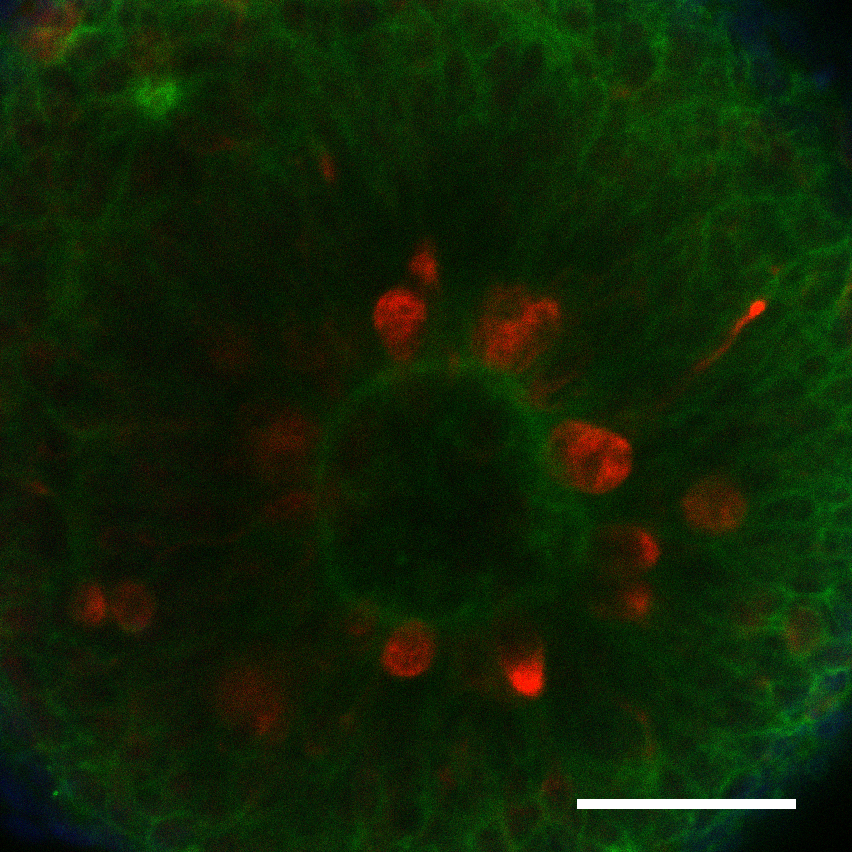
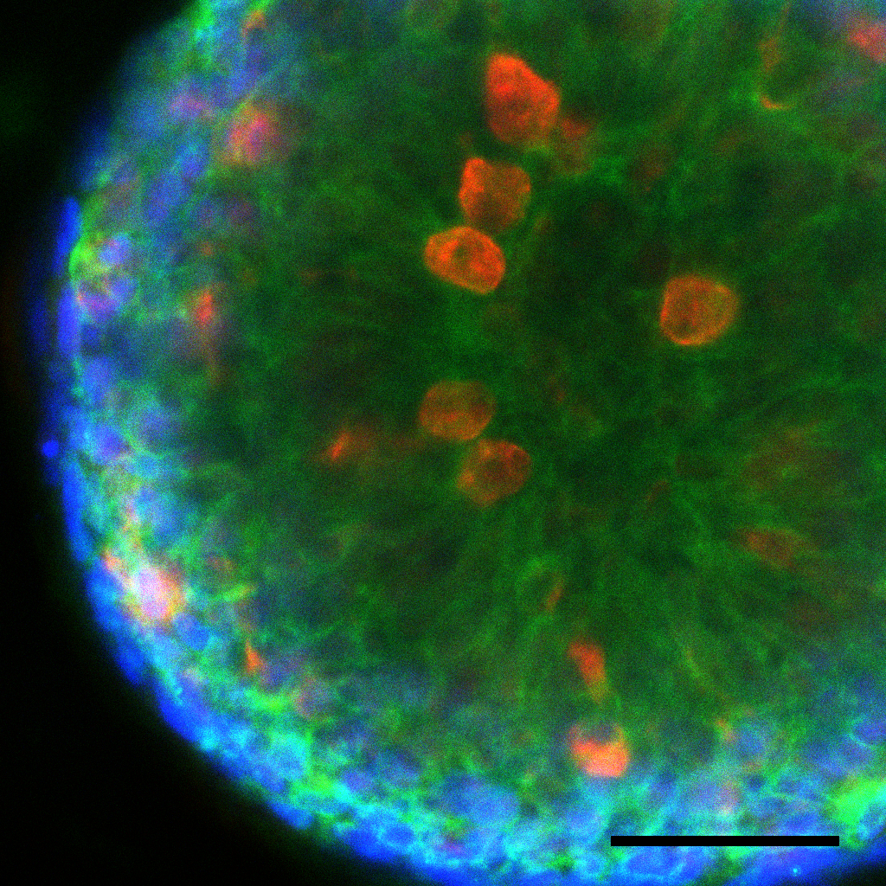
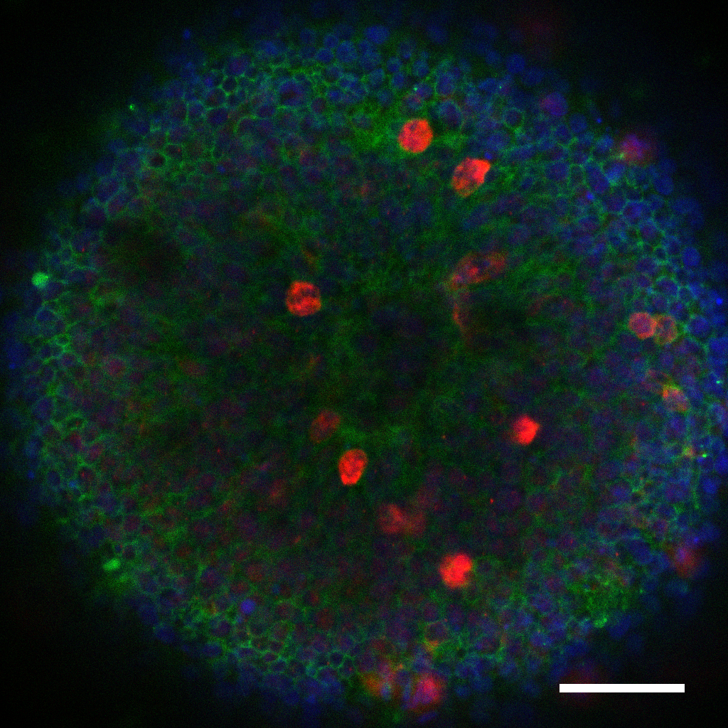
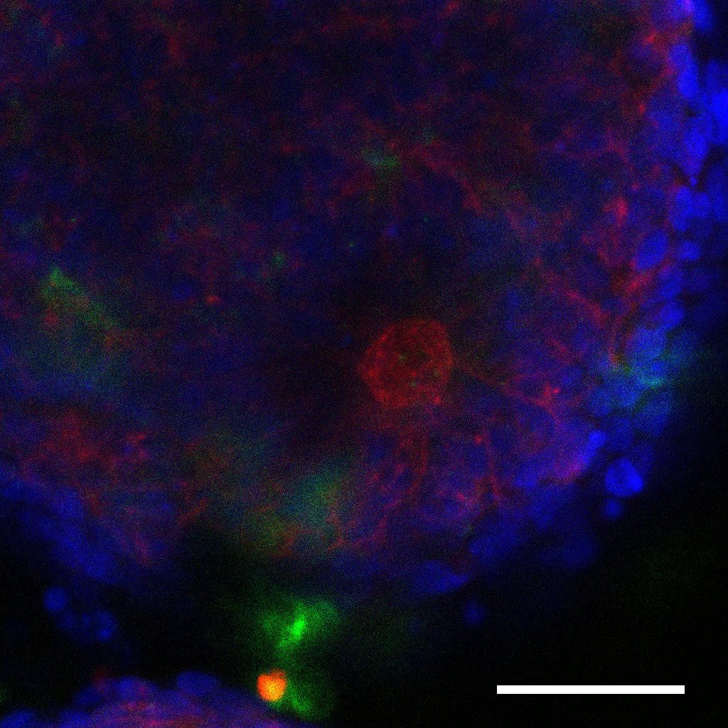
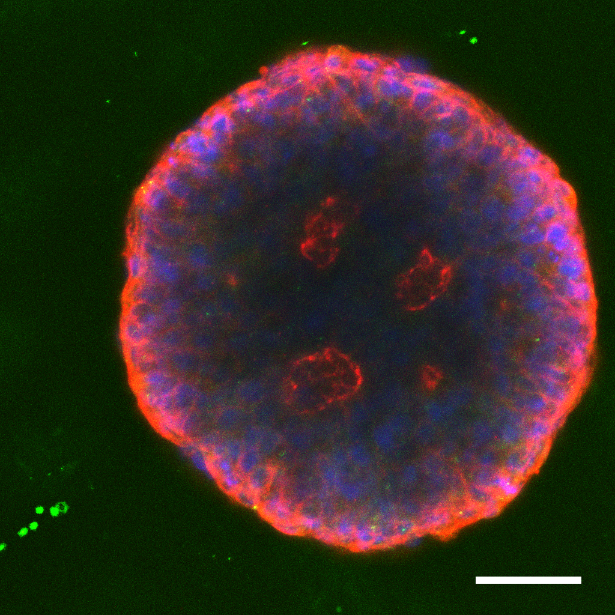
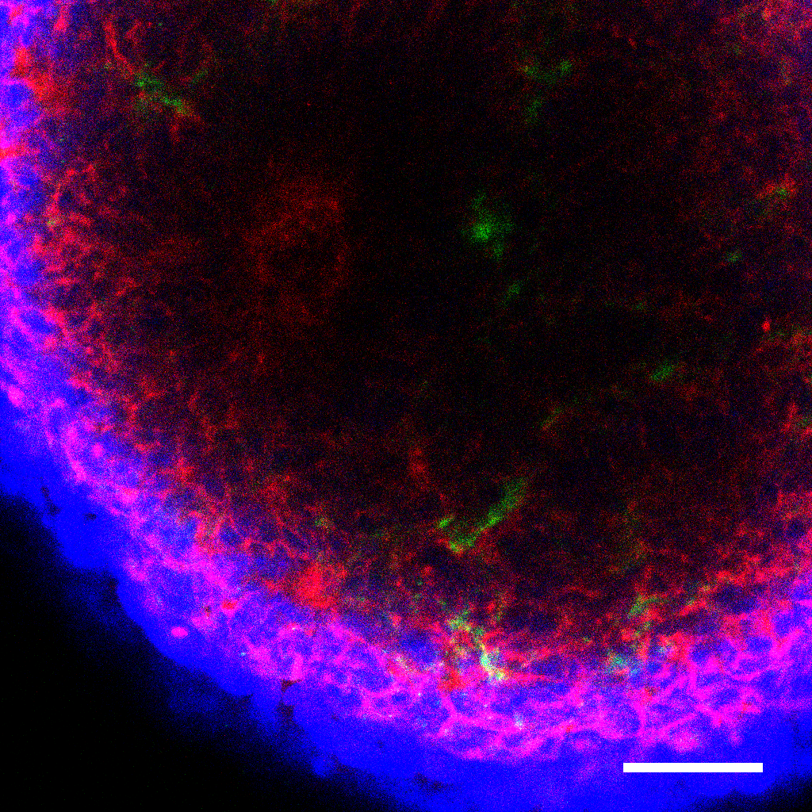
Supplementary Figure 4
pVIM
𝛃 –CATENIN DAPI
a
Lumen morphology
Radial glial cell alignment
b
pVIM 𝛃 –CATENIN DAPI
ZO-1 LAMININ DAPI
AKTi
-
+
WT/WT GD/WT MR/WT
WT/WT GD/WT MR/WT
Supplementary Figure 4. The change of lumen morphology and neuroepithelial cell alignment in PTEN^{G132D/WT} organoids by AKT signaling inhibition at the early time of formation of corticogenesis unit.
(a) Illustration showing changes of VZ-like lumen morphology and radial glial cell (red circles) alignment in the presence of AKT inhibitor. Sample image showing radial glial cell alignment (pVIM⁺) in PTEN^{WT/WT} organoid at day 7 around lumen surface (β-Catenin).
(b) IF staining of the pVIM and β–CATENIN, as well as ZO-1 and LAMININ at day 7 with and without AKT inhibitor in PTEN^{WT/WT}, PTEN^{G132ED/WT}, and PTEN^{M134R/WT} organoids. Dotted lines indicate the circular luminal shape and alignment of pVIM+ cells. Scale bars indicate 50 µm.

Slide 5
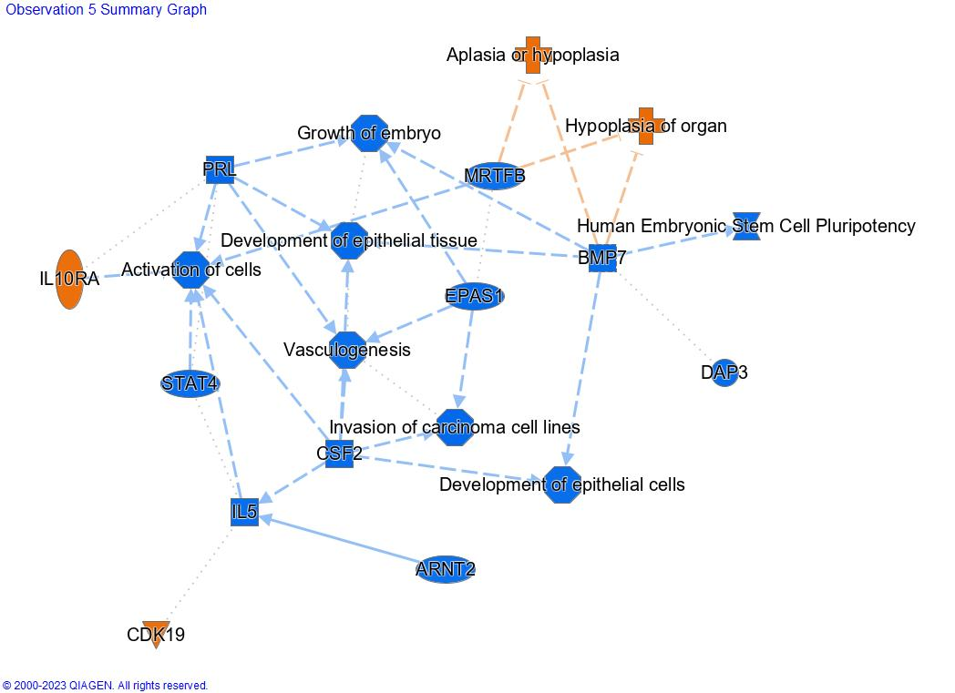
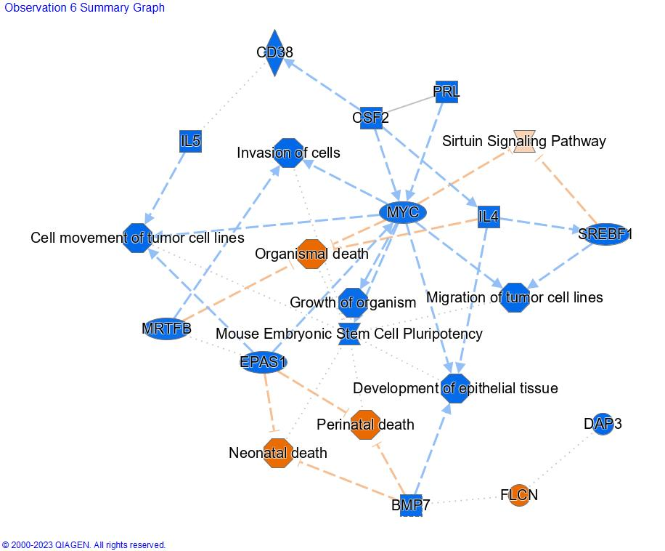
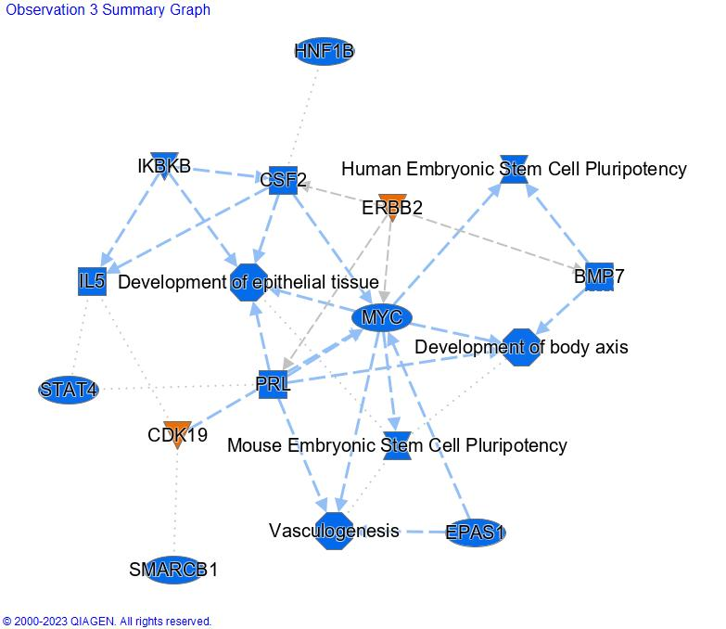
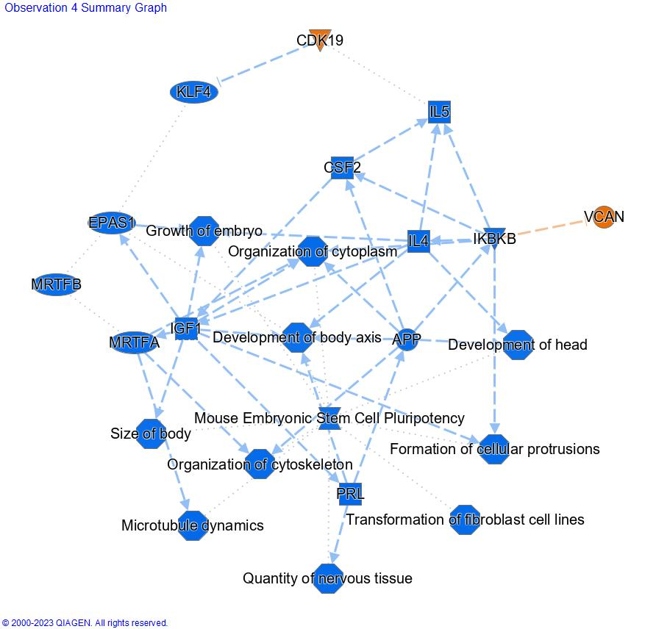
Supplementary Figure 5
a
WT vs entire dataset
d
WT AKTi vs entire dataset
b
MR vs entire dataset
e
MR AKTi vs entire dataset

Slide 6
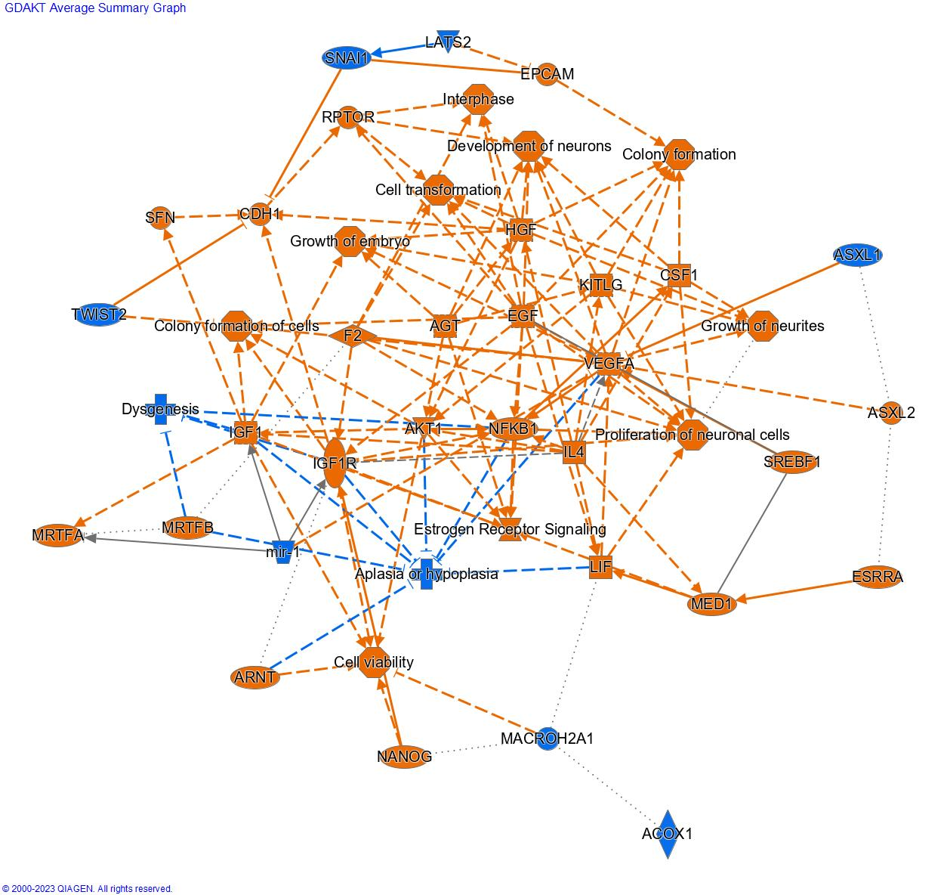
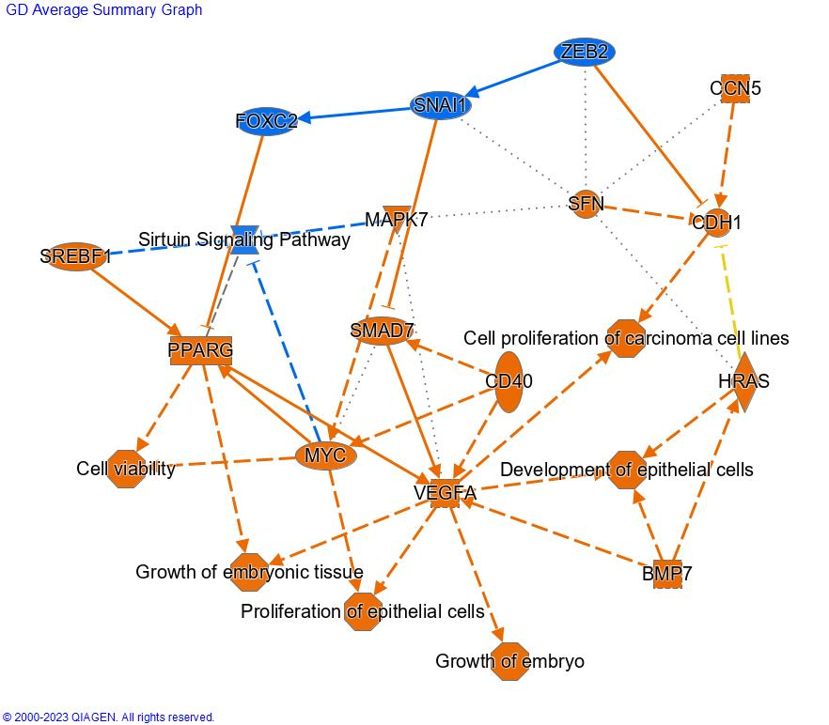
Supplementary Figure 5 Continued
c
Upregulated pathways in GD compared to MR
f
Upregulated pathways in GD AKTi compared to MR AKTi
Supplement Figure 5. IPA up and down regulated pathways.
(a) WT/WT vs entire dataset. (b) MR/WT vs entire dataset (c) GD/WT vs to MR/WT (d) WT/WT AKTi vs entire dataset (e) MR/WT AKTi vs entire dataset (f) Upregulated pathways in GD/WT AKTi vs MR/WT AKTi. Orange represents upregulated pathways and blue downregulated.

Slide 7
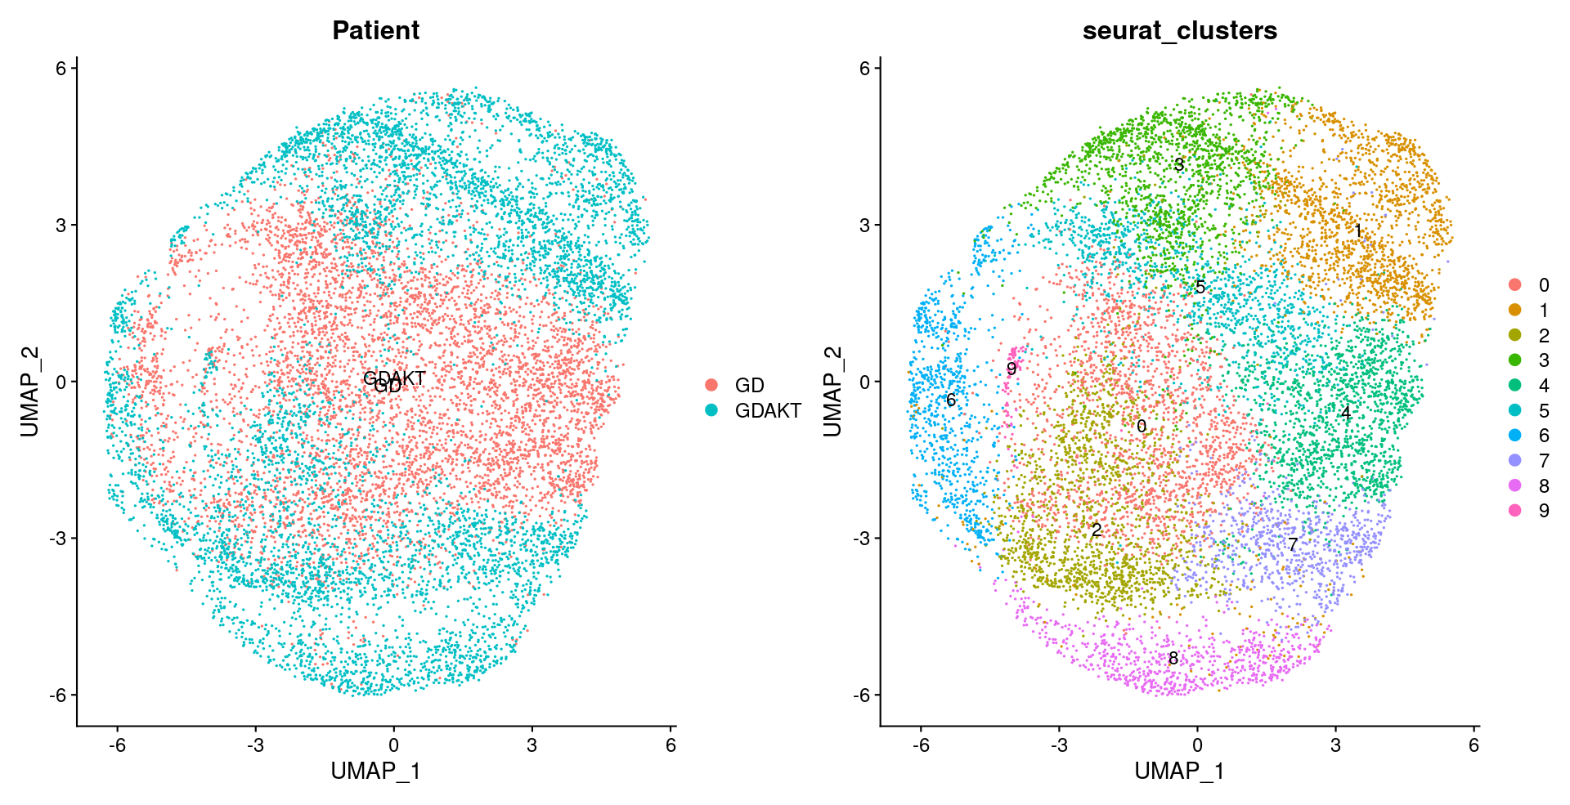
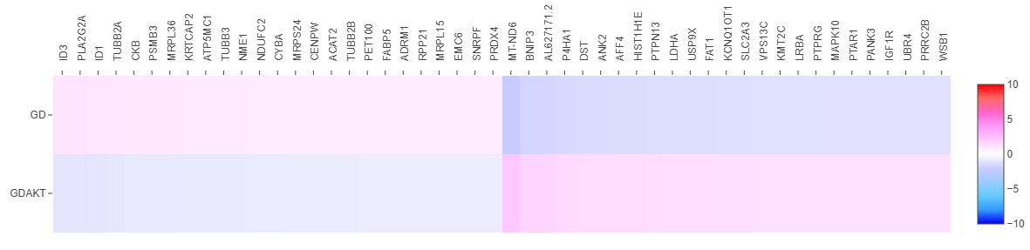
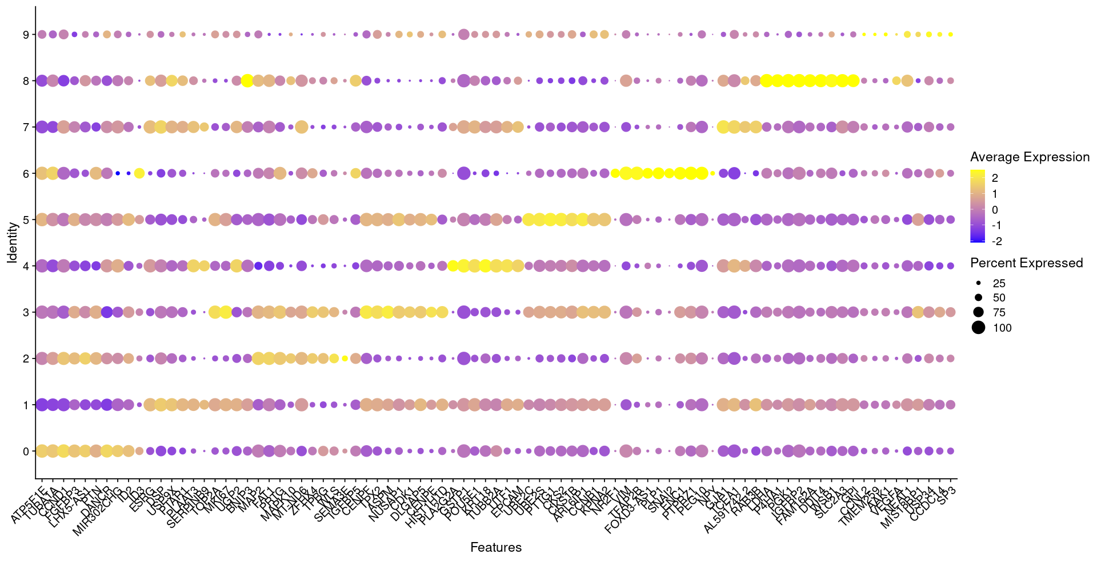
Supplementary Figure 6
a
c
b
Supplement Figure 6. DEG analysis of the GD genotype sub-sample.
(a) UMAP of GD/WT and GD/WT AKTi samples and k means clustering (b) Dot plot of top 5 upregulated genes in each cluster by Logfold2 expression method. (c) Heat map of the top 30 differentially expressed genes, Logfold2, between GD and GD AKTi samples.

Slide 8
Supplementary Table 1 Culture media for forebrain organoid induction
First Medium (Day 0-7) | Second Medium (Day 7-14) | Third Medium (Day 14+)
Essential 6 | DMEM/F12 | DMEM/F12
GlutaMax | GlutaMax | GlutaMax
MEM-NEAA | MEM-NEAA | MEM-NEAA
Pen/Strep | Pen/Strep | Pen/Strep
1x 2-Mercaptoethanol | 1x N-2 | 1x N-2
Dorsomorphine (2𝛍M) | SB431541 (1𝛍M) | 1xB-27
A83-1 (2𝛍M) | CHIR-99021(1𝛍M) | 1x Insulin solution
Perifosine (1𝛍M)* | Perifosine (1𝛍M)*
*Only for inhibition of AKT

Slide 9
Supplementary Table 2 Reagents
Reagents | Cat. no. | Vendor
StemFlex™ basal media | A3349401 | Gibco™, ThermoFisher
Essential 6 | A1516401 | Gibco™, ThermoFisher
DMEM/F12, HEPES | 11330032 | Gibco™, ThermoFisher
MEM non-essential amino acids solution (MEM-NEAA) | 11140050 | Gibco™, ThermoFisher
Penicillin-Streptomycin | 15140122 | Gibco™, ThermoFisher
2-Mercaptoethanol | M6250 | MilliporeSigma
N-2 supplement | 17502048 | Gibco™, ThermoFisher
B-27 supplement | 17504044 | Gibco™, ThermoFisher
Insulin solution | 19278-5ML | MilliporeSigma
Collagenase type IV solution | 17104019 | MilliporeSigma
Geltrex™ LDEV-Free Reduced Growth Factor | A1413202 | Gibco™, ThermoFisher
Matrigel® Matrix | 356234 | Corning®
A83-01 | 71022 | Stem Cell Technologies
Dorsomorphin | 72102 | Stem Cell Technologies
SB431542 | 72232 | Stem Cell Technologies
CHIR99021 | 72052 | Stem Cell Technologies
Perifosine | 10008112 | Cayman Chemical Company

Slide 10
Supplementary Table 3 Antibodies
Antibodies | Cat. no. | Vendor
SOX2 | MAB2018 | R&D systems
PAX6 | 561462 | BD Biosciences
NESTIN | 656802 | Biolegend
TUJ1 | 801201 , 802001 | Biolegend
TBR1 | ab31940 | Abcam
CTIP2 | ab18465 | Abcam
SATB2 | ab51502 | Abcam
PTEN | ABM-2052 | Cascade Bioscience Inc.
pVIMENTIN (Ser 56) | 7391 | Cell Signaling Technology
AKT | 9272 | Cell Signaling Technology
pAKT S473 (D9E) | 4060 | Cell Signaling Technology
E-CADHERIN | 4065 | Cell Signaling Technology
N-CADHERIN | 13116 | Cell Signaling Technology
𝛃 CATENIN | c19220 | BD Biosciences
LAMININ | SAB4200719 | MilliporeSigma
ZO-1 | PA5-28858 | Invitrogen ThermoFisher Scientific
𝛃 ACTIN | AM4302 | Invitrogen ThermoFisher Scientific
GAPDH | 2118 | Cell Signaling Technology
ALEXA FLUOR® 488, 594 | A11006, A11008, A32740 | Invitrogen, ThermoFisher Scientific
Cy3 | 712-165-153 | Jackson ImmunoResearch Laboratories, Inc.
Horse radish peroxides anti-Mouse, Rabbit IgG(H+L) | PRW4021, 4011 | Promega

