Slide 1
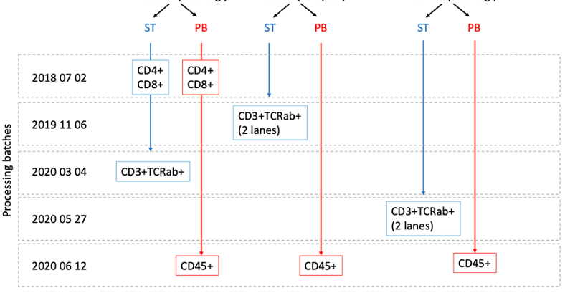
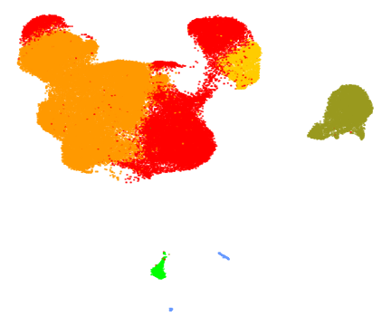
Supplementary fig 1a
PT1-JIA
PT2-SP
PT3-SN
1b
1c
1d
CD4+ T cells
NK cells
Monocytes
CD8+ T cells
B cells
DC

Slide 2
Supplementary fig 2a
2b
2c
2d
PT1-JIA
PT2-SP
PT3-SN

Slide 3
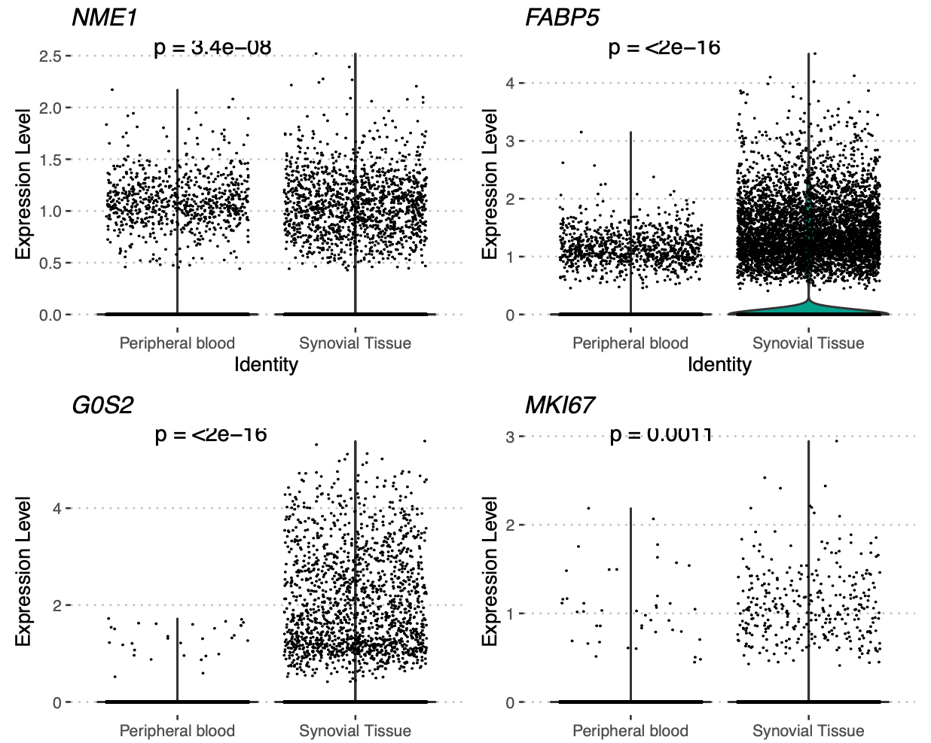
Supplementary fig 3
a
b
c
d
e
Effector memory
T regs
Tph/Tfh
f
h
g
v

Slide 4
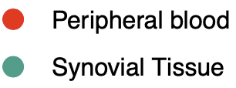
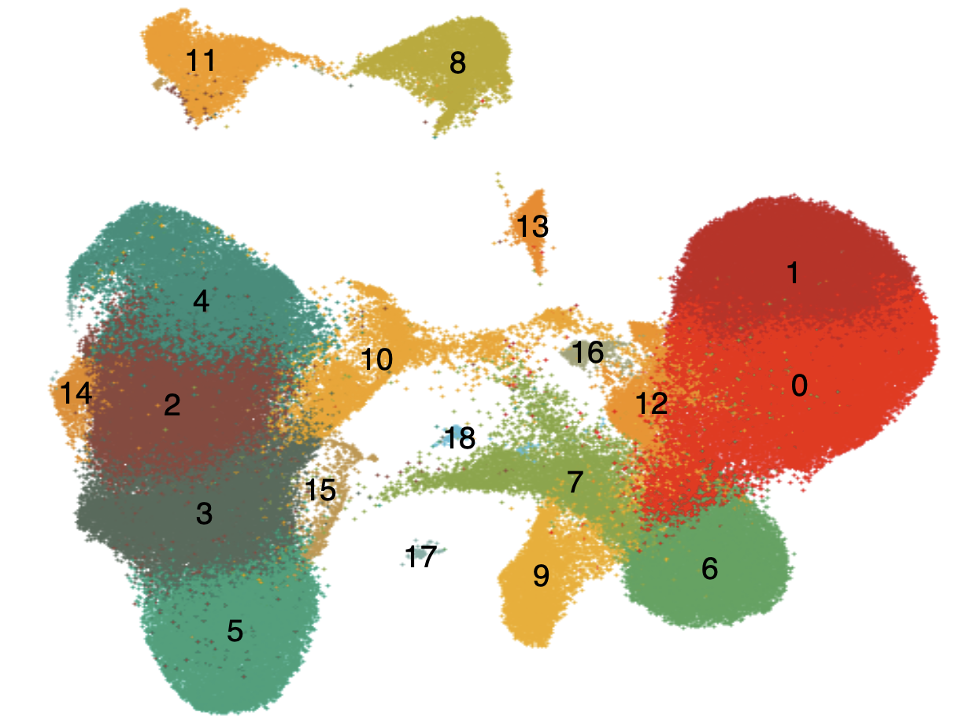
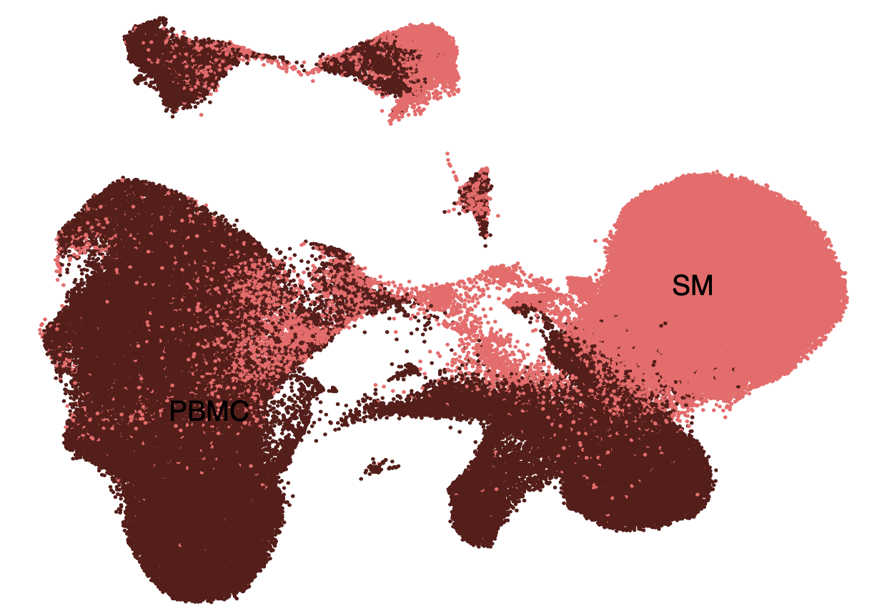
Supplementary fig 4a
Proliferation score
b
c
d
Peripheral Blood
Peripheral Blood
Synovial Membrane
Synovial Membrane
Proliferation score

Slide 5
Supplementary fig 5a
b
c
d
e

Slide 6
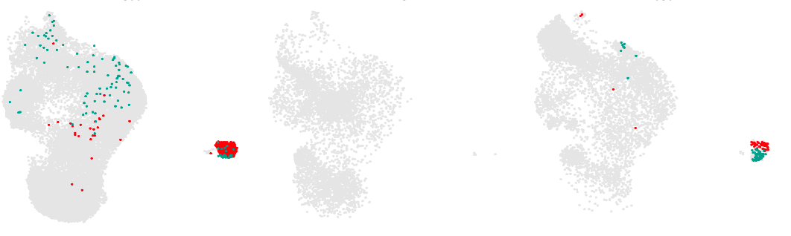
Supplementary fig 6a
b
P1-JIA
P3-SN
P2-SP
c
d
e
f
GLIPH2 predictions per cluster
g
h
Peripheral blood
Synovial tissue

