Slide 1
Original Western Blot Raw Images

Slide 2
Original Western Blot Raw Images
Transfected cells - 1
Transfected cells - 2
Negative control
Control
Transfected cells – 1 and -2 are data from independent trials.
The expression level of β-actin housekeeping gene was used as the loading control.
Due to low β-actin signal of the transfected cells – 2 sample, it is excluded from the final image to avoid confusion.
β-actin
Transfected cells - 1
Transfected cells - 2
Negative control
Control
Cleaved PARP

Slide 3
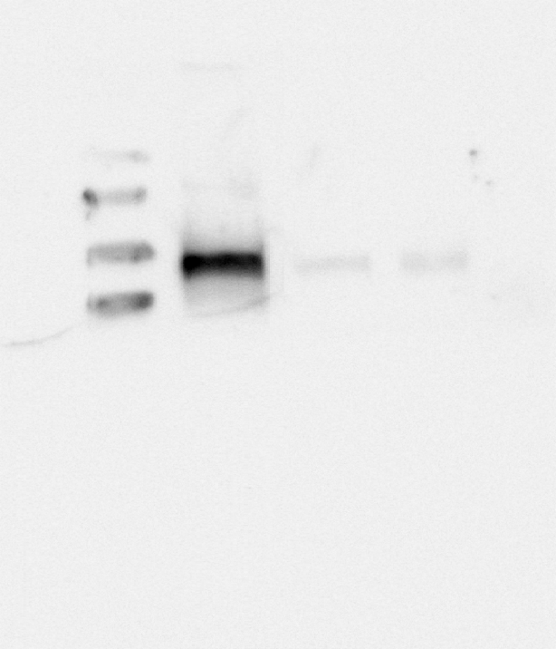
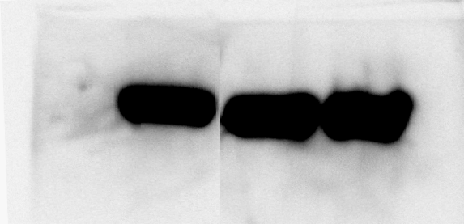
Western Blot Images with –
Transfected cells - 2 lane removed and realigned
Ladders
Transfected cells - 1
Negative control
Control
Due to low β-actin signal of the transfected cells – 2 sample, it is excluded from the final image to avoid confusion.
100 kDa
75 kDa
Cleaved PARP
β-actin

Slide 4
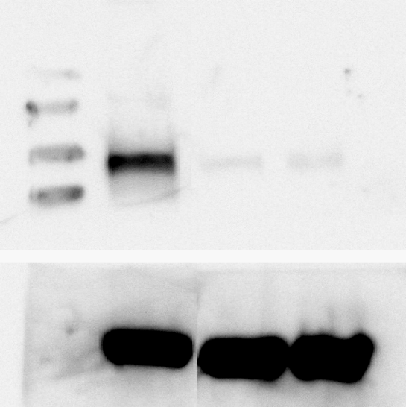
Final Edited Figure 4
Ladders
Transfected cells
Negative control
Control
100 kDa
75 kDa
Cleaved PARP
β-actin

